Slide 1
Event prediction
CS 590v
Notes:
Open with an image or video
Point is to “understand” everyday scenes and sequences
Email author?
Start with high-level idea for this particular paper

Slide 2
Applications
Video search
Surveillance
Detecting suspicious activities
Illegally parked cars
Abandoned bags
Intelligent environments
Healthcare: fall detector
Healthcare: hand-washing prompter

Slide 3
Common approaches
Compare keypoint (joint) trajectory shapes
Various spatio-temporal features with classifier
Notes:
Too historical?
Definitely mention
Space-time interest points on Ivan Laptev’s website – coffee and cigarettes 2007
human action detection
lots of flexibility

Slide 4
Trajectories of keypoints
Yilmaz and Shah, 2005 – UCF
Joint trajectories in XYT space
Compare trajectory shapes to classify actions

Slide 5
Trajectories of keypoints
Another approach: modeling trajectories likelihood
Flag low likelihood events
Notes:
Talk about the importance of

Slide 6
Scene context
Idea: transfer event information only from similar images
Use context to determine expected motion
E.g. climber on a rock wall vs. climber on a building

Slide 7
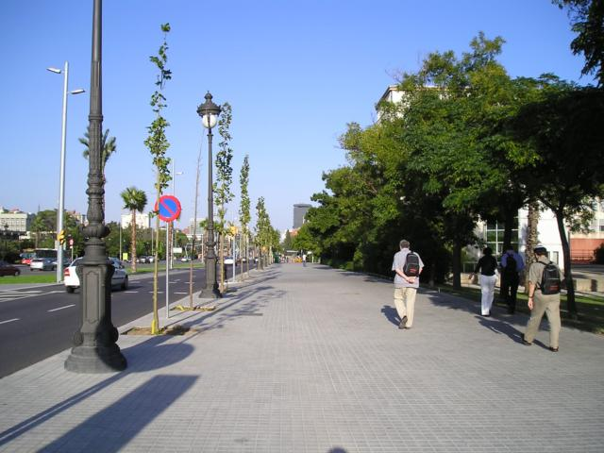
Features for matching images: Gist Oliva and Torralba, 2001
Apply oriented Gabor filters
over different scales
Average filter energy
in each bin
8 orientations
4 scales
x 16 bins
512 dimensions
Used for scene recognition
Similar to SIFT (Lowe 1999)

Slide 8
Retrieving similar images from large image databases
Image completion using Flickr images
Hays and Efros, 2007

Slide 9
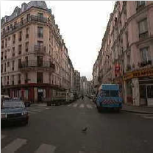
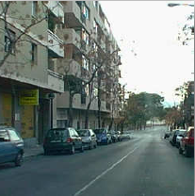
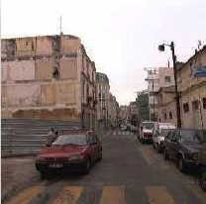
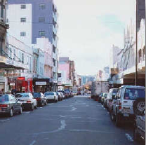
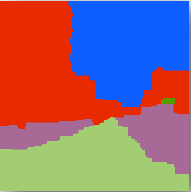
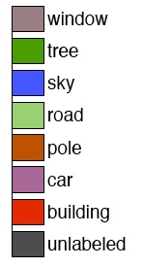
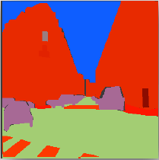
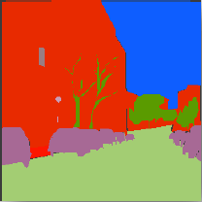
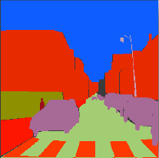
Transfer of knowledge: SIFT-flow
System
car
sidewalk
tree
C. Liu, J. Yuen, A. Torralba, 2009
Can “copy and paste” segmentation labels from similar labeled example to unknown

Slide 10
Task
Predict motion from static images
Predict semantic event from static images

Slide 11
Approach: high-level
Model video as trajectories of keypoints
Cluster of trajectories for each object
Global similarity measure

Slide 12
Tracking key points
KLT feature tracker
Solve for the displacement d that optimizes a dissimilarity metric, per pair of consecutive frames
Cluster trajectories into objects
By average distance between them
Notes:
Focus on

Slide 13
Comparing track clusters
Create spatial histogram of cluster velocities
Sum of histogram intersections is the similarity score
1-level spatial pyramid matching

Slide 14
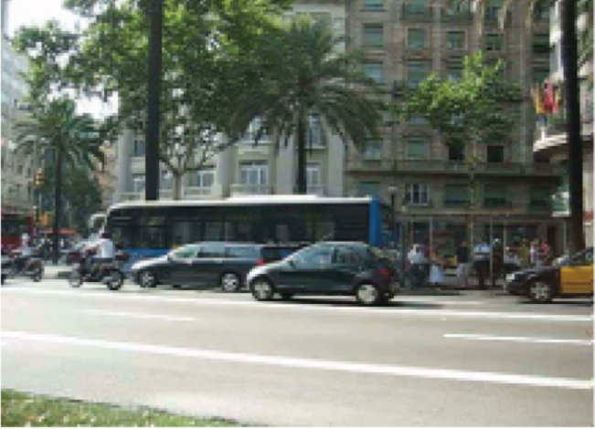
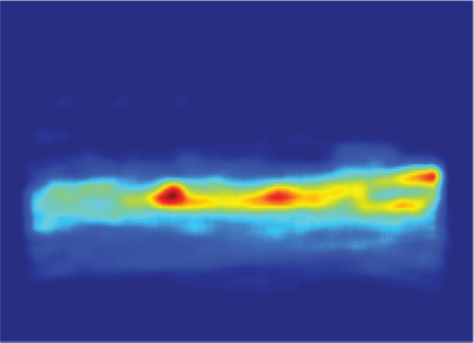
Predicting local motion
Average motion over N nearest neighbors

Slide 15
Event prediction
Match query with similar track clusters from database
Cluster retrieved tracks to reduce redundant results

Slide 16
Results: local motion prediction

Slide 17
Results: event prediction

Slide 18
Results: event prediction

Slide 19
Unusual events

Slide 20
Overall discussion
Still need training data from scenes similar to target
Possible corruption by unusual events in the training set?
Applications
Unusual event detector
Knowledge transference between environments

Slide 21
The end

