Slide 1
CSE590 V : Multi-View Reconstruction
Avanish Kushal

Slide 2
Multi-View Reconstruction Preserving Weakly-Supported Surfaces [CVPR 2011]
Michael Jancosek
Tomas Padjla

Slide 3
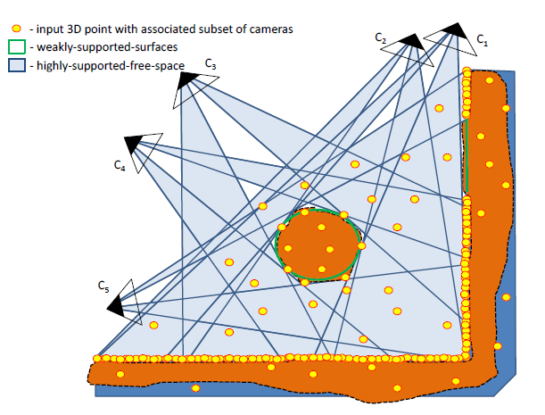
Motivation
Reconstruct Surfaces that do not have support in the input 3d point cloud (low textured walls, windows)

Slide 4
Robust and Efficient surface reconstruction from range-data[CGF- 09]
P. Labatut
J. P. Pons
R. Keriven

Slide 5
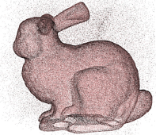
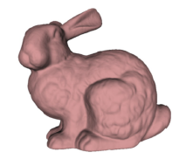
Problem Definition
Reconstruct a surface from a set of merged scans (noisy and outliers)

Slide 6
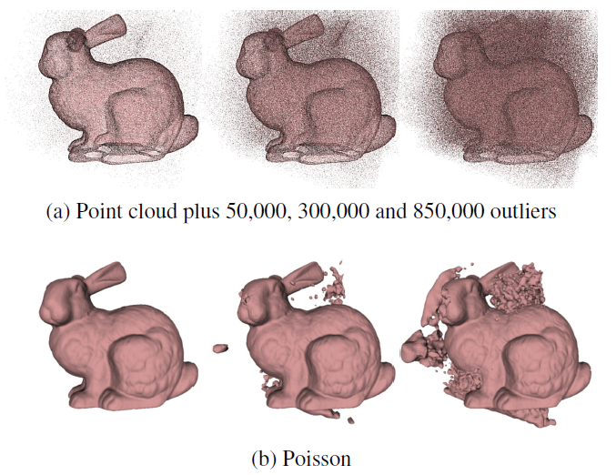
Related Work
2 Primary Themes
Implicit Surfaces (Poisson Surface Reconstruction)
Delaunay Methods

Slide 7
Algorithm
Perform a Delaunay Triangulation/Tetrahedralization of the 3d point cloud + cameras/sensors.

Slide 8
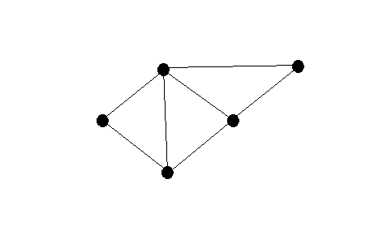
Algorithm
Perform a Delaunay Triangulation/Tetrahedralization of the 3d point cloud + cameras/sensors.

Slide 9
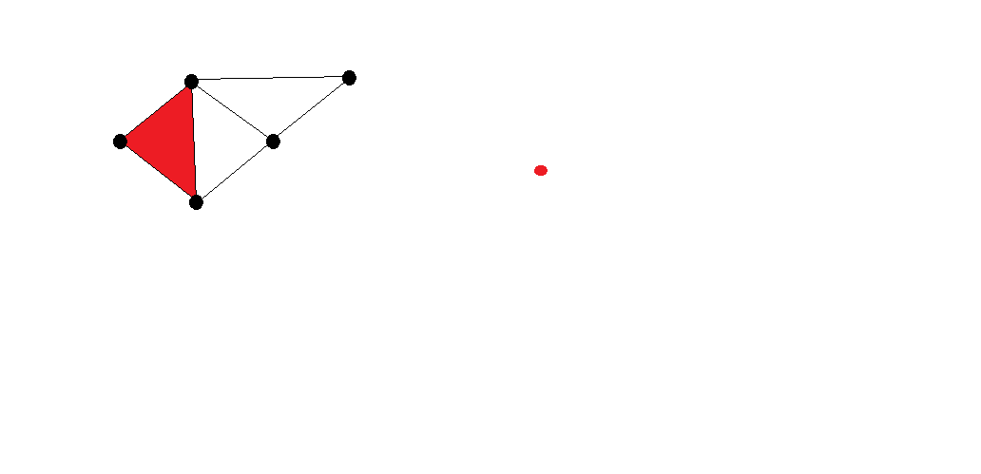
Algorithm
Construct a directed graph
Each tetrahedron is a vertex

Slide 10
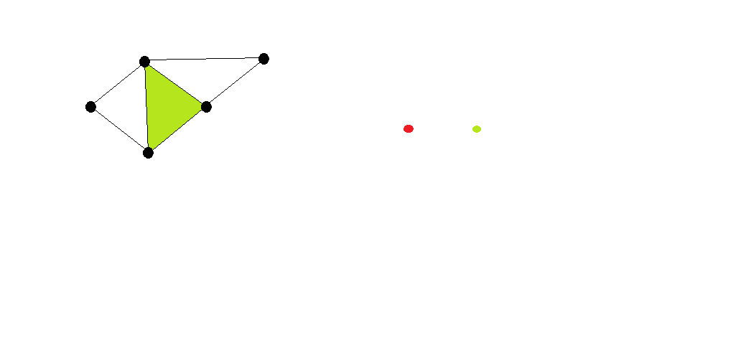
Algorithm
Construct a directed graph
Each tetrahedron is a vertex

Slide 11
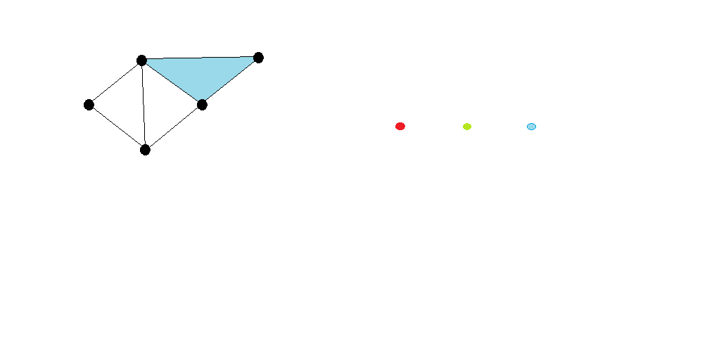
Algorithm
Construct a directed graph
Each tetrahedron is a vertex

Slide 12
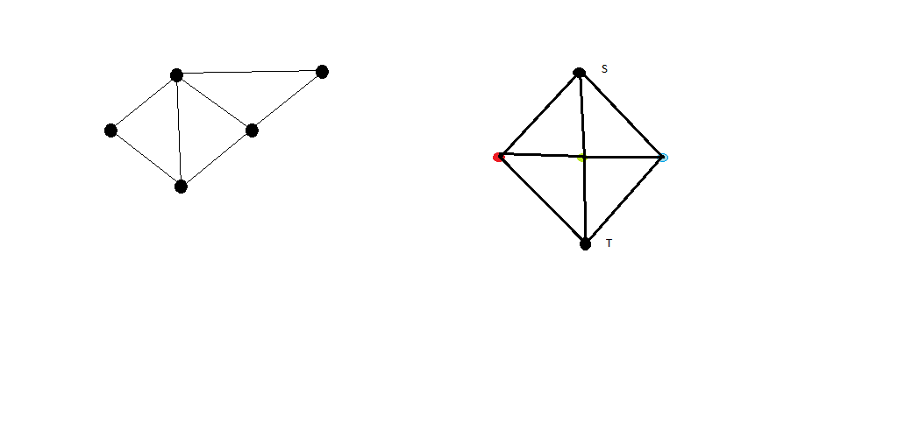
Algorithm
Find an s-t cutset of the directed graph
An additional s & t vertex

Slide 13
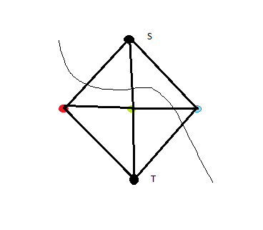
Algorithm
Find an s-t cutset of the directed graph
The s-t cutset gives the surface

Slide 14
Formulation
: Visibility Information from points, cameras.
: Quality of reconstructed surface in terms of size of triangles.

Slide 15
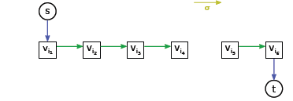
Surface Visibility

Slide 16
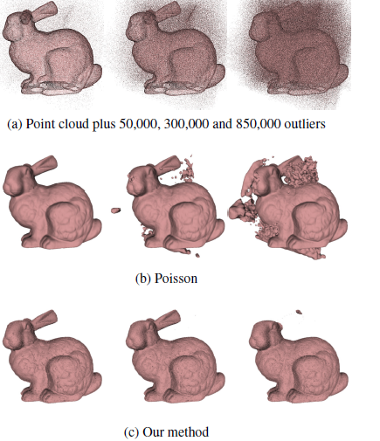
Results

Slide 17
Multi-View Reconstruction Preserving Weakly-Supported Surfaces[CVPR 2011]
Michael Jancosek
Tomas Padjla

Slide 18
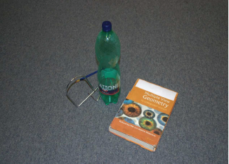
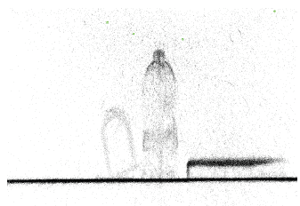
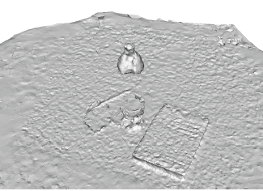
Problem Definition
Reconstruct Surfaces that do not have support in the input 3d point cloud (low textured walls, windows)
Input Image Point Cloud Reconstructed Surface
using CFG 09

Slide 19
Weakly Supported Surfaces

Slide 20
Key Claim
Large Jump in Free Space Support as we go from outside to inside.
Even true for weakly supported surfaces.

Slide 21
Weakly Supported Surfaces
Ws = 9 ( 3 * 3)

Slide 22
Weakly Supported Surfaces
Wt = 3 ( 1 * 3)

Slide 23
Weakly Supported Surfaces
Ws > Wt -> creates wrong cut.

Slide 24
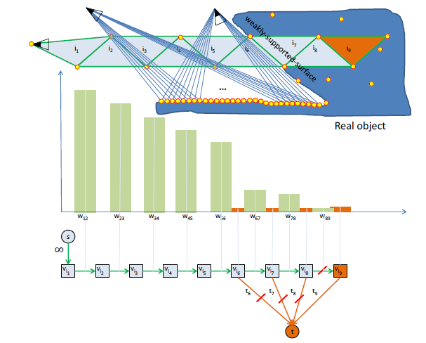
Old t-weights

Slide 25
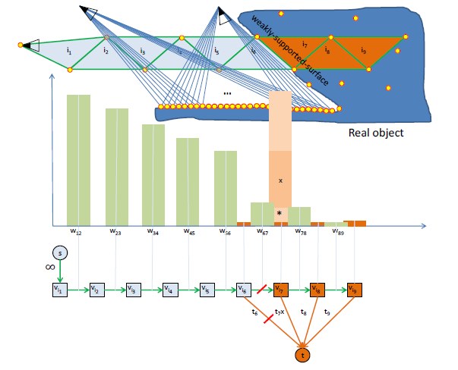
Modified Weights

Slide 26
Performance
DataSet/Method | Baseline[CFG 09](mins) | Ours(mins)
Castle | 30 | 32
Dragon | 90 | 94

Slide 27
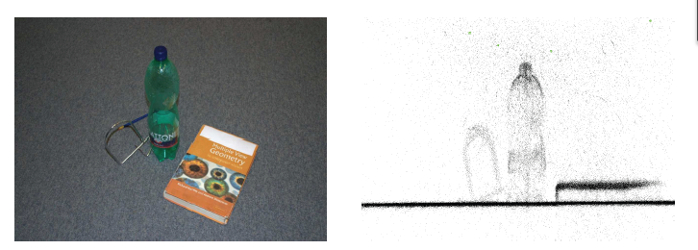
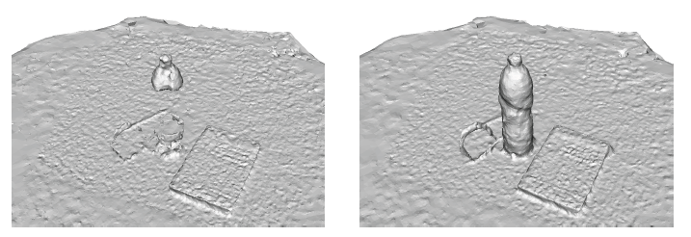
Results
INPUT IMAGE POINT CLOUD
CFG-09 OUR METHOD

Slide 28
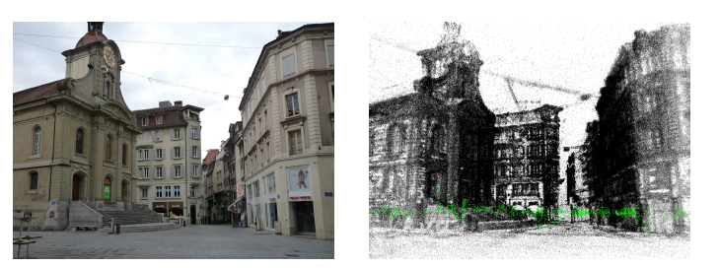
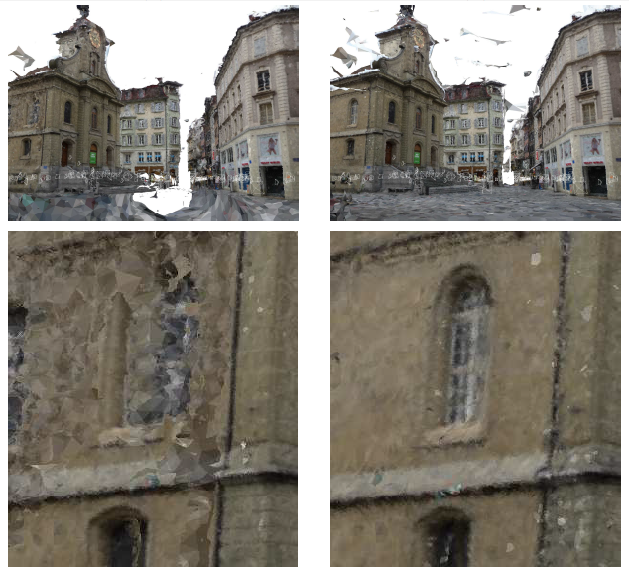
Results
INPUT IMAGE POINT CLOUD
CFG-09 OUR METHOD

Slide 29
Results
INPUT IMAGE POINT CLOUD
CGF-09 OUR METHOD

Slide 30
Discussion
How good is the claim about free space jumps ?
What should be the multiplication term ?

