Slide 1
Data-driven Crowd Analysis in Videos
Mikel Rodriguez Josef Sivic Ivan Laptev Jean-Yves Audibert
WILLOW project
Presented by Ezgi Mercan
Notes:
Cover

Slide 2
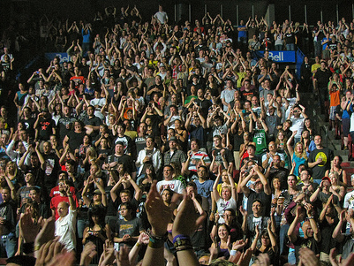
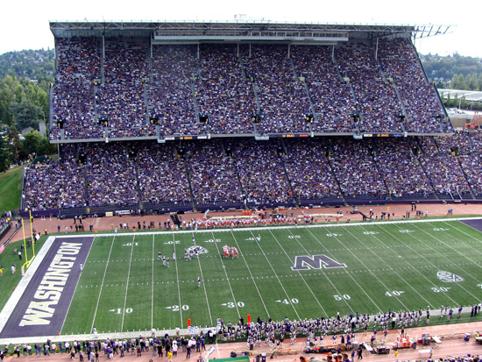
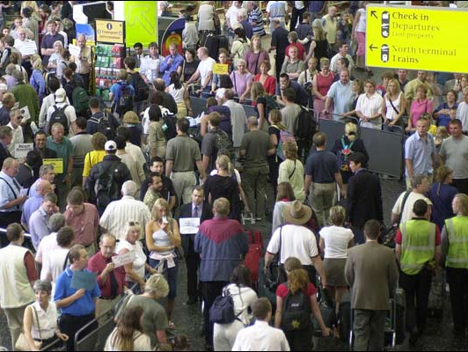
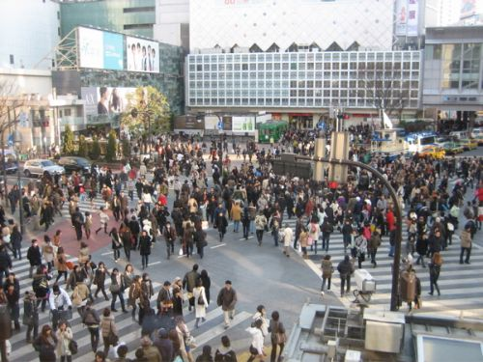
Crowd Analysis
Crowd management
Public space design
Video surveillance
Crowd simulation
Crowd analysis: a survey, Zhan, B., Monekosso, D.N., Remagnino, P., Velastin, S.A., Xu, L., Machine Vision and Applications, Vol 19, No 5-6, p. 345-357, DOI: 10.1007/s00138-008-0132-4.
Notes:
In the year 1999 the world population reached 6 billion, doubling the previous census estimate of 1960. The considerable portion of world population lives in densely populated areas, meaning crowd analysis is an important issue today. Different research disciplines have studied the crowd phenomenon and its dynamics from a social, psychological and computational standpoint respectively. Crowd scenes can be analyzed for different purposes:
Crowd management: understanding and managing the behavior of crowds in emergency situations.
Public space design: designing public spaces like stadiums or malls according to needs and behaviors of the crowd.
Video surveillance: watching crowd in real time and detect events or people for security purposed
Crowd simulation: Simulating crowd behavior to further study it, used by computer graphics people.

Slide 3
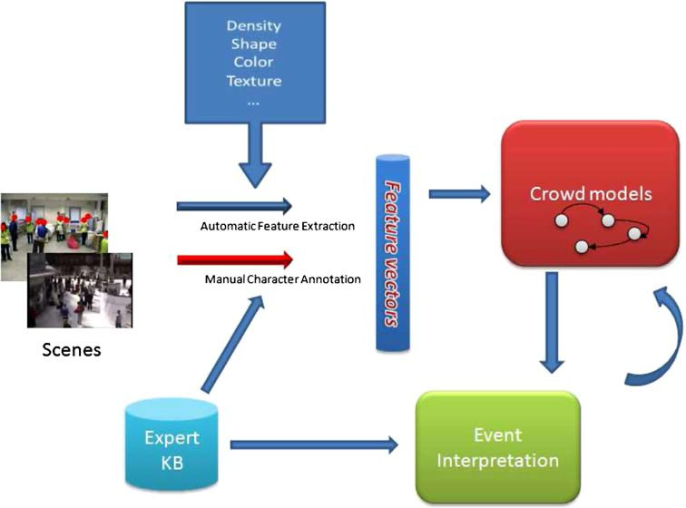
Crowd Analysis
Crowd analysis: a survey, Zhan, B., Monekosso, D.N., Remagnino, P., Velastin, S.A., Xu, L., Machine Vision and Applications, Vol 19, No 5-6, p. 345-357, DOI: 10.1007/s00138-008-0132-4.
Notes:
This is a classical crowd analysis system. It takes several scenes as input and extracts some features depending on the application. These scenes also can be manually annotated or labeled by some experts. Then using feature vectors, some crowd model is constructed. These crowd models are used to interpret the events or scenes.

Slide 4
Data-driven Crowd Analysis
Any given video can be thought as being a mixture of previously observed videos.
Notes:
The main idea behind this paper is that any scene can be thought as a mixture of previously observed scenes. In this image you can see that the motion of people in the video at the center is thought as a mixture of 4 different videos. These mixture is explained by matching some patches in some temporal and spatial window.

Slide 5
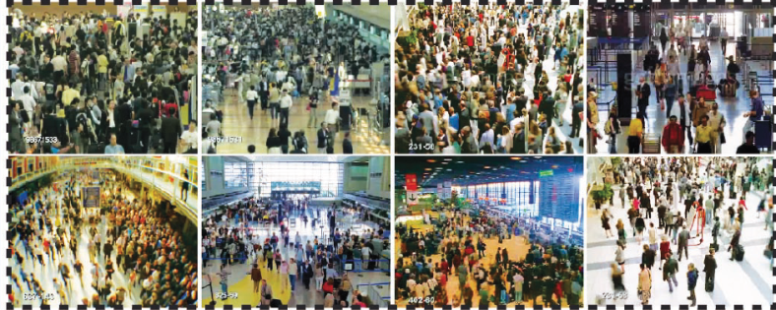
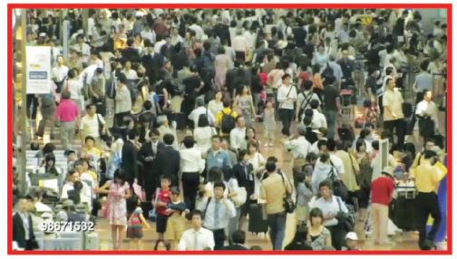
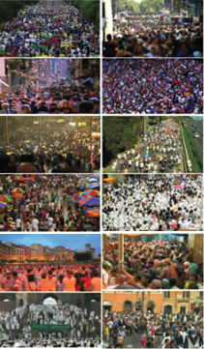
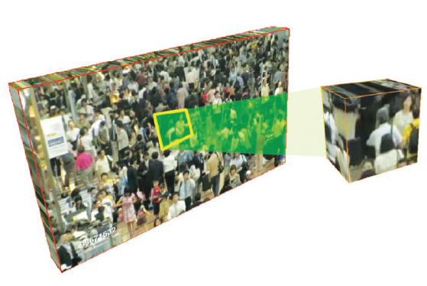
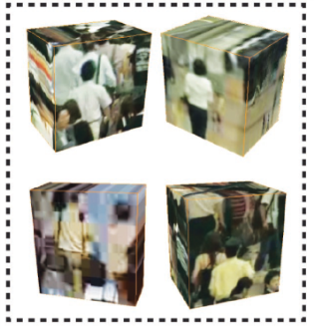
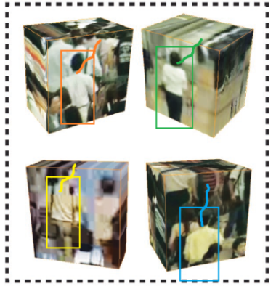
Learning Motion Patterns
Global Matching
similar scenes
test video
database
query for similar scenes
Local Matching
find similar scenes
find similar cells
cell of interest
query for similar cells
test video
Overview of Methodology
similar cells
individual to track
get motion patterns
Tracking using Motion Patterns
predict motion
similar cells
motion patterns of similar cells
Notes:
Overview of the methodology
During this whole presentation, I may mistakenly use the word image, but please keep in mind that we are dealing with videos.
Firstly we have a database of videos. Priors are learned by the off-line, long-term, unsupervised analysis of a large database of training videos.
When a test video comes, firstly something called ‘Global Matching’ is done.
The database is searched for similar scenes.
This is done, because we don’t want to look at scenes that are semantically very different. For example, if we want to track someone in an airport scene, we don’t want to look at other people in a stadium.
After global matching, we don’t need the whole database anymore, we just look at the globally matched scenes and do something called local matching.
Then we select a cell of interest that contains the person we want to track.
We search the ‘globally matched scenes’ for the similar cells.
We find similar cells, this time these cells contain a person similar to the one in our person of interest.
Now we are done with the scenes as well. We are trying to track the person using these patches or cells we obtained.
We get the motion patterns for the similar cells we learned during the database analysis.
We us these motion patterns to predict the motion of the person being tracked.

Slide 6
Learning Motion Patterns
Global Matching
similar scenes
test video
database
Local Matching
test video
similar cells
individual to track
Tracking using Motion Patterns
similar cells
motion patterns of similar cells
Notes:
Now we are going to look at the training part, especially how the motion patterns are extracted.

Slide 7
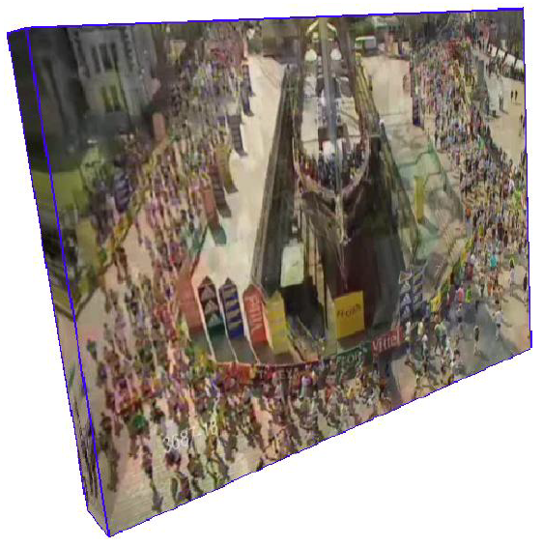
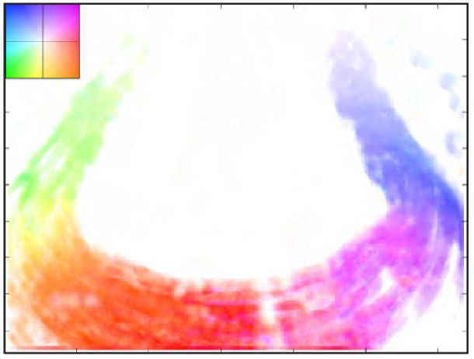
Learning Motion Patterns
Low-level Representation: Dense Optical Flow
For each pixel in each frame, calculate average optical flow.
Combine the optical flow vectors into a global motion field for a temporal window.
temporal window ω = 60 frames
spatial window 20 pixel x 20 pixel
An iterative image registration technique with an application to stereo vision. B. Lucas and T. Kanade. In IJCAI, volume 3, pages 674–679, 1981.
Notes:
In the first part of off-line database analysis, they try to learn a low-level representation for scenes. They use standard optical flow algorithms.
For each pixel, they calculate the average optical flow.
They combine the optical flow vectors to obtain a global motion field, over a temporal window of 60 frames and a spatial window of 20 pixel by 20 pixel.

Slide 8
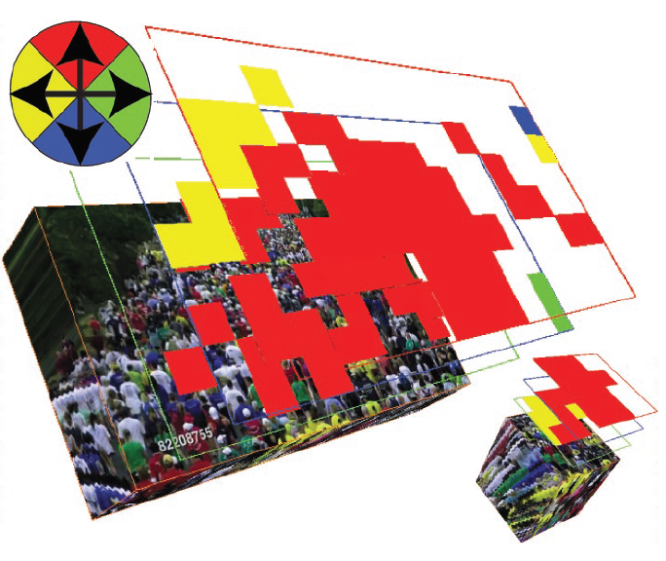
Learning Motion Patterns
Mid-level Representation: Correlated Topic Model
CTM captures spatial dependencies of different behaviors in the same scene.
Video(720x480)=> 10 sec clips => 36x24 cells(20x20)
Optical flow is quantized into directions => {V₀, V_{up}, V_{down}, V_{left}, V_{right}}
Motion word dictionary is constructed
Behavior is (hidden) topic from which motion words are generated.
A correlated topic model of science. D. Blei and J. Lafferty. AAS, 1(1):17–35, 2007
Notes:
In the second part of database analysis, they try to learn a mid-level representation using correlated topic models. CTM is very similar to bag-of-words model in image analysis.
CTM can capture the spatial dependencies of different behaviors in the same scene. For example, in a scene where pedestrians cross a road, there will not be a car moving on the road. CTM can capture this kinds of motion dependencies.
In order to construct CTM, videos are chopped into at most 10 second and 20pixel by 20pixel clips.
Then optical flow calculated in previous step is quantized into 5 directions, movement to left, right, up, down or no motion.
Motion word dictionary is constructed, each motion word is a combination of direction and position. CTM assigns probabilities for each word, for example cell at position o has 0.3 probability for V up, 0.2 probability for V down and such.
Behavior can be defined as the hidden topic from which motion words are generated.

Slide 9
Learning Motion Patterns
Global Matching
similar scenes
test video
database
Local Matching
test video
similar cells
individual to track
Tracking using Motion Patterns
similar cells
motion patterns of similar cells
Notes:
Now we are going to look at how they match test scene to the scenes in the database in a global level.

Slide 10
Global Crowded Scene Matching
Gist scene descriptor is used to retrieve similar scenes from the database.
Global matching provides semantically similar scenes.
Modeling the Shape of the Scene: A Holistic Representation of the Spatial Envelope, Oliva, A., Torralba, A., International Journal of Computer Vision 42(3), 145-175, 2001.
Notes:
Now we are trying to find semantically similar scenes. For example if we have an airport scene as a test scene, we are trying to find the airport scenes in the database.
They are using gist descriptor for this purpose.
Gist descriptors are good at classifying scenes as a whole. They assign each scene a set of attributes with different degrees, like openness, naturalness, perspective, symmetry, contrast and such.

Slide 11
Learning Motion Patterns
Global Matching
similar scenes
test video
database
Local Matching
test video
similar cells
individual to track
Tracking using Motion Patterns
similar cells
motion patterns of similar cells
Notes:
Now, we have similar scenes, we will look at how they locally match cells to our cell of interest.

Slide 12
Local Crowd Patch Matching
HOG3D is used to retrieve similar patches from the selected scenes.
HOG3D demonstrates good performance in action recognition.
A Spatio-Temporal Descriptor Based on 3D-Gradients, Kläser, A., Marszałek, M., Schmid, C., British Machine Vision Conference - sep 2008
Notes:
In local matching, they try to locate people move like the one in our person of interest.
They use Histogram of Gradients in 3D to retrieve similar patches.
HOG3D has a good performance in action recognition.

Slide 13
Learning Motion Patterns
Global Matching
similar scenes
test video
database
Local Matching
test video
similar cells
individual to track
Tracking using Motion Patterns
similar cells
motion patterns of similar cells
Notes:
Now, we have the similar patches, we can predict the motion in our cell of interest. This is how.

Slide 14
Tracking using Motion Patterns
Prediction of system
Using:
Optical Flow
CTM
Prediction by Kalman filter
Learnt from:
Test video
Database of videos
Tracker position for person at location O
P_{O} = K + λ S
Notes:
They use a simple equation to predict the next position of tracker.
This is the tracker position for the person at location O. This is what we want to predict.
K is the contribution of Kalman filter. It uses no prior.
S is the prediction of system and it is weighted by lambda. We will see that they used the system prediction in different meanings.
System can use just optical flow, in other words low level representation.
It can use CTM, in other words mid level representation.
These representations can be learnt from test video itself.
Or database of videos.
Of course they propose to use CTM with database of videos and 50% weight on Kalman and system.

Slide 15
Experiments
Data: Downloaded from video web sites using text queries like “crosswalk”, “political rally”, “festival”, “marathon”.
2 types of experiment:
1. Tracking Typical Crowd Behavior
2. Tracking Rare and Abrupt Events
Notes:
Now I try to explain the experiments and the results.
They obtained their data from video sites using test queries. They eliminated duplicate videos, time-lapsed videos and etc.
They do 2 types of experiment:
Tracking typical crowd behavior.
Tracking rare or unusual events.

Slide 16
Experiments
Test videos are manually annotated to measure the error in pixels.
Blue = Typical crowd behavior
Red = Rare events
Notes:
In their experiments, they manually annotate their test videos. Not the training videos because training is unsupervised. These are the 2 different events they try to detect.
Firstly they want to track the individuals moving in the direction of the crowd movement. They call it typical crowd behavior.
Secondly, they want to track the individuals moving in a different direction from the crowd like the lady in the first picture or the cameraman in the second picture.

Slide 17
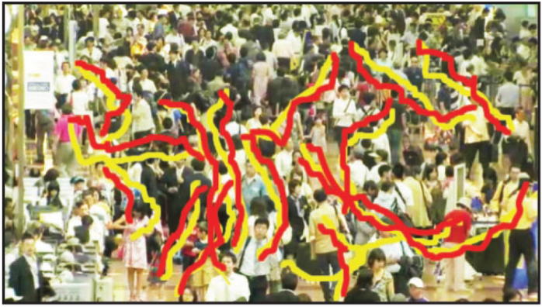
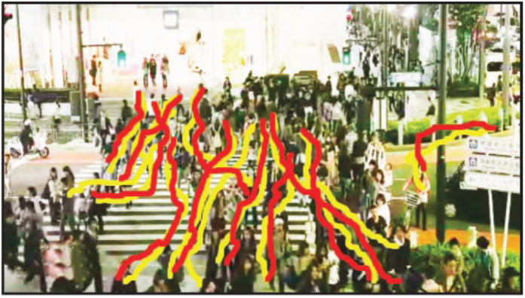
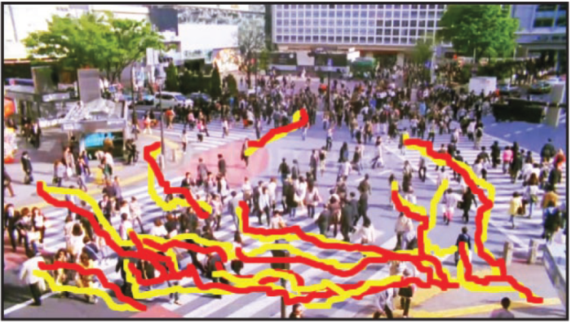
Experiments
Error = # of pixels between the positions of tracker and individual in each frame
Yellow = ground truth
Red = tracking results
Notes:
In their experiments, they measure the error as the number of pixels between the position of tracker and the individual in each frame. Here yellow is the ground truth which they manually annotated in the test scenes. Red is the predicted position by the system.

Slide 18
1st Experiment
Tracking typical crowd behavior
Notes:
Now we will look at the experiment results. Firstly tracking typical crowd behavior.

Slide 19
Notes:
In this video they try to track the man with a bag, in the green rectangle which is ground truth. Red rectangle is the systems prediction. They use no prior, meaning they predict according to Kalman filter.
It is not that successful.

Slide 20
Notes:
This is batch mode result meaning they try to learn from the test image and predict according to that.
It is actually pretty successful as you can see. Since the person of interest behaves like the most of the crowd, it can be learnt from the test scene.

Slide 21
Notes:
This is their proposed data-driven method. Here, they try to learn from the database and predict according to matched videos. It is quite successful but doesn’t add too much to the batch mode.

Slide 22
Results for tracking typical crowd behavior
 |  | Error
No prior |  | 86.24
Learned on test video | OF | 50.93
 | CTM | 46.93
Learned on database | 1st-nn OF | 57.06
 | 3-nn OF | 52.76
 | 1st-nn CTM | 50.59
 | 3-nn CTM | 47.47
Error
Error is measured in pixels.
Notes:
This is the results in numbers. You can see they tried a bunch of combination. They tried no priors, learning from the test video with just optical flow and with CTM, learning from database with optical flow and 1st nearest neighbor, optical flow with 3 nearest neighbor, CTM with 1st nearest neighbor and CTM with 3 nearest neighbor. Even though they have some improvement with every modification, it is not that much. And actually, best result is learning from the video itself. It is reasonable because the most similar motions can be found in the video in case of a typical behavior.

Slide 23
2nd Experiment
Tracking rare events
Notes:
Now second round of experiments. They try to track rare events this time.

Slide 24
Notes:
In this video, they try to track a person walking perpendicular to the general crowd motion without using any priors.
It is not successful at all. Prediction is that person will move like the rest of the crowd, and he doesn’t.

Slide 25
Notes:
This is the batch-mode we talked previously. They try to learn from the test video and again the prediction is not very successful. The system predicts like the previous video, according to general motion of video.

Slide 26
Notes:
Now we will see their proposed data-driven method. They find similar videos and similar patches from those videos. You will see that similar videos and similar patches are retrieved from the database. In this case a person moving up.
This is pretty successful, because it is probable to find such a rare event in a large video database and even though test video doesn’t help the predict the motion, these patches certainly does.

Slide 27
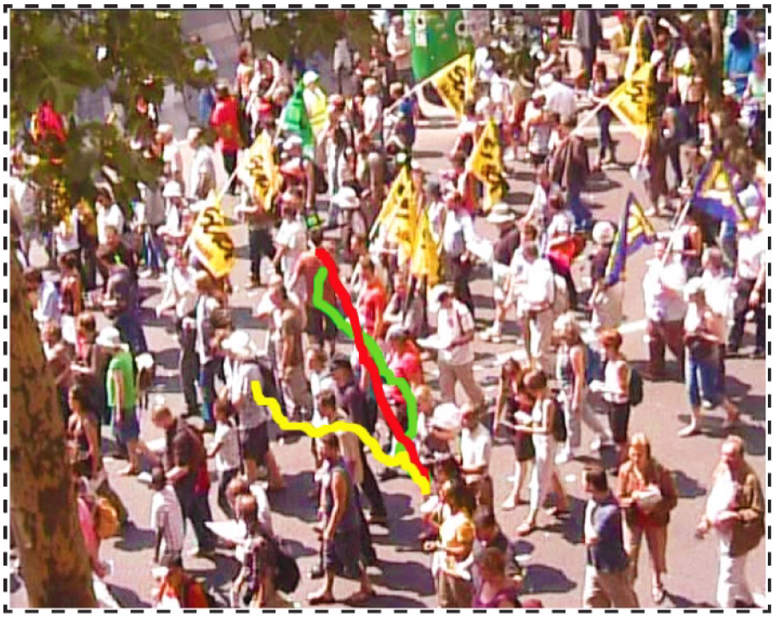
Results for tracking rare events
Red Ground Truth
Yellow Batch mode
Green Data-driven
Notes:
This is the comparison of three different method we’ve just seen. Red is the manually annotated ground truth.
Yellow is the batch mode where we learn from the test video.
Green is the data driven approach they proposed. It is the closer to the actual path.

Slide 28
Results for tracking rare events
 |  | Error
No prior |  | 89.8
Learned on test video | CTM | 58.82
Learned on database | k-nn CTM | 46.88
Error
Error is measured in pixels.
Notes:
These are the numerical results. I don’t know why they did not try the just optical flow method or why they did not publish the results. But their methodology is quite successful in reducing error rate.

Slide 29
Discussion
There is no information about the performance of ‘just optical flow’ method on tracking rare events (2nd experiments).
There is no information about the speed of the system although it is intended to be an online system.
Notes:
As discussion points, I can repeat the missing results in the second part.
And also they mention in the motivation part that they want to build a system that runs online, in real time. But they don’t mention it in the results.
Also maybe I can add that for such a system to work, the database must be quite large so it contains examples for many rare events.

Slide 30
Resources
Website: http://www.di.ens.fr/willow/research/datadriven/index.html
Database will be public soon.
Notes:
You can go and check their website in here. This paper is a part of a project called Willow.
And they are going to make their database publicly available.

