Slide 1
Taking Computer Vision Into The Wild
Neeraj Kumar
October 4, 2011
CSE 590V – Fall 2011
University of Washington

Slide 2
A Joke
Q. What is computer vision?
A. If it doesn’t work (in the wild), it’s computer vision.
(I’m only half-joking)

Slide 3
Instant Object Recognition Paper*

Slide 4
Instant Object Recognition Paper*
Design new algorithm
Pick dataset(s) to evaluate on
Repeat until conference deadline:
Train classifiers
Evaluate on test set
Tune parameters and tweak algorithm
Brag about results with ROC curves
- Fixed set of training examples
- Fixed set of classes/objects
- Training examples only have one object, often in center of image
- Fixed test set, usually from same overall dataset as training
- MTurk filtering, pruning responses, long training times, …
- How does it do on real data? New classes?
*Just add grad students

Slide 5
Instant Object Recognition Paper
User proposes new object class
System gathers images from flickr
Repeat until convergence:
Choose windows to label
Get labels from MTurk
Improve classifier (detector)
Also evaluate on Pascal VOC
- What representation?
- Which windows to pick?
- Which images to label?
- How does it compare to state of the art?
[S. Vijayanarasimhan & K. Grauman – Large-Scale Live Active Learning:
Training Object Detectors with Crawled Data and Crowds (CVPR 2011)]

Slide 6
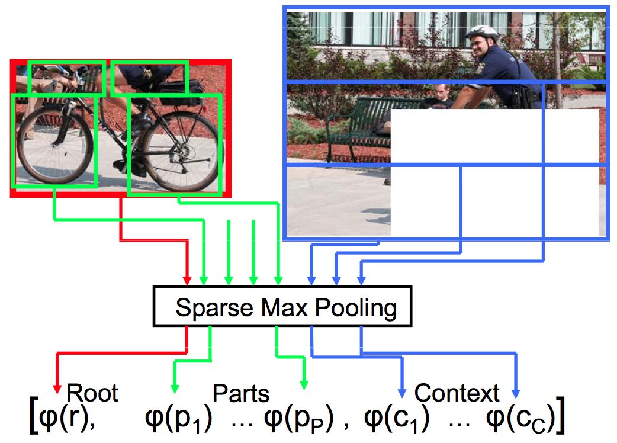
Object Representation
Deformable Parts: Root + Parts + Context
Root from here
P=6 parts, from bootstrap set
C=3 context windows, excluding object
candidate, defined to the left, right, above

Slide 7
Features: Sparse Max Pooling
 | Bag of Words | Sparse Max Pooling
Base features | SIFT | SIFT
Build vocabulary tree | ✔ | ✔
Quantize features | Nearest neighbor, hard decision | Weighted nearest neighbors, sparse coded
Aggregate features | Spatial pyramid | Max pooling
[Y.-L. Boureau, F. Bach, Y. LeCun, J. Ponce – Learning Mid-level Features for Recognition (CVPR 2010]
[J. Yang, K. Yu, Y. Gong, T. Huang – Linear Spatial Pyramid Matching Sparse Coding for Image Classification (CVPR 2009)]

Slide 8
How to Generate Root Windows?
100,000s of possible locations, aspect ratios, sizes
X
1000s of images
= too many possibilities!

Slide 9
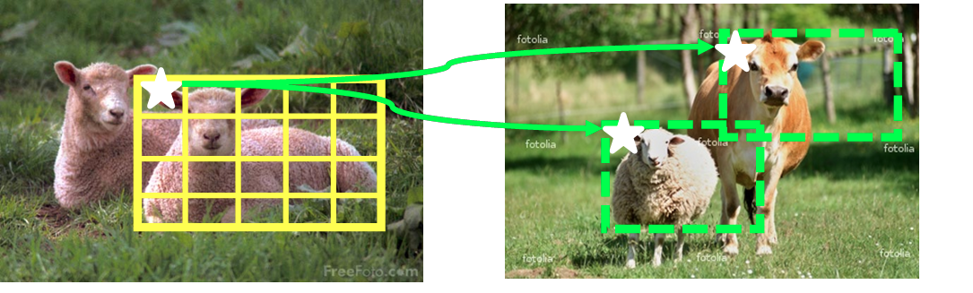
Jumping Windows
Training Image
Novel Query Image
Build lookup table of how frequently given feature in a grid cell predicts bounding box
Use lookup table to vote for candidate windows in query image a la generalized Hough transform

Slide 10
Pick Examples via Hyperplane Hashing
Want to label “hard” examples near the hyperplane boundary
But hyperplane keeps changing, so have to recompute distances…
Instead, hash all unlabeled examples into table
At run-time, hash current hyperplane to get index into table, to pick examples close to it
[P. Jain, S. Vijayanarasimhan & K. Grauman – Hashing Hyperplane Queries to
Near Points with Applications to Large-Scale Active Learning (NIPS 2010)]

Slide 11
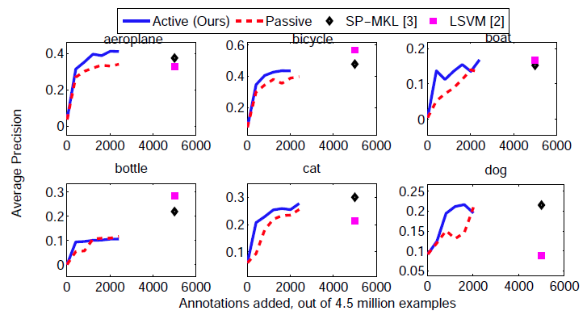
Comparison on Pascal VOC
Comparable to state-of-the-art, better on few classes
Many fewer annotations required!
Training time is 15mins vs 7 hours (LSVM) vs 1 week (SP+MKL)

Slide 12
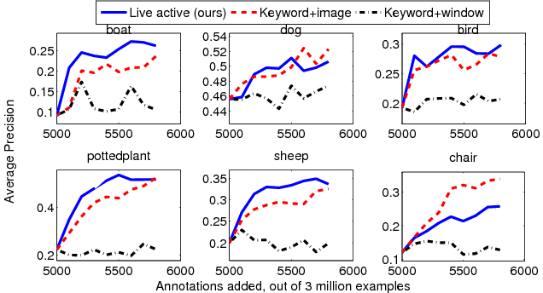
Online Live Learning for Pascal
Comparable to state-of-the-art, better on fewer classes
But using flickr data vs. Pascal data, and automatically

Slide 13
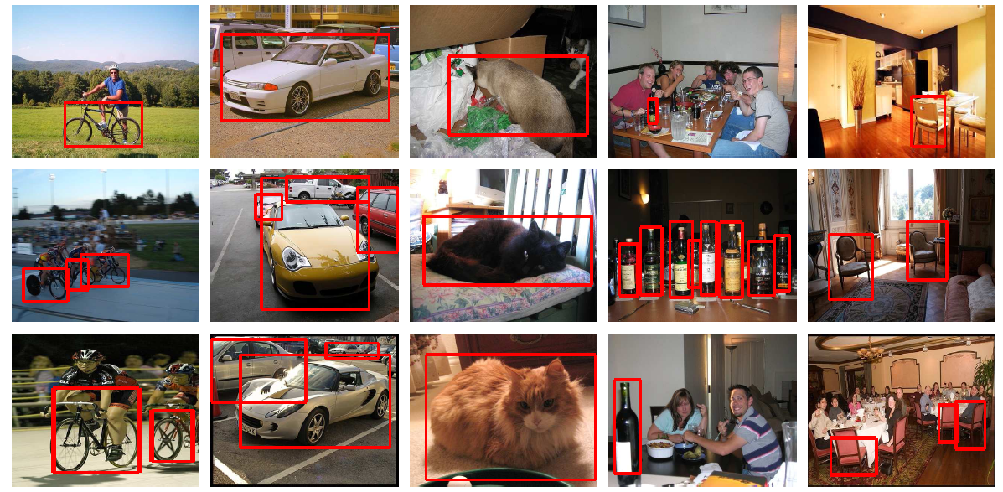
Sample Results
Correct
Incorrect

Slide 14
Lessons Learned
It is possible to leave the sandbox
And still do well on sandbox evaluations
Sparse max pooling with a part model works well
Linear SVMs can be competitive with these features
Jumping windows is MUCH faster than sliding
Picking examples to get labeled is a big win
Linear SVMs also allow for fast hyperplane hashing

Slide 15
Limitations
users
“Hell is other people”
Jean-Paul Sartre
With apologies to

Slide 17
Solving Real Problems for Users
Users want to do stuff
It doesn’t work well enough
Users express their displeasure gracefully
*With apologies to John Gabriel

Slide 18
…And Never The Twain Shall Meet?
User Expectation
?
Current Best of Vision Algorithms
Pascal VOC Results from Previous Paper

Slide 19
Unsolved Vision Problems
Segmentation
Optical Flow
Classification
Detection
Simplify Problem!
Shape Estimation
Recognition
Stereo
Tracking
Geometry

Slide 20
Columbia University
University of Maryland
Smithsonian Institution

Slide 21
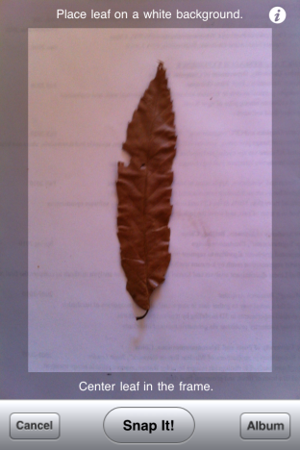
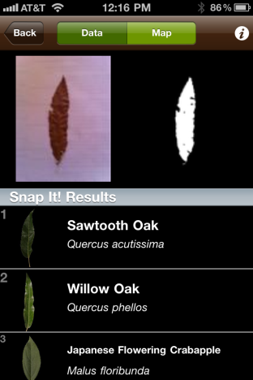

Slide 22
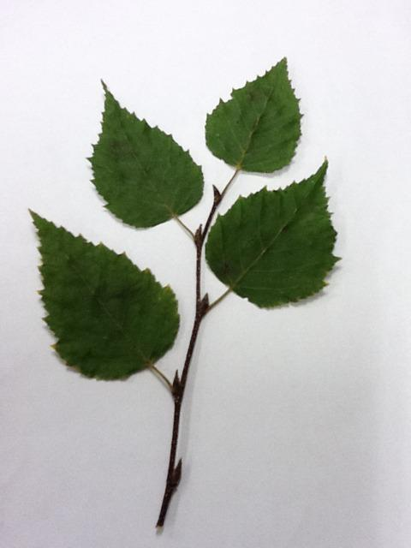
Easier Segmentation for Leafsnap

Slide 23
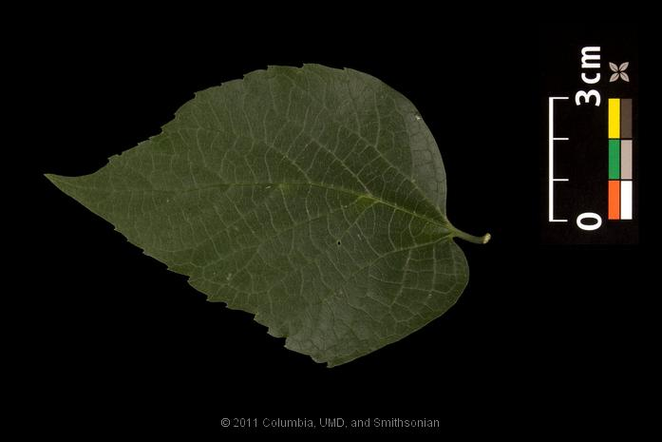
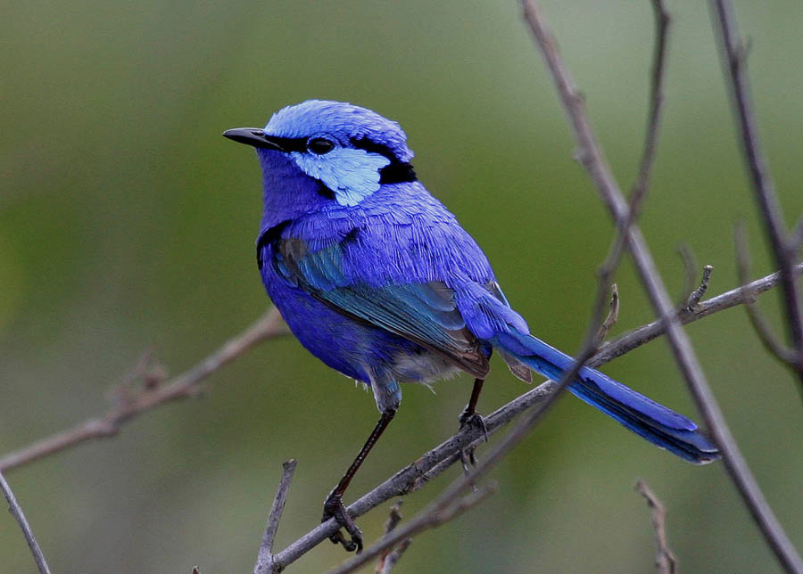
Plants vs Birds
2d | 3d
Doesn’t move | Moves
Okay to pluck from tree | Not okay to pluck from tree
Mostly single color | Many colors
Very few parts | Many parts
Adequately described by boundary | Not well described by boundary
Relatively easy to segment | Hard to segment

Slide 24
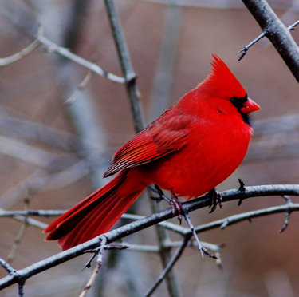
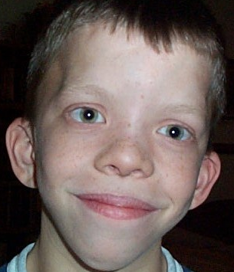
Human-Computer Cooperation
Red!
Where is it?
Top-right!
Okay.
Uh, it’s pointy?
<Shape descriptor>
Bottom-left!
Bottom-left!
What color is it?
Where’s the beak?
Describe its beak
Where’s the tail?
[S. Branson, C. Wah, F. Schroff, B. Babenko, P. Welinder, P. Perona, S. Belongie – Visual Recognition with Humans in the Loop (ECCV 2010)]

Slide 25
20 Questions
http://20q.net/

Slide 26
Information Gain for 20Q
Pick most informative question to ask next
Expected information gain of class c, given image & previous responses
Probability of getting response u_{i}, given image & previous responses
Entropy of class c, given image and possible new response u_{i}
Entropy of class c right now

Slide 27
Answers make distribution peakier

Slide 28
Incorporating Computer Vision
Probability of class c, given image and any set of responses
Bayes’ rule
Assume variations in user responses are NOT image-dependent
Probabilities affect entropies!

Slide 29
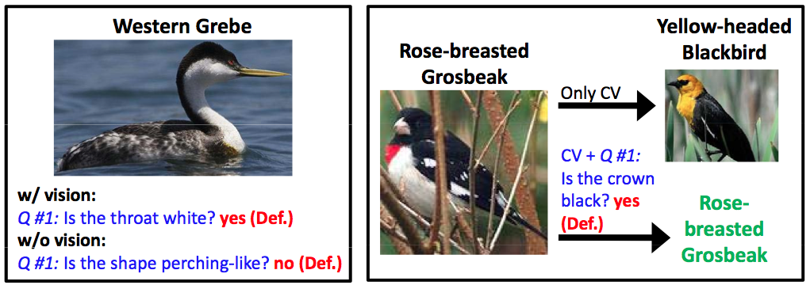
Incorporating Computer Vision…
…leads to different questions

Slide 30
Ask for User Confidences

Slide 31
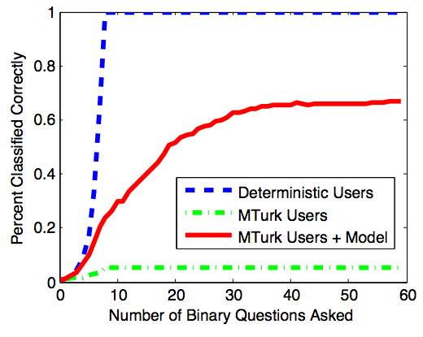
Modeling User Responses is Effective!

Slide 32
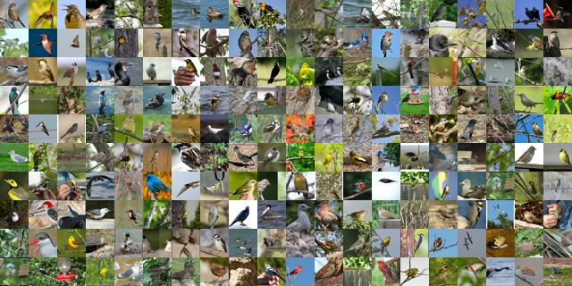
Birds-200 Dataset
http://www.vision.caltech.edu/visipedia/CUB-200.html

Slide 33
Results

Slide 34
Results
With fewer questions, CV does better
With more questions, humans do better

Slide 35
Lessons Learned
Computer vision is not (yet) good enough for users
But users can meet vision halfway
Minimizing user effort is key!
Users are not to be trusted (fully)
Adding vision improves recognition
For fine-scale categorization, attributes do better than 1-vs-all classifiers if there are enough of them
Classifier | 200 (1-vs-all) | 288 attr. | 100 attr. | 50 attr. | 20 attr. | 10 attr.
Avg # Questions | 6.43 | 6.72 | 7.01 | 7.67 | 8.81 | 9.52

Slide 36
Limitations
Real system still requires much human effort
Only birds
Collecting and labeling data
Crowdsourcing?
Experts?
Building usable system
Minimizing

Slide 37
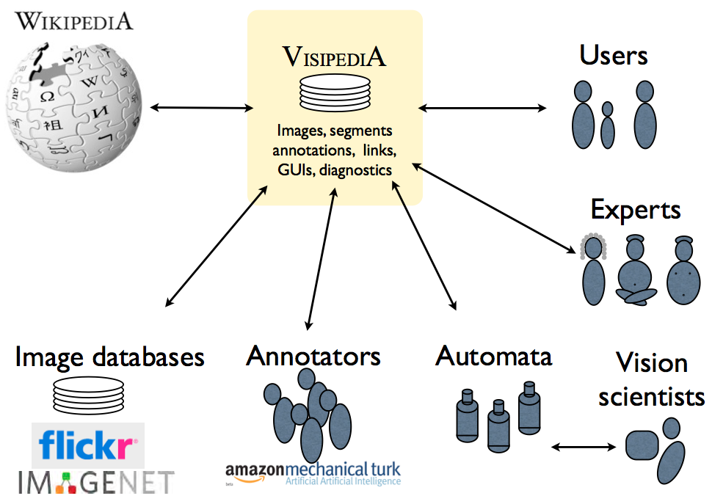
Visipedia
http://www.vision.caltech.edu/visipedia/

