Slide 1
HOGgles
Visualizing Object Detection Features
C. Vondrick, A. Khosla, T. Malisiewicz, A. Torralba
ICCV, 2013.
presented by
Ezgi Mercan

Slide 2
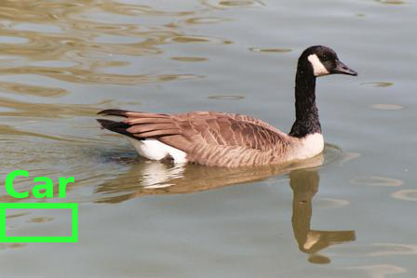
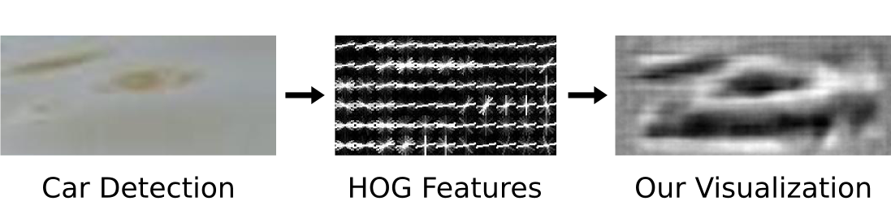
Object Detection Failures
Why do our detectors think water looks like a car?
  Data set?
  Machine learning method?
  Features?
A high scoring car detection
from DPM.
Notes:
Discriminatively trained part-based models.
Computers do not actually see the RGB images, they only see the feature vectors we give them.
What do computers see in the features?

Slide 3
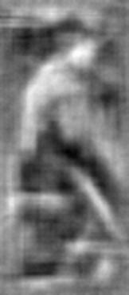
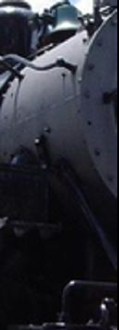
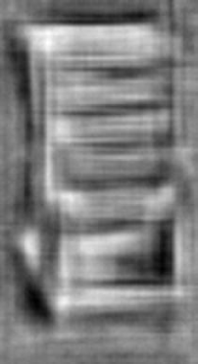
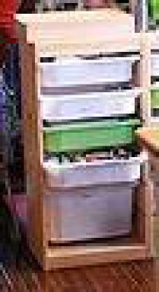
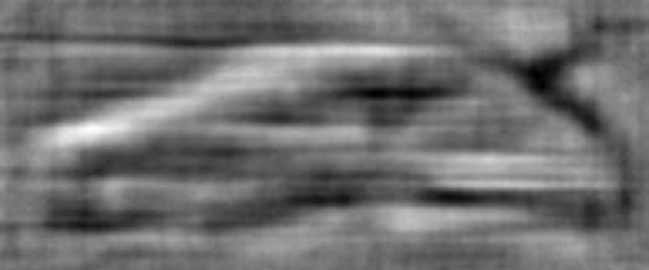
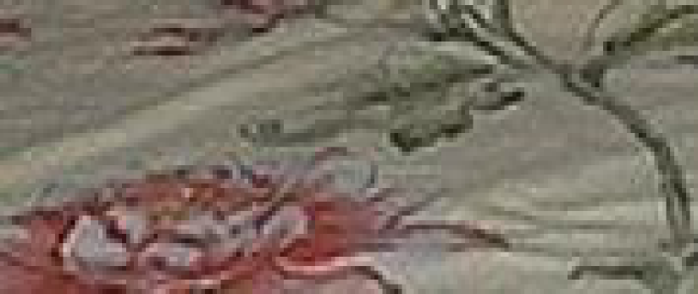
Object Detection Failures
Object Categories
Aeroplane | Table
Bicycle | Dog
Bird | Horse
Boat | Motorbike
Bottle | Person
Bus | Potted plant
Car | Sheep
Cat | Sofa
Chair | Train
Cow | TV/ monitor
Person
Chair
Car

Slide 4
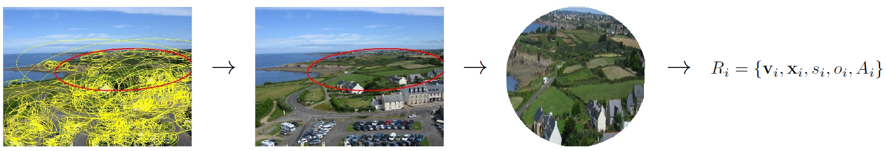
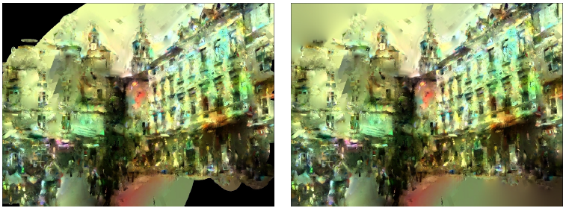
Reconstructing an Image
calculate SIFT
elliptic
region of interest
affine normalization
to square patch
local descriptor
copied patches
blending
interpolation
original image
Reconstructing an image from its local descriptors, Philippe Weinzaepfel, Hervé Jégou and Patrick Pérez, Proc. IEEE CVPR’11.
Notes:
For each descriptor, search its nearest neighbor descriptor and warp the corresponding image patch such that it fits into destination ellipse.
Seamlessly stitch all the patches, blend and complete the missing parts. Voila!

Slide 5
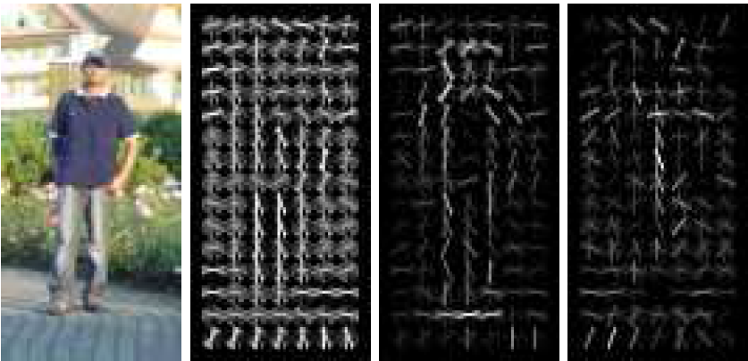
Histogram of Oriented Gradients
original image
R-HOG descriptor
(HOG glyph)
R-HOG descriptor
weighted by
positive SVM weights
R-HOG descriptor
weighted by
negative SVM weights
Histograms of oriented gradients for human detection, Dalal, N., Triggs, B., CVPR’05.
Notes:
Used by Dalal and Triggs for human detection in their 2005 CVPR paper.
-Gradient computation: 1D derivative mask in both horizontal and vertical directions. (Also can use more complex masks, such as 3x3 Sobel masks or diagonal masks)
-Orientation binning: Create cells, each pixel in a cell casts a weighted vote based on the values of gradient. Gradient can be signed or unsigned, bins could be spread over 0-180 degrees or 0-360 degrees. Vote can be the gradient value itself or a function of gradient.
-Descriptor blocks: Create overlapping blocks, rectangular or circular, group cells into overlapping blocks.
-Block normalization: Not really improves performance in human detection case.
What works best is 3x3 cell blocks of 6x6 pixel cells with 9 histogram channels. Or 2 radial bins with 4 angular bins, central radius of 4 pixels and an expansion factor of 2.

Slide 6
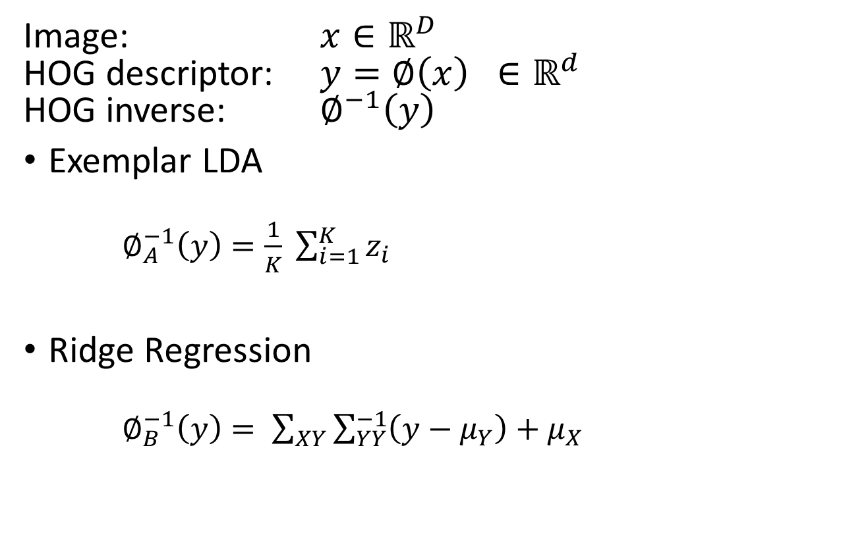
Algorithms
Image: $x∈ℝ^{D}$
HOG descriptor: $y=∅\left(x\right) ∈ℝ^{d}$
HOG inverse: $∅^{−1}\left(y\right)$
Exemplar LDA
  $∅_{A}^{−1}\left(y\right)=\frac{1}{K} \sum_{i=1}^{K}{z_{i}}$
Ridge Regression
  $∅_{B}^{−1}\left(y\right)= \sum_{XY}{\sum_{YY}^{−1}{\left(y−μ_{Y}\right)+μ_{X}}}$
Notes:
Exemplar LDA: Train an ELDA detector for the query. Then using the detector, find top K detections from the database and average them.
Very simple, produce reasonably good results but very slow because it requires running an object detector across a large database.
Ridge Regression: Assume P( image, HOG) is Gaussian, and calculate P( image | HOG). It’s single matrix multiplication, under one second. Statistically most likely image.
Very fast after calculating covariance and means. Inversions are blurry because HOG is invariant to shifts up to its bin size. That’s why an inverted patch is the average of all shifted patches that produce the same HOG descriptor.

Slide 7
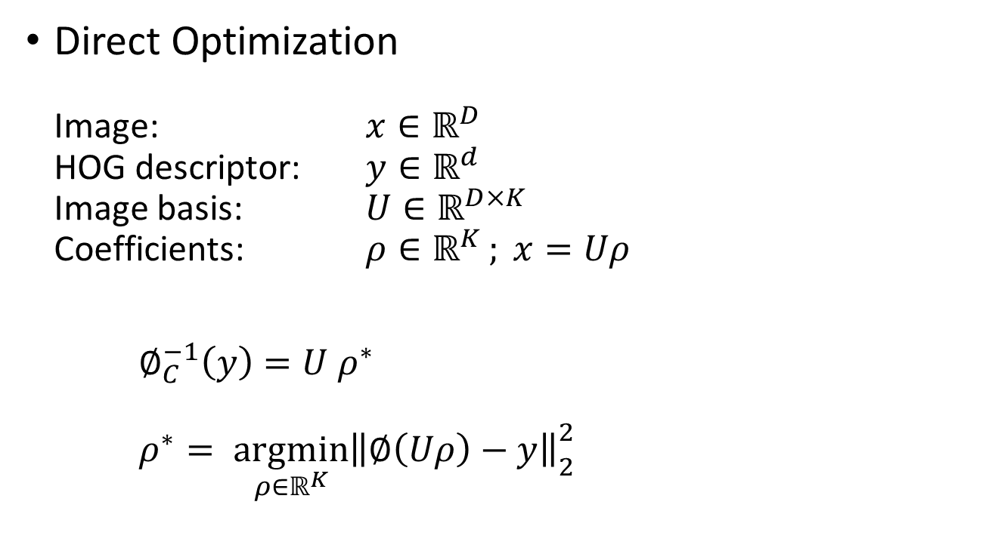
Algorithms
  Direct Optimization
  Image: $x∈ℝ^{D}$
  HOG descriptor: $y∈ℝ^{d}$
  Image basis: $U∈ℝ^{D×K}$
  Coefficients: $ρ∈ℝ^{K }; x=Uρ$
  $∅_{C}^{−1}\left(y\right)=U ρ^{∗}$
  $ρ^{∗}= \underset{ρ∈ℝ^{K}}{argmin}{{\left\|\left.∅\left(Uρ\right)−y\right\|\right.}_{2}^{2}}$
Notes:
Direct Optimization: Use only images that span a natural image basis (?). Use first K eigenvectors. Any image can be encoded by coefficients of these basis.
Noisy because recovers high frequency details.

Slide 8
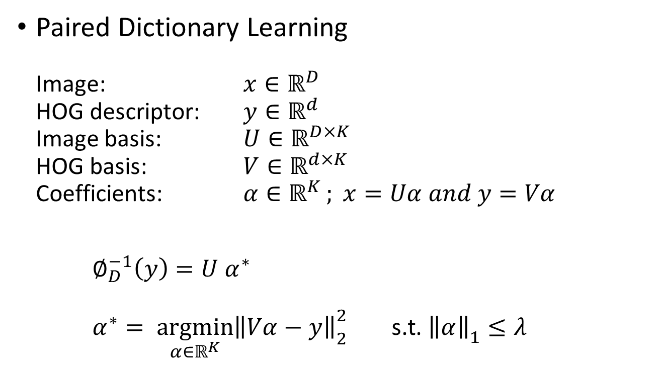
Algorithms
  Paired Dictionary Learning
  Image: $x∈ℝ^{D}$
  HOG descriptor: $y∈ℝ^{d}$
  Image basis: $U∈ℝ^{D×K}$
  HOG basis: $V∈ℝ^{d×K}$
  Coefficients: $α∈ℝ^{K }; x=Uα and y=Vα$
  $∅_{D}^{−1}\left(y\right)=U α^{∗}$
  $α^{∗}= \underset{α∈ℝ^{K}}{argmin}{{\left\|\left.Vα−y\right\|\right.}_{2}^{2}} \text{s}\text{.}\text{t}\text{. }{\left\|\left.α\right\|\right.}_{1}≤λ$
Notes:
Paired dictionaries require finding appropriate bases U and V.
Efficient solvers exist for alpha, it takes under 2 seconds to calculate it on a quad core CPU.

Slide 9
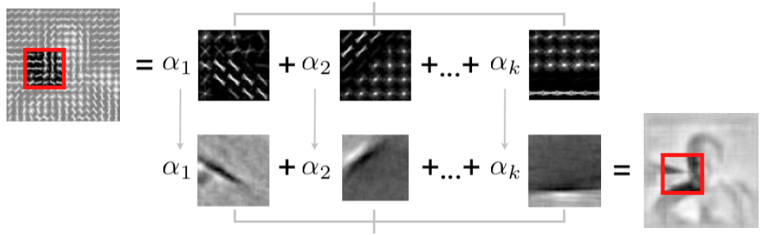




Paired Dictionary Learning
HOG feature
$$y$$
HOG Basis
$$V$$
Image Basis
$$U$$
HOG Inversion
$$∅_{D}^{−1}\left(y\right)$$

Slide 10

Paired Dictionary Learning
Solving paired dictionary learning problem:
$$\underset{U,V,α}{argmin}{\sum_{i=1}^{N}{({\left\|\left.x_{i}−Ua_{i}\right\| \right.}_{2}^{2}+{\left\|\left.{φ(x}_{i})−Va_{i}\right\| \right.}_{2}^{2})}}$$
s.t.${\left\|\left.a_{i}\right\|\right.}_{1}≤λ ∀i, {\left\|\left.U\right\| \right.}_{2}^{2} ≤γ_{1}$, ${\left\|\left.V\right\| \right.}_{2}^{2} ≤γ_{2}$
some learned pairs of dictionaries for $U$ and $V$
Notes:
It takes a few hours to learn U and V with dictionary size K = 10^3, and training samples N = 10^6.
The objective functions can be simplified to standard sparse coding and dictionary learning problem with concatenated dictionaries. They optimize it using SPAMS.

Slide 11
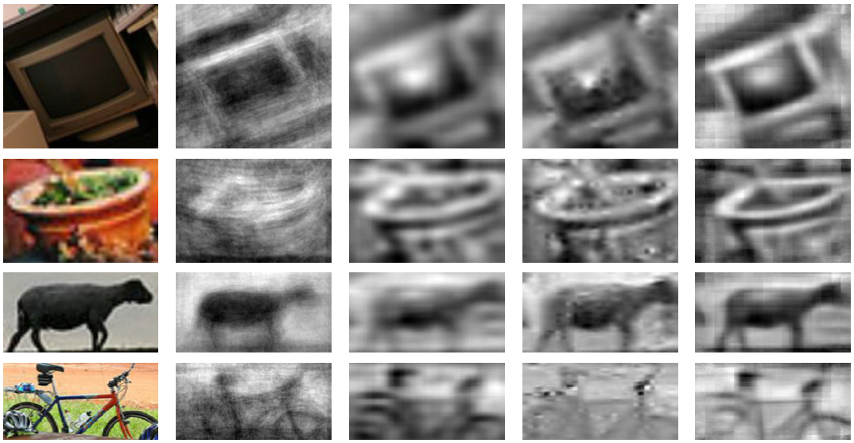
Feature Visualization
Original
ELDA
Ridge Regression
Direct Optimization
Paired Dict.
Learning

Slide 12
Notes:
Pixel level comparison. Compare the inverted HOG image to the original image pixel by pixel.
LDA does the best.

Slide 13
Notes:
People look at inverted object windows and try to categorize. They have a hard time categorizing glyph images.
Expert: MIT vision lab students look at glyphs and try to classify.
Mechanical Turks do better with direct optimization and paired dictionary than glyphs, and even experts on glyphs.

Slide 14
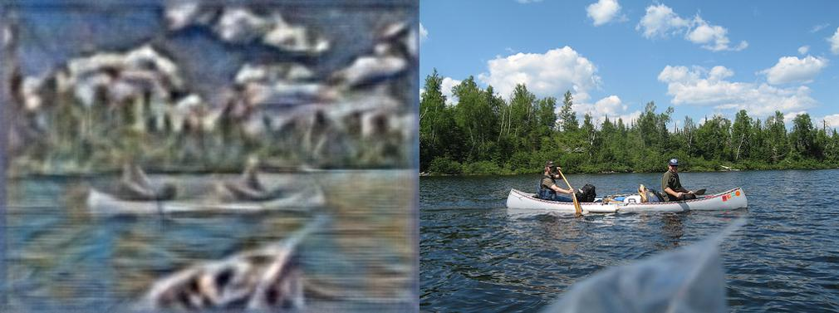
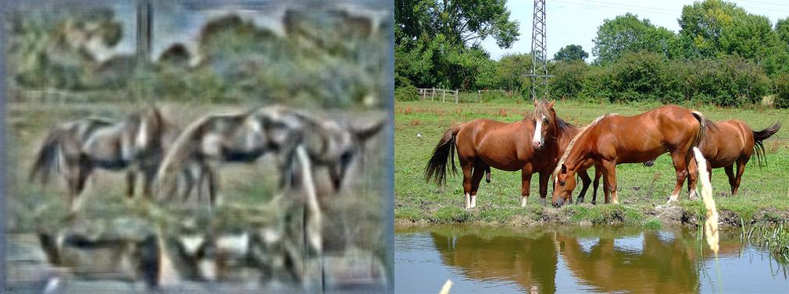
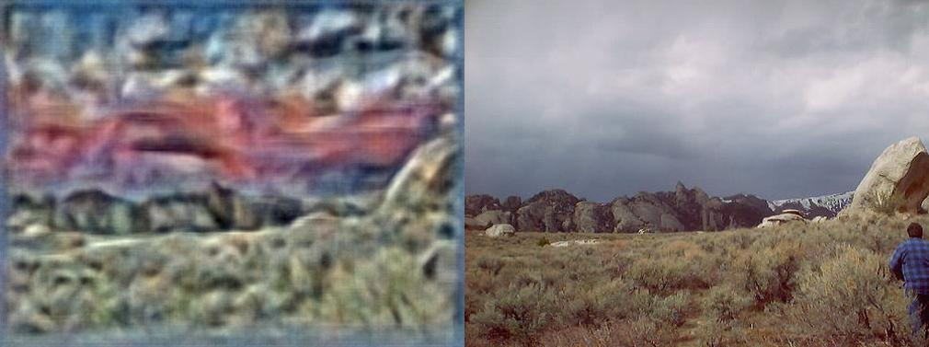
Deformable Parts
Model
Does HOG capture color?
Potted Plant
Chair
Object detection with discriminatively trained part-based models, P. Felzenszwalb, R. Girshick, D. McAllester, and D. Ramanan. PAMI, 2010.
Notes:
The famous object detector.
Train paired dictionaries on RGB images. Outdoor scenes produce reasonable results probably because those categories are strongly correlated to HOG descriptors. But indoor scenes with many man-made objects are arbitrarily colored probably because of many to one nature of HOG descriptor and the high variance of image patches that produce the same HOG descriptor.

Slide 15
Computers can see better than us
Notes:
Because HOG is invariant to illumination. It normalizes patches locally.

Slide 16
Questions?
Visit
web.mit.edu/vondrick/ihog/
for more cool stuff.

