Slide 1
(plain black-on-white slides are Evan’s)

Slide 2
Notes:
- problem: recover cam poses and dense shapes (more or less every pixel) from monocular color video

Slide 3
Notes:
- This and various other methods take point correspondences as input (and those must be defined over the whole sequence to be useful to matrix factorization approaches); traditionally these have come from point-feature tracking

Slide 4
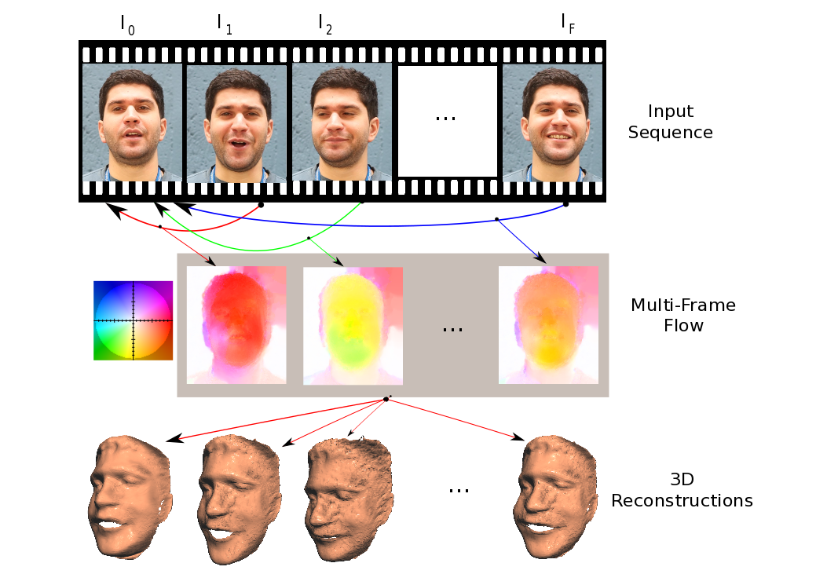
Dense NRSFM Approach Overview
Notes:
- Think of it as using flow rather than feat tracking as the method of getting correspondences over time in the previous approach

Slide 5
Multi-Frame Optical Flow Details
Set of points to be tracked comes from a reference frame
Represent trajectories with a linear basis
Penalties for deviating from the low-rank structure
Spatial pyramid
= .8
+ .2
+ .4
Garg, Roussos, Agapito, “Robust Trajectory-Space TV-L1 Optical Flow for Nonrigid Sequences”, EMMCVPR11
Notes:
Previous work forced trajectories to lie in the low-rank space; the contribution of this work (by the same authors) is that it allows them to deviate at all
Show flow videos from lourdes’ site (www.eecs.qmul.ac.uk/~lourdes/subspace_flow/)

Slide 6
Notes:
- This figure is a little unclear; you should think of B and S as having each ith row be the 3-d location of the ith point in a known list, rather than containing pixel values, which is what this picture suggests; it would be clearer if B and S were visualized as point clouds

Slide 7
Notes:
- The paper visualized here used a predefined trajectory basis made up of sinusoids; in this work the basis will be learned

Slide 8
Notes:
- Their optimization techniques basically all come from recent work on similar stuff that assumes rigidity and that runs at tens of frames a second on the gpu

Slide 9
Notes:
- Because of the very large number of points involved, this stuff isn’t really feasible on a cpu

Slide 10
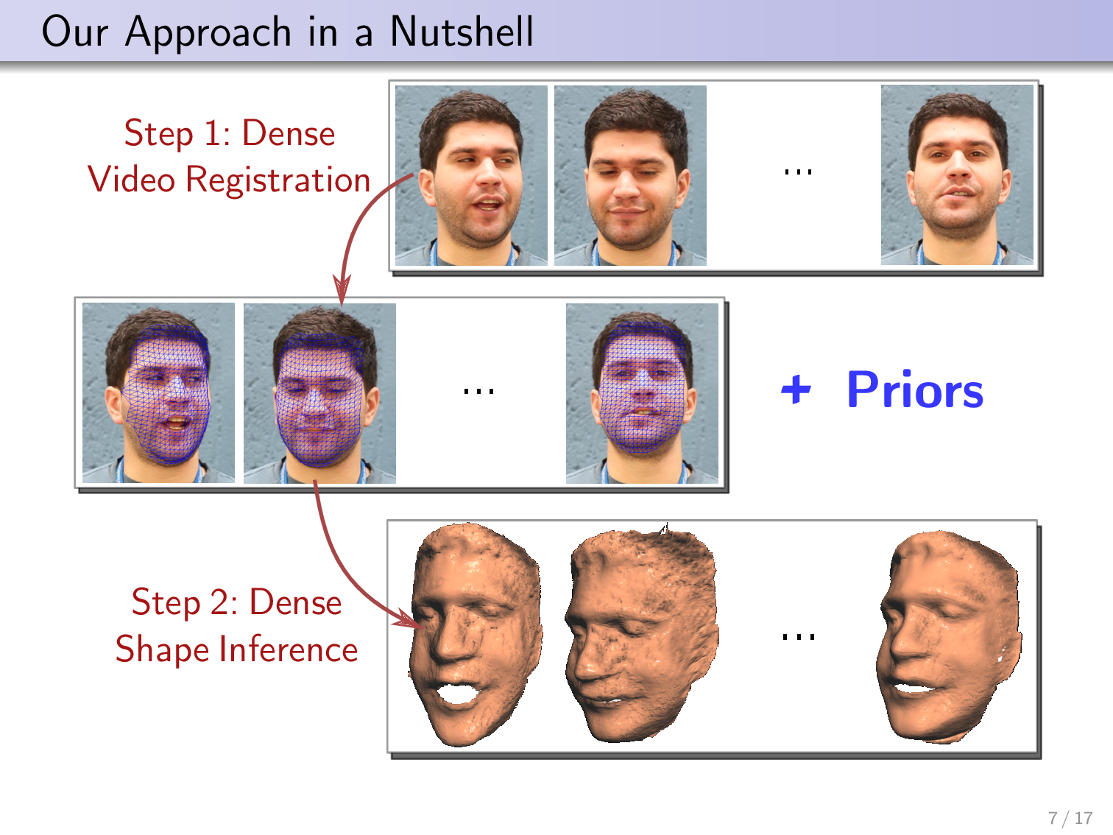
Notes:
They do a variational optimization: they optimize over a very large number of variables representing values of some field of interest (field in the sense of vector field), in order to estimate these fields at each pixel in some very large set, meaning they need lots of regularization
Because of the very large number of points involved, this stuff isn’t really feasible on a cpu

Slide 11
Notes:
- And this is the kind of objective function you end up with in variational approaches to vision problems: data term + regularization terms

Slide 12
Notes:
- Just mention this is the usual 2-norm

Slide 13
Orthographic Projection
Orthographic:
Perspective:
Requires small variation in depth
u = s_{u} x + u_{c}
v = s_{v} y + v_{c}
linear in (x, y, z)
u = (x – x_{c}) f / z + u_{c}
v = (y – y_{c}) f / z + v_{c}
nonlinear in (x, y, z)
Notes:
- For formulations based on linear algebra, like matrix factorization stuff, all operations need to be linear, so can’t use perspective

Slide 17
Notes:
- W comes from the results of running flow; we never change these points, so we’re always optimizing for whatever errors flow made; one of their future steps is to add the flow to the same optimization (which is perfectly doable in a parallelized framework)

Slide 19
Notes:
The trace norm is a convex relaxation of an exact low-rank constraint; I don’t have intuition for how low-rank the resulting matrix actually will be with the trace norm, but it’s been used before
Instead of a hard low-rank constraint as in some prior work, they use a weight to penalize deviation from the low-dimensional manifold

Slide 22
Notes:
it’s convex because we used the approximate low-rank constraint instead of an exact one

Slide 23
Optimizing for 3-D Shape
becomes
Notes:
- Auxiliary variables and alternating optimization, and reduce theta over time; guaranteed convergence if the original problem is convex

Slide 24
Qualitative Results
[online videos]

Slide 25
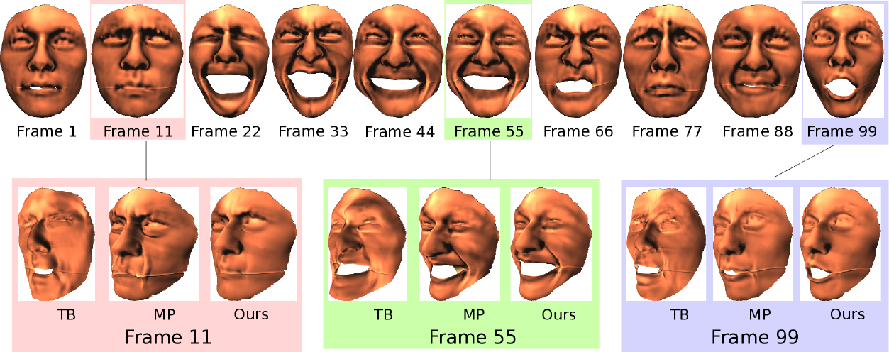
Quantitative Comparison
Top row: ground truth; bottom row: their result
RMS reconstruction error, with matrix rank in parens
Notes:
Ground truth is because these are synthetic sequences
Explain tau = 0 (no low-rank constraint; the numbers are the # of frames in the sequence)
Runtime isn’t one of their goals and they don’t discuss it

