Slide 1
Mid-level Visual Element Discovery as Discriminative Mode Seeking
Harley Montgomery
11/15/13

Slide 2
Main Idea
What are discriminative features exactly, and how can we find them automatically?
Discriminative features are local maxima in the feature distribution of positive/negative examples, p₊(x)/p₋(x)

Slide 3
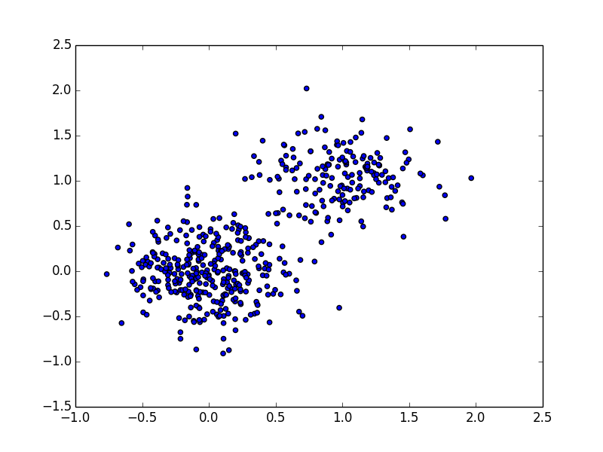
Mean Shift

Slide 4
Mean Shift

Slide 5
Mean Shift – 1st Issue
HOG distances vary significantly across feature space, different bandwidths are needed in different regions

Slide 6
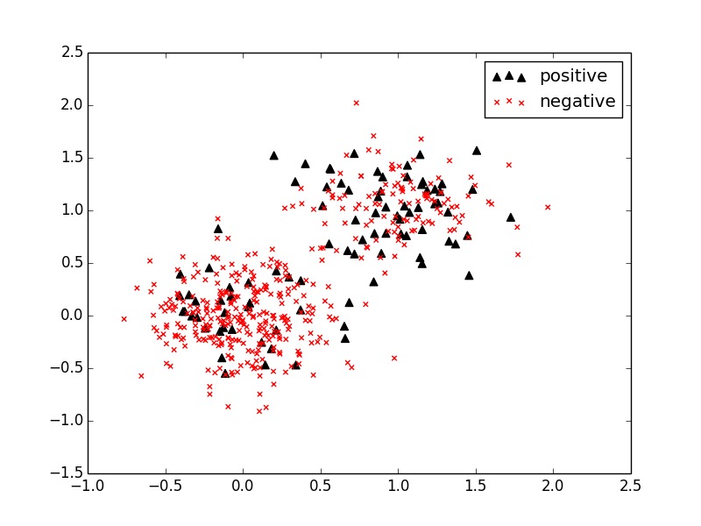
Mean Shift – 2nd Issue
We actually have labeled data, and we want to find maxima in p₊(x)/p₋(x)

Slide 7
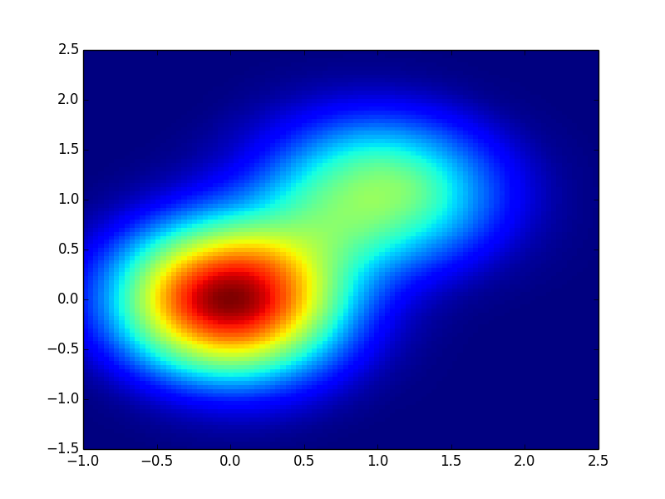
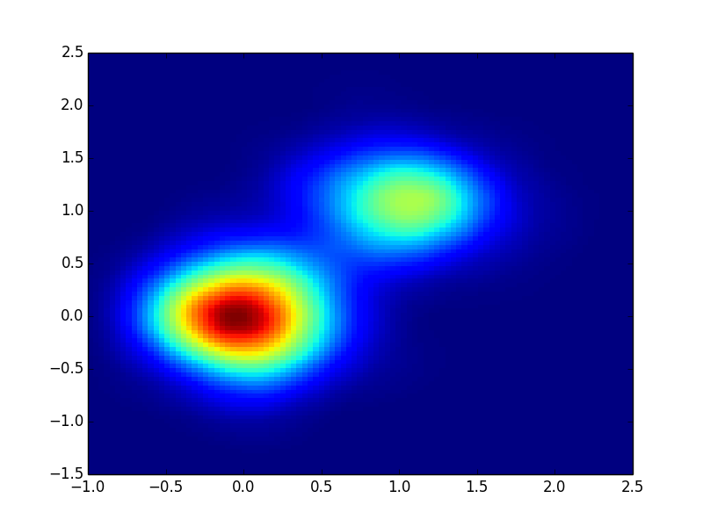
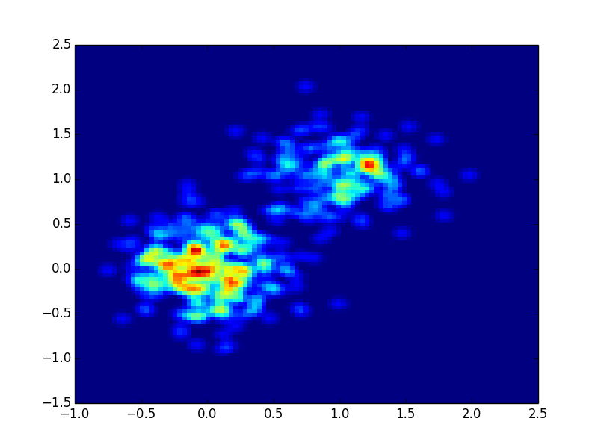
Mean Shift
Mean shift using flat kernel and bandwidth ‘b’ converges to maxima of KDE using triangular kernel:
b = 1
b = 0.5
b = 0.1

Slide 8
Mean Shift Reformulation
Take ratio of the KDEs for positive/negative patches, and use adaptive bandwidth:
Make denominator constant to adapt bandwidth:
Use normalized correlation rather than triangular kernel:

Slide 9
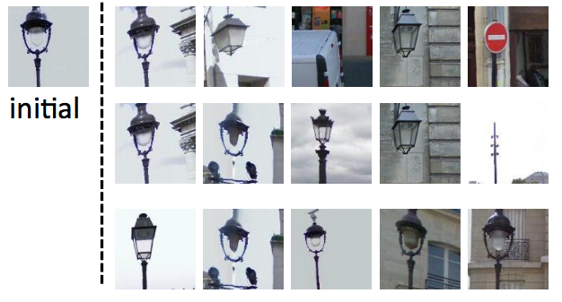
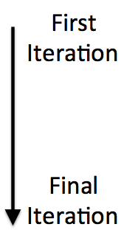
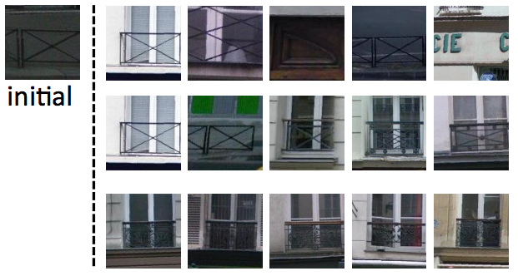

Slide 10
Inter-Element Communication
In practice, doing ‘m’ different runs starting from ‘m’ initializations. We can phrase this as a joint optimization:
α_{i,j} controls how much patch ‘i’ contributes to run ‘j’
First, cluster the paths based on inlying patches, then add competition between paths in different clusters
Intuition, very similar paths will still go to same mode, but other paths will be repelled

Slide 11
Cluster 2
Cluster 1
Elements near the Cluster 1 paths will be downweighted heavily for the Cluster 2 path and vice versa, preventing Cluster 2 from drifting toward more dominant mode
No competition occurs between the two Cluster 1 paths
In practice, calculated a per pixel quantity and averaged over patch:

Slide 12
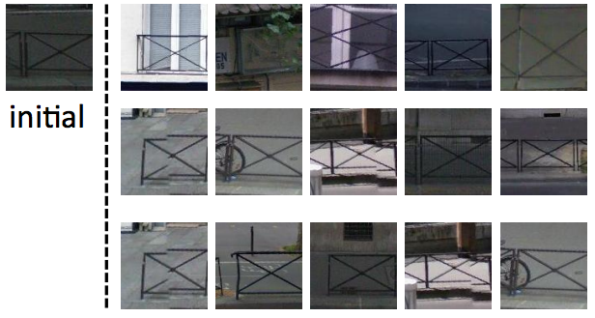
No inter-element communication
With inter-element communication

Slide 13
Purity Coverage Plot
Given a trained element, run patch detection on a hold-out set with some threshold
Purity: % of detections from positive images
Coverage: % of pixels covered in positive images by union of all patches
Given many elements, set each threshold so all have same purity, then pick N elements greedily to maximize total coverage
Ideally, resulting elements will be discriminative/representative

Slide 14
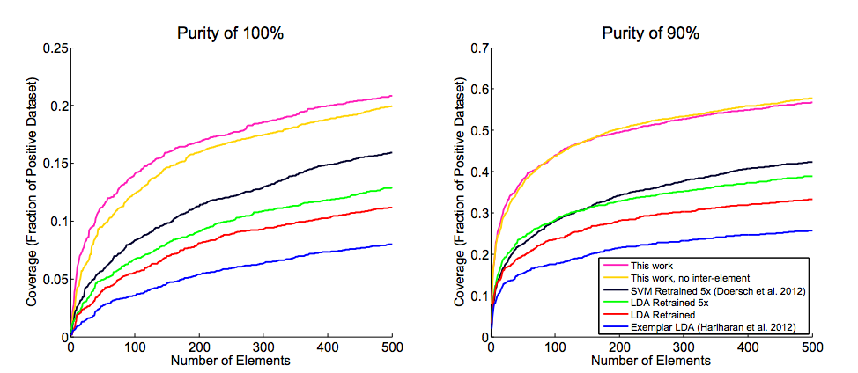
Purity Coverage Plot
Discriminative mode seeking finds better elements than previous methods

Slide 15
Classification
Used MIT Scene 67 dataset, learned 200 elements per class using discriminative mode seeking and PC-plots
Then computed BoP feature vectors with elements and trained 67 one vs. all linear SVMs for classification
13,400 elements
67,000 elements
2 level spatial pyramid
(1x1, 2x2)
Top detection in each region
…
…

Slide 16
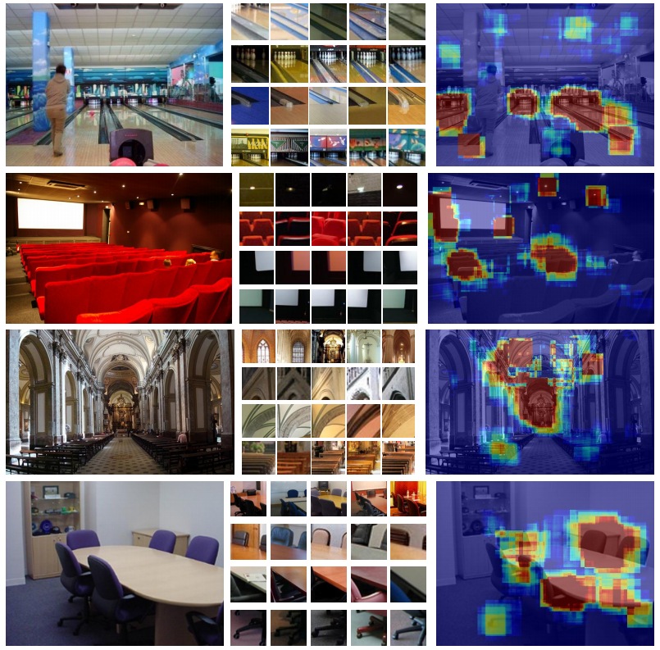

Slide 17
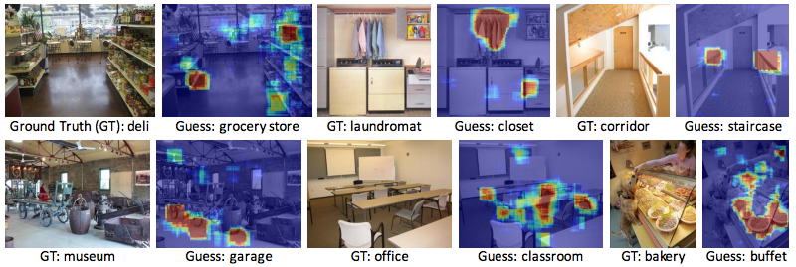

Slide 18
Conclusion
Defined discriminative elements as maxima in the ratio between positive/negative distributions
Adapted mean shift algorithm to find the maxima in these distributions
Introduced PC plots to choose best elements out of many
Achieved state-of-the-art accuracy on MIT Scene 67 dataset

