Slide 1
Learning to be a Depth Camera for Close-Range Human Capture and Interaction
Sean Ryan Fanello*^ (+9 other guys*) *Microsoft Research ^iCub Facility – Istituto Italiano di Tecnologia
Presented by Supasorn Suwajanakorn

Slide 2
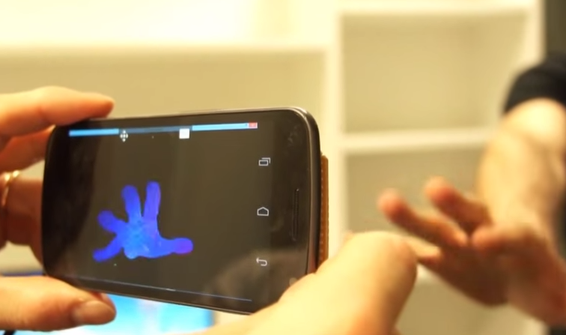
2D Camera -> Depth sensing

Slide 3
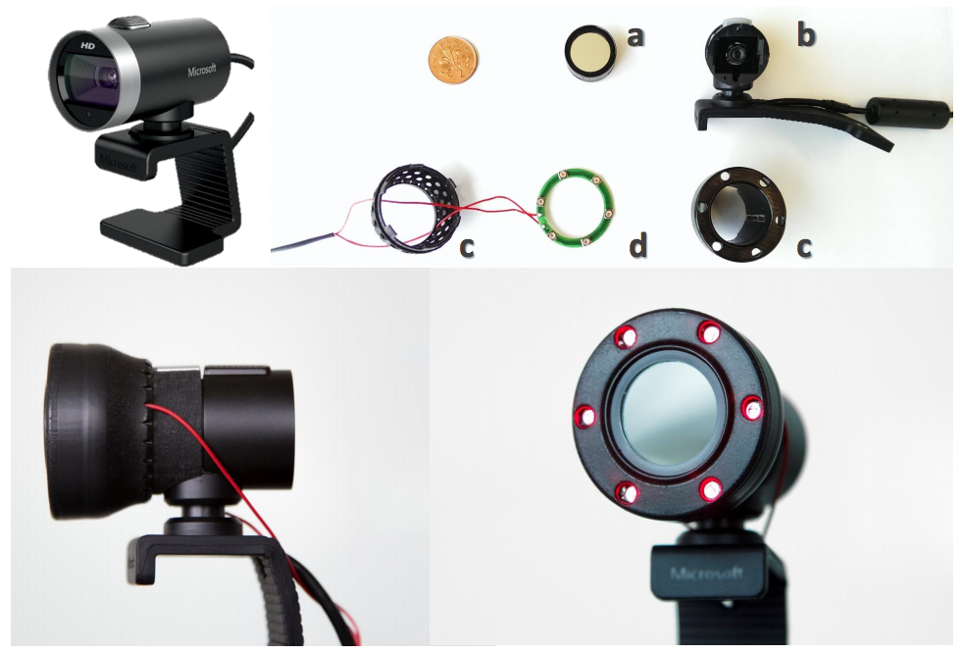
Camera’s modification

Slide 4
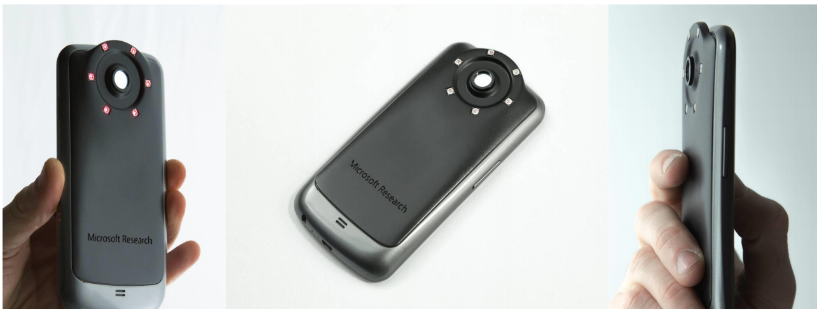
Camera’s modification

Slide 5
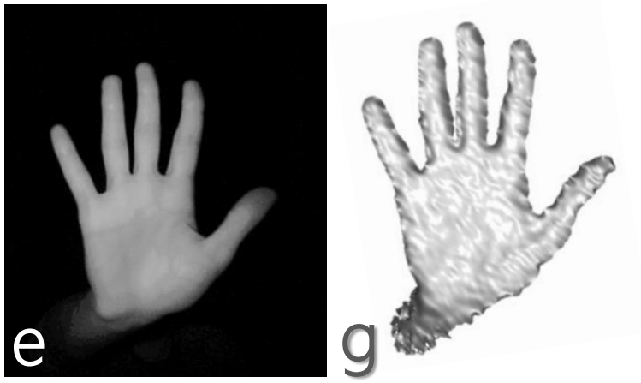
Machine Learning
Per pixel
IR intensity
Depth value
IR reflection is skin-tone invariant [Simpson et al. 1998]

Slide 6
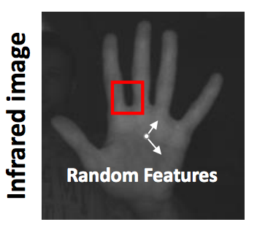
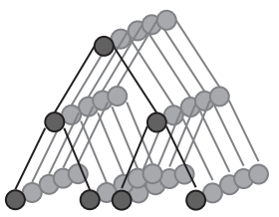
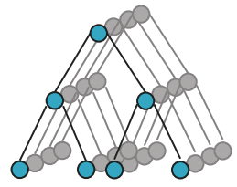
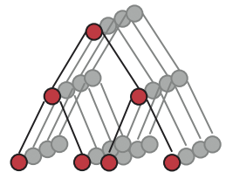
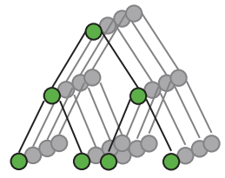
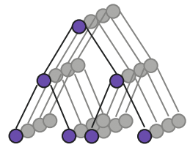
Multi-layered Decision Forest
IR Image pixel
Layer 1
Classification
Forest
Probability
0-25 cm
25-50 cm
50-75 cm
Quantized depth
75-100 cm
Layer 2
Regression
Forests
23cm
40cm
60cm
76cm
Output =
23 x +
40 x +
60 x +
76 x

Slide 7
Features
u
x
v
Tree splitting parameter
Invariant to additive illumination
yes
no
Left branch
Right branch

Slide 8
Training
Layer 1 (output quantized depth posterior)
Shanon Entropy
Maximize information gain
Layer 2 (output depth value)
Differential Entropy
( Fitting Gaussian to )

Slide 9
Training Data
Real
Synthetic
Photos taken with calibrated depth camera + IR camera
100K Renders of hand and face
Models illumination fall off, noise, vignetting, subsurface scattering
Face variations thru 100+ Blendshapes
Hand variations thru 26-dof model
Random global transformations

Slide 10
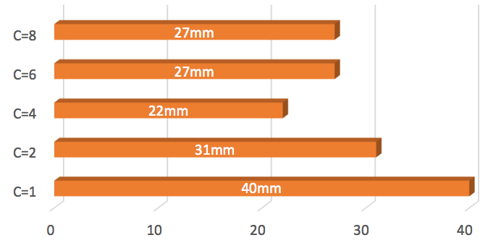
Hyper-parameter
Number of quantized depth
Error
Optimal : 4 quantized depths, 3 trees / forest, 25 max tree depth

Slide 11
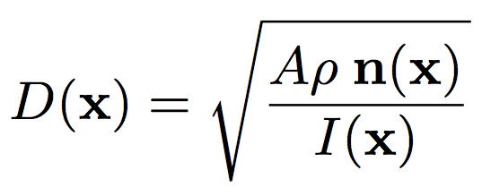
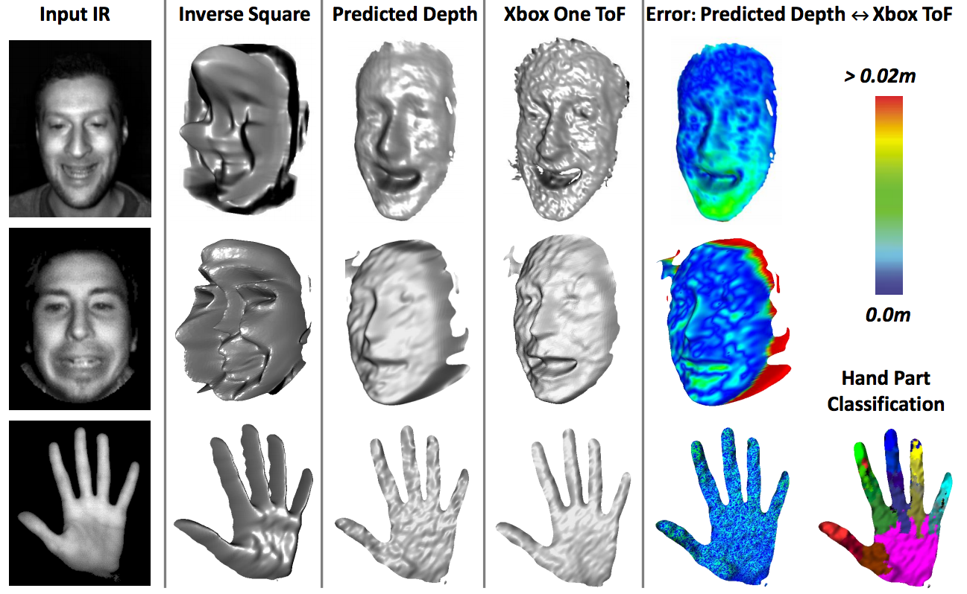

Slide 12
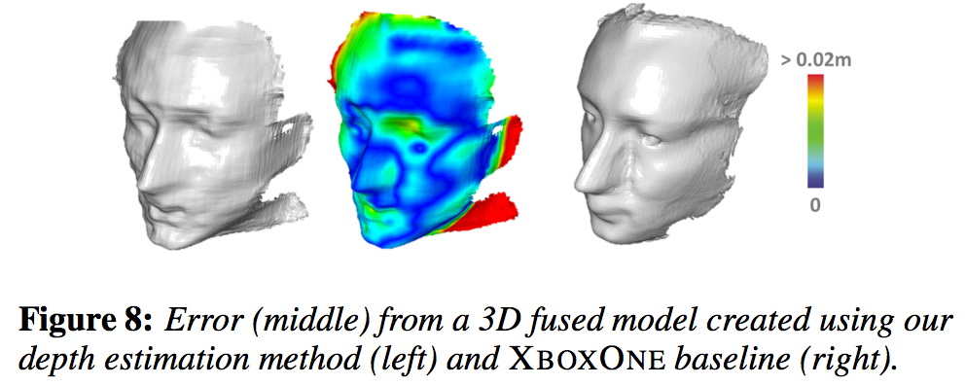
3D Fused

Slide 13
Generalization
Across Different People
Across Different Cameras

Slide 14
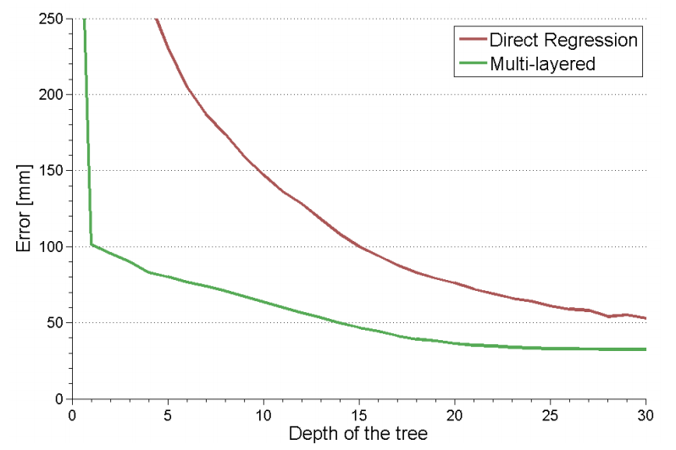
vs Single-Layer Regressor
Use single-tree forest for all
Claimed benefits
Multi-layer can infer useful intermediate results that simplify primary task, which in turn increases the accuracy of the model.
Shallower tree depth with comparable accuracy. Low memory usage.

Slide 15
Video Demo

Slide 16
Conclusion
Low-cost technique to convert 2D camera to real-time depth sensor.
Discriminative approach implicitly handles variations e.g. light physics, skin color, geometry
Multi-layer can achieve comparable accuracy to deeper single-layer forest
Notes:
Such as changes in shape, geometry, skin color, ambient illumination

Slide 17
Limitations & Discussion
Fails to generalize beyond face and hand
Strong shape prior / bias in the forest
Works only on uniform albedo (skin)
Feature too simple? Why does it even work?
Output is noisy even if IR image is smooth
No spatial or temporal smoothness
Baseline method too simple?
Interesting to compare to single view modeling

