Slide 1
CSE P 501 – Compilers
LR Parser Construction
Hal Perkins
Autumn 2011

Slide 2
Agenda
LR(0) state construction
FIRST, FOLLOW, and nullable
Variations: SLR, LR(1), LALR

Slide 3
LR State Machine
Idea: Build a DFA that recognizes handles
Language generated by a CFG is generally not regular, but
Language of handles for a CFG is regular
So a DFA can be used to recognize handles
Parser reduces when DFA accepts

Slide 4
Prefixes, Handles, &c (review)
If S is the start symbol of a grammar G,
If S =>* α then α is a sentential form of G
γ is a viable prefix of G if there is some derivation S =>*_{rm} αAw =>*_{rm} αβw and γ is a prefix of αβ.
The occurrence of β in αβw is a handle of αβw
An item is a marked production (a . at some position in the right hand side)
[A ::= . X Y ] [A ::= X . Y ] [A ::= X Y . ]

Slide 5
Building the LR(0) States
Example grammar
S’ ::= S $
S ::= ( L )
S ::= x
L ::= S
L ::= L , S
We add a production S’ with the original start symbol followed by end of file ($)
Question: What language does this grammar generate?
Notes:
Au02: Taken from Appel’s book

Slide 6
Start of LR Parse
0. S’ ::= S $
1. S ::= ( L )
2. S ::= x
3. L ::= S
4. L ::= L , S
Initially
Stack is empty
Input is the right hand side of S’, i.e., S $
Initial configuration is [S’ ::= . S $]
But, since position is just before S, we are also just before anything that can be derived from S

Slide 7
Initial state
0. S’ ::= S $
1. S ::= ( L )
2. S ::= x
3. L ::= S
4. L ::= L , S
A state is just a set of items
Start: an initial set of items
Completion (or closure): additional productions whose left hand side appears to the right of the dot in some item already in the state
S’ ::= . S $
S ::= . ( L )
S ::= . x
start
completion

Slide 8
Shift Actions (1)
0. S’ ::= S $
1. S ::= ( L )
2. S ::= x
3. L ::= S
4. L ::= L , S
To shift past the x, add a new state with the appropriate item(s)
In this case, a single item; the closure adds nothing
This state will lead to a reduction since no further shift is possible
S’ ::= . S $
S ::= . ( L )
S ::= . x
x
S ::= x .

Slide 9
Shift Actions (2)
0. S’ ::= S $
1. S ::= ( L )
2. S ::= x
3. L ::= S
4. L ::= L , S
If we shift past the ( , we are at the beginning of L
the closure adds all productions that start with L, which requires adding all productions starting with S
S ::= ( . L )
L ::= . L , S
L ::= . S
S ::= . ( L )
S ::= . x
S’ ::= . S $
S ::= . ( L )
S ::= . x
(

Slide 10
Goto Actions
0. S’ ::= S $
1. S ::= ( L )
2. S ::= x
3. L ::= S
4. L ::= L , S
Once we reduce S, we’ll pop the rhs from the stack exposing the first state. Add a goto transition on S for this.
S’ ::= . S $
S ::= . ( L )
S ::= . x
S
S’ ::= S . $

Slide 11
Basic Operations
Closure (S )
Adds all items implied by items already in S
Goto (I, X )
I is a set of items
X is a grammar symbol (terminal or non-terminal)
Goto moves the dot past the symbol X in all appropriate items in set I

Slide 12
Closure Algorithm
Closure (S ) =
repeat
for any item [A ::= α . X β] in S
for all productions X ::= γ
add [X ::= . γ] to S
until S does not change
return S

Slide 13
Goto Algorithm
Goto (I, X ) =
set new to the empty set
for each item [A ::= α . X β] in I
add [A ::= α X . β] to new
return Closure (new )
This may create a new state, or may return an existing one

Slide 14
LR(0) Construction
First, augment the grammar with an extra start production S’ ::= S $
Let T be the set of states
Let E be the set of edges
Initialize T to Closure ( [S’ ::= . S $] )
Initialize E to empty

Slide 15
LR(0) Construction Algorithm
repeat
for each state I in T
for each item [A ::= α . X β] in I
Let new be Goto ( I, X )
Add new to T if not present
Add I new to E if not present
until E and T do not change in this iteration
Footnote: For symbol $, we don’t compute goto (I, $); instead, we make this an accept action.
X

Slide 16
Example: States for
0. S’ ::= S $
1. S ::= ( L )
2. S ::= x
3. L ::= S
4. L ::= L , S

Slide 17
Building the Parse Tables (1)
x
For each edge I J
if X is a terminal, put sj in column X, row I of the action table (shift to state j )
If X is a non-terminal, put gj in column X, row I of the goto table

Slide 18
Building the Parse Tables (2)
For each state I containing an item [S’ ::= S . $], put accept in column $ of row I
Finally, for any state containing [A ::= γ .] put action rn in every column of row I in the table, where n is the production number

Slide 19
Example: Tables for
0. S’ ::= S $
1. S ::= ( L )
2. S ::= x
3. L ::= S
4. L ::= L , S

Slide 20
Where Do We Stand?
We have built the LR(0) state machine and parser tables
No lookahead yet
Different variations of LR parsers add lookahead information, but basic idea of states, closures, and edges remains the same

Slide 21
A Grammar that is not LR(0)
Build the state machine and parse tables for a simple expression grammar
S ::= E $
E ::= T + E
E ::= T
T ::= x

Slide 22
LR(0) Parser for
0. S ::= E $
1. E ::= T + E
2. E ::= T
3. T ::= x
1
2
 | x | + | $ | E | T
1 | s5 |  |  | g2 | G3
2 |  |  | acc
3 | r2 | s4,r2 | r2
4 | s5 |  |  | g6 | G3
5 | r3 | r3 | r3
6 | r1 | r1 | r1
S ::= . E $
E ::= . T + E
E ::= . T
T ::= . x
E
S ::= E . $
3
T
E ::= T . + E
E ::= T .
x
+
T
5
4
x
T ::= x .
E ::= T + . E
E ::= . T + E
E ::= . T
T ::= . x
State 3 is has two possible actions on +:
shift 4 or reduce 2
∴ Grammar is not LR(0)
6
E ::= T + E.
E

Slide 23
SLR Parsers
Idea: Use information about what can follow a non-terminal to decide if we should perform a reduction
Easiest form is SLR – Simple LR
We need to be able to compute FOLLOW(A ) – the set of symbols that can follow A in any possible derivation
i.e., t is in FOLLOW(A) if any derivation contains At
To compute this, we need to compute FIRST(γ) for strings γ that can follow A

Slide 24
Calculating FIRST(γ)
Sounds easy… If γ = X Y Z , then FIRST(γ) is FIRST(X ), right?
But what if we have the rule X ::= ε?
In that case, FIRST(γ) includes anything that can follow an X – i.e. FOLLOW(X )

Slide 25
FIRST, FOLLOW, and nullable
nullable(X ) is true if X can derive the empty string
Given a string γ of terminals and non-terminals, FIRST(γ) is the set of terminals that can begin strings derived from γ.
FOLLOW(X ) is the set of terminals that can immediately follow X in some derivation
All three of these are computed together

Slide 26
Computing FIRST, FOLLOW, and nullable (1)
Initialization
set FIRST and FOLLOW to be empty sets
set nullable(X) false for all non-terminals X
set FIRST[a] to a for all terminal symbols a

Slide 27
Computing FIRST, FOLLOW, and nullable (2)
repeat
for each production X := Y₁ Y₂ … Y_{k}
if Y₁ … Y_{k} are all nullable (or if k = 0)
set nullable[X ] = true
for each i from 1 to k and each j from i +1 to k
if Y₁ … Y_{i-1} are all nullable (or if i = 1)
add FIRST[Y_{i} ] to FIRST[X ]
if Y_{i+1} … Y_{k} are all nullable (or if i = k )
add FOLLOW[X ] to FOLLOW[Y_{i} ]
if Y_{i+1} … Y_{j-1} are all nullable (or if i+1=j)
add FIRST[Y_{j} ] to FOLLOW[Y_{i} ]
Until FIRST, FOLLOW, and nullable do not change

Slide 28
Example
Grammar
Z ::= d
Z ::= X Y Z
Y ::= ε
Y ::= c
X ::= Y
X ::= a
nullable FIRST FOLLOW
X
Y
Z

Slide 29
LR(0) Reduce Actions
In an LR(0) parser, if a state contains a reduction, it is unconditional regardless of the next input symbol
Algorithm:
Initialize R to empty
for each state I in T
for each item [A ::= α .] in I
add (I, A ::= α) to R

Slide 30
SLR Construction
This is identical to LR(0) – states, etc., except for the calculation of reduce actions
Algorithm:
Initialize R to empty
for each state I in T
for each item [A ::= α .] in I
for each terminal a in FOLLOW(A )
add (I, a, A ::= α) to R
i.e., reduce α to A in state I only on lookahead a

Slide 31
SLR Parser for
0. S ::= E $
1. E ::= T + E
2. E ::= T
3. T ::= x
1
2
 | x | + | $ | E | T
1 | s5 |  |  | g2 | g3
2 |  |  | acc
3 | r2 | s4,r2 | r2
4 | s5 |  |  | g6 | g3
5 | r3 | r3 | r3
6 | r1 | r1 | r1
S ::= . E $
E ::= . T + E
E ::= . T
T ::= . x
E
S ::= E . $
3
T
E ::= T . + E
E ::= T .
x
5
+
T
4
T ::= x .
x
E ::= T + . E
E ::= . T + E
E ::= . T
T ::= . x
6
E ::= T + E.
E

Slide 32
On To LR(1)
Many practical grammars are SLR
LR(1) is more powerful yet
Similar construction, but notion of an item is more complex, incorporating lookahead information

Slide 33
LR(1) Items
An LR(1) item [A ::= α . β, a] is
A grammar production (A ::= αβ)
A right hand side position (the dot)
A lookahead symbol (a)
Idea: This item indicates that α is the top of the stack and the next input is derivable from βa.
Full construction: see the book

Slide 34
LR(1) Tradeoffs
LR(1)
Pro: extremely precise; largest set of grammars / languages
Con: potentially very large parse tables with many states

Slide 35
LALR(1)
Variation of LR(1), but merge any two states that differ only in lookahead
Example: these two would be merged
[A ::= x . , a]
[A ::= x . , b]

Slide 36
LALR(1) vs LR(1)
LALR(1) tables can have many fewer states than LR(1)
LALR(1) may have reduce conflicts where LR(1) would not (but in practice this doesn’t happen often)
Most practical bottom-up parser tools are LALR(1) (e.g., yacc, bison, CUP)

Slide 37
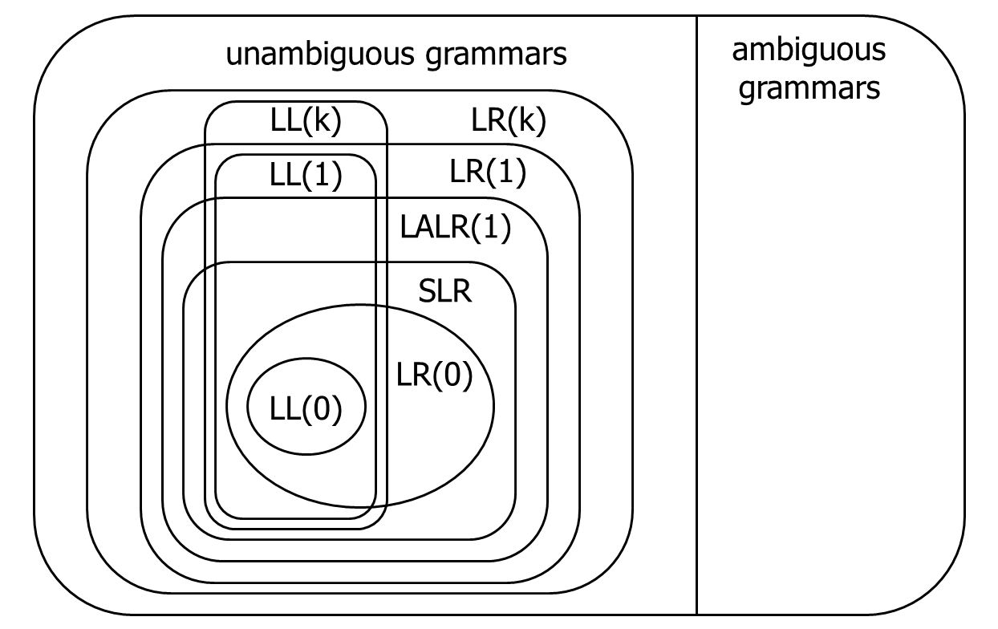
Language Heirarchies

Slide 38
Coming Attractions
LL(k) Parsing – Top-Down
Recursive Descent Parsers
What to do if you need a parser in a hurry

