Slide 1
Program Verification
K. Rustan M. Leino
Research in Software Engineering (RiSE)
Microsoft Research, Redmond
University of Washington
CSE P 503
12 January 2012

Slide 2
Reasoning about programs
Central to any programming task
From safety critical applications to scripting
From initial development to maintenance to debugging
Minimizes faults, security problems, time/cost to market
Thinking skill

Slide 3
Formal reasoning
Specifications record the intended program behavior
Tools verify the consistency of program and its specifications

Slide 4
Dafny
Class-based language
generic classes, no subclassing
object references, dynamic allocation
sequential control
Built-in specifications
pre- and postconditions
framing
loop invariants, inline assertions
termination
Specification support
Sets, sequences, inductive datatypes, …
User-defined recursive functions
Ghost variables

Slide 5
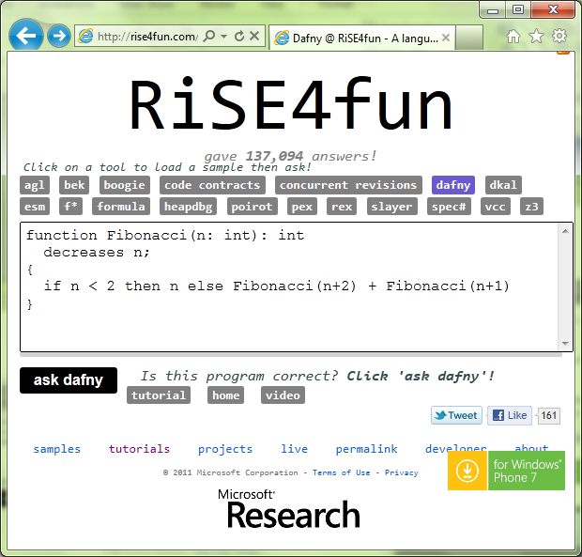
Using Dafny on the web
Dafny tutorial

Slide 6
Basics (assert, ensures, BVD, assume, requires, call, testing specs, debugging specs)
demo
Swap (parameters, globals, fields)
Notes:
class Cell {
var data: int;
}
method Swap2(c: Cell, d: Cell)
requires c != null && d != null && c != d;
modifies c, d;
ensures c.data == old(d.data) && d.data == old(c.data);
{
c.data := c.data + d.data;
d.data := c.data - d.data;
c.data := c.data - d.data;
}
var a: int;
var b: int;
method Swap1()
modifies this;
ensures a == old(b) && b == old(a);
{
a := a + b;
b := a - b;
a := a - b;
}
method Swap0(a: int, b: int) returns (x: int, y: int)
ensures x == b && y == a;
{
x := b;
y := a;
}
method Main()
{
var k, m := 5, 7;
k, m := Swap0(k, m);
assert k + m == 12;
var c, d := new Cell, new Cell;
c.data := 5; d.data := 7;
Swap2(c, d);
assert d.data == 5;
assert c.data == 7;
}

Slide 7
Reasoning about loops
A loop invariant
holds at the top of every iteration
is the only thing the verifier remembers from one iteration to another (about the variables being modified)
→ It is as if the loop body were not available
while (B) { S; }
Loop invariant holds here

Slide 8
Loops
demo
Iterative Fibonacci
Notes:
function Fib(n: nat): nat
{
if n < 2 then n else Fib(n-2) + Fib(n-1)
}
method ComputeFib(n: nat) returns (x: nat)
ensures x == Fib(n);
{
x := 0;
var y := 1;
var i := 0;
while (i < n)
invariant 0 <= i <= n;
invariant x == Fib(i) && y == Fib(i+1);
{
x, y := y, x+y;
i := i + 1;
}
}

Slide 9
Termination
A variant function is an expression whose values goes down (in some well-founded ordering) with every iteration/call
At the time of the call, the callee’s variant function must be less than the caller’s
while (B) { S; }
method M() { P(); }
At the time a loop back-edge is taken, the value of the variant function must be less than at the beginning of the iteration

Slide 10
Proving termination
demo
Termination
Notes:
method ComputeSum(a: array<int>) returns (s: int)
requires a != null;
{
var n := 0;
s := 0;
while (n < a.Length)
decreases a.Length - n;
{
s := s + a[n];
n := n + 1;
}
}
function Sum(xs: seq<int>): int
decreases xs;
{
if xs == [] then 0 else xs[0] + Sum(xs[1..])
}
function Ackermann(m: int, n: int): int
decreases m, n;
{
if m <= 0 then
n + 1
else if n <= 0 then
Ackermann(m - 1, 1)
else
Ackermann(m - 1, Ackermann(m, n - 1))
}

Slide 11
Review
Methods specifications have pre- and postconditions
Loops are specified with loop invariants
Termination is specified used variant functions
Debugging
Verification debugger gives a way to inspect values in a trace of a counterexample
Assert statements check that a condition is known to hold and can be used as lemmas
Assume statements restrict attention to certain executions and are useful for verification debugging

Slide 12
Abstraction and invariants
demo
TimeSpan
Notes:
class TimeSpan {
var days: int;
var h: int;
var m: int;
var s: int;
function Seconds(): int
reads this;
{
24*3600*days + 3600*h + 60*m + s
}
function Valid(): bool
reads this;
{
0 <= days &&
0 <= h < 24 &&
0 <= m < 60 &&
0 <= s < 60
}
constructor Init()
modifies this;
ensures Valid();
{
days, h, m, s := 0, 0, 0, 0;
}
method Add(seconds: int)
requires Valid() && 0 <= seconds;
modifies this;
ensures Valid() && Seconds() == old(Seconds()) + seconds;
{
s := s + seconds;
m, s := m + s / 60, s % 60;
h, m := h + m / 60, m % 60;
days, h := days + h / 24, h % 24;
}
method IsZero() returns (r: bool)
requires Valid();
ensures r <==> Seconds() == 0;
{
r := days == 0 && h == 0 && m == 0 && s == 0;
}
}

Slide 13
Abstraction, frames
demo
Counter
Notes:
method Main()
{
var c := new Counter.Init();
c.Inc();
c.Inc();
c.Dec();
c.Inc();
var k := c.GetValue();
assert k == 2;
assert c.Value == 2;
}
class Counter
{
var Value: int;
constructor Init()
modifies this;
ensures Value == 0;
{
Value := 0;
}
method GetValue() returns (x: int)
ensures x == Value;
{
x := Value;
}
method Inc()
modifies this;
ensures Value == old(Value) + 1;
{
Value := Value + 1;
}
method Dec()
modifies this;
ensures Value == old(Value) - 1;
{
Value := Value - 1;
}
}
// --------------------------------------------
method Main()
{
var c := new Counter.Init();
c.Inc();
c.Inc();
c.Dec();
c.Inc();
var k := c.GetValue();
assert k == 2;
assert c.Value == 2;
}
class Counter
{
// public
ghost var Value: int;
// private
var incs: int;
var decs: int;
function Valid(): bool
reads this;
{
Value == incs - decs
}
constructor Init()
modifies this;
ensures Valid();
ensures Value == 0;
{
incs, decs, Value := 0, 0, 0;
}
method GetValue() returns (x: int)
requires Valid();
ensures x == Value;
{
x := incs - decs;
}
method Inc()
requires Valid();
modifies this;
ensures Valid();
ensures Value == old(Value) + 1;
{
incs, Value := incs + 1, Value + 1;
}
method Dec()
requires Valid();
modifies this;
ensures Valid();
ensures Value == old(Value) - 1;
{
decs, Value := decs + 1, Value - 1;
}
}
// --------------------------------------------
method Main()
{
var c := new Counter.Init();
c.Inc();
c.Inc();
c.Dec();
c.Inc();
var k := c.GetValue();
assert k == 2;
assert c.Value == 2;
}
class Cell {
var data: int;
}
class Counter
{
// public
ghost var Value: int;
ghost var Repr: set<object>;
// private
var incs: Cell;
var decs: Cell;
function Valid(): bool
reads this, Repr;
{
this in Repr && null !in Repr &&
incs != null && incs in Repr &&
decs != null && decs in Repr &&
incs != decs &&
Value == incs.data - decs.data
}
constructor Init()
modifies this;
ensures Valid() && fresh(Repr - {this});
ensures Value == 0;
{
incs, decs := new Cell, new Cell;
incs.data, decs.data, Value := 0, 0, 0;
Repr := {this};
Repr := Repr + {incs, decs};
}
method GetValue() returns (x: int)
requires Valid();
ensures x == Value;
{
x := incs.data - decs.data;
}
method Inc()
requires Valid();
modifies Repr;
ensures Valid() && fresh(Repr - old(Repr));
ensures Value == old(Value) + 1;
{
incs.data, Value := incs.data + 1, Value + 1;
}
method Dec()
requires Valid();
modifies Repr;
ensures Valid() && fresh(Repr - old(Repr));
ensures Value == old(Value) - 1;
{
decs.data, Value := decs.data + 1, Value - 1;
}
}

Slide 14
Dynamic frames, recap
Conceptually: class C { invariant J; … }
Explicitly in Dafny: class C { function Valid(): bool … { J } ghost var Repr: set<object>; constructor Init() modifies this; ensures Valid() && fresh(Repr – {this}); method Mutate() requires Valid(); modifies Repr; ensures Valid() && fresh(Repr – old(Repr)); }

Slide 15
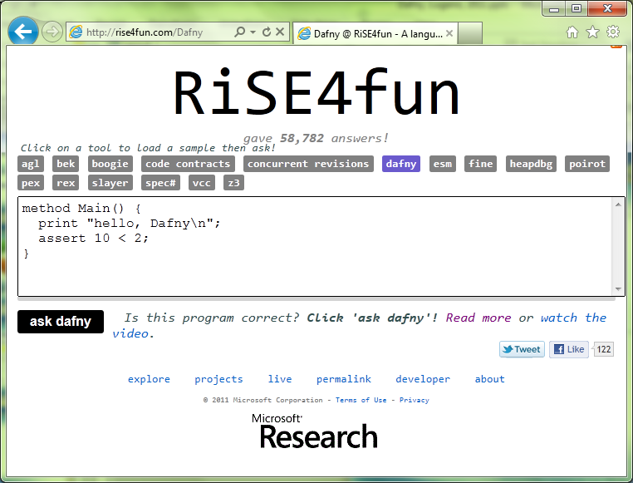
Links
Dafny
General information and Quick Reference:
research.microsoft.com/dafny
Tutorial:
rise4fun.com/Dafny/tutorial/guide
rise4fun
rise4fun.com
Verification Corner
research.microsoft.com/verificationcorner

