Slide 1
CSEP 504 Advanced topics in software systems
Reid Holmes • Winter 2010 • CSEP504 Lecture 6

Slide 2
CSEP 504: Advanced topics in software systems
Tonight: last lecture on software tools and environments – a look at recent research and future directions
Emphasis on:
Capturing latent knowledge
Task specificity and awareness
Supporting collaborative development

Slide 3
Tonight
Capturing latent knowledge
Hipikat / Bridge / Deep Intellisense / Hatari
Task specificity
Mylyn
TeamTracks
Bubbles
Supporting collaborative development
Jazz
FastDash
Customized Awareness Streams
Codebook
Visualization stuff
Only if interested

Slide 4
Latent Knowledge
Embrace practice rather than force change
Use available data more effectively
Source code is king [Singer ‘98]
Bugs
Version control
E-Mail / mailing lists
Forums
Improve mapping from data to task

Slide 5
Utility of Latent Knowledge
High-level information is key
Observing developers to identify their information needs [Ko & DeLine ‘07]
We rely heavily on implicit knowledge
Surveying developers to infer their habits and mental models [LaToza, DeLine, & Venolia ’06]
We search change and bug history daily
Surveying Windows developers about how they search through their source code

Slide 6
Hipikat
Cubranic et al. [TSE ‘05]
Implicit group memory (project memory)
Acts as informal mentor
Relevant for non-collocated teams
Volume hampers browsing
Silos impede searching
Notes:
http://ieeexplore.ieee.org/stamp/stamp.jsp?tp=&arnumber=1463229

Slide 7
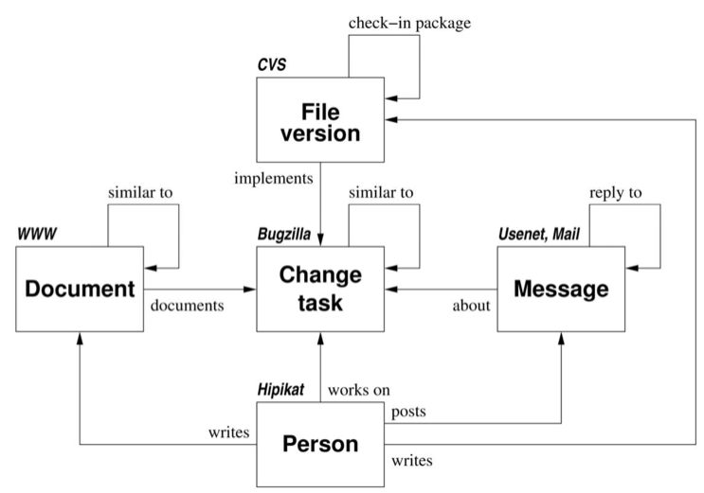
Hipikat Artifacts
Notes:
CVS infers commit sets to help recommend related resources
The code itself is not indexed
Early system that promotes the person as a first class attribute

Slide 8
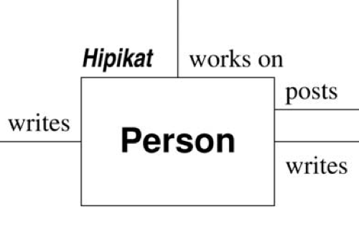
People as First-Class Members

Slide 9
Hipikat Evaluation
20 task case study
Identify most relevant files for 15T
1st or 2nd file rec. relevant for 11 / 16T
1st or 2nd construct rec. relevant for 10 / 13T
Eclipse study (8 devs)
Used to study problem but not perform task
(e.g., orientation within test system)

Slide 10
Bridge
Venolia [MSR ‘06]
Augments Hipikat with additional relations
Simple code relationships
Enhanced textual allusions
Most pressing concern:
“Understanding the rationale behind a piece of code”
Notes:
http://research.microsoft.com/en-us/projects/bridge/default.aspx
http://research.microsoft.com/pubs/74258/p151-venolia.pdf

Slide 11
Bridge Artifacts

Slide 12
Bridge Evaluation
Textual allusions == 19% of index
Source: 6 months of Windows development

Slide 13
Deep Intellisense
Holmes & Begel [MSR ‘08]
Embed Hipikat-like functionality in VS
Automatic updating; no queries required

Slide 14
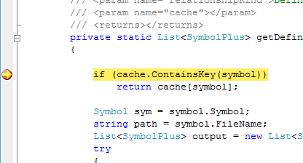
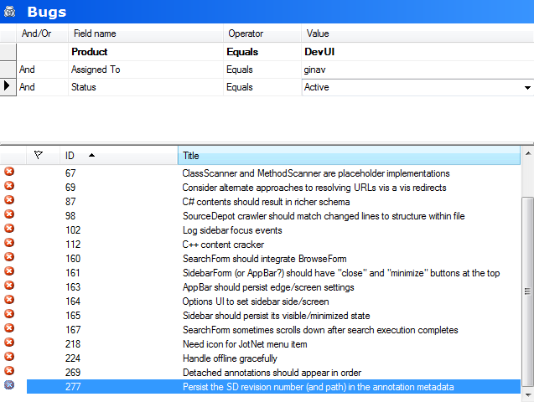
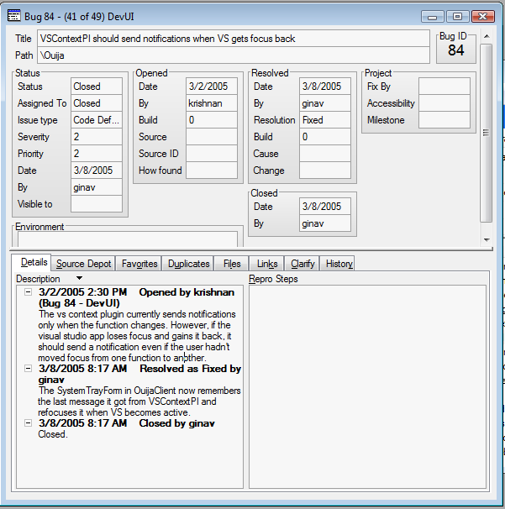
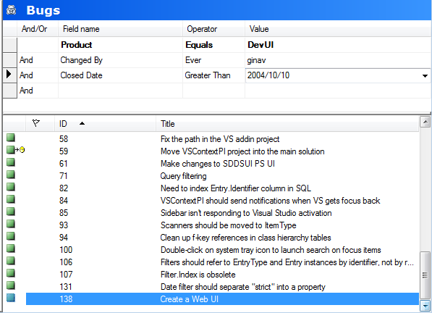
Usage Scenario

Slide 15
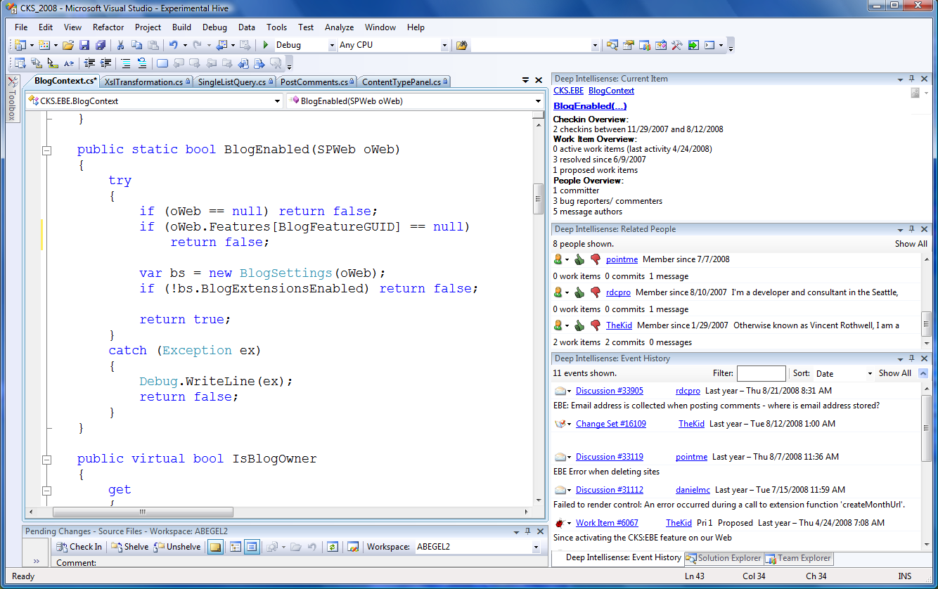
Deep Intellisense

Slide 16
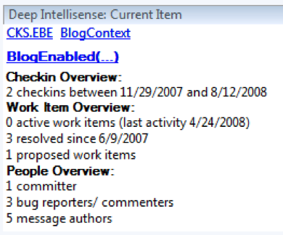
Deep Intellisense

Slide 17
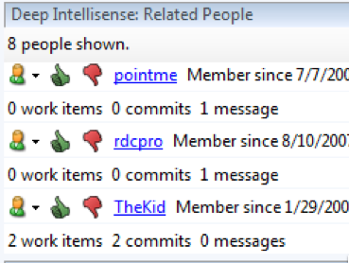
Deep Intellisense

Slide 18
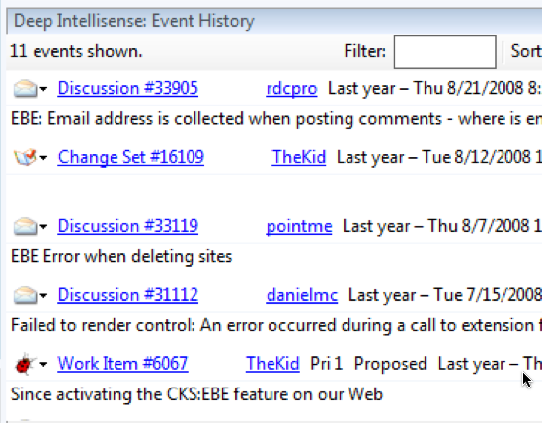
Deep Intellisense

Slide 19
Deep Intellisense Evaluation
Focus was on the information developers wanted, not the resulting tool
Rolled into CodeBook prototypes

Slide 20
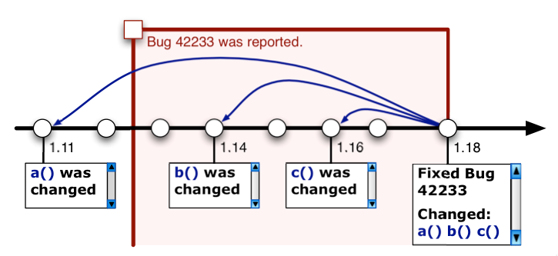
Hatari
Sliwerski et al. [FSE ‘05]
Using past defects to predict future defects
Identify fix-inducing changes
Notes:
http://portal.acm.org/citation.cfm?doid=1081706.1081725

Slide 21
Hatari

Slide 22
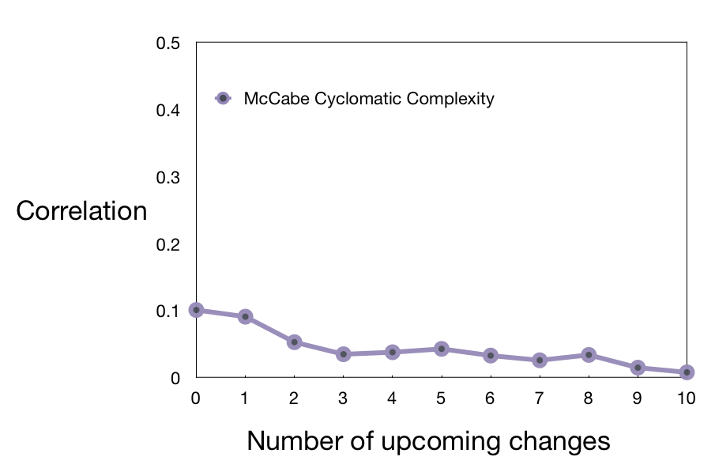
How to predict future risk

Slide 23
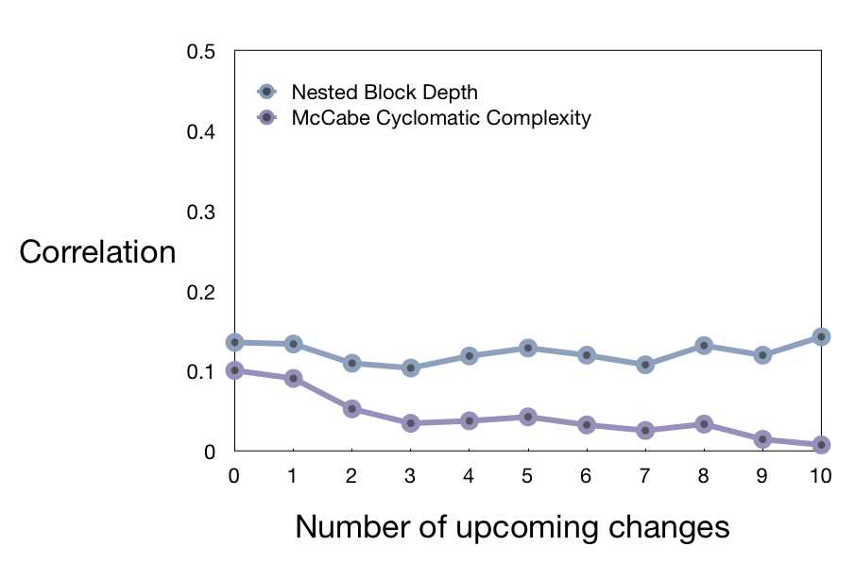
How to predict future risk

Slide 24
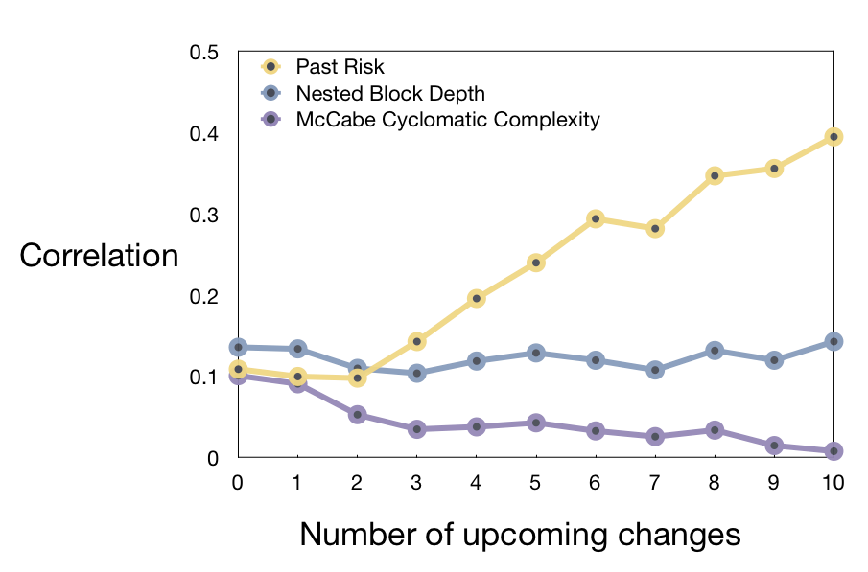
How to predict future risk

Slide 25
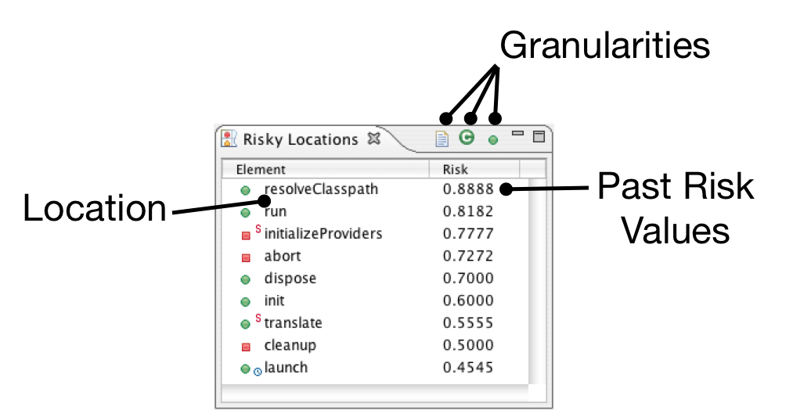
Hatari: Risky Locations

Slide 26
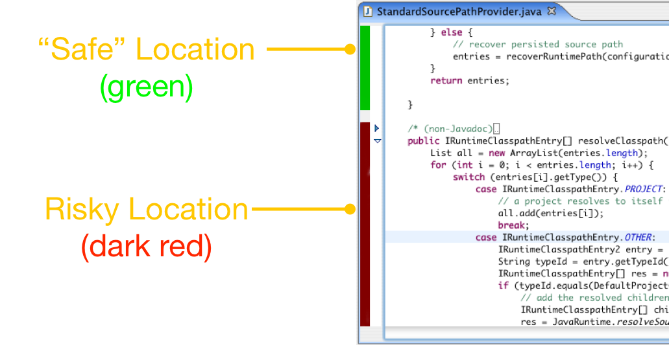
Hatari: Annotations

Slide 27
Task Specificity
Many development activities are task based
Fix this bug
Add this feature
Single tasks can involve many different data sources (files, documents, past changes etc.)
Tasks have collaborative and temporal aspects

Slide 28
Mylyn
Kersten and Murphy [FSE ‘06]
Degree-of-interest model
Captures task context
Generated by observing navigation
Connectors encourage adoption
Bug repositories
Version control
Tasks
Notes:
http://www.cs.ubc.ca/~murphy/papers/mylar/2006-11-mylar-fse.pdf
http://www.cs.ubc.ca/~murphy/papers/mylar/mylar-aosd20056.pdf
Interestingly: no relationships between elements; built entirely from navigation
Tasktop tries to take the focus from developers to all knowledge workers

Slide 29
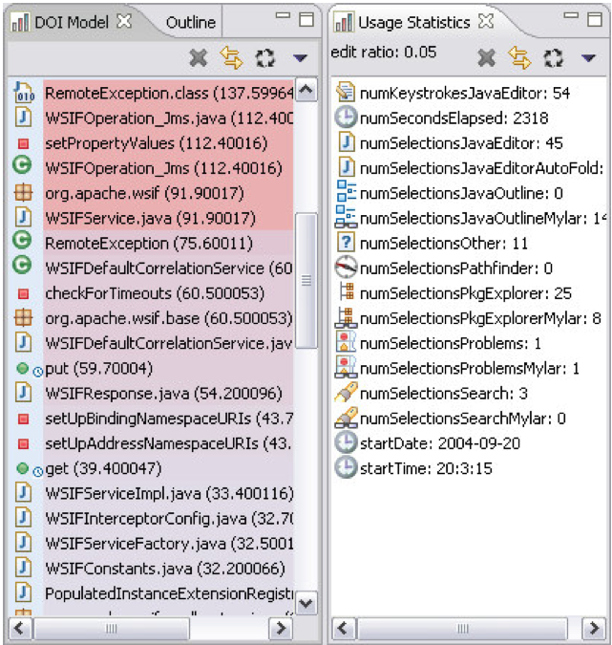
Mylyn

Slide 30
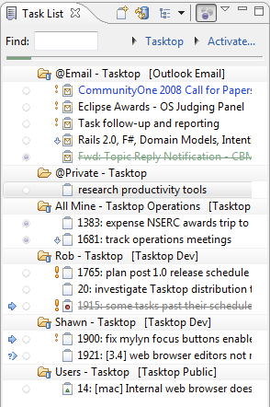
Mylyn

Slide 31
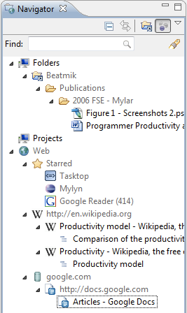
Mylyn

Slide 32
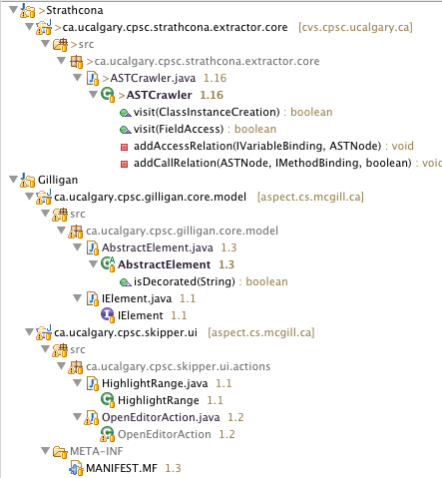
Mylyn

Slide 33
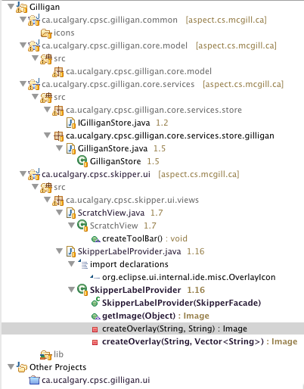
Mylyn

Slide 34
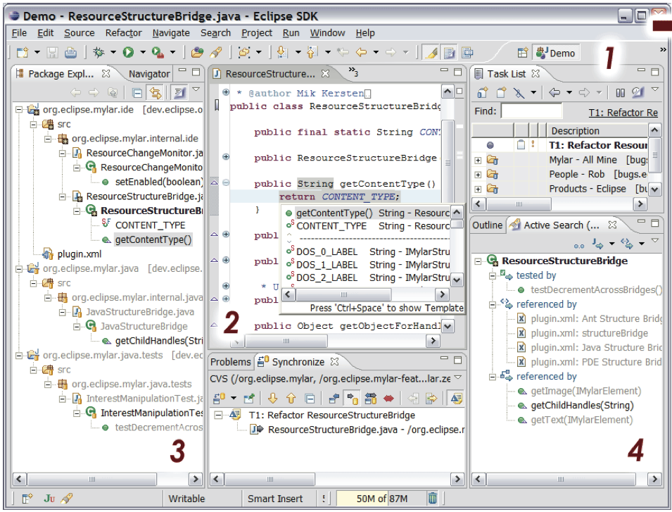
Mylyn: Switching Contexts

Slide 35
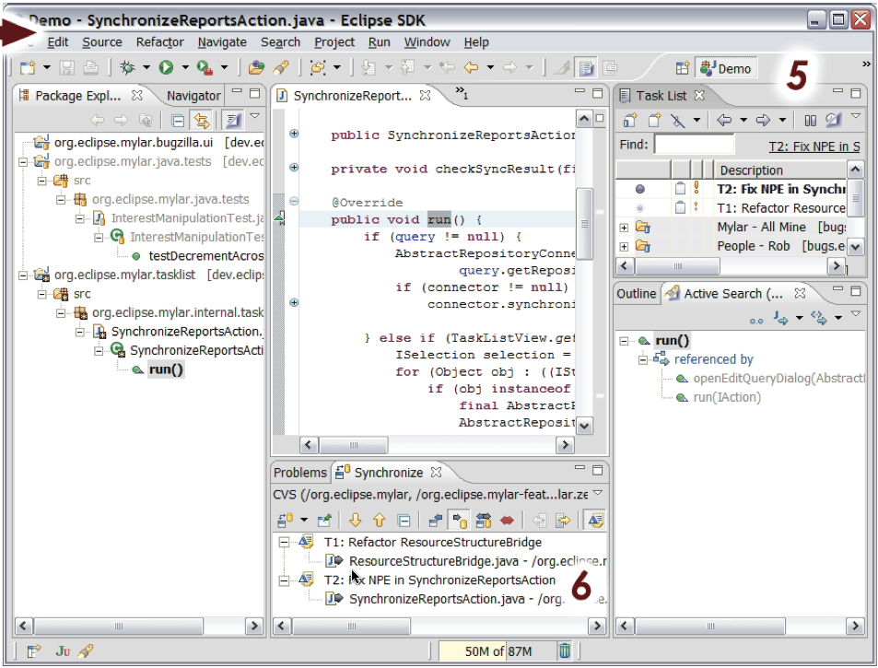
Mylyn: Switching Contexts

Slide 36
Mylyn Evaluation
Early DOI study (6 devs)
Tasks are *key*
Monitor study (99 devs monitored)
Mylyn study (16 devs from monitor study)
Significant increase in edit ratio
Ultimately, we vote with our feet
Mylyn is very popular in the Eclipse ecosystem

Slide 37
TeamTracks
DeLine et al. [VLHCC ‘05]
“Pick the brain” of the original developer
Two measures
Element is important if it is often visited
Two elements are related if visited in succession
Notes:
http://ieeexplore.ieee.org/stamp/stamp.jsp?tp=&arnumber=1509509&userType=&tag=1
Large software projects often require a programmer to make changes to unfamiliar source code. This paper describes a set of tools, called Team Tracks, designed to ease program comprehension by showing the source code navigation patterns of fellow development team members. One technique shows a list of Related Items, given that the user is viewing a given method or class. Another technique shows the Favorite Classes, by showing a class hierarchy view that hides less frequently visited classes, methods, and members. Two user studies, a laboratory study and a field study, were run to evaluate the effectiveness of these techniques. The results of the two studies demonstrate that sharing navigation data can improve program comprehension and are subjectively preferred by users.

Slide 38
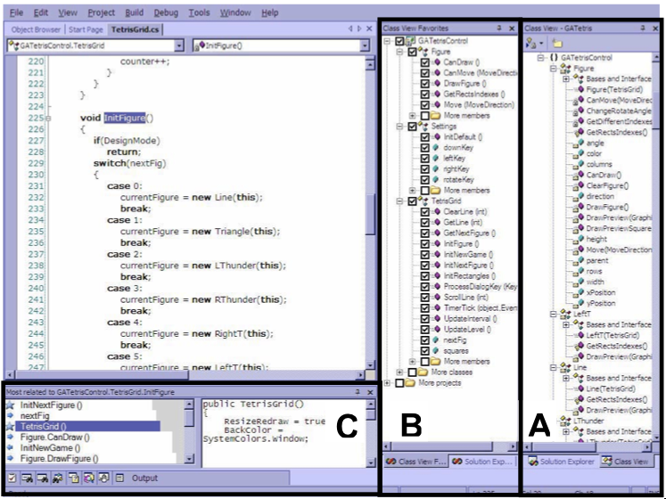
Team Tracks
Notes:
B = elements most often viewed (still ranked alph)
C = related elements
VHLCC == preliminary evaluation; in the eval the participants were replicating the _exact_ tasks that other devs had done previously (uncommon in practice, I would suspect)

Slide 39
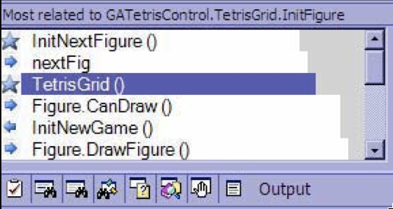
Team Tracks

Slide 40
TeamTracks Evaluation
Increased chances of success (set tasks)
Large increase in comprehension
2x more likely to give the right answer
Privacy concerns must be considered
Scope navigation data by time?
Hints at task specificity

Slide 41
Code Bubbles
Bragdon et al. [ICSE ‘10]
Editable fragments rather than files
Encourage task-based grouping
Easily persist and share past tasks
Support context switching

Slide 42
Code Bubbles

Slide 43
Code Bubbles Evaluation
Scrolling:
Decreased by ~49%
Search / navigation:
Decreased by ~55%
User study (20+ devs)
Generally positive, esp. about task-based features
Worried about scalability

Slide 44
Collaborative Development
Software is developed in teams
IDEs are typically designed for individual devs
Collaboration external to IDE
Valuable data can be lost
Processes unnecessarily ad hoc

Slide 45
Jazz
Li-Te Cheng [OOPSLA ’03]
Team communication
Explicitly link artifacts rather than mine them
Build chat logs into historical data
Enable snapshots to be sent by IM
Lifecycle integration
Integrated handling of builds & tests
Promote enhanced reporting etc.

Slide 46
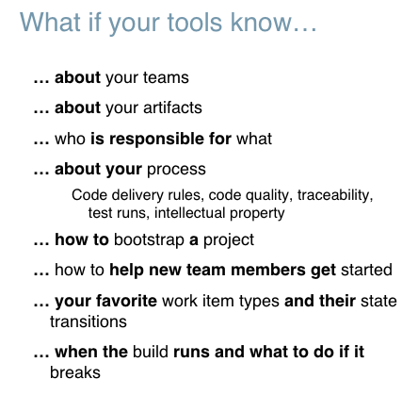
Jazz
Notes:
Jazz Goal: Be for collaboration tools what Visual Studio and Eclipse are for the desktop
http://ieeexplore.ieee.org/stamp/stamp.jsp?arnumber=04375254

Slide 47
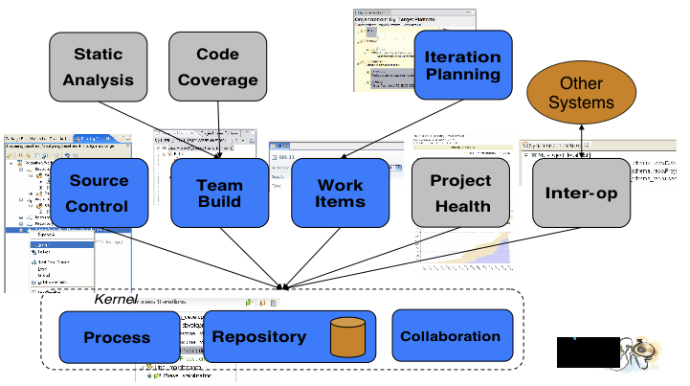
Jazz Information Sources

Slide 48
Sample Jazz Workflow
1. A build breaks owing to a test failure
2. A developer creates a bug report
3. Jazz links the bug report to both the build and the failed test
4. Jazz assigns the bug to an appropriate dev.
5. The dev commits their change set
6. Jazz links the change set to the bug and to the build

Slide 49
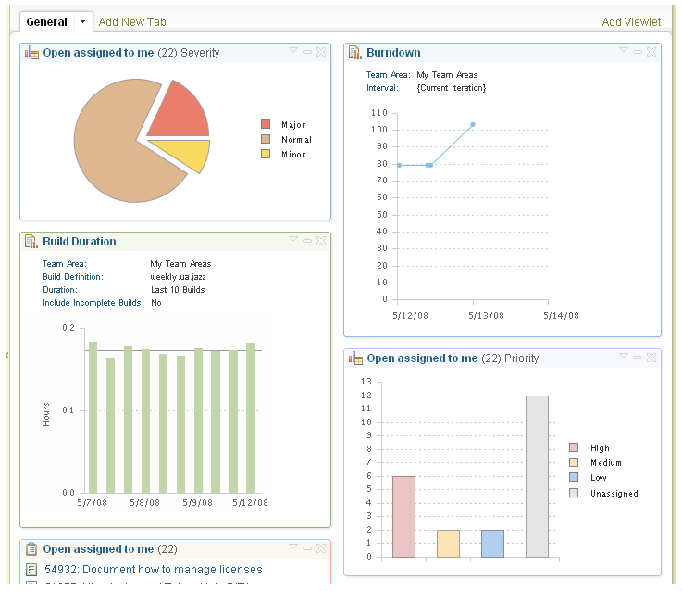
Jazz Dashboard

Slide 50
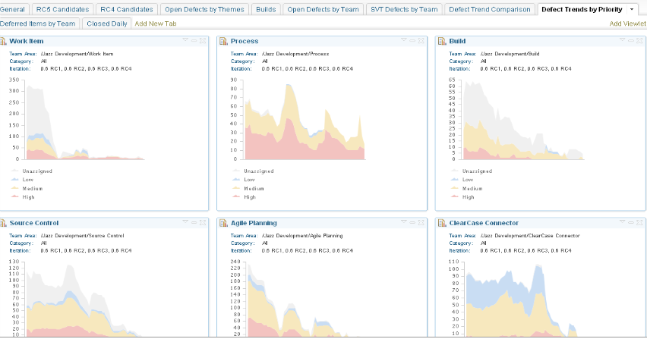
Jazz Dashboard

Slide 51
FastDash
Biehl et al. [CHI ‘07]
Assumption: Developers want to know what their co-workers are doing
Maintain awareness about:
Files being edited
Task assignments
Bug assignments
Targeted at large displays in common space
Decreased need for explicit communication
Notes:
http://research.microsoft.com/pubs/64290/chi2007-fastdash.pdf
Key items are also the ones that change the most frequently

Slide 52
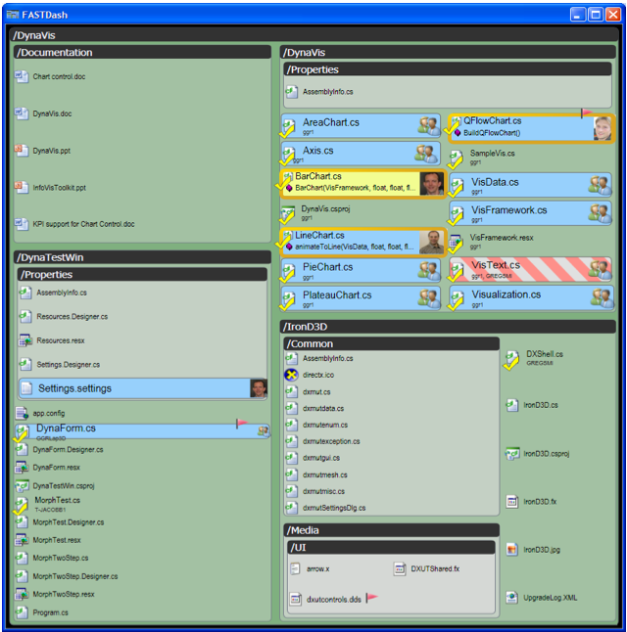
FastDash

Slide 53
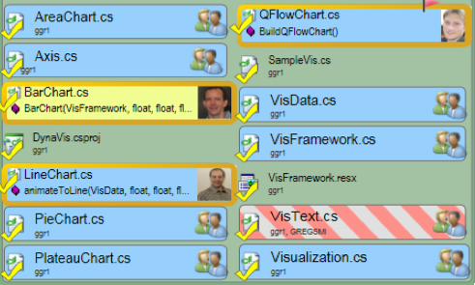
FastDash
Notes:
Gold border: file in focus in VS
Yellow highlight: file being edited
Blue highlight: file open by multiple devs
Hashed highlight: file checked out by multiple devs
Red border: file being debugged
Checkmark: file checked out

Slide 54
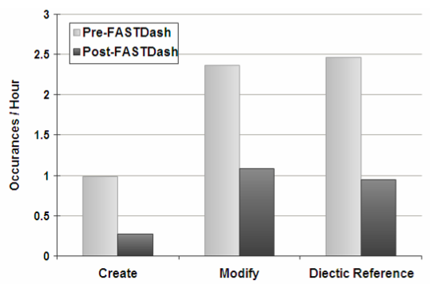
FastDash Evaluation
Shared resource contention decreased

Slide 55
Codebook
Begel & DeLine [MSR ‘08]
Extend social networks into software systems
E.g., developers can be ‘friends’ with their code
Social call graphs
Enable informal feedback channel for your APIs
Provide alternative means for discovering time contention
Evaluation not yet complete

Slide 56
Codebook
EventLogger.Connect() in EventLogger.cs
In class EventLogger in Microsoft.Research
Compiled into Logging.DLL
16 checkins between 1/24/2005 and 1/31/2006
5 pri0 bugs, 10 pri1 bugs, 1 pri2 bug
3 sibling methods:
void OnConnection(…)
bool Close()
void OnFailure(…)
2 sibling fields:
int numberConnections
bool currentlyConnected
Uses MAPI, OWA, and Passport external APIs.
Spec can be found in http://team/sites/devui/docs/Logger.doc
Newsfeed
— March 2009 —
Pialic checked in #1181 (tfs) and marked bug #9902 (ps) as closed.
changed methods openLogFile() and Connect() in class Connect
Moved to EventLogger class from OldEventLogger class by pialic
Modified by checkin #1181 (“BUG 9902…”) by pialic
Mentioned in bug #9902 (“fails to connect…”) is pri 1 by abegel
— Februrary 2009 —
Mentioned in checkin #381 (“BUG 3384…”) by sumeetg
Mentioned in email (“Failed to connect…”) from rdeline
Mentioned in bug #3384 (“hang when…”) is pri 1 by ginav
Mentioned in bug #1022 (“connects too slow…”) is pri 2 by pialic
— December 2008—
Added by checkin #211 (“ongoing…”) by pialic
Callers
Called by 41 methods: See all
EventLogger.OnConnection(): 3 calls
EventLogger.OnFailure(): 2 calls
Recommender.Startup(): 1 call
Code owned by 24 people calls Connect():
Mike Diaz, Jerry Ryan, Sumeet Gupta, Aaron Martin, Jenna Goldberg … (see all)
Related People
2 committers, 3 bug reporters/commenters (see all)
pialic RSDE MSR-Research 99/4219
rdeline SENIOR RESEARCHER MSR-Research 99/2132
sumeetg DEV LEAD 2 Windows 26/3012
Gadgets
Churn metrics
Get definition

Slide 57
Customized Awareness
Holmes and Walker [ICSE ‘10]
Projects are not created in isolation
Sometimes control is ceded to external teams
Similar information spread across many projects

Slide 58
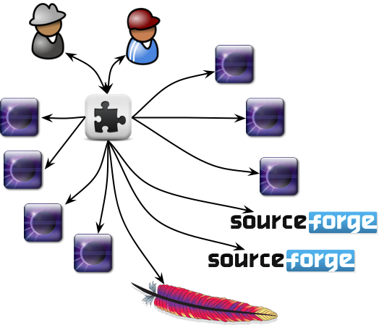
Heterogeneous Environments

Slide 59
Heterogeneous Environments
V2.3
V0.0.6
V3.5

Slide 60
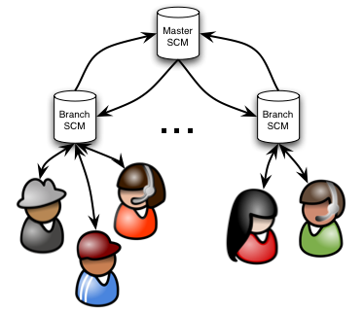
Large Teams

Slide 61
Large Teams
Makes Change

Slide 62
Large Teams
2 week delay
Makes Change

Slide 63
Large Teams
2 week delay
2 week delay
Makes Change
Code now failing

Slide 64
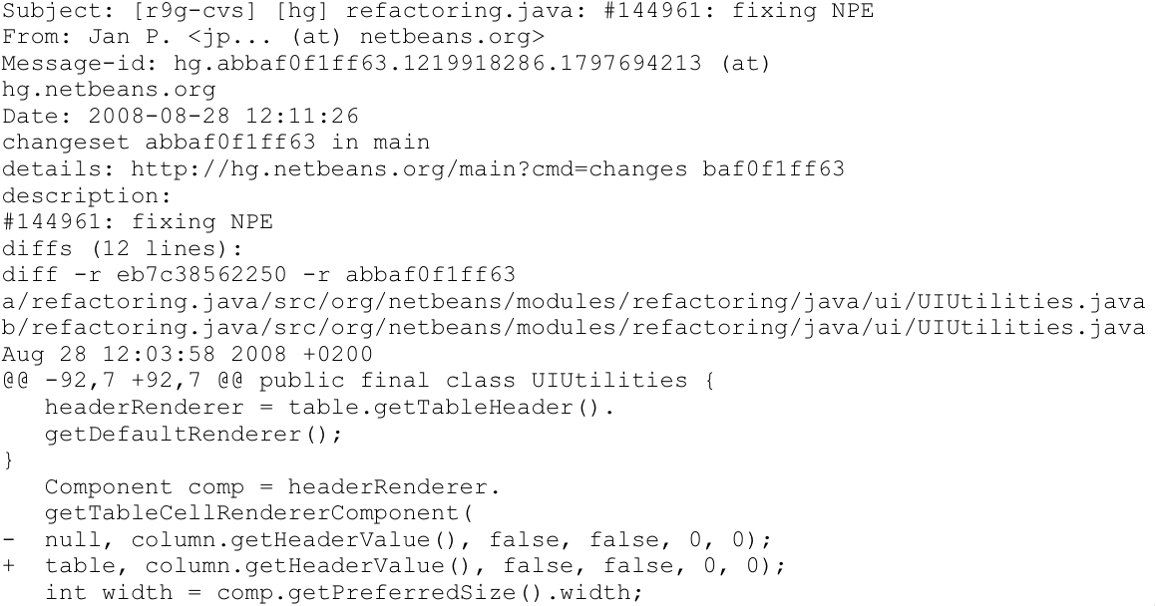
Commit Logs

Slide 65
Commit Log Volume
System msg / work day
KDE 515
Open Office 505
NetBeans 353
Linux Kernel 157

Slide 66
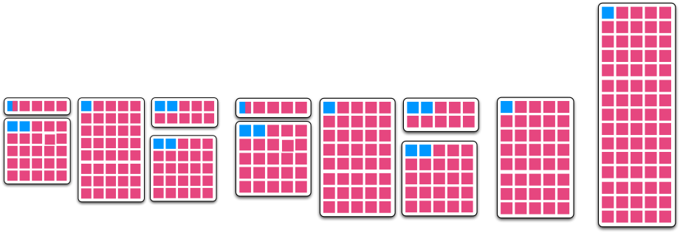
Concrete Example
Eclipse Metrics plug-in
Depends on 9xEclipse, 7xApache, 1xSF
Only uses a minority of each

Slide 67
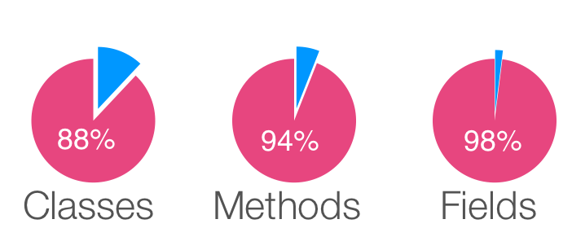
Concrete Example
Eclipse Metrics plug-in
Depends on 9xEclipse, 7xApache, 1xSF
Only uses a minority of each

Slide 68
Approach
Infer interest set
Code ownership + static analysis
Analyze changes
Identify changed elements
Determine change relevance
Structural relevance
Practical relevance

Slide 69
Evaluation
RQ1: How well is the stream compressed?
RQ2: Are impactful events really impactful?
RQ3: Are any impactful events misclassified?

Slide 70
Visualizations
Seek to provide unique insights about systems
Task-specific or general ‘understanding’?
Mappings to physical analogs difficult

Slide 71
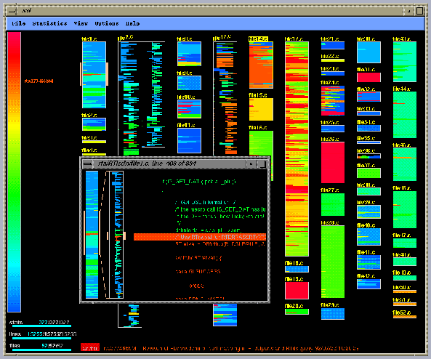
SeeSoft
Notes:
http://www.cc.gatech.edu/classes/cs7390_98_winter/reports/realsys/seesoft.html

Slide 72
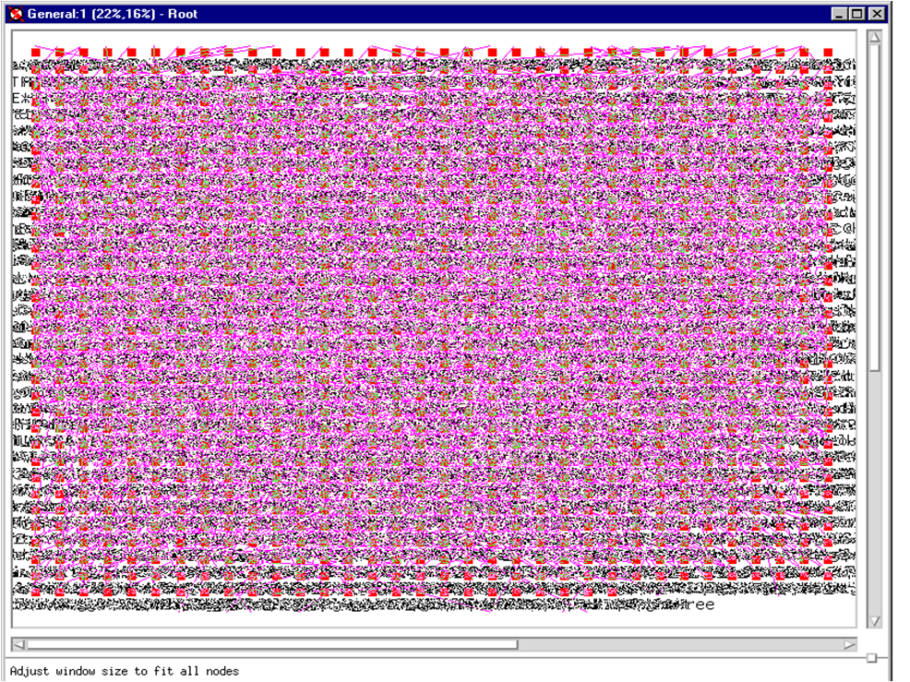
RIGI

Slide 73
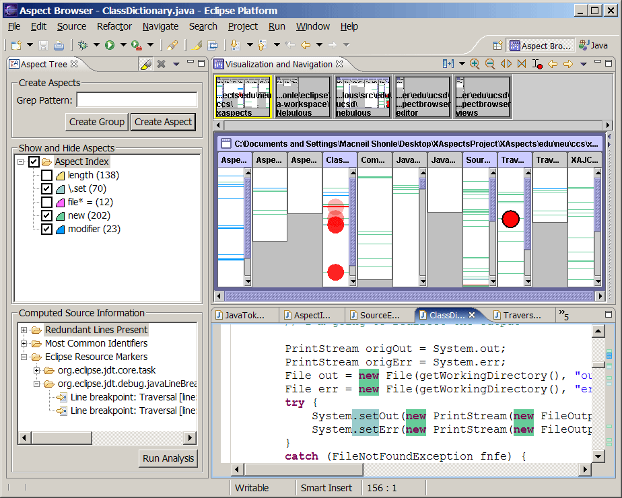
AspectBrowser
Notes:
http://cseweb.ucsd.edu/~wgg/Software/AB/

Slide 74
AspectBrowser

Slide 75
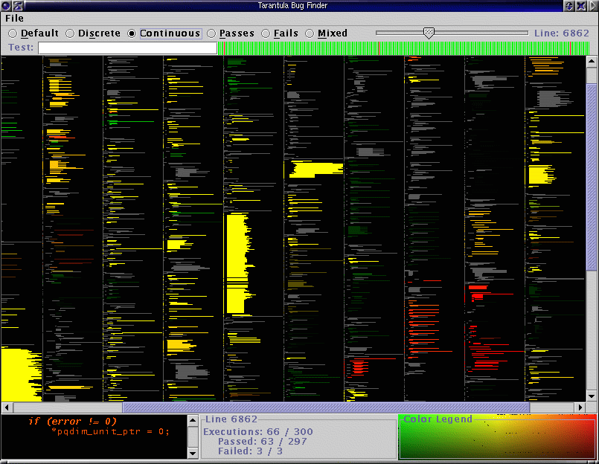
Tarantula
Notes:
http://pleuma.cc.gatech.edu/aristotle/Tools/tarantula/

Slide 76
Software Terrain Maps
DeLine [VLC 2005]
Navigate perceptually rather than cognitively
Ease navigation esp. backtracking
Region size corresponds to code size
Region locations capture affinity
Notes:
http://research.microsoft.com/pubs/74414/vlc05-final.pdf
Additional icons desired (e.g., loops, switch statements)
Stability cannot be maintained as system evolves
Too many size-1 nodes reduce their uniqueness
As experienced developers navigate around unfamiliar code, they often become disoriented. Indeed, in a recent observation study, we even saw a participant not recognize a method he had visited just a minute beforehand. It would be great if source code had a sense of "place" that would allow us to use our spatial memory when navigating, just as we do when navigating physical terrains. Software Terrain Maps are a prototype visualization based on the metaphor of cartographic maps, which are continuous (no wasted space), have enough visual landmarks to allow the viewer to recognize locations perceptually rather than cognitively, and lend themselves to data overlay.

Slide 77
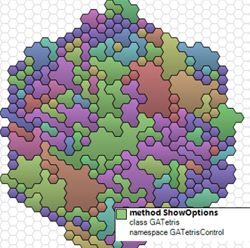
Software Terrain Maps

Slide 78
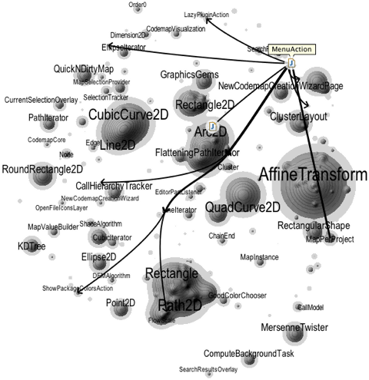
Software Cartography
Notes:
http://scg.unibe.ch/research/softwarecartography

Slide 79
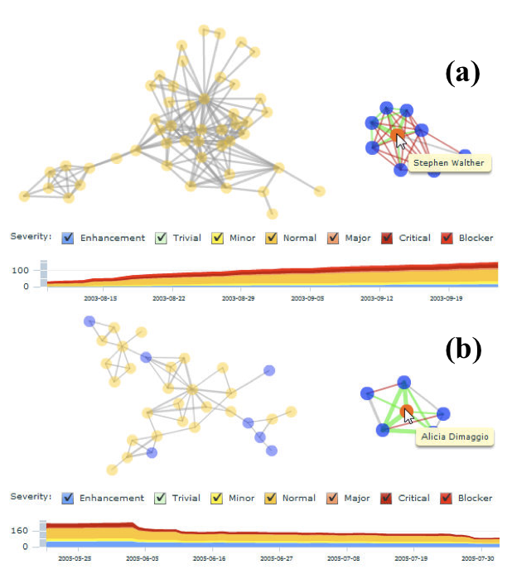
Tesseract
Notes:
http://www.cs.cmu.edu/%7Eantz/sarma_icse2009.pdf

Slide 80
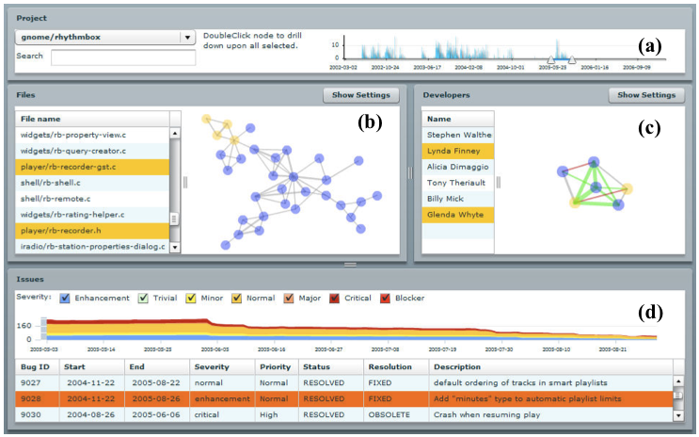
Tesseract

Slide 81
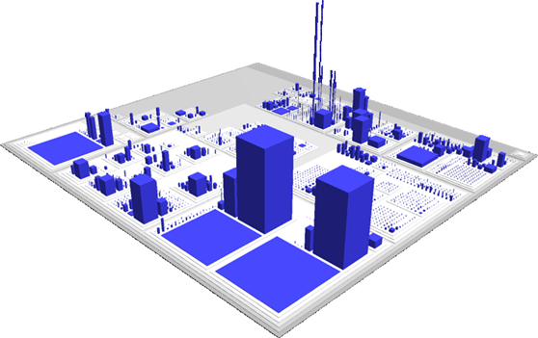
Code City

Slide 82
Summary
Tools help developers do _something_
The path from a research prototype to an industrial tool is convoluted at best
Start with an idea that could be useful in practice
Evaluation mismatch:
Academic merit vs. industrial merit

