Slide 1
CSEP 546 Data Mining
Instructor: Jesse Davis

Slide 2
Today’s Program
Logistics and introduction
Inductive learning overview
Instance-based learning
Collaborative filtering (Homework 1)

Slide 3
Logistics
Instructor: Jesse Davis
Email: jdavis@cs [Please include 546 in subject]
Office: CSE 356
Office hours: Mondays 5:30-6:20
TA: Andrey Kolobov
Email: akolobov@cs [Please include 546 in subject]
Office: TBD
Office hours: Mondays 5:30-6:20
Web: www.cs.washington.edu/p546
Mailing list: csep546@cs

Slide 4
Assignments
Four homeworks
Individual
Mix of questions and programming (to be done in either java or c++)
10% penalty per each day late (max of 5 days late)

Slide 5
Assignments
Homework 1: Due April 12th (100 points)
Collaborative filtering, IBL, d-trees and methodology
Homework 2: Due April 26th (100 points)
NB for spam filtering, rule learning, BNs
Homework 3: Due May 10th (100 points)
Perceptron for spam filtering, NNs, ensembles, GAs
Homework 4: Due June 1st (135-150 points)
Weka for empirical comparison, clustering, learning theory, association rules

Slide 6
Source Materials
Tom Mitchell, Machine Learning, McGraw-Hill, 1997.
R. Duda, P. Hart & D. Stork, Pattern Classification (2nd ed.), Wiley, 2001 (recommended)
Papers
Will be posted on the course Web page

Slide 7
Course Style
Primarily algorithmic & experimental
Some theory, both mathematical & conceptual (much on statistics)
"Hands on" experience, interactive lectures/discussions
Broad survey of many data mining/machine learning subfields

Slide 8
Course Goals
Understand what a data mining or machine learning system should do
Understand how current systems work
Algorithmically
Empirically
Their shortcomings
Try to think about how we could improve algorithms

Slide 9
Background Assumed
Programming languages
Java or C++
AI Topics
Search, first-order logic
Math
Calculus (i.e., partial derivatives) and simple probability (e.g., prob(A | B)
Assume no data mining or machine learning background (some overlap with CSEP 573)

Slide 10
What is Data Mining?
Data mining is the process of identifying valid, novel, useful and understandable patterns in data
Also known as KDD (Knowledge Discovery in Databases)
“We’re drowning in information, but starving for knowledge.” (John Naisbett)

Slide 11
Related Disciplines
Machine learning
Databases
Statistics
Information retrieval
Visualization
High-performance computing
Etc.

Slide 12
Applications of Data Mining
E-commerce
Marketing and retail
Finance
Telecoms
Drug design
Process control
Space and earth sensing
Etc.

Slide 13
The Data Mining Process
Understanding domain, prior knowledge, and goals
Data integration and selection
Data cleaning and pre-processing
Modeling and searching for patterns
Interpreting results
Consolidating and deploying discovered knowledge
Loop

Slide 14
Data Mining Tasks
Classification
Regression
Probability estimation
Clustering
Association detection
Summarization
Trend and deviation detection
Etc.

Slide 15
Requirements for a Data Mining System
Data mining systems should be
Computationally sound
Statistically sound
Ergonomically sound

Slide 16
Components of a Data Mining System
Representation
Evaluation
Search
Data management
User interface
Focus of this course

Slide 17
Representation
Decision trees
Sets of rules / Logic programs
Instances
Graphical models (Bayes/Markov nets)
Neural networks
Support vector machines
Model ensembles
Etc.

Slide 18
Evaluation
Accuracy
Precision and recall
Squared error
Likelihood
Posterior probability
Cost / Utility
Margin
Entropy
K-L divergence
Etc.

Slide 19
Search
Combinatorial optimization
E.g.: Greedy search
Convex optimization
E.g.: Gradient descent
Constrained search
E.g.: Linear programming

Slide 20
Topics for this Quarter (Slide 1 of 2)
Inductive learning
Instance based learning
Decision trees
Empirical evaluation
Rule induction
Bayesian learning
Neural networks

Slide 21
Topics for this Quarter (Slide 2 of 2)
Genetic algorithms
Model ensembles
Learning theory
Association rules
Clustering
Advanced topics, applications of data mining and machine learning

Slide 22
Inductive Learning

Slide 23
A Few Quotes
“A breakthrough in machine learning would be worth ten Microsofts” (Bill Gates, Chairman, Microsoft)
“Machine learning is the next Internet” (Tony Tether, Director, DARPA)
Machine learning is the hot new thing” (John Hennessy, President, Stanford)
“Web rankings today are mostly a matter of machine learning” (Prabhakar Raghavan, Dir. Research, Yahoo)
“Machine learning is going to result in a real revolution” (Greg Papadopoulos, CTO, Sun)

Slide 24
Traditional Programming
Machine Learning
Data
Computer
Output
Program
Data
Computer
Program
Output

Slide 25
What is Learning
Performance
Experience e.g.: amount of training data, time, etc.

Slide 26
Defining a Learning Problem
A program learns from experience E with respect to task T and performance measure P, if its performance at task T, as measured by P, improves with experience E
Example:
Task: Play checkers
Performance: % of games won
Experience: Play games against itself

Slide 27
Types of Learning
Supervised (inductive) learning
Training data includes desired outputs
Unsupervised learning
Training data does not include desired outputs
Semi-supervised learning
Training data includes a few desired outputs
Reinforcement learning
Rewards from sequence of actions

Slide 28
Inductive Learning
Inductive learning or Prediction:
Given: Examples of a function (X, F(X))
Predict: Function F(X) for new examples X
Discrete F(X): Classification
Continuous F(X): Regression
F(X) = Probability(X): Probability estimation

Slide 29
Example Applications
Disease diagnosis
x: Properties of patient (e.g., symptoms, lab test results)
f(x): Predict disease
Automated steering
x: Bitmap picture of road in front of car
f(x): Degrees to turn the steering wheel
Credit risk assessment
x: Customer credit history and proposed purchase
f(x): Approve purchase or not

Slide 30
Widely-used Approaches
Decision trees
Rule induction
Bayesian learning
Neural networks
Genetic algorithms
Instance-based learning
Etc.

Slide 31
Supervised Learning Task Overview
Real World
Feature construction and selection
(usually done by humans)
Feature Space
Classification rule construction
(done by learning algorithm)
Concepts/
Classes/
Decisions
Apply model to unseen
data

Slide 32
Task Definition
Given:
Set of positive examples of a concept/class/category
Set of negative examples (possibly)
Produce:
A description that covers
All/many positive examples
None/few negative examples
Goal: Properly categorizes most future examples!
The Key
Point!
Note: one can easily extend this definition to handle more than two classes

Slide 33
Learning from Labeled Examples
Most successful form of inductive learning
Given a set of data of the form: <x, f(x)>
x is a set of features
f(x) is the label for x
f is an unknown function
Learn: f’ which approximates f

Slide 34
Example
Positive Examples
Negative Examples
How do we classify this symbol?
Concept
Solid Red Circle in a (Regular?) Polygon
What about?
Figures on left side of page
Figures drawn before 5pm 3/29/89 <etc>

Slide 35
Assumptions
We are assuming examples are IID: independently identically distributed
We are ignoring temporal dependencies (covered in time-series learning)
We assume the learner has no say in which examples it gets (covered in active learning)

Slide 36
Design Choices for Inductive Learners
Need a language to represent each example (i.e., the training data)
Need a language to represent the learned “concept” or “hypothesis”
Need an algorithm to construct a hypothesis consistent with the training data
Need a method to label new examples
Focus of much of this course. Each choice effects the expressivity/efficiency of the algorithm

Slide 37
Constructing a Dataset
Step 1: Choose a feature space
Common approach: Fixed length feature vector
Choose N features
Each feature has V_{i} possible values
Each example is represented by a vector of N feature values (i.e., is a point in the feature space) e.g.: <red, 50, round>
^{color} ^{weight shape}
Feature types
Boolean
Nominal
Ordered
Hierarchical
Step 2: Collect examples (i.e., “I/O” pairs)

Slide 38
Types of Features
Nominal: No relationship between values
For example: color = {red, green, blue}
Linear/Ordered: Feature values are ordered
Continuous: Weight = {1,…,400}
Discrete: Size = {small, medium, large}
Hierarchical: Partial ordering according to an ISA relationship
closed
polygon
continuous
square
triangle
circle
ellipse

Slide 39
Terminology
Feature Space:
Properties that describe the problem
0.0 1.0 2.0 3.0
0.0 1.0 2.0 3.0 4.0 5.0 6.0

Slide 40
Another View of Feature Space
Plot examples as points in an N-dimensional space
Size
Big
?
Gray
Color
2500
Weight
A “concept” is then a (possibly disjoint) volume in this space.

Slide 41
Terminology
Example or instance:
<0.5,2.8,+>
0.0 1.0 2.0 3.0
+
+
+
+
-
+
+
-
-
-
-
+
+
-
-
+
-
-
+
-
-
+
+
+
-
-
0.0 1.0 2.0 3.0 4.0 5.0 6.0

Slide 42
Terminology
Hypothesis:
Function for labeling examples
0.0 1.0 2.0 3.0
+
+
Label: +
+
Label: -
?
+
-
+
+
-
-
-
-
+
+
-
?
?
-
+
-
-
+
-
-
+
+
+
-
?
-
0.0 1.0 2.0 3.0 4.0 5.0 6.0

Slide 43
Terminology
Hypothesis Space:
Set of legal hypotheses
0.0 1.0 2.0 3.0
+
+
+
+
-
+
+
-
-
-
-
+
+
-
-
+
-
-
+
-
-
+
+
+
-
-
0.0 1.0 2.0 3.0 4.0 5.0 6.0

Slide 44
Terminology Overview
Training example: Data point of the form <x, f(x)>
Target function (concept): the true f
Hypothesis (or model): A proposed function h, believed to be similar to f
Concept: A Boolean function
Examples where f(x) = 1 are called positive examples or positive instances
Examples where f(x) = 0 are called negative examples or negative instances

Slide 45
Terminology Overview
Classifier: A discrete-valued function f {1,…,K}
Each of 1,…,K are called classes or labels
Hypothesis space: The space of all hypotheses that can be output by the learner
Version space: The set of all hypotheses (in the hypothesis space) that haven’t been ruled by the training data

Slide 46
Example
Consider IMDB as a problem.
Work in groups for 5 minutes
Think about
What tasks could you perform?
E.g., predict genre, predict how much the movie will gross, etc.
What features are relevant

Slide 49
Inductive Bias
Need to make assumptions
Experience alone doesn’t allow us to make conclusions about unseen data instances
Two types of bias:
Restriction: Limit the hypothesis space (e.g., look at rules)
Preference: Impose ordering on hypothesis space (e.g., more general, consistent with data)

Slide 50
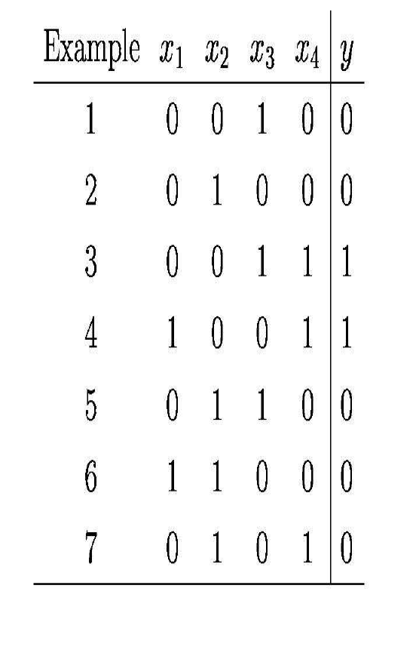

Slide 51
x₁ ⇒ y
x₃ ⇒ y
x₄ ⇒ y

Slide 57
Eager
0.0 1.0 2.0 3.0
+
+
Label: +
+
Label: -
+
-
+
+
-
-
-
-
+
+
-
-
+
-
-
+
-
-
+
+
+
-
-
0.0 1.0 2.0 3.0 4.0 5.0 6.0

Slide 58
Eager
0.0 1.0 2.0 3.0
Label: +
Label: -
?
?
?
?
0.0 1.0 2.0 3.0 4.0 5.0 6.0

Slide 59
Lazy
0.0 1.0 2.0 3.0
+
+
?
+
+
-
+
+
-
-
-
-
+
+
-
?
Label based on neighbors
?
-
+
-
-
+
-
-
+
+
+
-
?
-
0.0 1.0 2.0 3.0 4.0 5.0 6.0

Slide 60
Batch
0.0 1.0 2.0 3.0
0.0 1.0 2.0 3.0 4.0 5.0 6.0

Slide 61
Batch
0.0 1.0 2.0 3.0
+
+
Label: +
+
Label: -
+
-
+
+
-
-
-
-
+
+
-
-
+
-
-
+
-
-
+
+
+
-
-
0.0 1.0 2.0 3.0 4.0 5.0 6.0

Slide 62
Online
0.0 1.0 2.0 3.0
0.0 1.0 2.0 3.0 4.0 5.0 6.0

Slide 63
Online
0.0 1.0 2.0 3.0
+
Label: -
Label: +
-
0.0 1.0 2.0 3.0 4.0 5.0 6.0

Slide 64
Online
0.0 1.0 2.0 3.0
+
+
Label: +
Label: -
-
0.0 1.0 2.0 3.0 4.0 5.0 6.0

Slide 65
Take a 15 minute break

Slide 66
Instance Based Learning

Slide 67
Simple Idea: Memorization
Employed by first learning systems
Memorize training data and look for exact match when presented with a new example
If a new example does not match what we have seen before, it makes no decision
Need computer to generalize from experience

Slide 68
Nearest-Neighbor Algorithms
Learning ≈ memorize training examples
Classification: Find most similar example and output its category
Regression: Find most similar example and output its value
Venn
-
-
+
+
“Voronoi
Diagrams”
(pg 233)
+
+
-
…
+
-
-
-
+
-
+
+
?
+
+
-

Slide 69
Example
Training Set
a=0, b=0, c=1 +
a=0, b=0, c=0 -
a=1, b=1, c=1 -
Test Example
a=0, b=1, c=0 ?
“Hamming Distance”
Ex 1 = 2
Ex 2 = 1
Ex 3 = 2
So output -

Slide 70
Sample Experimental Results (see UCI archive for more)
Testbed | Testset Correctness
 | 1-NN | D-Trees | Neural Nets
Wisconsin Cancer | 98% | 95% | 96%
Heart Disease | 78% | 76% | ?
Tumor | 37% | 38% | ?
Appendicitis | 83% | 85% | 86%
Simple algorithm works quite well!

Slide 71
K-NN Algorithm
Learning ≈ memorize training examples
For example unseen test example e, collect K nearest examples to e
Combine the classes to label e’s
Question: How do we pick K?
Highly problem dependent
Use tuning set to select its value
Tuning Set
Error Rate
1
2
3
4
5
K

Slide 72
Distance Functions:
Hamming: Measures overlap/differences between examples
Value difference metric: Attribute values are close if they make similar predictions
a=0, b=0, c=1 +
a=0, b=2, c=0 -
a=1, b=3, c=1 -
a=1, b=1, c=0 +

Slide 73
Distance functions
Euclidean
Manhattan
L^{n} norm
Note: Often want to normalize these values
In general, distance function is problem specific

Slide 74
Variations on a Theme
(From Aha, Kibler and Albert in ML Journal)
IB1 – keep all examples
IB2 – keep next instance if incorrectly classified by using previous instances
Uses less storage (good)
Order dependent (bad)
Sensitive to noisy data (bad)

Slide 75
Variations on a Theme (cont.)
IB3 – extend IB2 to more intelligently decide which examples to keep (see article)
Better handling of noisy data
Another Idea - cluster groups, keep example from each (median/centroid)
Less storage, faster lookup

Slide 76
Distance Weighted K-NN
Consider the following example for 3-NN
The unseen example is much closer to the positive example, but labeled as a negative
Idea: Weight nearer examples more heavily
+
-
?
-
+
+
-

Slide 77
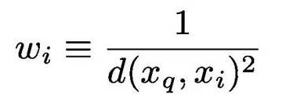
Distance Weighted K-NN
Classification function is:
Where
Notice that now we should use all training examples instead of just k

Slide 78
Advantages of K-NN
Training is very fast
Learn complex target function easily
No loss of information from training data
Easy to implement
Good baseline for empirical evaluation
Possible to do incremental learning
Plausible model for human memory

Slide 79
Disadvantages of K-NN
Slow at query time
Memory intensive
Easily fooled by irrelevant attributes
Picking the distance function can be tricky
No insight into the domain as there is no explicit model
Doesn’t exploit, notice structure in examples

Slide 80
Reducing the Computation Cost
Use clever data structures
E.g., k-D trees (for low dimensional spaces)
Efficient similarity computation
Use a cheap, approximate metric to weed out examples
Use expensive metric on remaining examples
Use a subset of the features

Slide 81
Reducing the Computation Cost
Form prototypes
Use a subset of the training examples
Remove those that don’t effect the frontier
Edited k-NN

Slide 83
Curse of Dimensionality
Imagine instances are described by 20 attributes, but only two are relevant to the concept
Curse of dimensionality
With lots of features, can end up with spurious correlations
Nearest neighbors are easily mislead with high-dim X
Easy problems in low-dim are hard in high-dim
Low-dim intuition doesn’t apply in high-dim

Slide 84
Example: Points on Hypergrid
In 1-D space: 2 NN are equidistant
In 2-D space: 4 NN are equidistant

Slide 85
Feature Selection
Filtering-Based Feature Selection
all features
subset of features
model
Wrapper-Based Feature Selection
all features
FS algorithm
FS algorithm
calls ML algorithm many times, uses it to help select features
ML algorithm
model
ML algorithm

Slide 86
Feature Selection as Search Problem
State = set of features
Start state = empty (forward selection) or full (backward selection)
Goal test = highest scoring state
Operators
add/subtract features
Scoring function
accuracy on training (or tuning) set of ML algorithm using this state’s feature set

Slide 87
Forward Feature Selection
Greedy search (aka “Hill Climbing”)
{}
50%
add F₁
add F_{N}
add F₂
{F₁}
62%
{F₂}
72%
{F_{N}}
52%
...
add F_{N}
add F₁
add F₃
{F₁,F₂}
74%
{F₂,F₃}
73%
{F₂,F_{N}}
84%
...

Slide 89
Backward Feature Selection
Greedy search (aka “Hill Climbing”)
{F₁,…,F₂}
75%
subtract F₁
subtract F_{N}
subtract F₂
{F₂,…,F_{N}}
72%
{F₁, F₃,…,F_{N}}
82%
{F₁,…,F_{N-1}}
78%
...
subtract F_{N}
subtract F₁
subtract F₃
{F₃,…,F_{N}}
80%
{F₁, F₄,…,F_{N}}
83%
{F₁, F₃,…,F_{N-1}}
81%
...

Slide 91
Forward vs. Backward Feature Selection
Forward
Backward
Faster in early steps because fewer features to test
Fast for choosing a small subset of the features
Misses features whose usefulness requires other features (feature synergy)
Fast for choosing all but a small subset of the features
Preserves features whose usefulness requires other features
Example: area important, features = length, width

Slide 92
Local Learning
Collect k nearest neighbors
Give them to some supervised ML algo
Apply learned model to test example
+
-
+
Train on these
+
-
+
-
-
-
?
+
+
+

Slide 93
Locally Weighted Regression
Form an explicit approximation for each query point seen
Fit learn linear, quadratic, etc., function to the k nearest neighbors
Provides a piecewise approximation to f

Slide 95
Homework 1: Programming Component
Implement collaborative filtering algorithm
Apply to (subset of) Netflix Prize data
1821 movies, 28,978 users, 3.25 million ratings (* - *****)
Try to improve predictions
Optional: Add your ratings & get recommendations
Paper: Breese, Heckerman & Cadie, “Empirical Analysis of Predictive Algorithms for Collaborative Filtering” (UAI-98)

Slide 96
Collaborative Filtering
Problem: Predict whether someone will like a Web page, movie, book, CD, etc.
Previous approaches: Look at content
Collaborative filtering
Look at what similar users liked
Intuition is that similar users will have similar likes and dislikes

Slide 97
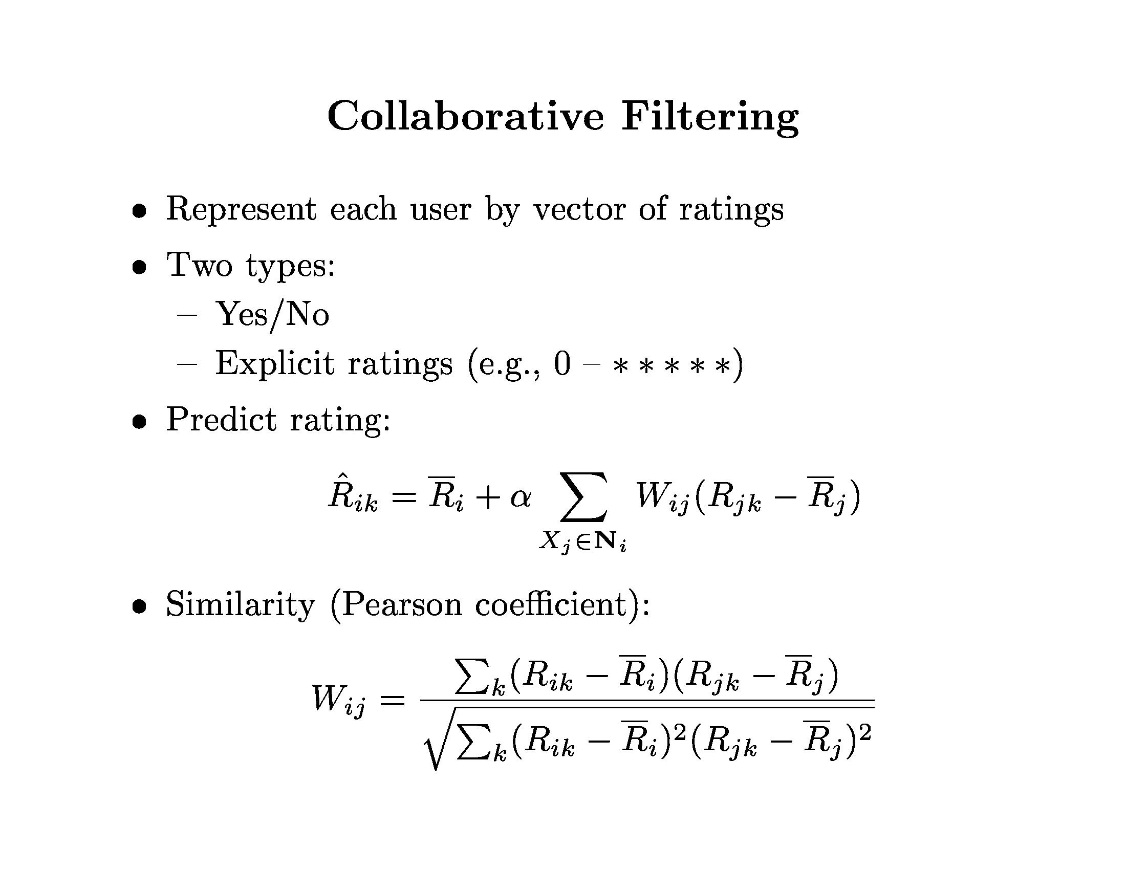
∑_{k}(R_{ik –} R_{i}) (R_{jk –} R_{j})
W_{ij} =
[∑_{k} (R_{ik –} R_{i})² ∑_{k} (R_{jk –} R_{j})² ]^{0.5}

Slide 99
Example
 | R1 | R2 | R3 | R4 | R5 | R6
Alice | 2 | - | 4 | 4 | - | 2
Bob | 1 | 5 | 4 | - | - | 2
Chris | 4 | 3 | - | - | - | 5
Diana | 3 | - | 2 | 4 | - | 5
Compare Alice and Bob

Slide 100
Example
 | R1 | R2 | R3 | R4 | R5 | R6
Alice | 2 | - | 3 | 2 | - | 1
Bob | 1 | 5 | 4 | - | - | 2
Chris | 4 | 3 | - | - | - | 5
Diana | 3 | - | 2 | 4 | - | 5
Alice = 2
Bob = 3
W = [0 + (1)(1) + (-1)(-1)] /… = 2 / 12^{0.5}
Alice_{R2} = 2 + 1/w * [w *(5-3)] = 4

Slide 101
Summary
Brief introduction to data mining
Overview of inductive learning
Problem definition
Key terminology
Instance-based learning: k-NN
Homework 1: Collaborative filtering

Slide 102
Next Class
Decision Trees
Read Mitchell chapter 3
Empirical methodology
Provost, Fawcett and Kohavi, “The Case Against Accuracy Estimation”
Davis and Goadrich, “The Relationship Between Precision-Recall and ROC Curves”
Homework 1 overview

Slide 103
Questions?

