Slide 1
Computational Photography
CSE P 576
Larry Zitnick (larryz@microsoft.com)

Slide 2
What is computational photography?
Def: The generation of an photograph requiring the use of a computer that enhances or extends the capabilities of photography.
Typically, multiple images are used to create a final “photograph.”
How can these images vary?

Slide 3
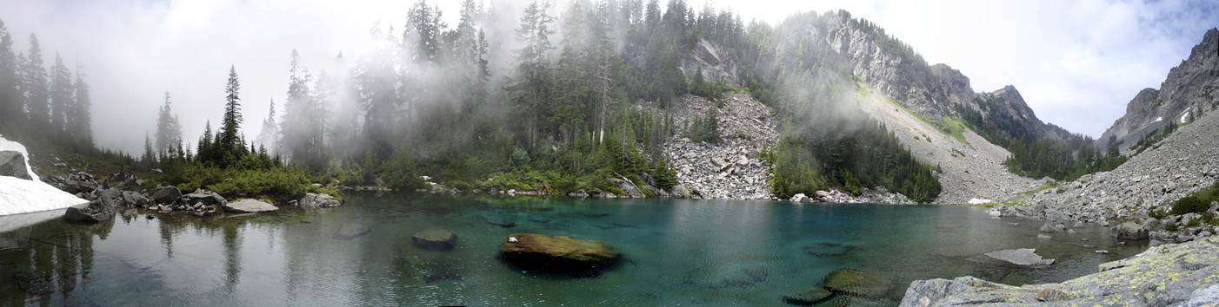
Panoramas
We already covered this…

Slide 4
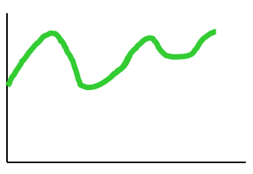
Composite
How do Photoshop’s cloning and healing brushes work? What is the difference?
Cloning
Cut
Healing

Slide 5
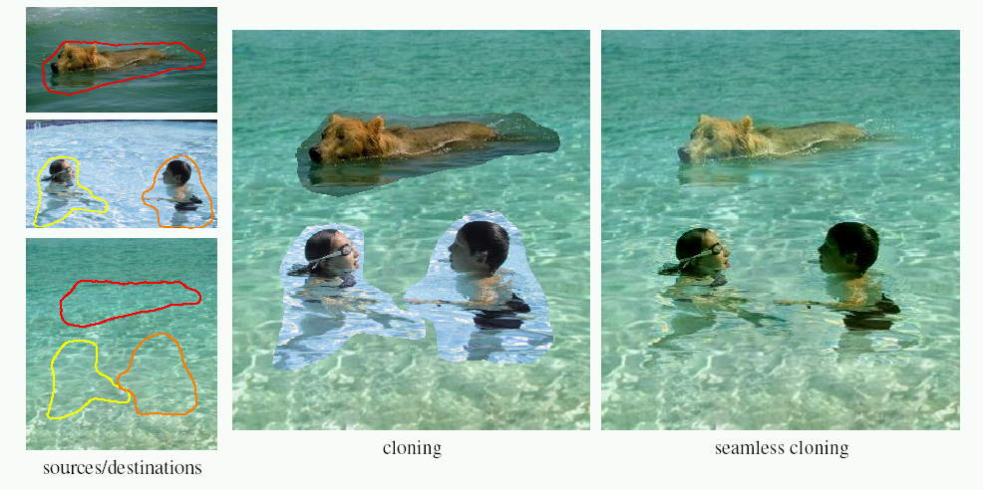
Poisson blending
Limitations:
  Can’t do contrast reversal (gray on black -> gray on white)
  Colored backgrounds “bleed through”
  Images need to be very well aligned
  Textures may not perfectly agree
Perez et al, SIGGRAPH 2003

Slide 6
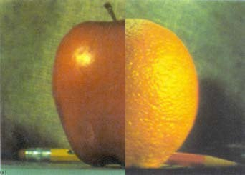
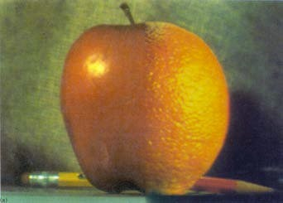
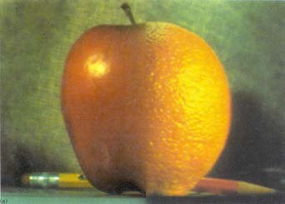
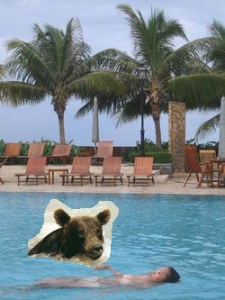
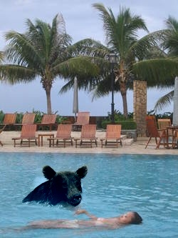
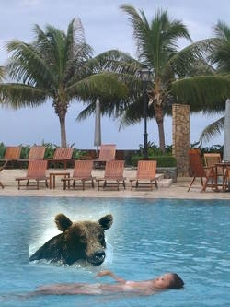
Comparison
Cut and paste
Poisson
Laplacian
Steve Gomez http://www.cs.brown.edu/courses/csci1950-g/results/proj2/steveg/

Slide 7
Selecting regions
Use Photoshop’s “magic wand.”

Slide 8
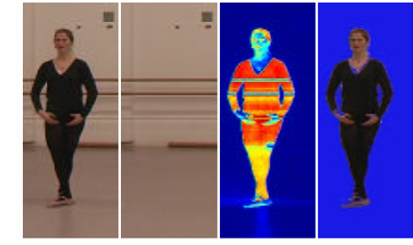
Background Subtraction
A largely unsolved problem…
One video
frame
Estimated
background
Difference
Image
Thresholded
Foreground
on blue

Slide 9
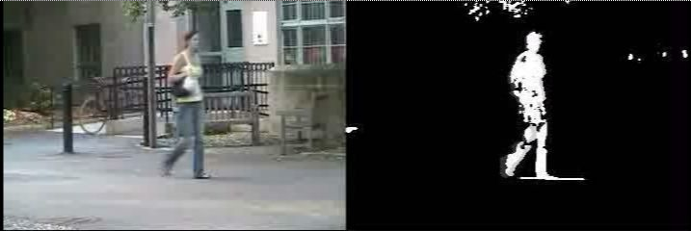
Background Subtraction
Harder than you think…
Jodoin et al., 2008

Slide 10
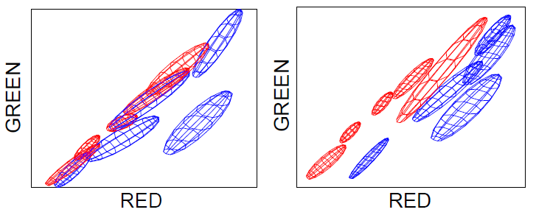
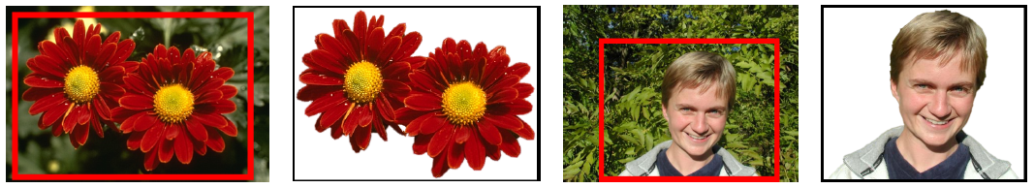
Grabcut
Compute color model for foreground and background using EM (k=5).
C. Rother, V. Kolmogorov, A. Blake. GrabCut: Interactive Foreground Extraction using Iterated Graph Cuts. ACM Transactions on Graphics (SIGGRAPH'04), 2004

Slide 11
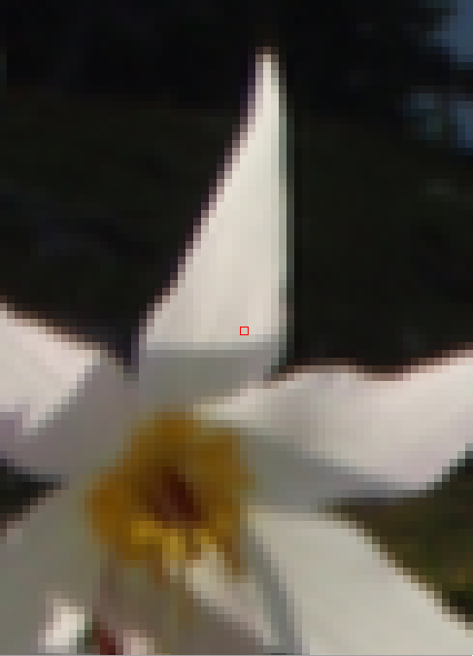
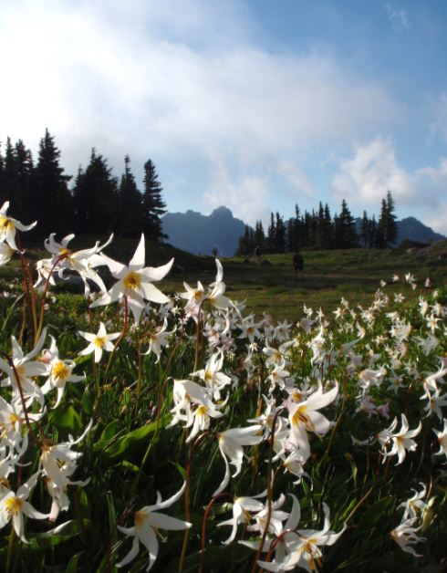
Matting

Slide 12
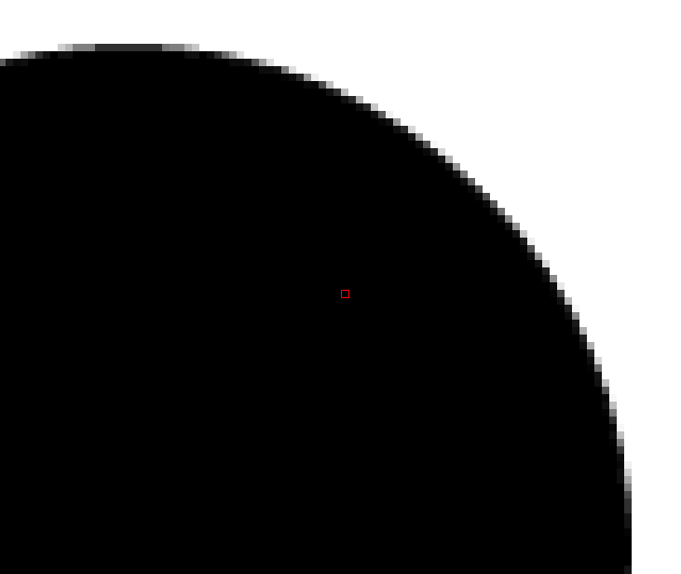
Matting

Slide 13
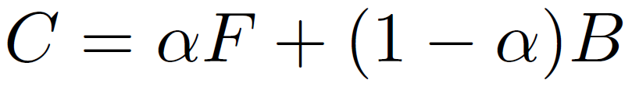
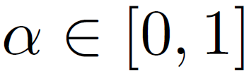
Matting equation
observed
color
blending
foreground color
background color
http://www.alphamatting.com/

Slide 14
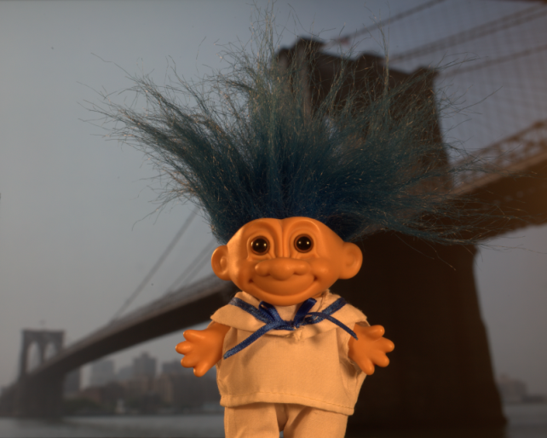

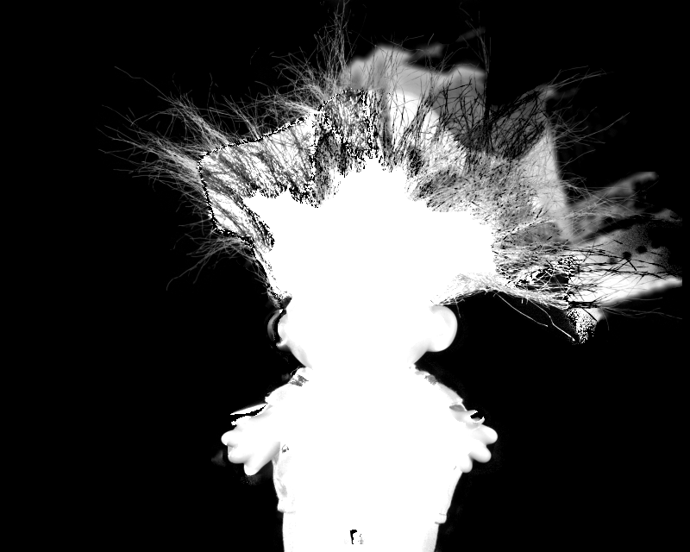
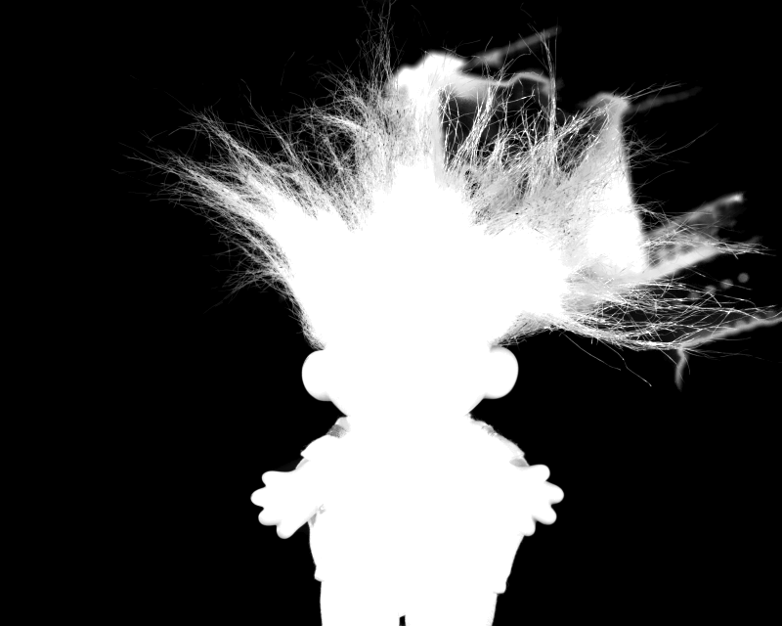
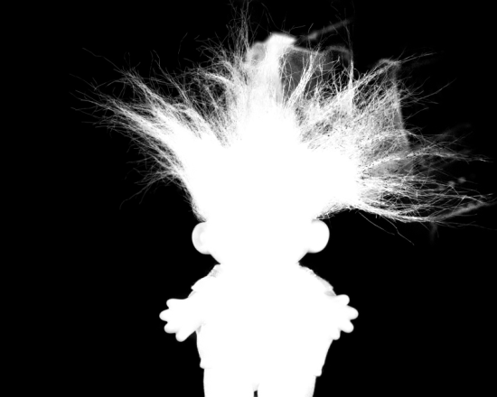
Solving
Bayesian Matting, Chuang et al., 2001
Robust Matting, Wang et al., 2007
Shared matting, Eduardo et al., 2010

Slide 15
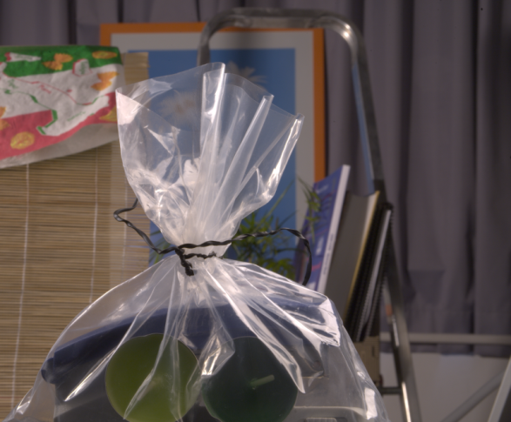
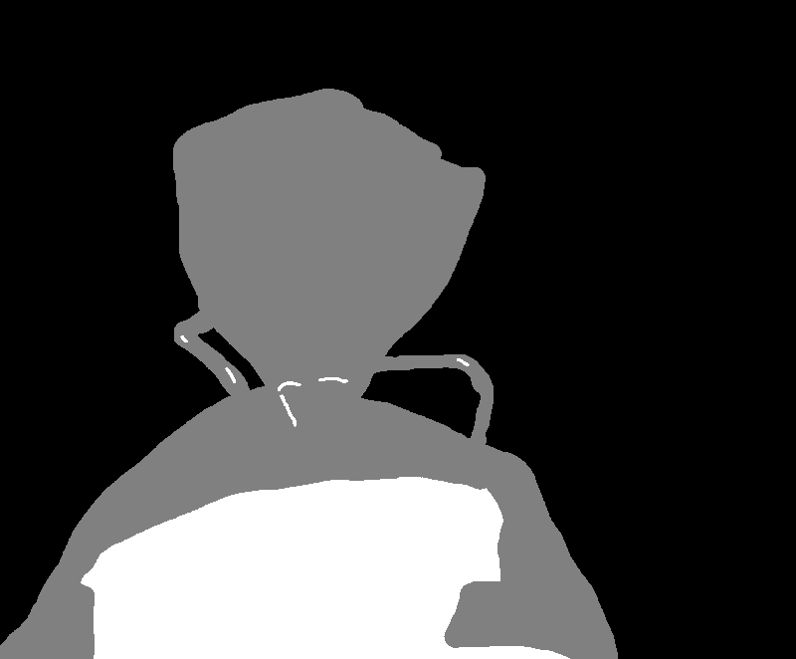
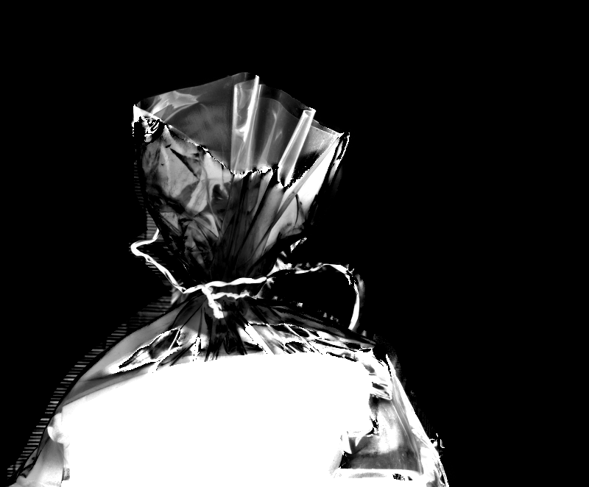
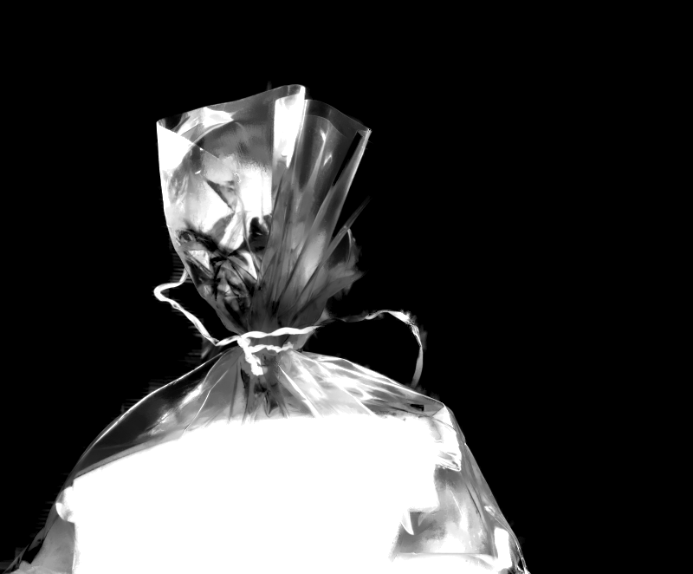
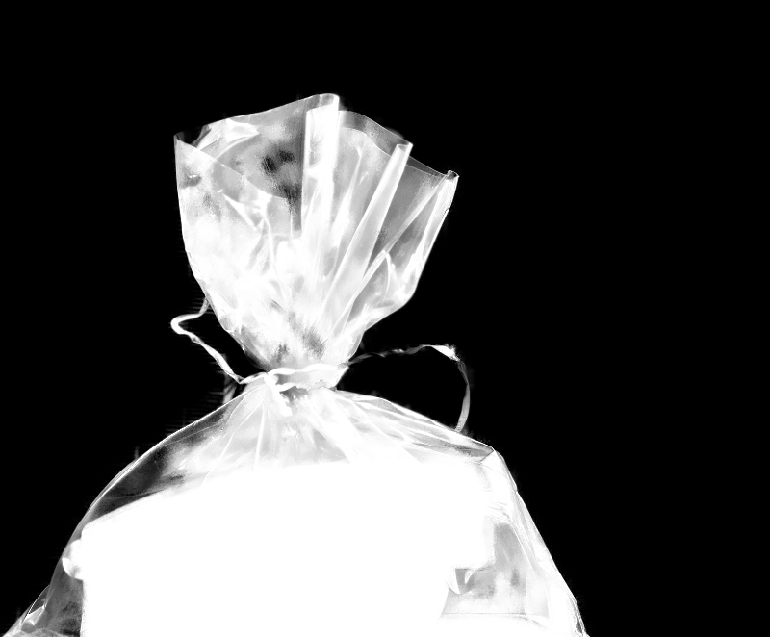
Harder problems
Bayesian Matting, Chuang et al., 2001
Robust Matting, Wang et al., 2007
Shared matting, Eduardo et al., 2010

Slide 16
Movies
How do they perform matting in movies?

Slide 17
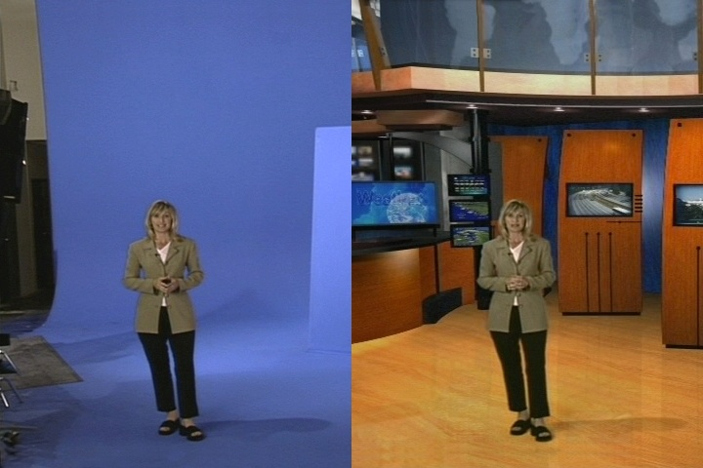
Blue Screen

Slide 18
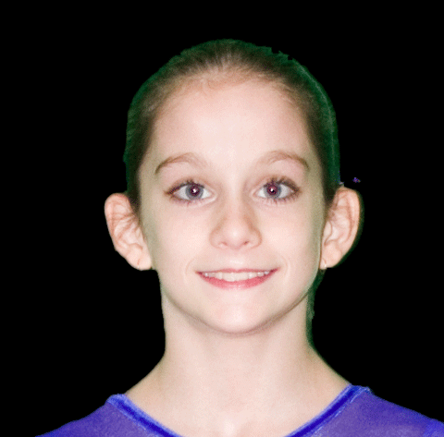
Blue Screen matting
Most common form of matting in TV studios & movies
Petros Vlahos invented blue screen matting in the 50s. His Ultimatte® is still the most popular equipment. He won an Oscar for lifetime achievement.
A form of background subtraction:
  Need a known background
  Foreground not equal to background
    no blue ties!
  Why blue?
  Why uniform?

Slide 19
Improving resolution: super resolution
What if you don’t have a zoom lens or a mega-pixel sensor?

Slide 20
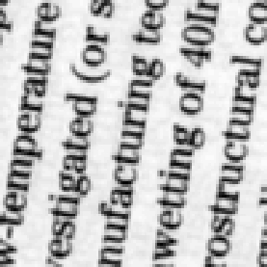
Intuition (slides from Yossi Rubner & Miki Elad)
For a given band-limited image, the Nyquist sampling theorem states that if a uniform sampling is fine enough (≥D), perfect reconstruction is possible.
D
D
20
Notes:
20

Slide 21
Intuition (slides from Yossi Rubner & Miki Elad)
Due to our limited camera resolution, we sample using an insufficient 2D grid
2D
2D
21
Notes:
21

Slide 22
Intuition (slides from Yossi Rubner & Miki Elad)
However, if we take a second picture, shifting the camera ‘slightly to the right’ we obtain:
2D
2D
22
Notes:
22

Slide 23
Intuition (slides from Yossi Rubner & Miki Elad)
Similarly, by shifting down we get a third image:
2D
2D
23
Notes:
23

Slide 24
Intuition (slides from Yossi Rubner & Miki Elad)
And finally, by shifting down and to the right we get the fourth image:
2D
2D
24
Notes:
24

Slide 25
Intuition
By combining all four images the desired resolution is obtained, and thus perfect reconstruction is guaranteed.
25
Notes:
25

Slide 26










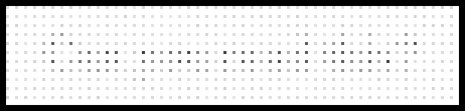
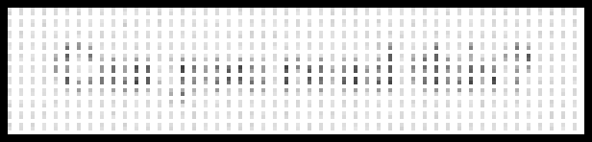
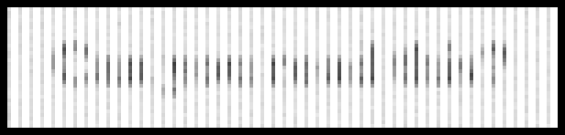


Example
3:1 scale-up in each axis using 9 images, with pure global translation between them
26
Notes:
26

Slide 27
Handling more general 2D motions
What if the camera displacement is Arbitrary ?
What if the camera rotates? Gets closer to the object (zoom)?
27
Notes:
27

Slide 28
Super-resolution
Basic idea:
  define a destination (dst) image of desired resolution
  assume mapping from dst to each input image is known
    usually a combination of a 2D motion/warp and an average (point-spread function)
    can be expressed as a set of linear constraints
    sometimes the mapping is solved for as well
  add some form of regularization (e.g., “smoothness assumption”)
    can also be expressed using linear constraints
    but L1, other nonlinear methods work better

Slide 29
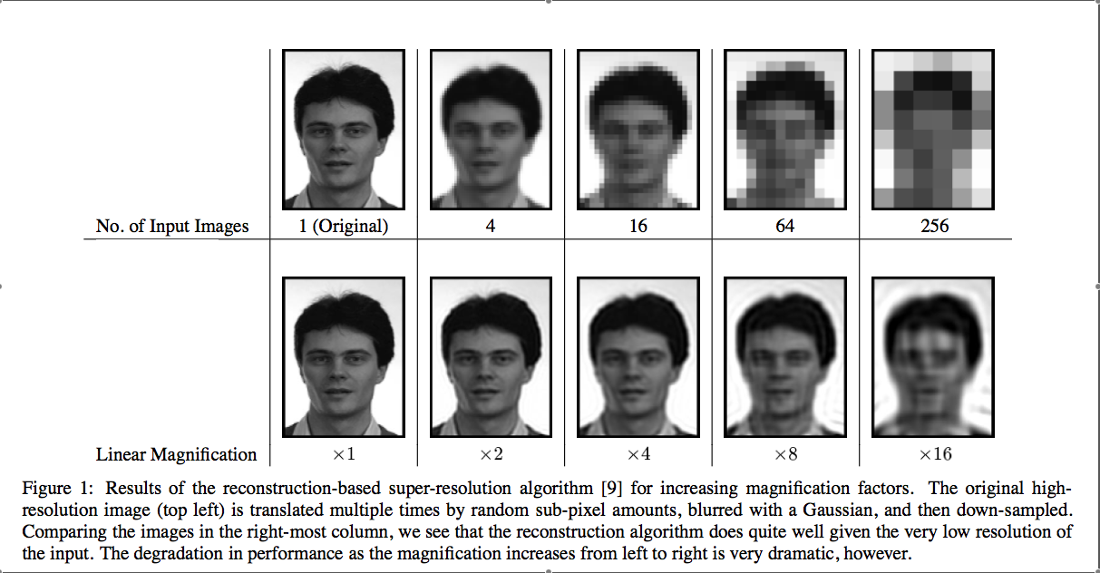
How does this work? [Baker & Kanade, 2002]

Slide 30
Limits of super-resolution [Baker & Kanade, 2002]
Performance degrades significantly beyond 4x or so
Doesn’t matter how many new images you add
  space of possible (ambiguous) solutions explodes quickly
Major cause
  quantizing pixels to 8-bit gray values
Possible solutions:
  nonlinear techniques (e.g., L1)
  better priors (e.g., using domain knowledge)
    Baker & Kanade “Hallucination”, 2002
    Freeman et al. “Example-based super-resolution”

Slide 31
Noise
Many possible techniques:
Bilateral filter and median filter are very common.
Blur color more than intensity. Why?
There are more advanced techniques…

Slide 32
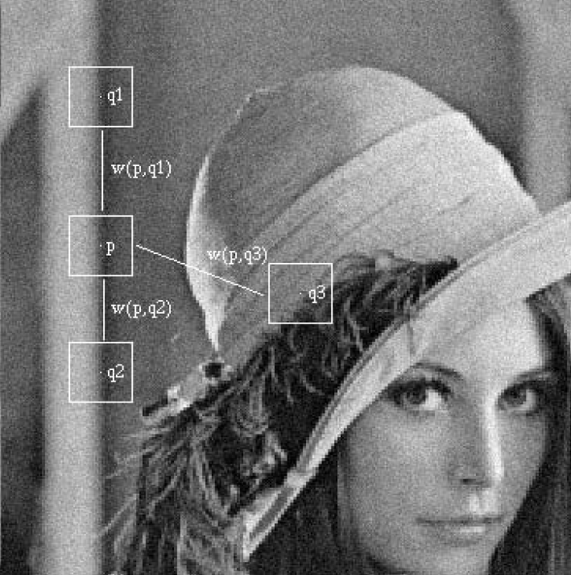
Non-local means
Look for similar patches in the image…
A. Buades, B. Coll, J.M. Morel"A non local algorithm for image denoising"
IEEE Computer Vision and Pattern Recognition 2005, Vol 2, pp:60-65, 2005.

Slide 33
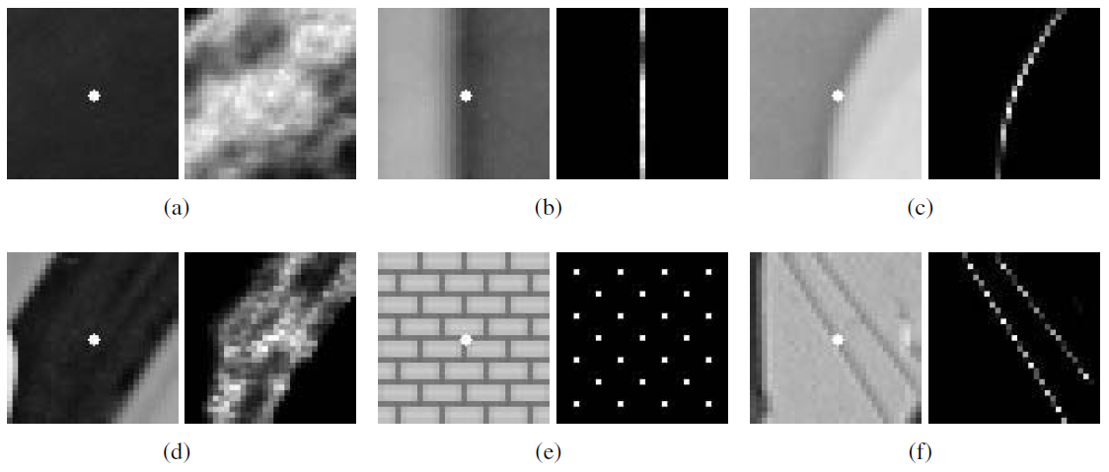
Non-local means
Look for similar patches in the image…
A. Buades, B. Coll, J.M. Morel"A non local algorithm for image denoising"
IEEE Computer Vision and Pattern Recognition 2005, Vol 2, pp:60-65, 2005.

Slide 34
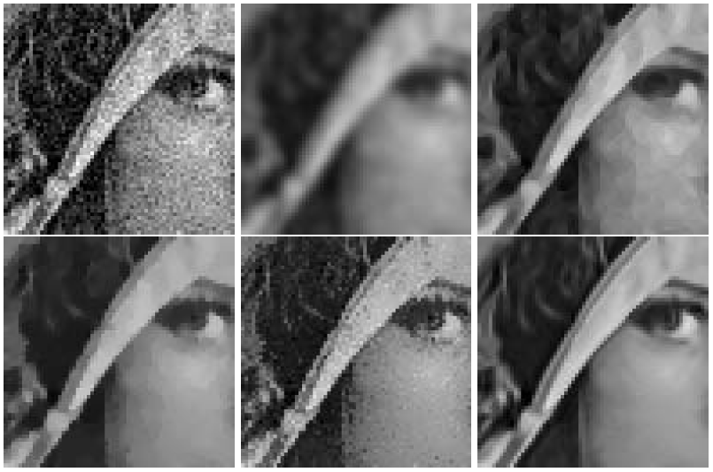
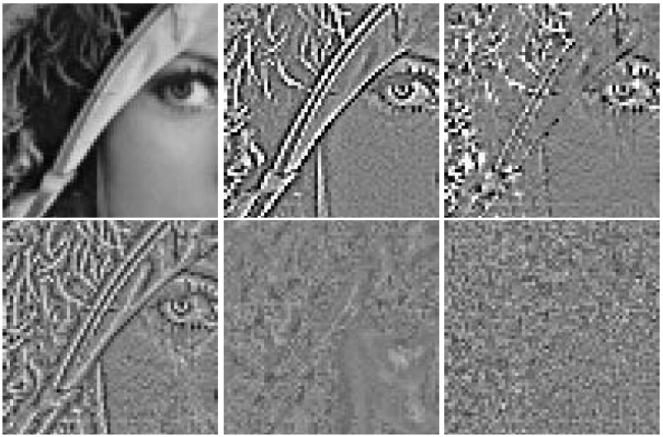
Non-local means results
De-noising results
Subtracted images

Slide 35
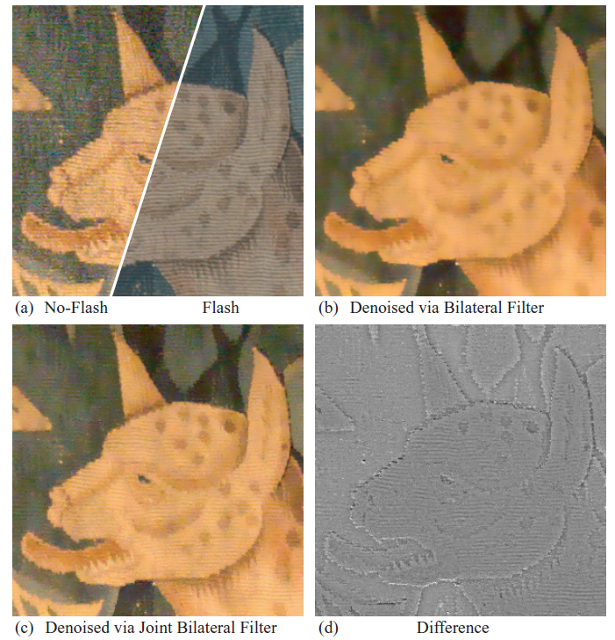
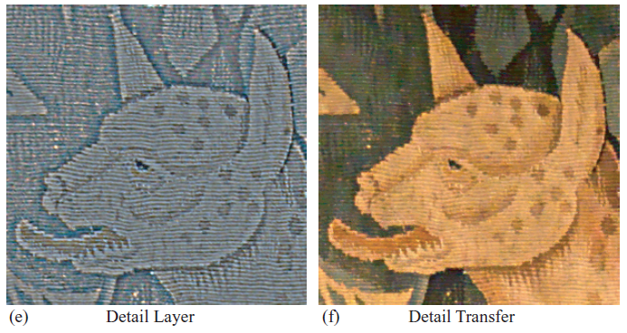
Multiple images
Use two images: Flash and no flash
G. Petschnigg, M. Agrawala, H. Hoppe, R. Szeliski, M. Cohen, K. Toyama. Digital Photography with Flash and No-Flash Image Pairs. SIGGRAPH 2004

Slide 36
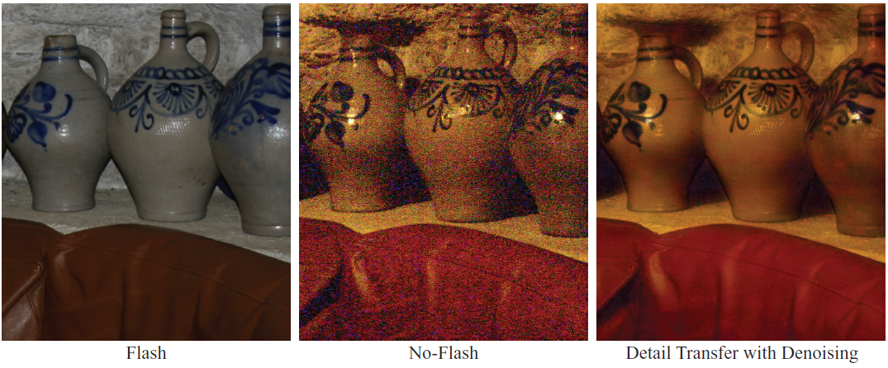
Multiple images
Flash/no flash

Slide 37
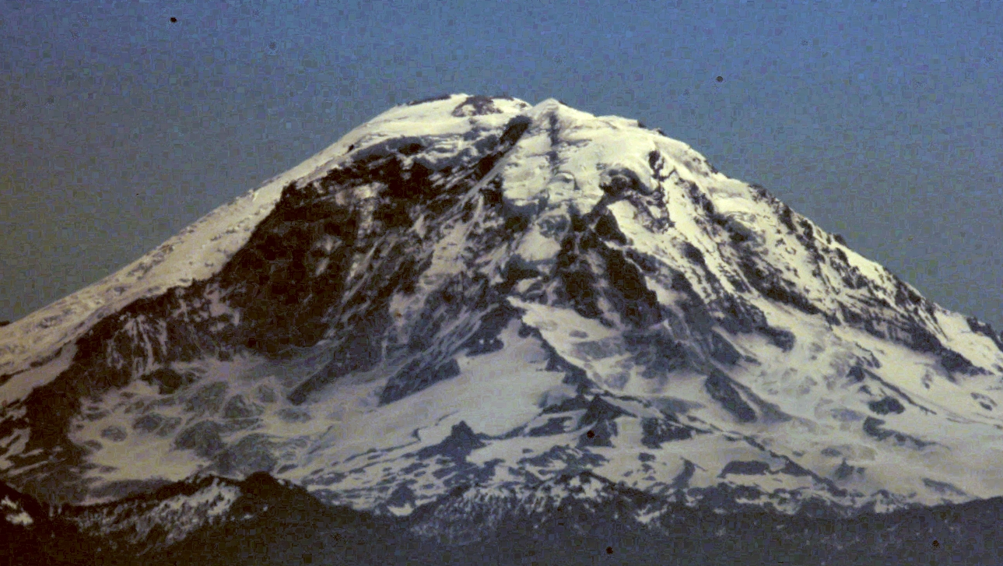

Seeing Mt. Rainier
What if we want to take a picture of Mt. Rainier from Seattle?

Slide 38

Seeing Mt. Rainier
Joshi, N. and Cohen, M. Seeing Mt. Rainier: Lucky Imaging for Multi-Image Denoising, Sharpening, and Haze Removal. IEEE ICCP 2010.

Slide 39
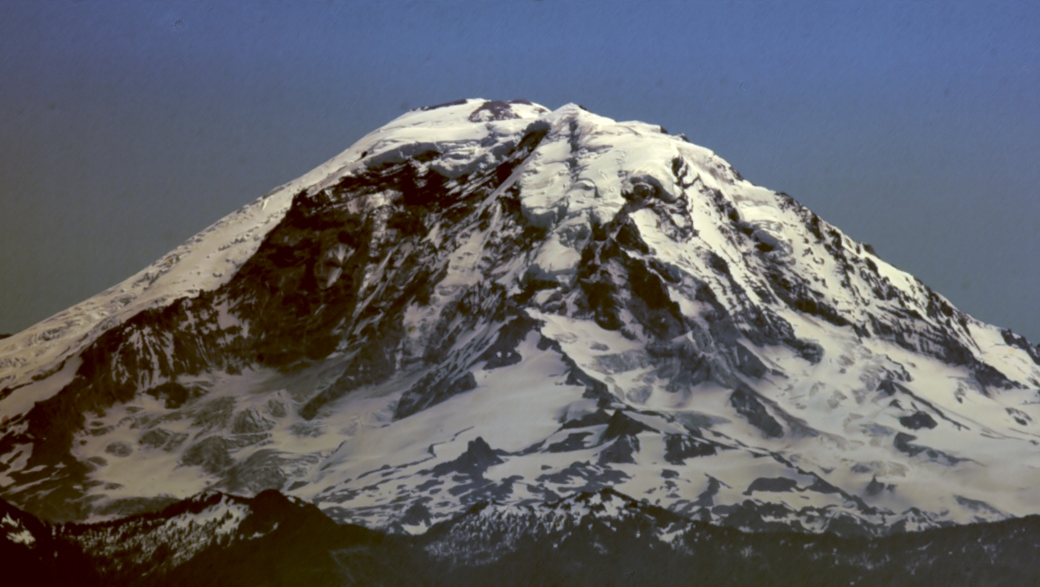
Seeing Mt. Rainier

Slide 40
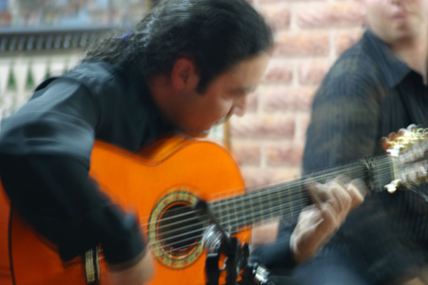
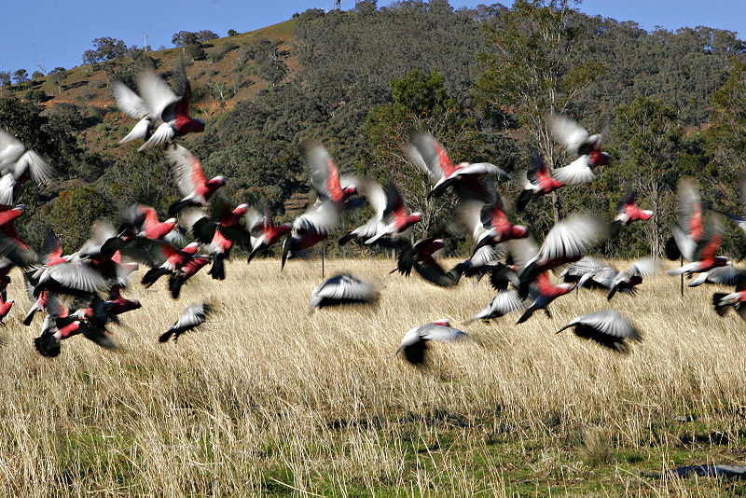
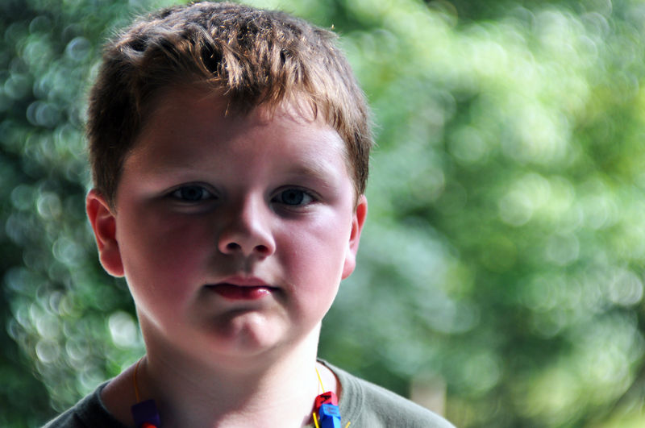
Deblurring
What causes blur?
Depth of field (focus)
Motion
Camera shake

Slide 41
Deblurring
Two main problems:
      What is the blur kernel?
      How do we de-convolve the image?
Chicken and egg problem.

Slide 42
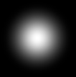
Deblurring
What do blur kernels look like?
Gaussian?

Slide 43
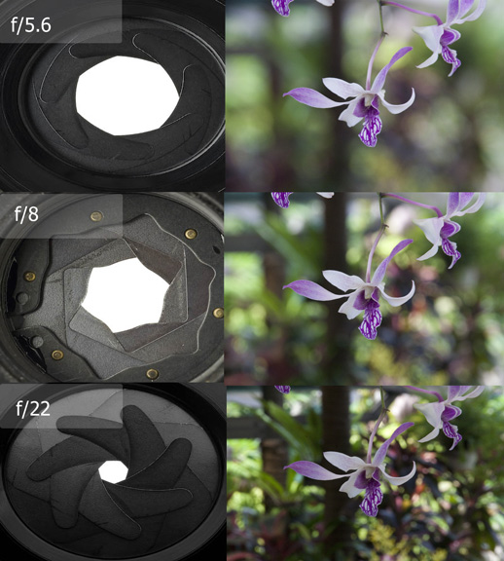
Blur kernel and the aperture
http://www.wildlife-photography-tips.com/examples-of-depth-of-field.html

Slide 44
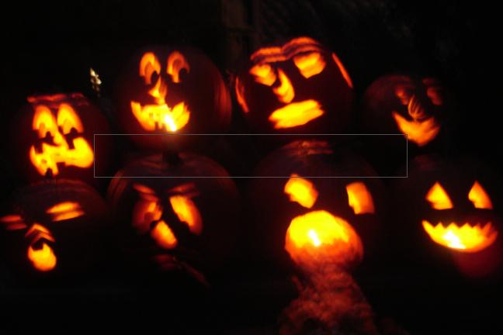
Deblurring
What do blur kernels look like?

Slide 45
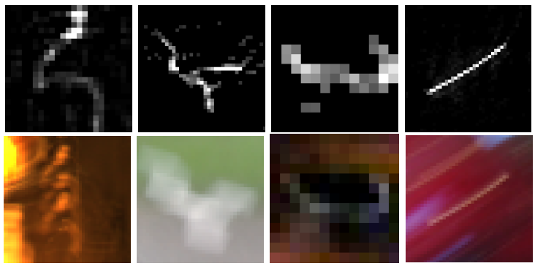
Deblurring
What do blur kernels look like?
R. Fergus, B. Singh, A. Hertzmann, S. Roweis and W. Freeman, Removing Camera Shake From A Single Photograph, SIGGRAPH 2006

Slide 46




Multiple possible solutions
Sharp image
Blur kernel
Original photograph
=
⊗
=
⊗
Blurry image
=
⊗
Slide courtesy of Rob Fergus
Notes:
Difficult image. Lots of saturation. Selected region is the best I could do.

Slide 47

Finding the kernel
Original photograph
Joshi, N., Szeliski, R., and Kriegman, D. PSF Estimation using Sharp Edge Prediction. Proceedings of IEEE CVPR 2008.
Notes:
Difficult image. Lots of saturation. Selected region is the best I could do.

Slide 48


Finding the kernel
Find the kernel that produces images with “natural” image statistics.
Histogram of image gradients
R. Fergus, B. Singh, A. Hertzmann, S. Roweis and W. Freeman, Removing Camera Shake From A Single Photograph, SIGGRAPH 2006
Slide courtesy of Rob Fergus
Notes:
Difficult image. Lots of saturation. Selected region is the best I could do.

Slide 49


Deconvolution
Solve the following:
Blur kernel
Data term:
Sparse gradient prior:

Slide 50
Deblurring: Special hardware
Can we make the deblurring process easier using special hardware?

Slide 51

Image stabilization
Image stabilization can be done using a floating lens.
Vibration is detected using gyroscopic sensors and compensated for.
Mainly on high-end lenses. $$$
Canon EF 300mm

Slide 52

Image stabilization
Image stabilization can be done by moving the sensor.
This “Mechanical image stabilization” also uses gyros to sense motion. Actuators move the sensor.
Cheaper than lens stabilization and any lens may be used.
Pentax K200D
http://en.wikipedia.org/wiki/Image_stabilization

Slide 53

Multiple images
Long exposure/short exposure
YUAN, L., SUN, J., QUAN, L., AND SHUM, H.-Y. Image
deblurring with blurred/noisy image pairs. Siggraph, 2007.

Slide 54
Coded aperture
How can we get rid of depth of field de-focusing?

Slide 55

Levin et al., SIGGRAPH 2007
Notes:
This is made possible with a simple modification to conventional images: inserting into the lens aperture a coded pattern which we cut from a piece of cardboard. A quick assembly manual is: open the lens, place a cardboard mask in the aperture and close it up.

Slide 56























Levin et al., SIGGRAPH 2007

Slide 57

Input

Slide 58

All-focused (deconvolved)
Notes:
Unlike conventional plenoptic cameras, our approach produces images at full resolution, which in this case
exceeds that of the projector, so we need to zoom in to see better.

Slide 59


Close-up
Original image
All-focus image

Slide 60
Motion blur removal
Instead of coding the aperture, code the...

Slide 61

























Shutter is OPEN and CLOSED
Raskar et al.,
SIGGRAPH 2007

Slide 62



Raskar et al.,
SIGGRAPH 2007
License Plate Retrieval
Notes:
License plate example: Blur = 60 pixels

Slide 63

Spatially variant blurs
Why do the blur kernels vary across the image?

Slide 64



Slide 65



Slide 66


Slide 69





6 degrees = many motions
Y
X-translation
Z-translation
Y
Pitch (X-rotation)
Y
Z
X
X
Z
Z
X
Y-translation
Roll (Z-rotation)
Yaw (Y-rotation)
Y
Y
Y
Z
X
X
Z
X
Z
* Also spatially variant due to depth (DoF).

Slide 70

Inertial Measurement Sensors
Image deblurring with inertial measurement sensors, N. Joshi, S.B. Kang, C.L. Zitnick, and R. Szeliski, SIGGRAPH, 2010

Slide 71


Slide 72
Focus
Suppose we want to produce images where the desired object is guaranteed to be in focus?
Or suppose we want everything to be in focus?

Slide 73


Light field camera [Ng et al., 2005]
http://lytro.com/gallery/

Slide 74


Conventional vs. light field camera

Slide 75





Prototype camera
Contax medium format camera
Kodak 16-megapixel sensor
Adaptive Optics microlens array
125μ square-sided microlenses
4000 × 4000 pixels ÷ 292 × 292 lenses = 14 × 14 pixels per lens

Slide 76


Simulating depth of field
Σ
Σ
stopping down aperture = summing only the central portion of each microlens

Slide 77

Digital refocusing
Σ
Σ
refocusing = summing windows extracted from several microlenses

Slide 78





Example of digital refocusing
What is the tradeoff with using microlenses?

Slide 79

High Dynamic Range Images
Slides from Alexei A. Efros
and Paul Debevec
Notes:
http://www.flickr.com/photos/artiephotography/3513060620/

Slide 80





Problem: Dynamic Range
1
The real world is
high dynamic range.
1500
25,000
400,000
2,000,000,000

Slide 81
Long Exposure
10⁻⁶
High dynamic range
10⁶
Real world
10⁻⁶
10⁶
Picture
^{0 to 255}

Slide 82
Short Exposure
10⁻⁶
High dynamic range
10⁶
Real world
10⁻⁶
10⁶
Picture
^{0 to 255}

Slide 83
Camera Calibration
Geometric
  How pixel coordinates relate to directions in the world
Photometric
  How pixel values relate to radiance amounts in the world

Slide 84
The Image Acquisition Pipeline
Lens
Shutter
scene
radiance
(W/sr/m )
sensor
irradiance
∫
sensor
exposure
2
Δt
CCD
ADC
Remapping
analog
voltages
digital
values
pixel
values
Raw
Image
JPEG
Image
Notes:
3

Slide 85
Imaging system response function
255
Pixel
value
0
log Exposure = log (Radiance * Δt)
(CCD photon count)
Notes:
1
is this curve sloped the wrong way? Isn’t more detail given to darker regions? oh no it’s correct because the x axis is log scale.

Slide 86

Varying Exposure
Notes:
memorial church, Stanford.

Slide 87
Shutter Speed
Ranges: Canon D30: 30 to 1/4,000 sec.
Sony VX2000: ¼ to 1/10,000 sec.
Pros:
Directly varies the exposure
Usually accurate and repeatable
Issues:
Noise in long exposures

Slide 88
Shutter Speed
Note: shutter times usually obey a power series – each “stop” is a factor of 2
¼, 1/8, 1/15, 1/30, 1/60, 1/125, 1/250, 1/500, 1/1000 sec
Usually really is:
¼, 1/8, 1/16, 1/32, 1/64, 1/128, 1/256, 1/512, 1/1024 sec

Slide 89
The Algorithm
Image series
• 1
• 1
• 1
• 1
• 1
• 2
• 2
• 2
• 2
•
2
• 3
• 3
• 3
• 3
• 3
Δt =
1/64 sec
Δt =
1/16 sec
Δt =
1/4 sec
Δt =
1 sec
Δt =
4 sec
Pixel Value Z = f(Exposure)
Exposure = Radiance ∗ Δt
log Exposure = log Radiance + log Δt
Notes:
10

Slide 90
Response Curve
Assuming unit radiance
for each pixel
After adjusting radiances to obtain a smooth response curve
3
2
Pixel value
Pixel value
1
ln Exposure
ln Exposure

Slide 91
The Math
Let g(z) be the discrete inverse response function
For each pixel site i in each image j, want:
Solve the overdetermined linear system:
fitting term
smoothness term

Slide 92

Global Operator (Reinhart et al)

Slide 93


Global Operator Results

Slide 94


Reinhart Operator
Darkest 0.1% scaled to display device

Slide 95

Local tone mapping
3 exposures, Keith Moyer

Slide 96

Local tone mapping
“Do it right, it works. Do it wrong, it's brutal.”
Keith Moyer

Slide 97


Tonal Aspects of Look
Ansel Adams
Kenro Izu
Slides courtesy of Sylvain Paris
Notes:
Let us look closely at what we call the tonal aspects of look. We will see that they can be discussed in terms of multiscale contrast.
Let us compare two photos.

Slide 98
Tonal aspects of Look
- Global Contrast
Ansel Adams
Kenro Izu
High Global Contrast
Low Global Contrast
Notes:
First look at the overall contrast.
Ansel Adams’ photo, on the left, has a high global contrast. The rocks and trees are dark, but the sky is bright.
In comparison, Kenro Izu’s photo is gray overall and has a lower global contrast.

Slide 99
Tonal aspects of Look
- Local Contrast
Ansel Adams
Kenro Izu
Variable amount of texture
Texture everywhere
Notes:
Now, consider local contrast.
The photo by Ansel Adams has very textured regions like trees, but it also has smooth regions in the sky.
In comparison, Kenro Izu’s photo exhibits texture everywhere and has a rather uniform amount of local contrast.
We have seen that photographs differ in their global contrast, but also in the variation of their local contrast. This inspires us to transfer tonal aspect of photographic look using a two-scale approach.
Now, let’s have a look at the related work.

Slide 100







Method
Global contrast
Intensity
matching
Bilateral
Filter
Constrained
Poisson
Input
Image
Soft focus
Toning
Grain
Textureness
matching
Local contrast
Result
Notes:
To recap, we transfer the look of the model to the input.
First, we split an input image using bilateral filtering.
Then, we use the base layer and detail layer to manipulate global and local contrast separately.
We recombine two modified layers using constrained Poisson equation.
As a post-processing, we add soft focus, toning, and grain effect.

Slide 101


Input
Model
Result
Notes:
With this input picture, let us transfer the look of Ansel Adams picture.
( with its strong global contrast and variation of local contrast. )
<click>
This is our result. Global contrast has been increased and
details in the leaves, rocks, and clouds have been increased.
Our output would probably not be mistaken for an Ansel Adams picture, but we argue that the tonal look that we achieve has taken the image much closer to the look of Adams. .

Slide 102



Model
Input
Result
Notes:
With this temple photo as an input image, and the model photo by Alfred Stieglitz,
<click>
We can generate an old-looking picture.
( with paper grains and global tonal balance.)
You can see the sky and buildings got the grain effects and global contrast got transferred from the model image.

Slide 103

Professional examples
Who took this photo?

Slide 104

Ansel Adams
Contact print
Final

Slide 105

Dodge and burn
Is this dodging or burning?

Slide 106

Ernst Haas

Slide 107

Ernst Haas

Slide 108

Cassandra Jones
http://www.youtube.com/watch?v=Oyi0lzbDJVc

Slide 109

Peter Funch

Slide 110

Peter Funch

Slide 111

Peter Funch
http://www.peterfunch.com/

Slide 112
Many more possibilities
Seeing through/behind objects
  Using a camera array (“synthetic aperture”)
  Levoy et al., SIGGRAPH 2004
Removing interreflections
  Nayar et al., SIGGRAPH 2006
Family portraits where everyone’s smiling
  Photomontage (Agarwala at al., SIGGRAPH 2004)
…

Slide 113
More on computational photography
SIGGRAPH course notes and video
Other courses
  MIT course
  CMU course
  Stanford course
  Columbia course
Wikipedia page
Symposium on Computational Photography
ICCP 2009 (conference)

