Slide 1
Filtering
CSE P 576
Larry Zitnick (larryz@microsoft.com)

Slide 2
What do computers see?
243 | 239 | 240 | 225 | 206 | 185 | 188 | 218 | 211 | 206 | 216 | 225
242 | 239 | 218 | 110 | 67 | 31 | 34 | 152 | 213 | 206 | 208 | 221
243 | 242 | 123 | 58 | 94 | 82 | 132 | 77 | 108 | 208 | 208 | 215
235 | 217 | 115 | 212 | 243 | 236 | 247 | 139 | 91 | 209 | 208 | 211
233 | 208 | 131 | 222 | 219 | 226 | 196 | 114 | 74 | 208 | 213 | 214
232 | 217 | 131 | 116 | 77 | 150 | 69 | 56 | 52 | 201 | 228 | 223
232 | 232 | 182 | 186 | 184 | 179 | 159 | 123 | 93 | 232 | 235 | 235
232 | 236 | 201 | 154 | 216 | 133 | 129 | 81 | 175 | 252 | 241 | 240
235 | 238 | 230 | 128 | 172 | 138 | 65 | 63 | 234 | 249 | 241 | 245
237 | 236 | 247 | 143 | 59 | 78 | 10 | 94 | 255 | 248 | 247 | 251
234 | 237 | 245 | 193 | 55 | 33 | 115 | 144 | 213 | 255 | 253 | 251
248 | 245 | 161 | 128 | 149 | 109 | 138 | 65 | 47 | 156 | 239 | 255
190 | 107 | 39 | 102 | 94 | 73 | 114 | 58 | 17 | 7 | 51 | 137
23 | 32 | 33 | 148 | 168 | 203 | 179 | 43 | 27 | 17 | 12 | 8
17 | 26 | 12 | 160 | 255 | 255 | 109 | 22 | 26 | 19 | 35 | 24
Images can be viewed as a 2D function.

Slide 3
Image filtering
Linear filtering = Applying a local function to the image using a sum of weighted neighboring pixels.
Such as blurring:
0 | 0 | 0 | 0 | 0 | 0
0 | 0 | 0 | 0 | 0 | 0
0 | 0 | 200 | 0 | 0 | 0
0 | 0 | 0 | 0 | 0 | 0
0 | 0 | 0 | 100 | 0 | 0
0 | 0 | 0 | 0 | 0 | 0
0 | 0 | 0 | 0 | 0 | 0
0 | 22 | 22 | 22 | 0 | 0
0 | 22 | 22 | 22 | 0 | 0
0 | 22 | 33 | 33 | 11 | 0
0 | 0 | 11 | 11 | 11 | 0
0 | 0 | 11 | 11 | 11 | 0
0 | 0 | 0 | 0 | 0
0 | 0.11 | 0.11 | 0.11 | 0
0 | 0.11 | 0.11 | 0.11 | 0
0 | 0.11 | 0.11 | 0.11 | 0
0 | 0 | 0 | 0 | 0
=
*
Input image
Kernel
Output image

Slide 4
Image filtering
Mean filter
0 | 0 | 0 | 0 | 0 | 0
0 | 0 | 0 | 0 | 0 | 0
0 | 0 | 200 | 0 | 0 | 0
0 | 0 | 0 | 0 | 0 | 0
0 | 0 | 0 | 100 | 0 | 0
0 | 0 | 0 | 0 | 0 | 0
0 | 0 | 0 | 0 | 0 | 0
0 | 22 | 22 | 22 | 0 | 0
0 | 22 | 22 | 22 | 0 | 0
0 | 22 | 33 | 33 | 11 | 0
0 | 0 | 11 | 11 | 11 | 0
0 | 0 | 11 | 11 | 11 | 0
0 | 0 | 0 | 0 | 0
0 | 0.11 | 0.11 | 0.11 | 0
0 | 0.11 | 0.11 | 0.11 | 0
0 | 0.11 | 0.11 | 0.11 | 0
0 | 0 | 0 | 0 | 0
=
*
Input image f
Filter h
Output image g

Slide 5
Image filtering
Linear filters can have arbitrary weights.
Typically they sum to 0 or 1, but not always.
Weights may be positive or negative.
Many filters aren’t linear (median filter.)
0 | 0 | 0 | 0 | 0
0 | 0 | 0 | 0 | 0
0 | 0 | 0 | 1 | 0
0 | 0 | 0 | 0 | 0
0 | 0 | 0 | 0 | 0
What does this filter do?

Slide 6
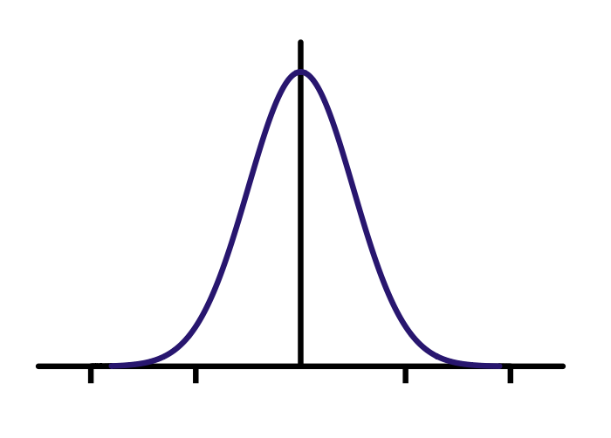
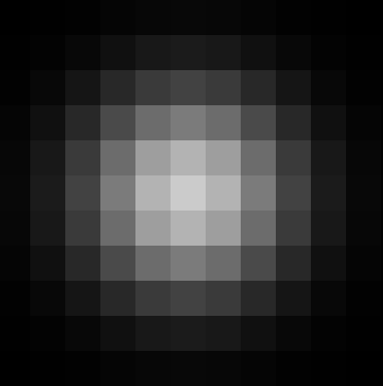
Gaussian filter
Compute empirically
=
*
Filter h
Input image f
Output image g

Slide 7
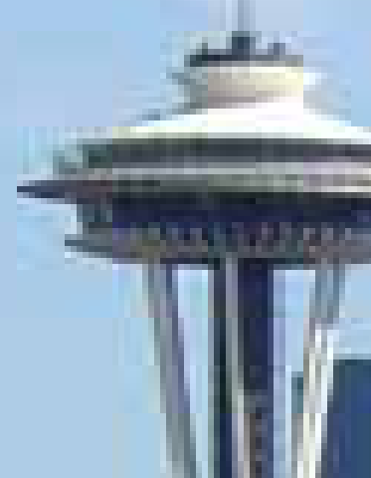
Gaussian vs. mean filters
What does real blur look like?

Slide 8
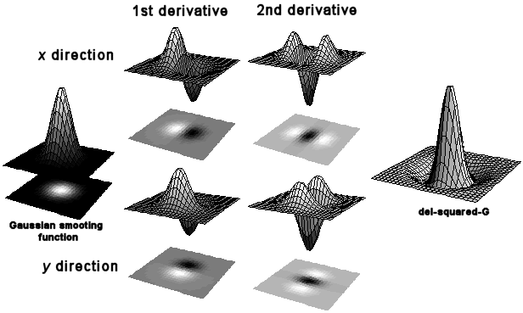
First and second derivatives
=
*

Slide 9
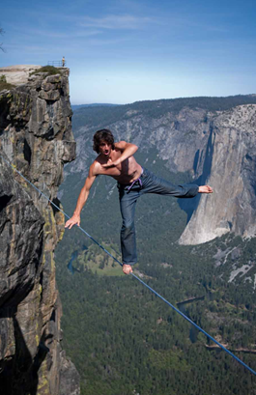
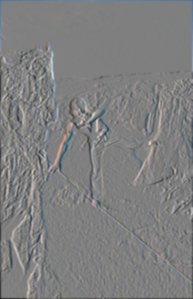
First and second derivatives
What are these good for?
Original
First Derivative x
Second Derivative x, y

Slide 10
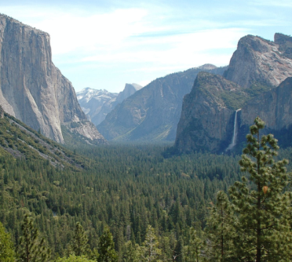
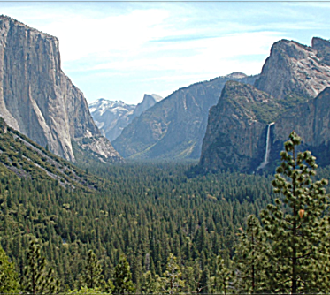
Subtracting filters
Original
Second Derivative
Sharpened

Slide 11
Combining filters
for some
0 | 0 | 0 | 0 | 0
0 | 0 | 0 | 0 | 0
0 | -1 | 0 | 1 | 0
0 | 0 | 0 | 0 | 0
0 | 0 | 0 | 0 | 0
=
*
0 | 0 | 0 | 0 | 0
0 | 0 | -1 | 0 | 0
0 | -1 | 4 | -1 | 0
0 | 0 | -1 | 0 | 0
0 | 0 | 0 | 0 | 0
=
*
It’s also true:

Slide 12
Combining Gaussian filters
=
*
?
More blur than either individually (but less than )

Slide 13
Separable filters
Compute Gaussian in horizontal direction, followed by the vertical direction.
Much faster!
=
*
Not all filters are separable. Freeman and Adelson, 1991

Slide 14
Sums of rectangular regions
How do we compute the sum of the pixels in the red box?
243 | 239 | 240 | 225 | 206 | 185 | 188 | 218 | 211 | 206 | 216 | 225
242 | 239 | 218 | 110 | 67 | 31 | 34 | 152 | 213 | 206 | 208 | 221
243 | 242 | 123 | 58 | 94 | 82 | 132 | 77 | 108 | 208 | 208 | 215
235 | 217 | 115 | 212 | 243 | 236 | 247 | 139 | 91 | 209 | 208 | 211
233 | 208 | 131 | 222 | 219 | 226 | 196 | 114 | 74 | 208 | 213 | 214
232 | 217 | 131 | 116 | 77 | 150 | 69 | 56 | 52 | 201 | 228 | 223
232 | 232 | 182 | 186 | 184 | 179 | 159 | 123 | 93 | 232 | 235 | 235
232 | 236 | 201 | 154 | 216 | 133 | 129 | 81 | 175 | 252 | 241 | 240
235 | 238 | 230 | 128 | 172 | 138 | 65 | 63 | 234 | 249 | 241 | 245
237 | 236 | 247 | 143 | 59 | 78 | 10 | 94 | 255 | 248 | 247 | 251
234 | 237 | 245 | 193 | 55 | 33 | 115 | 144 | 213 | 255 | 253 | 251
248 | 245 | 161 | 128 | 149 | 109 | 138 | 65 | 47 | 156 | 239 | 255
190 | 107 | 39 | 102 | 94 | 73 | 114 | 58 | 17 | 7 | 51 | 137
23 | 32 | 33 | 148 | 168 | 203 | 179 | 43 | 27 | 17 | 12 | 8
17 | 26 | 12 | 160 | 255 | 255 | 109 | 22 | 26 | 19 | 35 | 24
After some pre-computation, this can be done in constant time for any box.
This “trick” is commonly used for computing Haar wavelets (a fundemental building block of many object recognition approaches.)

Slide 15
Sums of rectangular regions
The trick is to compute an “integral image.” Every pixel is the sum of its neighbors to the upper left.
Sequentially compute using:

Slide 16
Sums of rectangular regions
 |  | A |  |  |  |  |  |  | B
 |  | C |  |  |  |  |  |  | D
Solution is found using:
A + D – B - C

Slide 17
Spatially varying filters
Some filters vary spatially.
Durand, 02
Useful for deblurring.

Slide 18
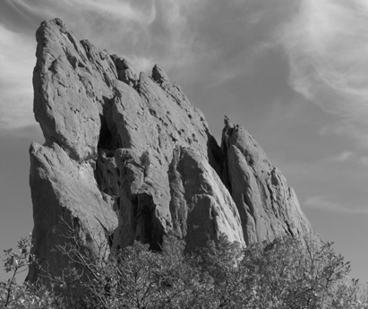
Constant blur
*
input
output
*
*
Same Gaussian kernel everywhere.
Slides courtesy of Sylvian Paris

Slide 19
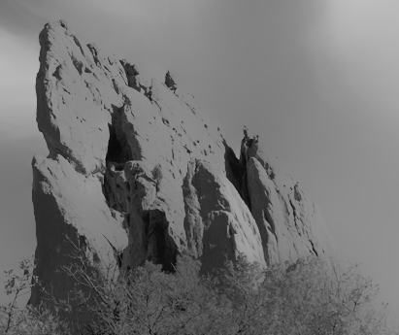
Bilateral filter
Maintains edges when blurring!
*
input
output
*
*
The kernel shape depends on the image content.
Slides courtesy of Sylvian Paris

Slide 20
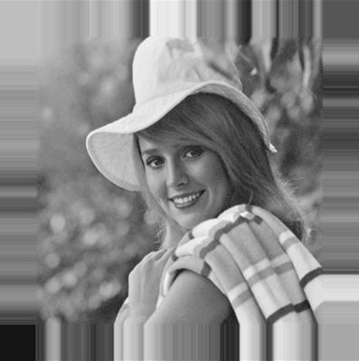
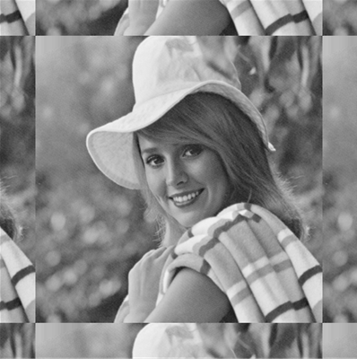
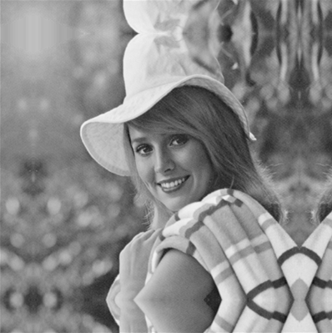
Borders
What to do about image borders:
black
fixed
periodic
reflected

Slide 21
Sampling
CSE P 576
Larry Zitnick (larryz@microsoft.com)

Slide 22
Up-sampling
How do we compute the values of pixels at fractional positions?

Slide 23
Up-sampling
How do we compute the values of pixels at fractional positions?
f (x,y)
f (x+1,y)
Bilinear sampling:
f (x+0.8,y+0.3)
f (x + a, y + b) =
(1 - a)(1 - b) f (x, y) +
a(1 - b) f (x + 1, y) +
(1 - a)b f (x,y + 1) +
ab f (x + 1, y + 1)
f (x,y+1)
f (x+1,y+1)
Bicubic sampling fits a higher order function using a larger area of support.

Slide 24
Up-sampling
Nearest neighbor
Bilinear
Bicubic

Slide 25
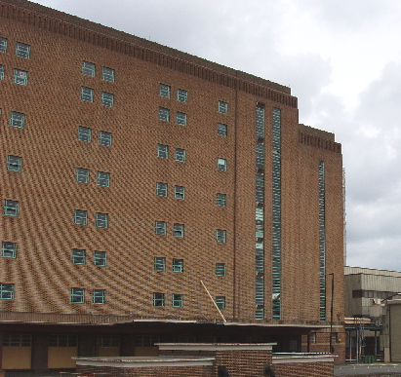
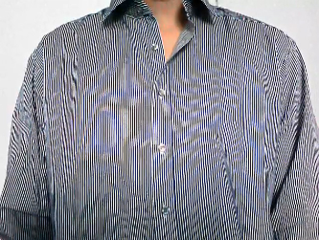
Down-sampling
If you do it incorrectly your images could look like this:
Check out Moire patterns on the web.

Slide 26
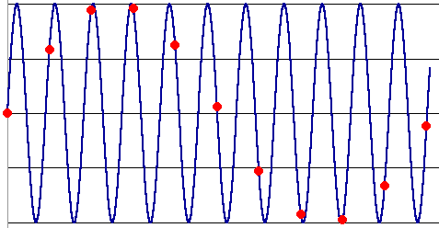
Down-sampling
Aliasing can arise when you sample a continuous signal or image
occurs when your sampling rate is not high enough to capture the amount of detail in your image
Can give you the wrong signal/image—an alias
formally, the image contains structure at different scales
called “frequencies” in the Fourier domain
the sampling rate must be high enough to capture the highest frequency in the image

Slide 27
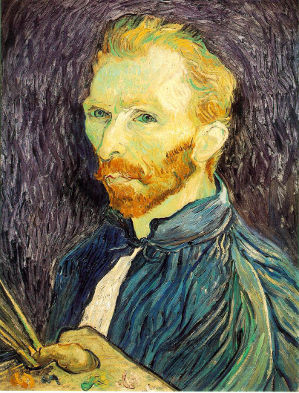
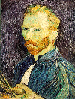
Solution
Filter before sampling, i.e. blur the image first.
With blur
Without blur

