Slide 1
Computer Vision (CSE P 576)
Instructor:
Larry Zitnick (larryz@microsoft.com)
TA:
Dun-Yu Hsiao (dyhsiao@u.washington.edu)
Webpage:
http://www.cs.washington.edu/education/courses/csep576/11sp/

Slide 2
Today
Computer vision overview
Course overview
Image filtering
Image sampling
Edge detection?

Slide 3
What do computers see?
243 | 239 | 240 | 225 | 206 | 185 | 188 | 218 | 211 | 206 | 216 | 225
242 | 239 | 218 | 110 | 67 | 31 | 34 | 152 | 213 | 206 | 208 | 221
243 | 242 | 123 | 58 | 94 | 82 | 132 | 77 | 108 | 208 | 208 | 215
235 | 217 | 115 | 212 | 243 | 236 | 247 | 139 | 91 | 209 | 208 | 211
233 | 208 | 131 | 222 | 219 | 226 | 196 | 114 | 74 | 208 | 213 | 214
232 | 217 | 131 | 116 | 77 | 150 | 69 | 56 | 52 | 201 | 228 | 223
232 | 232 | 182 | 186 | 184 | 179 | 159 | 123 | 93 | 232 | 235 | 235
232 | 236 | 201 | 154 | 216 | 133 | 129 | 81 | 175 | 252 | 241 | 240
235 | 238 | 230 | 128 | 172 | 138 | 65 | 63 | 234 | 249 | 241 | 245
237 | 236 | 247 | 143 | 59 | 78 | 10 | 94 | 255 | 248 | 247 | 251
234 | 237 | 245 | 193 | 55 | 33 | 115 | 144 | 213 | 255 | 253 | 251
248 | 245 | 161 | 128 | 149 | 109 | 138 | 65 | 47 | 156 | 239 | 255
190 | 107 | 39 | 102 | 94 | 73 | 114 | 58 | 17 | 7 | 51 | 137
23 | 32 | 33 | 148 | 168 | 203 | 179 | 43 | 27 | 17 | 12 | 8
17 | 26 | 12 | 160 | 255 | 255 | 109 | 22 | 26 | 19 | 35 | 24

Slide 4
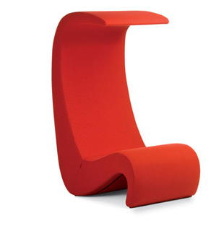
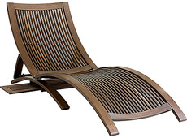
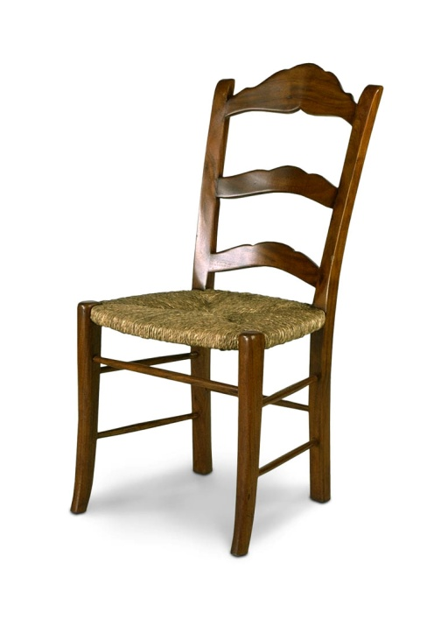
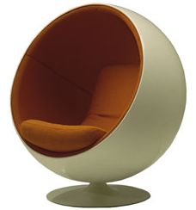
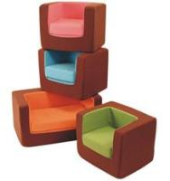
What do humans see?

Slide 5
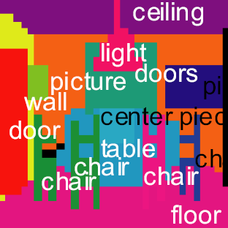
What do humans see?
Torralba et al. PAMI 2008

Slide 6
What do humans see?
chair
light
picture
table setting
Torralba et al. PAMI 2008

Slide 7
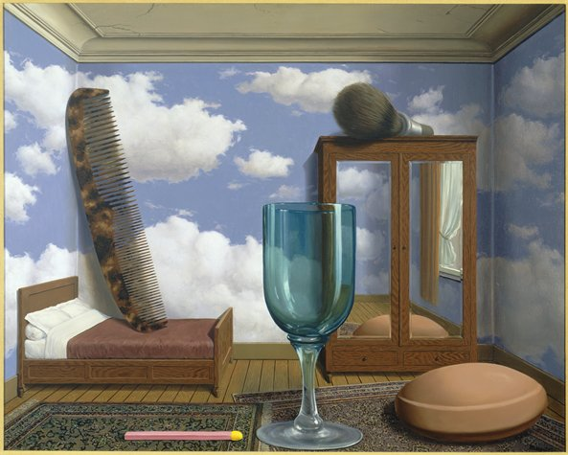
What do humans see?
René Magritte, Les valeurs personnelles, 1952

Slide 8
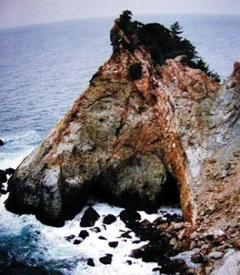
What do humans see?

Slide 9
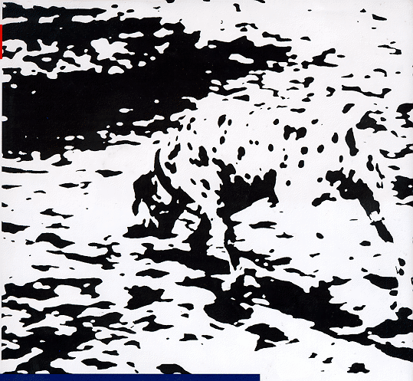
What do humans see?

Slide 10
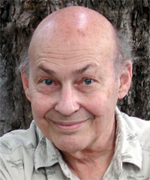
How hard is computer vision?
“In 1966, Minsky hired a first-year undergraduate student and assigned him a problem to solve over the summer: connect a television camera to a computer and get the machine to describe what it sees.”
Crevier 1993, pg. 88
Marvin Minsky, MIT
Turing award,1969

Slide 11
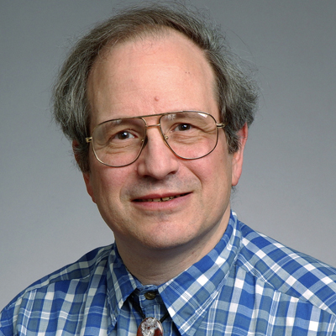
How hard is computer vision?
Marvin Minsky, MIT
Turing award,1969
Gerald Sussman, MIT
“You’ll notice that Sussman never worked in vision again!” – Berthold Horn

Slide 12
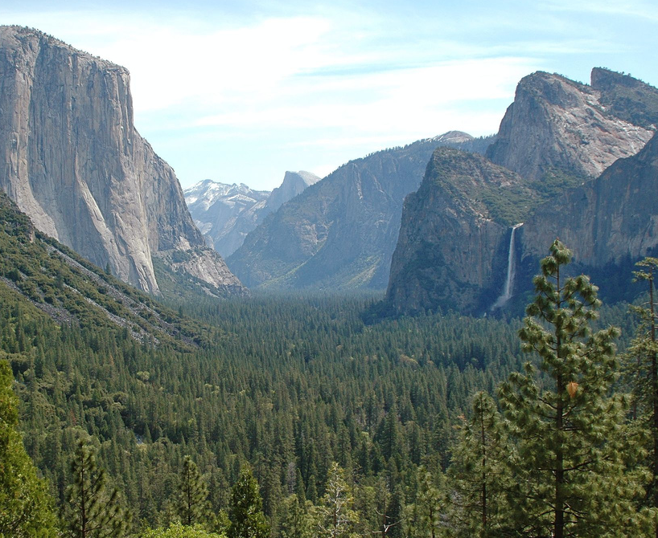
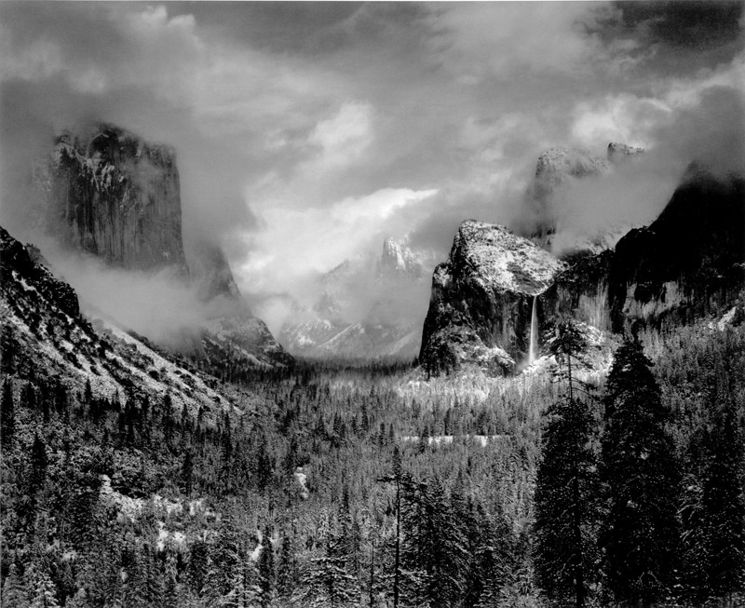
Computational photography
Vs.
Ansel Adams

Slide 13
Computational photography
Agarwala et al., Siggraph 2006

Slide 14
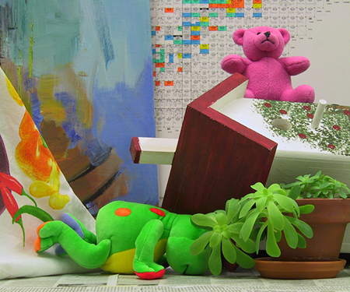
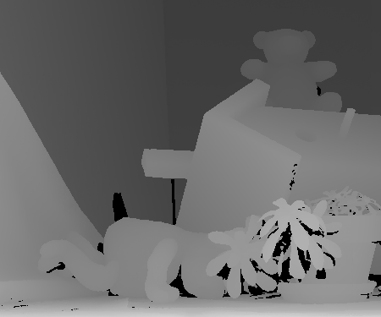
Depth

Slide 15
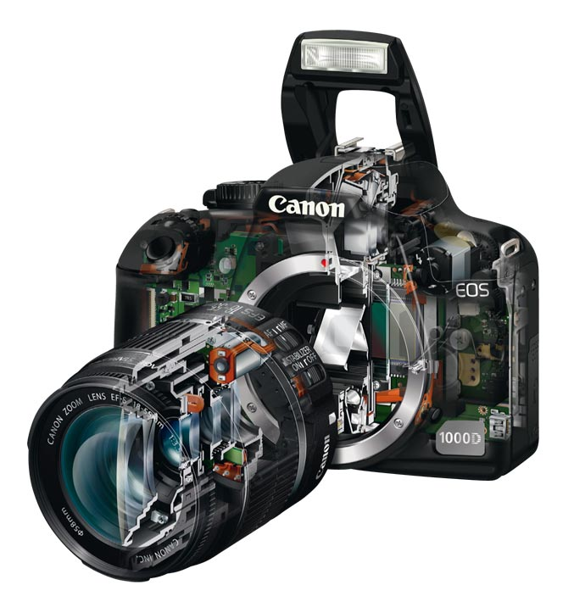
Cameras

Slide 16
Course overview
Emphasis on practical approaches
What is important to industry
Gain intuition
Less emphasis on “academic” problems

Slide 17
Syllabus
Week | Topics | Reading | Assignments
1 March 28 | Introduction Filtering Sampling Edge detection | Filtering: Szeliski (pp. 89-104) Sampling: Szeliski (pp. 127-131) Edge detection: Szeliski (pp. 210-219)
2 April 4 | Geometric transformations Interest point detection Patch descriptors | Geometric transformations: Szeliski (pp. 29-54) Interest points and descriptors: Szeliski (pp. 183-209)
3 April 11 | Image formation Cameras Displays Segmentation
4 April 18 (Rick) | Feature-based alignment Creating panoramas Structure from motion |  | First assignment due: Image filtering and detecting edges.
5 April 25 | Stereo vision Optical flow

Slide 18
Syllabus
Week | Topics | Reading | Assignments
6 May 2 | Computational Photography High dynamic range imaging Super-resolution Alpha matting/compositing Blur removal Poisson blending |  | Second assignment due: Detecting interest points and creating panoramas.
7 May 9 | Image-based rendering 3D reconstruction Structured light Kinect (Part 1)
8 May 16 | Object instance recognition Hashing Face detection |  | Third assignment due: Stereo vision and optical flow.
9 May 23 | Object category recognition
10 May 30 | No classes
11 June 6 | Kinect (Part 2) Advanced topics TBD |  | Fourth assignment due: Face detection

Slide 19
Grading
Four assignments (25% each)
Mix of coding and written answers.
Using Qt (cross platform UI in c++) qt.nokia.com
Use of interactive UIs for exploring and gaining intuition
Filters and edge detection
Creating panoramas
Computing depth from stereo
Face detection

Slide 20
Book (optional)
Good reference for latest works, and basic approaches.
Covers many areas not talked about in class.
Free online.
http://szeliski.org/Book/

