Slide 1
Kinect Case Study
CSE P 576
Larry Zitnick (larryz@microsoft.com)

Slide 2
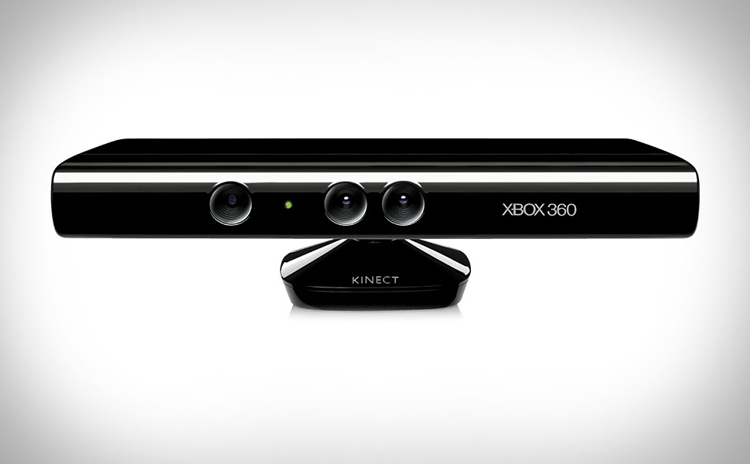

Slide 3
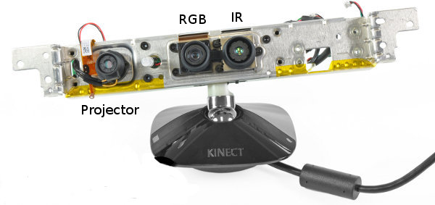
Motorized base

Slide 4
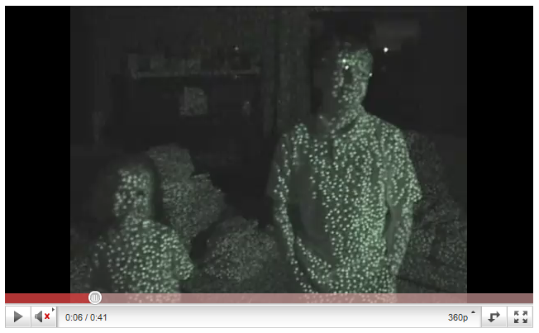
http://www.youtube.com/watch?v=dTKlNGSH9Po&feature=related

Slide 5
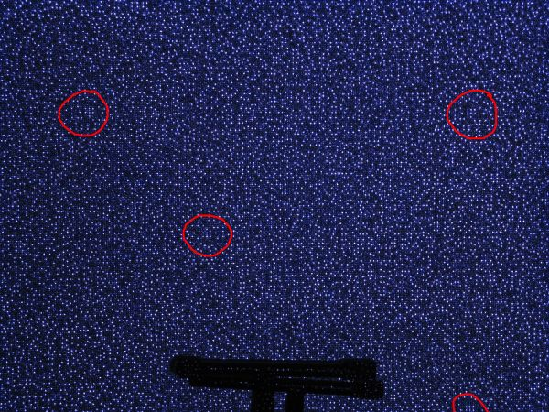

Slide 6
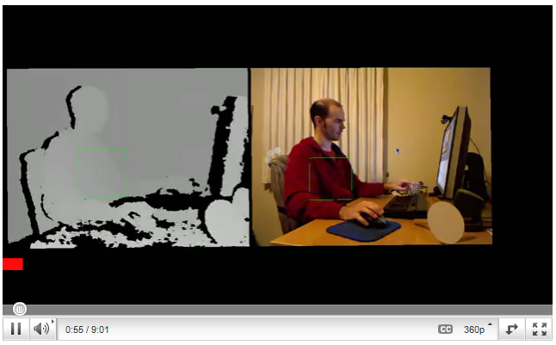
Depth
http://www.youtube.com/watch?v=inim0xWiR0o
http://www.youtube.com/watch?v=7TGF30-5KuQ&feature=related

Slide 7
Questions
Why a dot pattern?
Why a laser?
Why only one IR camera?
Is the dot pattern random?
Why is heat a problem?
How is it calibrated?
Why isn’t depth computed everywhere?
Would it work outside?

Slide 8
Pose recognition
Research in pose recognition has been on going for 20+ years.
Many assumptions: multiple cameras, manual initialization, controlled/simple backgrounds

Slide 9
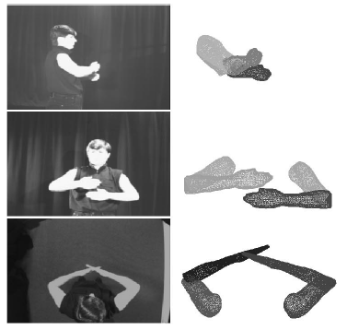
Model-Based Estimation of 3D Human Motion, Ioannis Kakadiaris and Dimitris Metaxas, PAMI 2000

Slide 10
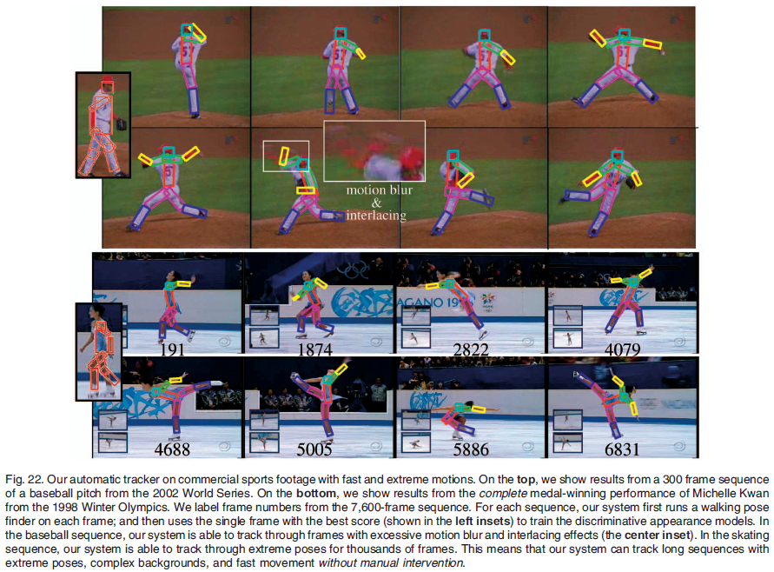
Tracking People by Learning Their Appearance, Deva Ramanan, David A. Forsyth, and Andrew Zisserman, PAMI 2007

Slide 11
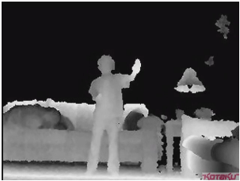
Kinect
Why does depth help?

Slide 12
Algorithm design
Shotton et al. proposed two main steps:
1. Find body parts
2. Compute joint positions.
Real-Time Human Pose Recognition in Parts from Single Depth Images
Jamie Shotton Andrew Fitzgibbon Mat Cook Toby Sharp Mark Finocchio
Richard Moore Alex Kipman Andrew Blake, CVPR 2011

Slide 13
Finding body parts
What should we use for a feature?
What should we use for a classifier?

Slide 14
Finding body parts
What should we use for a feature?
Difference in depth
What should we use for a classifier?
Random Decision Forests

Slide 15
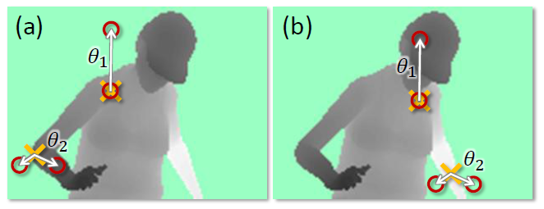
Features

Slide 16
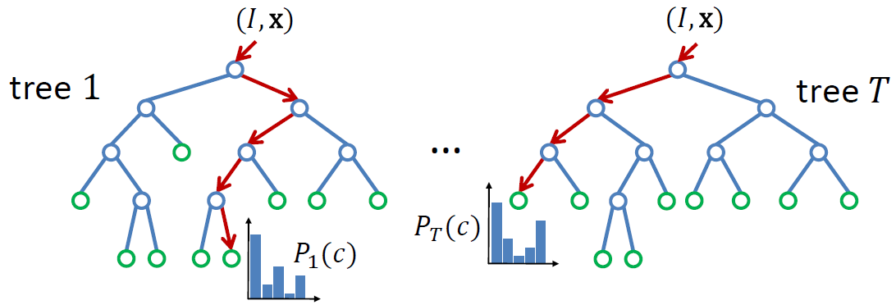
Classification
Learning:
Randomly choose a set of thresholds and features for splits.
Pick the threshold and feature that provide the largest information gain.
Recurse until a certain accuracy is reached or depth is obtained.

Slide 17
Implementation details
3 trees (depth 20) (why so few?)
300k unique training images per tree.
2000 candidate features, and 50 thresholds
One day on 1000 core cluster.
Why RDF and not AdaBoost, SVMs, etc.?

Slide 18
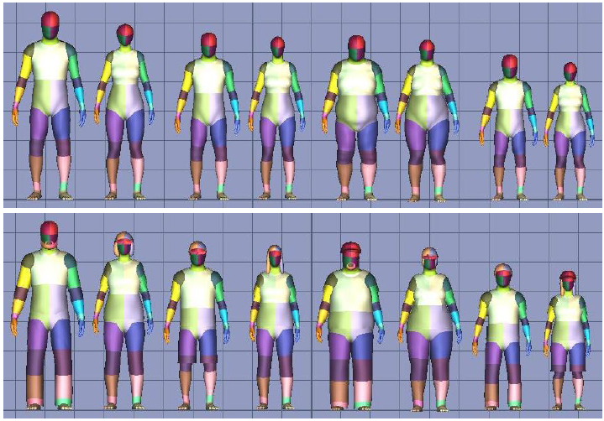
Synthetic data

Slide 19
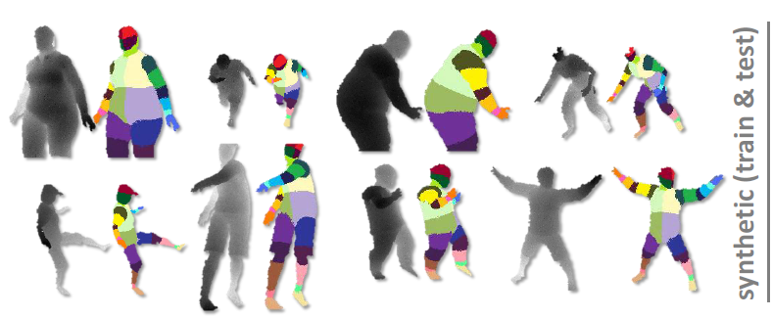
Synthetic training/testing

Slide 20
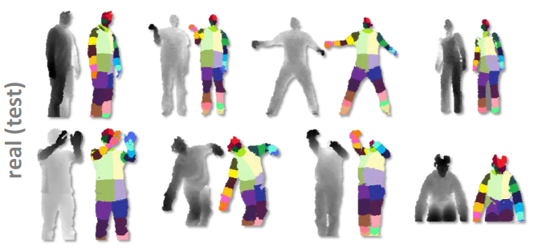
Real test

Slide 21
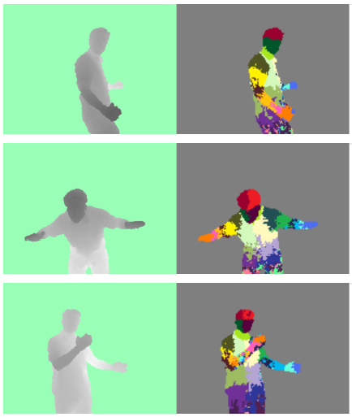
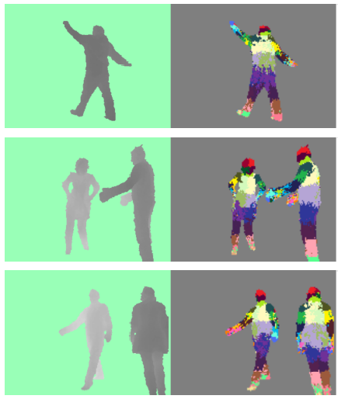
Results

Slide 22
Joint estimation
Apply mean-shift clustering to the labeled pixels. (why mean shift?)
“Push back” each mode to lie at the center of the part.

Slide 23
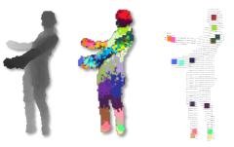
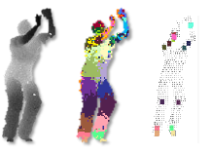
Results

Slide 24
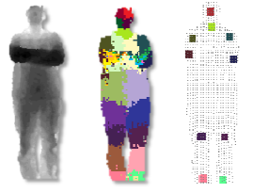
Failures
Why would the system fail?

Slide 25
Video
http://research.microsoft.com/pubs/145347/CVPR%202011%20-%20Final%20Video.mp4
Story about the making of Kinect:
http://www.wired.co.uk/magazine/archive/2010/11/features/the-game-changer

