Slide 1
Large-scale matching
CSE P 576
Larry Zitnick (larryz@microsoft.com)

Slide 2
20,000 images of Rome

Slide 3
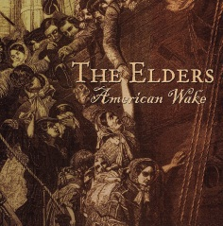
?
=

Slide 4
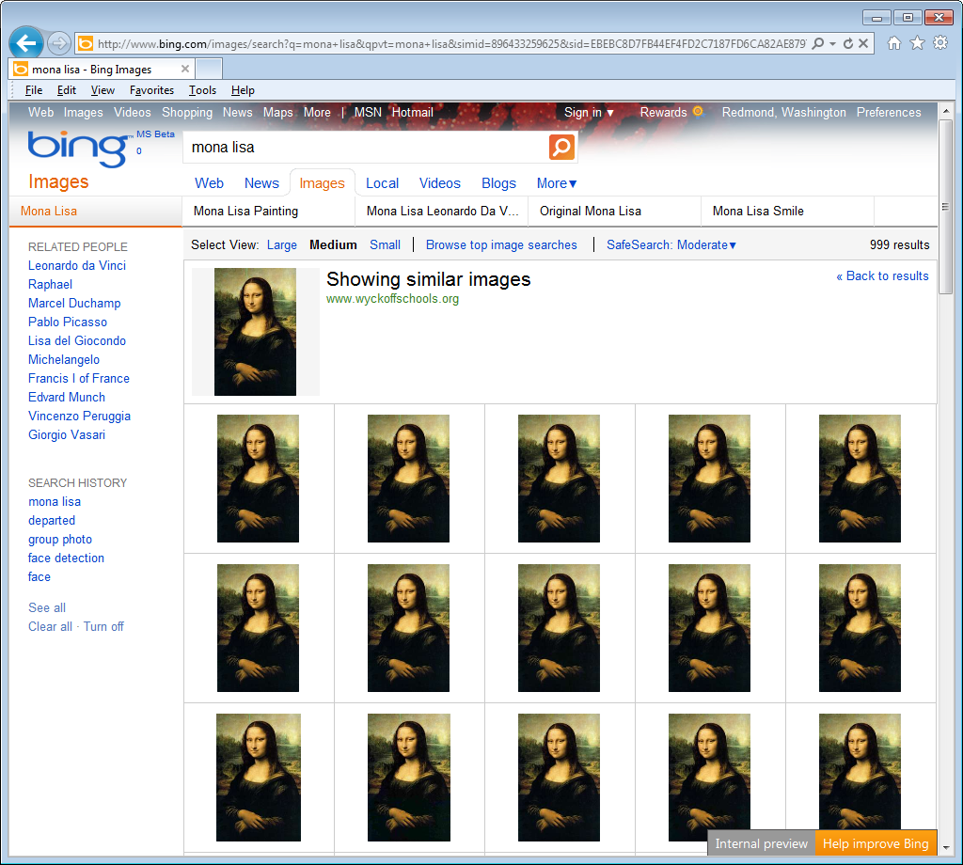
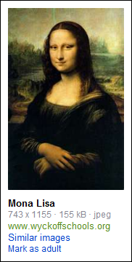

Slide 5
Large scale matching
How do we match millions or billions of images in under a second?
Is it even possible to store the information necessary?
1 image (640x480 jpg) = 100 kb
1 million images = 100 gigabytes
1 billion images = 100 terabytes
100 billion images = 10,000 terabytes (Flickr has 5 billion)

Slide 6
Interest points
Currently, interest point techniques are the main method for scaling to large databases.
Find interest points
Extract patches

Slide 7
Searching interest points
How do we find similar descriptors across images?
Nearest neighbor search:
Linear search:
1 million images x 1,000 descriptors = 1 billion descriptors (Too slow!)
Instead use approximate nearest neighbor:
KD-tree
Locality sensitive hashing

Slide 8
KD-tree
Short for “k-dimensional tree.”
Creates a binary tree that splits the data along one dimension:
X > 0
Y > 0
Y > 1
X > 1

Slide 9
KD-tree
Algorithm for creating tree:
Find dimension with highest variance (sometimes cycle through dimensions).
Split at median.
Recursively repeat steps 1 and 2, until less than “n” data points exist in leaves.
Searching for approximate nearest neighbor:
Traverse down the tree until you reach the leaf node.
Linearly search for nearest neighbor among all data points in leaf node.

Slide 10
Problem:
The nearest neighbor may not be in the “found” leaf:

Slide 11
Backtracking (or priority search)
The nearest neighbor may not be in the “found” leaf:
Backtrack to see if any decision boundaries are closer than your current “nearest neighbor.”
In high dimensional space, the number of “backtracks” are typically limited to a fixed number. The closest decision boundaries are stored and sorted.

Slide 12
High-dimensional space
How far away are two random points on an n-dimensional sphere?
2D
4D
6D
10D
Don’t follow your “2D intuitions”

Slide 13
KD-tree
Other variations:
Use Principal Component Analysis to align the principal axes of the data with the coordinate axes
Use multiple randomized KD-trees (by rotating data points)
Optimised KD-trees for fast image descriptor matching
Chanop Silpa-Anan Richard Hartley, CVPR 2008

Slide 14
Storing the descriptors
Storing the descriptors is expensive:
1000 descriptors x 128 dimensions x 1 byte = 128,000 bytes per image
1 million images = 120 gigabytes

Slide 15
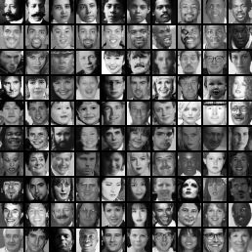
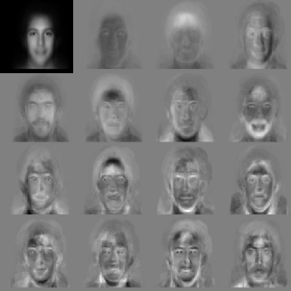
PCA
Reduce the dimensionality of the descriptor using PCA.
Pick the “n” orthogonal dimensions with highest variance.
Eigenvectors of face images
Storing the descriptors is still expensive:
1000 descriptors x 32 dimensions x 1 byte =
32,000 bytes per image
1 million images = 30 gigabytes

Slide 16
Locality sensitive hashing
Assume points are embedded in Euclidean space
How to binarize so Hamming distance approximates Euclidean distance?
Ham_Dist(10001010,11101110)=3
1000 descriptors x 64 dimensions x 1 bit =
8,000 bytes per image
1 million images = 7.5 gigabytes
We’re in RAM!

Slide 17
Finding the binary code
For each bit:
Compute a random unit vector “r”.
For input vector “v”, set the bit equal to:
h(v) = sign(v r)
.
The following holds:
1
0
0
is closely related to cos(θ(u,v)).

Slide 18
P-stable distributions
Projects onto an integer instead of bit:
Compute a random Gaussian vector “a”.
For input vector “v”, set the index equal to:
“b” and “r” are chosen by hand.
Datar, M.; Immorlica, N., Indyk, P., Mirrokni, V.S. (2004). "Locality-Sensitive Hashing Scheme Based on p-Stable Distributions". Proceedings of the Symposium on Computational Geometry.

Slide 19
Other methods
Spectral hashing (uses thresholded eigenvectors) to find binary codes:
.
h(v) = sign(cos(kw v))
“w” is a principal component, “k” is chosen based on data.
Spectral Hashing, Yair Weiss, Antonio Torralba, Rob Fergus, NIPS 2008
Locality-sensitive binary codes:
.
h(v) = sign(cos(kw v))
“w” is a randomly sampled vector, “k” is chosen based on data.
Locality-Sensitive Binary Codes from Shift-Invariant Kernels,
Maxim Raginsky, Svetlana Lazebnik, NIPS 2009

Slide 20
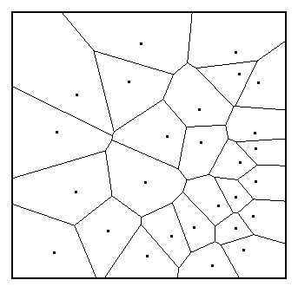
Visual words
What if we just quantize the descriptors to create “visual words.”
Each descriptor = one integer
1000 descriptors x 32 bits =
4,000 bytes per image
1 million images = 3.7 gigabytes
We’re in RAM (on my laptop)!

Slide 21
Inverse lookup table
0 | 3 | 0 | 1 | 1

Slide 22
Creating vocabulary
Naïve method is to use k-means clustering on the descriptors.
But this is slow to assign new descriptors to visual words. Need to match the descriptor to every cluster mean = expensive when the vocabulary has 1,000,000 words.

Slide 23
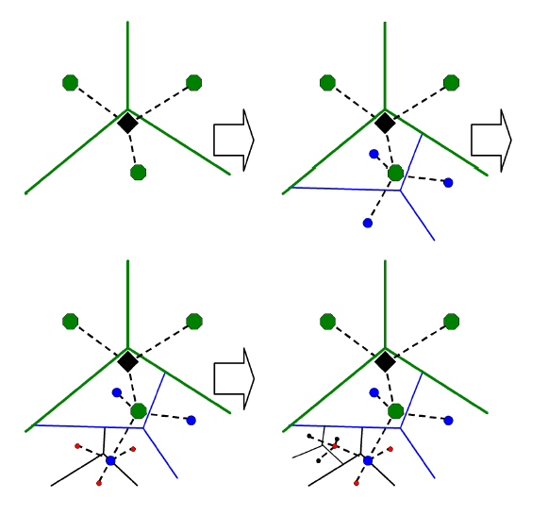
Vocabulary tree
Recursively split descriptor space using k-means, with k ϵ [3,10]
Only need 60 comparisons for k = 10 with 1,000,000 visual words.
Scalable Recognition with a Vocabulary Tree, D. Nister, H. Stewenius, CVPR 2006.

Slide 24
Stop words
If a visual word commonly occurs in many images remove it. You don’t want too many images returned for a single word in the inverse look-up table.
It is common practice to have a few thousand stop words for large vocabulary sizes.
It’s why search engines don’t use the words “a” and “the” in their search queries…

Slide 25
Weighting visual words
Some visual words are more informative than others.
Use TF-IDF weighting. If a visual word occurs frequently in an image but is rare in other images give it a higher weight.
TF (term frequency)
IDF (inverse document frequency)
TF-IDF
Commonly used in many types of document retrieval.

Slide 26
Reducing # of visual words
What if storing a single integer per visual word is too much?
1000 descriptors x 32 bits =
4,000 bytes per image
1 million images = 3.7 gigabytes
How can we reduce the number of visual words?
100 visual words x 32 bits =
400 bytes per image
1 million images = 380 megabytes
We’re in RAM (on smartphone)!

Slide 27
Randomly removing visual words
P(v ϵ I₁, v ϵ I₂) = 0.5
Randomly remove 2/3s of visual words:
P(v ϵ I₁, v ϵ I₂) = 0.5*0.33*0.33 = 0.0555
Image 1
Image 2
Image 1
Image 2
2
21
23
67
105
231
321
363
375
578
586
745
2
32
85
86
35
105
231
321
375
678
743
745
2
67
321
363
85
231
678
743
Not a good idea!

Slide 28
Randomly remove specific visual words
For example: Remove all even visual words.
P(v ϵ I₁, v ϵ I₂) = 0.5
Some images may not have any visual words remaining:
Image 1
Image 2
Image 1
Image 2
2
22
24
63
104
232
325
366
378
578
586
745
2
32
85
86
35
105
231
321
378
678
743
745
63
325
745
85
35
105
231
321
743
745

Slide 29
Min-hash
Maintain Jaccard similarity while keeping a constant number of visual words per image.
Jaccard similarity:
C₁ C₂
0 1
1 0
1 1 sim_{J}(C₁,C₂) = 2/5 = 0.4
0 0
1 1
0 1
*Minhash slides based on material from Rajeev Motwani and Jeff Ullman

Slide 30
Key Observation
For columns C_{i}, C_{j}, four types of rows
C_{i} C_{j}
A 1 1
B 1 0
C 0 1
D 0 0
Overload notation: A = # of rows of type A
Claim

Slide 31
Min Hashing
Randomly permute rows
Hash h(C_{i}) = index of first row with 1 in column C_{i}
Suprising Property
Why?
Both are A/(A+B+C)
Look down columns C_{i}, C_{j} until first non-Type-D row
h(C_{i}) = h(C_{j}) ←→ type A row

Slide 32
Min-Hash Signatures
Pick – P random row permutations
MinHash Signature
sig(C) = list of P indexes of first rows with 1 in column C
Similarity of signatures
Let sim_{H}(sig(C_{i}),sig(C_{j})) = fraction of permutations where MinHash values agree
Observe E[sim_{H}(sig(C_{i}),sig(C_{j}))] = sim_{J}(C_{i},C_{j})

Slide 33
Sketches
What if hashes aren’t unique enough? I.e., we return too many possible matches per hash in an inverse look-up table?
Concatenate the hashes into “sketches” of size “k”.
h₁ = 23, h₂ = 243, h₃ = 598 s₁ = 598,243,023
The probability of two sketches colliding is:
Typically you have to balance the precision/recall tradeoffs when picking the sketch size and number of sketches.

Slide 34
Overview
1 million images 100 GB
1 million images (descriptors) 120 GB
1 million images (descriptors PCA) 30 GB
1 million images (binary descriptors) 7.5 GB
1 million images (visual words) 3.7 GB
1 million images (hashed visual words) 380 MB
10 billion images (hashed visual words) 3.6 TB

