Slide 1
ORT (other random topics)
CSE P 576
Larry Zitnick (larryz@microsoft.com)

Slide 2
Autonomous vehicles
Navlab (1990’s)
Stanley (Offroad, 2004)
Boss (Urban, 2007)

Slide 3

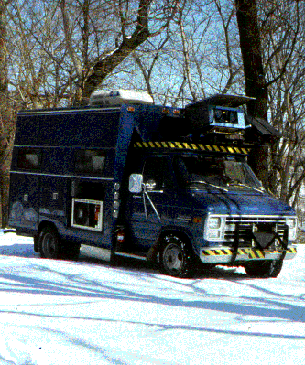
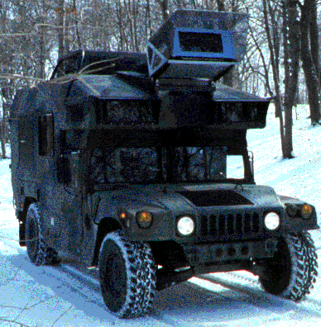
Navlab (1985-2001)
Navlab 1
Navlab 2

Slide 4
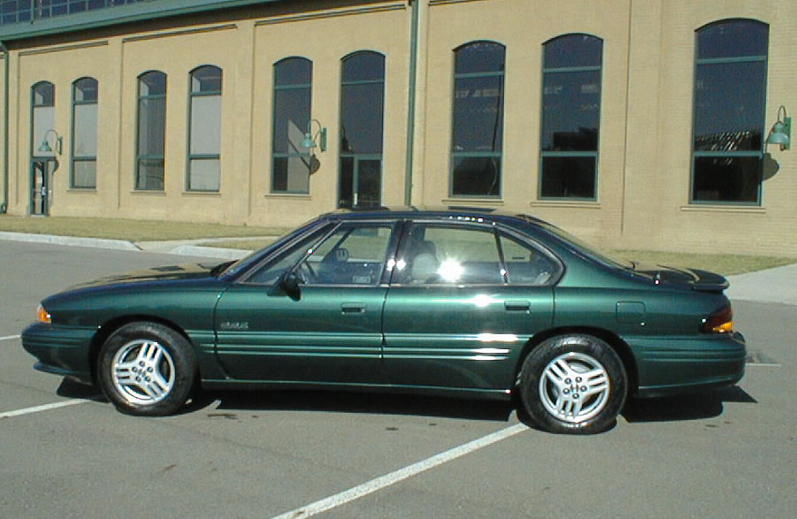
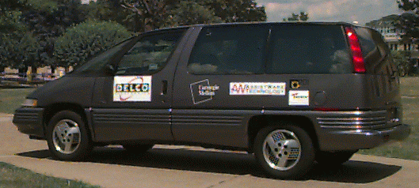
Navlab (1985-2001)
Navlab 5
Navlab 6

Slide 5
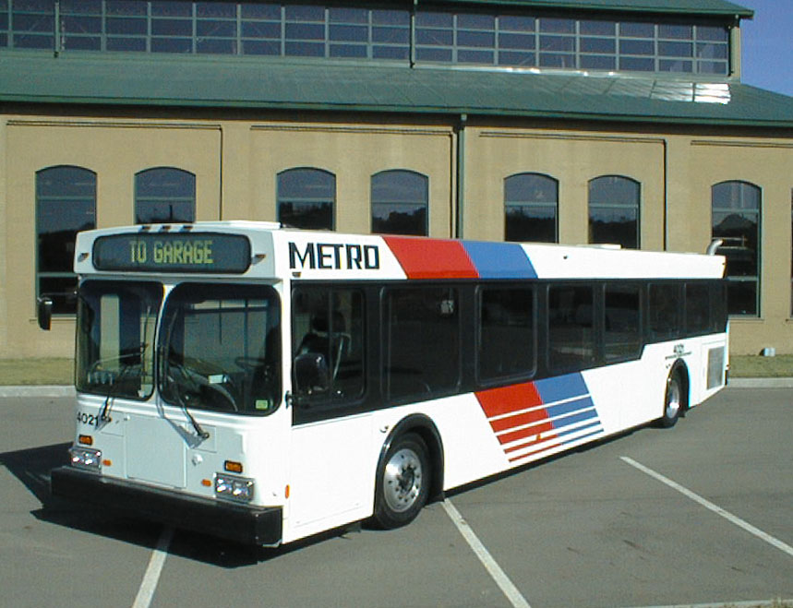
Navlab (1985-2001)
Navlab 10

Slide 6
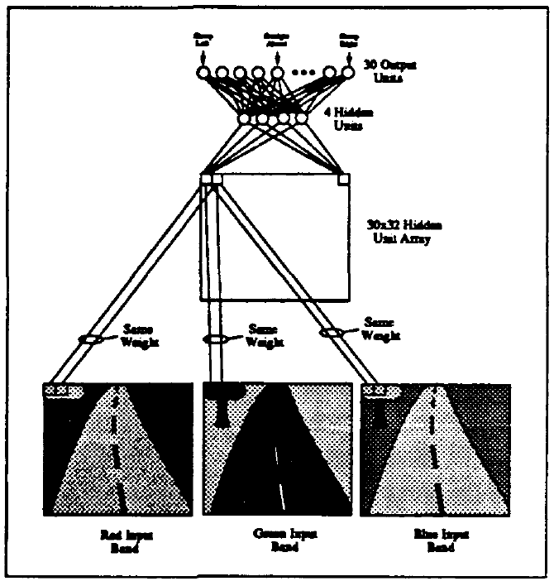
Navlab (1992)
Neural Network Perception for Mobile Robot Guidance, Dean A. Pomerleau, 1992

Slide 7
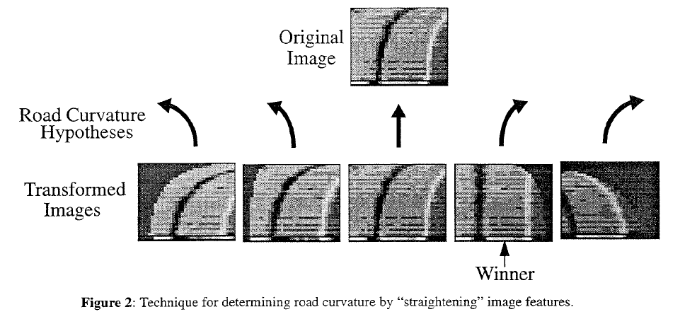
RALPH: Rapidly Adapting Lateral Position Handler, Dean Pomerleau, 1995

Slide 8

No Hands Across America
2797/2849 miles (98.2%)
The researchers handled the throttle and brake.
When did it fail?

Slide 9

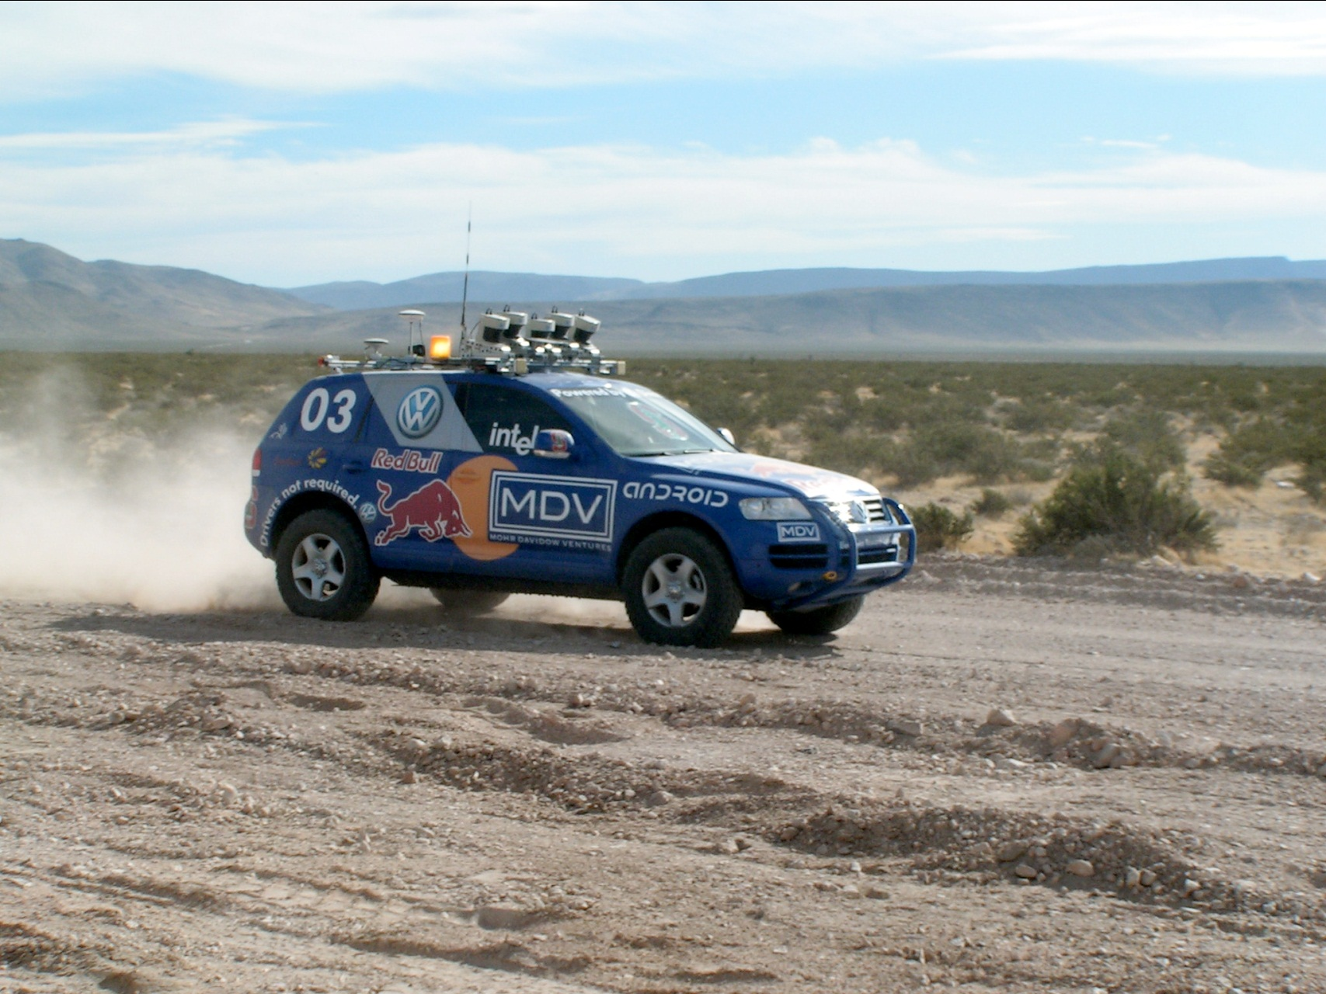
Stanley
Following slides courtesy of Sebastian Thrun

Slide 10
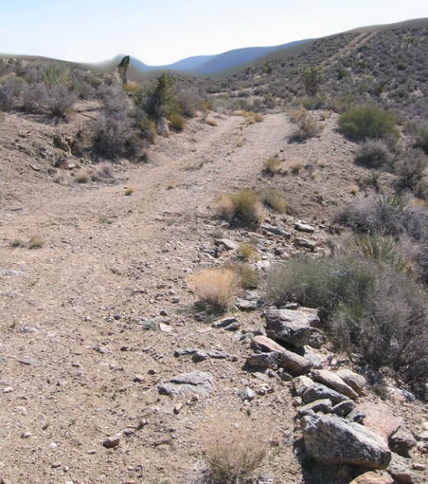
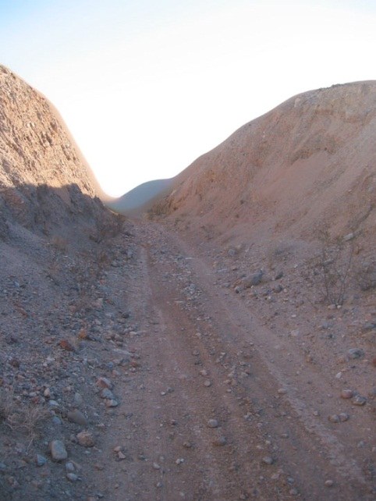
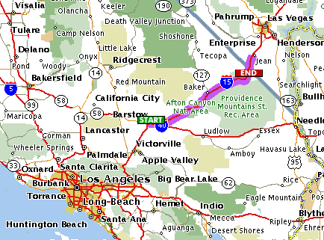
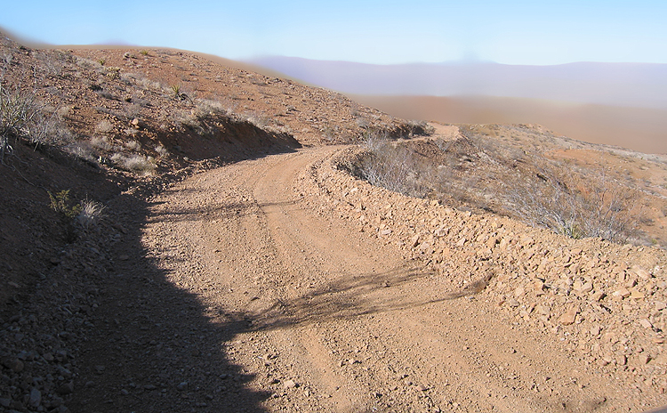
2004: Barstow, CA, to Primm, NV
150 mile off-road robot race across the Mojave desert
Natural and manmade hazards
No driver, no remote control
No dynamic passing
Fastest vehicle wins the race (and 2 million dollar prize)

Slide 11
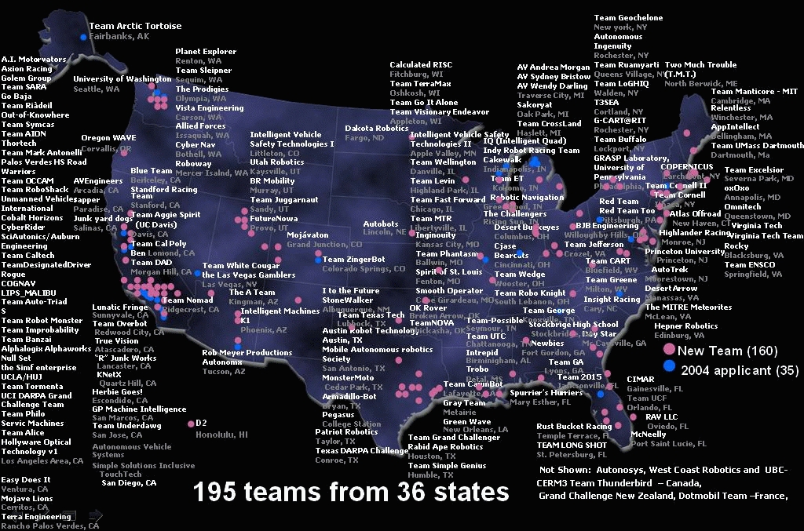
Grand Challenge 2005: 195 Teams

Slide 12
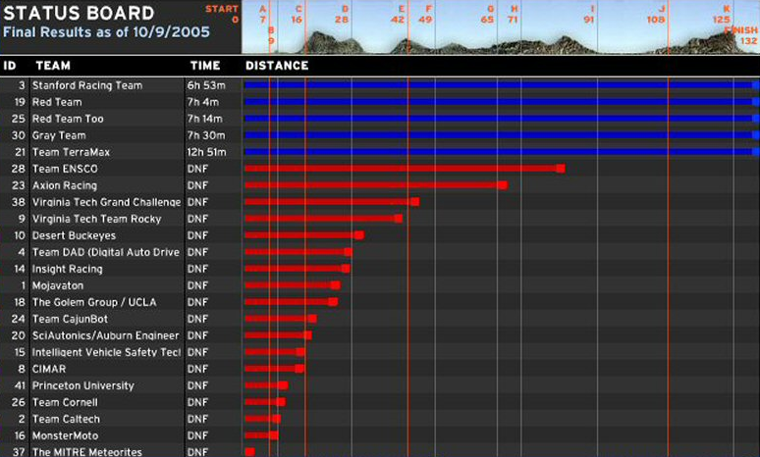
Final Result: Five Robots finished!

Slide 13
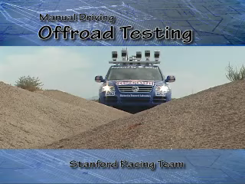
Manual Offroad Driving

Slide 14
Software Architecture

Slide 15
Stanley Software Architecture
SENSOR INTERFACE PERCEPTION PLANNING&CONTROL USER INTERFACE
RDDF database
corridor
Top level control
Touch screen UI
Laser 1 interface
pause/disable command
Wireless E-Stop
Laser 2 interface
RDDF corridor (smoothed and original)
driving mode
Laser 3 interface
Road finder
road center
Path planner
Laser 4 interface
laser map
Laser 5 interface
Laser mapper
map
trajectory
VEHICLE
INTERFACE
Camera interface
Vision mapper
vision map
Radar interface
Radar mapper
obstacle list
Steering control
vehicle state (pose, velocity)
Touareg interface
GPS position
UKF Pose estimation
vehicle
state
Throttle/brake control
Power server interface
GPS compass
vehicle state (pose, velocity)
IMU interface
Surface assessment
velocity limit
Wheel velocity
Brake/steering
heart beats
Linux processes start/stop
emergency stop
Process controller
health status
Health monitor
data
power on/off
GLOBAL
SERVICES
Data logger
File system
Communication requests
Communication channels
clocks
Inter-process communication (IPC) server
Time server

Slide 16
Planning and Steering Control

Slide 17
Low-Level Steering Control
Steering Angle
(with respect to trajectory)
Cross-Track Error
Velocity
Planer Output

Slide 18
Discuss Kalman Filter
To the whiteboard…

Slide 19
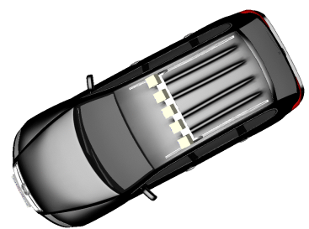
Parameterizing Search Space
Road boundary
Lateral offset

Slide 20
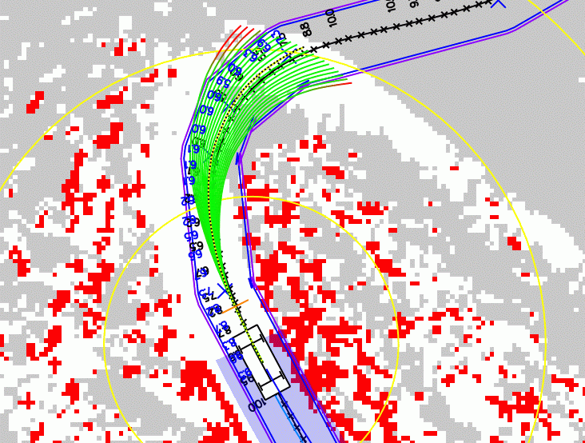
Planning = Rolling out Trajectories

Slide 21
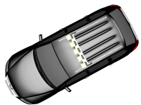

Lateral Offset Profiles
Swerves
  step changes in desired lateral offset
  avoidance of frontal obstacles
Nudges
  ramp changes in desired lateral offset
  Road centering
time
time

Slide 22
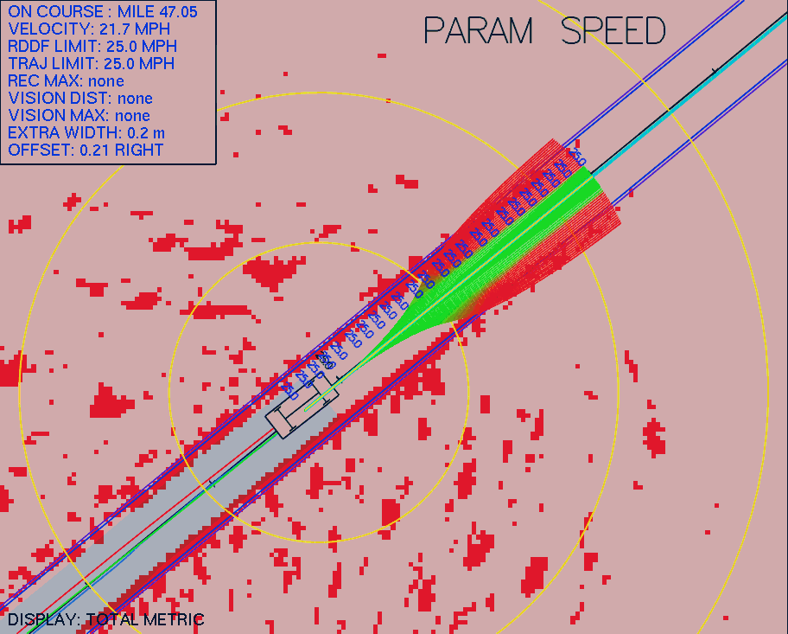
Smooth Driving at 25mph

Slide 23
Laser Terrain Mapping

Slide 24
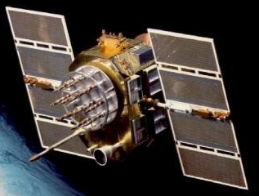
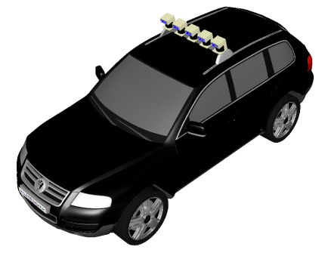

UKF Position Estimation

Slide 25
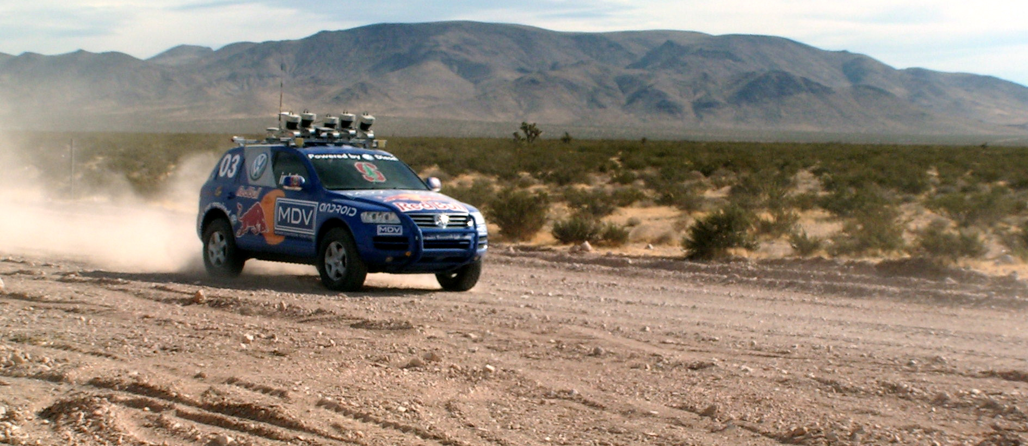
Laser Range Data Integration

Slide 26
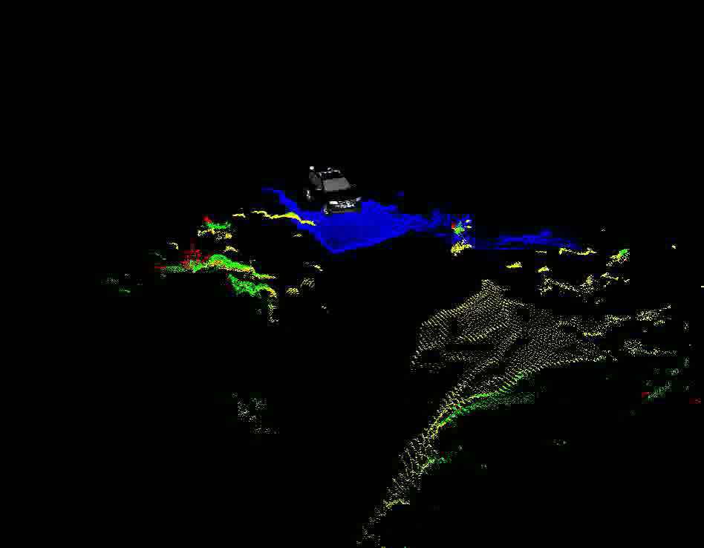

Slide 27
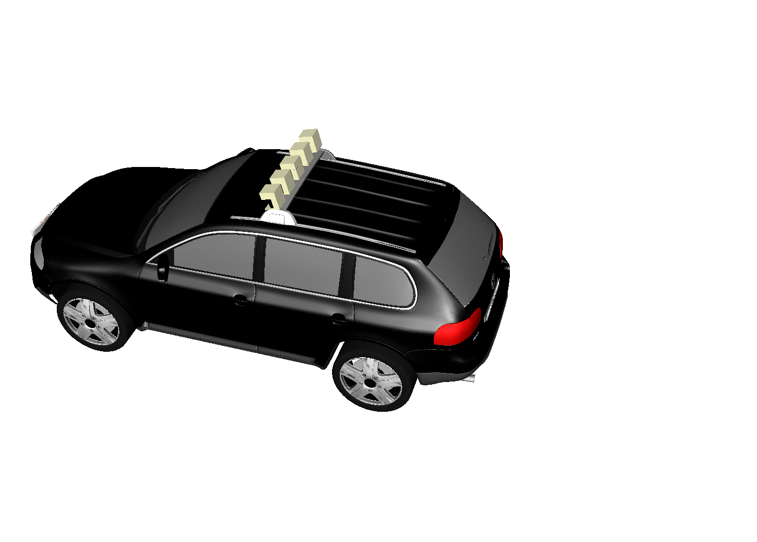
Range Sensor Interpretation
3
2
1

Slide 28
Obstacle Detection
ΔZ

Slide 29
Effect of Pitching
4
3
1
2

Slide 30
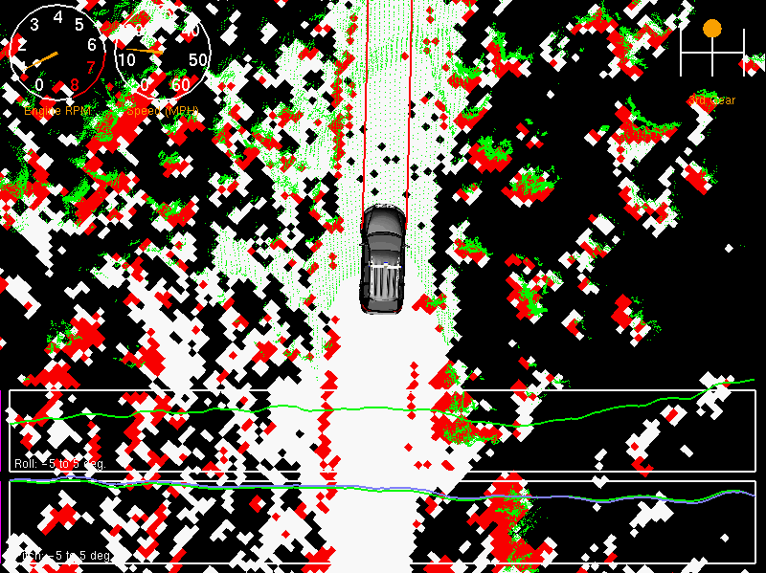
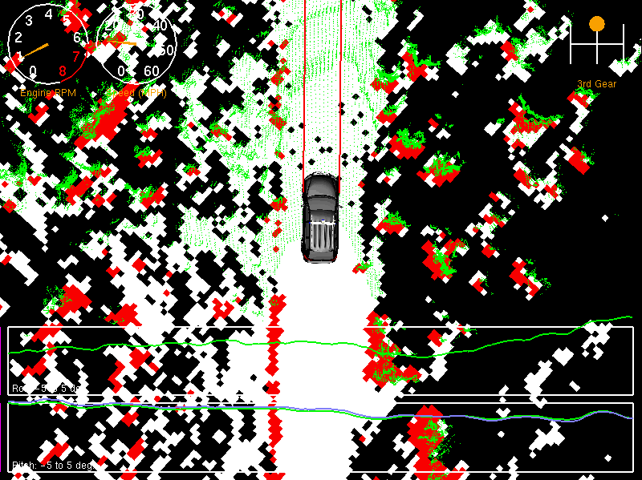
Stanley….After Learning
Without Learning: 12.6% false positives
With Learning: 0.02% false positives

Slide 31
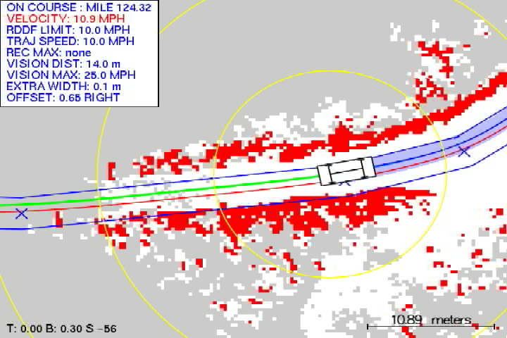
Driving Beer Bottle Pass: Laser

Slide 32
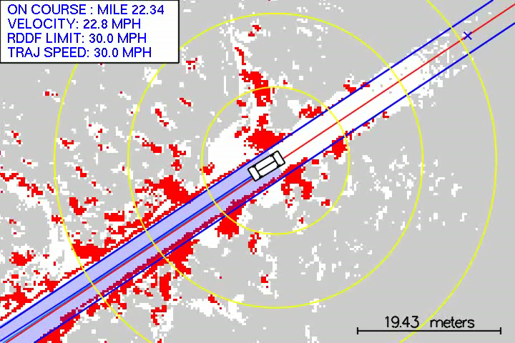
Stanley Problems at Mile 22.34
Cause: Delay of laser data by 500 msec. Hard drive problem? Linux problem?

Slide 33
Computer Vision Terrain Mapping

Slide 34
Limits of lasers
Lasers see 22m = 25mph
They needed to go 35mph to finish the race.

Slide 35
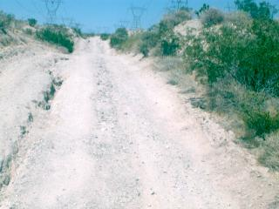
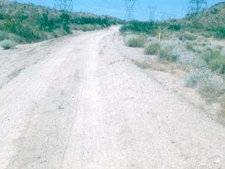
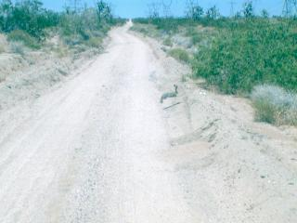
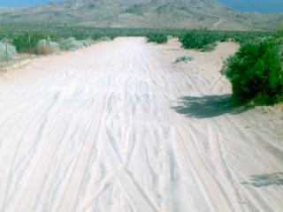
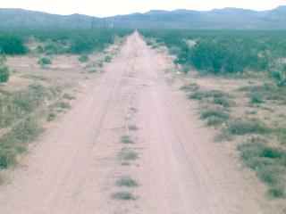
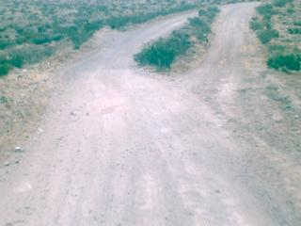
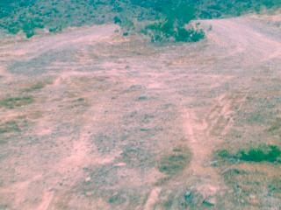
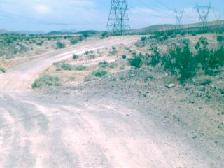
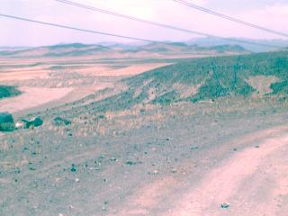
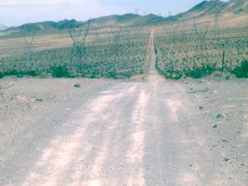
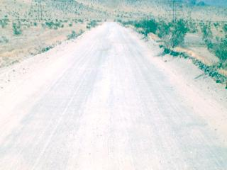
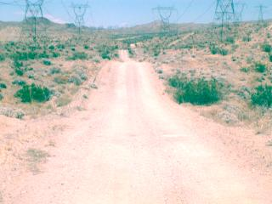
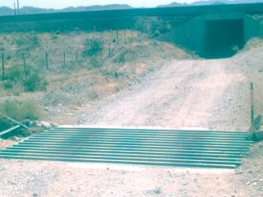
What Defines A Road?

Slide 36
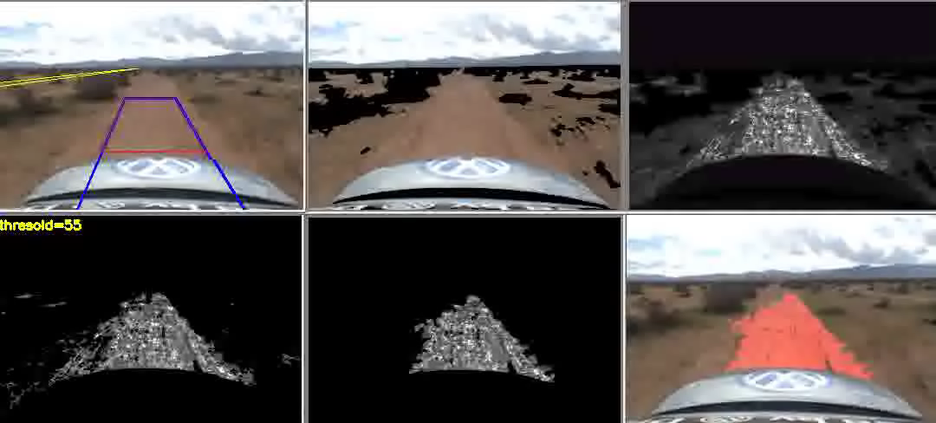
Idea: Continual Terrain Adaptation
Fast adaptation: Mean & covariance of Gaussian, exponential forgetting
Slow learning: memory of k past Gaussians

Slide 37
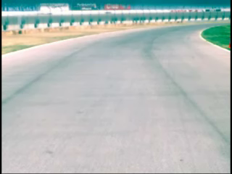
Adaptive Vision In Action (NQE)

Slide 38
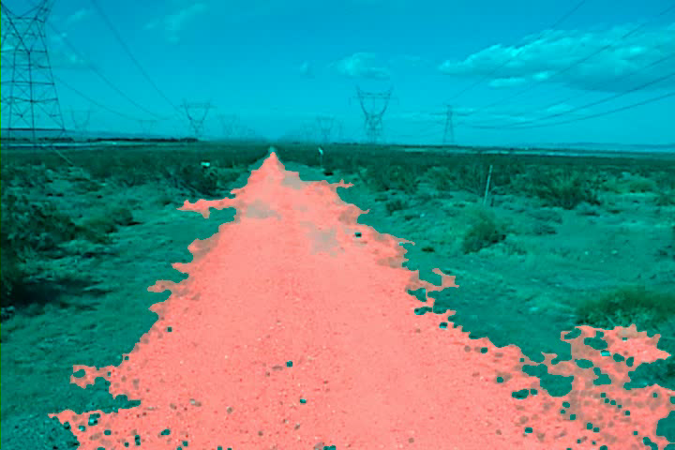
Adaptive Vision in Mojave Desert

Slide 39
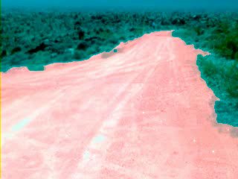
Driving Beer Bottle Pass: Vision

Slide 40
Speed Control

Slide 41
Speed Controllers
DARPA Speed Limit
DARPA Speed Limit
Curvature
Curvature
Vehicle pitch/roll
Velocity
Controller
Vehicle pitch/roll
Obstacles Clearance
Obstacles Clearance
Vertical acceleration
Vertical acceleration
target velocity
target velocity
Throttle
Throttle &
Brake
Controller
Brake pressure
Throttle, Brake
Forward velocity

Slide 42
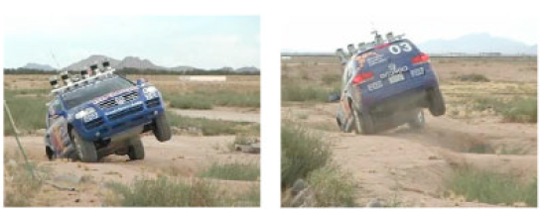
Controlling speed
If you hit a bump, slow down (that first pothole really hurts…)
If you haven’t hit a bump in awhile linearly increase speed.
Slow down on hills.

Slide 43
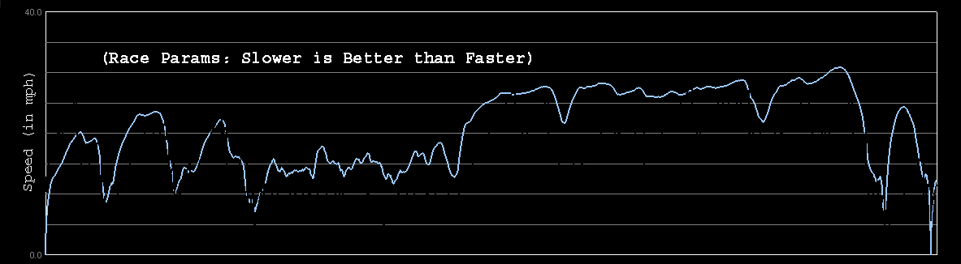
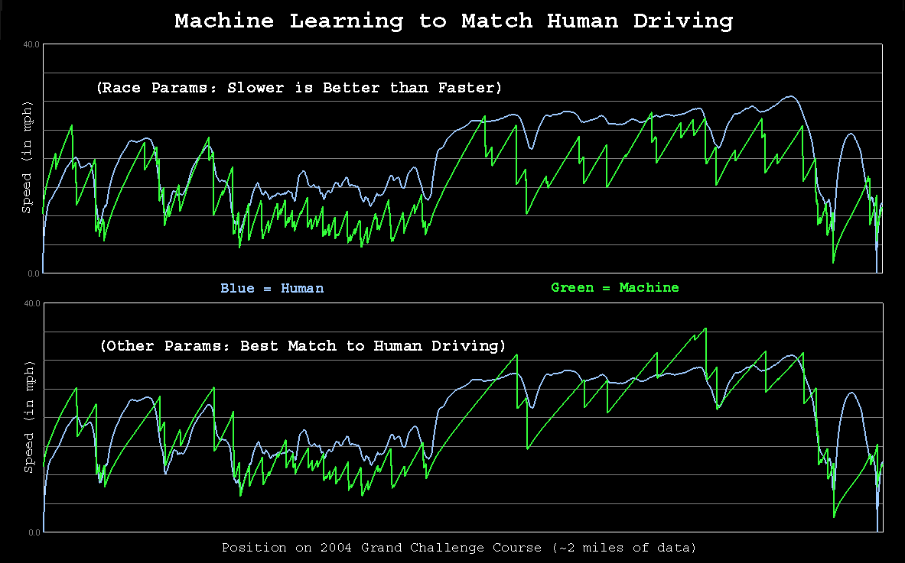
How Fast Do Humans Drive

Slide 44
Learning To Drive Like a Person
Sebastian
Stanley

Slide 45
More info
For full detail read the paper:
Stanley: The Robot that Won the DARPA Grand Challenge, Sebastian et al., Journal of Field Robotics, 2006

Slide 46
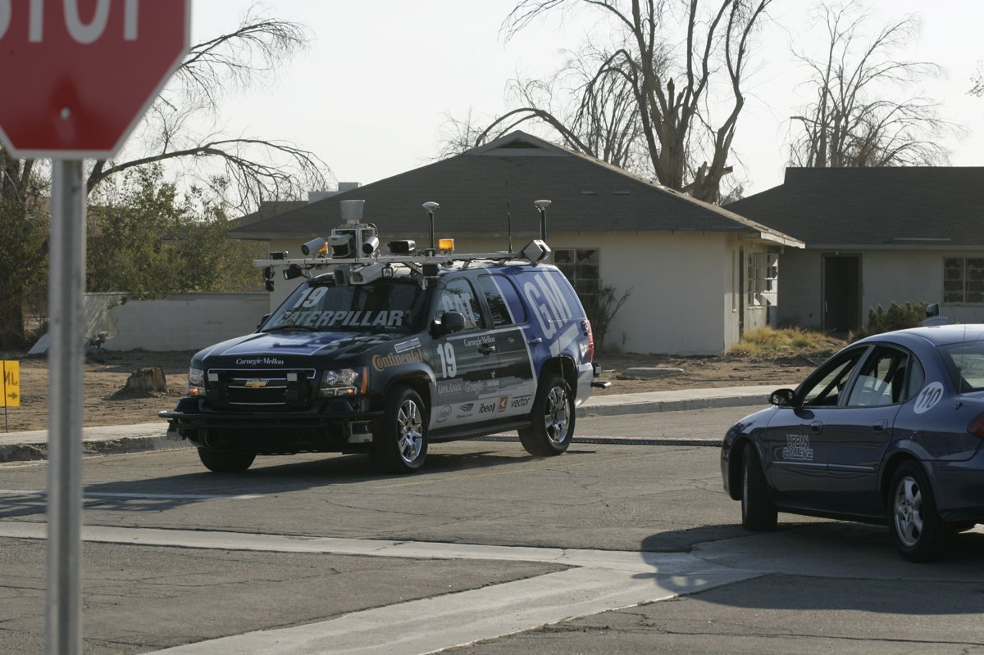
Boss
http://www.tartanracing.org/blog/index.html#22

Slide 47
DARPA Urban Challenge
36 teams invited to National Qualification Event.
11 teams invited to Urban Challenge Final Event
Suddenly, the vehicle did a U-turn and headed directly at Tether’s vehicle. “Five of us in the vehicle were all yelling ‘pause!’” Tether recalled, referring to the pause command that DARPA could send to a vehicle.
http://www.tartanracing.org/blog/index.html#22

Slide 48
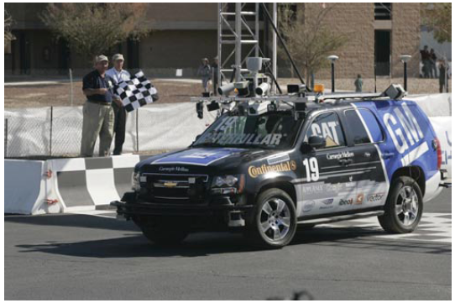
Boss
2007 Chevrolet Tahoe
CompactPCI chassis with 10 2.16-GHz Core2Duo processors, each with 2 GB of memory

Slide 49


Slide 50
Motion planning
Structured driving (road following)
Unstructured driving (maneuvering in parking lots)

Slide 51


Slide 52


Slide 53
Where am I?
GPS + inertial + wheel encoder = 0.1m, but if you go under a tree you loose the signal. 30 minutes to reacquire.
Lane markers are found using SICK lasers.

Slide 54

Particle Filters
Particle filter slides courtesy of Sebastian Thrun

Slide 55


Sensor Information: Importance Sampling

Slide 56


Robot Motion

Slide 57

Sensor Information: Importance Sampling

Slide 58


Robot Motion

Slide 59


Slide 60


Slide 61


Slide 62


Slide 63


Slide 64


Slide 65


Slide 66

Road estimation

Slide 67



Slide 68

Failures

Slide 69

Failures

Slide 70

Failures

Slide 71

Failures

Slide 72
More info
Autonomous Driving in Urban Environments: Boss and the Urban Challenge, Urmson et al., Journal of Field Robotics, 2008

Slide 73

A Fast Approximation of the Bilateral Filter using a Signal Processing Approach
Sylvain Paris and Frédo Durand
Computer Science and Artificial Intelligence Laboratory
Massachusetts Institute of Technology

Slide 74



Link with Linear Filtering
Introducing a Convolution
space: 1D Gaussian
× range: 1D Gaussian
combination: 2D Gaussian
p
q
space
range

Slide 75
Link with Linear Filtering
Introducing a Convolution
space: 1D Gaussian
× range: 1D Gaussian
combination: 2D Gaussian
p
q
space x range
Corresponds to a 3D Gaussian on a 2D image.

Slide 76


Link with Linear Filtering
Introducing a Convolution
sum all values
black = zero
space-range Gaussian
sum all values multiplied by kernel ⇨ convolution

Slide 77

Link with Linear Filtering
Introducing a Convolution
result of the convolution
space-range Gaussian

Slide 78

Link with Linear Filtering
Introducing a Convolution
result of the convolution
space-range Gaussian

Slide 79





higher dimensional functions
w i
w
Gaussian convolution
division
slicing

Slide 80
higher dimensional functions
w i
w
Low-pass filter
Gaussian convolution
Almost only
low freq.
High freq.
negligible
division
slicing

Slide 81




higher dimensional functions
w i
w
D O W N S A M P L E
Gaussian convolution
Almost no
information
loss
U P S A M P L E
division
slicing

Slide 82


Accuracy versus Running Time
Finer sampling increases accuracy.
More precise than previous work.
PSNR as function of Running Time
Digital
photograph
1200 × 1600
finer sampling
Straightforward implementation is over 10 minutes.

Slide 83






Visual Results
Comparison with previous work [Durand 02]
  running time = 1s for both techniques
1200 × 1600
input
exact BF
our result
prev. work
difference
with exact
computation
(intensities in [0:1])
0.1
0

Slide 84

More advanced approaches:
http://graphics.stanford.edu/papers/gkdtrees/
http://graphics.stanford.edu/papers/permutohedral/

