Slide 1
Object recognition (part 1)
CSE P 576
Larry Zitnick (larryz@microsoft.com)

Slide 2
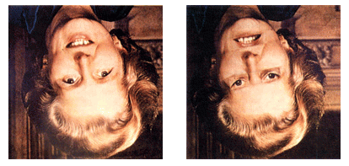
Recognition
The “Margaret Thatcher Illusion”, by Peter Thompson
Readings
  Szeliski Chapter 14

Slide 3
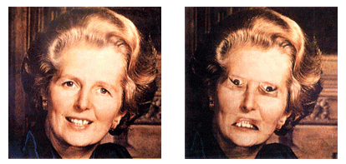
Recognition
The “Margaret Thatcher Illusion”, by Peter Thompson
Readings
  Szeliski Chapter 14

Slide 4
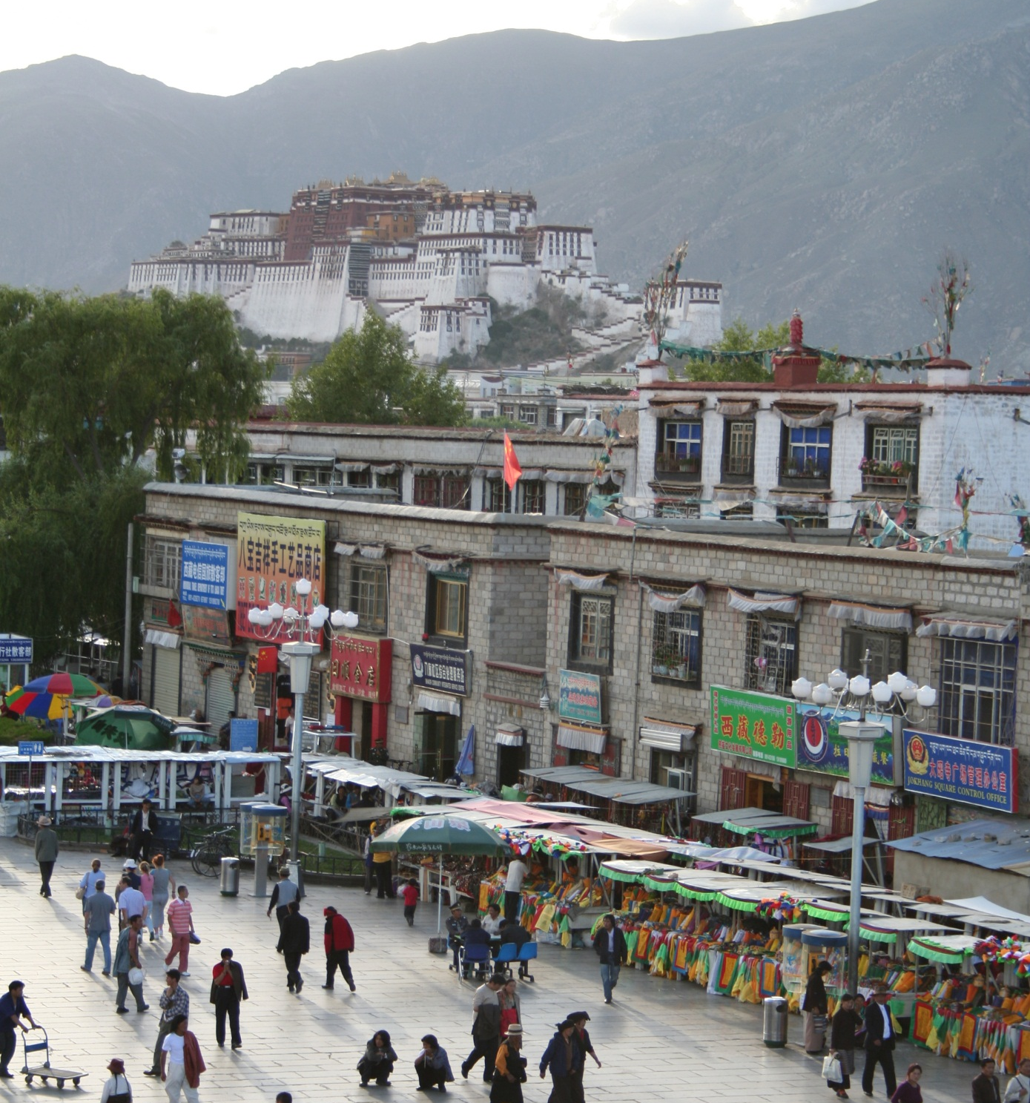
What do we mean by “object recognition”?
Next 15 slides adapted from
Li, Fergus, & Torralba’s excellent short course on category and object recognition

Slide 5
Verification: is that a lamp?

Slide 6
Detection: are there people?

Slide 7
Identification: is that Potala Palace?

Slide 8
Object categorization
mountain
tree
building
banner
street lamp
vendor
people

Slide 9
Scene and context categorization
outdoor
city
…

Slide 10
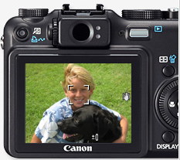
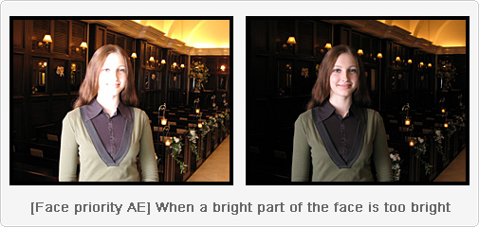
Applications: Computational photography

Slide 11
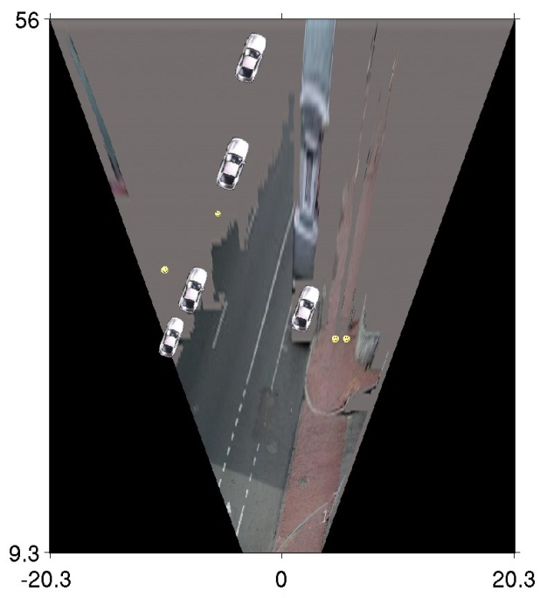
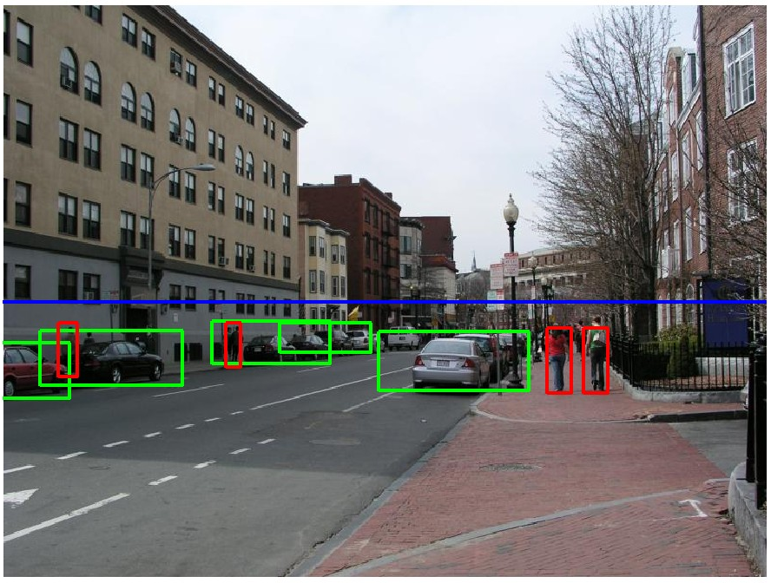
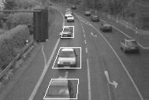
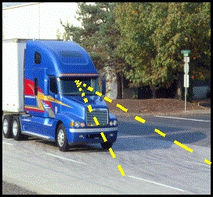
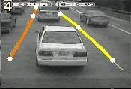
Applications: Assisted driving
Pedestrian and car detection
meters
Ped
Ped
Car
meters
Lane detection
Collision warning systems with adaptive cruise control,
Lane departure warning systems,
Rear object detection systems,

Slide 12
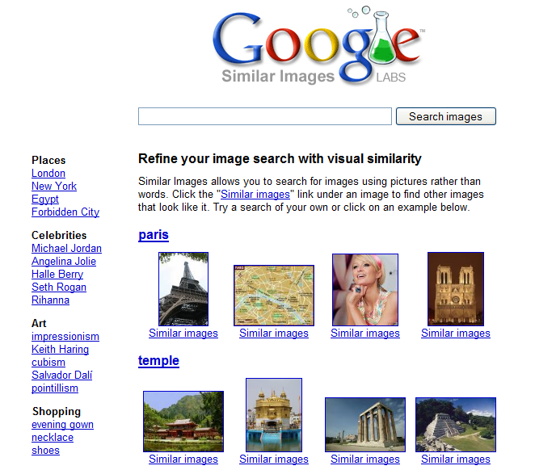
Applications: image search

Slide 13
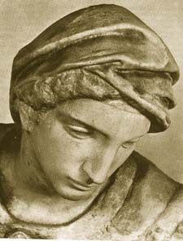
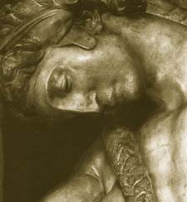
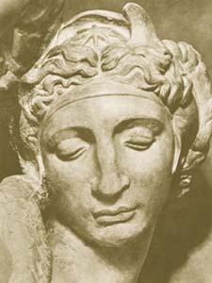
Challenges: viewpoint variation
Michelangelo 1475-1564

Slide 14
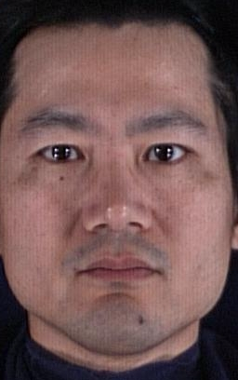
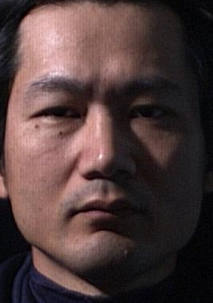
Challenges: illumination variation
slide credit: S. Ullman

Slide 15
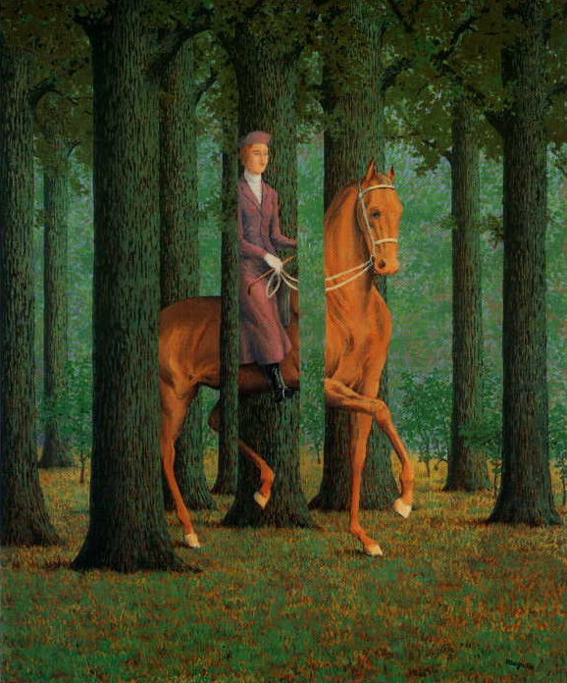
Challenges: occlusion
Magritte, 1957

Slide 16
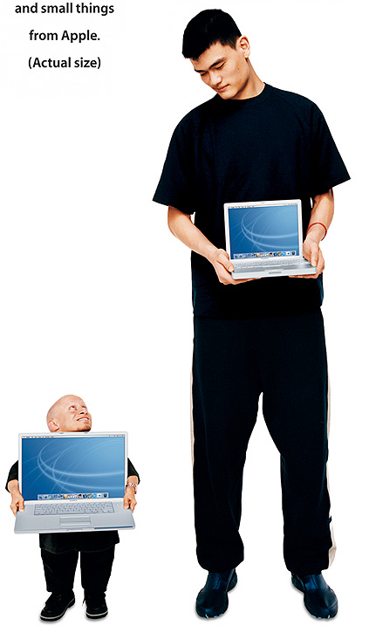
Challenges: scale

Slide 17
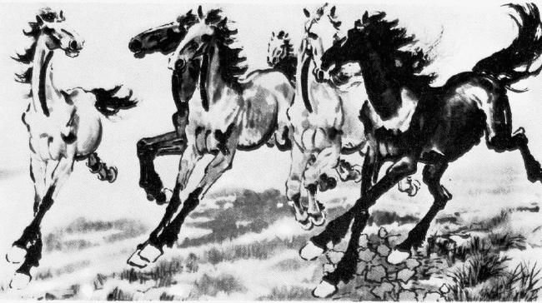
Challenges: deformation
Xu, Beihong 1943

Slide 18
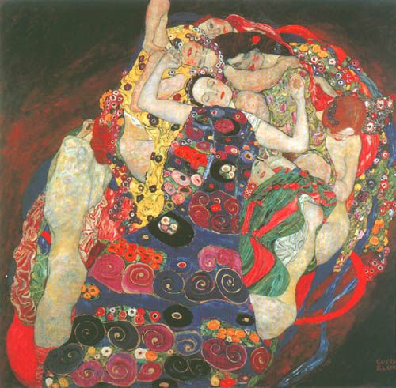
Challenges: background clutter
Klimt, 1913

Slide 19


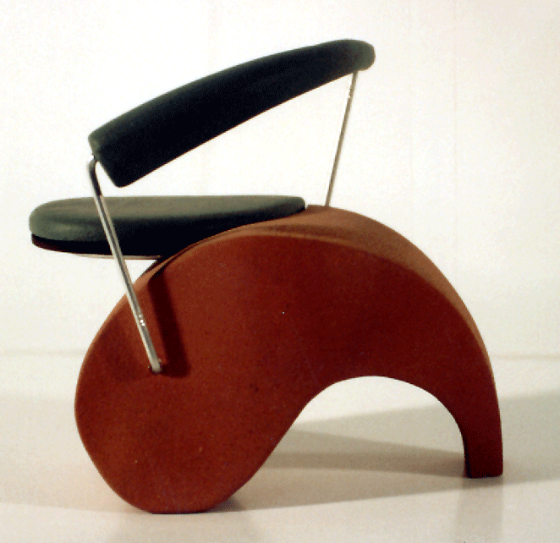
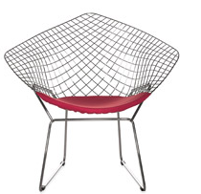


Challenges: intra-class variation

Slide 20
Let’s start simple
Today
  skin detection
  face detection with adaboost

Slide 21
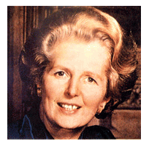
Face detection
How to tell if a face is present?
Notes:
You can ask people to see what they come up with

Slide 22
One simple method: skin detection
skin
Skin pixels have a distinctive range of colors
  Corresponds to region(s) in RGB color space
    for visualization, only R and G components are shown above
Skin classifier
  A pixel X = (R,G,B) is skin if it is in the skin region
  But how to find this region?

Slide 23
Skin detection
Learn the skin region from examples
  Manually label pixels in one or more “training images” as skin or not skin
  Plot the training data in RGB space
    skin pixels shown in orange, non-skin pixels shown in blue
    some skin pixels may be outside the region, non-skin pixels inside. Why?
Skin classifier
  Given X = (R,G,B): how to determine if it is skin or not?
Notes:
Q1: under certain lighting conditions, some surfaces have the same RGB color as skin
Q2: ask class, see what they come up with. We’ll talk about this in the next few slides

Slide 24
Skin classification techniques
Skin classifier
  Given X = (R,G,B): how to determine if it is skin or not?
  Nearest neighbor
    find labeled pixel closest to X
    choose the label for that pixel
  Data modeling
    fit a model (curve, surface, or volume) to each class
  Probabilistic data modeling
    fit a probability model to each class

Slide 25


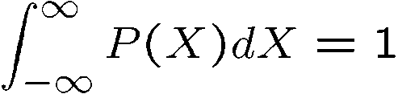

Probability
Basic probability
  X is a random variable
  P(X) is the probability that X achieves a certain value
  or
  Conditional probability: P(X | Y)
    probability of X given that we already know Y
called a PDF
  probability distribution/density function
  a 2D PDF is a surface, 3D PDF is a volume
continuous X
discrete X

Slide 26






Probabilistic skin classification
Now we can model uncertainty
  Each pixel has a probability of being skin or not skin
Skin classifier
  Given X = (R,G,B): how to determine if it is skin or not?
  Choose interpretation of highest probability
    set X to be a skin pixel if and only if
Where do we get and ?

Slide 27


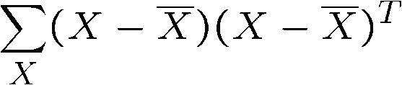
Learning conditional PDF’s
We can calculate P(R | skin) from a set of training images
  It is simply a histogram over the pixels in the training images
    each bin R_{i} contains the proportion of skin pixels with color R_{i}
This doesn’t work as well in higher-dimensional spaces. Why not?
Approach: fit parametric PDF functions
  common choice is rotated Gaussian
    center
    covariance
      orientation, size defined by eigenvecs, eigenvals

Slide 28
Learning conditional PDF’s
We can calculate P(R | skin) from a set of training images
  It is simply a histogram over the pixels in the training images
    each bin R_{i} contains the proportion of skin pixels with color R_{i}
But this isn’t quite what we want
  Why not? How to determine if a pixel is skin?
  We want P(skin | R) not P(R | skin)
  How can we get it?

Slide 29
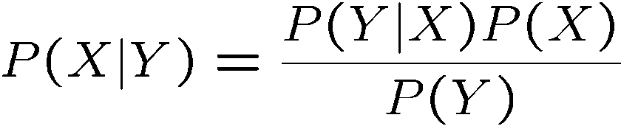
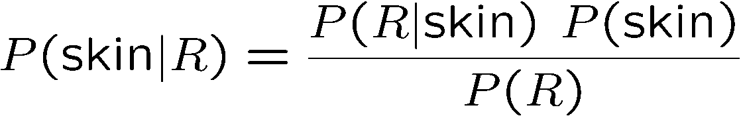
Bayes rule
In terms of our problem:
what we measure
(likelihood)
domain knowledge
(prior)
what we want
(posterior)
normalization term
The prior: P(skin)
  Could use domain knowledge
    P(skin) may be larger if we know the image contains a person
    for a portrait, P(skin) may be higher for pixels in the center
  Could learn the prior from the training set. How?
    P(skin) may be proportion of skin pixels in training set

Slide 30


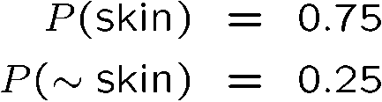

Bayesian estimation
likelihood
posterior (unnormalized)
= minimize probability of misclassification
Bayesian estimation
  Goal is to choose the label (skin or ~skin) that maximizes the posterior
    this is called Maximum A Posteriori (MAP) estimation
  Suppose the prior is uniform: P(skin) = P(~skin) =
0.5
    in this case ,
    maximizing the posterior is equivalent to maximizing the likelihood
      if and only if
    this is called Maximum Likelihood (ML) estimation

Slide 31
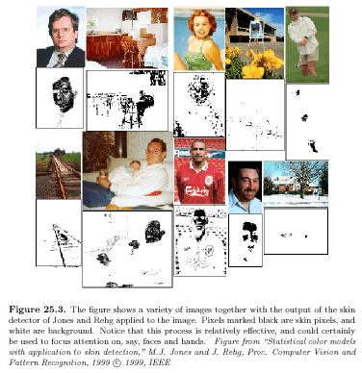
Skin detection results

Slide 32
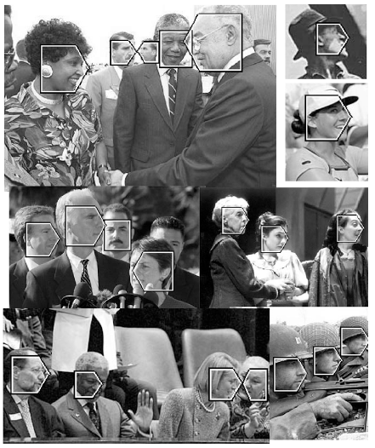
General classification
This same procedure applies in more general circumstances
  More than two classes
  More than one dimension
Example: face detection
  Here, X is an image region
    dimension = # pixels
    each face can be thought
    of as a point in a high
    dimensional space
H. Schneiderman, T. Kanade. "A Statistical Method for 3D Object Detection Applied to Faces and Cars". IEEE Conference on Computer Vision and Pattern Recognition (CVPR 2000)
http://www-2.cs.cmu.edu/afs/cs.cmu.edu/user/hws/www/CVPR00.pdf
H. Schneiderman and T.Kanade

Slide 33





Issues: metrics
What’s the best way to compare images?
  need to define appropriate features
  depends on goal of recognition task
exact matching
complex features work well
(SIFT, MOPS, etc.)
classification/detection
simple features work well
(Viola/Jones, etc.)

Slide 34
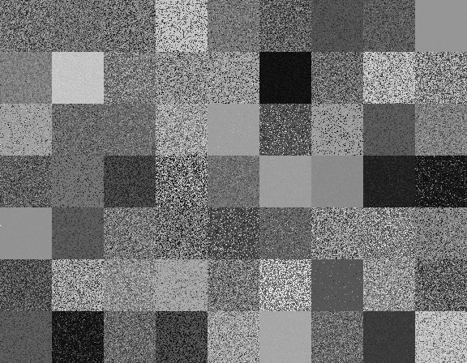
Issues: metrics
What do you see?

Slide 35
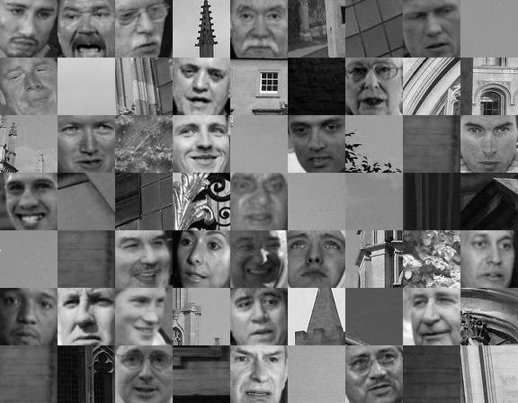
Issues: metrics
What do you see?

Slide 36
Metrics
Lots more feature types that we haven’t mentioned
  moments, statistics
    metrics: Earth mover’s distance, ...
  edges, curves
    metrics: Hausdorff, shape context, ...
  3D: surfaces, spin images
    metrics: chamfer (ICP)
  ...
We’ll discuss more in Part 2

Slide 37

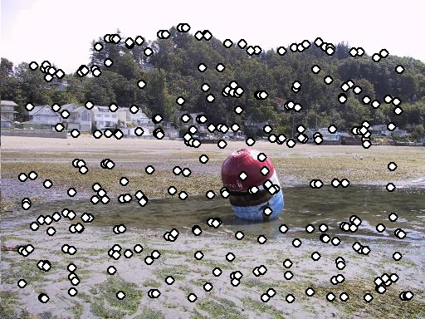
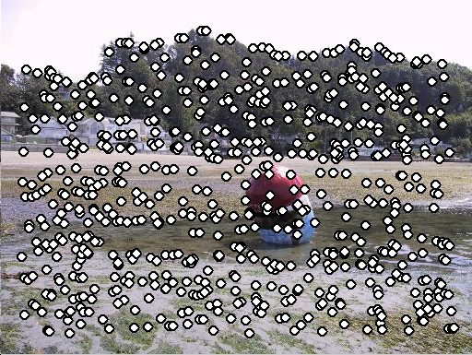
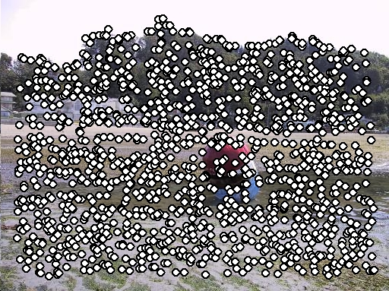
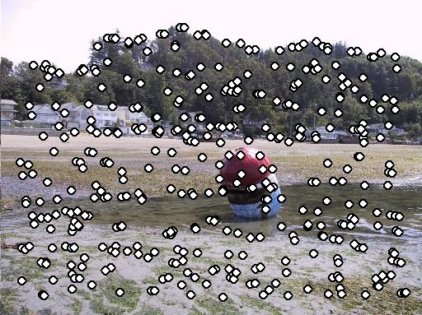
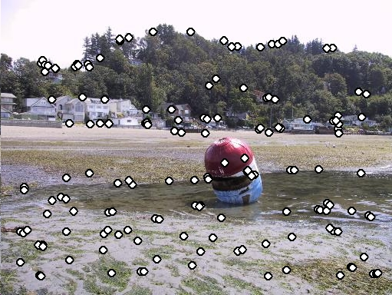
Issues: feature selection
If all you have is one image:
non-maximum suppression, etc.
If you have a training set of images:
AdaBoost, etc.

Slide 38
Issues: data modeling
Generative methods
  model the “shape” of each class
    histograms, PCA, mixtures of Gaussians
    graphical models (HMM’s, belief networks, etc.)
    ...
Discriminative methods
  model boundaries between classes
    perceptrons, neural networks
    support vector machines (SVM’s)

Slide 39
Generative vs. Discriminative
Generative Approach
model individual classes, priors
Discriminative Approach
model posterior directly
from Chris Bishop

Slide 40
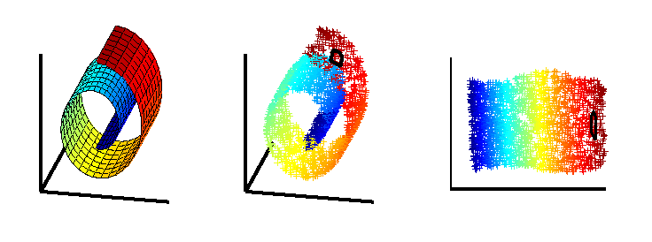
Issues: dimensionality
What if your space isn’t flat?
  PCA may not help
Nonlinear methods
LLE, MDS, etc.

Slide 41
Issues: speed
Case study: Viola Jones face detector
Next few slides adapted Grauman & Liebe’s tutorial
  http://www.vision.ee.ethz.ch/~bleibe/teaching/tutorial-aaai08/
Also see Paul Viola’s talk (video)
  http://www.cs.washington.edu/education/courses/577/04sp/contents.html#DM

Slide 42
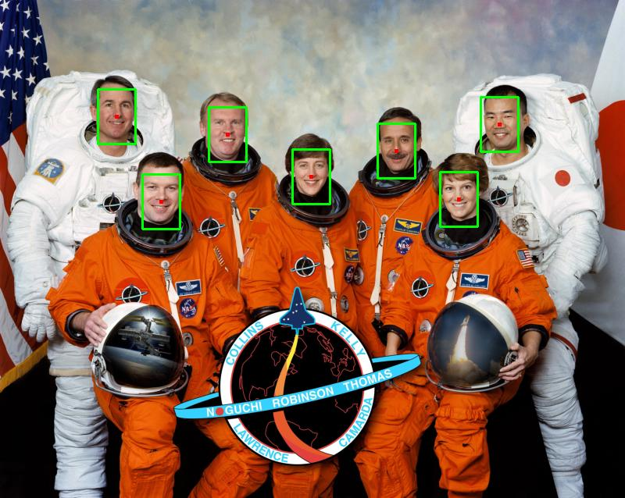
Face detection
Where are the faces? Not who they are, that’s recognition or identification.

Slide 43


Feature extraction
“Rectangular” filters
  Feature output is difference between adjacent regions
  Efficiently computable with integral image: any sum can be computed in constant time
  Avoid scaling images scale features directly for same cost
Viola & Jones, CVPR 2001
43
K. Grauman, B. Leibe
Notes:
43

Slide 44
Sums of rectangular regions
How do we compute the sum of the pixels in the red box?
243 | 239 | 240 | 225 | 206 | 185 | 188 | 218 | 211 | 206 | 216 | 225
242 | 239 | 218 | 110 | 67 | 31 | 34 | 152 | 213 | 206 | 208 | 221
243 | 242 | 123 | 58 | 94 | 82 | 132 | 77 | 108 | 208 | 208 | 215
235 | 217 | 115 | 212 | 243 | 236 | 247 | 139 | 91 | 209 | 208 | 211
233 | 208 | 131 | 222 | 219 | 226 | 196 | 114 | 74 | 208 | 213 | 214
232 | 217 | 131 | 116 | 77 | 150 | 69 | 56 | 52 | 201 | 228 | 223
232 | 232 | 182 | 186 | 184 | 179 | 159 | 123 | 93 | 232 | 235 | 235
232 | 236 | 201 | 154 | 216 | 133 | 129 | 81 | 175 | 252 | 241 | 240
235 | 238 | 230 | 128 | 172 | 138 | 65 | 63 | 234 | 249 | 241 | 245
237 | 236 | 247 | 143 | 59 | 78 | 10 | 94 | 255 | 248 | 247 | 251
234 | 237 | 245 | 193 | 55 | 33 | 115 | 144 | 213 | 255 | 253 | 251
248 | 245 | 161 | 128 | 149 | 109 | 138 | 65 | 47 | 156 | 239 | 255
190 | 107 | 39 | 102 | 94 | 73 | 114 | 58 | 17 | 7 | 51 | 137
23 | 32 | 33 | 148 | 168 | 203 | 179 | 43 | 27 | 17 | 12 | 8
17 | 26 | 12 | 160 | 255 | 255 | 109 | 22 | 26 | 19 | 35 | 24
After some pre-computation, this can be done in constant time for any box.
This “trick” is commonly used for computing Haar wavelets (a fundemental building block of many object recognition approaches.)

Slide 45
Sums of rectangular regions
The trick is to compute an “integral image.” Every pixel is the sum of its neighbors to the upper left.
Sequentially compute using:

Slide 46
Sums of rectangular regions
 |  | A |  |  |  |  |  |  | B
 |  | C |  |  |  |  |  |  | D
Solution is found using:
A + D – B - C
What if the position of the box lies between pixels?

Slide 47
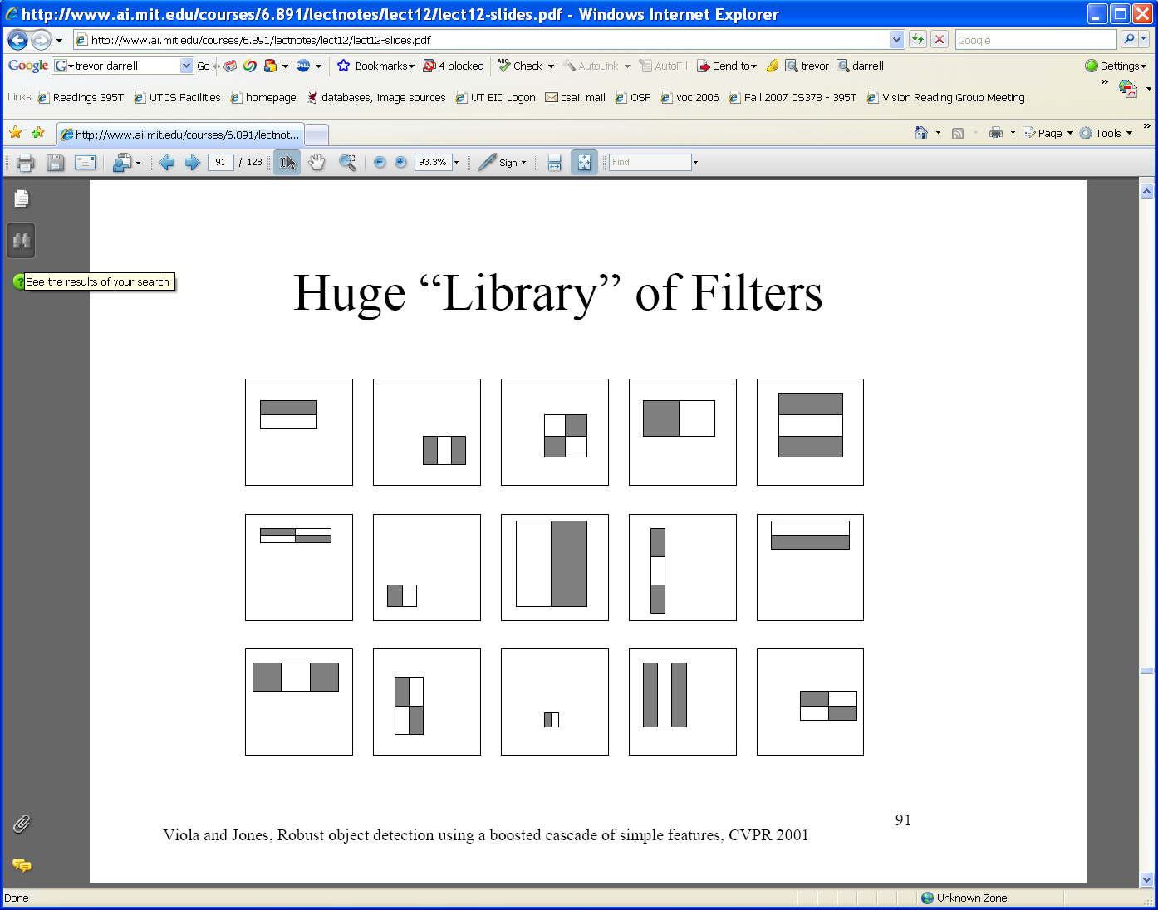
Large library of filters
  Considering all possible filter parameters: position, scale, and type:
180,000+ possible features associated with each 24 x 24 window
Use AdaBoost both to select the informative features and to form the classifier
Viola & Jones, CVPR 2001
Notes:
47

Slide 48
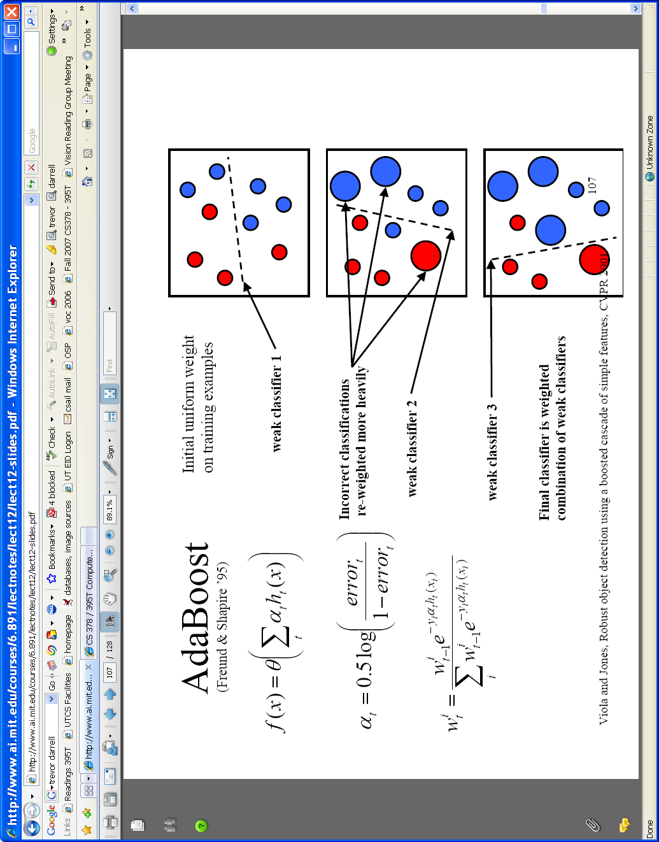

AdaBoost for feature+classifier selection
Want to select the single rectangle feature and threshold that best separates positive (faces) and negative (non-faces) training examples, in terms of weighted error.
Resulting weak classifier:
For next round, reweight the examples according to errors, choose another filter/threshold combo.
…
Outputs of a possible rectangle feature on faces and non-faces.
Viola & Jones, CVPR 2001
Notes:
48

Slide 49
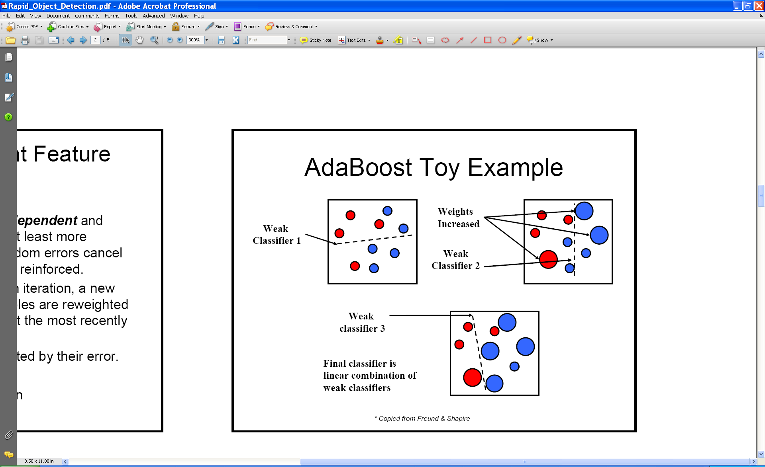
AdaBoost: Intuition
Consider a 2-d feature space with positive and negative examples.
Each weak classifier splits the training examples with at least 50% accuracy.
Examples misclassified by a previous weak learner are given more emphasis at future rounds.
Figure adapted from Freund and Schapire
49
K. Grauman, B. Leibe
Notes:
49

Slide 50
AdaBoost: Intuition
50
K. Grauman, B. Leibe
Notes:
50

Slide 51
AdaBoost: Intuition
Final classifier is combination of the weak classifiers
51
K. Grauman, B. Leibe
Notes:
51

Slide 52
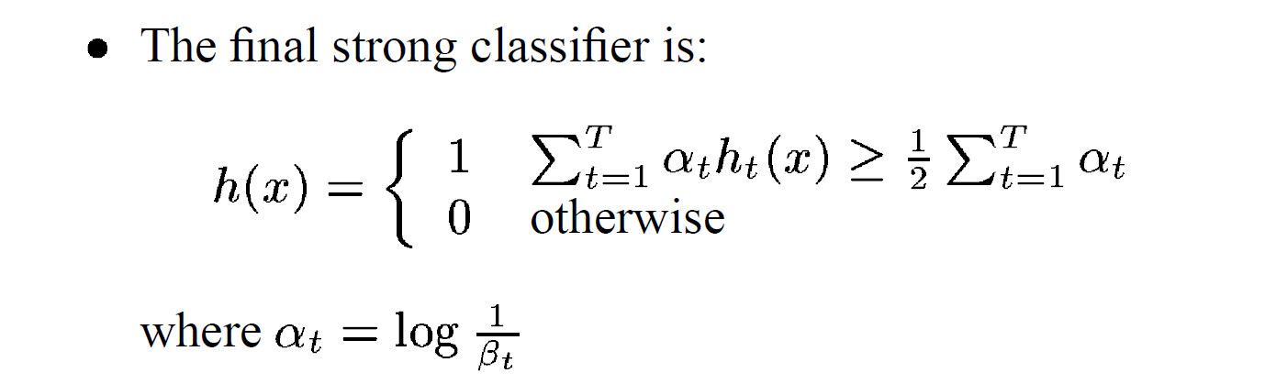
Final classifier is combination of the weak ones, weighted according to error they had.

Slide 53
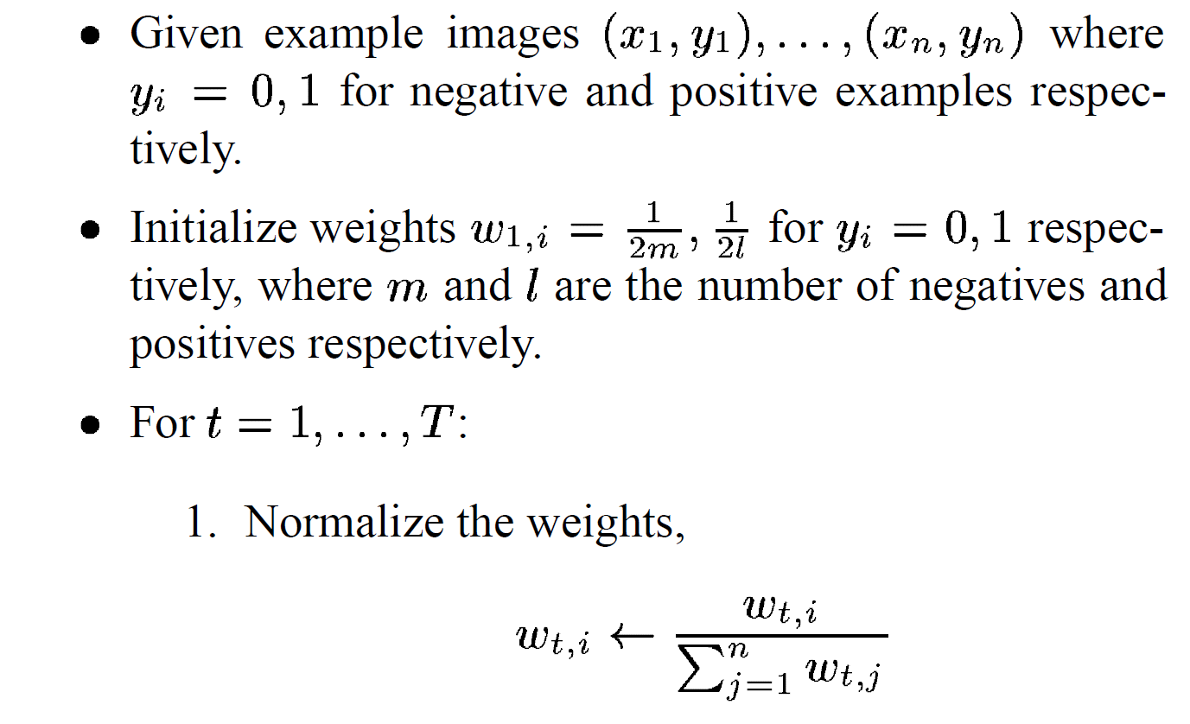
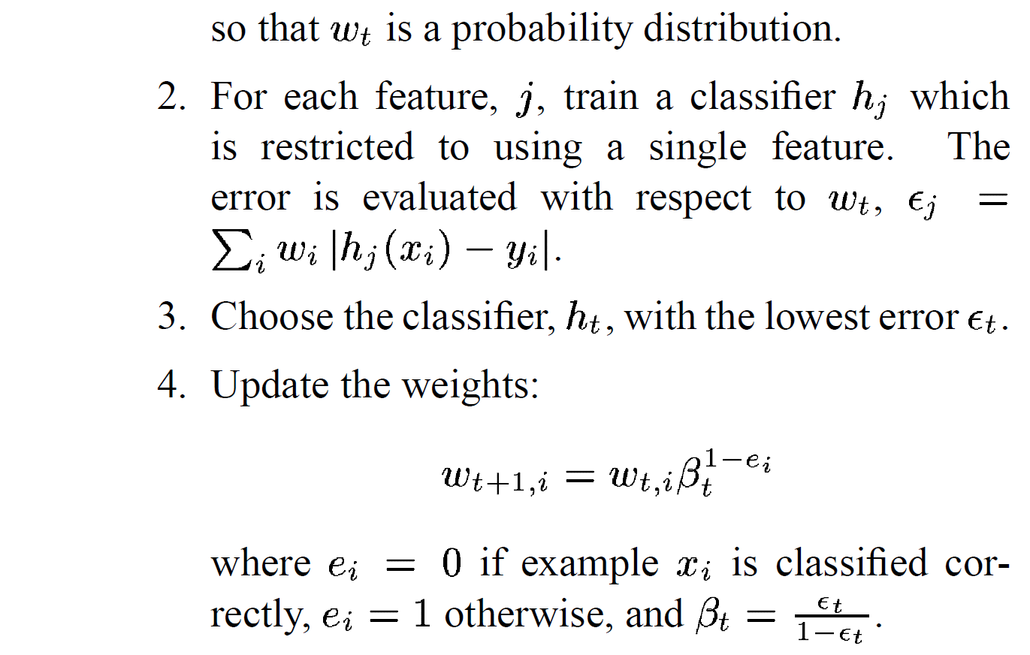
AdaBoost Algorithm
Start with uniform weights on training examples
{x₁,…x_{n}}
For T rounds
Find the best threshold and polarity for each feature, and return error.
Re-weight the examples:
Incorrectly classified -> more weight
Correctly classified -> less weight
Notes:
53

Slide 54

Picking the best classifier
Efficient single pass approach:
At each sample compute:
= min ( S + (T – S), S + (T – S) )
Find the minimum value of , and use the value of the corresponding sample as the threshold.
S = sum of samples below the current sample
T = total sum of all samples

Slide 55
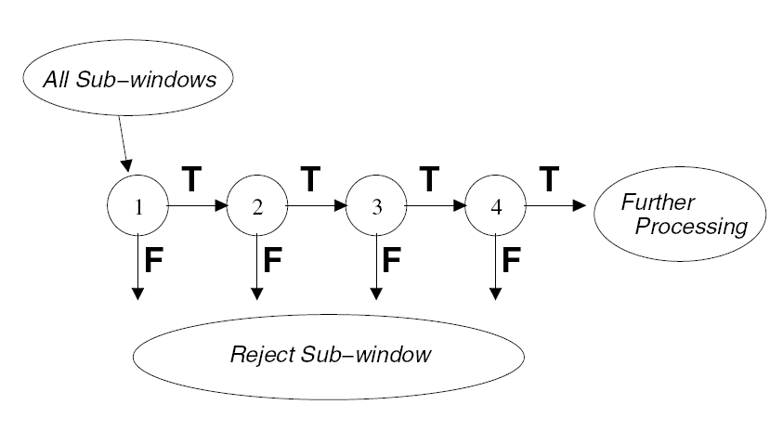
Cascading classifiers for detection
For efficiency, apply less accurate but faster classifiers first to immediately discard windows that clearly appear to be negative; e.g.,
  Filter for promising regions with an initial inexpensive classifier
  Build a chain of classifiers, choosing cheap ones with low false negative rates early in the chain
Fleuret & Geman, IJCV 2001
Rowley et al., PAMI 1998
Viola & Jones, CVPR 2001
55
K. Grauman, B. Leibe
Figure from Viola & Jones CVPR 2001
Notes:
55

Slide 56
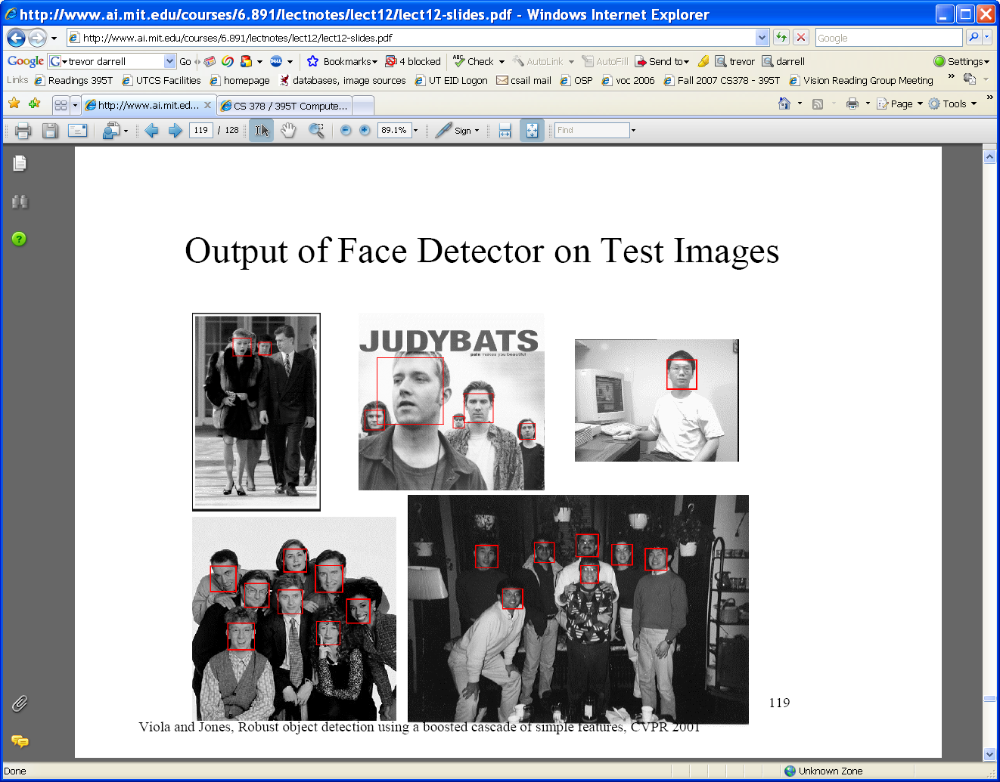
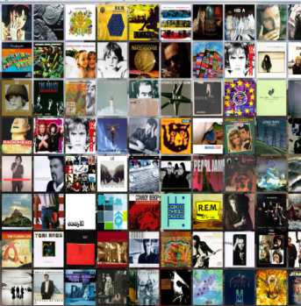





Viola-Jones Face Detector: Summary
Train cascade of classifiers with AdaBoost
Apply to each subwindow
Faces
New image
Selected features, thresholds, and weights
Non-faces
Train with 5K positives, 350M negatives
Real-time detector using 38 layer cascade
6061 features in final layer
[Implementation available in OpenCV: http://www.intel.com/technology/computing/opencv/]
56
K. Grauman, B. Leibe
Notes:
56

Slide 57
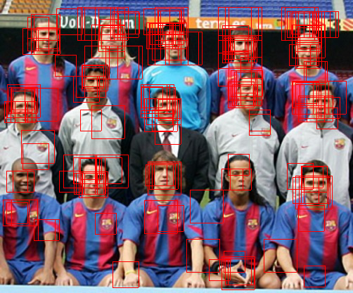
Non-maximal suppression (NMS)
Many detections above threshold.

Slide 58
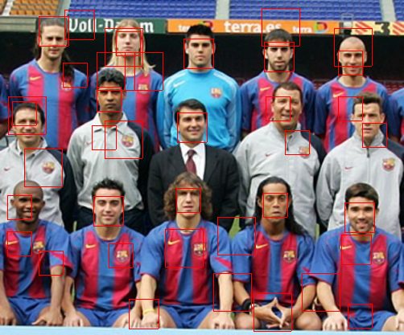
Non-maximal suppression (NMS)

Slide 59

Viola-Jones Face Detector: Results
First two features selected
59
K. Grauman, B. Leibe
Notes:
59

Slide 60

Is this good?
Similar accuracy, but 10x faster

Slide 61
Viola-Jones Face Detector: Results
Notes:
61

Slide 62

Viola-Jones Face Detector: Results
Notes:
62

Slide 63


Viola-Jones Face Detector: Results

Slide 64


Detecting profile faces?
Detecting profile faces requires training separate detector with profile examples.

Slide 65



Viola-Jones Face Detector: Results
Paul Viola, ICCV tutorial

Slide 66
http://www.pittpatt.com/face_tracking/

