Slide 1
Object recognition (part 2)
CSE P 576
Larry Zitnick (larryz@microsoft.com)

Slide 2


Slide 3
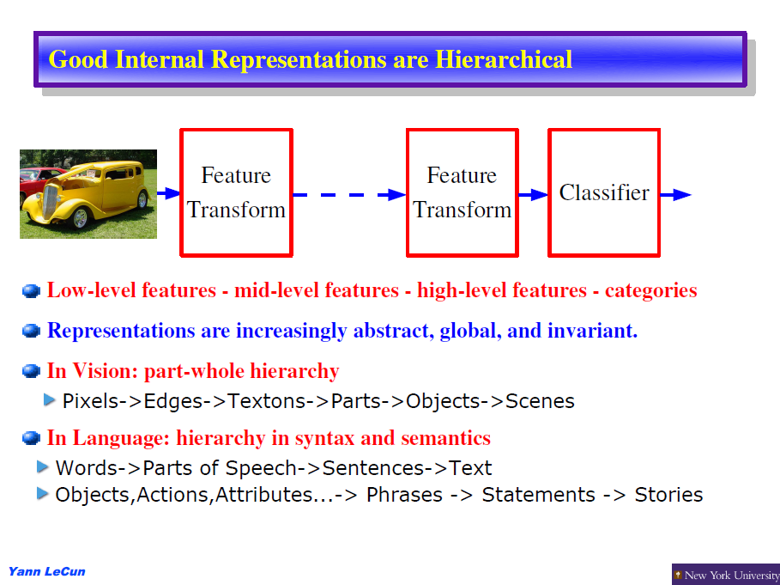

Slide 4
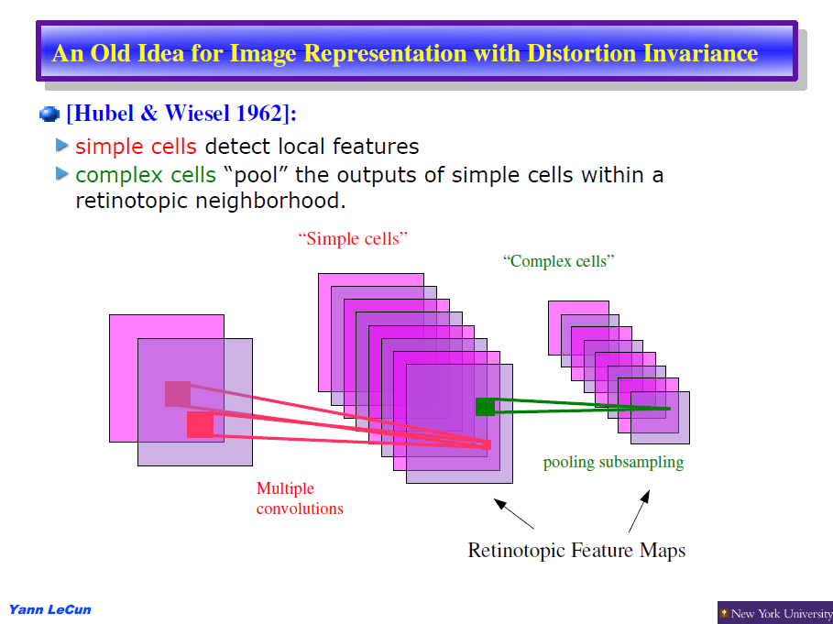

Slide 5
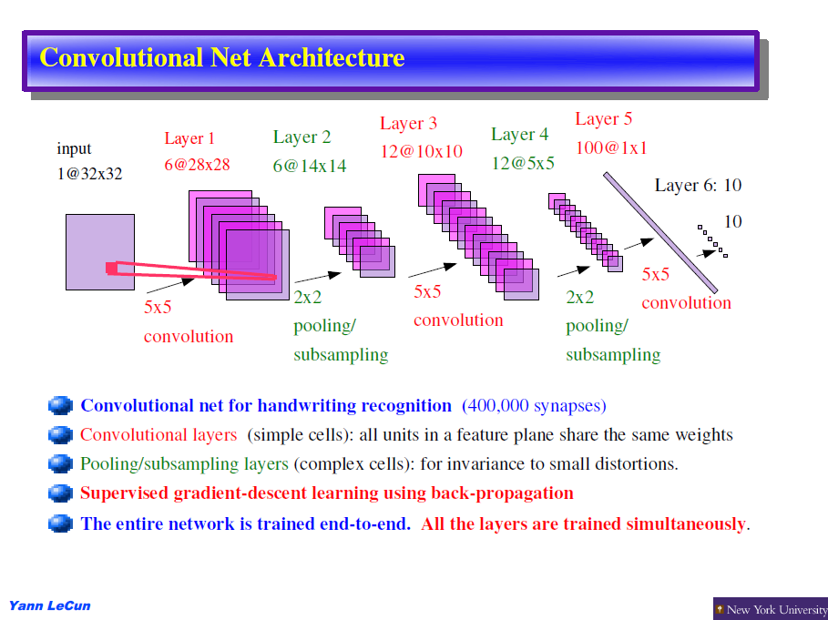

Slide 6
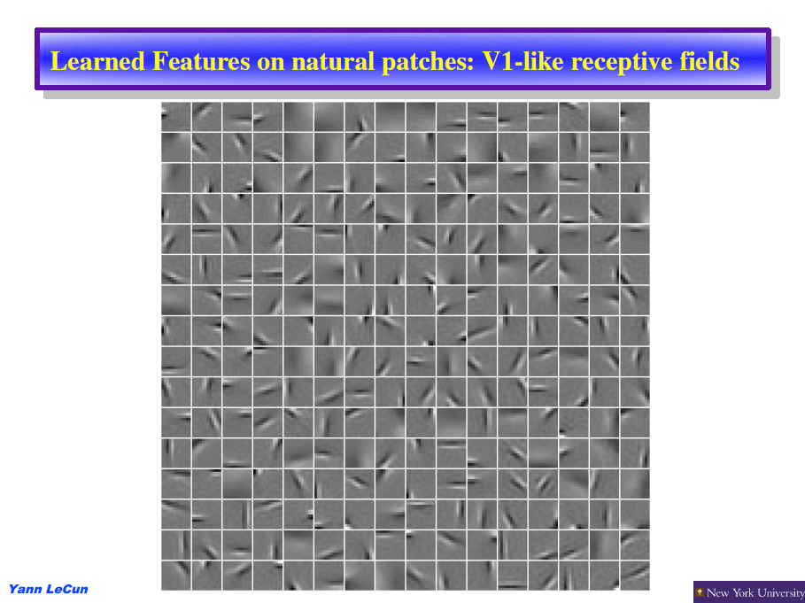

Slide 7
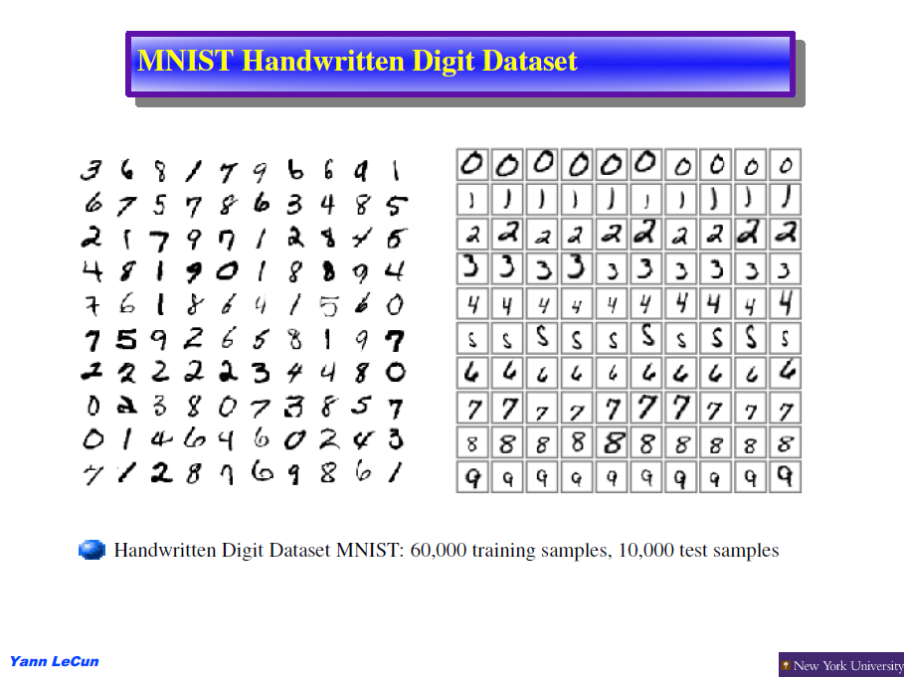

Slide 8
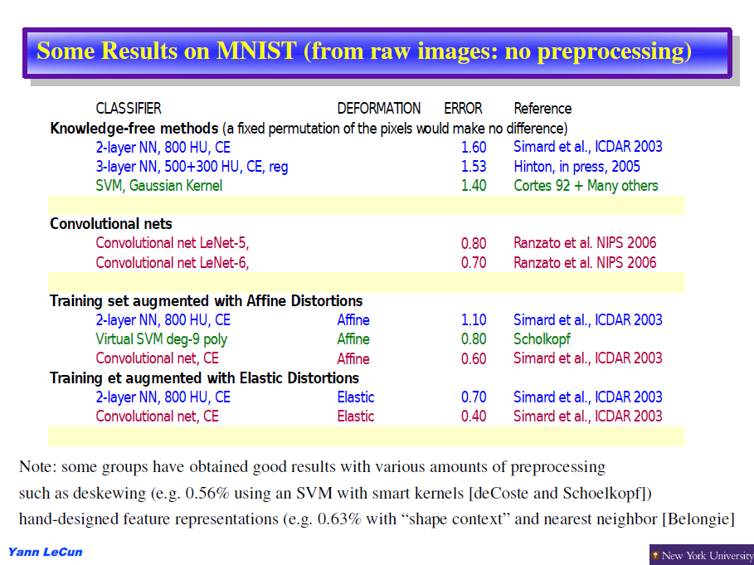

Slide 9
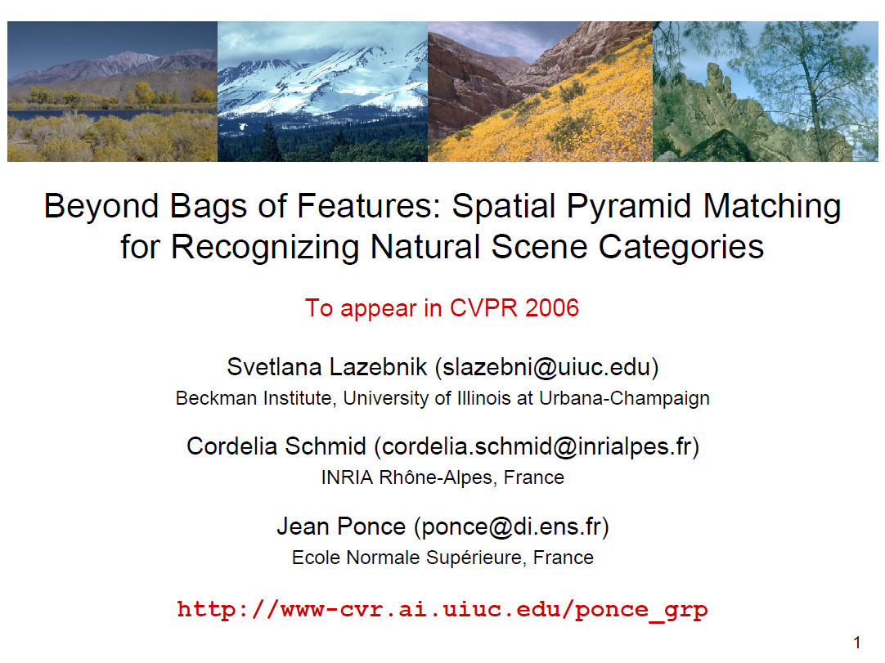

Slide 10
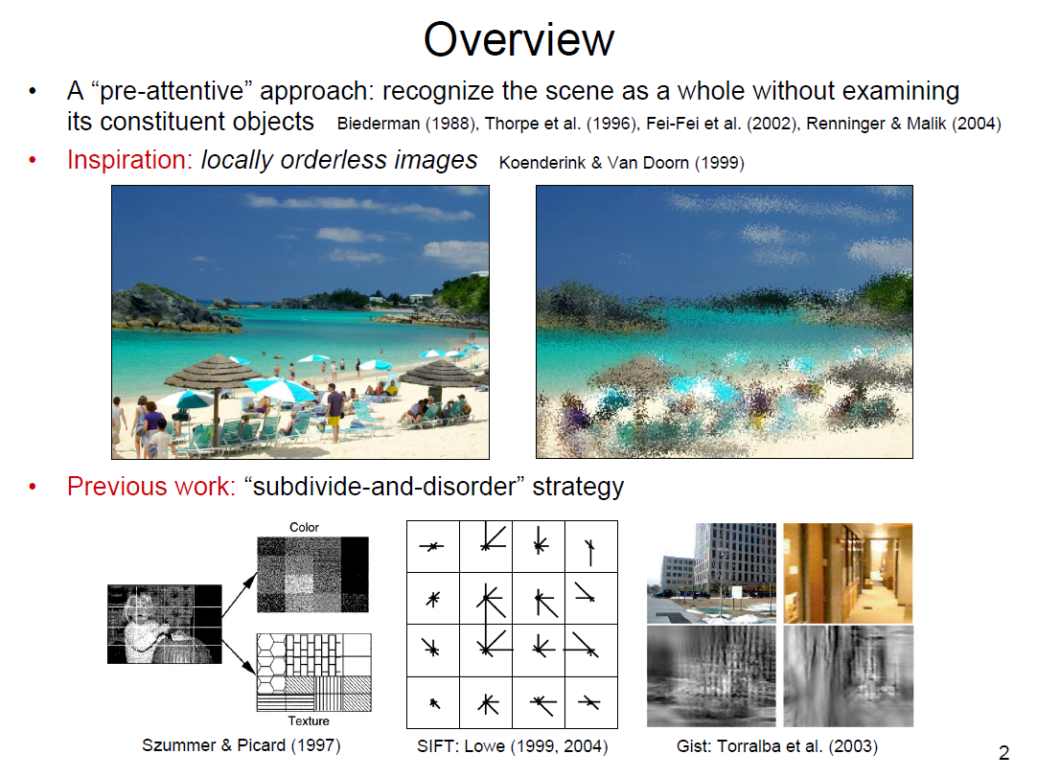

Slide 11
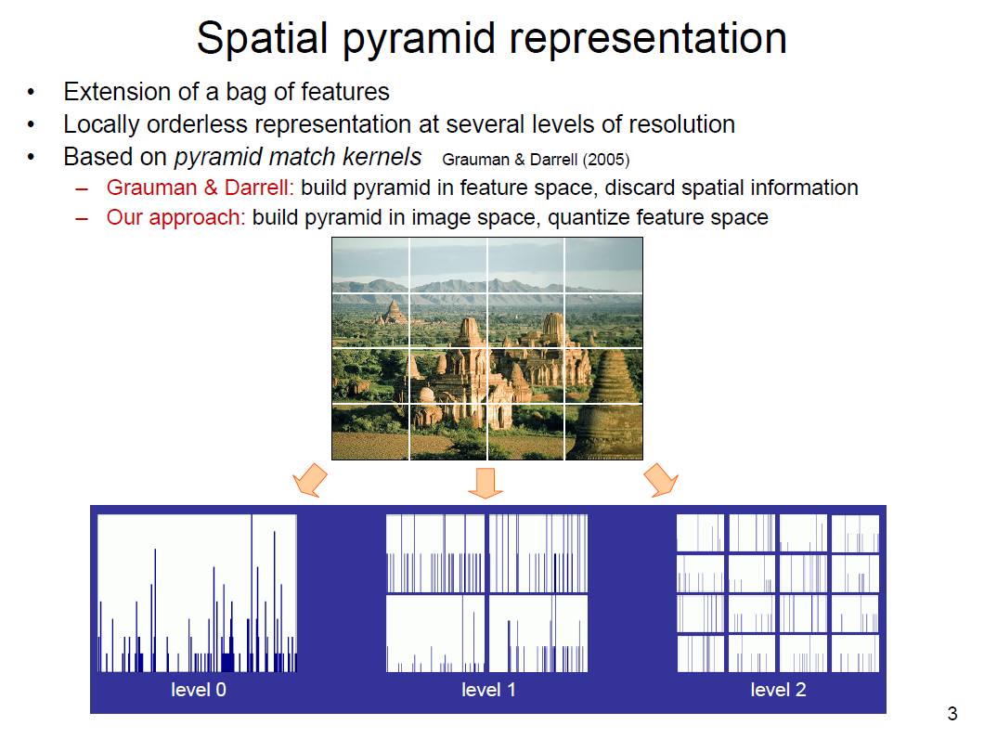

Slide 12
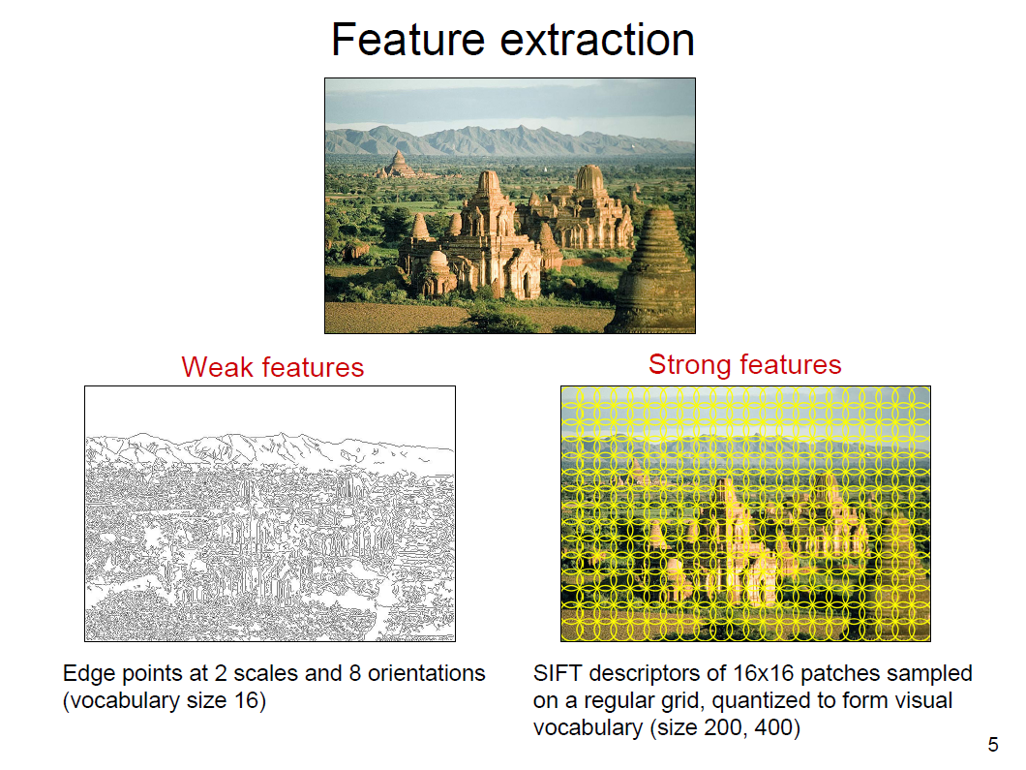

Slide 13
Support Vector Machines
Modified from the slides by Dr. Andrew W. Moore
http://www.cs.cmu.edu/~awm/tutorials

Slide 14
Linear Classifiers
α
x
f
y^{est}
f(x,w,b) = sign(w. x - b)
denotes +1
denotes -1
How would you classify this data?

Slide 15
Linear Classifiers
α
x
f
y^{est}
f(x,w,b) = sign(w. x - b)
denotes +1
denotes -1
How would you classify this data?

Slide 16
Linear Classifiers
α
x
f
y^{est}
f(x,w,b) = sign(w. x - b)
denotes +1
denotes -1
How would you classify this data?

Slide 17
Linear Classifiers
α
x
f
y^{est}
f(x,w,b) = sign(w. x - b)
denotes +1
denotes -1
How would you classify this data?

Slide 18
Linear Classifiers
α
x
f
y^{est}
f(x,w,b) = sign(w. x - b)
denotes +1
denotes -1
Any of these would be fine..
..but which is best?

Slide 19
Classifier Margin
α
x
f
y^{est}
f(x,w,b) = sign(w. x - b)
denotes +1
denotes -1
Define the margin of a linear classifier as the width that the boundary could be increased by before hitting a datapoint.

Slide 20
Maximum Margin
α
x
f
y^{est}
f(x,w,b) = sign(w. x - b)
denotes +1
denotes -1
The maximum margin linear classifier is the linear classifier with the, um, maximum margin.
This is the simplest kind of SVM (Called an LSVM)
Linear SVM

Slide 21
Maximum Margin
α
x
f
y^{est}
f(x,w,b) = sign(w. x - b)
denotes +1
denotes -1
The maximum margin linear classifier is the linear classifier with the, um, maximum margin.
This is the simplest kind of SVM (Called an LSVM)
Support Vectors are those datapoints that the margin pushes up against
Linear SVM

Slide 22
Why Maximum Margin?
Intuitively this feels safest.
If we’ve made a small error in the location of the boundary (it’s been jolted in its perpendicular direction) this gives us least chance of causing a misclassification.
LOOCV is easy since the model is immune to removal of any non-support-vector datapoints.
There’s some theory (using VC dimension) that is related to (but not the same as) the proposition that this is a good thing.
Empirically it works very very well.
f(x,w,b) = sign(w. x - b)
denotes +1
denotes -1
The maximum margin linear classifier is the linear classifier with the, um, maximum margin.
This is the simplest kind of SVM (Called an LSVM)
Support Vectors are those datapoints that the margin pushes up against

Slide 23
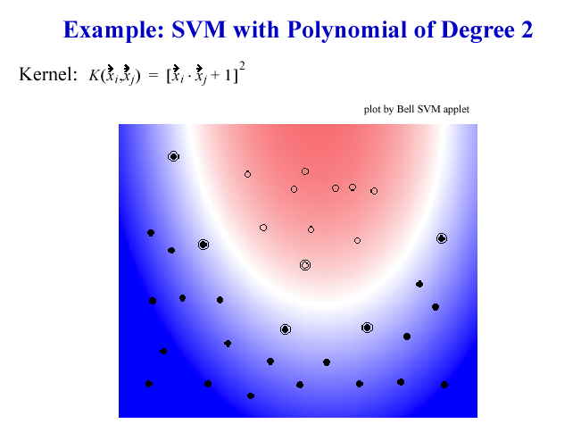
Nonlinear Kernel (I)

Slide 24
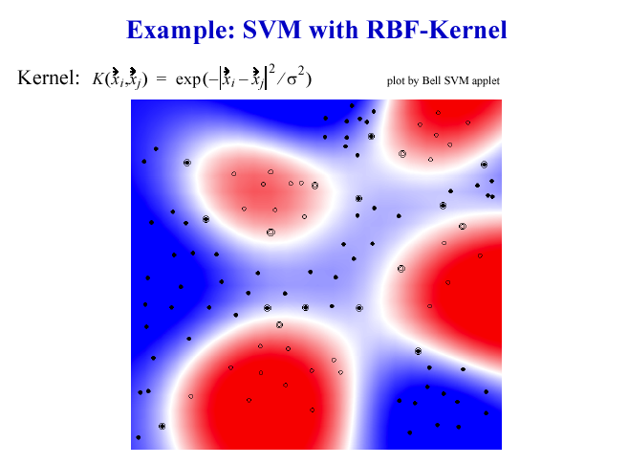
Nonlinear Kernel (II)

Slide 25
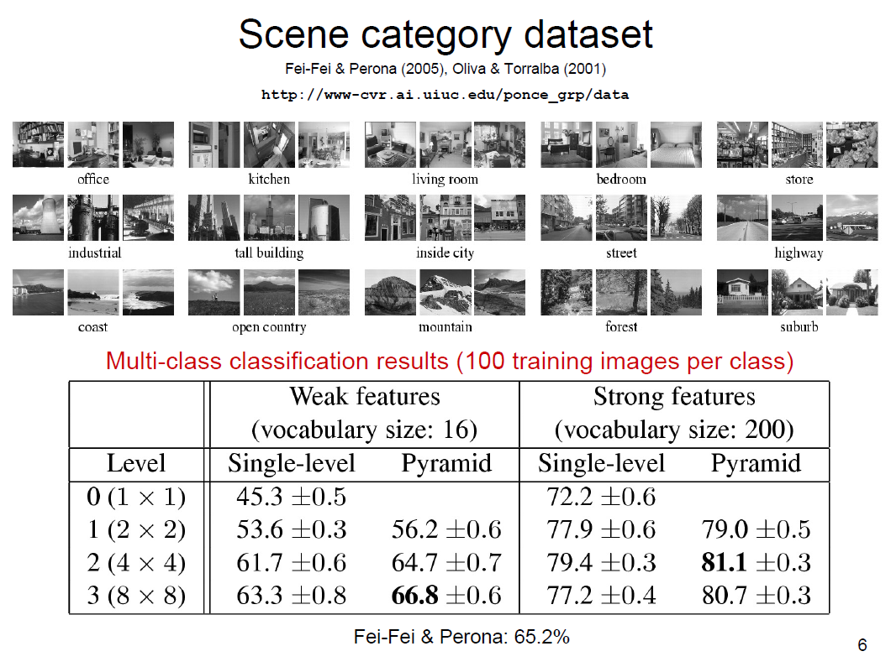

Slide 26
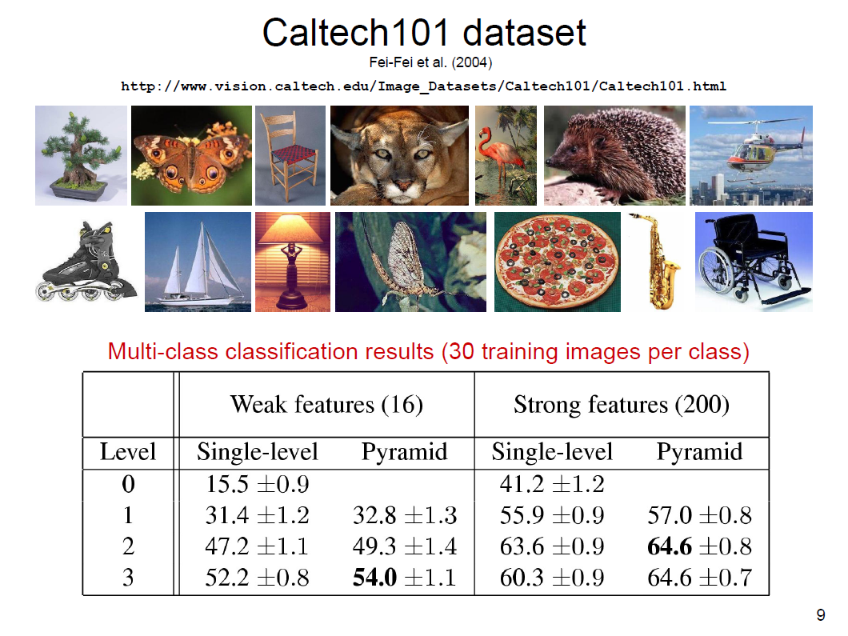

Slide 27
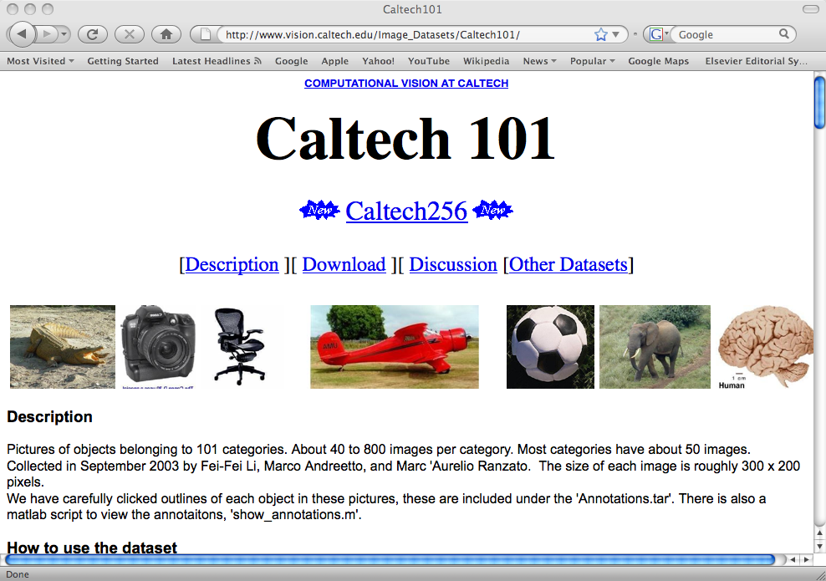

Slide 28




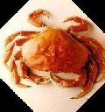
Caltech-101: Drawbacks
Smallest category size is 31 images:
Too easy?
  left-right aligned
  Rotation artifacts
  Soon will saturate performance

Slide 29
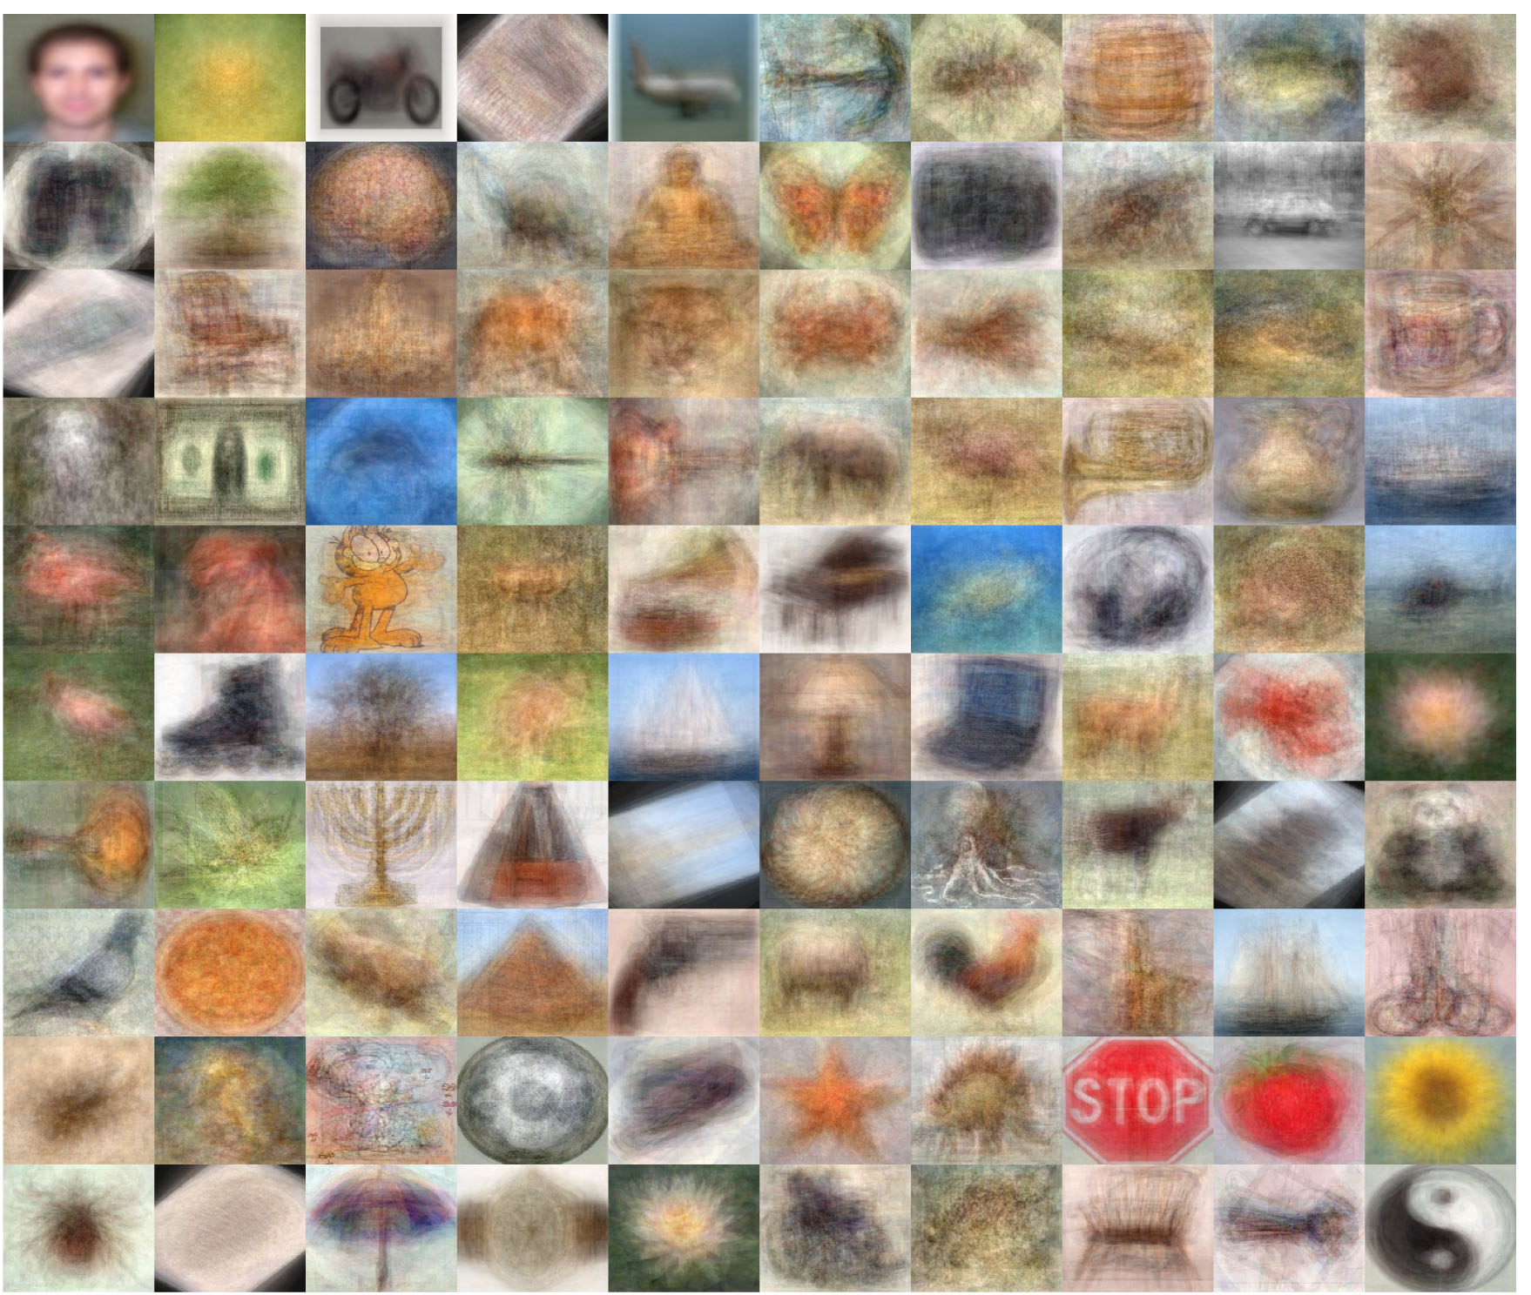
Antonio Torralba generated these average images of the Caltech 101 categories

Slide 30
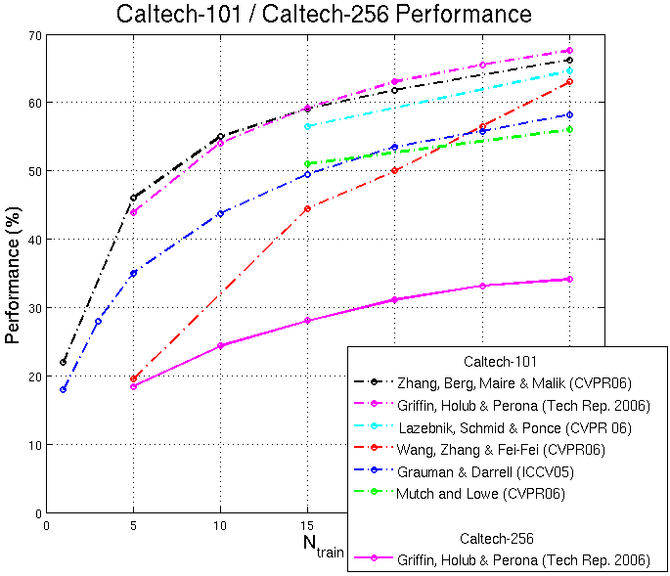

Slide 31
Jump to Nicolas Pinto’s slides. (page 29)

Slide 32
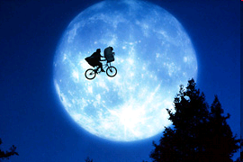
Objects in Context
R. Gokberk Cinbis
MIT 6.870 Object Recognition and Scene Understanding

Slide 33
Papers
A. Torralba. Contextual priming for object detection. IJCV 2003.
A. Rabinovich, A. Vedaldi, C. Galleguillos, E. Wiewiora and S. Belongie. Objects in Context. ICCV 2007

Slide 34
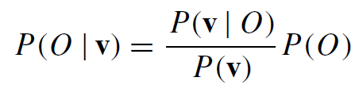
Object Detection
Probabilistic Framework
Object presence at a particular location/scale
(Single Object
Likelihood)
Given all image
features (local/object and scene/context)
v = v_{Local} + v_{Contextual}

Slide 35
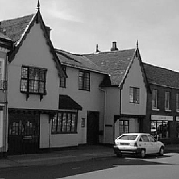

Contextual Reasoning
2D Reasoning
2,5D / 3D Reasoning
Scene Centered
Object Centered
Surface orientations w.r.t. camera
SKY
VERTICAL
VERTICAL
?
SUPPORT
Contextual priming for object detection
Geometric context from a single image.
Objects in Context

Slide 36
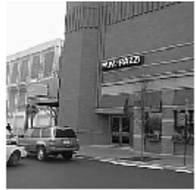
Preview: Contextual Priming for Object Detection
Input test image

Slide 37
Preview: Contextual Priming for Object Detection
Correlate with
many filters

Slide 38
Preview: Contextual Priming for Object Detection
Using previously collected statistics about filter output predict information about objects

Slide 39

Preview: Contextual Priming for Object Detection
Predict information about objects
people
chair
car
Where I can find the objects easily?
Which objects do I expect to see?
How large objects do I expect to see?

Slide 40
Contextual Priming for Object Detection: Probabilistic Framework
Local measurements
(a lot in the literature)
Contextual features

Slide 41
Contextual Priming for Object Detection: Contextual Features
Use PCA on filter output images to reduce the number of features (< 64)
Gabor filters at
4 scales and
6 orientations
Use Mixture of Gaussians to model the probabilities. (Other alternatives
include KNN, parzen window, logistic regression, etc)

Slide 42
Contextual Priming for Object Detection: Object Priming Results
(o₁ =people, o₂ =furniture, o₃ =vehicles and o₄ =trees

Slide 43
Contextual Priming for Object Detection: Focus of Attention Results
Heads

Slide 44
Contextual Priming for Object Detection:
Conclusions
Proves the relation btw low level features and scene/context
Can be seen as a computational evidence for the (possible) existence of low-level feature based biological attention mechanisms
Also a warning: Whether an object recognition system understands the object or works by lots bg features.

Slide 45
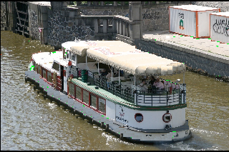
Preview: Objects in Context
Input test image

Slide 46

Preview: Objects in Context
Do segmentation on the image

Slide 47
Preview: Objects in Context
Building, boat, person
Road
Building,
boat, motorbike
Water,
sky
Do classification (find label probabilities) in each segment only with local info

Slide 48
Preview: Objects in Context
Building, boat, person
Building
Road
Road
Building,
boat, motorbike
Boat
Water,
sky
Water
Most consistent labeling according to object co-occurrences & local label probabilities.

Slide 49
Objects in Context:
Local Categorization
Building, boat, person
Extract random patches on zero-padded segments
Calculate SIFT descriptors
Road
Building,
boat, motorbike
Water,
sky
Use BoF:
Training:
- Cluster patches in training (Hier. K-means, K=10x3)
- Histogram of words in each segment
- NN classifier (returns a sorted list of categories)
Each segment is classified independently

Slide 50
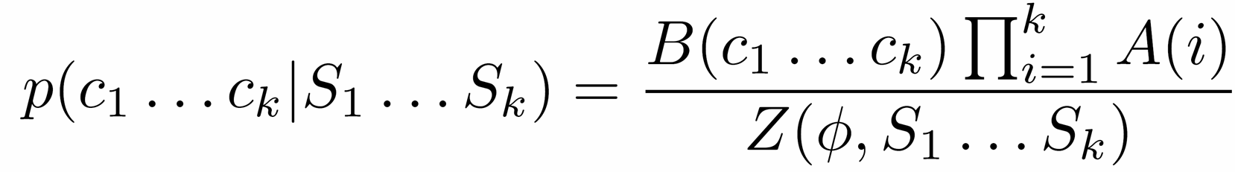
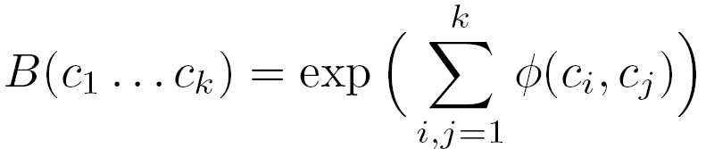

Objects in Context:
Contextual Refinement
Building
Contextual model based on co-occurrences
Try to find the most consistent labeling with high posterior probability and high mean pairwise interaction.
Use CRF for this purpose.
Road
Boat
Water
Independent
segment classification
Mean interaction of all label pairs
Φ(i,j) is basically the observed label co-occurrences in training set.

Slide 51
Objects in Context:
Learning Context
Using labeled image datasets (MSRC, PASCAL)
Using labeled text based data (Google Sets): Contains list of related items
→ A large set turns out to be useless! (anything is related)

Slide 52
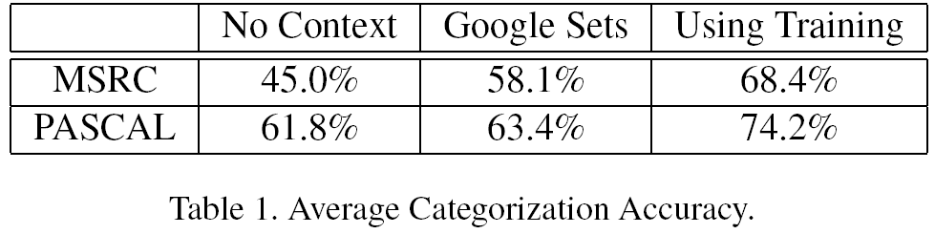
Objects in Context:
Results

Slide 53
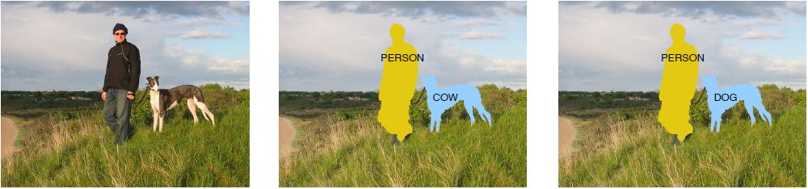
“Objects in Context” – Limitations: Context modeling
Categorization without context
Local information only
With co-occurrence context
Means: P(person,dog) > P(person, cow)
Segmentation
(Bonus Q: How did it handle the background?)

Slide 54
“Objects in Context” – Limitations: Context modeling
With co-occurrence context
P(person,horse) > P(person, dog)
Categorization without context
Local information only
Segmentation
But why? Isn’t it only a dataset bias? We have seen in the previous example that P(person,dog) is common too.

Slide 55
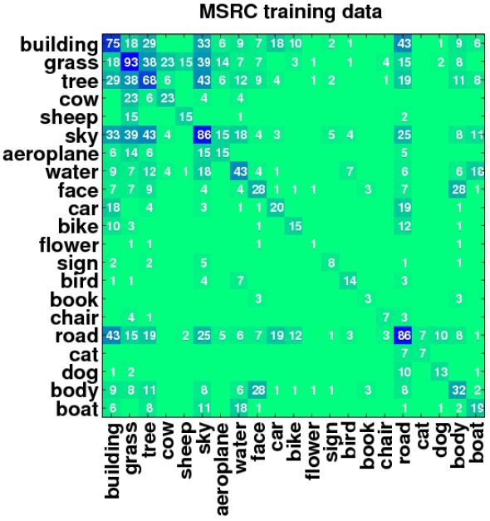
“Objects in Context”
Object-Object or Stuff-Object ?
Stuff-like
Looks like “background” stuff – object (such as water-boat) does help rather than “foreground” object co-occurrences (such as person-horse)
[but still car-person-motorbike is useful in PASCAL]
Stuff
Labels with high
co-occurrences with other labels

Slide 56
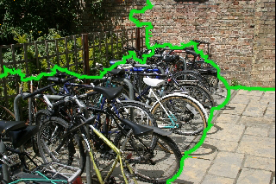
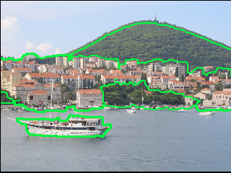
“Objects in Context” – Limitations: Segmentation
Too good: A few or many? How to select a good segmentation in multiple segmentations?
Can make object recognition & contextual reasoning (due to stuff detection) much easier.
Notes:
Notes:
Object detection framework is very simple, this can boost the performance

Slide 57
“Objects in Context” - Limitations
No cue by unknown objects
No spatial relationship reasoning
Object detection part heavily depends on good segmentations
Improvements using object co-occurrences are demonstrated with images where many labels are already correct. → How good is the model?

Slide 58
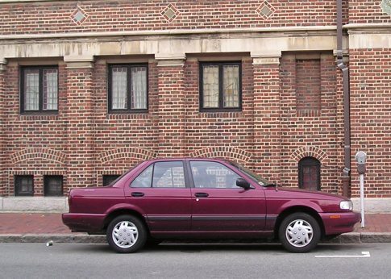
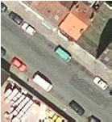
Contextual Priming vs. Objects in Context
Scene->Object
{Object,Stuff} <-> {Object,Stuff}
Simpler training data
(only target object’s labels are enough)
May need huge amount of labeled data
Scene information is view-dependent
(due to gist)
Can be more generic than scene->object with a very good model
Object detector independent
Contextual model is object detector independent, in theory. But:
+ use segmentation → easier to detect stuff
- uses segmentation → can be unreliable

Slide 59
Finding the weakest link in person detectors
Devi Parikh
TTI, Chicago
Larry Zitnick
Microsoft Research

Slide 60
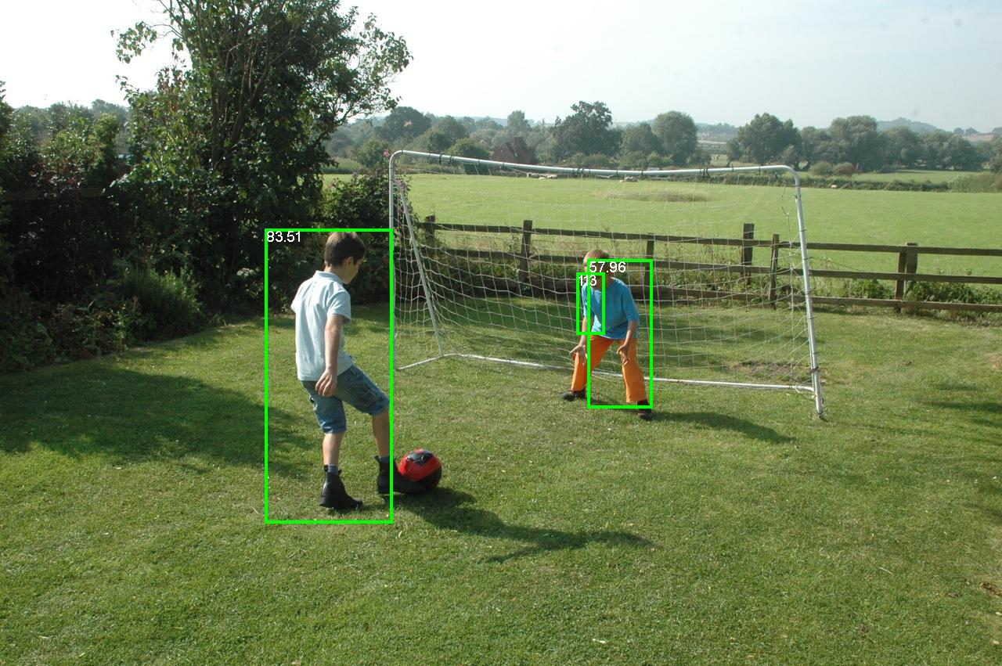
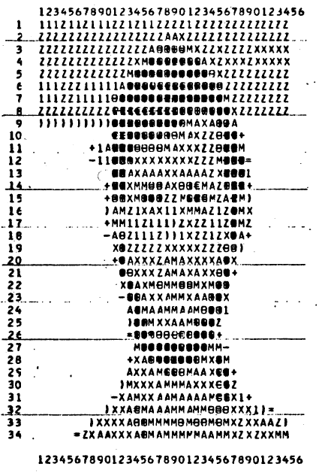
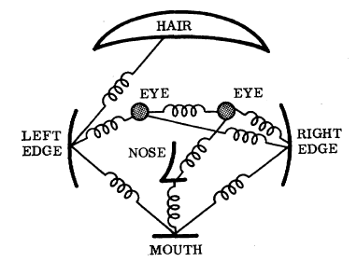
Object recognition
We’ve come a long way…
Fischler and Elschlager, 1973
Dollar et al., BMVC 2009

Slide 61
Still a ways to go…
Dollar et al., BMVC 2009

Slide 62
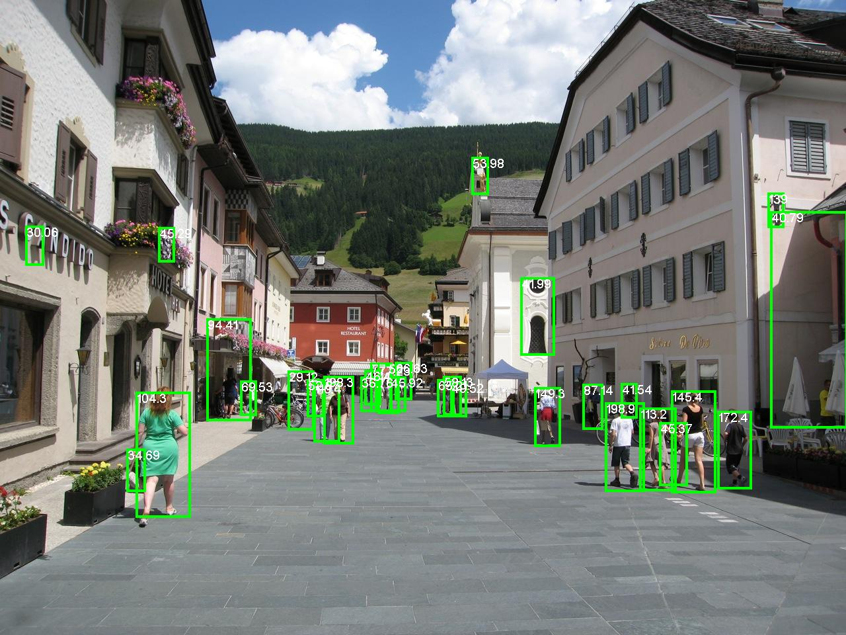
Dollar et al., BMVC 2009

Slide 63
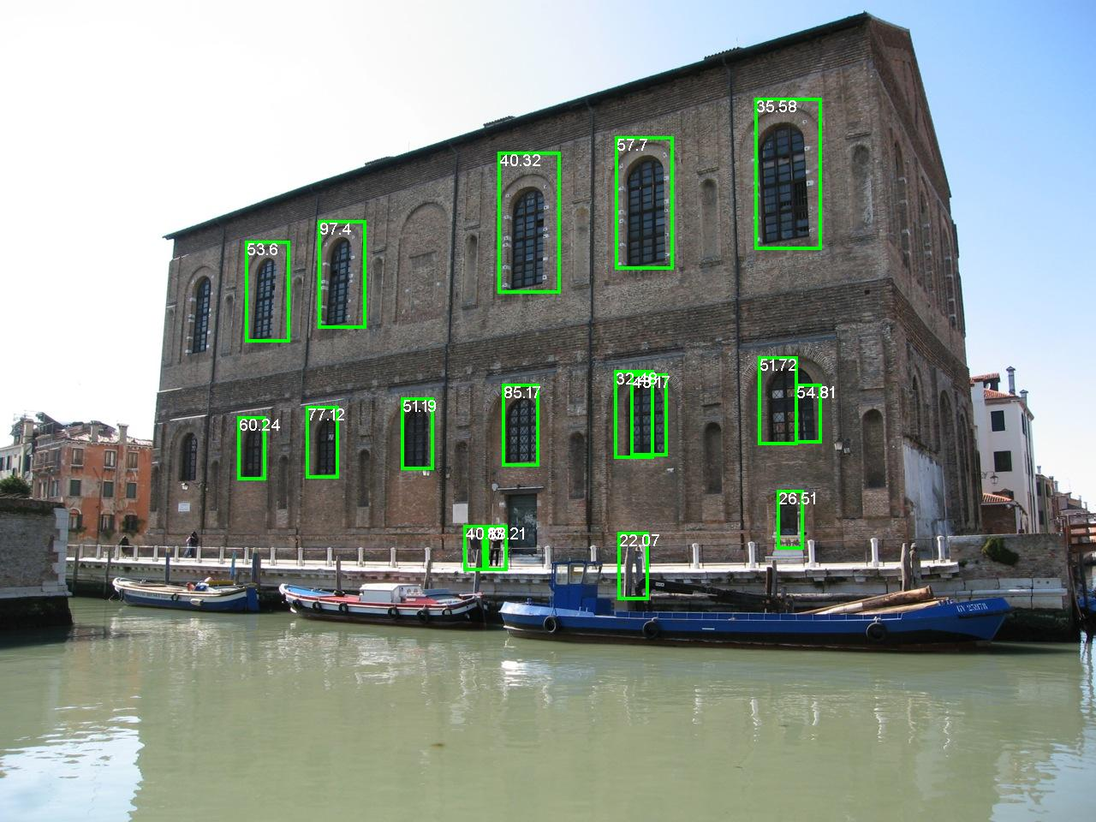
Still a ways to go…
Dollar et al., BMVC 2009

Slide 64
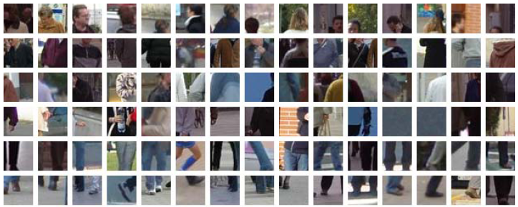
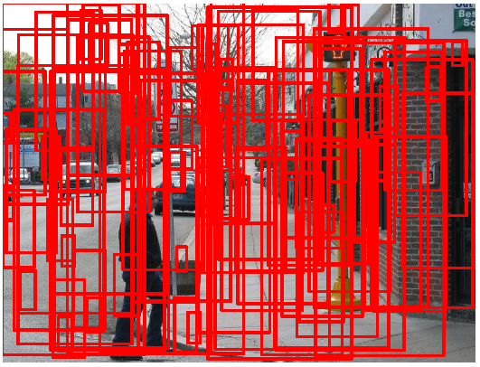
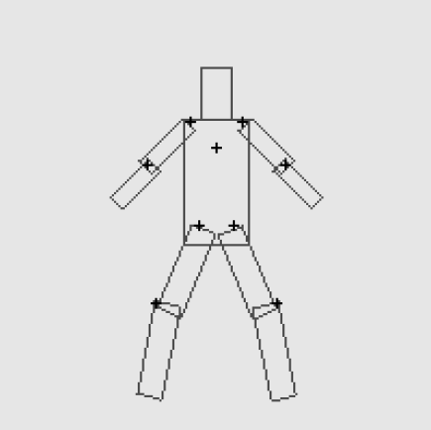
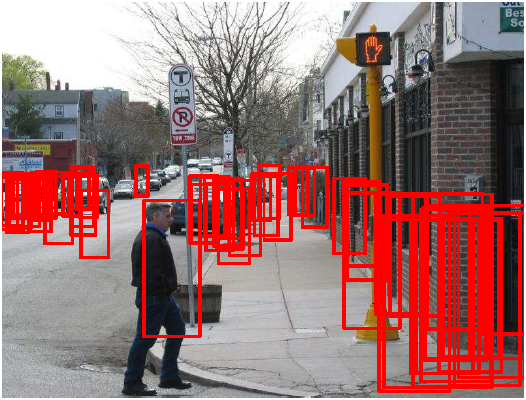
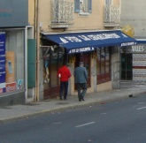
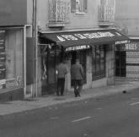
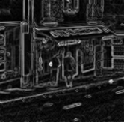
Part-based person detector
4 main components:
Feature selection
Part detection
Spatial model
NMS / context
Color
Intensity
Edges
Hoiem et al., 2006
Felzenszwalb et al., 2005

Slide 65

How can we help?
Humans supply training data…
  100,000s labeled images
Help me!
We design the algorithms.
  Going on 40 years.
Can we use humans to debug?

Slide 66
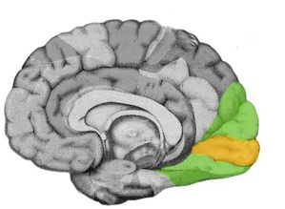
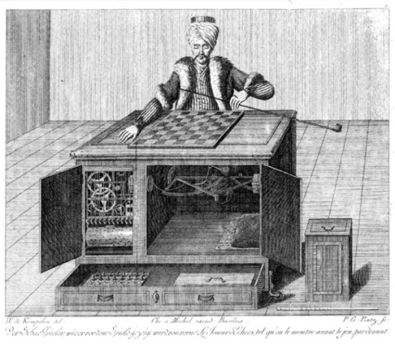
Human debugging
Feature selection
Part detection
Spatial model
NMS / context
Feature selection
Spatial model
NMS / context
Feature selection
Part detection
NMS / context
Amazon Mechanical Turk
Feature selection
Part detection

Slide 67
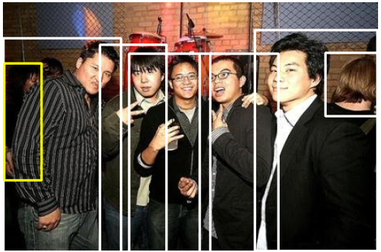
Human performance
Humans ~90% average precision
Machines ~46% average precision
PASCAL VOC dataset

Slide 68







Human debugging
Feature selection
Spatial model
NMS / context
Is it a head, torso, arm, leg, foot, hand, or nothing?
Head
Leg
Nothing
Low resolution 20x20 pixels
Feet
Head
?

Slide 69
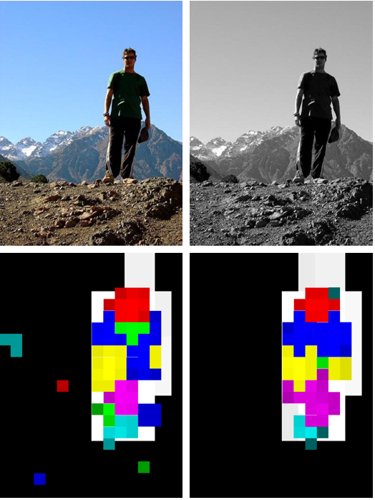
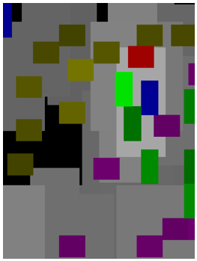
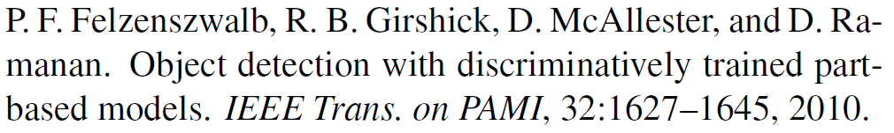
Part detections
Head
Torso
Arm
Hand
Leg
Foot
Person
Machine
Humans

Slide 70


Part detections
Machine
Humans

Slide 71


Part detections
Machine
Humans

Slide 72



Part detections
High res
Low res
Machine

Slide 73



AP results

Slide 74


Spatial model
Feature selection
Part detection
NMS / context
Person
High res
Not a person
Low res

Slide 75


Spatial model

Slide 76





Context/NMS
vs.
NMS / context

Slide 77

Conclusion

Slide 78

http://www.ted.com/talks/lang/eng/pawan_sinha_on_how_brains_learn_to_see.html 7:00min

