Slide 1
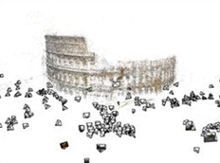
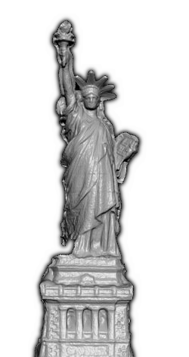
Photo Tourism ++
Computer Vision
CSE P 576, Spring 2011
Richard Szeliski
Microsoft Research
Notes:
1

Slide 2
Photo Tourism ++
Richard Szeliski
Microsoft Research
Interactive Visual Media Group
Noah Snavely
Cornell University
Steve Seitz, Ian Simon, Sameer Agarwal
University of Washington &
Microsoft & Google
Notes:
2

Slide 3
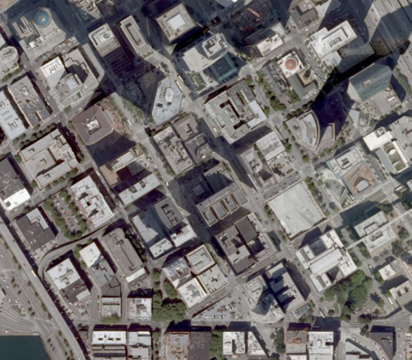
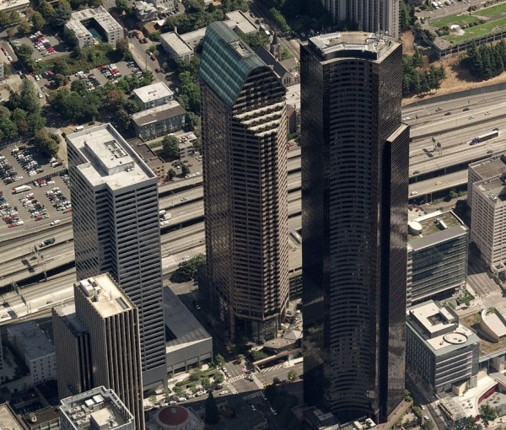
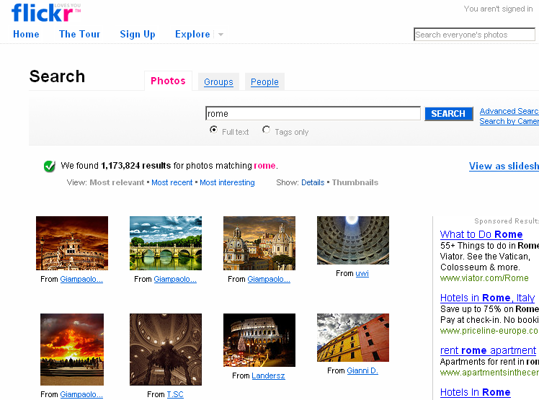
The world in photos
There are billions of photos online
Photographic record of the surface of the earth
Photo sharing on a massive scale

Slide 4

20,000 images of Rome

Slide 5
Flickr
2.5 billion
2 billion
1.5 billion
1 billion
500 million

Slide 6

Photo Sharing
How can we manipulate
(visualize, navigate, find)
such immense numbers
of images?

Slide 7
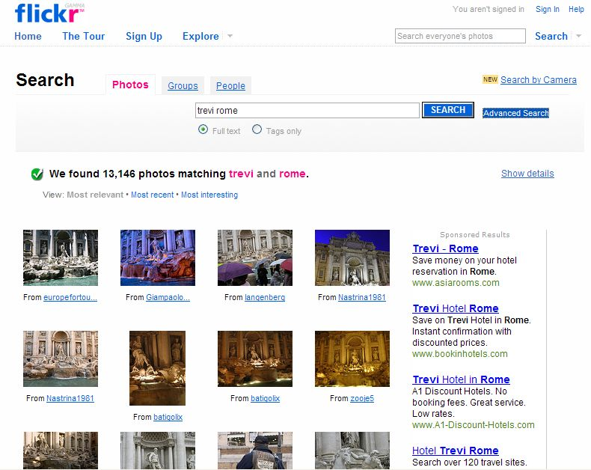
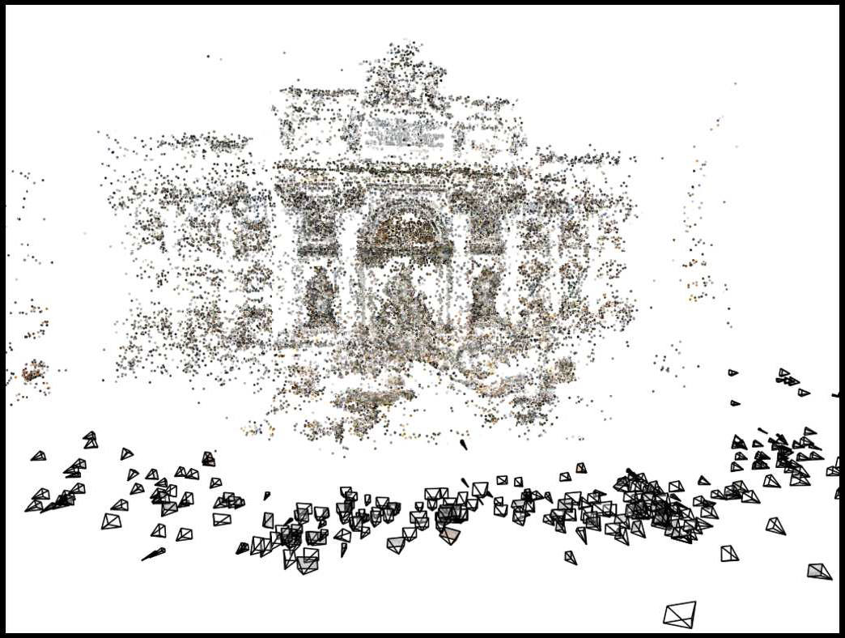
Photo Tourism
[Snavely, Seitz, Szeliski, SIGGRAPH 2006]
Images on the Internet
Computed 3D structure

Slide 8
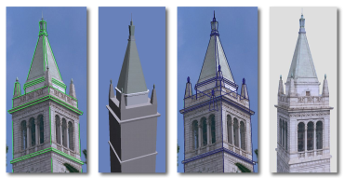
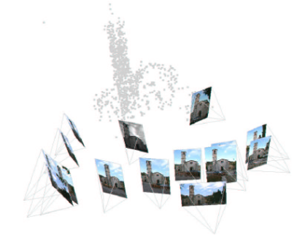
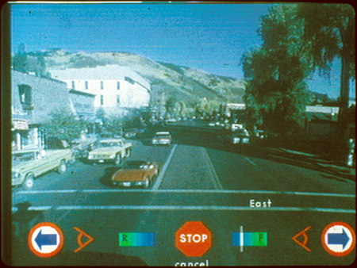
Related work
Image-based modeling
Image-based rendering
Debevec, et al.
SIGGRAPH 1996
Schaffalitzky and Zisserman ECCV 2002
Brown and Lowe
3DIM 2005
Photorealistic IBR:
Levoy and Hanrahan, SIGGRAPH 1996
Gortler, et al, SIGGRAPH 1996
Seitz and Dyer, SIGGRAPH 1996
Aliaga, et al, SIGGRAPH 2001
Uyttendaele, et al, CG&A 2004
Aspen Movie Map
Lippman, et al., 1978
Notes:
Before I get into the details of our system, I’ll briefly discuss some relevant prior work.
Our system uses automatic image-based modeling to recover the geometry of the scene. Prior work in this area includes the semi-automatic Façade system of Debevec and collegues, as well as other work, such as that of Schaffaltzky and Zisserman and Brown and Lowe on automatic structure from motion on unordered sets of images. However, to our knowledge, our modeling system is the first to be successfully applied to hundreds of images taken from the Internet.
Our work also uses image-based rendering to depict transitions between images. The Aspen Movie Map project at MIT, which created an interactive virtual tour of the city of Aspen, is one system in this area with many of the same exploration features as ours, but which required extensive manual effort to create.
More recent image-based rendering techniques seek to create photo-realistic in-between images, while our system focuses on the photographs themselves, using transitions only as a way to get between two photos.

Slide 9
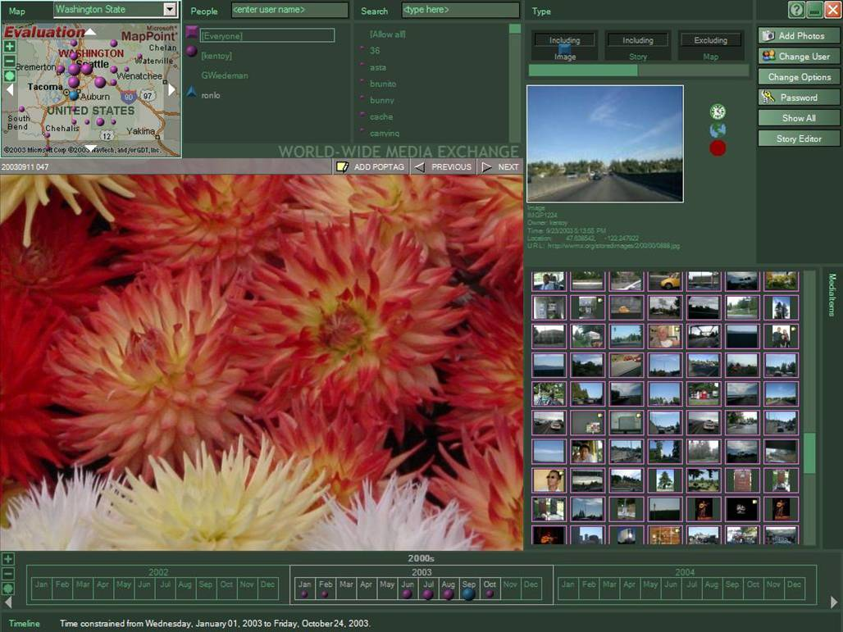
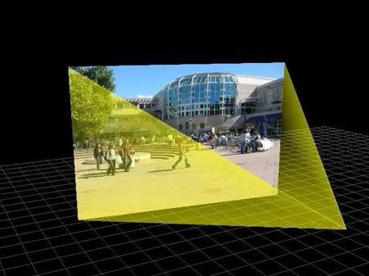
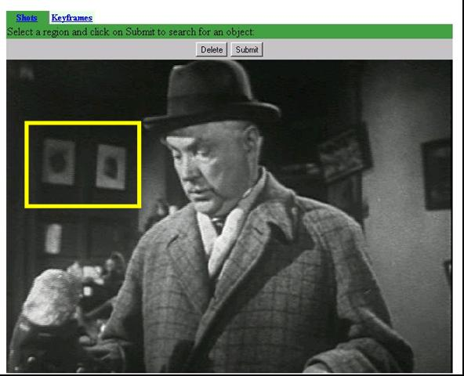
Related work
Image browsing
Toyama, et al,
World Wide Media Exchange
Int. Conf. Multimedia, 2003
McCurdy and Griswold
Mobisys 2003
Sivic and Zisserman
ICCV 2003
Notes:
Finally, there is a lot of related work in the field of image browsing and image retrieval. WWMX is a photo-browsing web site that also uses location information to organize photos, but doesn’t provide an immersive browsing experience. The Realityflythrough project uses GPS information to situate video streams in space in an interface similar to ours, but our system works without GPS. Finally, Video Google allows users to find objects in videos by selecting them. We have similar tools in our explorer, but in the context of a 3D photo browser.

Slide 10
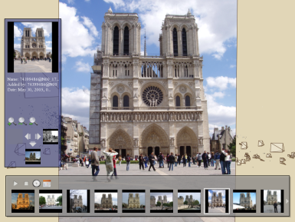
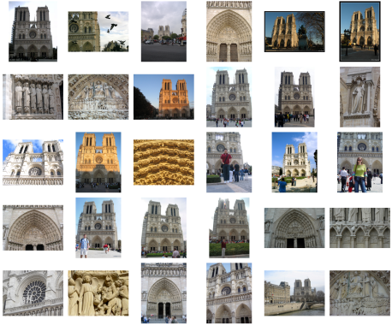
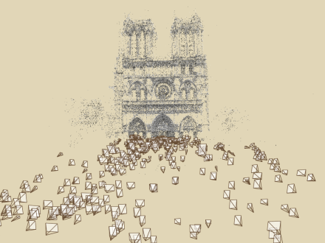
Photo Tourism overview
Photo Explorer
Scene reconstruction
Input photographs
Relative camera positions and orientations
Point cloud
Sparse correspondence
Notes:
Our system takes as input an unordered set of photos, either from an Internet search or from a large personal collection. We assume the photos are largely from the same static scene.
The first step of our system is to apply a computer vision techniques to reconstruct the geometry of the scene. The output of this procedure is the relative positions and orientation for the cameras used to take a connected set of the photographs, as well as a point cloud representing the geometry of the scene, and a sparse set of correspondences between the photos.
This information is then loaded into our interactive photo explorer tool.

Slide 11
Scene reconstruction
Automatically estimate
  position, orientation, and focal length of cameras
  3D positions of feature points
Feature detection
Incremental structure from motion
Pairwise
feature matching
Correspondence estimation
Notes:
Again, the goal of the reconstruction procedure is to automatically estimate the relative positions and orientations, as well as the focal length or zoom, of each of the photographs in a connected component of the scene. The process consists of four steps: detecting features in each of the input photos; matching features between each pair of photos; grouping the matches into correspondences across multiple photos; and using the correspondences to estimate the geometry of the scene and the cameras in a technique known as structure from motion.
I’ll now describe each of these steps in more detail.
[Structure from motion techniques for unordered image collections have also been developed by others, such as Brown and Lowe and Schaffalitzky and Zisserman, and the basic pipeline of our system closely follows that of Brown and Lowe. To our knowledge, our system is the first to have been demonstrated on large collections of photos from the Internet.]

Slide 12
Structure from motion
p₄
p₁
p₃
minimize
p₂
f (R, T, P)
p₅
p₇
p₆
Camera 1
Camera 3
R₁,t₁
R₃,t₃
Camera 2
R₂,t₂
Notes:
Structure from motion solves the following problem:
Given a set of images of a static scene with 2D points in correspondence, shown here as color-coded points, find…
a set of 3D points P and
a rotation R and position t of the cameras that explain the observed correspondences. In other words, when we project a point into any of the cameras, the reprojection error between the projected and observed 2D points is low.
This problem can be formulated as an optimization problem where we want to find the rotations R, positions t, and 3D point locations P that minimize sum of squared reprojection errors f. This is a non-linear least squares problem and can be solved with algorithms such as Levenberg-Marquart. However, because the problem is non-linear, it can be susceptible to local minima. Therefore, it’s important to initialize the parameters of the system carefully. In addition, we need to be able to deal with erroneous correspondences.

Slide 13
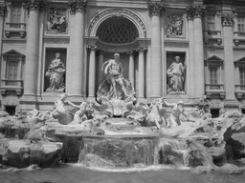
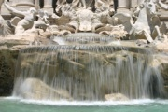
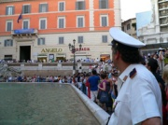
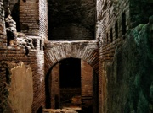
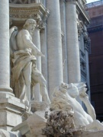
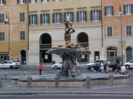
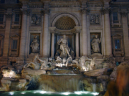
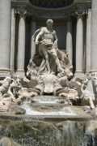

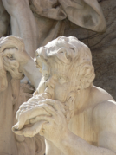
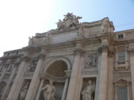
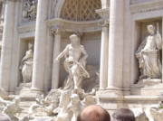
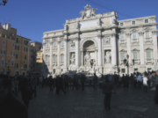

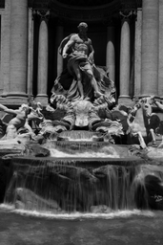

Incremental structure from motion
Automatically select an initial pair of images
Notes:
To help get good initializations for all of the parameters of the system, we reconstruct the scene incrementally, starting from two photographs and the points they observe.

Slide 14
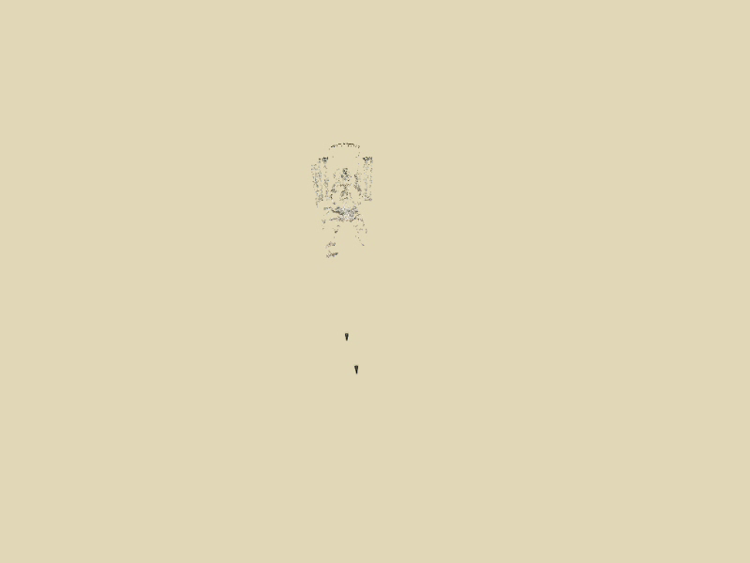
Incremental structure from motion
Notes:
We then add several photos at a time to the reconstruction, refine the model, and repeat until no more photos match any points in the scene.

Slide 15
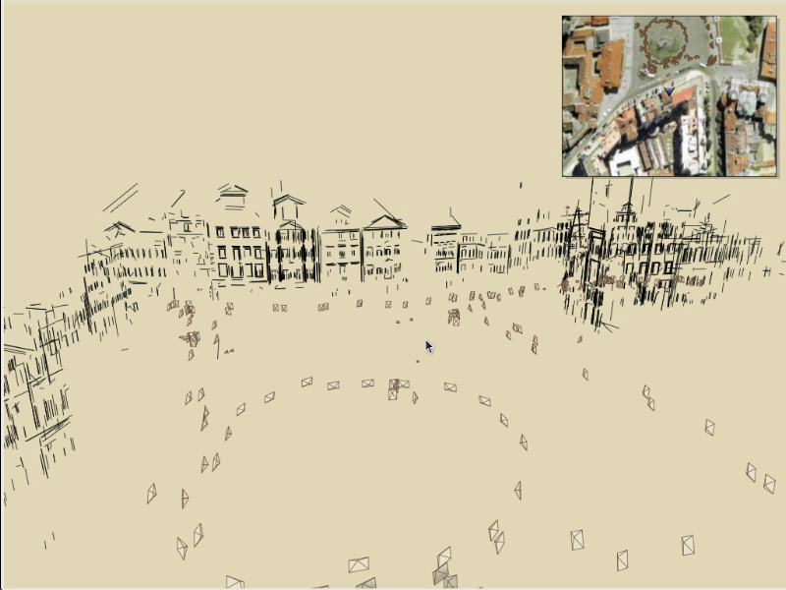
Navigation: Prague Old Town Square
Notes:
Now we’ll move on to another dataset to demonstrate some more of the navigation features of our system.
This is a reconstruction of the Old Town Square in Prague from about 200 photos, shown inside our photo explorer. An overhead map is shown in the upper right corner.
For this dataset, we render the scene using 3D line segments and add color to the scene by projecting blurred, partially transparent versions of the photos onto detected planes.
The user can select photos from the map, and the map tracks the movement of the virtual camera. Here the user selects a building to see a better picture.
Now here’s another example of relation-based browsing – the user can click on the “move right” button to move right to the next building in the row of façades.
Now the user clicks on the zoom out button to see more of the scene.

Slide 16
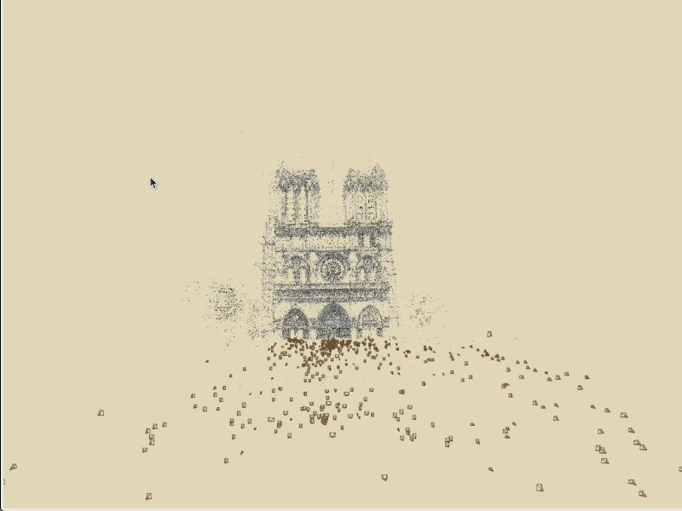
Annotations: Notre Dame

Slide 17
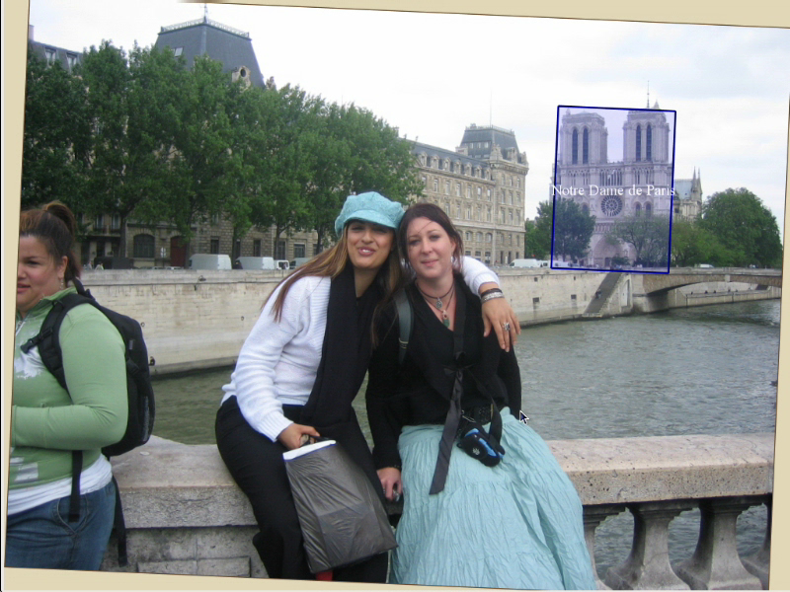
Hierarchical annotations

Slide 18
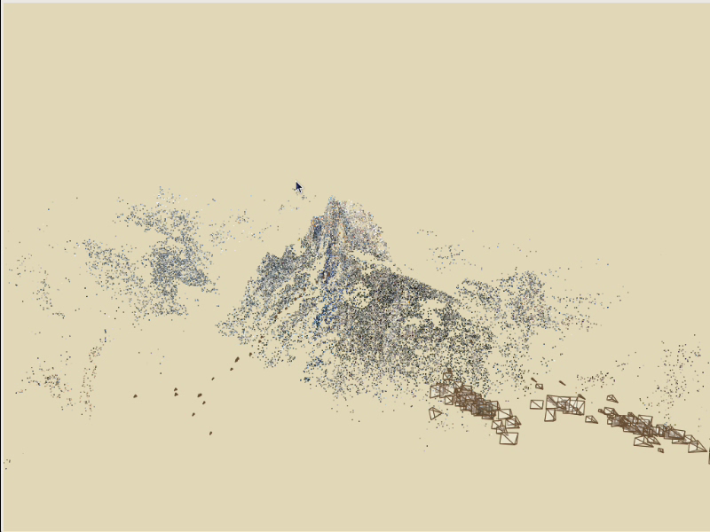
Locking the camera (stabilization)

Slide 19
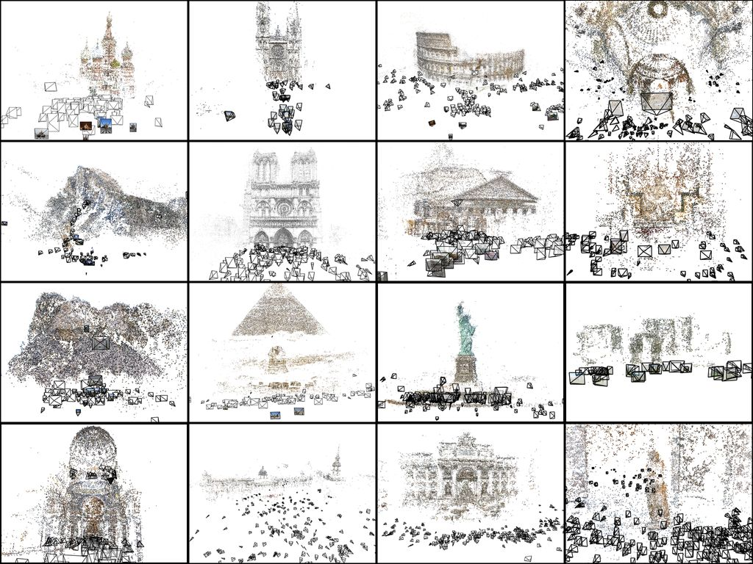

Slide 20
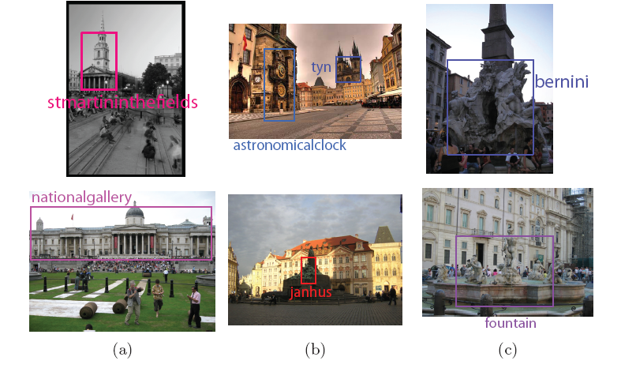
Scene Segmentation Using the Wisdom of Crowds
[Simon and Seitz, ECCV 2008]

Slide 21
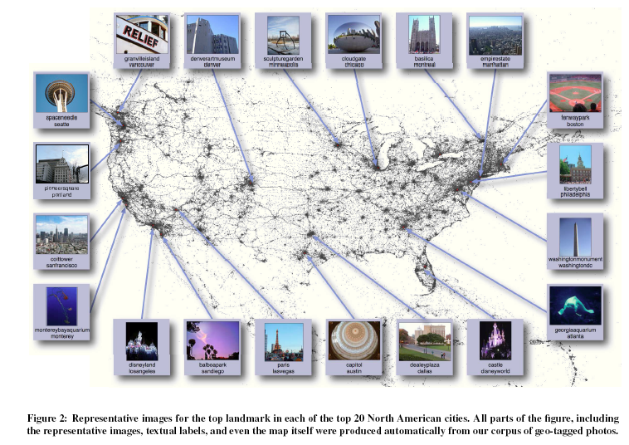
Mapping the World’s Photos
David Crandall, Lars Backstrom, Daniel Huttenlocher and Jon Kleinberg

Slide 22
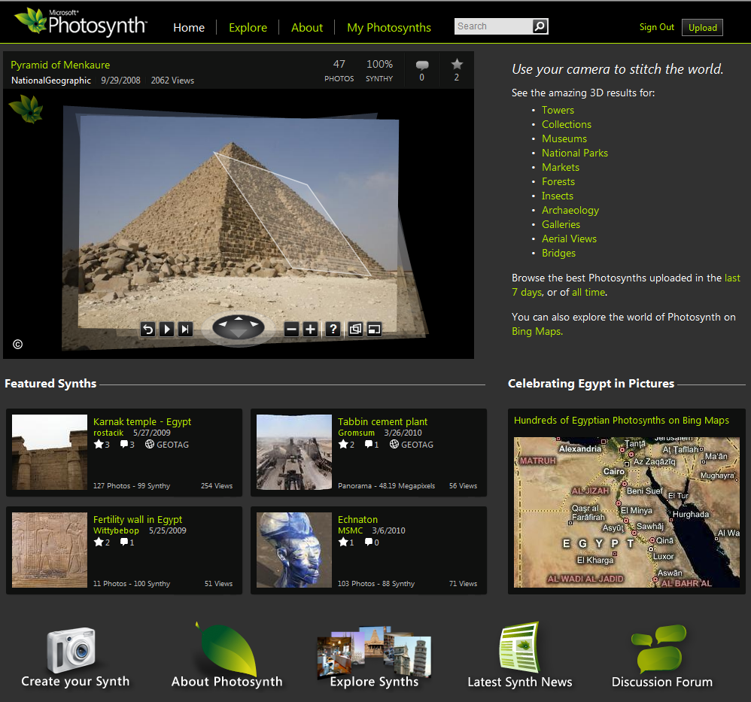
Microsoft Photosynth
http://photosynth.net/

Slide 23
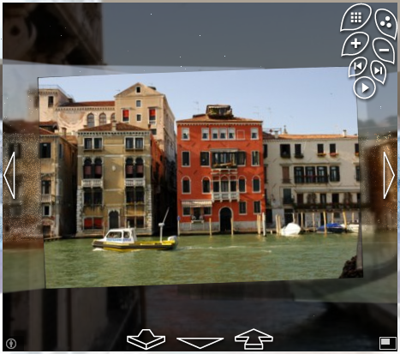
Microsoft Photosynth
3D reconstruction
Multi-resolution streaming & zooming
Quad-based
exploration
Community
photo sharing
http://photosynth.net/

Slide 24
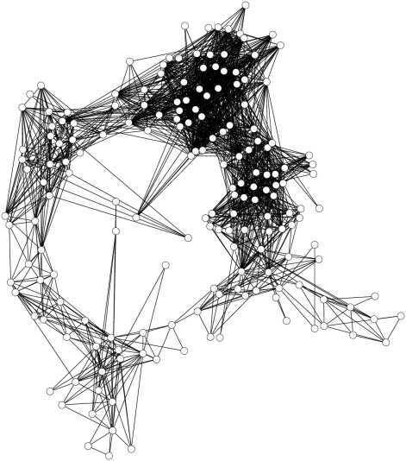
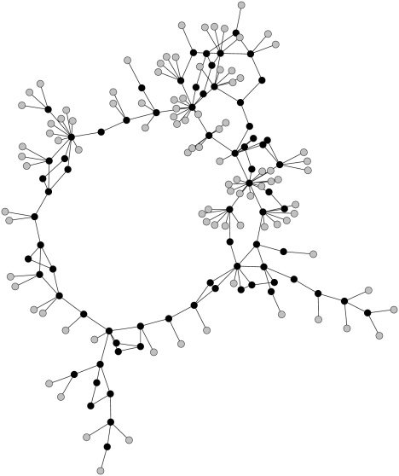
Skeletal graphs for efficient structure from motion
Noah Snavely, Steve Seitz,
Richard Szeliski
CVPR’2008

Slide 25
Large-scale reconstruction
Most of the models shown so far have had ~500 images
How do we scale from 100s to 10,000s of images?
Observation: Internet collections represent very non-uniform samplings of viewpoint

Slide 26
Skeletal set
Goal: select a smaller set of images to reconstruct, without sacrificing quality of reconstruction
Two problems:
  How do we measure quality?
  How do we find a subset of images with bounded quality loss?

Slide 27

Skeletal set
Goal: given an image graph ,
select a small set S of important images to reconstruct, bounding the loss in quality of the reconstruction
Reconstruct the skeletal set S
Estimate the remaining images with much faster pose estimation steps

Slide 28
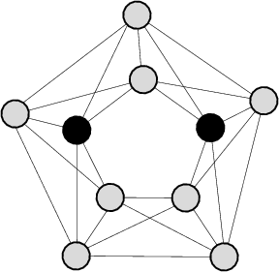

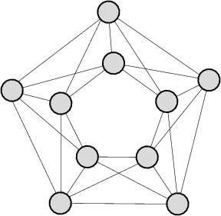
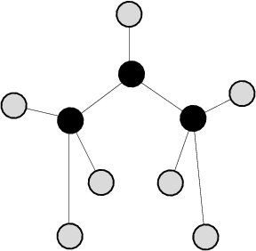
Properties of the skeletal set
Should touch all parts of
  Dominating set
Should form a single reconstruction
  Connected dominating set
Should result in an accurate reconstruction
?

Slide 29
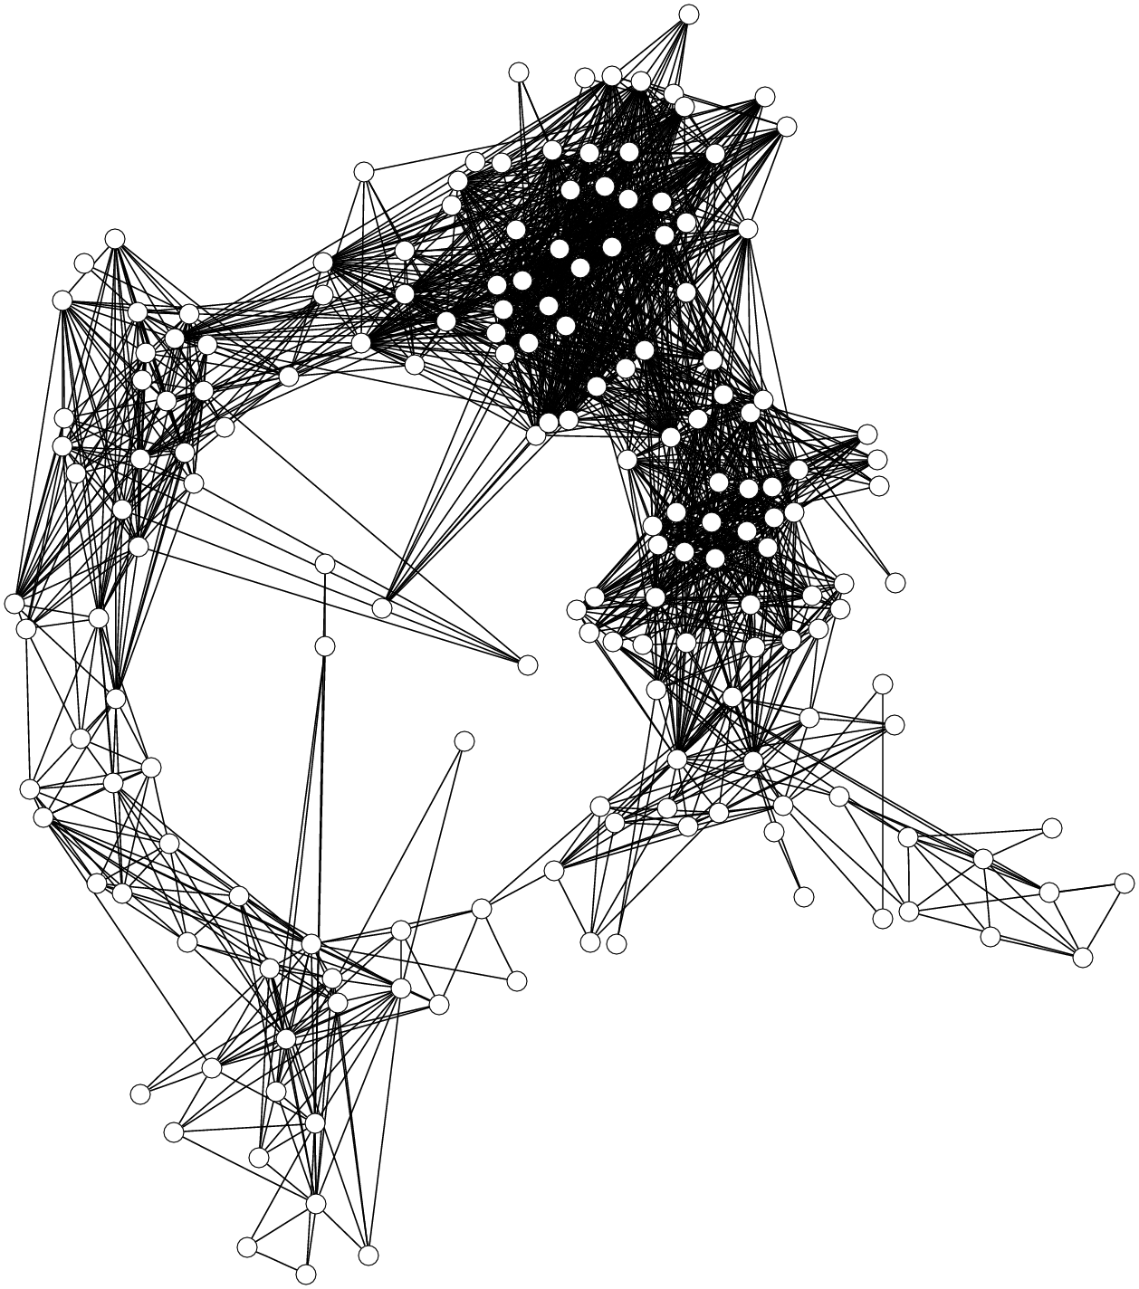
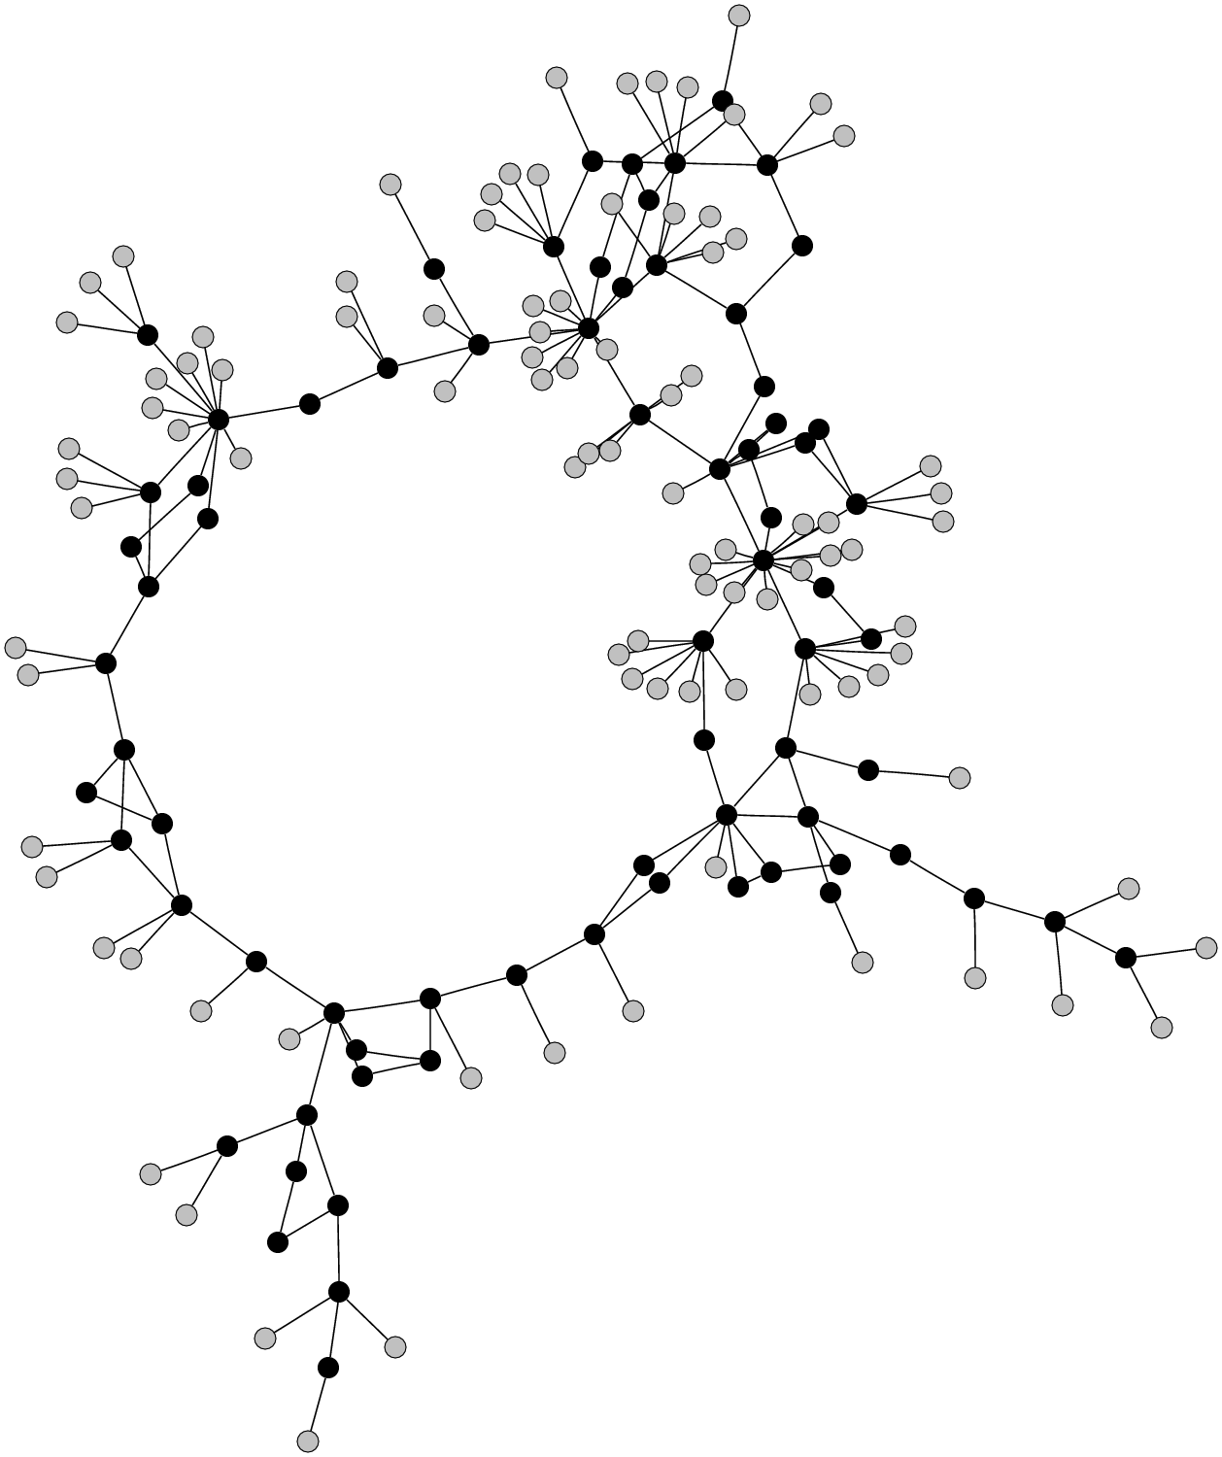
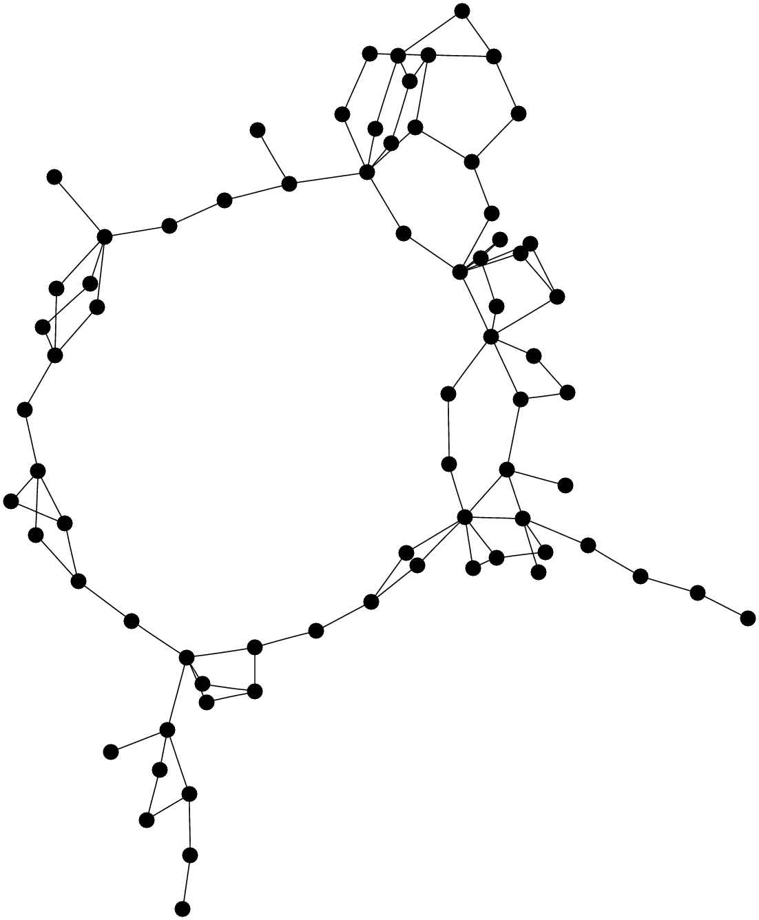
Example
Full graph
Skeletal graph

Slide 30
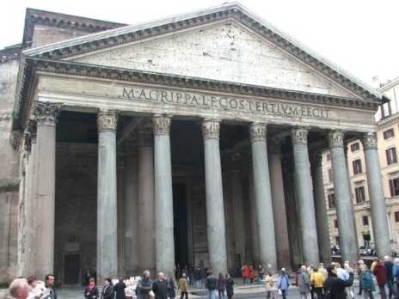
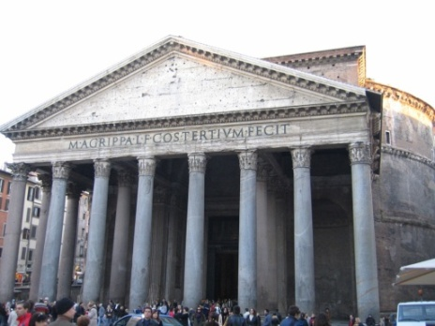
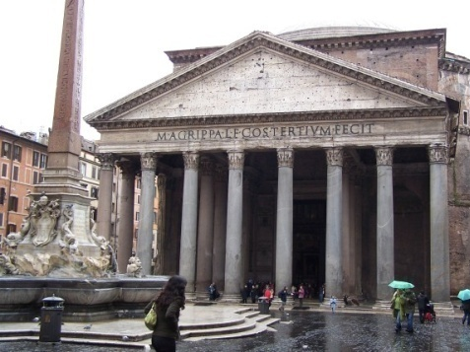
Representing information in a graph
What kind of information?
  No absolute information about camera positions
  Each edge provides information about the relative positions of two images
  … but not all edges are equally informative
We model information with the uncertainty (covariance) in pairwise camera positions

Slide 31
Estimating certainty
Usually measured with covariance matrix
SfM has thousands or millions of parameters
We only measure covariance in camera positions (3x3 matrix for every camera)

Slide 32


Pantheon
Full graph
Skeletal graph (t=16)

Slide 33



Pantheon
Skeletal reconstruction
101 images
After adding leaves
579 images
After final optimization
579 images

Slide 34


Trafalgar Square
2973 images registered (277 in skeletal set)

Slide 35


Trafalgar Square

Slide 36

Object retrieval with large vocabularies and fast spatial matching
[Philbin et al. CVPR 2008]

Slide 37

Object Mining using a Matching Graph on Very Large Image Collections
[Philbin and Zisserman. ICCVGIP 2008]

Slide 38

Modeling and Recognition of Landmark Image
Collections Using Iconic Scene Graphs
[Li et al., ECCV 2008]

Slide 39


Building Rome in a Day
Sameer Agarwal, Noah Snavely,
Ian Simon, Steven M. Seitz,
Richard Szeliski
ICCV’2009

Slide 40

Distributed matching pipeline

Slide 41

Query expansion

Slide 42

Results: Dubrovnik

Slide 43


Slide 44

Results: Rome

Slide 45

Reconstructing Rome on a Cloudless Day
[J.M. Frahm et al., ECCV 2010]

Slide 46
Applications

Slide 47



Community photo collections
“Wikipedia for photos” – visual record of world through community of photographers
  Geograph British Isles http://www.geograph.org.uk/
Users can tag and comment on photos, link to other content
  World-wide telescope
“Where should I take a photo?”
  http://photocitygame.com/

Slide 48


Community photo collections
Leveraging large databases of photos, large number of users
  Annotations / augmented reality

Slide 49







Virtual tour guide scenario
St. Peter’s Basilica
Built: 1506-1626
http://en.wikipedia.org/wiki/St._Peter's_Basilica
St. Peter’s Basilica
Built: 1506-1626

Slide 50




Rephotography
Topographic data courtesy USGS

Slide 51





Internet Computer Vision

Slide 52



Summary
Large (Internet) photo collections: the next frontier in computer vision
Efficient algorithms for large-scale 3D matching and reconstruction
New challenges for 3D recognition

Slide 54


