Slide 1
Structure from Motion
Computer Vision CSE P 576, Spring 2011 Richard Szeliski Microsoft Research

Slide 2
Today’s lecture
Geometric camera calibration
camera matrix (Direct Linear Transform)
non-linear least squares
separating intrinsics and extrinsics
focal length and optic center

Slide 3
Today’s lecture
Structure from Motion
triangulation and pose
two-frame methods
factorization
bundle adjustment
robust statistics
Photo Tourism

Slide 4
Parameterizing rotations
How do we parameterize R and ΔR?
Euler angles: bad idea
quaternions: 4-vectors on unit sphere
use incremental rotation R(I + ΔR)
update with Rodriguez formula

Slide 5
Camera Calibration

Slide 6
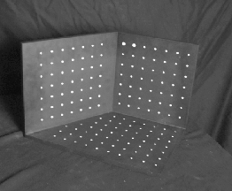
Camera calibration
Determine camera parameters from known 3D points or calibration object(s)
internal or intrinsic parameters such as focal length, optical center, aspect ratio: what kind of camera?
external or extrinsic (pose) parameters: where is the camera?
How can we do this?

Slide 7
Camera calibration – approaches
Possible approaches:
linear regression (least squares)
non-linear optimization
vanishing points
multiple planar patterns
panoramas (rotational motion)

Slide 8
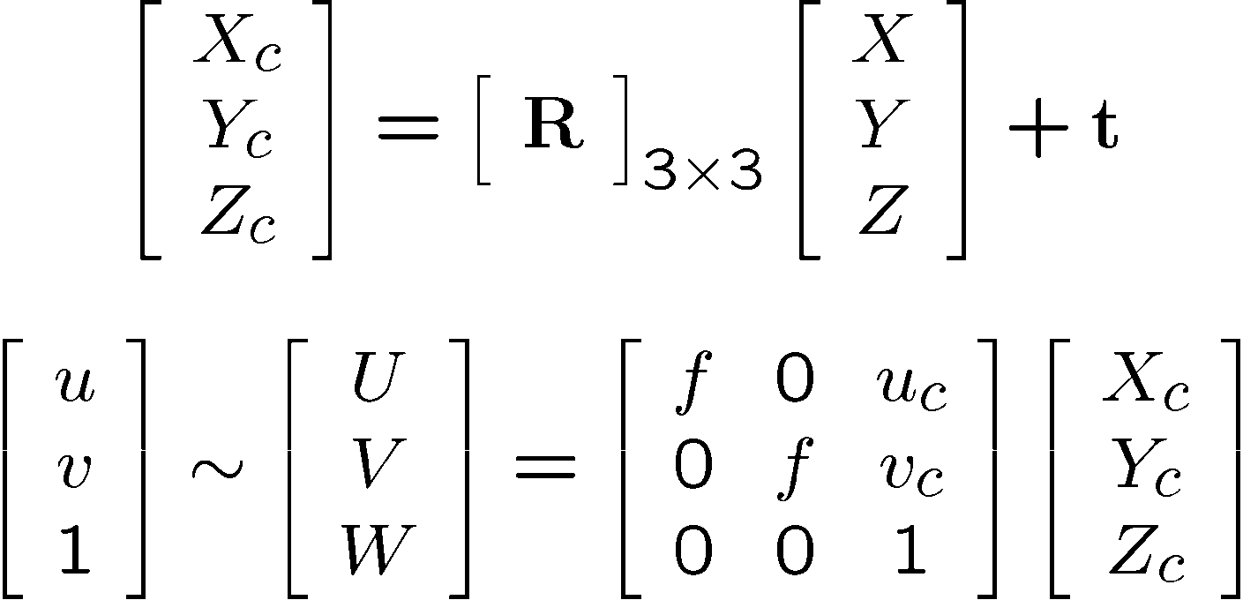
Image formation equations
(X_{c},Y_{c},Z_{c})
f
u_{c}
u

Slide 9
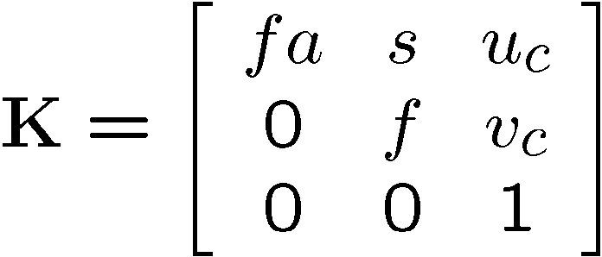
Calibration matrix
Is this form of K good enough?
non-square pixels (digital video)
skew
radial distortion

Slide 10
Camera matrix
Fold intrinsic calibration matrix K and extrinsic pose parameters (R,t) together into a camera matrix
M = K [R | t ]
(put 1 in lower r.h. corner for 11 d.o.f.)

Slide 11
Camera matrix calibration
Directly estimate 11 unknowns in the M matrix using known 3D points (X_{i},Y_{i},Z_{i}) and measured feature positions (u_{i},v_{i})

Slide 12
Camera matrix calibration
Linear regression:
Bring denominator over, solve set of (over-determined) linear equations. How?
Least squares (pseudo-inverse)
Is this good enough?

Slide 13
Optimal estimation
Feature measurement equations
Likelihood of M given {(u_{i},v_{i})}

Slide 14
Optimal estimation
Log likelihood of M given {(u_{i},v_{i})}
How do we minimize C?
Non-linear regression (least squares), because û_{i} and v_{i} are non-linear functions of M

Slide 15
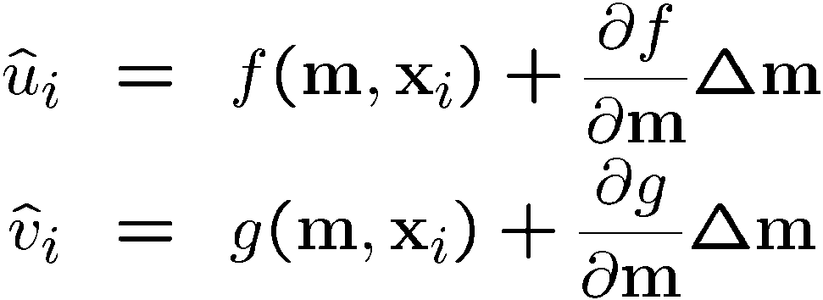
Levenberg-Marquardt
Iterative non-linear least squares [Press’92]
Linearize measurement equations
Substitute into log-likelihood equation: quadratic cost function in Δm

Slide 16
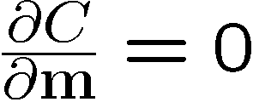
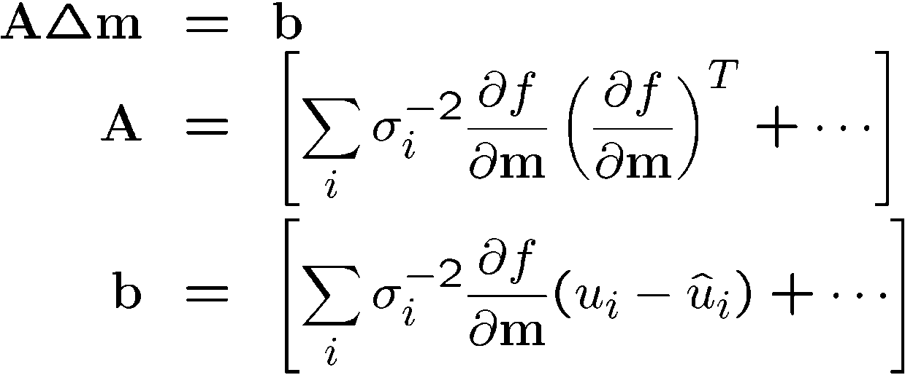
Levenberg-Marquardt
Iterative non-linear least squares [Press’92]
Solve for minimum Hessian: error:

Slide 17
Levenberg-Marquardt
What if it doesn’t converge?
Multiply diagonal by (1 + λ), increase λ until it does
Halve the step size Δm
Use line search
Other ideas?
Uncertainty analysis: covariance Σ = A⁻¹
Is maximum likelihood the best idea?
How to start in vicinity of global minimum?

Slide 18
Camera matrix calibration
Advantages:
very simple to formulate and solve
can recover K [R | t] from M using QR decomposition [Golub & VanLoan 96]
Disadvantages:
doesn't compute internal parameters
more unknowns than true degrees of freedom
need a separate camera matrix for each new view

Slide 19
Separate intrinsics / extrinsics
New feature measurement equations
Use non-linear minimization
Standard technique in photogrammetry, computer vision, computer graphics
[Tsai 87] – also estimates κ₁ (freeware @ CMU) http://www.cs.cmu.edu/afs/cs/project/cil/ftp/html/v-source.html
[Bogart 91] – View Correlation

Slide 20
Intrinsic/extrinsic calibration
Advantages:
can solve for more than one camera pose at a time
potentially fewer degrees of freedom
Disadvantages:
more complex update rules
need a good initialization (recover K [R | t] from M)

Slide 21
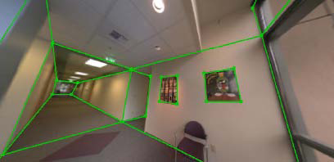
Vanishing Points
Determine focal length f and optical center (u_{c},v_{c}) from image of cube’s (or building’s) vanishing points [Caprile ’90][Antone & Teller ’00]
u₀
u₁
u₂

Slide 22
Vanishing Points
X, Y, and Z directions, X_{i} = (1,0,0,0) … (0,0,1,0) correspond to vanishing points that are scaled version of the rotation matrix:
u₀
u₁
(X_{c},Y_{c},Z_{c})
u₂
f
u_{c}
u

Slide 23
Vanishing Points
Orthogonality conditions on rotation matrix R,
r_{i} ¢r_{j} = δ_{ij}
Determine (u_{c},v_{c}) from orthocenter of vanishing point triangle
Then, determine f² from two equations (only need 2 v.p.s if (u_{c},v_{c}) known)
u₀
u₁
u₂

Slide 24
Vanishing point calibration
Advantages:
only need to see vanishing points (e.g., architecture, table, …)
Disadvantages:
not that accurate
need rectihedral object(s) in scene

Slide 25
Single View Metrology
A. Criminisi, I. Reid and A. Zisserman (ICCV 99)
Make scene measurements from a single image
Application: 3D from a single image
Assumptions
3 orthogonal sets of parallel lines
4 known points on ground plane
1 height in the scene
Can still get an affine reconstruction without 2 and 3

Slide 26
Criminisi et al., ICCV 99
Complete approach
Load in an image
Click on parallel lines defining X, Y, and Z directions
Compute vanishing points
Specify points on reference plane, ref. height
Compute 3D positions of several points
Create a 3D model from these points
Extract texture maps
Output a VRML model

Slide 27
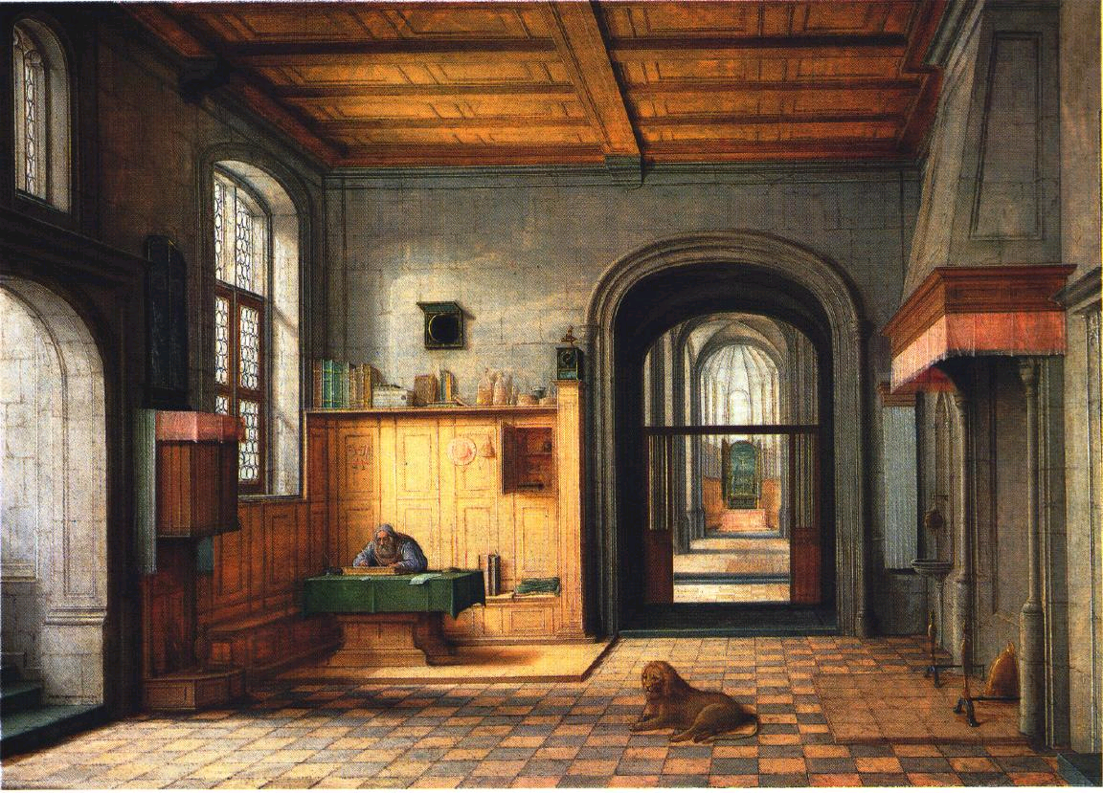
3D Modeling from a Photograph

Slide 28
3D Modeling from a Photograph

Slide 29
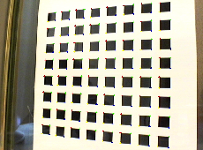
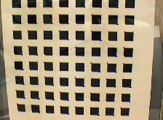
Multi-plane calibration
Use several images of planar target held at unknown orientations [Zhang 99]
Compute plane homographies
Solve for K^{-T}K⁻¹ from H_{k}’s
1plane if only f unknown
2 planes if (f,u_{c},v_{c}) unknown
3+ planes for full K
Code available from Zhang and OpenCV

Slide 30
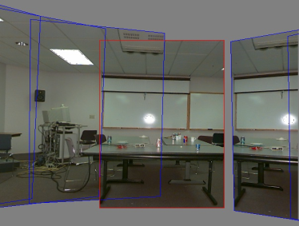
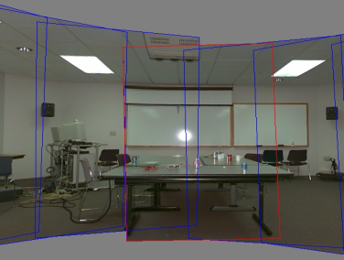
Rotational motion
Use pure rotation (large scene) to estimate f
estimate f from pairwise homographies
re-estimate f from 360º “gap”
optimize over all {K,R_{j}} parameters [Stein 95; Hartley ’97; Shum & Szeliski ’00; Kang & Weiss ’99]
Most accurate way to get f, short of surveying distant points
f=510
f=468

Slide 31
Pose estimation and triangulation

Slide 32
Pose estimation
Once the internal camera parameters are known, can compute camera pose
[Tsai87] [Bogart91]
Application: superimpose 3D graphics onto video
How do we initialize (R,t)?

Slide 33
Pose estimation
Previous initialization techniques:
vanishing points [Caprile 90]
planar pattern [Zhang 99]
Other possibilities
Through-the-Lens Camera Control [Gleicher92]: differential update
3+ point “linear methods”:
[DeMenthon 95][Quan 99][Ameller 00]

Slide 34
Pose estimation
Solve orthographic problem, iterate
[DeMenthon 95]
Use inter-point distance constraints
[Quan 99][Ameller 00]
Solve set of polynomial equations in x_{i}^{2p}
(X_{c},Y_{c},Z_{c})
f
u_{c}
u

Slide 35
Triangulation
Problem: Given some points in correspondence across two or more images (taken from calibrated cameras), {(u_{j},v_{j})}, compute the 3D location X

Slide 36
Triangulation
Method I: intersect viewing rays in 3D, minimize:
X is the unknown 3D point
C_{j} is the optical center of camera j
V_{j} is the viewing ray for pixel (u_{j},v_{j})
s_{j} is unknown distance along V_{j}
Advantage: geometrically intuitive
X
V_{j}
C_{j}

Slide 37
Triangulation
Method II: solve linear equations in X
advantage: very simple
Method III: non-linear minimization
advantage: most accurate (image plane error)

Slide 38
Structure from Motion

Slide 39
Today’s lecture
Structure from Motion
two-frame methods
factorization
bundle adjustment
robust statistics

Slide 40
Structure from motion
p₄
p₁
p₃
minimize
p₂
f (R, T, P)
p₅
p₇
p₆
Camera 1
Camera 3
R₁,t₁
R₃,t₃
Camera 2
R₂,t₂
Notes:
Structure from motion solves the following problem:
Given a set of images of a static scene with 2D points in correspondence, shown here as color-coded points, find…
a set of 3D points P and
a rotation R and position t of the cameras that explain the observed correspondences. In other words, when we project a point into any of the cameras, the reprojection error between the projected and observed 2D points is low.
This problem can be formulated as an optimization problem where we want to find the rotations R, positions t, and 3D point locations P that minimize sum of squared reprojection errors f. This is a non-linear least squares problem and can be solved with algorithms such as Levenberg-Marquart. However, because the problem is non-linear, it can be susceptible to local minima. Therefore, it’s important to initialize the parameters of the system carefully. In addition, we need to be able to deal with erroneous correspondences.

Slide 41
Structure from motion
Given many points in correspondence across several images, {(u_{ij},v_{ij})}, simultaneously compute the 3D location x_{i} and camera (or motion) parameters (K, R_{j}, t_{j})
Two main variants: calibrated, and uncalibrated (sometimes associated with Euclidean and projective reconstructions)

Slide 42
Structure from motion
How many points do we need to match?
2 frames:
(R,t): 5 dof + 3n point locations ≤
4n point measurements ⇒
n ≥ 5
k frames:
6(k–1)-1 + 3n ≤ 2kn
always want to use many more

Slide 43
Two-frame methods
Two main variants:
Calibrated: “Essential matrix” E use ray directions (x_{i}, x_{i}’ )
Uncalibrated: “Fundamental matrix” F
[Hartley & Zisserman 2000]

Slide 44
Essential matrix
Co-planarity constraint:
x’ ≈ R x + t
[t]× x’ ≈ [t]× R x
x’^{T} [t]× x’ ≈ x’ ^{T} [t]× R x
x’ ^{T} E x = 0 with E =[t]× R
Solve for E using least squares (SVD)
t is the least singular vector of E
R obtained from the other two sing. vectors

Slide 45
Fundamental matrix
Camera calibrations are unknown
x’ F x = 0 with F = [e]× H = K’[t]× R K⁻¹
Solve for F using least squares (SVD)
re-scale (x_{i}, x_{i}’ ) so that |x_{i}|≈1/2 [Hartley]
e (epipole) is still the least singular vector of F
H obtained from the other two s.v.s
“plane + parallax” (projective) reconstruction
use self-calibration to determine K [Pollefeys]

Slide 46
Three-frame methods
Trifocal tensor
[Hartley & Zisserman 2000]

Slide 47
Multi-frame Structure from Motion

Slide 48
Factorization
[Tomasi & Kanade, IJCV 92]

Slide 49
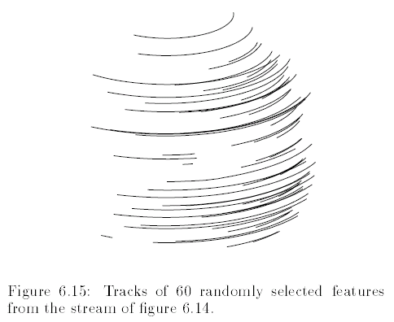
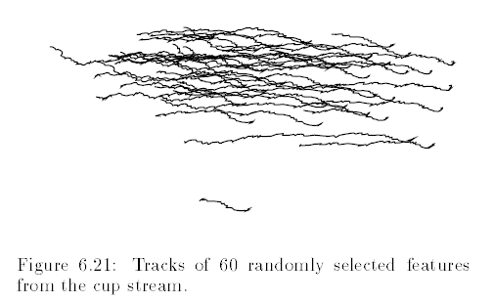
Structure [from] Motion
Given a set of feature tracks, estimate the 3D structure and 3D (camera) motion.
Assumption: orthographic projection

Slide 50
Structure [from] Motion
Given a set of feature tracks, estimate the 3D structure and 3D (camera) motion.
Assumption: orthographic projection
Tracks: (u_{fp},v_{fp}), f: frame, p: point
Subtract out mean 2D position…
u_{fp} = i_{f}^{T} s_{p} i_{f}: rotation, s_{p}: position
v_{fp} = j_{f}^{T} s_{p}

Slide 51
Measurement equations
Measurement equations
u_{fp} = i_{f}^{T} s_{p} i_{f}: rotation, s_{p}: position
v_{fp} = j_{f}^{T} s_{p}
Stack them up…
W = R S
R = (i₁,…,i_{F}, j₁,…,j_{F})^{T}
S = (s₁,…,s_{P})

Slide 52
Factorization
W = R_{2F×3} S_{3×P}
SVD
W = U Λ V Λ must be rank 3
W’ = (U Λ ^{1/2})(Λ^{1/2} V) = U’ V’
Make R orthogonal
R = QU’ , S = Q⁻¹V’
i_{f}^{T}Q^{T}Qi_{f} = 1 …

Slide 53
Results

Slide 54
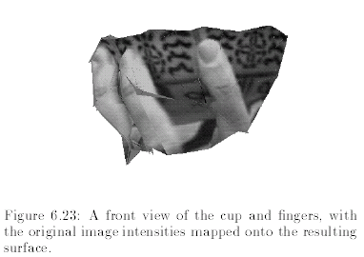
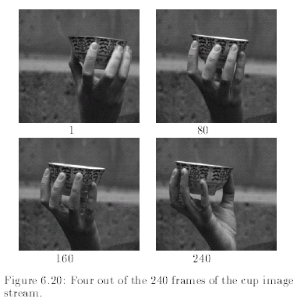
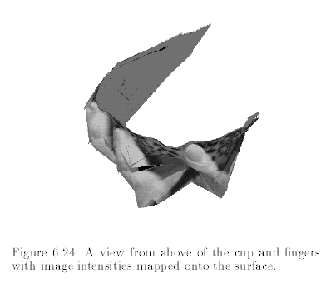
Results

Slide 55
Extensions
Paraperspective
[Poelman & Kanade, PAMI 97]
Sequential Factorization
[Morita & Kanade, PAMI 97]
Factorization under perspective
[Christy & Horaud, PAMI 96]
[Sturm & Triggs, ECCV 96]
Factorization with Uncertainty
[Anandan & Irani, IJCV 2002]

Slide 56
Bundle Adjustment
What makes this non-linear minimization hard?
many more parameters: potentially slow
poorer conditioning (high correlation)
potentially lots of outliers
gauge (coordinate) freedom

Slide 57
Levenberg-Marquardt
Iterative non-linear least squares [Press’92]
Linearize measurement equations
Substitute into log-likelihood equation: quadratic cost function in Δm

Slide 58
Levenberg-Marquardt
Iterative non-linear least squares [Press’92]
Solve for minimum Hessian: error:

Slide 59
Levenberg-Marquardt
What if it doesn’t converge?
Multiply diagonal by (1 + λ), increase λ until it does
Halve the step size Δm
Use line search
Other ideas?
Uncertainty analysis: covariance Σ = A⁻¹
Is maximum likelihood the best idea?
How to start in vicinity of global minimum?

Slide 60
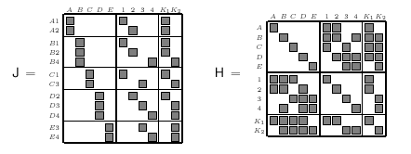
Lots of parameters: sparsity
Only a few entries in Jacobian are non-zero

Slide 61
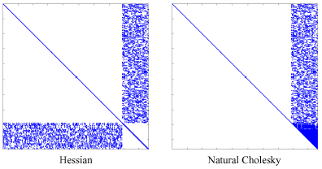
Sparse Cholesky (skyline)
First used in finite element analysis
Applied to SfM by [Szeliski & Kang 1994] structure | motion fill-in

Slide 62
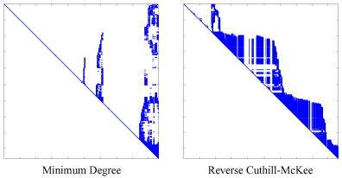
Conditioning and gauge freedom
Poor conditioning:
use 2nd order method
use Cholesky decomposition
Gauge freedom
fix certain parameters (orientation) or
zero out last few rows in Cholesky decomposition

Slide 63
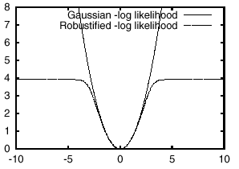
Robust error models
Outlier rejection
use robust penalty applied to each set of joint measurements
for extremely bad data, use random sampling [RANSAC, Fischler & Bolles, CACM’81]

Slide 64
Correspondences
Can refine feature matching after a structure and motion estimate has been produced
decide which ones obey the epipolar geometry
decide which ones are geometrically consistent
(optional) iterate between correspondences and SfM estimates using MCMC [Dellaert et al., Machine Learning 2003]

Slide 65
Structure from motion: limitations
Very difficult to reliably estimate metric structure and motion unless:
large (x or y) rotation or
large field of view and depth variation
Camera calibration important for Euclidean reconstructions
Need good feature tracker

Slide 66
Bibliography
M.-A. Ameller, B. Triggs, and L. Quan.
Camera pose revisited -- new linear algorithms.
http://www.inrialpes.fr/movi/people/Triggs/home.html, 2000.
M. Antone and S. Teller.
Recovering relative camera rotations in urban scenes.
In IEEE Computer Society Conference on Computer Vision and Pattern Recognition (CVPR'2000), volume 2, pages 282--289, Hilton Head Island, June 2000.
S. Becker and V. M. Bove.
Semiautomatic {3-D model extraction from uncalibrated 2-d camera views.
In SPIE Vol. 2410, Visual Data Exploration and Analysis {II, pages 447--461, San Jose, CA, February 1995. Society of Photo-Optical Instrumentation Engineers.
R. G. Bogart.
View correlation.
In J. Arvo, editor, Graphics Gems II, pages 181--190. Academic Press, Boston, 1991.

Slide 67
Bibliography
D. C. Brown.
Close-range camera calibration.
Photogrammetric Engineering, 37(8):855--866, 1971.
B. Caprile and V. Torre.
Using vanishing points for camera calibration.
International Journal of Computer Vision, 4(2):127--139, March 1990.
R. T. Collins and R. S. Weiss.
Vanishing point calculation as a statistical inference on the unit sphere.
In Third International Conference on Computer Vision (ICCV'90), pages 400--403, Osaka, Japan, December 1990. IEEE Computer Society Press.
A. Criminisi, I. Reid, and A. Zisserman.
Single view metrology.
In Seventh International Conference on Computer Vision (ICCV'99), pages 434--441, Kerkyra, Greece, September 1999.

Slide 68
Bibliography
L. {de Agapito, R. I. Hartley, and E. Hayman.
Linear calibration of a rotating and zooming camera.
In IEEE Computer Society Conference on Computer Vision and Pattern Recognition (CVPR'99), volume 1, pages 15--21, Fort Collins, June 1999.
D. I. DeMenthon and L. S. Davis.
Model-based object pose in 25 lines of code.
International Journal of Computer Vision, 15:123--141, June 1995.
M. Gleicher and A. Witkin.
Through-the-lens camera control.
Computer Graphics (SIGGRAPH'92), 26(2):331--340, July 1992.
R. I. Hartley.
An algorithm for self calibration from several views.
In IEEE Computer Society Conference on Computer Vision and Pattern Recognition (CVPR'94), pages 908--912, Seattle, Washington, June 1994. IEEE Computer Society.

Slide 69
Bibliography
R. I. Hartley.
Self-calibration of stationary cameras.
International Journal of Computer Vision, 22(1):5--23, 1997.
R. I. Hartley, E. Hayman, L. {de Agapito, and I. Reid.
Camera calibration and the search for infinity.
In IEEE Computer Society Conference on Computer Vision and Pattern Recognition (CVPR'2000), volume 1, pages 510--517, Hilton Head Island, June 2000.
R. I. Hartley. and A. Zisserman.
Multiple View Geometry.
Cambridge University Press, 2000.
B. K. P. Horn.
Closed-form solution of absolute orientation using unit quaternions.
Journal of the Optical Society of America A, 4(4):629--642, 1987.

Slide 70
Bibliography
S. B. Kang and R. Weiss.
Characterization of errors in compositing panoramic images.
Computer Vision and Image Understanding, 73(2):269--280, February 1999.
M. Pollefeys, R. Koch and L. Van Gool.
Self-Calibration and Metric Reconstruction in spite of Varying and Unknown Internal Camera Parameters.
International Journal of Computer Vision, 32(1), 7-25, 1999. [pdf]
L. Quan and Z. Lan.
Linear N-point camera pose determination.
IEEE Transactions on Pattern Analysis and Machine Intelligence, 21(8):774--780, August 1999.
G. Stein.
Accurate internal camera calibration using rotation, with analysis of sources of error.
In Fifth International Conference on Computer Vision (ICCV'95), pages 230--236, Cambridge, Massachusetts, June 1995.

Slide 71
Bibliography
Stewart, C. V. (1999). Robust parameter estimation in computer vision. SIAM Reviews, 41(3),
513–537.
R. Szeliski and S. B. Kang.
Recovering 3D Shape and Motion from Image Streams using Nonlinear Least Squares
Journal of Visual Communication and Image Representation, 5(1):10-28, March 1994.
R. Y. Tsai.
A versatile camera calibration technique for high-accuracy {3D machine vision metrology using off-the-shelf {TV cameras and lenses.
IEEE Journal of Robotics and Automation, RA-3(4):323--344, August 1987.
Z. Zhang.
Flexible camera calibration by viewing a plane from unknown orientations.
In Seventh International Conference on Computer Vision (ICCV'99), pages 666--687, Kerkyra, Greece, September 1999.

