Slide 1
Reconstruction
CSEP 576
Ali Farhadi
Several slides from Steve Seitz, Larry Zitnick, Lana Lazebnik, Carlos Hernández, George Vogiatzis,Yasutaka Furukawa

Slide 2
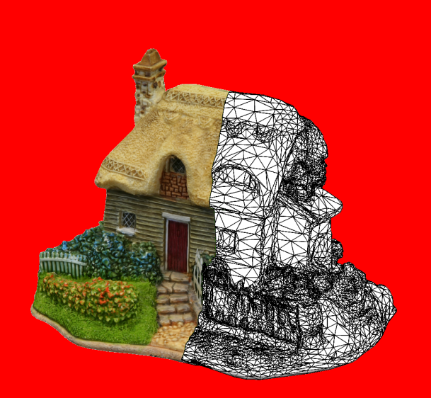
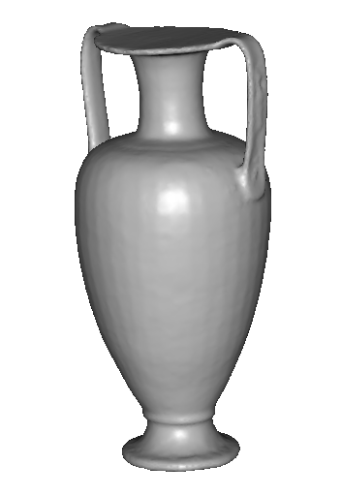
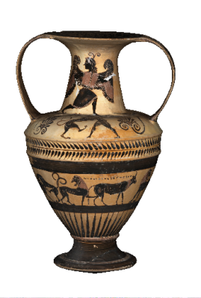
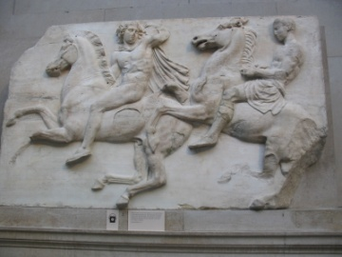
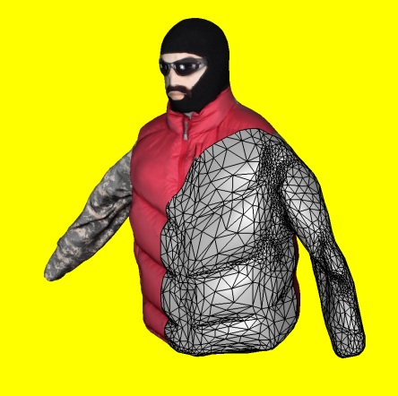
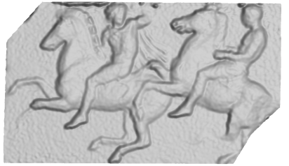
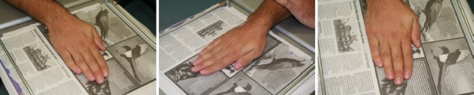
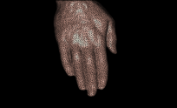
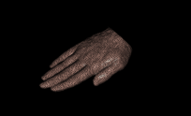
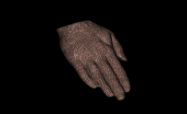
3d model
“Digital copy” of real object
Allows us to
  Inspect details of object
  Measure properties
  Reproduce in different material
Many applications
  Cultural heritage preservation
  Computer games and movies
  City modelling
  E-commerce
  3d object recognition/scene analysis

Slide 3
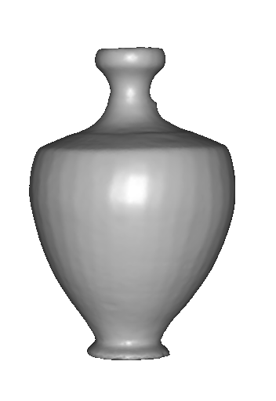
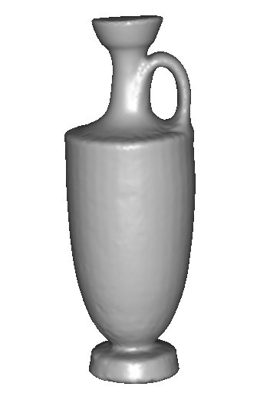
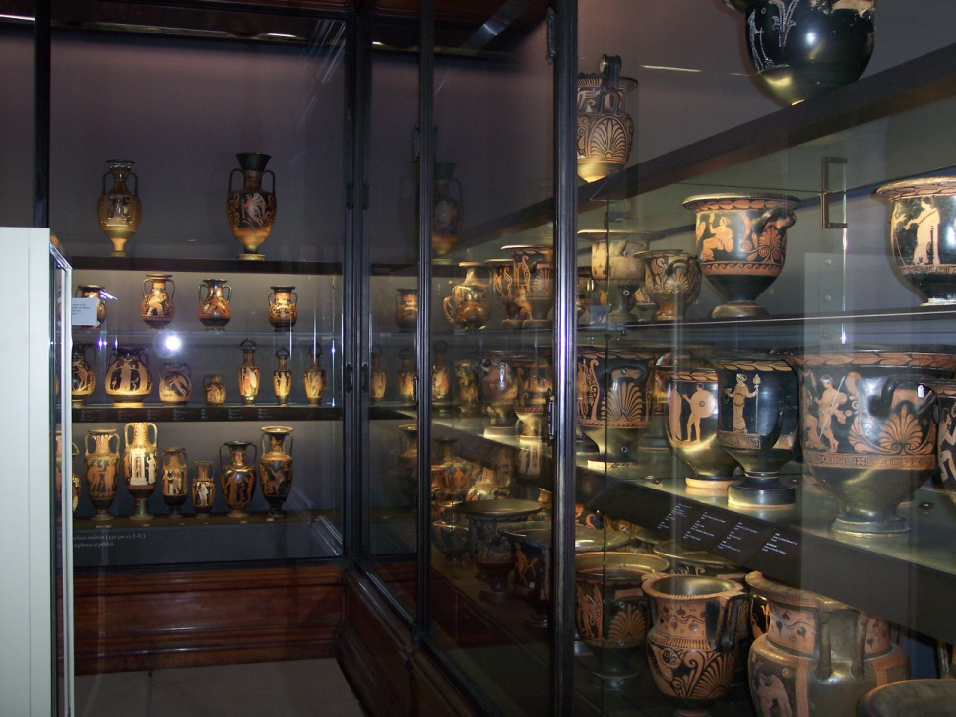
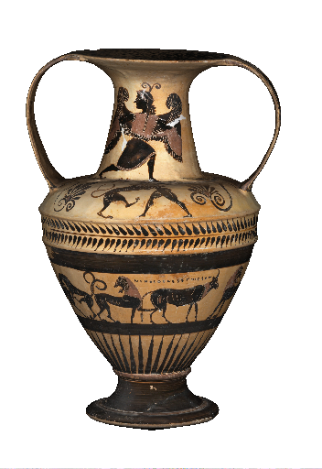
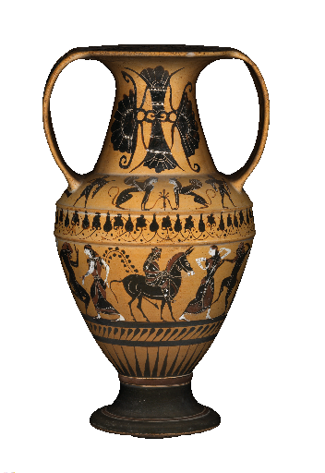
Applications: cultural heritage
SCULPTEUR European project
Notes:
To sum up,

Slide 4
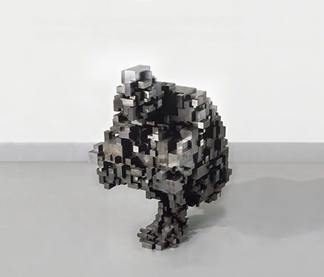
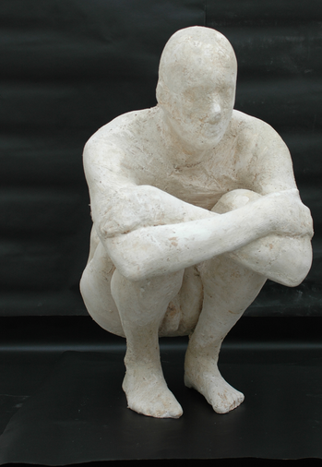
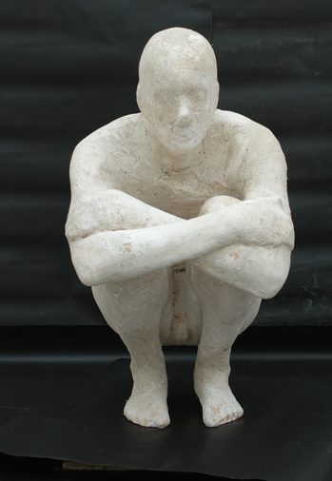
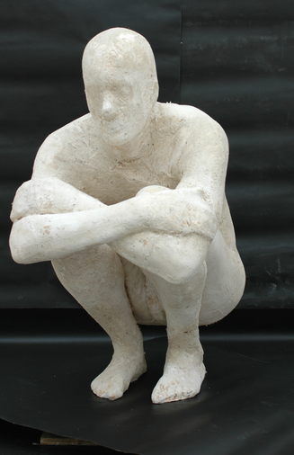
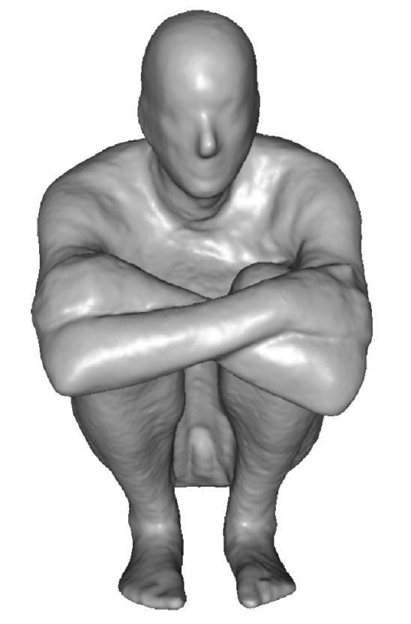
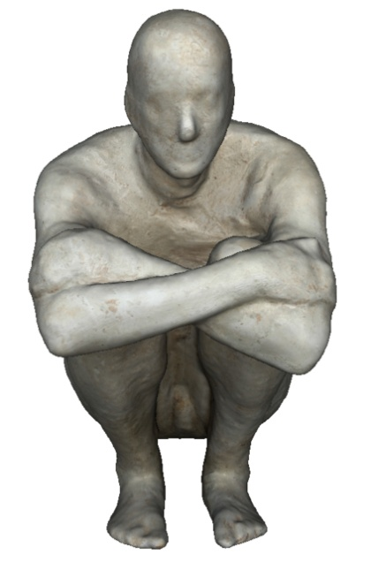
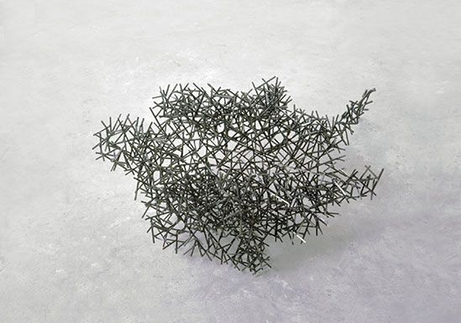
Applications: art
Block Works Precipitate III 2004
Mild steel blocks 80 x 46 x 66 cm
Domain Series Domain VIII Crouching
1999 Mild steel bar 81 x 59 x 63 cm
Notes:
To sum up,

Slide 5
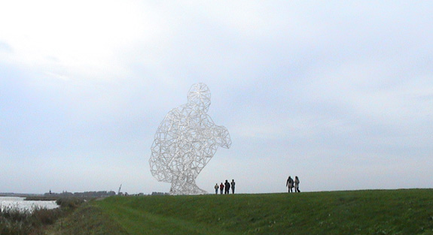
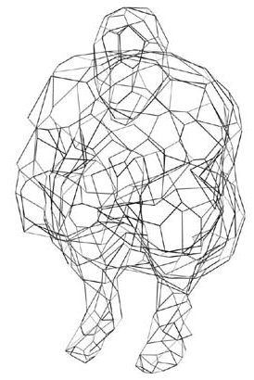
Applications: structure engineering
BODY / SPACE / FRAME, Antony Gormley, Lelystad, Holland
Notes:
To sum up,

Slide 6
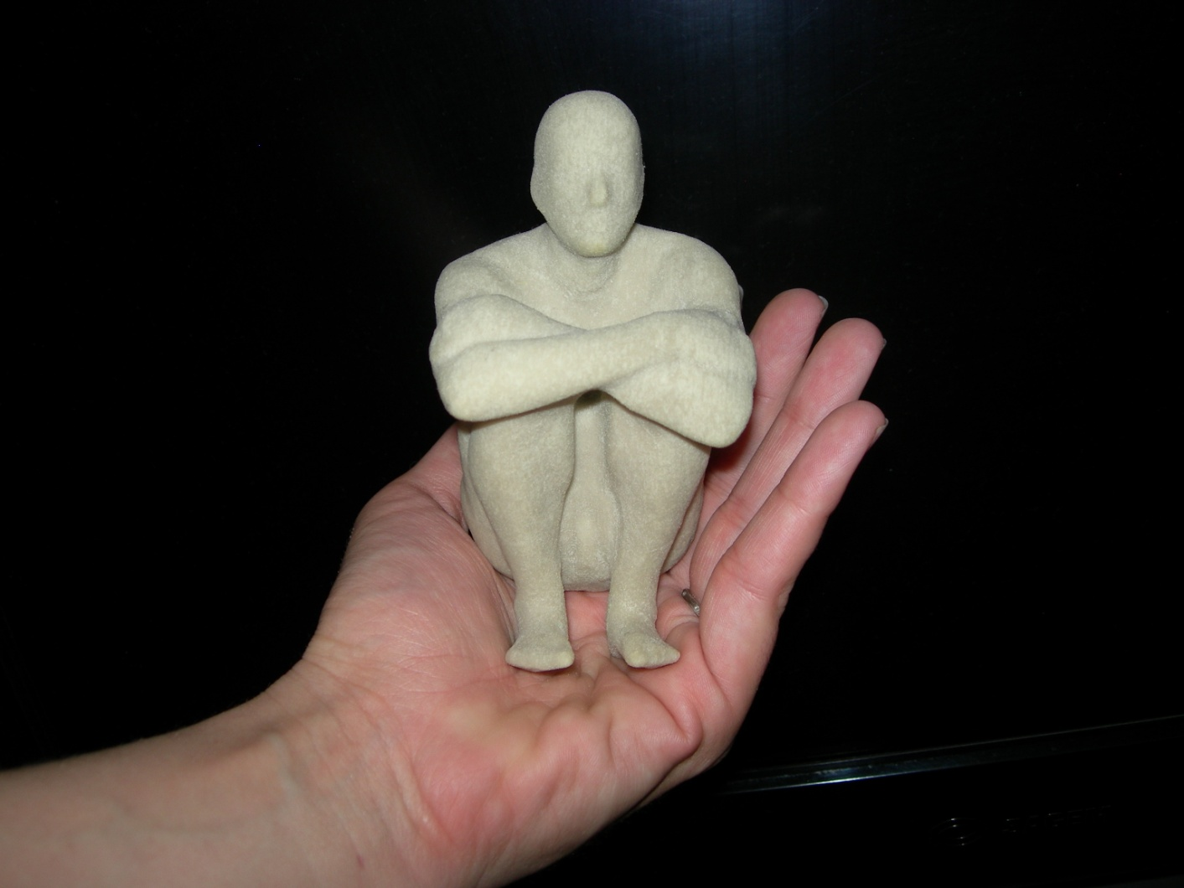
Applications: art
Notes:
To sum up,

Slide 7
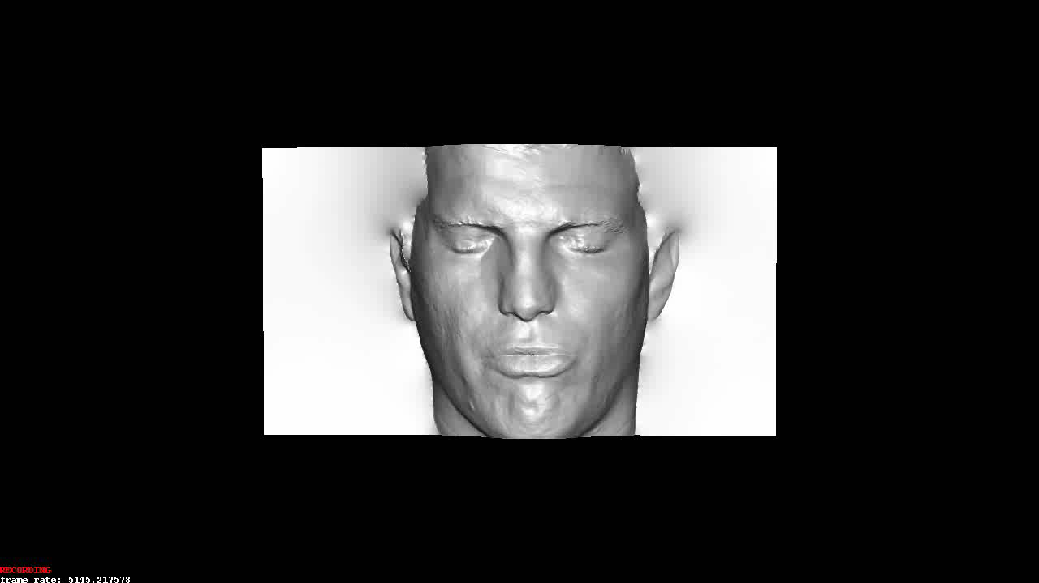
Applications: computer games
Notes:
To sum up,

Slide 8
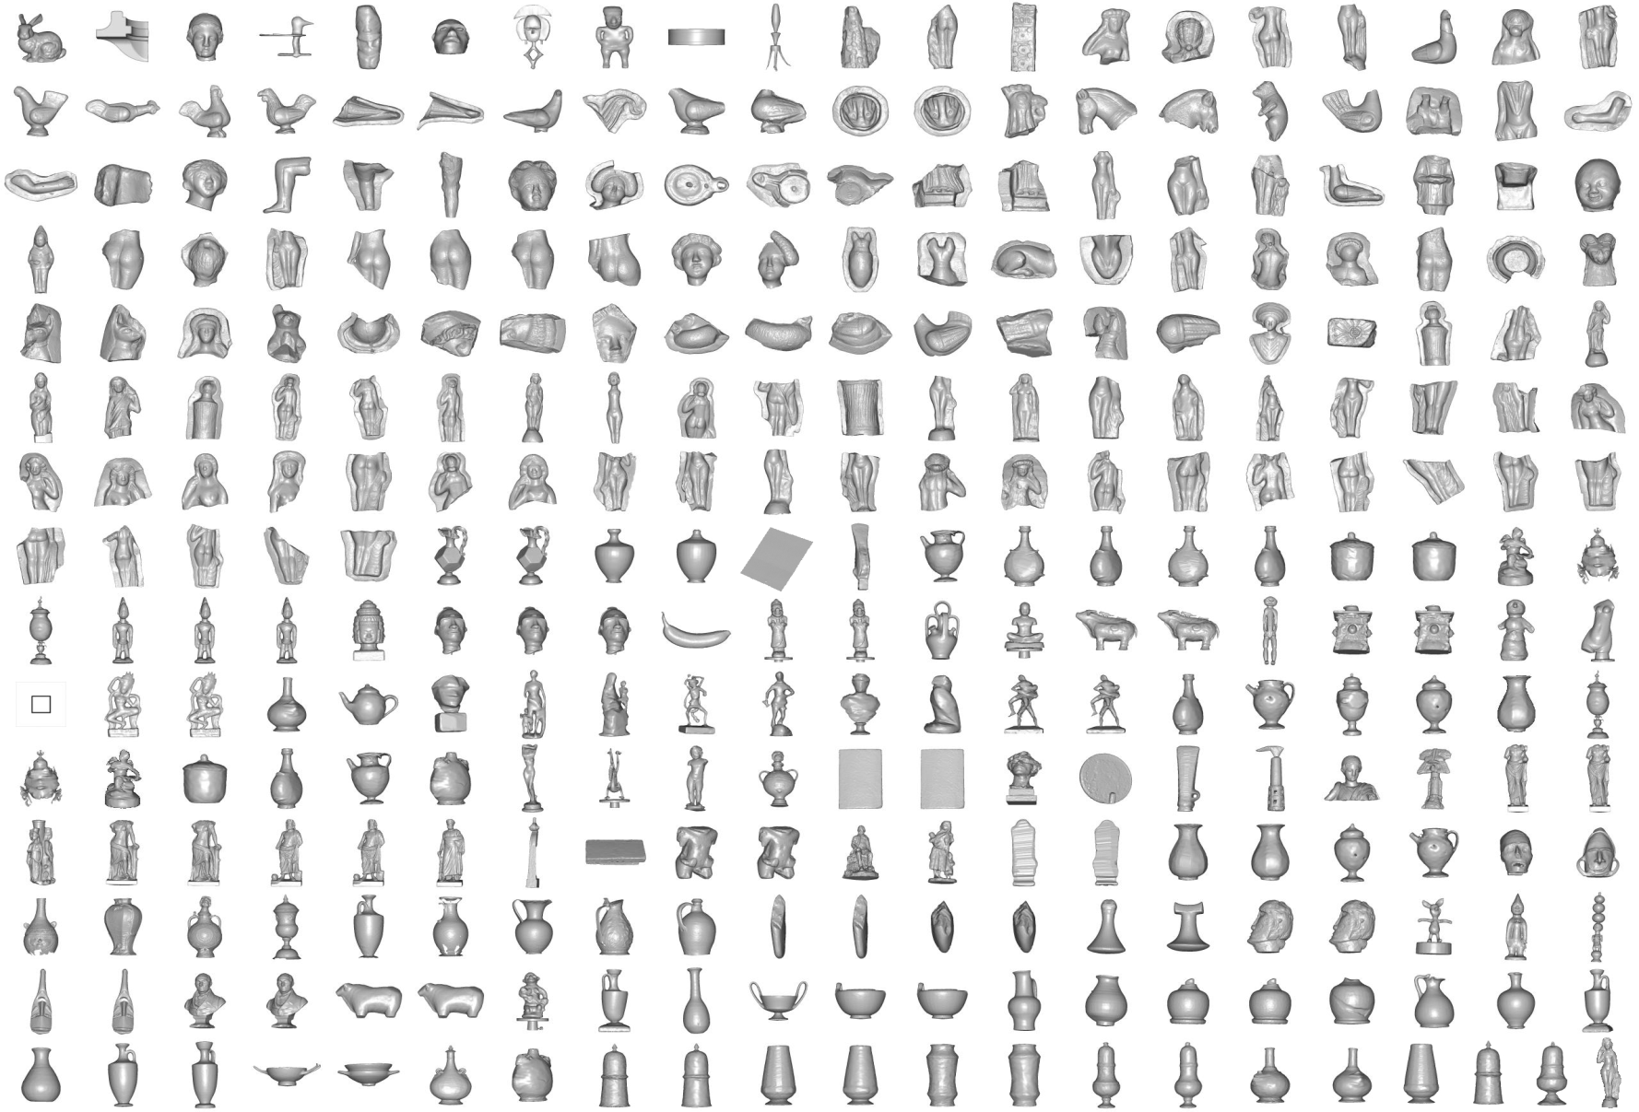
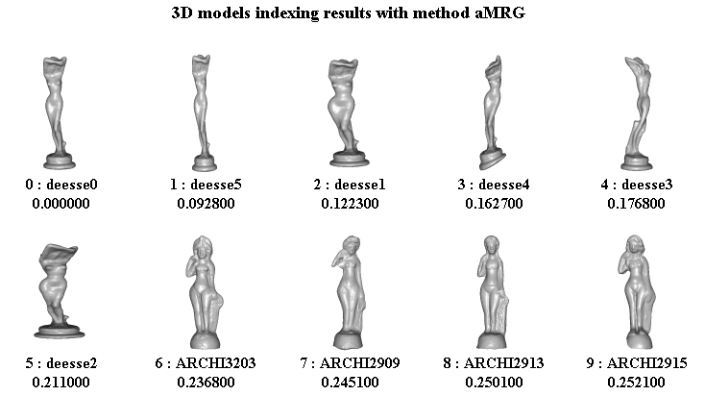
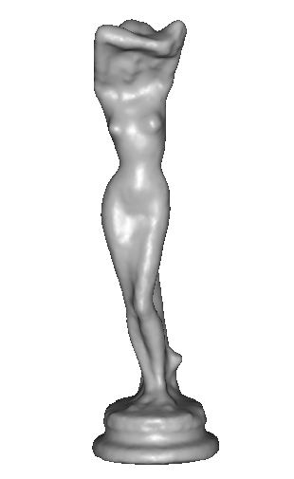
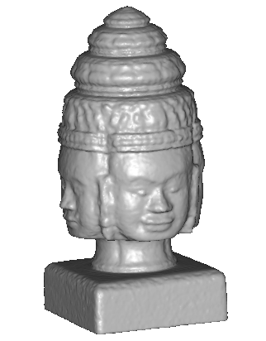
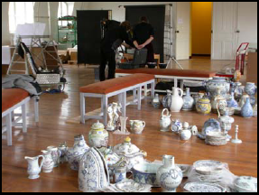
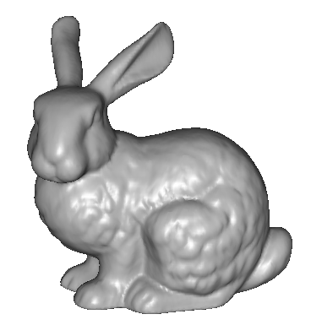
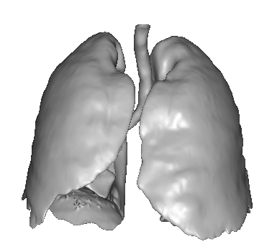
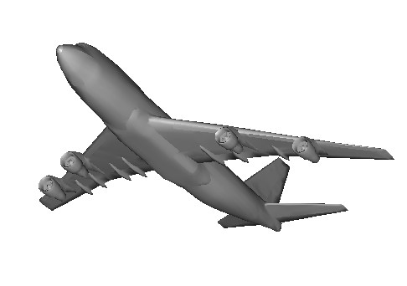
Applications: 3D indexation
? ?
? ? ?
?
? ?
?
SCULPTEUR European project
medical, industrial and cultural heritage indexation

Slide 9
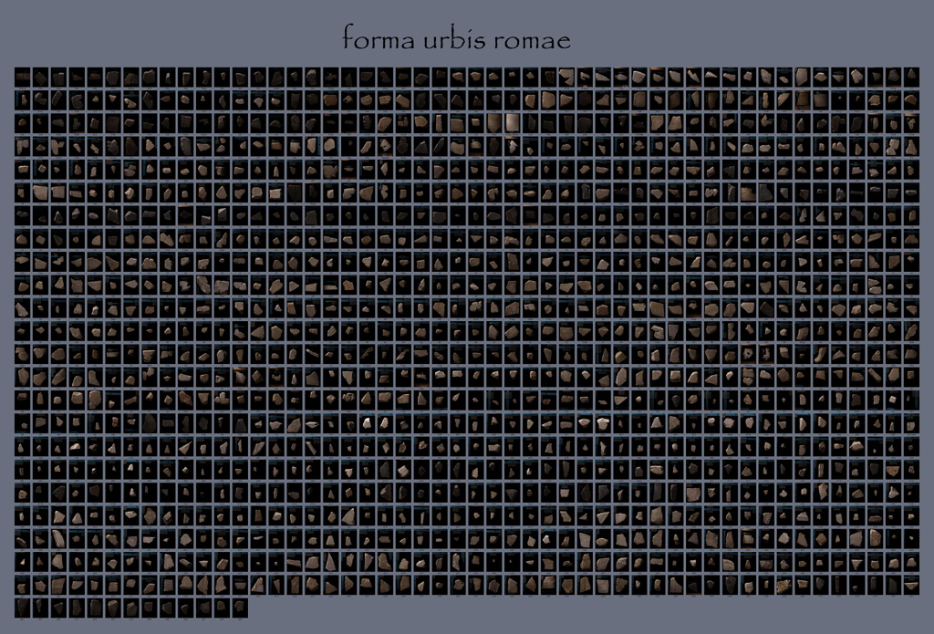
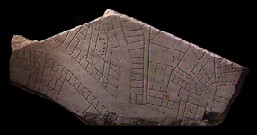
Applications: archaeology
“forma urbis romae” project
Fragments of the City: Stanford's Digital Forma Urbis Romae Project
David Koller, Jennifer Trimble, Tina Najbjerg, Natasha Gelfand, Marc Levoy
Proc. Third Williams Symposium
on Classical Architecture,
Journal of Roman Archaeology
supplement, 2006.
1186 fragments

Slide 10
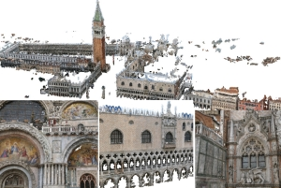
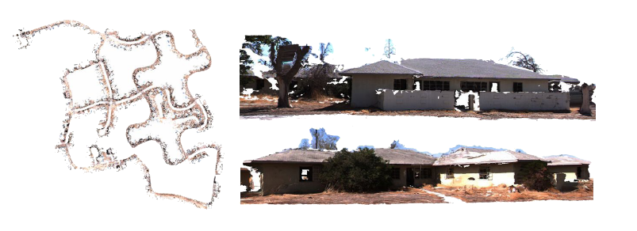
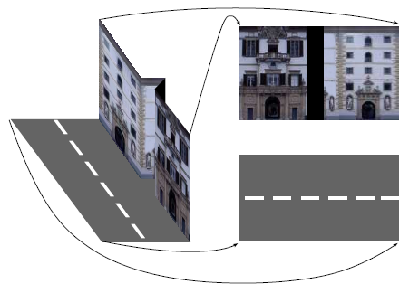

Applications: large scale modelling
[Furukawa10]
[Pollefeys08]
[Cornelis08]
[Goesele07]

Slide 11
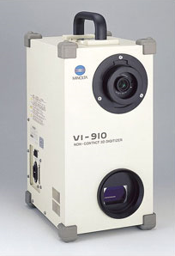
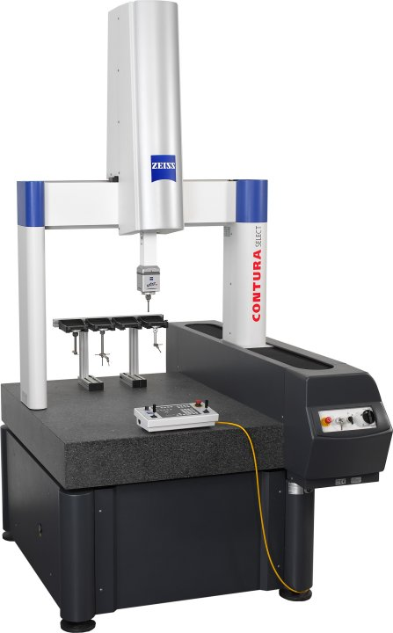

Scanning technologies
Laser scanner, coordinate measuring machine
  Very accurate
  Very Expensive
  Complicated to use
Minolta
“Michelangelo” project
Contura CMM

Slide 12
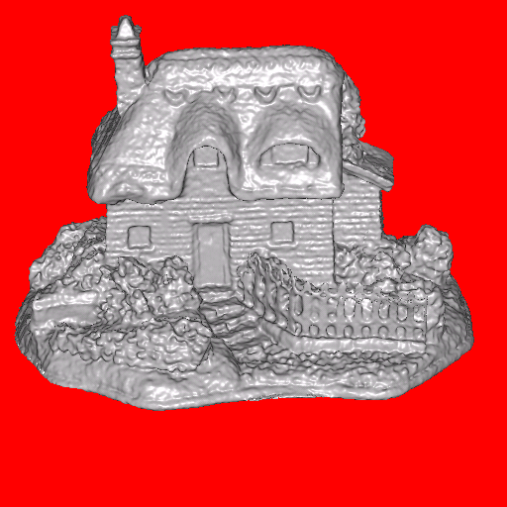
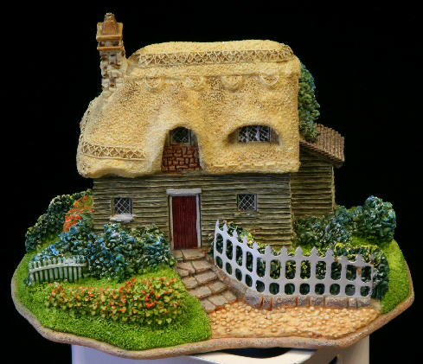
3d shape from photographs
“Estimate a 3d shape that would generate the input photographs given the same material, viewpoints and illumination”
viewpoint
?
geometry
material
illumination
image

Slide 13
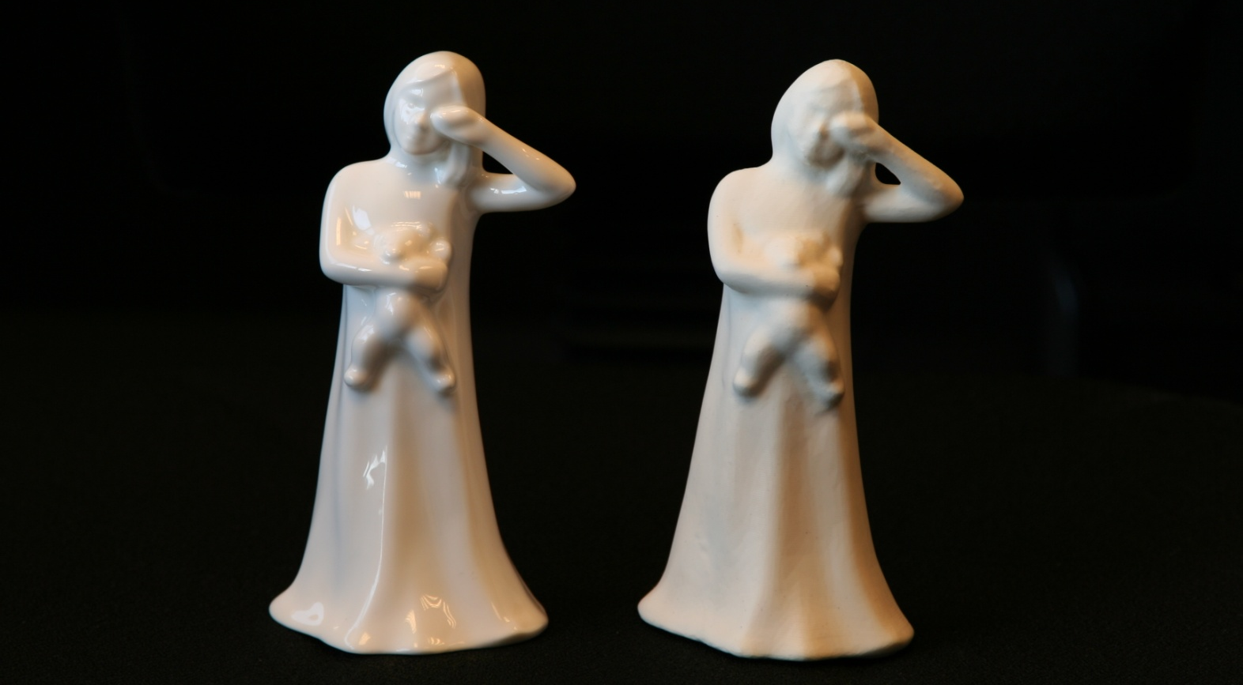
3d shape from photographs
“Estimate a 3d shape that would generate the input photographs given the same material, viewpoints and illumination”
Real
Replica

Slide 14
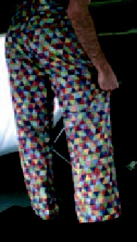
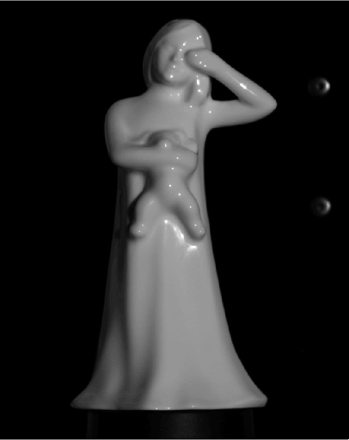
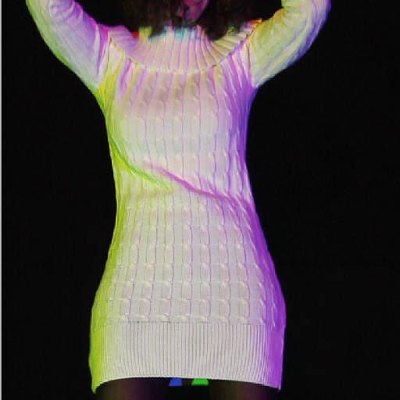
3d shape from photographs
Appearance strongly depends on the material and lighting
textured
rigid
deforming
textureless

Slide 15
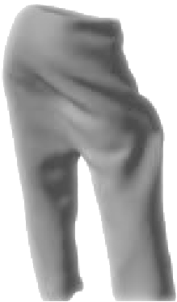
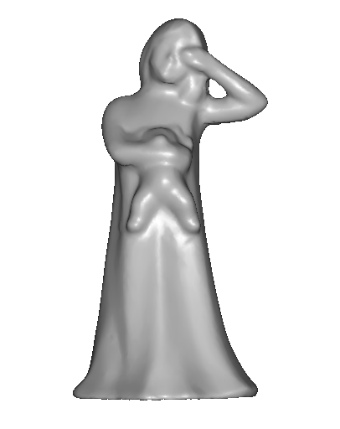
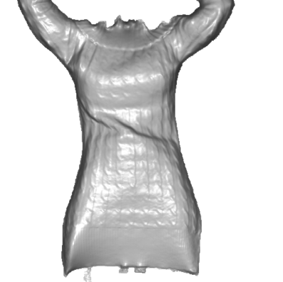
3d shape from photographs
Appearance strongly depends on the material and lighting
⇓
⇓
No single algorithm exists dealing with any type of scene
textured
rigid
deforming
textureless

Slide 16
3d shape from photographs
Photograph based 3d reconstruction is:
  practical
  fast
  non-intrusive
  low cost
  Easily deployable outdoors
  “low” accuracy
  Results depend on material properties

Slide 17

Review: Epipolar geometry
X
x
x’
Baseline – line connecting the two camera centers
Epipoles
= intersections of baseline with image planes
= projections of the other camera center
Epipolar Plane – plane containing baseline (1D family)
Epipolar Lines - intersections of epipolar plane with image
planes (always come in corresponding pairs)

Slide 18

Review: Binocular stereo
If necessary, rectify the two stereo images to transform epipolar lines into scanlines
For each pixel x in the first image
  Find corresponding epipolar scanline in the right image
  Examine all pixels on the scanline and pick the best match x’
  Compute disparity x-x’ and set depth(x) = B*f/(x-x’)

Slide 19


Review: Depth

Slide 20
Review: Depth from disparity
X
z
x
x’
f
f
O
Baseline
B
O’
Disparity is inversely proportional to depth.

Slide 21
Choosing the stereo baseline
all of these
points project
to the same
pair of pixels
width of
a pixel
Large Baseline
Small Baseline
What’s the optimal baseline?
  Too small: large depth error
  Too large: difficult search problem

Slide 22

Multi-view stereo

Slide 23

What is stereo vision?
Generic problem formulation: given several images of the same object or scene, compute a representation of its 3D shape

Slide 24
What is stereo vision?
Generic problem formulation: given several images of the same object or scene, compute a representation of its 3D shape
“Images of the same object or scene”
  Arbitrary number of images (from two to thousands)
  Arbitrary camera positions (camera network or video sequence)
  Calibration may be initially unknown
“Representation of 3D shape”
  Depth maps
  Meshes
  Point clouds
  Patch clouds
  Volumetric models
  Layered models

Slide 25

Beyond two-view stereo
The third view can be used for verification

Slide 26


Multiple-baseline stereo
Pick a reference image, and slide the corresponding window along the corresponding epipolar lines of all other images, using inverse depth relative to the first image as the search parameter
M. Okutomi and T. Kanade, “A Multiple-Baseline Stereo System,” IEEE Trans. on Pattern Analysis and Machine Intelligence, 15(4):353-363 (1993).

Slide 27


Multiple-baseline stereo
For larger baselines, must search larger
area in second image
width of
a pixel
1/z
pixel matching score
width of
a pixel
1/z

Slide 28




Slide 29




Multiple-baseline stereo results
I1
I2
I10
M. Okutomi and T. Kanade, “A Multiple-Baseline Stereo System,” IEEE Trans. on Pattern Analysis and Machine Intelligence, 15(4):353-363 (1993).

Slide 30
Multi-baseline stereo
Basic Approach
  Choose a reference view
  Use your favorite stereo algorithm BUT
    replace two-view SSD with SSD over all baselines
Limitations
  Must choose a reference view
  Visibility!

Slide 31
Plane Sweep Stereo
Choose a reference view
Sweep family of planes at different depths with respect to the reference camera
input image
input image
reference camera
  Each plane defines a homography warping each input image into the reference view
R. Collins. A space-sweep approach to true multi-image matching. CVPR 1996.

Slide 32






Plane Sweep Stereo
For each depth plane
  For each pixel in the composite image stack, compute the variance
For each pixel, select the depth that gives the lowest variance

Slide 33
Plane Sweep Stereo
For each depth plane
  For each pixel in the composite image stack, compute the variance
For each pixel, select the depth that gives the lowest variance
Can be accelerated using graphics hardware
R. Yang and M. Pollefeys. Multi-Resolution Real-Time Stereo on Commodity Graphics Hardware, CVPR 2003

Slide 34
Reconstruction from Silhouettes
The case of binary images: a voxel is photo-consistent if it lies inside the object’s silhouette in all views
Binary Images

Slide 35






Use silhouettes
Can be computed robustly
Can be computed efficiently
background
+
foreground
background
foreground
-
=

Slide 36
Reconstruction from Silhouettes
The case of binary images: a voxel is photo-consistent if it lies inside the object’s silhouette in all views
Binary Images
Finding the silhouette-consistent shape (visual hull):
  Backproject each silhouette
  Intersect backprojected volumes

Slide 37
Volume intersection
Reconstruction Contains the True Scene
  But is generally not the same
  In the limit (all views) get visual hull
    Complement of all lines that don’t intersect S

Slide 38
Voxel algorithm for volume intersection
Color voxel black if on silhouette in every image

Slide 39
Volumetric Stereo / Voxel Coloring
Discretized
Scene Volume
Input Images
(Calibrated)
Goal: Assign RGB values to voxels in V
      photo-consistent with images

Slide 40


Photo-consistency of a 3d point
Photo-consistent point
≈

Slide 41
Photo-consistency of a 3d point
Non photo-consistent point
≠

Slide 42
Photo-consistency of a 3d patch

Slide 44
Photo-consistency
A photo-consistent scene is a scene that exactly reproduces your input images from the same camera viewpoints
You can’t use your input cameras and images to tell the difference between a photo-consistent scene and the true scene
True
Scene
All Scenes
Photo-Consistent
Scenes

Slide 45



Challenges of photo-consistency
Camera visibility
Failure of comparison metric
  repeated texture
  lack of texture
  specularities

Slide 46
Voxel Coloring Approach
1. Choose voxel
Color if consistent
  (standard deviation of pixel
  colors below threshold)
2. Project and correlate
Visibility Problem: in which images is each voxel visible?

Slide 47
Depth Ordering: visit occluders first!
Layers
Scene
Traversal
Condition: depth order is the same for all input views

Slide 48
Panoramic Depth Ordering
  Cameras oriented in many different directions
  Planar depth ordering does not apply

Slide 49
Panoramic Depth Ordering
Layers radiate outwards from cameras

Slide 50
Panoramic Layering
Layers radiate outwards from cameras

Slide 51
Panoramic Layering
Layers radiate outwards from cameras

Slide 52


Compatible Camera Configurations
Depth-Order Constraint
  Scene outside convex hull of camera centers
Inward-Looking
cameras above scene
Outward-Looking
cameras inside scene

Slide 53





Calibrated Image Acquisition
Selected Dinosaur Images
Calibrated Turntable
360° rotation (21 images)
Selected Flower Images

Slide 54


Voxel Coloring Results (Video)
Dinosaur Reconstruction
72 K voxels colored
7.6 M voxels tested
7 min. to compute
on a 250MHz SGI
Flower Reconstruction
70 K voxels colored
7.6 M voxels tested
7 min. to compute
on a 250MHz SGI

Slide 55
Space Carving
Image 1
Image N
…...
Space Carving Algorithm
  Initialize to a volume V containing the true scene
  Choose a voxel on the outside of the volume
  Project to visible input images
  Carve if not photo-consistent
  Repeat until convergence
K. N. Kutulakos and S. M. Seitz, A Theory of Shape by Space Carving, ICCV 1999

Slide 56


Which shape do you get?
V
V
True Scene
Photo Hull
The Photo Hull is the UNION of all photo-consistent scenes in V
  It is a photo-consistent scene reconstruction
  Tightest possible bound on the true scene
Source: S. Seitz

Slide 57
Photo-consistency vs. silhouette-consistency
True Scene
Photo Hull
Visual Hull

Slide 58




Space Carving Results: African Violet
Input Image (1 of 45)
Reconstruction
Reconstruction
Reconstruction
Source: S. Seitz

Slide 59



Space Carving Results: Hand
Input Image
(1 of 100)
Views of Reconstruction

Slide 60
Carved visual hulls
The visual hull is a good starting point for optimizing
photo-consistency
  Easy to compute
  Tight outer boundary of the object
  Parts of the visual hull (rims) already lie on the surface and are already photo-consistent
Yasutaka Furukawa and Jean Ponce, Carved Visual Hulls for Image-Based Modeling, ECCV 2006.

Slide 61

Carved visual hulls
Compute visual hull
Use dynamic programming to find rims (photo-consistent parts of visual hull)
Carve the visual hull to optimize photo-consistency keeping the rims fixed
Yasutaka Furukawa and Jean Ponce, Carved Visual Hulls for Image-Based Modeling, ECCV 2006.

Slide 62
Patch Based Reconsutructoin

Slide 63
What is a patch?
Patch consists of
  Position (x, y, z)
  Normal (nx, ny, nz)
  Extent (radius)
Tangent plane approximation
Normal
Position
Extent

Slide 64


What is a patch?
Patch consists of
  Position (x, y, z)
  Normal (nx, ny, nz)
  Extent (radius)
Tangent plane approximation
Mesh
Normal
Position
Extent
Patch

Slide 65
Patch definition
Position, normal, and extent
Normal
Position
Extent

Slide 66



Patch definition
Patch p is defined by
  Position c(p)
  Normal n(p)
  Visible images V(p)
Extent is set so that
p is roughly 9x9 pixels
in V(p)
Normal n(p)
Position c(p)
Extent
9x9 pixels
Visible images V(p)

Slide 67

Photo-consistency
Photo-consistency N(I, J, p) of p between
two images I and J
Ixy: pixel color in image I
I12
I11
I
J

Slide 68

Photo-consistency
Photo-consistency N(I, J, p) of p between
two images I and J
Ixy: pixel color in image I
Jxy: pixel color in image J
I
J11
J
J12

Slide 69

Photo-consistency
Photo-consistency N(I, J, p) of p between
two images I and J
Ixy: pixel color in image I
Jxy: pixel color in image J
Photo-consistency N(p) of p with visible images V(p) = {I1, I2, …, In}
I
J11
J
J12

Slide 70
Reconstruct patch p
Given initial estimates of
  Position c(p)
  Normal n(p)
  Visible images V(p)
Refine c(p) and n(p)
c(p)
n(p)

Slide 71
Reconstruct patch p
Given initial estimates of
  Position c(p)
  Normal n(p)
  Visible images V(p)
Refine c(p) and n(p)
1 DOF

Slide 72
Reconstruct patch p
Given initial estimates of
  Position c(p)
  Normal n(p)
  Visible images V(p)
Refine c(p) and n(p)
2 DOF

Slide 73
Verify a patch
Textures may match by accident

Slide 74
Verify a patch
Textures may match by accident
Photo-consistency must be reasonably high

Slide 75
Verify a patch
Textures may match by accident
Photo-consistency must be reasonably high
Verification process
  Keep only high photo-consistency images in V(p)

Slide 76
Verify a patch
Textures may match by accident
Photo-consistency must be reasonably high
Verification process
  Keep only high photo-consistency images in V(p)
  Accept if |V(p)|≥3

Slide 77

Patch-based MVS [Furukawa and Ponce 07]
Preliminaries
Algorithm
Input image
#1
#2
#3

Slide 78
Patch-based MVS [Furukawa and Ponce 07]
#1. Feature detection
#2. Initial feature matching
#3. Patch expansion and filtering
Input image
#1
#2
#3

Slide 79
Algorithm overview
#1. Feature detection
#2. Initial feature matching
#3. Patch expansion and filtering
Input image
#1
#2
#3

Slide 80






Feature detection
Extract local maxima of
  Harris corner detector (corners)
  Difference of Gaussian (blobs)

Slide 81
Algorithm overview
#1. Feature detection
#2. Initial feature matching
#3. Patch expansion and filtering
Input image
#1
#2
#3

Slide 82

Initial feature matching
c(p):
n(p):
V(p):
c(p): triangulation
n(p):
V(p):
p
Epipolar line
Image 3
Image 1
Image 2

Slide 83
Initial feature matching
c(p):
n(p):
V(p):
c(p): triangulation
n(p): parallel to Image1
V(p): {Image1, Image2}
p
Epipolar line
Image 3
Image 1
Image 2

Slide 84
Initial feature matching
c(p):
n(p):
V(p):
c(p): triangulation
n(p): parallel to Image1
V(p): {Image1, Image2}
c(p): triangulation
n(p): parallel to Image1
V(p): {Image1, Image2, Image3}
p
Add visible images
If
Epipolar line
Image 3
Image 1
Image 2

Slide 85
Initial feature matching
c(p): triangulation
n(p): parallel to Image1
V(p): {Image1, Image2, Image3}
p
Epipolar line
Image 3
Image 1
Image 2

Slide 86
Initial feature matching
c(p): refine
n(p): refine
V(p): {Image1, Image2, Image3}
p
Epipolar line
Image 3
Image 1
Image 2

Slide 87
Initial feature matching
c(p): refine
n(p): refine
V(p): {Image1, Image2, Image3}
p
Epipolar line
Image 3
Image 1
Image 2

Slide 88
Initial feature matching
Verification
(update V(p) and check |V(p)|≥3)
p
Image 3
Image 1
Image 2

Slide 89
Initial feature matching
p
Occupied
Image 3
Image 1
Image 2

Slide 90
Initial feature matching
Occupied
Epipolar line
Image 3
Image 1
Image 2

Slide 91
Initial feature matching
Occupied
Epipolar line
Image 3
Image 1
Image 2

Slide 92
Initial feature matching
Occupied
Epipolar line
Image 3
Image 1
Image 2

Slide 93
Initial feature matching
Repeat for all the image features
Occupied
Image 3
Image 1
Image 2

Slide 94
Algorithm overview
#1. Feature detection
#2. Initial feature matching
#3. Patch expansion and filtering
Input image
#1
#2
#3

Slide 95
Patch expansion
Occupied pixel
Image 1
Image 2
Image 3

Slide 96
Patch expansion
Pick a patch
Image 1
Image 2
Image 3

Slide 97
Patch expansion
Pick a patch
Look for neighboring
empty pixels
All occupied
Do nothing
Image 1
Image 2
Image 3

Slide 98
Patch expansion
p
Pick a patch
Image 1
Image 2
Image 3

Slide 99
Patch expansion
p
Pick a patch
Identify neighboring
empty pixels
Image 1
Image 2
Image 3

Slide 100
Patch expansion
p
c(q):
n(q):
V(q):
q
c(q): {tangent plane of p
intersects w/ ray}
n(q):
V(q):
Reconstruct a patch
visible in an empty pixel
Image 1
Image 2
Image 3

Slide 101
Patch expansion
p
c(q):
n(q):
V(q):
q
c(q): {tangent plane of p
intersects w/ ray}
n(q): n(p)
V(q): V(p)
Reconstruct a patch
visible in an empty pixel
Image 1
Image 2
Image 3

Slide 102
Patch expansion
p
q
c(q): refine
n(q): refine
V(q): V(p)
q
Reconstruct a patch
visible in an empty pixel
Image 1
Image 2
Image 3

Slide 103
Patch expansion
p
c(q): refine
n(q): refine
V(q): V(p)
q
Reconstruct a patch
visible in an empty pixel
Patch verification!
Image 1
Image 2
Image 3

Slide 104
Patch expansion
p
c(q): refine
n(q): refine
V(q): V(p)
q
Reconstruct a patch
visible in an empty pixel
Patch verification!
Image 1
Image 2
Image 3

Slide 105
Patch expansion
p
q
Repeat
for every patch
for every neighboring empty pixel
Image 1
Image 2
Image 3

Slide 106
Patch-based MVS [Furukawa and Ponce 07]
#1. Feature detection
#2. Initial feature matching
#3. Patch expansion and filtering
Input image
#1
#2
#3

Slide 107

From feature matching to dense stereo
http://www.cs.washington.edu/homes/furukawa/gallery/
Yasutaka Furukawa and Jean Ponce, Accurate, Dense, and Robust Multi-View Stereopsis, CVPR 2007.

Slide 108


Stereo from community photo collections
Up to now, we’ve always assumed that camera calibration is known
For photos taken from the Internet, we need structure from motion techniques to reconstruct both camera positions and 3D points

Slide 109




Slide 110



Stereo from community photo collections
stereo
laser scan
Comparison: 90% of points within 0.128 m of laser scan (building height 51m)
M. Goesele, N. Snavely, B. Curless, H. Hoppe, S. Seitz, Multi-View Stereo for Community Photo Collections, ICCV 2007

Slide 111



Scanning technologies
Structured light
[Zhang02]

Slide 112


Kinect: Structured infrared light
http://bbzippo.wordpress.com/2010/11/28/kinect-in-infrared/

Slide 113

Kinect Fusion
Paper link (ACM Symposium on User Interface Software and Technology, October 2011)
YouTube Video

