Slide 1
Images and Filters
CSEP 576
Ali Farhadi
Many slides from Steve Seitz and Larry Zitnick

Slide 2
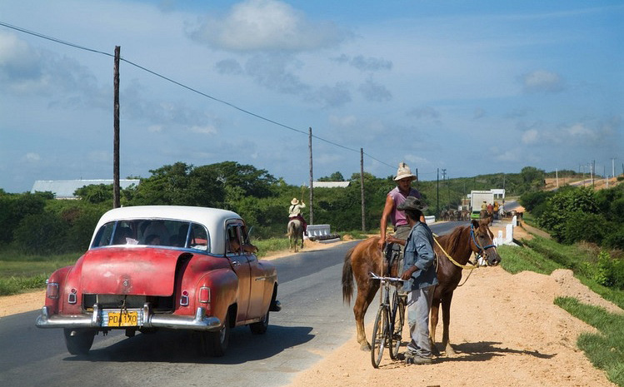
What is an image?

Slide 5
Image Operations
(functions of functions)
F( ) =

Slide 6
Image Operations
(functions of functions)
F( ) =

Slide 7
Image Operations
(functions of functions)
0.1
0
0.8
0.9
0.9
0.9
0.2
0.4
0.3
0.6
0
0
0.1
0.5
0.9
0.9
0.2
0.4
0.3
0.6
0
0
0.1
0.9
0.9
0.2
0.4
0.3
0.6
0
0
0.1
0.5
F( ) =

Slide 8
Image Operations
(functions of functions)
F( , ) =
0.23

Slide 9
Local image functions
F( ) =

Slide 10
Image filtering
1
1
1
1
1
1
1
1
1
0 | 0 | 0 | 0 | 0 | 0 | 0 | 0 | 0 | 0
0 | 0 | 0 | 0 | 0 | 0 | 0 | 0 | 0 | 0
0 | 0 | 0 | 90 | 90 | 90 | 90 | 90 | 0 | 0
0 | 0 | 0 | 90 | 90 | 90 | 90 | 90 | 0 | 0
0 | 0 | 0 | 90 | 90 | 90 | 90 | 90 | 0 | 0
0 | 0 | 0 | 90 | 0 | 90 | 90 | 90 | 0 | 0
0 | 0 | 0 | 90 | 90 | 90 | 90 | 90 | 0 | 0
0 | 0 | 0 | 0 | 0 | 0 | 0 | 0 | 0 | 0
0 | 0 | 90 | 0 | 0 | 0 | 0 | 0 | 0 | 0
0 | 0 | 0 | 0 | 0 | 0 | 0 | 0 | 0 | 0
 | 0
0 | 0 | 0 | 0 | 0 | 0 | 0 | 0 | 0 | 0
0 | 0 | 0 | 0 | 0 | 0 | 0 | 0 | 0 | 0
0 | 0 | 0 | 90 | 90 | 90 | 90 | 90 | 0 | 0
0 | 0 | 0 | 90 | 90 | 90 | 90 | 90 | 0 | 0
0 | 0 | 0 | 90 | 90 | 90 | 90 | 90 | 0 | 0
0 | 0 | 0 | 90 | 0 | 90 | 90 | 90 | 0 | 0
0 | 0 | 0 | 90 | 90 | 90 | 90 | 90 | 0 | 0
0 | 0 | 0 | 0 | 0 | 0 | 0 | 0 | 0 | 0
0 | 0 | 90 | 0 | 0 | 0 | 0 | 0 | 0 | 0
0 | 0 | 0 | 0 | 0 | 0 | 0 | 0 | 0 | 0
Credit: S. Seitz

Slide 11
Image filtering
1
1
1
1
1
1
1
1
1
0 | 0 | 0 | 0 | 0 | 0 | 0 | 0 | 0 | 0
0 | 0 | 0 | 0 | 0 | 0 | 0 | 0 | 0 | 0
0 | 0 | 0 | 90 | 90 | 90 | 90 | 90 | 0 | 0
0 | 0 | 0 | 90 | 90 | 90 | 90 | 90 | 0 | 0
0 | 0 | 0 | 90 | 90 | 90 | 90 | 90 | 0 | 0
0 | 0 | 0 | 90 | 0 | 90 | 90 | 90 | 0 | 0
0 | 0 | 0 | 90 | 90 | 90 | 90 | 90 | 0 | 0
0 | 0 | 0 | 0 | 0 | 0 | 0 | 0 | 0 | 0
0 | 0 | 90 | 0 | 0 | 0 | 0 | 0 | 0 | 0
0 | 0 | 0 | 0 | 0 | 0 | 0 | 0 | 0 | 0
 | 0 | 10
0 | 0 | 0 | 0 | 0 | 0 | 0 | 0 | 0 | 0
0 | 0 | 0 | 0 | 0 | 0 | 0 | 0 | 0 | 0
0 | 0 | 0 | 90 | 90 | 90 | 90 | 90 | 0 | 0
0 | 0 | 0 | 90 | 90 | 90 | 90 | 90 | 0 | 0
0 | 0 | 0 | 90 | 90 | 90 | 90 | 90 | 0 | 0
0 | 0 | 0 | 90 | 0 | 90 | 90 | 90 | 0 | 0
0 | 0 | 0 | 90 | 90 | 90 | 90 | 90 | 0 | 0
0 | 0 | 0 | 0 | 0 | 0 | 0 | 0 | 0 | 0
0 | 0 | 90 | 0 | 0 | 0 | 0 | 0 | 0 | 0
0 | 0 | 0 | 0 | 0 | 0 | 0 | 0 | 0 | 0
Credit: S. Seitz
Notes:
ones, divide by 9

Slide 12
Image filtering
1
1
1
1
1
1
1
1
1
0 | 0 | 0 | 0 | 0 | 0 | 0 | 0 | 0 | 0
0 | 0 | 0 | 0 | 0 | 0 | 0 | 0 | 0 | 0
0 | 0 | 0 | 90 | 90 | 90 | 90 | 90 | 0 | 0
0 | 0 | 0 | 90 | 90 | 90 | 90 | 90 | 0 | 0
0 | 0 | 0 | 90 | 90 | 90 | 90 | 90 | 0 | 0
0 | 0 | 0 | 90 | 0 | 90 | 90 | 90 | 0 | 0
0 | 0 | 0 | 90 | 90 | 90 | 90 | 90 | 0 | 0
0 | 0 | 0 | 0 | 0 | 0 | 0 | 0 | 0 | 0
0 | 0 | 90 | 0 | 0 | 0 | 0 | 0 | 0 | 0
0 | 0 | 0 | 0 | 0 | 0 | 0 | 0 | 0 | 0
 | 0 | 10 | 20
0 | 0 | 0 | 0 | 0 | 0 | 0 | 0 | 0 | 0
0 | 0 | 0 | 0 | 0 | 0 | 0 | 0 | 0 | 0
0 | 0 | 0 | 90 | 90 | 90 | 90 | 90 | 0 | 0
0 | 0 | 0 | 90 | 90 | 90 | 90 | 90 | 0 | 0
0 | 0 | 0 | 90 | 90 | 90 | 90 | 90 | 0 | 0
0 | 0 | 0 | 90 | 0 | 90 | 90 | 90 | 0 | 0
0 | 0 | 0 | 90 | 90 | 90 | 90 | 90 | 0 | 0
0 | 0 | 0 | 0 | 0 | 0 | 0 | 0 | 0 | 0
0 | 0 | 90 | 0 | 0 | 0 | 0 | 0 | 0 | 0
0 | 0 | 0 | 0 | 0 | 0 | 0 | 0 | 0 | 0
Credit: S. Seitz
Notes:
ones, divide by 9

Slide 13
Image filtering
1
1
1
1
1
1
1
1
1
0 | 0 | 0 | 0 | 0 | 0 | 0 | 0 | 0 | 0
0 | 0 | 0 | 0 | 0 | 0 | 0 | 0 | 0 | 0
0 | 0 | 0 | 90 | 90 | 90 | 90 | 90 | 0 | 0
0 | 0 | 0 | 90 | 90 | 90 | 90 | 90 | 0 | 0
0 | 0 | 0 | 90 | 90 | 90 | 90 | 90 | 0 | 0
0 | 0 | 0 | 90 | 0 | 90 | 90 | 90 | 0 | 0
0 | 0 | 0 | 90 | 90 | 90 | 90 | 90 | 0 | 0
0 | 0 | 0 | 0 | 0 | 0 | 0 | 0 | 0 | 0
0 | 0 | 90 | 0 | 0 | 0 | 0 | 0 | 0 | 0
0 | 0 | 0 | 0 | 0 | 0 | 0 | 0 | 0 | 0
 | 0 | 10 | 20 | 30
0 | 0 | 0 | 0 | 0 | 0 | 0 | 0 | 0 | 0
0 | 0 | 0 | 0 | 0 | 0 | 0 | 0 | 0 | 0
0 | 0 | 0 | 90 | 90 | 90 | 90 | 90 | 0 | 0
0 | 0 | 0 | 90 | 90 | 90 | 90 | 90 | 0 | 0
0 | 0 | 0 | 90 | 90 | 90 | 90 | 90 | 0 | 0
0 | 0 | 0 | 90 | 0 | 90 | 90 | 90 | 0 | 0
0 | 0 | 0 | 90 | 90 | 90 | 90 | 90 | 0 | 0
0 | 0 | 0 | 0 | 0 | 0 | 0 | 0 | 0 | 0
0 | 0 | 90 | 0 | 0 | 0 | 0 | 0 | 0 | 0
0 | 0 | 0 | 0 | 0 | 0 | 0 | 0 | 0 | 0
Credit: S. Seitz

Slide 14
Image filtering
1
1
1
1
1
1
1
1
1
0 | 0 | 0 | 0 | 0 | 0 | 0 | 0 | 0 | 0
0 | 0 | 0 | 0 | 0 | 0 | 0 | 0 | 0 | 0
0 | 0 | 0 | 90 | 90 | 90 | 90 | 90 | 0 | 0
0 | 0 | 0 | 90 | 90 | 90 | 90 | 90 | 0 | 0
0 | 0 | 0 | 90 | 90 | 90 | 90 | 90 | 0 | 0
0 | 0 | 0 | 90 | 0 | 90 | 90 | 90 | 0 | 0
0 | 0 | 0 | 90 | 90 | 90 | 90 | 90 | 0 | 0
0 | 0 | 0 | 0 | 0 | 0 | 0 | 0 | 0 | 0
0 | 0 | 90 | 0 | 0 | 0 | 0 | 0 | 0 | 0
0 | 0 | 0 | 0 | 0 | 0 | 0 | 0 | 0 | 0
 | 0 | 10 | 20 | 30 | 30
Credit: S. Seitz

Slide 15
Image filtering
1
1
1
1
1
1
1
1
1
0 | 0 | 0 | 0 | 0 | 0 | 0 | 0 | 0 | 0
0 | 0 | 0 | 0 | 0 | 0 | 0 | 0 | 0 | 0
0 | 0 | 0 | 90 | 90 | 90 | 90 | 90 | 0 | 0
0 | 0 | 0 | 90 | 90 | 90 | 90 | 90 | 0 | 0
0 | 0 | 0 | 90 | 90 | 90 | 90 | 90 | 0 | 0
0 | 0 | 0 | 90 | 0 | 90 | 90 | 90 | 0 | 0
0 | 0 | 0 | 90 | 90 | 90 | 90 | 90 | 0 | 0
0 | 0 | 0 | 0 | 0 | 0 | 0 | 0 | 0 | 0
0 | 0 | 90 | 0 | 0 | 0 | 0 | 0 | 0 | 0
0 | 0 | 0 | 0 | 0 | 0 | 0 | 0 | 0 | 0
 | 0 | 10 | 20 | 30 | 30
?
Credit: S. Seitz

Slide 16
Image filtering
1
1
1
1
1
1
1
1
1
0 | 0 | 0 | 0 | 0 | 0 | 0 | 0 | 0 | 0
0 | 0 | 0 | 0 | 0 | 0 | 0 | 0 | 0 | 0
0 | 0 | 0 | 90 | 90 | 90 | 90 | 90 | 0 | 0
0 | 0 | 0 | 90 | 90 | 90 | 90 | 90 | 0 | 0
0 | 0 | 0 | 90 | 90 | 90 | 90 | 90 | 0 | 0
0 | 0 | 0 | 90 | 0 | 90 | 90 | 90 | 0 | 0
0 | 0 | 0 | 90 | 90 | 90 | 90 | 90 | 0 | 0
0 | 0 | 0 | 0 | 0 | 0 | 0 | 0 | 0 | 0
0 | 0 | 90 | 0 | 0 | 0 | 0 | 0 | 0 | 0
0 | 0 | 0 | 0 | 0 | 0 | 0 | 0 | 0 | 0
 | 0 | 10 | 20 | 30 | 30
 |  |  |  | 50
?
Credit: S. Seitz

Slide 17
Image filtering
1
1
1
1
1
1
1
1
1
0 | 0 | 0 | 0 | 0 | 0 | 0 | 0 | 0 | 0
0 | 0 | 0 | 0 | 0 | 0 | 0 | 0 | 0 | 0
0 | 0 | 0 | 90 | 90 | 90 | 90 | 90 | 0 | 0
0 | 0 | 0 | 90 | 90 | 90 | 90 | 90 | 0 | 0
0 | 0 | 0 | 90 | 90 | 90 | 90 | 90 | 0 | 0
0 | 0 | 0 | 90 | 0 | 90 | 90 | 90 | 0 | 0
0 | 0 | 0 | 90 | 90 | 90 | 90 | 90 | 0 | 0
0 | 0 | 0 | 0 | 0 | 0 | 0 | 0 | 0 | 0
0 | 0 | 90 | 0 | 0 | 0 | 0 | 0 | 0 | 0
0 | 0 | 0 | 0 | 0 | 0 | 0 | 0 | 0 | 0
 | 0 | 10 | 20 | 30 | 30 | 30 | 20 | 10
 | 0 | 20 | 40 | 60 | 60 | 60 | 40 | 20
 | 0 | 30 | 60 | 90 | 90 | 90 | 60 | 30
 | 0 | 30 | 50 | 80 | 80 | 90 | 60 | 30
 | 0 | 30 | 50 | 80 | 80 | 90 | 60 | 30
 | 0 | 20 | 30 | 50 | 50 | 60 | 40 | 20
 | 10 | 20 | 30 | 30 | 30 | 30 | 20 | 10
 | 10 | 10 | 10 | 0 | 0 | 0 | 0 | 0
Credit: S. Seitz

Slide 18
Box Filter
What does it do?
Replaces each pixel with an average of its neighborhood
Achieve smoothing effect (remove sharp features)
1
1
1
1
1
1
1
1
1
Slide credit: David Lowe (UBC)

Slide 19
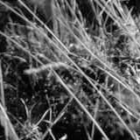
Smoothing with box filter

Slide 20
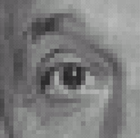
Practice with linear filters
0
0
0
?
0
1
0
0
0
0
Original
Source: D. Lowe

Slide 21
Practice with linear filters
0
0
0
0
1
0
0
0
0
Original
Filtered
(no change)
Source: D. Lowe

Slide 22
Practice with linear filters
0
0
0
?
0
0
1
0
0
0
Original
Source: D. Lowe

Slide 23
Practice with linear filters
0
0
0
0
0
1
0
0
0
Original
Shifted left
By 1 pixel
Source: D. Lowe

Slide 24
Practice with linear filters
0
0
0
-
1
1
1
?
0
2
0
1
1
1
0
0
0
1
1
1
(Note that filter sums to 1)
Original
Source: D. Lowe

Slide 25
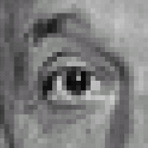
Practice with linear filters
0
0
0
-
1
1
1
0
2
0
1
1
1
0
0
0
1
1
1
Original
Sharpening filter
Accentuates differences with local average
Source: D. Lowe

Slide 26
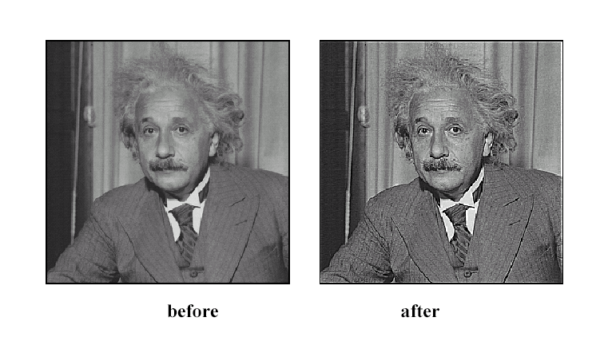
Sharpening
Source: D. Lowe

Slide 27
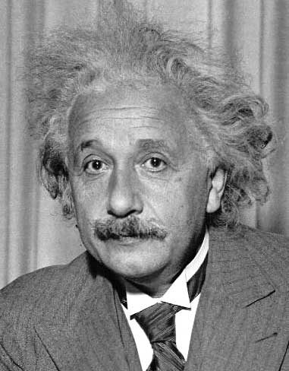
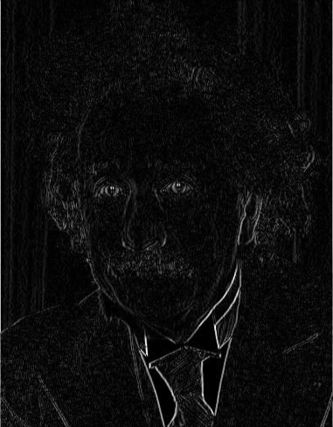
Other filters
1
0
-1
2
0
-2
1
0
-1
Sobel
Vertical Edge
(absolute value)

Slide 28
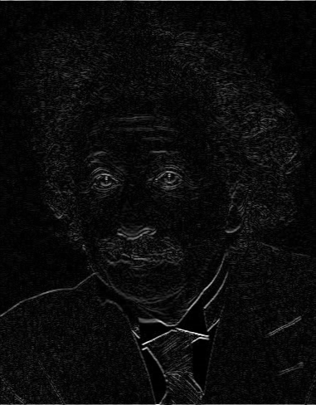
Other filters
1
2
1
0
0
0
-1
-2
-1
Sobel
Horizontal Edge
(absolute value)

Slide 29
Basic gradient filters
Horizontal Gradient
Vertical Gradient
0
0
0
0
1
0
-1
0
1
-1
0
1
0
0
0
or
0
0
0
0
-1
0
or
-1
0
1

Slide 30
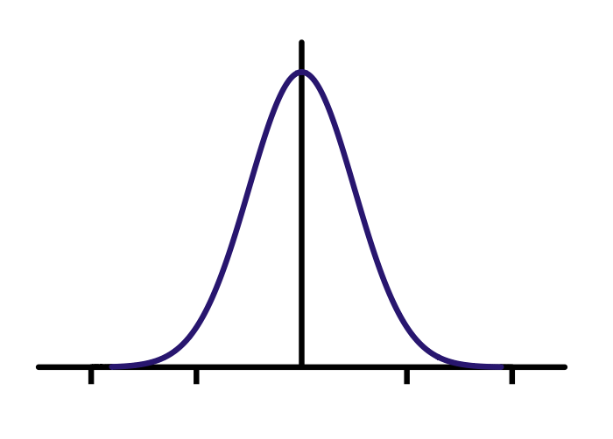
Gaussian filter
Compute empirically
=
*
Filter h
Input image f
Output image g

Slide 31
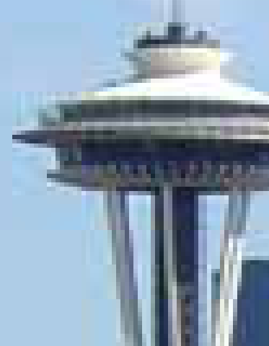
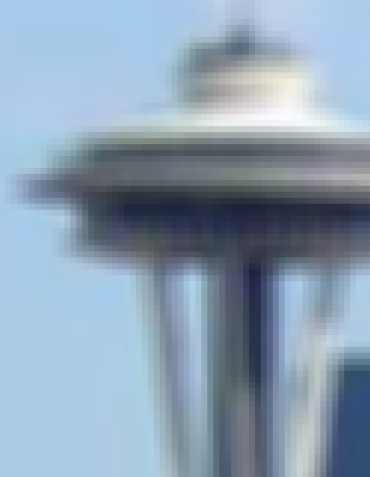
Gaussian vs. mean filters
What does real blur look like?

Slide 32
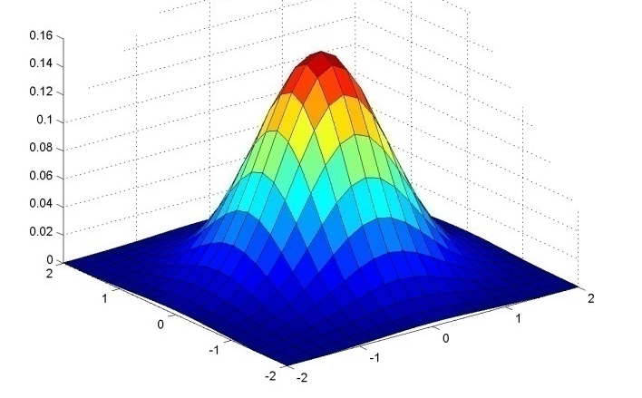
Important filter: Gaussian
Spatially-weighted average
0.003 0.013 0.022 0.013 0.003
0.013 0.059 0.097 0.059 0.013
0.022 0.097 0.159 0.097 0.022
0.013 0.059 0.097 0.059 0.013
0.003 0.013 0.022 0.013 0.003
5 x 5, σ = 1
Slide credit: Christopher Rasmussen

Slide 33
Smoothing with Gaussian filter

Slide 34
Smoothing with box filter

Slide 35
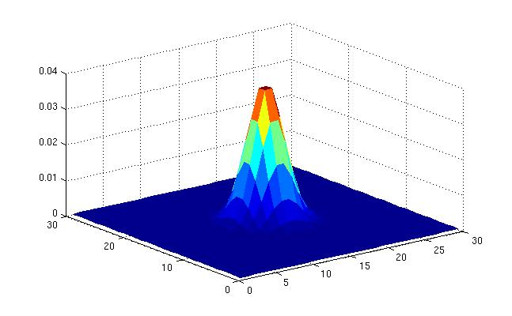
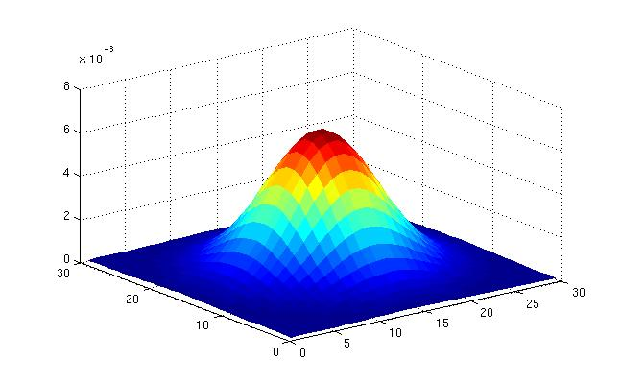
Gaussian filters
What parameters matter here?
Variance of Gaussian: determines extent of smoothing
Source: K. Grauman

Slide 36
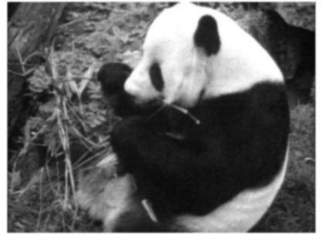
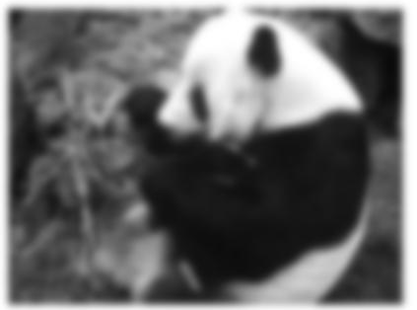
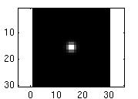
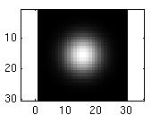
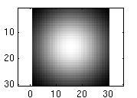
Smoothing with a Gaussian
Parameter σ is the “scale” / “width” / “spread” of the Gaussian kernel, and controls the amount of smoothing.
…
Source: K. Grauman

Slide 37
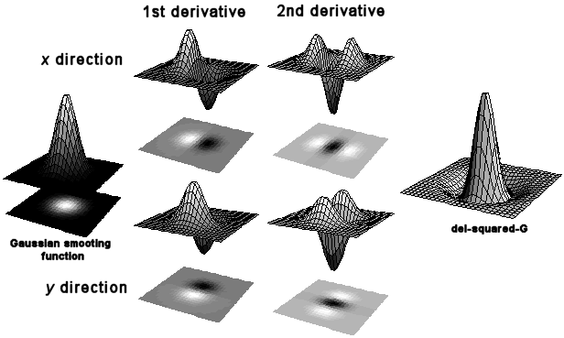
First and second derivatives
=
*

Slide 38
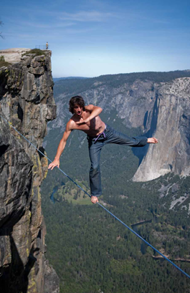
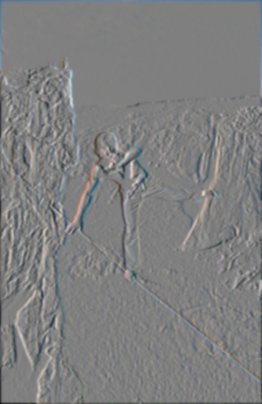
First and second derivatives
What are these good for?
Original
First Derivative x
Second Derivative x, y

Slide 39
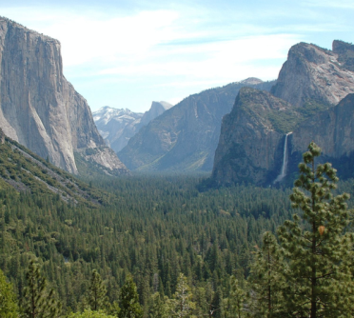
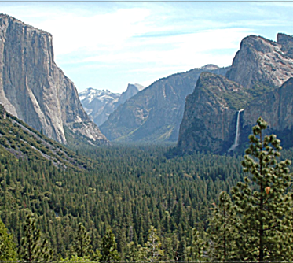
Subtracting filters
Original
Second Derivative
Sharpened

Slide 40
Combining filters
for some
0 | 0 | 0 | 0 | 0
0 | 0 | 0 | 0 | 0
0 | -1 | 0 | 1 | 0
0 | 0 | 0 | 0 | 0
0 | 0 | 0 | 0 | 0
=
*
0 | 0 | 0 | 0 | 0
0 | 0 | -1 | 0 | 0
0 | -1 | 4 | -1 | 0
0 | 0 | -1 | 0 | 0
0 | 0 | 0 | 0 | 0
=
*
It’s also true:

Slide 41
Combining Gaussian filters
=
*
?
More blur than either individually (but less than )

Slide 42
Separable filters
Compute Gaussian in horizontal direction, followed by the vertical direction.
Much faster!
=
*
Not all filters are separable. Freeman and Adelson, 1991

Slide 43
Sums of rectangular regions
How do we compute the sum of the pixels in the red box?
243 | 239 | 240 | 225 | 206 | 185 | 188 | 218 | 211 | 206 | 216 | 225
242 | 239 | 218 | 110 | 67 | 31 | 34 | 152 | 213 | 206 | 208 | 221
243 | 242 | 123 | 58 | 94 | 82 | 132 | 77 | 108 | 208 | 208 | 215
235 | 217 | 115 | 212 | 243 | 236 | 247 | 139 | 91 | 209 | 208 | 211
233 | 208 | 131 | 222 | 219 | 226 | 196 | 114 | 74 | 208 | 213 | 214
232 | 217 | 131 | 116 | 77 | 150 | 69 | 56 | 52 | 201 | 228 | 223
232 | 232 | 182 | 186 | 184 | 179 | 159 | 123 | 93 | 232 | 235 | 235
232 | 236 | 201 | 154 | 216 | 133 | 129 | 81 | 175 | 252 | 241 | 240
235 | 238 | 230 | 128 | 172 | 138 | 65 | 63 | 234 | 249 | 241 | 245
237 | 236 | 247 | 143 | 59 | 78 | 10 | 94 | 255 | 248 | 247 | 251
234 | 237 | 245 | 193 | 55 | 33 | 115 | 144 | 213 | 255 | 253 | 251
248 | 245 | 161 | 128 | 149 | 109 | 138 | 65 | 47 | 156 | 239 | 255
190 | 107 | 39 | 102 | 94 | 73 | 114 | 58 | 17 | 7 | 51 | 137
23 | 32 | 33 | 148 | 168 | 203 | 179 | 43 | 27 | 17 | 12 | 8
17 | 26 | 12 | 160 | 255 | 255 | 109 | 22 | 26 | 19 | 35 | 24
After some pre-computation, this can be done in constant time for any box.
This “trick” is commonly used for computing Haar wavelets (a fundemental building block of many object recognition approaches.)

Slide 44
Sums of rectangular regions
The trick is to compute an “integral image.” Every pixel is the sum of its neighbors to the upper left.
Sequentially compute using:

Slide 45
Sums of rectangular regions
 |  | A |  |  |  |  |  |  | B
 |  | C |  |  |  |  |  |  | D
Solution is found using:
A + D – B - C

Slide 46
Spatially varying filters
Some filters vary spatially.
Durand, 02
Useful for deblurring.

Slide 47
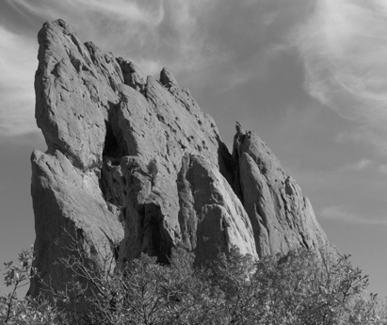
Constant blur
*
input
output
*
*
Same Gaussian kernel everywhere.
Slides courtesy of Sylvian Paris

Slide 48
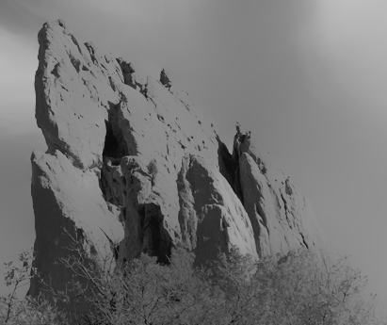
Bilateral filter
Maintains edges when blurring!
*
input
output
*
*
The kernel shape depends on the image content.
Slides courtesy of Sylvian Paris

Slide 49
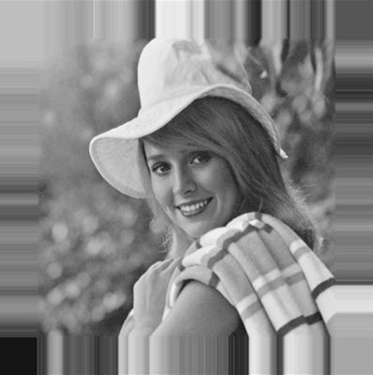
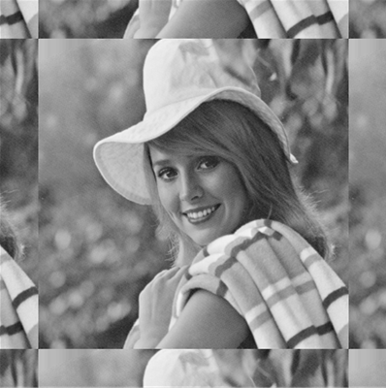
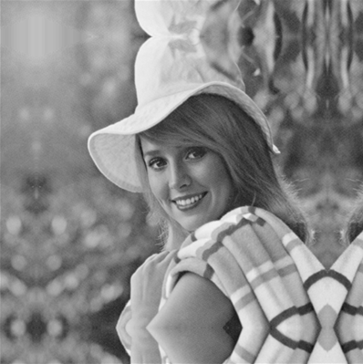
Borders
What to do about image borders:
black
fixed
periodic
reflected

