Slide 1
Practical Aspects of Modern Cryptography
Winter 2011
Josh Benaloh
Brian LaMacchia

Slide 2
Public-Key History
1976 New Directions in Cryptography
    Whit Diffie and Marty Hellman
    One-Way functions
    Diffie-Hellman Key Exchange
1978 RSA paper
    Ron Rivest, Adi Shamir, and Len Adleman
    RSA Encryption System
    RSA Digital Signature Mechanism

Slide 3
The Fundamental Equation
Z=Y^{X} mod N

Slide 4
Diffie-Hellman
Z=Y^{X} mod N
When X is unknown, the problem is known as the discrete logarithm and is generally believed to be hard to solve.

Slide 5
Diffie-Hellman Key Exchange
Alice
Randomly select a large integer a and send A = Yª mod N.
Compute the key K = Bª mod N.
Bob
Randomly select a large integer b and send B = Y^{b} mod N.
Compute the key K = A^{b} mod N.
Bª = Y^{ba} = Y^{ab} = A^{b}

Slide 6
One-Way Trap-Door Functions
Z=Y^{X} mod N
Recall that this equation is solvable for Y if the factorization of N is known, but is believed to be hard otherwise.

Slide 7
RSA Public-Key Cryptosystem
Alice
Select two large random primes P & Q.
Publish the product N=PQ.
Use knowledge of P & Q to compute Y.
Anyone
To send message Y to Alice, compute Z=Y^{X} mod N.
Send Z and X to Alice.

Slide 8
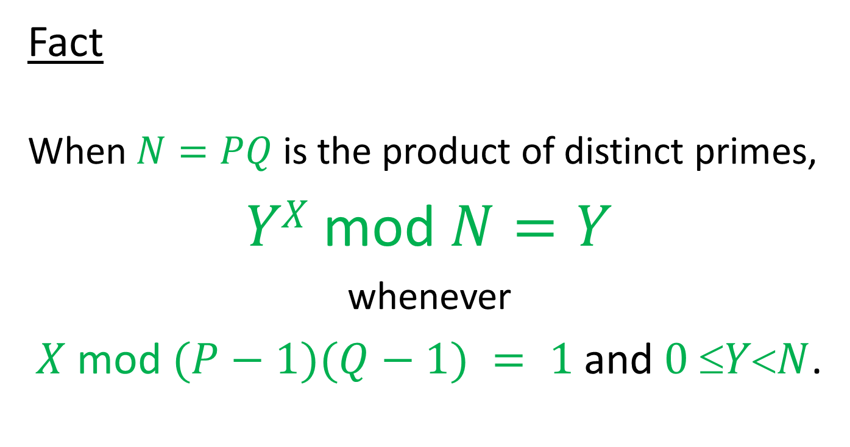
Why Does RSA Work?
Fact
When $N=PQ$ is the product of distinct primes,
$YX$mod $N=Y$
whenever
$X$ mod $(P−1)(Q−1) = 1$and $0 YN$.

Slide 9
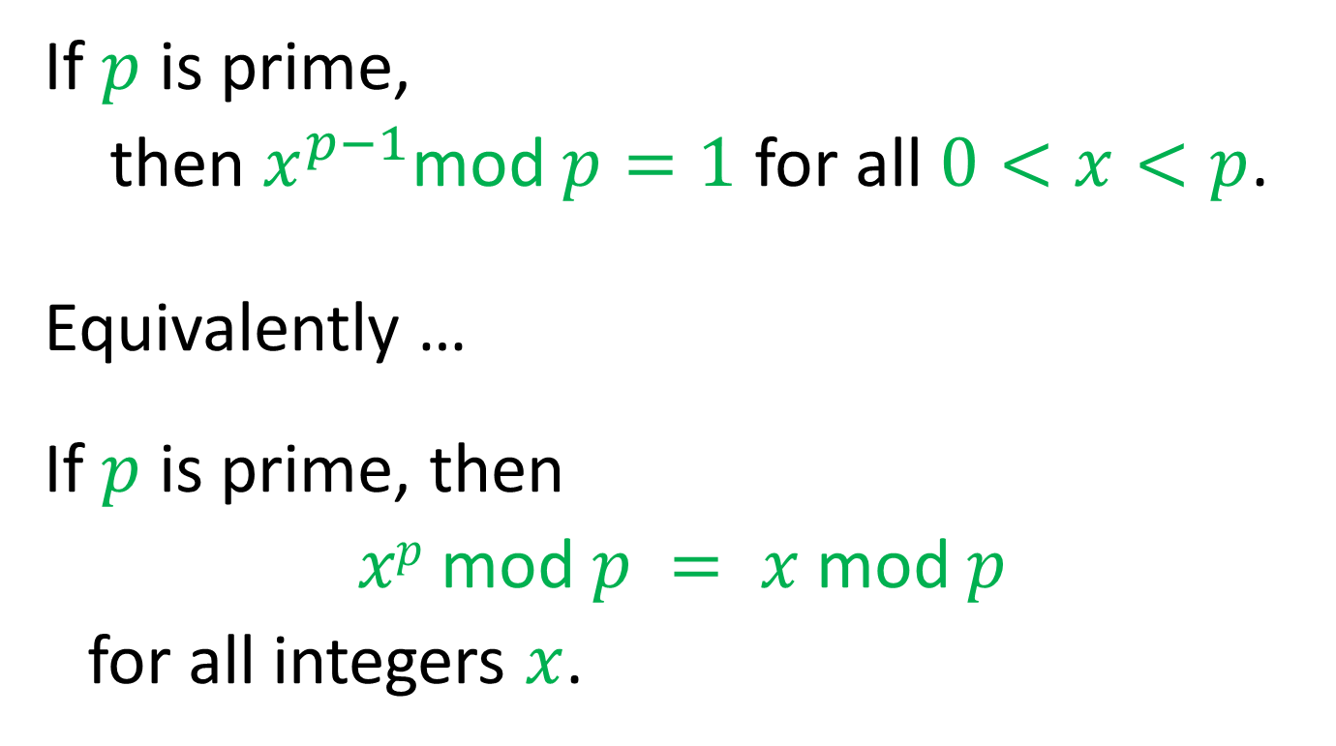
Fermat’s Little Theorem
If $p$ is prime,
then $x^{p−1}$mod $p=1$ for all $0<x<p$.
Equivalently …
If $p$ is prime, then
$xp$ mod $p = x$ mod $p$
for all integers $x$.

Slide 10

Proof of Fermat’s Little Theorem
The Binomial Theorem
${\left(x+y\right)}^{p}=\sum_{i=0}^{p}{\left({n \atop i}\right)x^{i}y^{p−i}}$ where $\left({p \atop i}\right)=\frac{p!}{i!\left(p−i\right)!}$

Slide 11
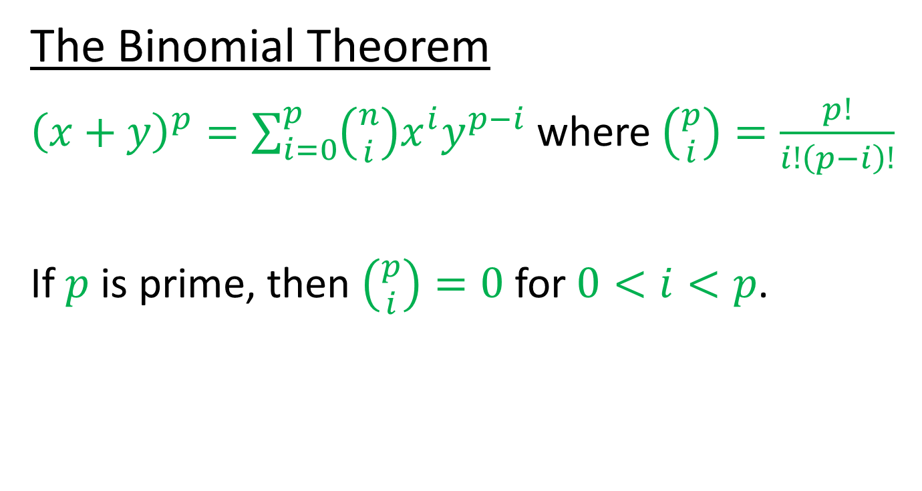
Proof of Fermat’s Little Theorem
The Binomial Theorem
${\left(x+y\right)}^{p}=\sum_{i=0}^{p}{\left({n \atop i}\right)x^{i}y^{p−i}}$ where $\left({p \atop i}\right)=\frac{p!}{i!\left(p−i\right)!}$
If $p$ is prime, then $\left({p \atop i}\right)=0$ for $0<i<p$.

Slide 12
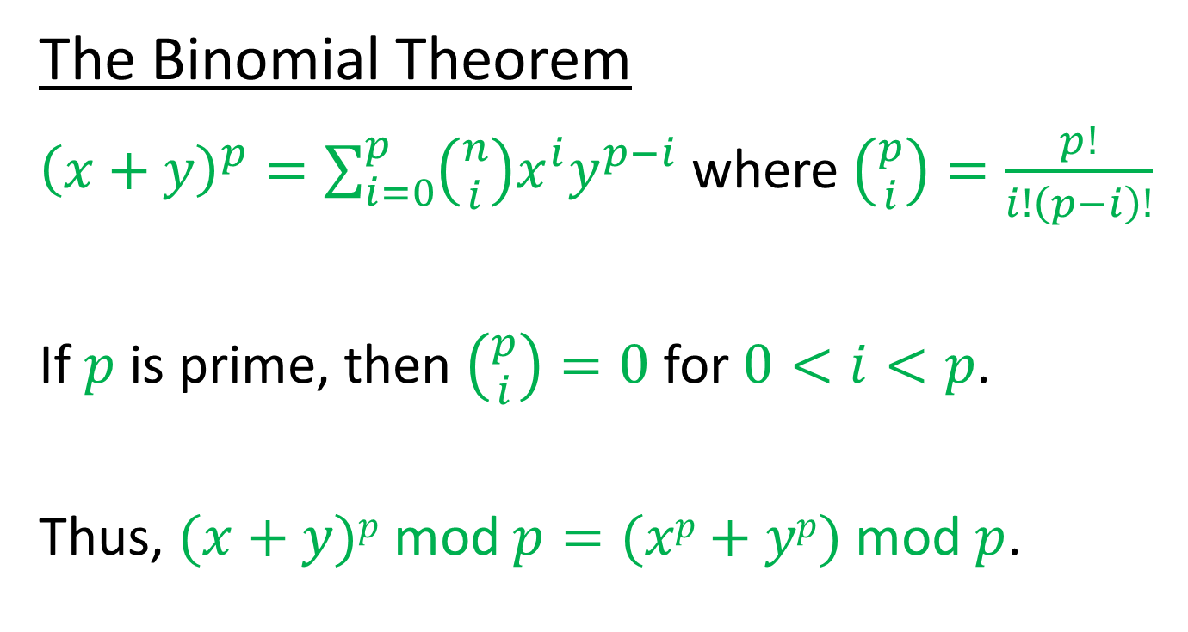
Proof of Fermat’s Little Theorem
The Binomial Theorem
${\left(x+y\right)}^{p}=\sum_{i=0}^{p}{\left({n \atop i}\right)x^{i}y^{p−i}}$ where $\left({p \atop i}\right)=\frac{p!}{i!\left(p−i\right)!}$
If $p$ is prime, then $\left({p \atop i}\right)=0$ for $0<i<p$.
Thus, $(x+y)p$mod $p=(xp+yp)$mod $p$.

Slide 13

Proof of Fermat’s Little Theorem
$x^{p}$ mod $p=x$ mod $p$

Slide 14

Proof of Fermat’s Little Theorem
$x^{p}$ mod $p=x$ mod $p$
By induction on $x$…

Slide 15

Proof of Fermat’s Little Theorem
$x^{p}$ mod $p=x$ mod $p$
By induction on $x$…
Basis

Slide 16
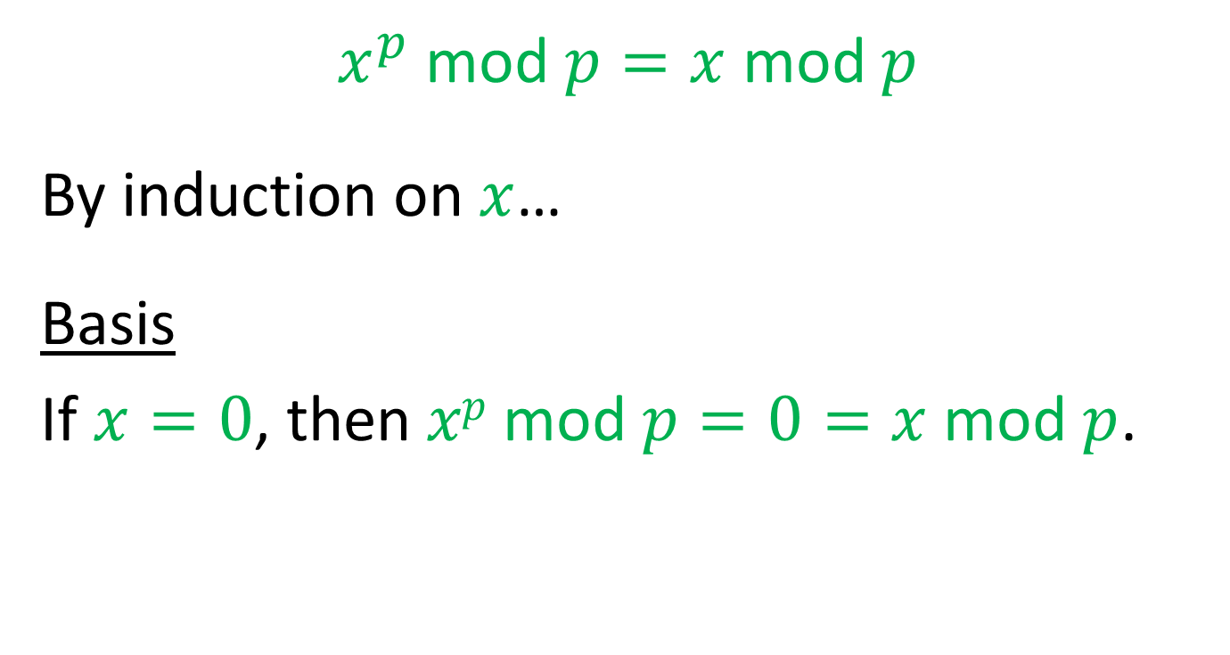
Proof of Fermat’s Little Theorem
$x^{p}$ mod $p=x$ mod $p$
By induction on $x$…
Basis
If $x=0$, then $xp$ mod $p=0=x$mod $p$.

Slide 17
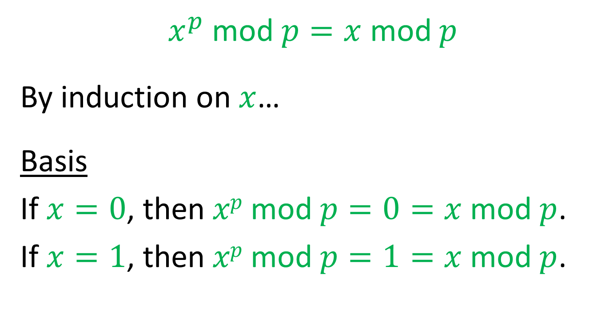
Proof of Fermat’s Little Theorem
$x^{p}$ mod $p=x$ mod $p$
By induction on $x$…
Basis
If $x=0$, then $xp$ mod $p=0=x$mod $p$.
If $x=1$, then $xp$ mod $p=1=x$mod $p$.

Slide 18
Proof of Fermat’s Little Theorem
Inductive Step

Slide 19

Proof of Fermat’s Little Theorem
Inductive Step
Assume that $xp$ mod $p = x$ mod $p$.

Slide 20
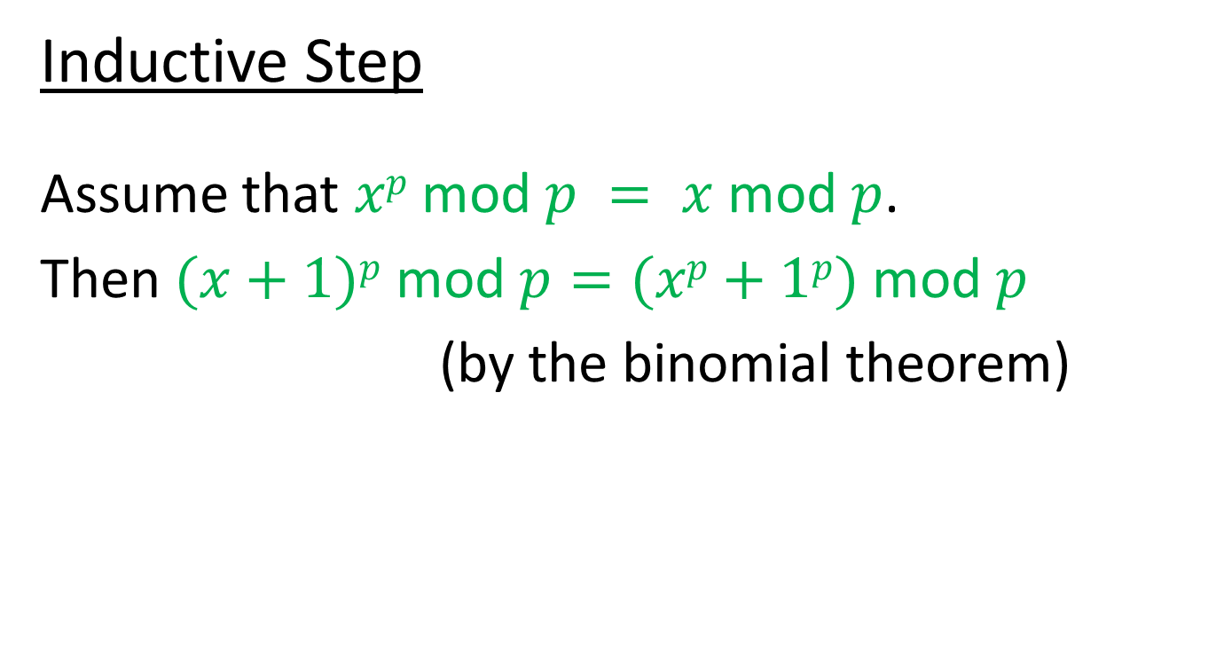
Proof of Fermat’s Little Theorem
Inductive Step
Assume that $xp$ mod $p = x$ mod $p$.
Then $(x+1)p$ mod $p=(xp+1p)$ mod $p$
(by the binomial theorem)

Slide 21
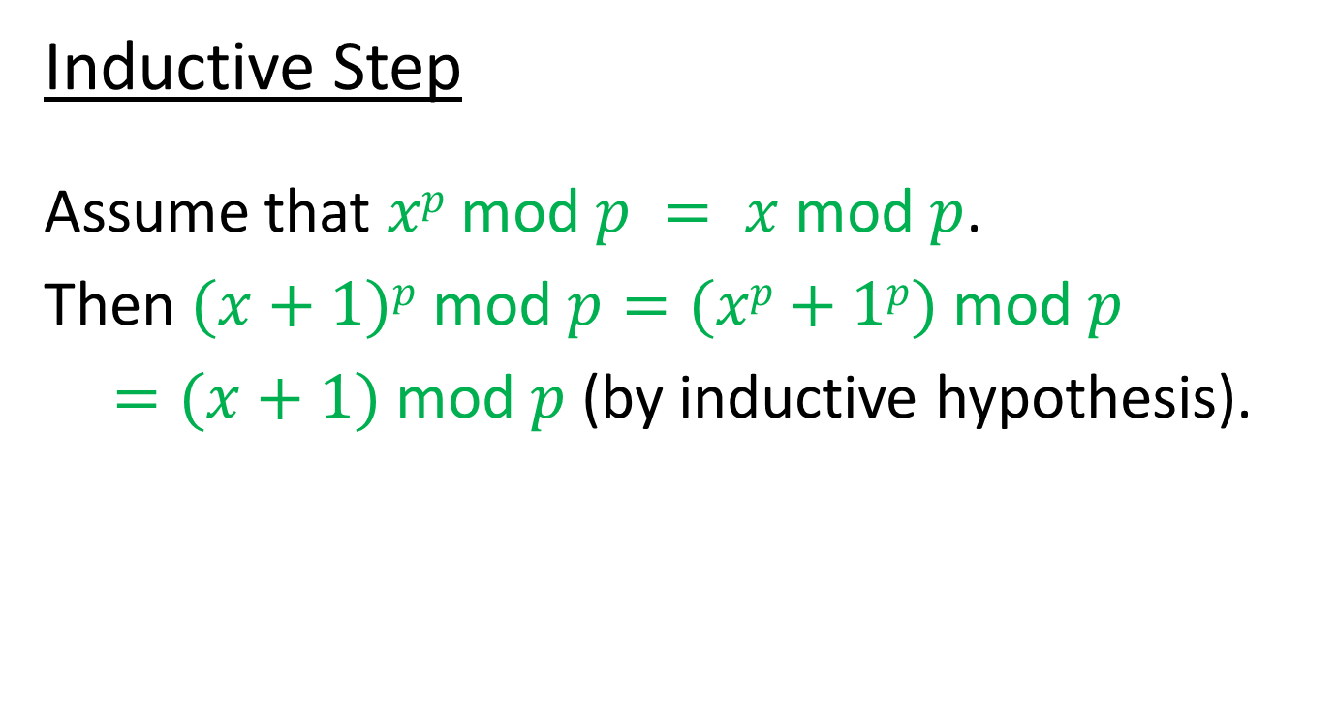
Proof of Fermat’s Little Theorem
Inductive Step
Assume that $xp$ mod $p = x$ mod $p$.
Then $(x+1)p$ mod $p=(xp+1p)$ mod $p$
$=(x+1)$ mod $p$ (by inductive hypothesis).

Slide 22
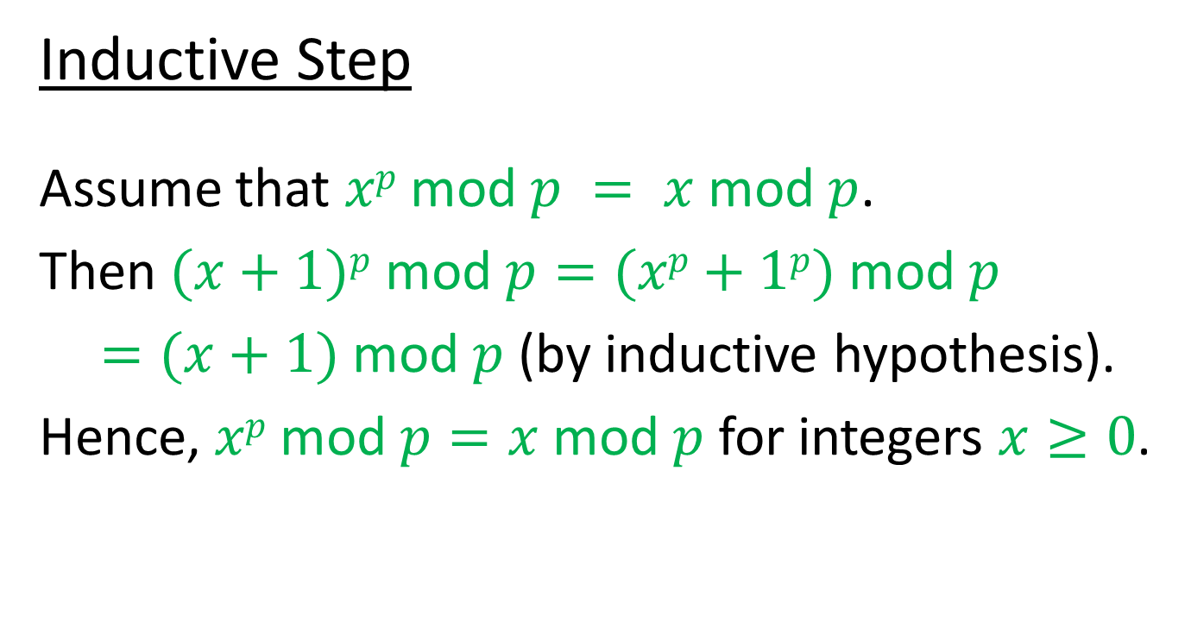
Proof of Fermat’s Little Theorem
Inductive Step
Assume that $xp$ mod $p = x$ mod $p$.
Then $(x+1)p$ mod $p=(xp+1p)$ mod $p$
$=(x+1)$ mod $p$ (by inductive hypothesis).
Hence, $xp$ mod $p=x$ mod $p$ for integers $x≥0$.

Slide 23
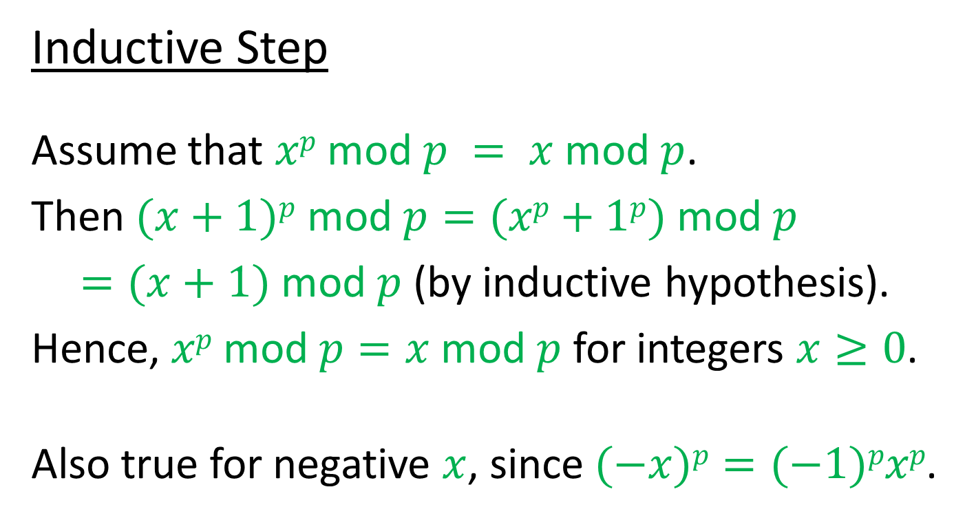
Proof of Fermat’s Little Theorem
Inductive Step
Assume that $xp$ mod $p = x$ mod $p$.
Then $(x+1)p$ mod $p=(xp+1p)$ mod $p$
$=(x+1)$ mod $p$ (by inductive hypothesis).
Hence, $xp$ mod $p=x$ mod $p$ for integers $x≥0$.
Also true for negative $x$, since $(−x)p=(−1)pxp$.

Slide 24
Proof of RSA

Slide 25

Proof of RSA
We have shown …
$Y^{P}$mod $P=Y$whenever $0≤Y<P$
and $P$ is prime.

Slide 26
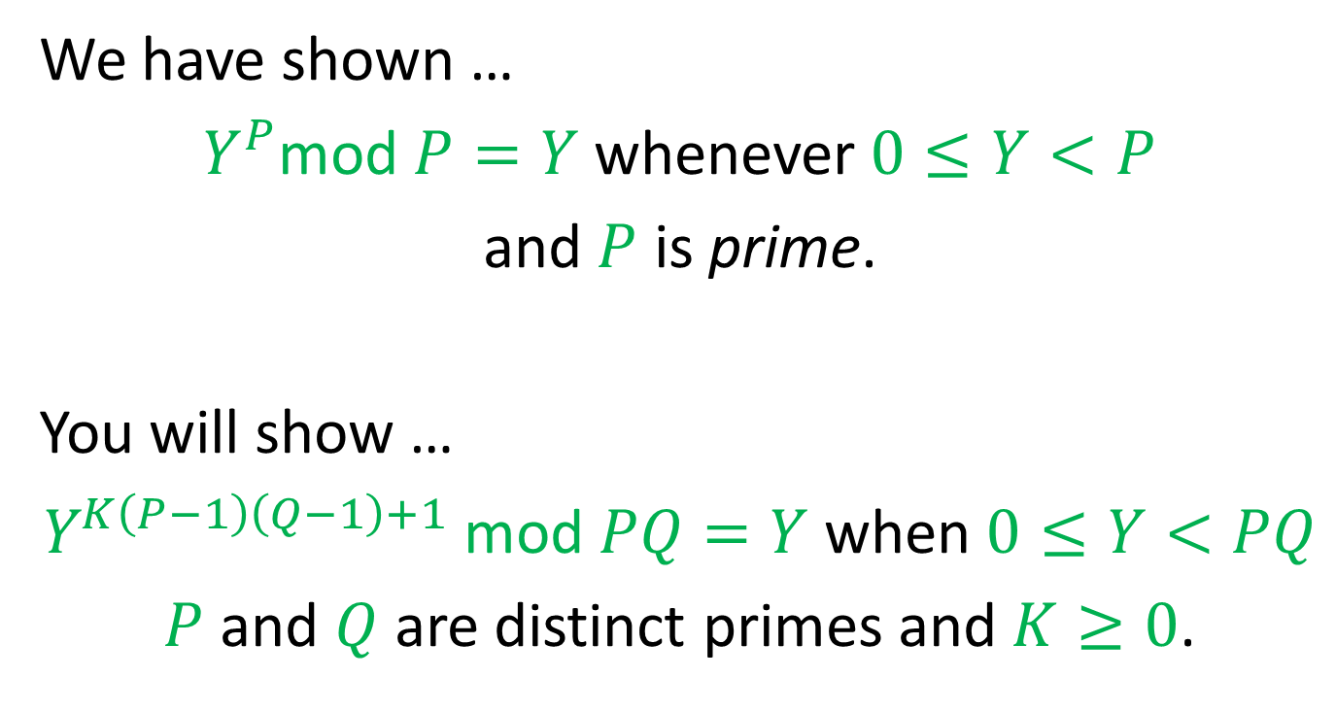
Proof of RSA
We have shown …
$Y^{P}$mod $P=Y$whenever $0≤Y<P$
and $P$ is prime.
You will show …
$Y^{K\left(P−1\right)\left(Q−1\right)+1}$ mod $PQ=Y$when $0≤Y<PQ$
$P$ and $Q$ are distinct primes and $K≥0$.

Slide 27
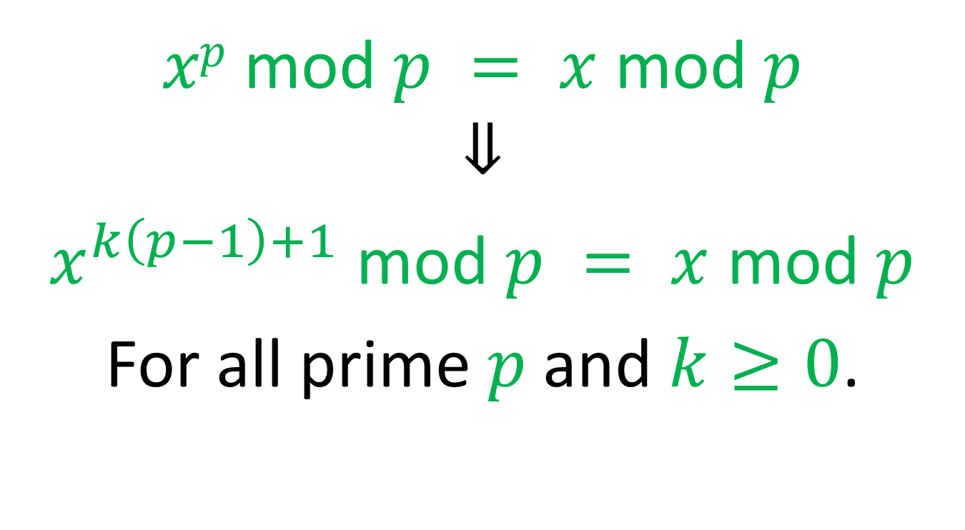
Corollary of Fermat
$xp$ mod $p = x$ mod $p$
$$⇓$$
$x^{k\left(p−1\right)+1}$ mod $p = x$ mod $p$
For all prime $p \text{and} k≥0$.

Slide 28
Finding Primes

Slide 29
Finding Primes
Euclid’s proof of the infinity of primes

Slide 30
Finding Primes
Euclid’s proof of the infinity of primes
Suppose that the set of all primes were finite.

Slide 31

Finding Primes
Euclid’s proof of the infinity of primes
Suppose that the set of all primes were finite.
Let $N$be the product of all of the primes.

Slide 32

Finding Primes
Euclid’s proof of the infinity of primes
Suppose that the set of all primes were finite.
Let $N$be the product of all of the primes.
Consider $N+1$.

Slide 33

Finding Primes
Euclid’s proof of the infinity of primes
Suppose that the set of all primes were finite.
Let $N$be the product of all of the primes.
Consider $N+1$. Is $N+1$ prime or composite?

Slide 34
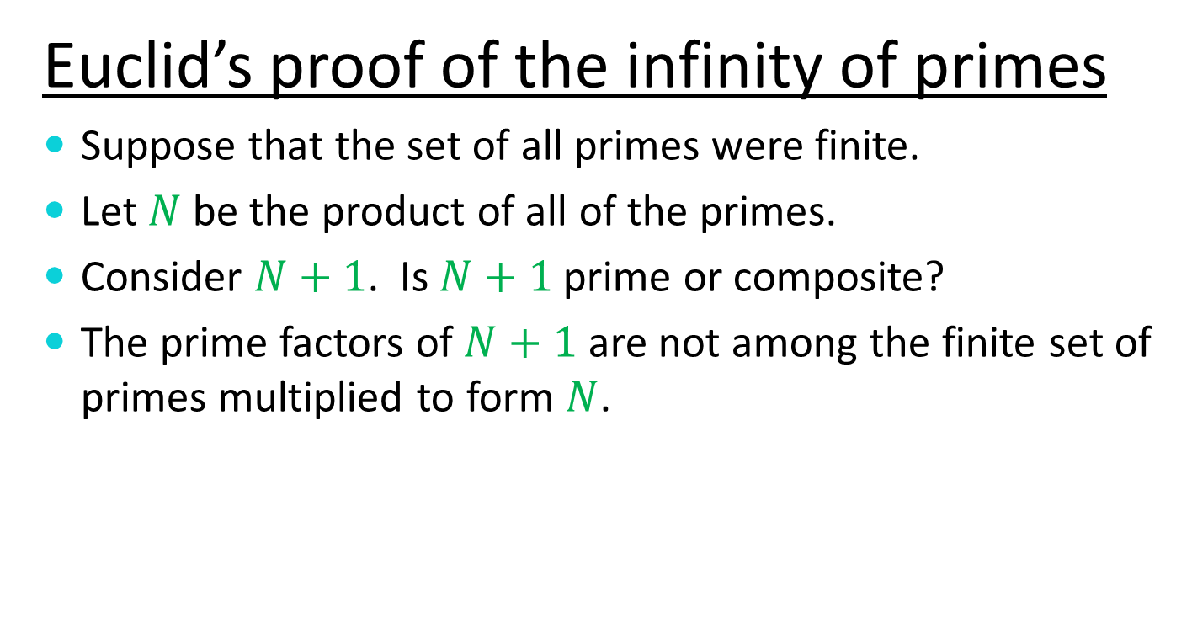
Finding Primes
Euclid’s proof of the infinity of primes
Suppose that the set of all primes were finite.
Let $N$be the product of all of the primes.
Consider $N+1$. Is $N+1$ prime or composite?
The prime factors of $N+1$ are not among the finite set of primes multiplied to form $N$.

Slide 35
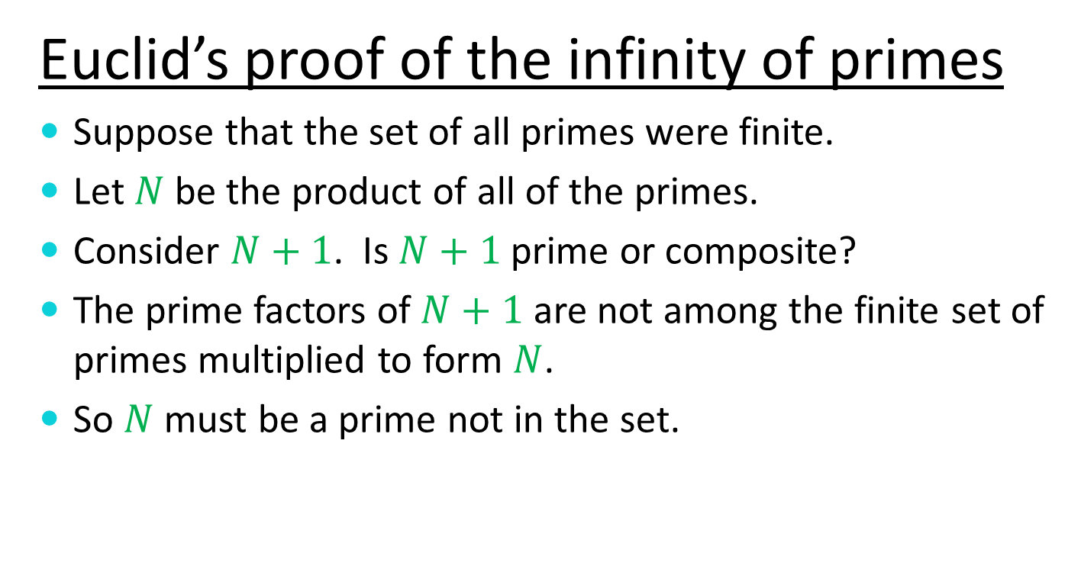
Finding Primes
Euclid’s proof of the infinity of primes
Suppose that the set of all primes were finite.
Let $N$ be the product of all of the primes.
Consider $N+1$. Is $N+1$ prime or composite?
The prime factors of $N+1$ are not among the finite set of primes multiplied to form $N$.
So $N$ must be a prime not in the set.

Slide 36
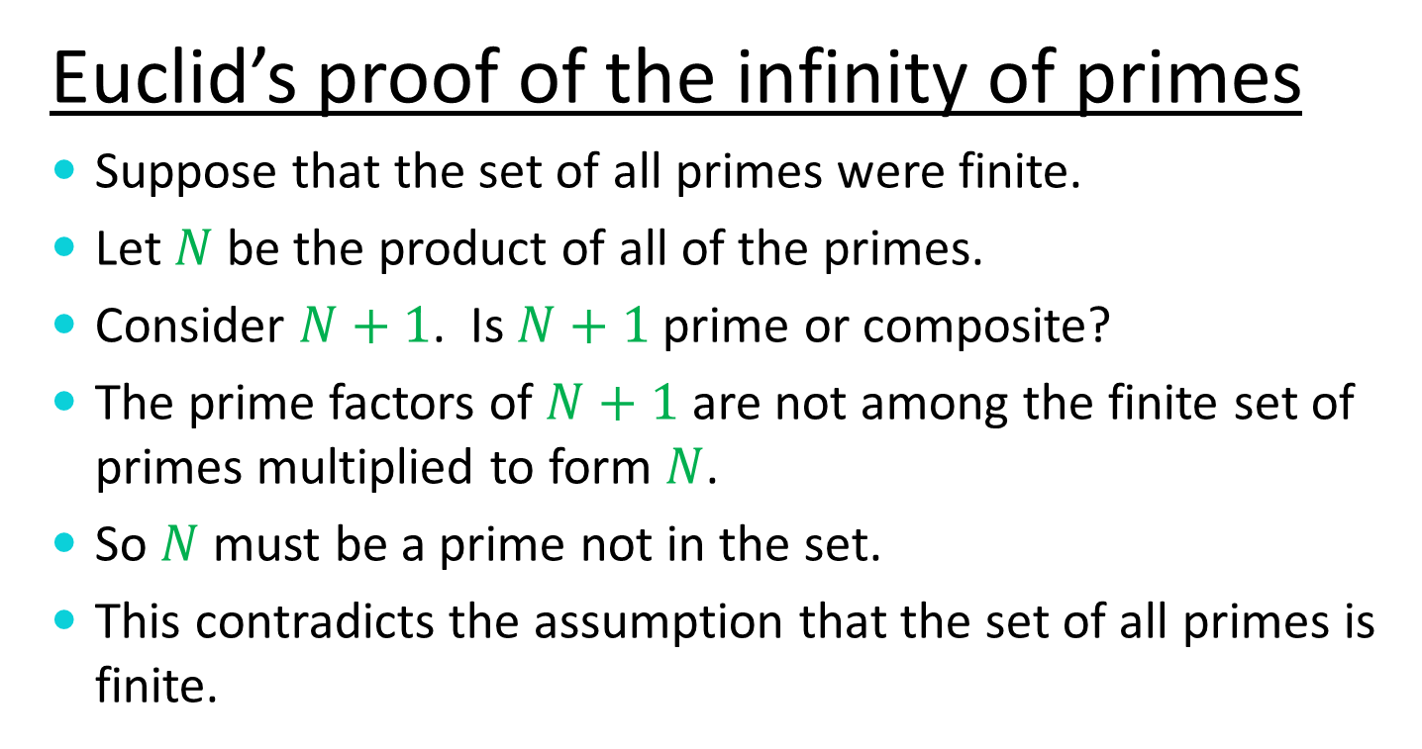
Finding Primes
Euclid’s proof of the infinity of primes
Suppose that the set of all primes were finite.
Let $N$ be the product of all of the primes.
Consider $N+1$. Is $N+1$ prime or composite?
The prime factors of $N+1$ are not among the finite set of primes multiplied to form $N$.
So $N$ must be a prime not in the set.
This contradicts the assumption that the set of all primes is finite.

Slide 37
The Prime Number Theorem

Slide 38

The Prime Number Theorem
The number of primes less than $N$ is approximately $N/{(\ln{N})}$.

Slide 39
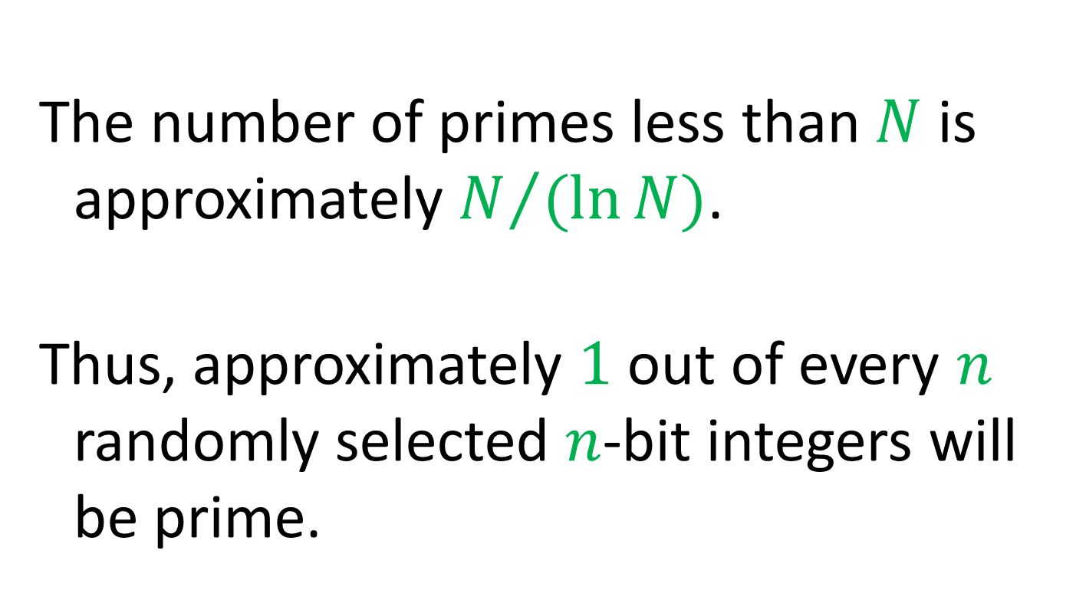
The Prime Number Theorem
The number of primes less than $N$ is approximately $N/{(\ln{N})}$.
Thus, approximately $1$ out of every $n$ randomly selected $n$-bit integers will be prime.

Slide 40
But How Do We Find Primes?

Slide 41
Testing Primality

Slide 42

Testing Primality
Recall Fermat’s Little Theorem
If $p$ is prime, then $a^{p−1}$ mod $p=1$for all $a$ in the range $0<a<p$.

Slide 43
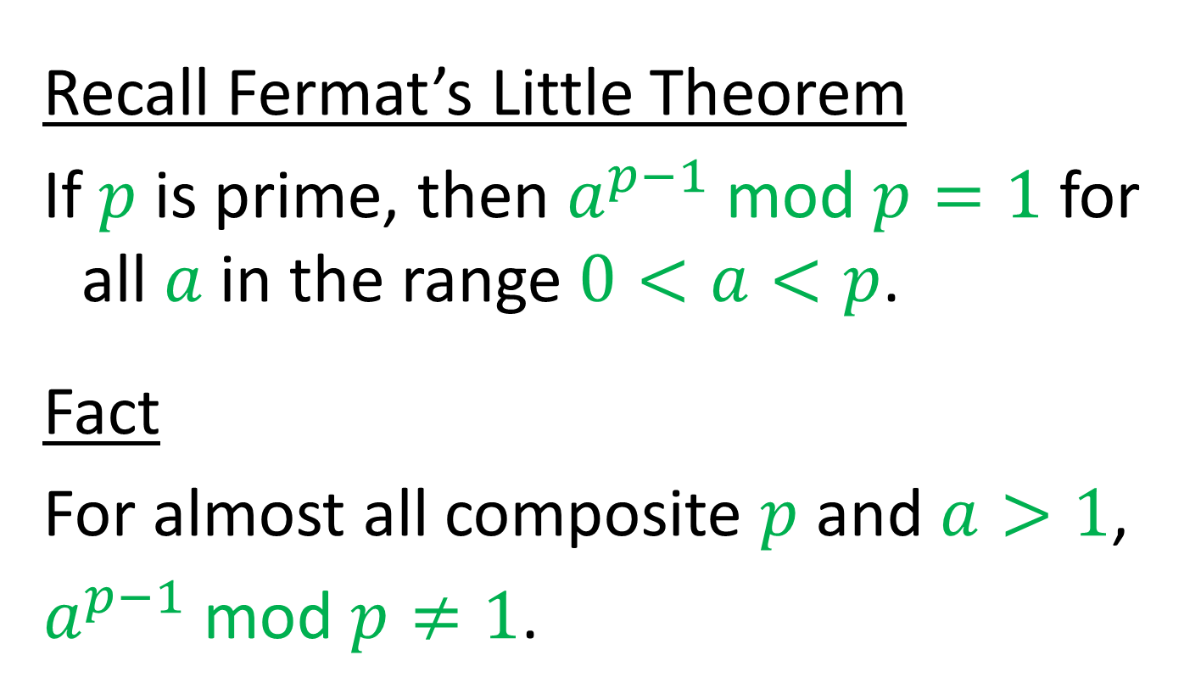
Testing Primality
Recall Fermat’s Little Theorem
If $p$ is prime, then $a^{p−1}$ mod $p=1$for all $a$ in the range $0<a<p$.
Fact
For almost all composite $p$ and $a>1$,
$a^{p−1}$ mod $p≠1$.

Slide 44
The Miller-Rabin Primality Test

Slide 45

The Miller-Rabin Primality Test
To test an integer $N$ for primality, write $N–1$ as $N–1=m2k$where $m$ is odd.

Slide 46

The Miller-Rabin Primality Test
To test an integer $N$ for primality, write $N–1$ as $N–1=m2k$where $m$ is odd.
Repeat several (many) times

Slide 47

The Miller-Rabin Primality Test
To test an integer $N$ for primality, write $N–1$ as $N–1=m2k$where $m$ is odd.
Repeat several (many) times
Select a random $a$ in $1<a<N–1$

Slide 48
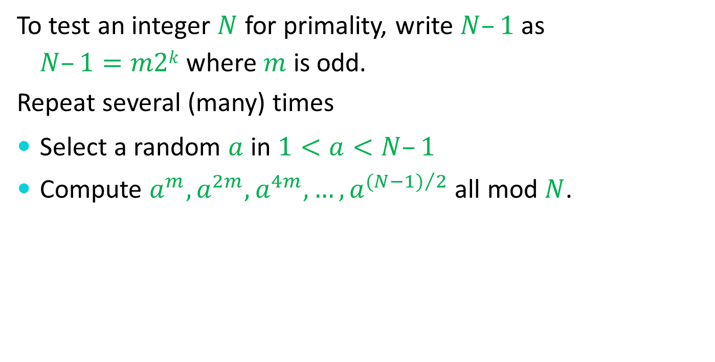
The Miller-Rabin Primality Test
To test an integer $N$ for primality, write $N–1$ as $N–1=m2k$where $m$ is odd.
Repeat several (many) times
Select a random $a$ in $1<a<N–1$
Compute $a^{m},a^{2m},a^{4m}, …, a^{{(N−1)}/2}$ all mod $N$.

Slide 49
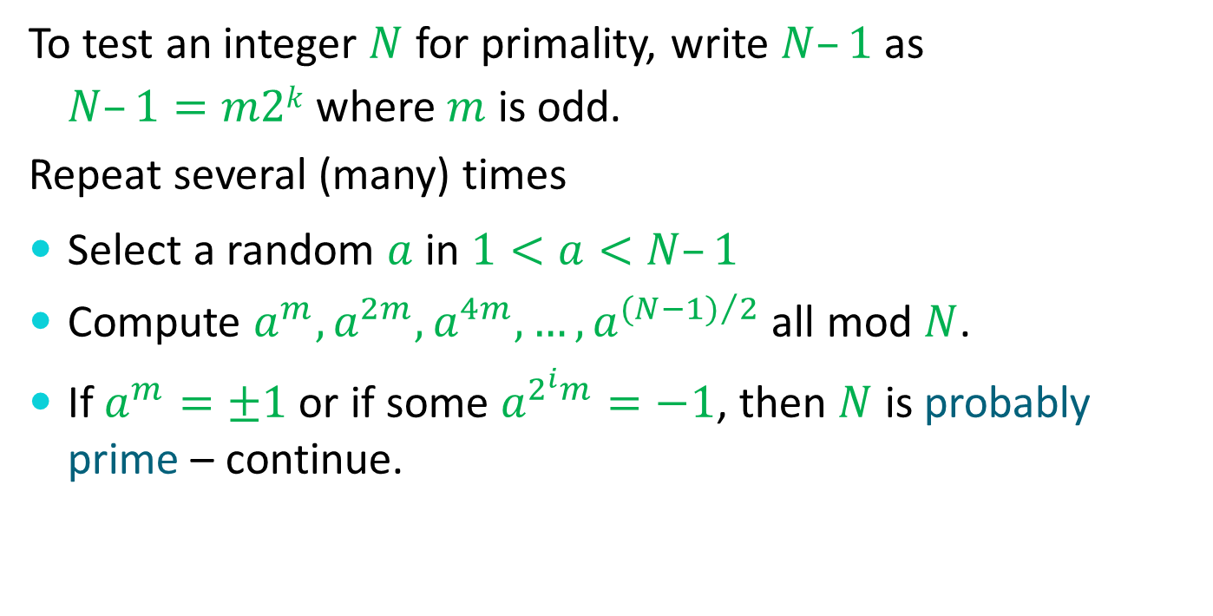
The Miller-Rabin Primality Test
To test an integer $N$ for primality, write $N–1$ as $N–1=m2k$where $m$ is odd.
Repeat several (many) times
Select a random $a$ in $1<a<N–1$
Compute $a^{m},a^{2m},a^{4m}, …, a^{{(N−1)}/2}$ all mod $N$.
If $a^{m}=±1$ or if some $a^{2^{i}m}=−1$, then $N$ is probably prime – continue.

Slide 50
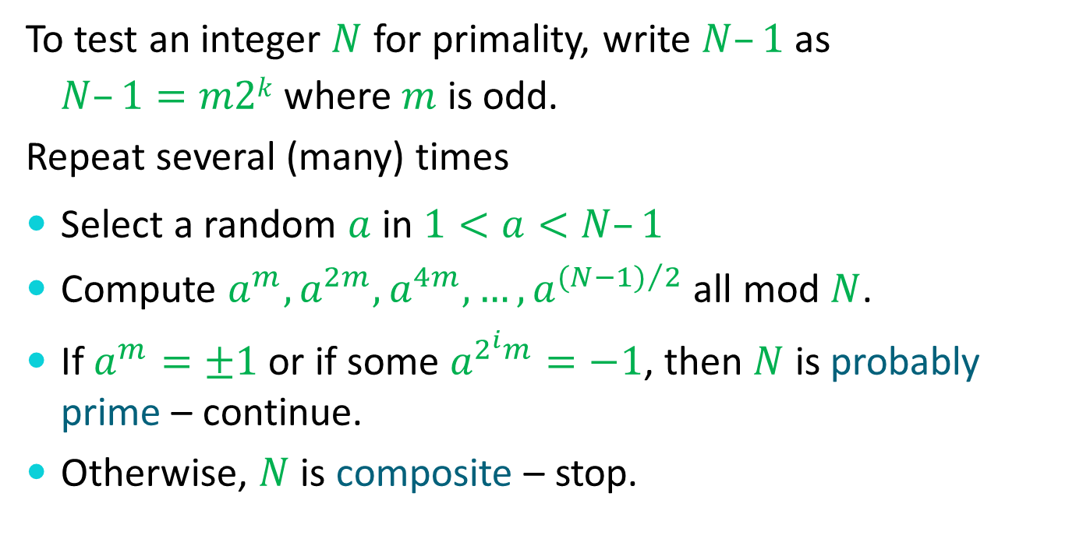
The Miller-Rabin Primality Test
To test an integer $N$ for primality, write $N–1$ as $N–1=m2k$where $m$ is odd.
Repeat several (many) times
Select a random $a$ in $1<a<N–1$
Compute $a^{m},a^{2m},a^{4m}, …, a^{{(N−1)}/2}$ all mod $N$.
If $a^{m}=±1$ or if some $a^{2^{i}m}=−1$, then $N$ is probably prime – continue.
Otherwise, $N$ is composite – stop.

Slide 51

Sieving for Primes
Pick a random starting point $N$.
N | N+1 | N+2 | N+3 | N+4 | N+5 | N+6 | N+7 | N+8 | N+9 | N+10 | N+11
Sieving out multiples of
2

Slide 52
Sieving for Primes
Pick a random starting point $N$.
N | N+1 | N+2 | N+3 | N+4 | N+5 | N+6 | N+7 | N+8 | N+9 | N+10 | N+11
Sieving out multiples of
2

Slide 53
Sieving for Primes
Pick a random starting point $N$.
N | N+1 | N+2 | N+3 | N+4 | N+5 | N+6 | N+7 | N+8 | N+9 | N+10 | N+11
Sieving out multiples of
2

Slide 54
Sieving for Primes
Pick a random starting point $N$.
N | N+1 | N+2 | N+3 | N+4 | N+5 | N+6 | N+7 | N+8 | N+9 | N+10 | N+11
Sieving out multiples of
2

Slide 55
Sieving for Primes
Pick a random starting point $N$.
N | N+1 | N+2 | N+3 | N+4 | N+5 | N+6 | N+7 | N+8 | N+9 | N+10 | N+11
Sieving out multiples of
2

Slide 56
Sieving for Primes
Pick a random starting point $N$.
N | N+1 | N+2 | N+3 | N+4 | N+5 | N+6 | N+7 | N+8 | N+9 | N+10 | N+11
Sieving out multiples of
2

Slide 57
Sieving for Primes
Pick a random starting point $N$.
N | N+1 | N+2 | N+3 | N+4 | N+5 | N+6 | N+7 | N+8 | N+9 | N+10 | N+11
Sieving out multiples of
2

Slide 58
Sieving for Primes
Pick a random starting point $N$.
N | N+1 | N+2 | N+3 | N+4 | N+5 | N+6 | N+7 | N+8 | N+9 | N+10 | N+11
Sieving out multiples of
3

Slide 59
Sieving for Primes
Pick a random starting point $N$.
N | N+1 | N+2 | N+3 | N+4 | N+5 | N+6 | N+7 | N+8 | N+9 | N+10 | N+11
Sieving out multiples of
3

Slide 60
Sieving for Primes
Pick a random starting point N.
N | N+1 | N+2 | N+3 | N+4 | N+5 | N+6 | N+7 | N+8 | N+9 | N+10 | N+11
Sieving out multiples of
3

Slide 61
Sieving for Primes
Pick a random starting point $N$.
N | N+1 | N+2 | N+3 | N+4 | N+5 | N+6 | N+7 | N+8 | N+9 | N+10 | N+11
Sieving out multiples of
3

Slide 62
Sieving for Primes
Pick a random starting point $N$.
N | N+1 | N+2 | N+3 | N+4 | N+5 | N+6 | N+7 | N+8 | N+9 | N+10 | N+11
Sieving out multiples of
3

Slide 63
Sieving for Primes
Pick a random starting point $N$.
N | N+1 | N+2 | N+3 | N+4 | N+5 | N+6 | N+7 | N+8 | N+9 | N+10 | N+11
Sieving out multiples of
5

Slide 64
Sieving for Primes
Pick a random starting point $N$.
N | N+1 | N+2 | N+3 | N+4 | N+5 | N+6 | N+7 | N+8 | N+9 | N+10 | N+11
Sieving out multiples of
5

Slide 65
Sieving for Primes
Pick a random starting point $N$.
N | N+1 | N+2 | N+3 | N+4 | N+5 | N+6 | N+7 | N+8 | N+9 | N+10 | N+11
Sieving out multiples of
5

Slide 66
Sieving for Primes
Pick a random starting point $N$.
N | N+1 | N+2 | N+3 | N+4 | N+5 | N+6 | N+7 | N+8 | N+9 | N+10 | N+11
Sieving out multiples of
5

Slide 67
Sieving for Primes
Pick a random starting point $N$.
N | N+1 | N+2 | N+3 | N+4 | N+5 | N+6 | N+7 | N+8 | N+9 | N+10 | N+11
Sieving out multiples of
5
Only a few “good” candidate primes will survive.

Slide 68
Reprise of RSA Set-Up

Slide 69
Reprise of RSA Set-Up
Use sieving to find large candidate primes.

Slide 70

Reprise of RSA Set-Up
Use sieving to find large candidate primes.
Use Miller-Rabin on candidate primes to find two almost certainly prime integers $P$ and $Q$.

Slide 71

Reprise of RSA Set-Up
Use sieving to find large candidate primes.
Use Miller-Rabin on candidate primes to find two almost certainly prime integers $P$ and $Q$.
Form public modulus $N=PQ$.

Slide 72
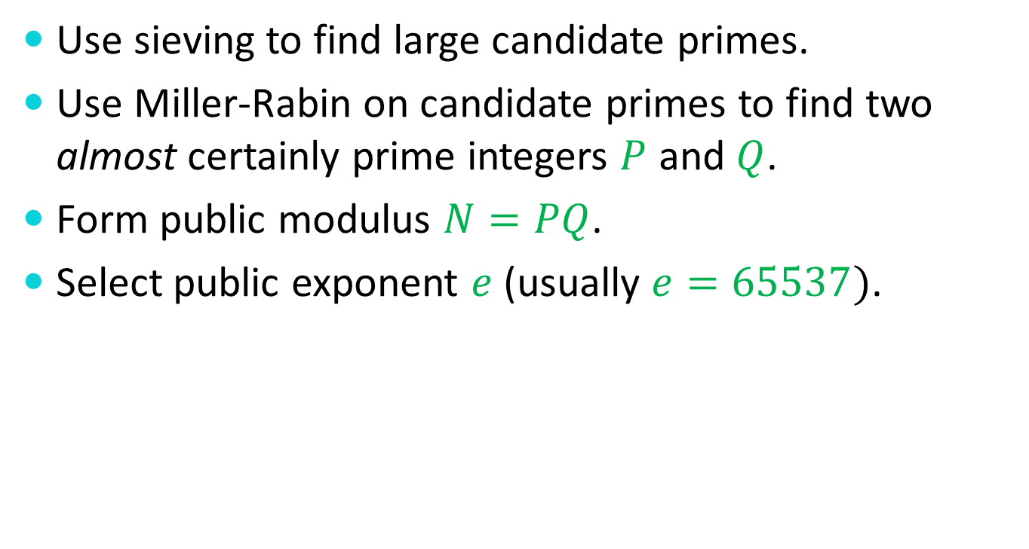
Reprise of RSA Set-Up
Use sieving to find large candidate primes.
Use Miller-Rabin on candidate primes to find two almost certainly prime integers $P$ and $Q$.
Form public modulus $N=PQ$.
Select public exponent $e$ (usually $e=65537)$.

Slide 73
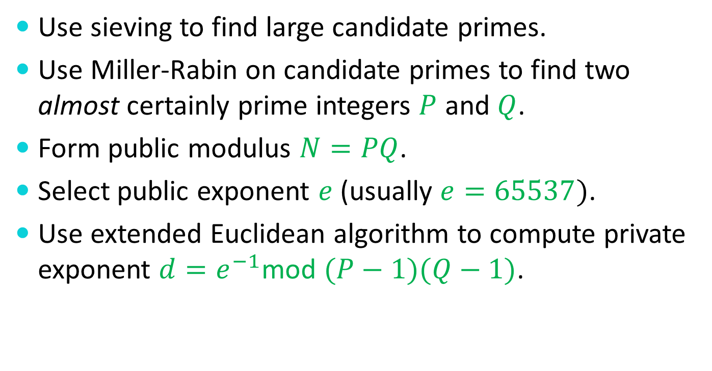
Reprise of RSA Set-Up
Use sieving to find large candidate primes.
Use Miller-Rabin on candidate primes to find two almost certainly prime integers $P$ and $Q$.
Form public modulus $N=PQ$.
Select public exponent $e$ (usually $e=65537)$.
Use extended Euclidean algorithm to compute private exponent $d=e^{−1}$mod $(P−1)(Q−1)$.

Slide 74
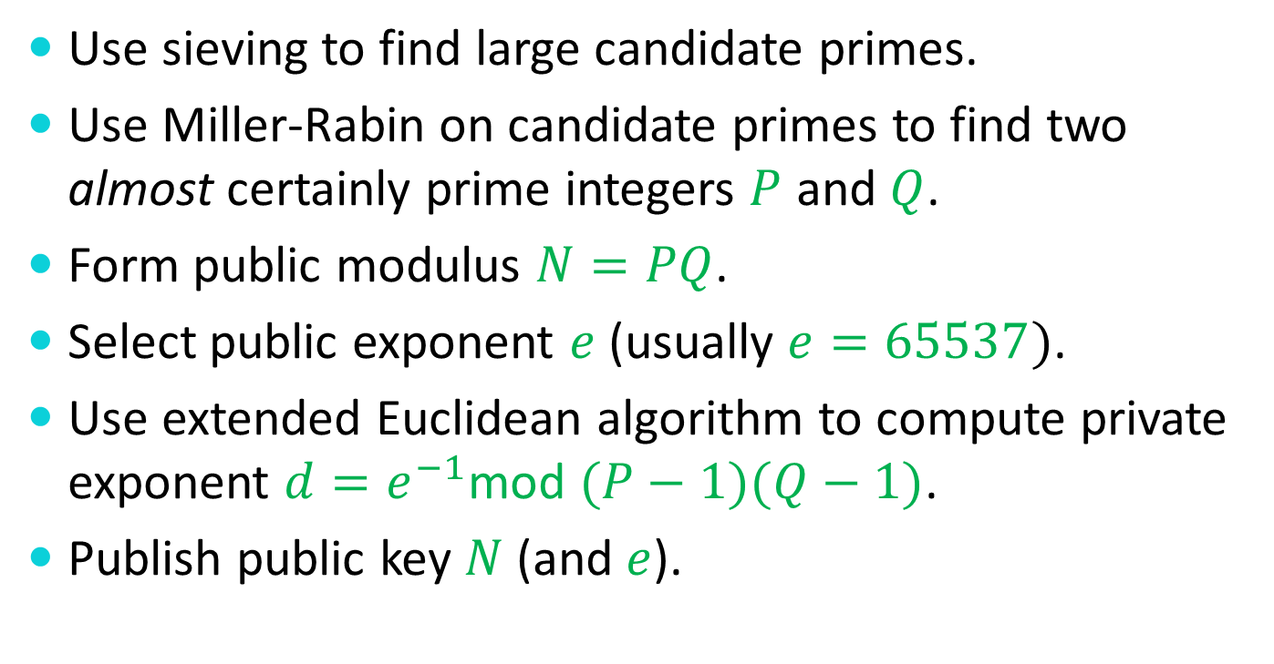
Reprise of RSA Set-Up
Use sieving to find large candidate primes.
Use Miller-Rabin on candidate primes to find two almost certainly prime integers $P$ and $Q$.
Form public modulus $N=PQ$.
Select public exponent $e$ (usually $e=65537)$.
Use extended Euclidean algorithm to compute private exponent $d=e^{−1}$mod $(P−1)(Q−1)$.
Publish public key $N$ (and $e$).

Slide 75
Reprise of RSA Encryption

Slide 76

Reprise of RSA Encryption
Use public key to encrypt message $0≤m<N$ as

Slide 77

Reprise of RSA Encryption
Use public key to encrypt message $0≤m<N$ as
$E\left(m\right)=m^{e}$mod $N.$

Slide 78

Reprise of RSA Encryption
Use public key to encrypt message $0≤m<N$ as
$E\left(m\right)=m^{e}$mod $N.$
Use private decryption exponent $d$ to decrypt

Slide 79
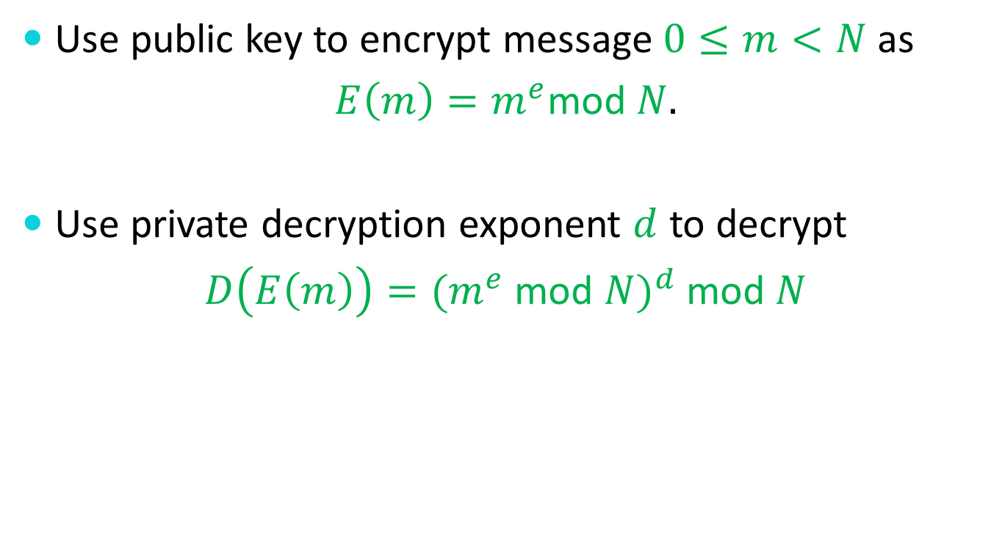
Reprise of RSA Encryption
Use public key to encrypt message $0≤m<N$ as
$E\left(m\right)=m^{e}$mod $N.$
Use private decryption exponent $d$ to decrypt
$D\left(E\left(m\right)\right)={(m}^{e}$ mod $N)^{d}$ mod $N$

Slide 80
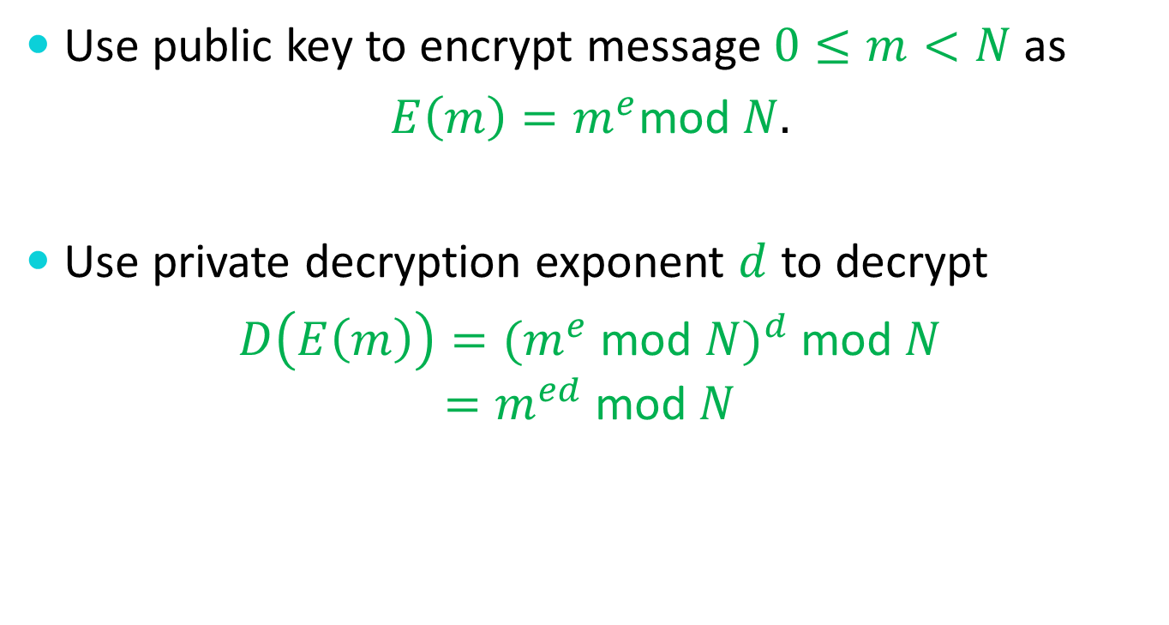
Reprise of RSA Encryption
Use public key to encrypt message $0≤m<N$ as
$E\left(m\right)=m^{e}$mod $N.$
Use private decryption exponent $d$ to decrypt
$D\left(E\left(m\right)\right)={(m}^{e}$ mod $N)^{d}$ mod $N$
$$=m^{ed} \text{mod} N$$

Slide 81
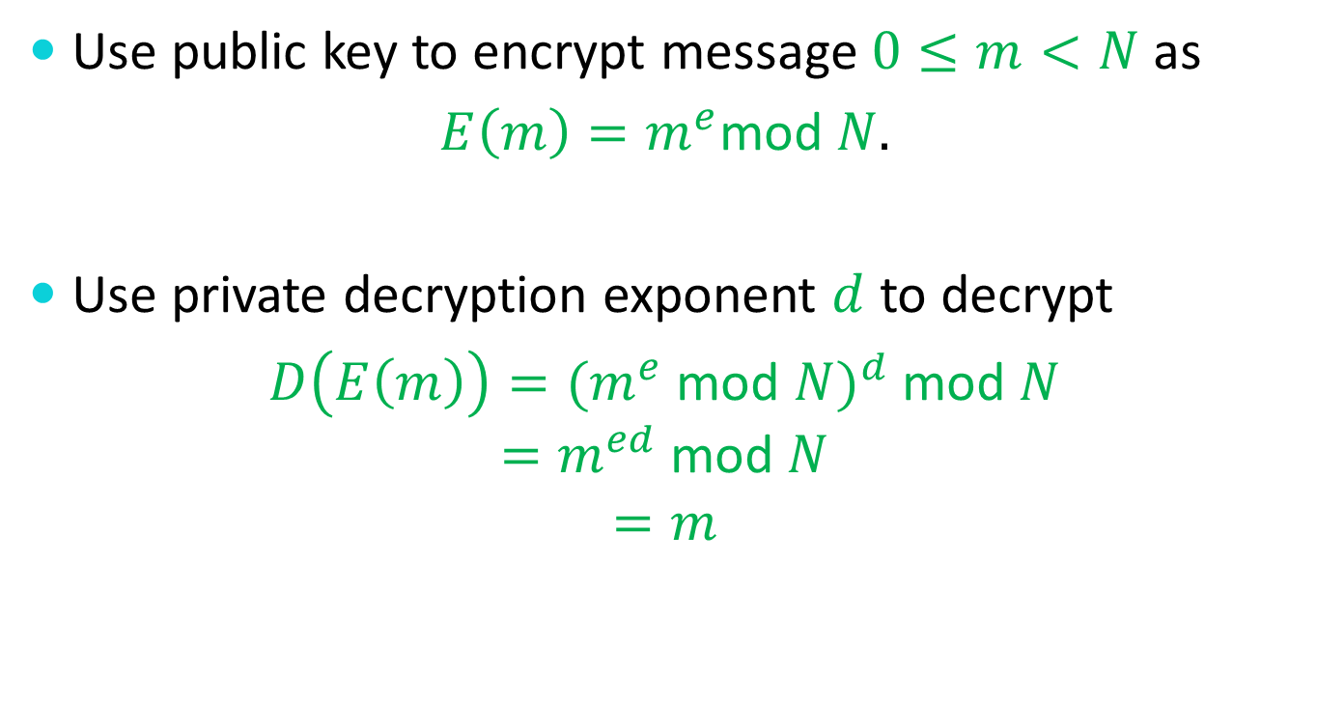
Reprise of RSA Encryption
Use public key to encrypt message $0≤m<N$ as
$E\left(m\right)=m^{e}$mod $N.$
Use private decryption exponent $d$ to decrypt
$D\left(E\left(m\right)\right)={(m}^{e}$ mod $N)^{d}$ mod $N$
$$=m^{ed} \text{mod} N$$
$$=m$$

Slide 82
Reprise of RSA Signatures

Slide 83

Reprise of RSA Signatures
Use private decryption exponent $d$ to sign message $0≤m<N$ as

Slide 84

Reprise of RSA Signatures
Use private decryption exponent $d$ to sign message $0≤m<N$ as
$D\left(m\right)=m^{d}$ mod $N.$

Slide 85
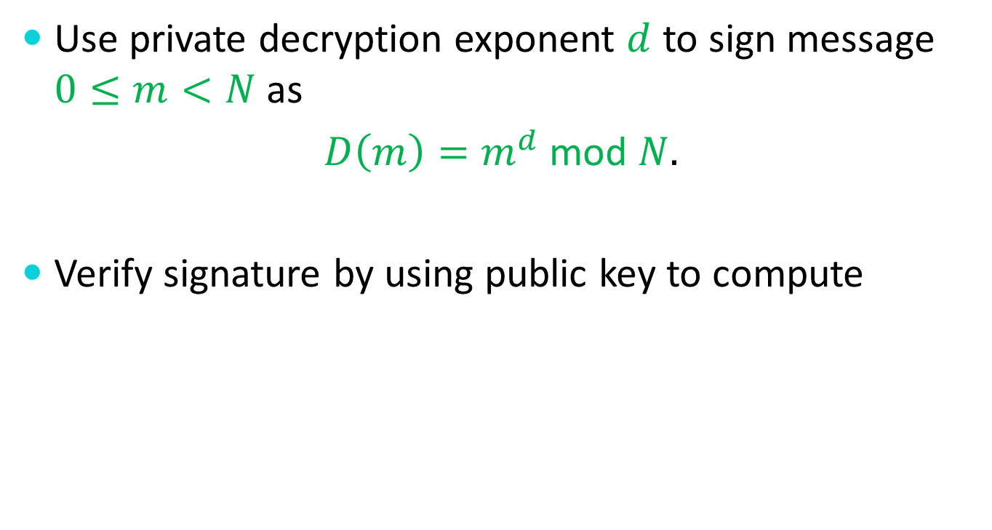
Reprise of RSA Signatures
Use private decryption exponent $d$ to sign message $0≤m<N$ as
$D\left(m\right)=m^{d}$ mod $N.$
Verify signature by using public key to compute

Slide 86
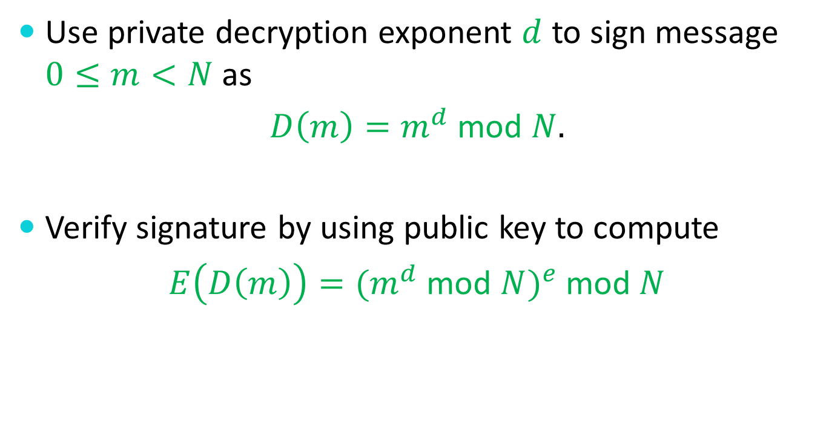
Reprise of RSA Signatures
Use private decryption exponent $d$ to sign message $0≤m<N$ as
$D\left(m\right)=m^{d}$ mod $N.$
Verify signature by using public key to compute
$E\left(D\left(m\right)\right)={(m}^{d}$ mod $N)^{e}$ mod $N$

Slide 87
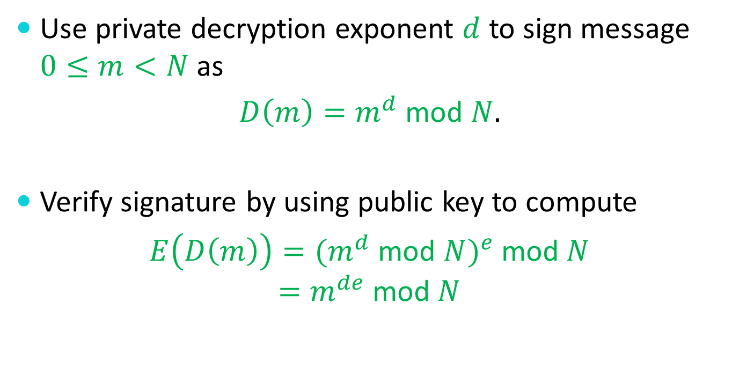
Reprise of RSA Signatures
Use private decryption exponent $d$ to sign message $0≤m<N$ as
$D\left(m\right)=m^{d}$ mod $N.$
Verify signature by using public key to compute
$E\left(D\left(m\right)\right)={(m}^{d}$ mod $N)^{e}$ mod $N$
$$=m^{de} \text{mod} N$$

Slide 88

Reprise of RSA Signatures
Use private decryption exponent $d$ to sign message $0≤m<N$ as
$D\left(m\right)=m^{d}$ mod $N.$
Verify signature by using public key to compute
$E\left(D\left(m\right)\right)={(m}^{d}$ mod $N)^{e}$ mod $N$
$$=m^{de} \text{mod} N$$
$$=m$$

Slide 89
The Digital Signature Algorithm
In 1991, the National Institute of Standards and Technology published a Digital Signature Standard that was intended as an option free of intellectual property constraints.

Slide 90

The Digital Signature Algorithm
DSA uses the following parameters
Prime $p$ – anywhere from 512 to 1024 bits
Prime $q$ – 160 bits such that $q$ divides $p−1$
Integer $h$ in the range $1<h<p−1$
Integer $g=h^{{(p−1)}/q}$ mod $p$
Secret integer $x$ in the range $1<x<q$
Integer $y=g^{x}$ mod $p$

Slide 91
The Digital Signature Algorithm

Slide 92

The Digital Signature Algorithm
To sign a 160-bit message $M$,

Slide 93

The Digital Signature Algorithm
To sign a 160-bit message $M$,
Generate a random integer $k$ with $0<k<q$,

Slide 94

The Digital Signature Algorithm
To sign a 160-bit message $M$,
Generate a random integer $k$ with $0<k<q$,
Compute $r = (g^{k}$ mod $p)$ mod $q$,

Slide 95

The Digital Signature Algorithm
To sign a 160-bit message $M$,
Generate a random integer $k$ with $0<k<q$,
Compute $r = (g^{k}$ mod $p)$ mod $q$,
Compute $s = ((M+xr)/k)$ mod $q$.

Slide 96

The Digital Signature Algorithm
To sign a 160-bit message $M$,
Generate a random integer $k$ with $0<k<q$,
Compute $r = (g^{k}$ mod $p)$ mod $q$,
Compute $s = ((M+xr)/k)$ mod $q$.
The pair $(r,s)$is the signature on $M$.

Slide 97
The Digital Signature Algorithm

Slide 98

The Digital Signature Algorithm
A signature $(r,s)$on $M$ is verified as follows:

Slide 99

The Digital Signature Algorithm
A signature $(r,s)$on $M$ is verified as follows:
Compute $w = 1/s mod q$,

Slide 100

The Digital Signature Algorithm
A signature $(r,s)$on $M$ is verified as follows:
Compute $w = 1/s mod q$,
Compute $a = wM mod q$,

Slide 101

The Digital Signature Algorithm
A signature $(r,s)$on $M$ is verified as follows:
Compute $w = 1/s mod q$,
Compute $a = wM mod q$,
Compute $b = wr mod q$,

Slide 102

The Digital Signature Algorithm
A signature $(r,s)$on $M$ is verified as follows:
Compute $w = 1/s mod q$,
Compute $a = wM mod q$,
Compute $b = wr mod q$,
Compute $v = (g^{a}y^{b}$ mod $p)$ mod $q$.

Slide 103

The Digital Signature Algorithm
A signature $(r,s)$on $M$ is verified as follows:
Compute $w = 1/s mod q$,
Compute $a = wM mod q$,
Compute $b = wr mod q$,
Compute $v = (g^{a}y^{b}$ mod $p)$ mod $q$.
Accept the signature only if $v = r$.

Slide 104
Elliptic Curve Cryptosystems

Slide 105
Elliptic Curve Cryptosystems
An elliptic curve

Slide 106
Elliptic Curve Cryptosystems
An elliptic curve
y² = x³ + Ax + B

Slide 107
Elliptic Curves
y² = x³ + Ax + B

Slide 108
Elliptic Curves
y = x³ + Ax + B

Slide 109
Elliptic Curves
y = x³ + Ax + B
y
x

Slide 110
Elliptic Curves
y² = x³ + Ax + B
y
x

Slide 111
Elliptic Curves
y² = x³ + Ax + B
y
x

Slide 112
Elliptic Curves
y² = x³ + Ax + B
y
x

Slide 113
Elliptic Curves
y² = x³ + Ax + B
y
x

Slide 114
Elliptic Curves
y² = x³ + Ax + B
y
x

Slide 115
Elliptic Curves
y² = x³ + Ax + B
y
x

Slide 116
Elliptic Curves
y² = x³ + Ax + B
y
x

Slide 117
Elliptic Curves
y² = x³ + Ax + B
y
x

Slide 118
Elliptic Curves Intersecting Lines
y² = x³ + Ax + B
y
x
y = ax + b

Slide 119
Elliptic Curves Intersecting Lines
Non-vertical Lines
y² = x³ + Ax + B
y = ax + b
(ax + b)² = x³ + Ax + B
x³ + A′x² + B′x + C′ = 0

Slide 120
Elliptic Curves Intersecting Lines
x³ + A′x² + B′x + C′ = 0
y
x

Slide 121
Elliptic Curves Intersecting Lines
x³ + A′x² + B′x + C′ = 0
y
x
3 solutions

Slide 122
Elliptic Curves Intersecting Lines
x³ + A′x² + B′x + C′ = 0
y
x
1 solution

Slide 123
Elliptic Curves Intersecting Lines
x³ + A′x² + B′x + C′ = 0
y
x
1 solution

Slide 124
Elliptic Curves Intersecting Lines
x³ + A′x² + B′x + C′ = 0
y
x
2 solutions

Slide 125
Elliptic Curves Intersecting Lines
Non-vertical Lines
1 intersection point (typical case)
2 intersection points (tangent case)
3 intersection points (typical case)

Slide 126
Elliptic Curves Intersecting Lines
Vertical Lines
y² = x³ + Ax + B
x = c
y² = c³ + Ac + B
y² = C′

Slide 127
Elliptic Curves Intersecting Lines
Vertical Lines
0 intersection point (typical case)
1 intersection points (tangent case)
2 intersection points (typical case)

Slide 128
Elliptic Groups
y² = x³ + Ax + B
y
x

Slide 129
Elliptic Groups
y² = x³ + Ax + B
y
x

Slide 130
Elliptic Groups
y² = x³ + Ax + B
y
x
y = ax + b

Slide 131
Elliptic Groups
y² = x³ + Ax + B
y
x
y = ax + b

Slide 132
Elliptic Groups
y² = x³ + Ax + B
y
x
y = ax + b

Slide 133
Elliptic Groups
y² = x³ + Ax + B
y
x
y = ax + b

Slide 134
Elliptic Groups
y² = x³ + Ax + B
y
x

Slide 135
Elliptic Groups
y² = x³ + Ax + B
y
x
y = ax + b

Slide 136
Elliptic Groups
y² = x³ + Ax + B
y
x
y = ax + b

Slide 137
Elliptic Groups
y² = x³ + Ax + B
y
x

Slide 138
Elliptic Groups
y² = x³ + Ax + B
y
x
x = c

Slide 139

Elliptic Groups
Add an “artificial” point $I$ to handle the vertical line case.
This point $I$ also serves as the group identity value.

Slide 140
Elliptic Groups
y² = x³ + Ax + B
y
x
x = c

Slide 141
Elliptic Groups
(x₁,y₁) × (x₂,y₂) = (x₃,y₃)
x₃ = ((y₂–y₁)/(x₂–x₁))² – x₁ – x₂
y₃ = -y₁ + ((y₂–y₁)/(x₂–x₁)) (x₁–x₃)
when x₁ ≠ x₂

Slide 142
Elliptic Groups
(x₁,y₁) × (x₂,y₂) = (x₃,y₃)
x₃ = ((3x₁²+A)/(2y₁))² – 2x₁
y₃ = -y₁ + ((3x₁²+A)/(2y₁)) (x₁–x₃)
when x₁ = x₂ and y₁ = y₂ ≠ 0

Slide 143

Elliptic Groups
(x₁,y₁) × (x₂,y₂) = $I$
when x₁= x₂ but y₁≠ y₂ or y₁= y₂= 0
(x₁,y₁) × $I$ = (x₁,y₁) = $I$ × (x₁,y₁)
$I$ × $I$ = $I$

Slide 144
Finite Elliptic Groups

Slide 145
Finite Elliptic Groups
The equations use basic arithmetic operations (addition, subtraction, multiplication, and division) on real values.

Slide 146

Finite Elliptic Groups
The equations use basic arithmetic operations (addition, subtraction, multiplication, and division) on real values.
But we know how to do modular operations, so we can do the same computations modulo a prime $p$.

Slide 147

The Elliptic Group $E_{p}(A,B)$
(x₁,y₁) × (x₂,y₂) = (x₃,y₃)
x₃ = ((y₂–y₁)/(x₂–x₁))² – x₁ – x₂
y₃ = -y₁ + ((y₂–y₁)/(x₂–x₁)) (x₁–x₃)
when x₁ ≠ x₂

Slide 148
The Elliptic Group $E_{p}(A,B)$
(x₁,y₁) × (x₂,y₂) = (x₃,y₃)
x₃ = ((y₂–y₁)/(x₂–x₁))² – x₁ – x₂ mod p
y₃ = -y₁ + ((y₂–y₁)/(x₂–x₁)) (x₁–x₃) mod p
when x₁ ≠ x₂

Slide 149
The Elliptic Group $E_{p}(A,B)$
(x₁,y₁) × (x₂,y₂) = (x₃,y₃)
x₃ = ((3x₁²+A)/(2y₁))² – 2x₁
y₃ = -y₁ + ((3x₁²+A)/(2y₁)) (x₁–x₃)
when x₁ = x₂ and y₁ = y₂ ≠ 0

Slide 150
The Elliptic Group $E_{p}(A,B)$
(x₁,y₁) × (x₂,y₂) = (x₃,y₃)
x₃ = ((3x₁²+A)/(2y₁))² – 2x₁ mod p
y₃ = -y₁ + ((3x₁²+A)/(2y₁)) (x₁–x₃) mod p
when x₁ = x₂ and y₁ = y₂ ≠ 0

Slide 151
The Elliptic Group $E_{p}(A,B)$
(x₁,y₁) × (x₂,y₂) = $I$
when x₁= x₂ but y₁≠ y₂ or y₁= y₂= 0
(x₁,y₁) × $I$ = (x₁,y₁) = $I$ × (x₁,y₁)
$I$ × $I$ = $I$

Slide 152
The Fundamental Equation
Z=Y^{X} mod N

Slide 153
The Fundamental Equation
Z=Y^{X} in E_{p}(A,B)

Slide 154
The Fundamental Equation
Z=Y^{X} in E_{p}(A,B)
When Z is unknown, it can be efficiently computed by repeated squaring.

Slide 155
The Fundamental Equation
Z=Y^{X} in E_{p}(A,B)
When X is unknown, this version of the discrete logarithm is believed to be quite hard to solve.

Slide 156
The Fundamental Equation
Z=Y^{X} in E_{p}(A,B)
When Y is unknown, it can be efficiently computed by “sophisticated” means.

Slide 157
Diffie-Hellman Key Exchange
Alice
Randomly select a large integer a and send A = Yª mod N.
Compute the key K = Bª mod N.
Bob
Randomly select a large integer b and send B = Y^{b} mod N.
Compute the key K = A^{b} mod N.
Bª = Y^{ba} = Y^{ab} = A^{b}

Slide 158
Diffie-Hellman Key Exchange
Alice
Randomly select a large integer a and send A = Yª in E_{p}.
Compute the key K = Bª in E_{p}.
Bob
Randomly select a large integer b and send B = Y^{b} in E_{p}.
Compute the key K = A^{b} in E_{p}.
Bª = Y^{ba} = Y^{ab} = A^{b}

Slide 159
DSA on Elliptic Curves

Slide 160
DSA on Elliptic Curves
Almost identical to DSA over the integers.

Slide 161
DSA on Elliptic Curves
Almost identical to DSA over the integers.
Replace operations mod p and q with operations in E_{p} and E_{q}.

Slide 162
Why use Elliptic Curves?

Slide 163
Why use Elliptic Curves?
The best currently known algorithm for EC discrete logarithms would take about as long to find a 160-bit EC discrete log as the best currently known algorithm for integer discrete logarithms would take to find a 1024-bit discrete log.

Slide 164
Why use Elliptic Curves?
The best currently known algorithm for EC discrete logarithms would take about as long to find a 160-bit EC discrete log as the best currently known algorithm for integer discrete logarithms would take to find a 1024-bit discrete log.
160-bit EC algorithms are somewhat faster and use shorter keys than 1024-bit “traditional” algorithms.

Slide 165
Why not use Elliptic Curves?

Slide 166
Why not use Elliptic Curves?
EC discrete logarithms have been studied far less than integer discrete logarithms.

Slide 167
Why not use Elliptic Curves?
EC discrete logarithms have been studied far less than integer discrete logarithms.
Results have shown that a fundamental break in integer discrete logs would also yield a fundamental break in EC discrete logs, although the reverse may not be true.

Slide 168
Why not use Elliptic Curves?
EC discrete logarithms have been studied far less than integer discrete logarithms.
Results have shown that a fundamental break in integer discrete logs would also yield a fundamental break in EC discrete logs, although the reverse may not be true.
Basic EC operations are more cumbersome than integer operations, so EC is only faster if the keys are much smaller.

Slide 169
Symmetric
Cryptography

Slide 170
The Practical Side
For efficiency, one generally uses RSA (or another public-key algorithm) to transmit a private (symmetric) key.
The private session key is used to encrypt and authenticate any subsequent data.
Digital signatures are only used to sign a digest of the message.

Slide 171
One-Way Hash Functions
Generally, a one-way hash function is a function H : {0,1}* → {0,1}^{k} (typically k is 128, 160, 256, 384, or 512) such that given an input value x, one cannot find a value x′ ≠ x such H(x) = H(x′ ).

Slide 172
One-Way Hash Functions
There are many measures for one-way hashes.
Non-invertability: given y, it’s difficult to find any x such that H(x) = y.
Collision-intractability: one cannot find a pair of values x′ ≠ x such that H(x) = H(x′ ).

Slide 173
One-Way Hash Functions
When using a stream cipher, a hash of the message can be appended to ensure integrity. [Message Authentication Code]
When forming a digital signature, the signature need only be applied to a hash of the message. [Message Digest]

Slide 174
A Cryptographic Hash: SHA-1
(IV)
512-bit Input
Compression
Function
160-bit Output

Slide 175
A Cryptographic Hash: SHA-1
160-bit
512-bit
One of 80 rounds

Slide 176
A Cryptographic Hash: SHA-1
160-bit
512-bit
No Change
One of 80 rounds

Slide 177
A Cryptographic Hash: SHA-1
160-bit
512-bit
Rotate 30 bits
One of 80 rounds

Slide 178
A Cryptographic Hash: SHA-1
160-bit
512-bit
No Change
One of 80 rounds

Slide 179
A Cryptographic Hash: SHA-1
160-bit
512-bit
No Change
One of 80 rounds

Slide 180
A Cryptographic Hash: SHA-1
160-bit
512-bit
?
One of 80 rounds

Slide 181
A Cryptographic Hash: SHA-1
What’s in the final 32-bit transform?
Take the rightmost word.
Add in the leftmost word rotated 5 bits.
Add in a round-dependent function f of the middle three words.

Slide 182
A Cryptographic Hash: SHA-1
160-bit
512-bit
f
One of 80 rounds

Slide 183
A Cryptographic Hash: SHA-1
Depending on the round, the “non-linear” function f is one of the following.
f(X,Y,Z) = (X∧Y) ∨ ((¬X)∧Z)
f(X,Y,Z) = (X∧Y) ∨ (X∧Z) ∨ (Y∧Z)
f(X,Y,Z) = X ⊕ Y ⊕ Z

Slide 184
A Cryptographic Hash: SHA-1
What’s in the final 32-bit transform?
Take the rightmost word.
Add in the leftmost word rotated 5 bits.
Add in a round-dependent function f of the middle three words.

Slide 185
A Cryptographic Hash: SHA-1
What’s in the final 32-bit transform?
Take the rightmost word.
Add in the leftmost word rotated 5 bits.
Add in a round-dependent function f of the middle three words.
Add in a round-dependent constant.

Slide 186
A Cryptographic Hash: SHA-1
What’s in the final 32-bit transform?
Take the rightmost word.
Add in the leftmost word rotated 5 bits.
Add in a round-dependent function f of the middle three words.
Add in a round-dependent constant.
Add in a portion of the 512-bit message.

Slide 187
A Cryptographic Hash: SHA-1
160-bit
512-bit
One of 80 rounds

Slide 188
Symmetric Ciphers
Private-key (symmetric) ciphers are usually divided into two classes.
Stream ciphers
Block ciphers

Slide 189
Symmetric Ciphers
Private-key (symmetric) ciphers are usually divided into two classes.
Stream ciphers
Block ciphers

Slide 190
Stream Ciphers
Use the key as a seed to a pseudo-random number-generator.
Take the stream of output bits from the PRNG and XOR it with the plaintext to form the ciphertext.

Slide 191
Stream Cipher Encryption
Plaintext:
PRNG(seed):
Ciphertext:

Slide 192
Stream Cipher Decryption
Plaintext:
PRNG(seed):
Ciphertext:

Slide 193
A PRNG: Alleged RC4
Initialization
S[0..255] = 0,1,…,255
K[0..255] = Key,Key,Key,…
for i = 0 to 255
j = (j + S[i] + K[i]) mod 256
swap S[i] and S[j]

Slide 194
A PRNG: Alleged RC4
Iteration
i = (i + 1) mod 256
j = (j + S[i]) mod 256
swap S[i] and S[j]
t = (S[i] + S[j]) mod 256
Output S[t]

Slide 195
Stream Cipher Integrity
It is easy for an adversary (even one who can’t decrypt the ciphertext) to alter the plaintext in a known way.
Bob to Bob’s Bank: Please transfer $0,000,002.00 to the account of my good friend Alice.

Slide 196
Stream Cipher Integrity
It is easy for an adversary (even one who can’t decrypt the ciphertext) to alter the plaintext in a known way.
Bob to Bob’s Bank: Please transfer $1,000,002.00 to the account of my good friend Alice.

Slide 197
Stream Cipher Integrity
It is easy for an adversary (even one who can’t decrypt the ciphertext) to alter the plaintext in a known way.
Bob to Bob’s Bank: Please transfer $1,000,002.00 to the account of my good friend Alice.
This can be protected against by the careful addition of appropriate redundancy.

Slide 198
Symmetric Ciphers
Private-key (symmetric) ciphers are usually divided into two classes.
Stream ciphers
Block ciphers

Slide 199
Block Ciphers
Key
Block
Cipher
Plaintext Data
Ciphertext

Slide 200
Block Ciphers
Key
Block
Cipher
Plaintext Data
Ciphertext
Usually 16 bytes.

Slide 201
Block Cipher Modes
Electronic Code Book (ECB) Encryption:
Plaintext
Block
Cipher
Block
Cipher
Block
Cipher
Block
Cipher
Ciphertext

Slide 202
Block Cipher Modes
Electronic Code Book (ECB) Decryption:
Plaintext
Inverse
Cipher
Inverse
Cipher
Inverse
Cipher
Inverse
Cipher
Ciphertext

Slide 203
Block Cipher Modes
Electronic Code Book (ECB) Encryption:
Plaintext
Block
Cipher
Block
Cipher
Block
Cipher
Block
Cipher
Ciphertext

Slide 204
Block Cipher Modes
Cipher Block Chaining (CBC) Encryption:
Plaintext
IV
Block
Cipher
Block
Cipher
Block
Cipher
Block
Cipher
Ciphertext

Slide 205
Block Cipher Modes
Cipher Block Chaining (CBC) Decryption:
Plaintext
IV
Inverse
Cipher
Inverse
Cipher
Inverse
Cipher
Inverse
Cipher
Ciphertext

Slide 206
Block Cipher Modes
Cipher Block Chaining (CBC) Encryption:
Plaintext
IV
Block
Cipher
Block
Cipher
Block
Cipher
Block
Cipher
Ciphertext

Slide 207
How to Build a Block Cipher
Plaintext
Block
Cipher
Key
Ciphertext

Slide 208
Feistel Ciphers
Ugly

Slide 209
Feistel Ciphers
Ugly

Slide 210
Feistel Ciphers
Ugly

Slide 211
Feistel Ciphers
Ugly

Slide 212
Feistel Ciphers
Ugly
Ugly

Slide 213
Feistel Ciphers
Typically, most Feistel ciphers are iterated for about 16 rounds.
Different “sub-keys” are used for each round.
Even a weak round function can yield a strong Feistel cipher if iterated sufficiently.

Slide 214
Data Encryption Standard (DES)
64-bit Plaintext
Block
Cipher
56-bit Key
64-bit Ciphertext

Slide 215
Data Encryption Standard (DES)
64-bit Plaintext
16 Feistel
Rounds
56-bit Key
64-bit Ciphertext

Slide 216
Data Encryption Standard (DES)
64-bit Plaintext
16 Feistel
Rounds
56-bit Key
64-bit Ciphertext

Slide 217
DES Round
Ugly

Slide 218
Simplified DES Round Function
32 bits
Ugly
Sub-key
4-bit substitutions
32-bit permutation

Slide 219
Actual DES Round Function
32 bits
Ugly
Sub-key
48 bits
6/4-bit substitutions
32-bit permutation

Slide 220
Cryptographic Tools
One-Way Trapdoor Functions
Public-Key Encryption Schemes
One-Way Functions
One-Way Hash Functions
Pseudo-Random Number-Generators
Secret-Key Encryption Schemes
Digital Signature Schemes

