Slide 1
Practical Aspects of Modern Cryptography
Winter 2011
Josh Benaloh
Brian LaMacchia

Slide 2
Fun with Public-Key
Tonight we’ll …
Introduce some basic tools of public-key crypto
Combine the tools to create more powerful tools
Lay the ground work for substantial applications

Slide 3
Challenge-Response Protocols

Slide 4
Challenge-Response Protocols
One party often wants to convince another party that something is true …

Slide 5
Challenge-Response Protocols
One party often wants to convince another party that something is true …
… without giving everything away.

Slide 6

Proof of Knowledge
“I know the secret key $k$.”

Slide 7
PoK: Method 1

Slide 8
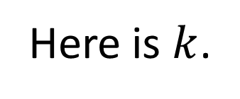
PoK: Method 1
Here is $k$.

Slide 9
PoK: Method 2

Slide 10
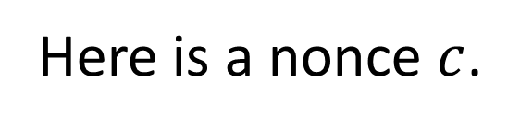
PoK: Method 2
Here is a nonce $c$.

Slide 11
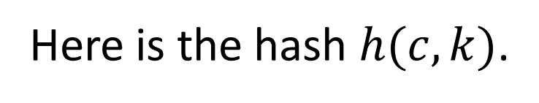
PoK: Method 2
Here is a nonce $c$.
Here is the hash $h(c,k)$.

Slide 12
Interactive Proofs and Zero Knowledge
There are non-traditional methods of convincing others that something is true without writing down a proof.
These methods can be used to convince others of the veracity of partial information about a secret.

Slide 13
Traditional Proofs

Slide 14
Traditional Proofs
I want to convince you that something is true.

Slide 15
Traditional Proofs
I want to convince you that something is true.
I write down a proof and give it to you.

Slide 16
Interactive Proofs
We engage in a dialogue at the conclusion of which you are convinced that my claim is true.

Slide 17
Graph Isomorphism

Slide 18
Graph Isomorphism
B
C
A
E
D

Slide 19
Graph Isomorphism
B
C
A
A
E
D
C
D
B
E

Slide 20
IP of Graph Isomorphism
G₁
G₂

Slide 21
IP of Graph Isomorphism
Generate, say, 100 additional graphs isomorphic to G₁ (and therefore also isomorphic to G₂).

Slide 22
IP of Graph Isomorphism
H₁
H₂
G₁
H₃
G₂
H₁₀₀

Slide 23
IP of Graph Isomorphism

Slide 24
IP of Graph Isomorphism
Accept a single bit challenge “L/R” for each of the 100 additional graphs.

Slide 25
IP of Graph Isomorphism
Accept a single bit challenge “L/R” for each of the 100 additional graphs.
Display the indicated isomorphism for each of the additional graphs.

Slide 26
IP of Graph Isomorphism
H₁
H₂
G₁
H₃
G₂
H₁₀₀

Slide 27
IP of Graph Isomorphism
L
H₁
H₂
R
G₁
H₃
R
G₂
L
H₁₀₀

Slide 28
IP of Graph Isomorphism
H₁
H₂
G₁
H₃
G₂
H₁₀₀

Slide 29
IP of Graph Isomorphism

Slide 30
IP of Graph Isomorphism
If graphs G₁ and G₂ were not isomorphic, then the “prover” would not be able to show any additional graph to be isomorphic to both G₁ and G₂.

Slide 31
IP of Graph Isomorphism
If graphs G₁ and G₂ were not isomorphic, then the “prover” would not be able to show any additional graph to be isomorphic to both G₁ and G₂.
A successful false proof would require the prover to guess all 100 challenges in advance: probability 1 in 2¹⁰⁰.

Slide 32
Fiat-Shamir Heuristic

Slide 33
Fiat-Shamir Heuristic
Instead of challenge bits being externally generated, they can be produced by applying a one-way hash function to the full set of additional graphs.

Slide 34
Fiat-Shamir Heuristic
Instead of challenge bits being externally generated, they can be produced by applying a one-way hash function to the full set of additional graphs.
This allows an interactive proof to be “published” without need for interaction.

Slide 35
IP of Graph Non-Isomorphism

Slide 36
IP of Graph Non-Isomorphism
G₁
G₂

Slide 37
IP of Graph Non-Isomorphism
A verifier can generate 100 additional graphs, each isomorphic to one of G₁ and G₂ , and present them to the prover.

Slide 38
IP of Graph Non-Isomorphism
A verifier can generate 100 additional graphs, each isomorphic to one of G₁ and G₂ , and present them to the prover.
The prover can then demonstrate that the graphs are not isomorphic by identifying which of G₁ and G₂ each additional graph is isomorphic to.

Slide 39
IP of Graph Non-Isomorphism
G₁
G₂

Slide 40
IP of Graph Non-Isomorphism
H₁
H₂
G₁
H₃
G₂
H₁₀₀

Slide 41
IP of Graph Non-Isomorphism
H₁
H₂
G₁
H₃
G₂
H₁₀₀

Slide 42
Proving Something is a Square

Slide 43

Proving Something is a Square
Suppose I want to convince you that $Y$ is a square modulo $N$.
[There exists an $X$ such that $Y = X^{2} \operatorname{mod}{N}$.]

Slide 44
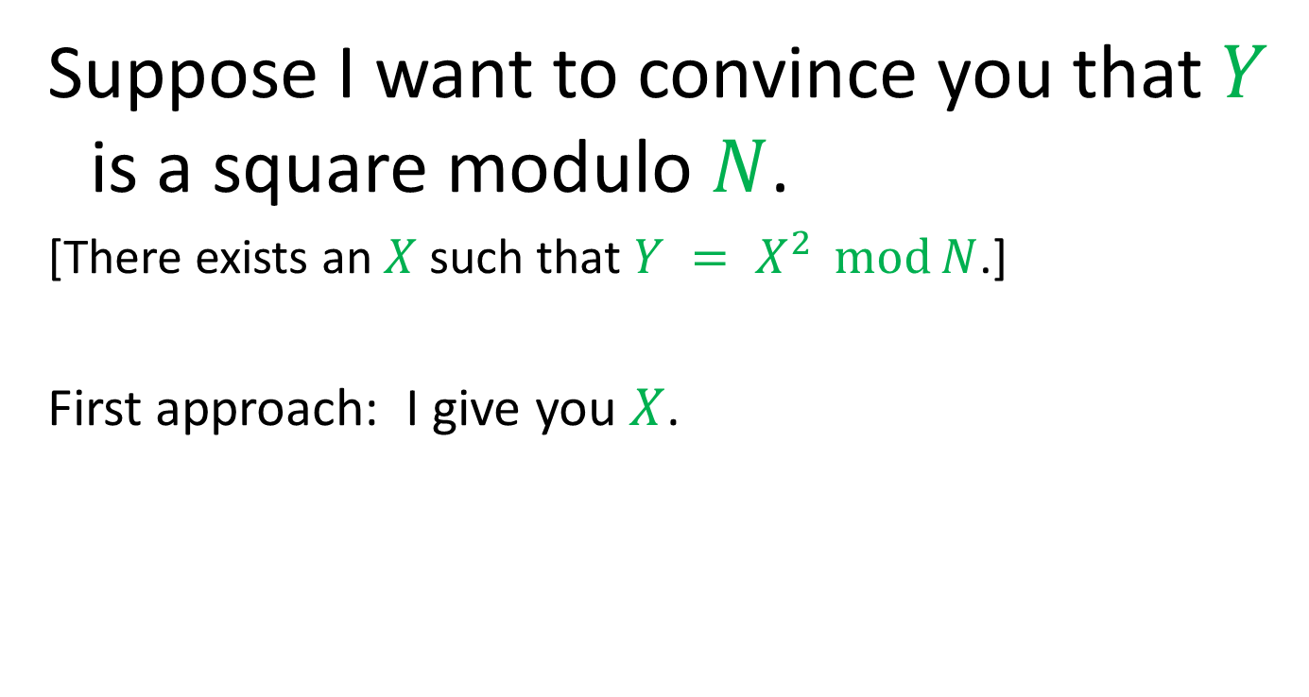
Proving Something is a Square
Suppose I want to convince you that $Y$ is a square modulo $N$.
[There exists an $X$ such that $Y = X^{2} \operatorname{mod}{N}$.]
First approach: I give you $X$.

Slide 45
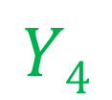
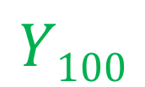
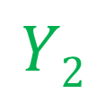
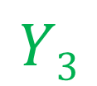
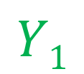
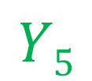

An Interactive Proof
$$Y$$
$$Y1$$
$$Y2$$
$$Y3$$
$$Y4$$
$$Y5$$
$$Y100$$

Slide 46

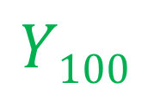
An Interactive Proof
$$Y$$
$$Y1$$
$$Y2$$
$$Y3$$
$$Y4$$
$$Y5$$
$$Y100$$
0
1
0
0
1
1

Slide 47
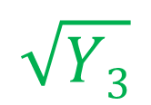
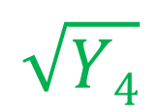
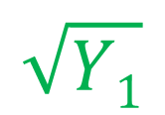
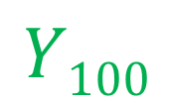
An Interactive Proof
$$Y$$
$$Y1$$
$$Y2$$
$$Y3$$
$$Y4$$
$$Y5$$
$$Y100$$
0
1
0
0
1
1
$$\sqrt{Y1}$$
$$\sqrt{Y3}$$
$$\sqrt{Y4}$$

Slide 48
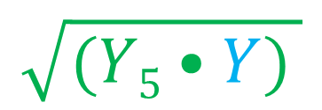
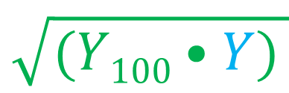
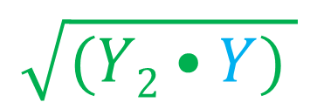
An Interactive Proof
$$Y$$
$$Y1$$
$$Y2$$
$$Y3$$
$$Y4$$
$$Y5$$
$$Y100$$
0
1
0
0
1
1
$$\sqrt{Y1}$$
$$\sqrt{Y3}$$
$$\sqrt{Y4}$$
$$\sqrt{(Y2•Y) }$$
$$\sqrt{(Y5•Y) }$$
$$\sqrt{(Y100•Y) }$$

Slide 49
An Interactive Proof

Slide 50
An Interactive Proof
In order for me to “fool” you, I would have to guess your exact challenge sequence.

Slide 51
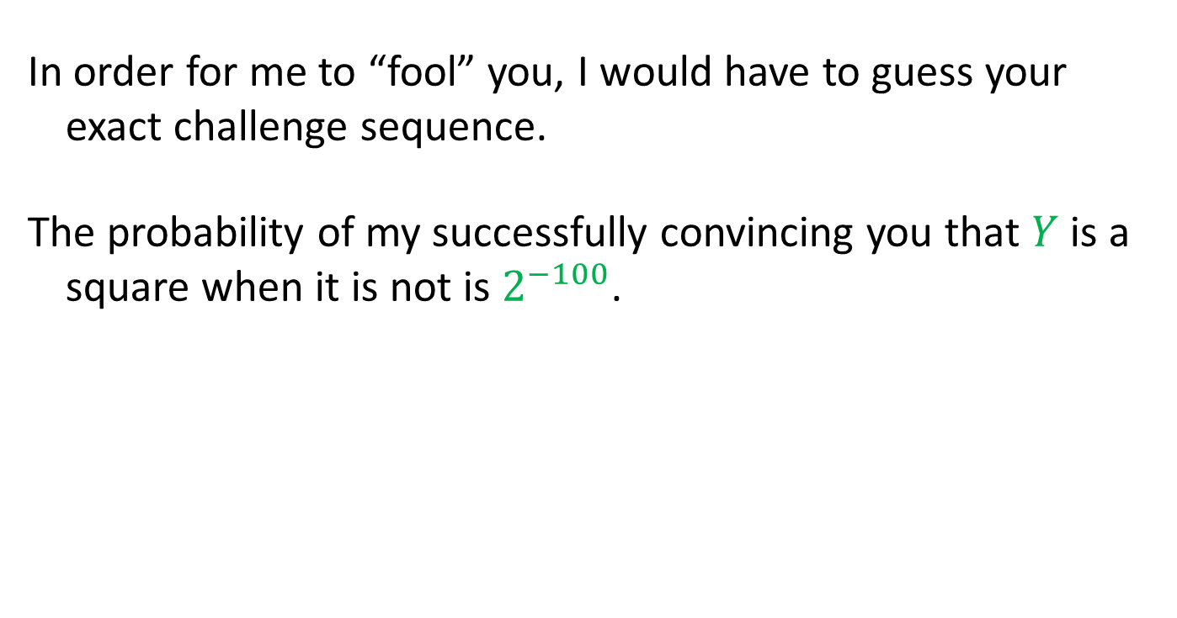
An Interactive Proof
In order for me to “fool” you, I would have to guess your exact challenge sequence.
The probability of my successfully convincing you that $Y$ is a square when it is not is $2^{−100}$.

Slide 52
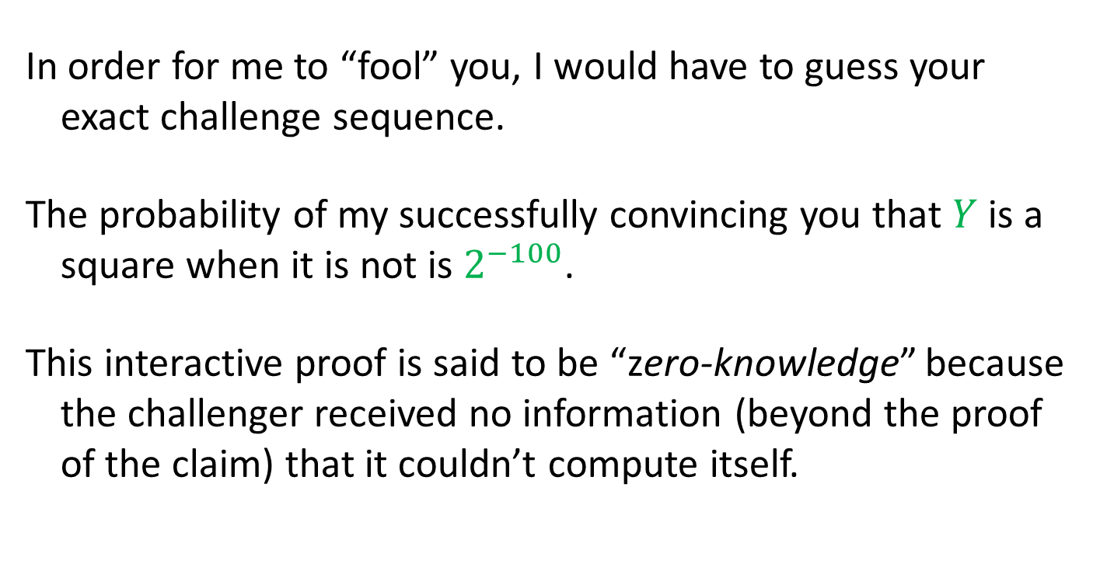
An Interactive Proof
In order for me to “fool” you, I would have to guess your exact challenge sequence.
The probability of my successfully convincing you that $Y$ is a square when it is not is $2^{−100}$.
This interactive proof is said to be “zero-knowledge” because the challenger received no information (beyond the proof of the claim) that it couldn’t compute itself.

Slide 53
Applying Fiat-Shamir
Once again, the verifier challenges can be simulated by the use of a one-way function to generate the challenge bits.

Slide 54
An Non-Interactive ZK Proof
$$Y$$
$$Y1$$
$$Y2$$
$$Y3$$
$$Y4$$
$$Y5$$
$$Y100$$

Slide 55
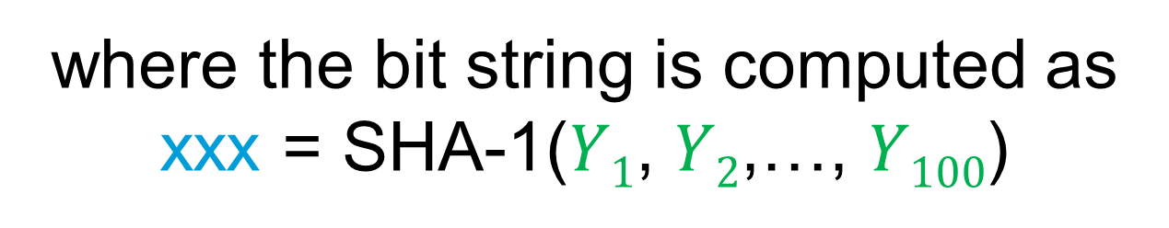
An Non-Interactive ZK Proof
$$Y$$
$$Y1$$
$$Y2$$
$$Y3$$
$$Y4$$
$$Y5$$
$$Y100$$
0
1
0
0
1
1
where the bit string is computed as
xxx = SHA-1($Y1$, $Y2$,…, $Y100$)

Slide 56
An Non-Interactive ZK Proof
$$Y$$
$$Y1$$
$$Y2$$
$$Y3$$
$$Y4$$
$$Y5$$
$$Y100$$
0
1
0
0
1
1
$$\sqrt{Y1}$$
$$\sqrt{Y3}$$
$$\sqrt{Y4}$$

Slide 57
An Non-Interactive ZK Proof
$$Y$$
$$Y1$$
$$Y2$$
$$Y3$$
$$Y4$$
$$Y5$$
$$Y100$$
0
1
0
0
1
1
$$\sqrt{Y1}$$
$$\sqrt{Y3}$$
$$\sqrt{Y4}$$
$$\sqrt{(Y2•Y) }$$
$$\sqrt{(Y5•Y) }$$
$$\sqrt{(Y100•Y) }$$

Slide 58
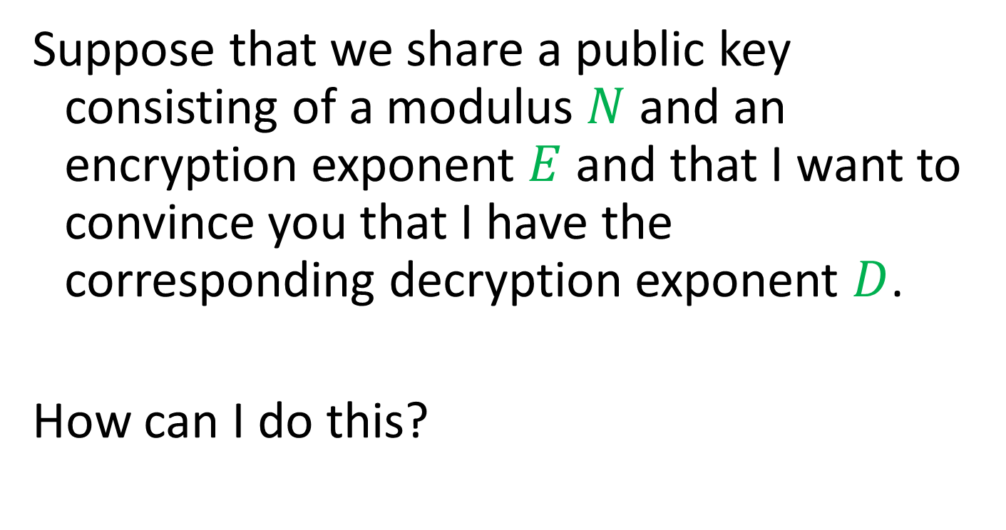
Proving Knowledge
Suppose that we share a public key consisting of a modulus $N$ and an encryption exponent $E$ and that I want to convince you that I have the corresponding decryption exponent $D$.
How can I do this?

Slide 59
Proving Knowledge

Slide 60

Proving Knowledge
I can give you my private key $D$.

Slide 61

Proving Knowledge
I can give you my private key $D$.
You can encrypt something for me and I decrypt it for you.

Slide 62
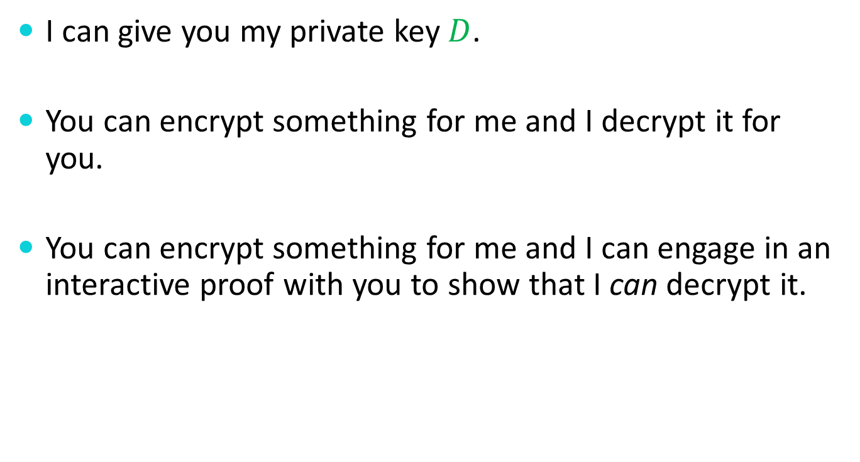
Proving Knowledge
I can give you my private key $D$.
You can encrypt something for me and I decrypt it for you.
You can encrypt something for me and I can engage in an interactive proof with you to show that I can decrypt it.

Slide 63

A Proof of Knowledge
$$Y$$

Slide 64
A Proof of Knowledge
$$Y$$
$$Y1$$
$$Y2$$
$$Y3$$
$$Y4$$
$$Y5$$
$$Y100$$

Slide 65
A Proof of Knowledge
$$Y$$
$$Y1$$
$$Y2$$
$$Y3$$
$$Y4$$
$$Y5$$
$$Y100$$
0
1
0
0
1
1

Slide 66
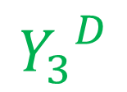
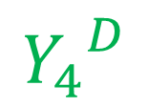
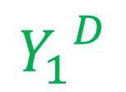
A Proof of Knowledge
$$Y$$
$$Y1$$
$$Y2$$
$$Y3$$
$$Y4$$
$$Y5$$
$$Y100$$
0
1
0
0
1
1
$${Y_{1}}^{D}$$
$${Y_{3}}^{D}$$
$${Y_{4}}^{D}$$

Slide 67
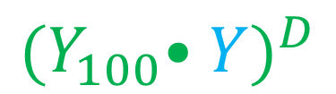

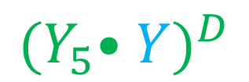
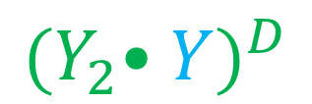
A Proof of Knowledge
$$Y$$
$$Y1$$
$$Y2$$
$$Y3$$
$$Y4$$
$$Y5$$
$$Y100$$
0
1
0
0
1
1
$${Y_{1}}^{D}$$
$${Y_{3}}^{D}$$
$${Y_{4}}^{D}$$
$${{(Y}_{2}•Y)}^{D}$$
$${{(Y}_{5}•Y)}^{D}$$
$${{(Y}_{100}•Y)}^{D}$$

Slide 68
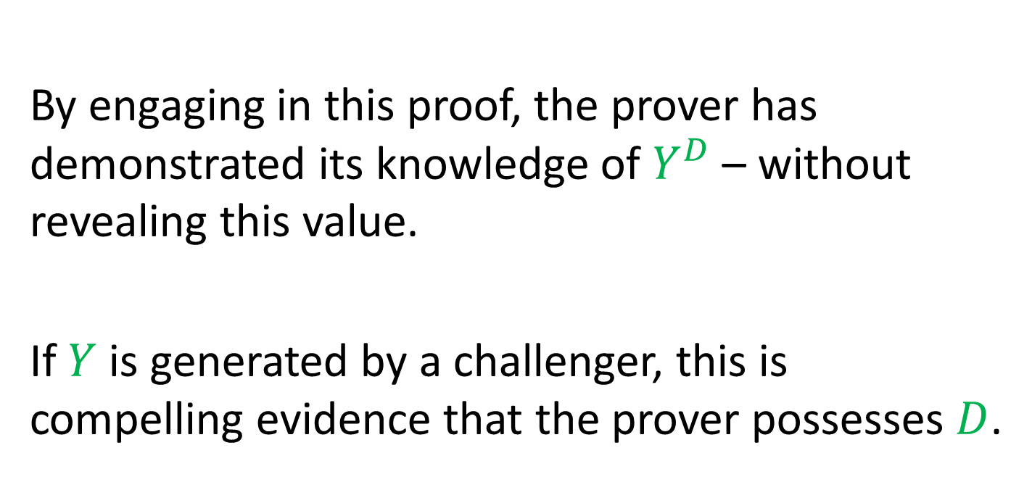
A Proof of Knowledge
By engaging in this proof, the prover has demonstrated its knowledge of $Y^{D}$ – without revealing this value.
If $Y$ is generated by a challenger, this is compelling evidence that the prover possesses $D$.

Slide 69
Facts About Interactive Proofs
Anything in PSPACE can be proven with a polynomial-time interactive proof.
Anything in NP can be proven with a zero-knowledge interactive proof.

Slide 70
Secret Sharing

Slide 71
Secret Sharing
Suppose that I have some data that I want to share amongst three people such that

Slide 72
Secret Sharing
Suppose that I have some data that I want to share amongst three people such that
any two can uniquely determine the data

Slide 73
Secret Sharing
Suppose that I have some data that I want to share amongst three people such that
any two can uniquely determine the data
but any one alone has no information whatsoever about the data.

Slide 74
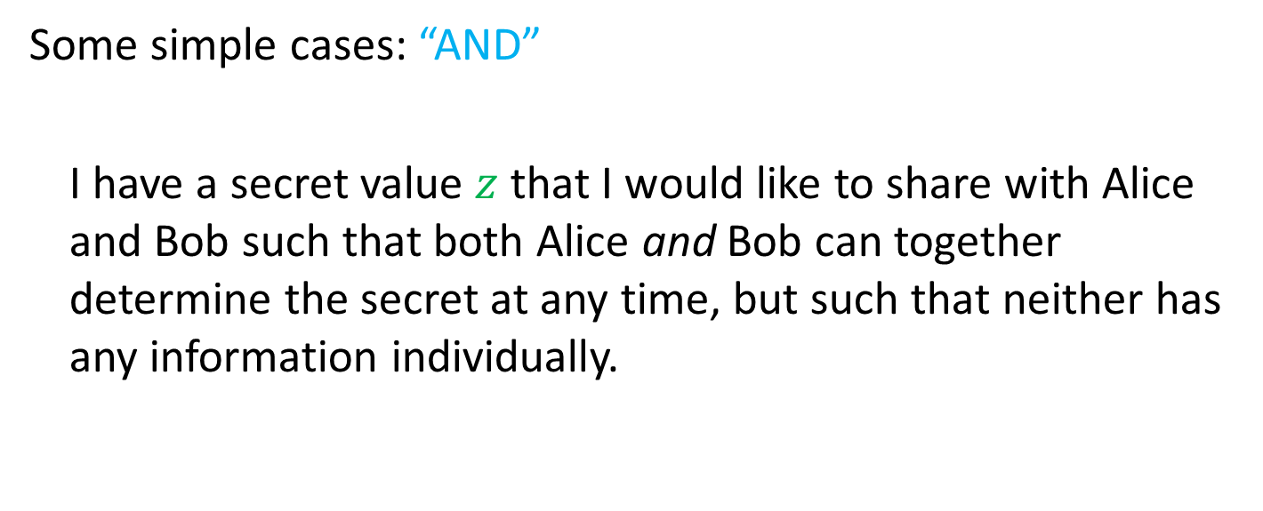
Secret Sharing
Some simple cases: “AND”
I have a secret value $z$ that I would like to share with Alice and Bob such that both Alice and Bob can together determine the secret at any time, but such that neither has any information individually.

Slide 75
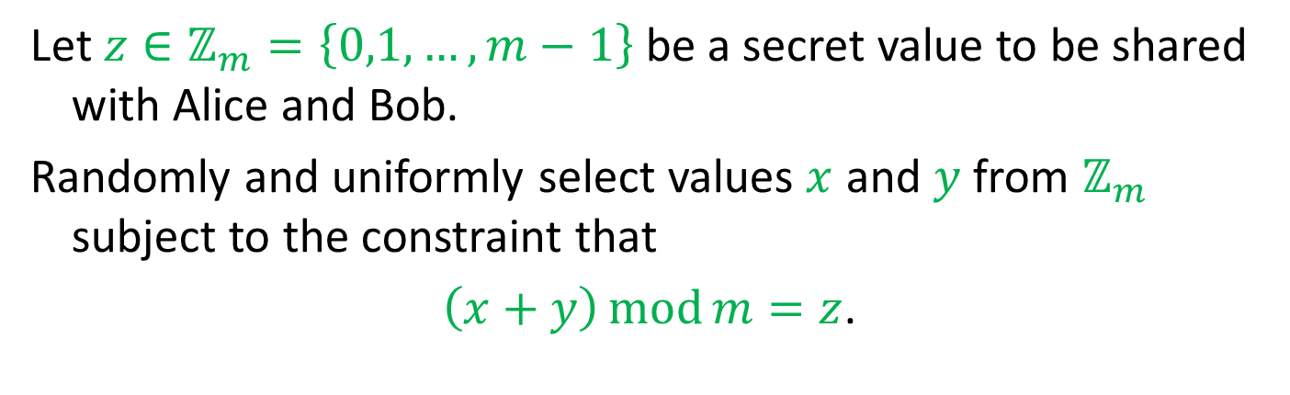
Secret Sharing – AND
Let $z∈ℤ_{m}=\left\{0,1,…,m−1\right\}$be a secret value to be shared with Alice and Bob.
Randomly and uniformly select values $x$ and $y$ from $ℤ_{m}$ subject to the constraint that
$\left(x+y\right)\operatorname{mod}{m}=z$.

Slide 76
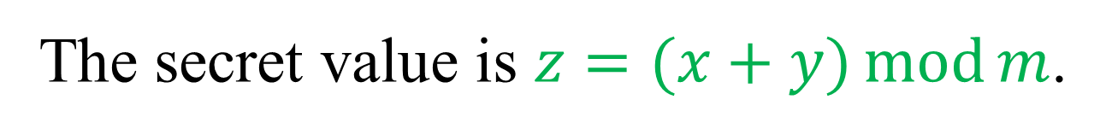
Secret Sharing – AND
The secret value is $z=(x+y)\operatorname{mod}{m}$.

Slide 77


Secret Sharing – AND
The secret value is $z=(x+y)\operatorname{mod}{m}$.
$$x$$
$$y$$

Slide 78
Secret Sharing – AND
The secret value is $z=(x+y)\operatorname{mod}{m}$.
$$x$$
$$y$$

Slide 79
Secret Sharing – AND
The secret value is $z=(x+y)\operatorname{mod}{m}$.
$$y$$

Slide 80
Secret Sharing – AND
The secret value is $z=(x+y)\operatorname{mod}{m}$.
$$y$$

Slide 81
Secret Sharing – AND
The secret value is $z=(x+y)\operatorname{mod}{m}$.

Slide 82
Secret Sharing – AND
The secret value is $z=(x+y)\operatorname{mod}{m}$.

Slide 83
Secret Sharing – AND
The secret value is $z=(x+y)\operatorname{mod}{m}$.
$$x$$

Slide 84
Secret Sharing – AND
The secret value is $z=(x+y)\operatorname{mod}{m}$.
$$x$$
$$y$$

Slide 85
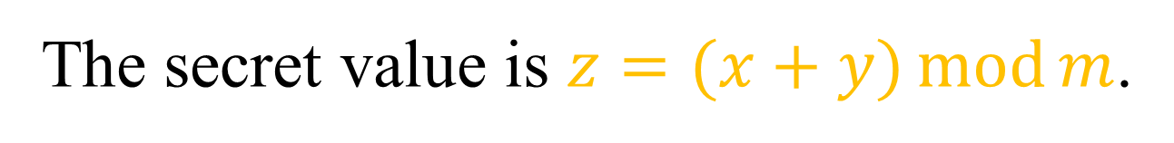
Secret Sharing – AND
The secret value is $z=(x+y)\operatorname{mod}{m}$.
$$x$$
$$y$$

Slide 86
Secret Sharing – AND
This trick easily generalizes to more than two shareholders.

Slide 87
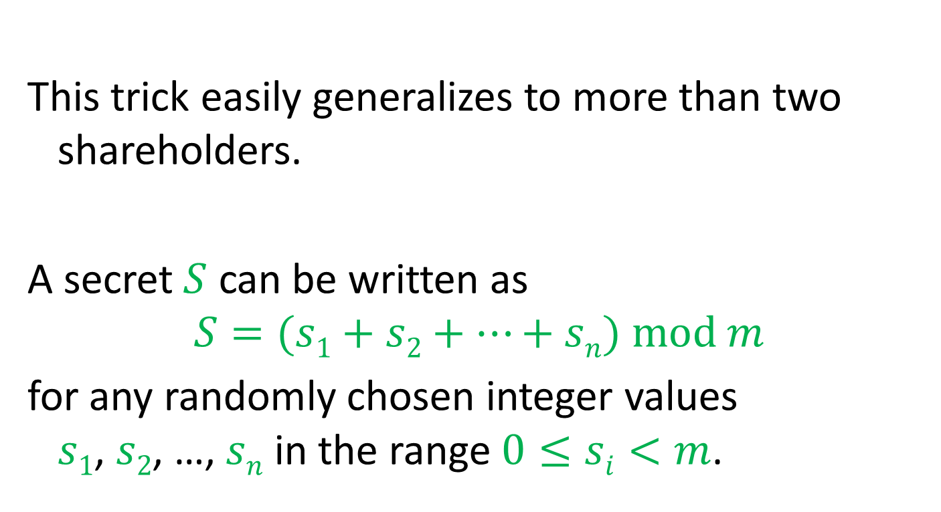
Secret Sharing – AND
This trick easily generalizes to more than two shareholders.
A secret $S$ can be written as
$$S=(s1+s2+…+sn) mod m$$
for any randomly chosen integer values $s1$, $s2$, …, $sn$ in the range $0≤si<m$.

Slide 88
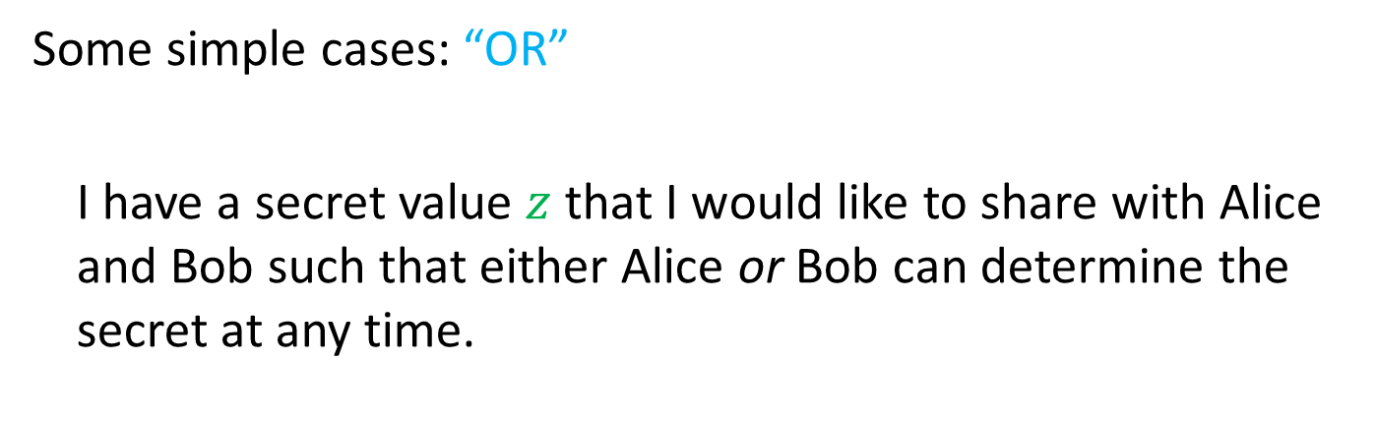
Secret Sharing
Some simple cases: “OR”
I have a secret value $z$ that I would like to share with Alice and Bob such that either Alice or Bob can determine the secret at any time.

Slide 89

Secret Sharing – OR
The secret value is $z$.

Slide 90


Secret Sharing – OR
The secret value is $z$.
$$z$$
$$z$$

Slide 91
Secret Sharing – OR
The secret value is $z$.
$$z$$
$$z$$

Slide 92
Secret Sharing – OR
The secret value is $z$.
$$z$$

Slide 93
Secret Sharing – OR
The secret value is $z$.
$$z$$

Slide 94
Secret Sharing – OR
The secret value is $z$.

Slide 95
Secret Sharing – OR
The secret value is $z$.
$$z$$

Slide 96
Secret Sharing – OR
The secret value is $z$.
$$z$$

Slide 97
Secret Sharing – OR
This case also generalizes easily to more than two shareholders.

Slide 98
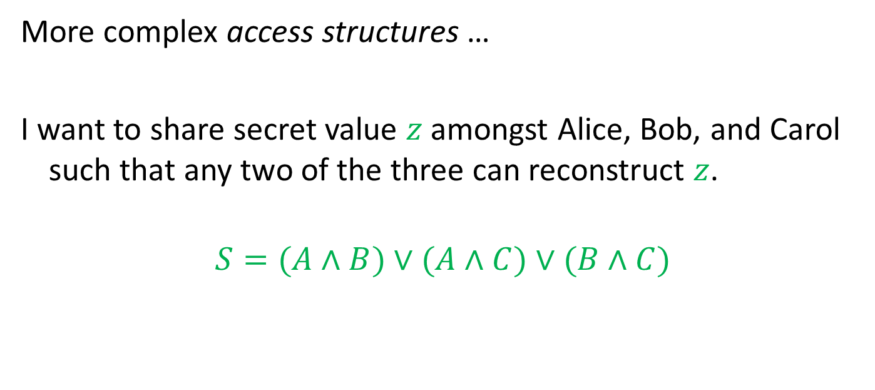
Secret Sharing
More complex access structures …
I want to share secret value $z$ amongst Alice, Bob, and Carol such that any two of the three can reconstruct $z$.
$$S=(A∧B)∨(A∧C)∨(B∧C)$$

Slide 99
Secret Sharing
OR
AND
AND
AND
A
B
A
C
B
C

Slide 100
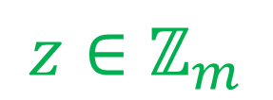
Secret Sharing
$$z∈ℤ_{m}$$
OR
AND
AND
AND
A
B
A
C
B
C

Slide 101


Secret Sharing
$$z∈ℤ_{m}$$
OR
$$z$$
$$z$$
$$z$$
AND
AND
AND
A
B
A
C
B
C

Slide 102
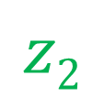
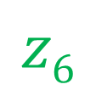
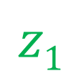
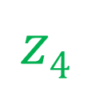
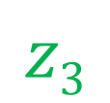
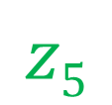
Secret Sharing
$$z∈ℤ_{m}$$
OR
$$z$$
$$z$$
$$z$$
AND
AND
AND
$$z1$$
$$z2$$
$$z3$$
$$z4$$
$$z5$$
$$z6$$
A
B
A
C
B
C

Slide 103
Threshold Schemes

Slide 104

Threshold Schemes
I want to distribute a secret datum amongst $n$ trustees such that

Slide 105
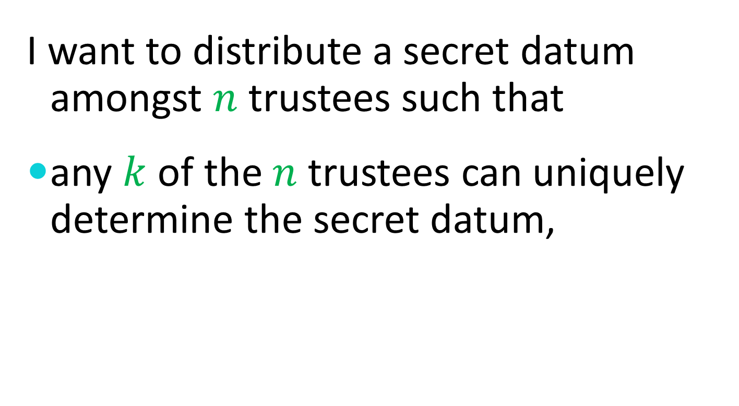
Threshold Schemes
I want to distribute a secret datum amongst $n$ trustees such that
any $k$ of the $n$ trustees can uniquely determine the secret datum,

Slide 106

Threshold Schemes
I want to distribute a secret datum amongst $n$ trustees such that
any $k$ of the $n$ trustees can uniquely determine the secret datum,
but any set of fewer than $k$ trustees has no information whatsoever about the secret datum.

Slide 107


Threshold Schemes
OR
1 out of $n$
AND
$n$ out of $n$

Slide 108

Shamir’s Threshold Scheme
Any $k$ points $s_{1}$, $s_{2}$, …, $s_{k}$ in a field uniquely determine a polynomial $P$ of degree at most $k−1$ with $P\left(i\right)=s_{i}$ for $i=1, 2,…,k$.
This not only works of the reals, rationals, and other infinite fields, but also over the finite field
$$ℤ_{p}=\left\{0,1,…,p−1\right\}$$
where $p$ is a prime.

Slide 109

Shamir’s Threshold Scheme
To distribute a secret value $s∈ℤ_{p}$ amongst a set of $n$ Trustees $\left\{T_{1},T_{2},…,T_{n}\right\}$such that any $k$ can determine the secret

Slide 110

Shamir’s Threshold Scheme
To distribute a secret value $s∈ℤ_{p}$ amongst a set of $n$ Trustees $\left\{T_{1},T_{2},…,T_{n}\right\}$such that any $k$ can determine the secret
pick random coefficients $a_{1},a_{2},…,a_{k−1}∈ℤ_{p}$

Slide 111

Shamir’s Threshold Scheme
To distribute a secret value $s∈ℤ_{p}$ amongst a set of $n$ Trustees $\left\{T_{1},T_{2},…,T_{n}\right\}$such that any $k$ can determine the secret
pick random coefficients $a_{1},a_{2},…,a_{k−1}∈ℤ_{p}$
let $P\left(x\right)=a_{k−1}x^{k−1}+…+a_{2}x^{2}+a_{1}x+s$

Slide 112

Shamir’s Threshold Scheme
To distribute a secret value $s∈ℤ_{p}$ amongst a set of $n$ Trustees $\left\{T_{1},T_{2},…,T_{n}\right\}$such that any $k$ can determine the secret
pick random coefficients $a_{1},a_{2},…,a_{k−1}∈ℤ_{p}$
let $P\left(x\right)=a_{k−1}x^{k−1}+…+a_{2}x^{2}+a_{1}x+s$
give $P(i)$ to trustee $T_{i}$.

Slide 113

Shamir’s Threshold Scheme
To distribute a secret value $s∈ℤ_{p}$ amongst a set of $n$ Trustees $\left\{T_{1},T_{2},…,T_{n}\right\}$such that any $k$ can determine the secret
pick random coefficients $a_{1},a_{2},…,a_{k−1}∈ℤ_{p}$
let $P\left(x\right)=a_{k−1}x^{k−1}+…+a_{2}x^{2}+a_{1}x+s$
give $P(i)$ to trustee $T_{i}$.
The secret value is $s = P(0)$.

Slide 114

Shamir’s Threshold Scheme
The threshold 2 case:
Example: Range = $ℤ_{11}=\left\{0,1,…,10\right\}$, Secret = 9

Slide 115
Shamir’s Threshold Scheme
The threshold 2 case:
Example: Range = $ℤ_{11}=\left\{0,1,…,10\right\}$, Secret = 9

Slide 116
Shamir’s Threshold Scheme
The threshold 2 case:
Example: Range = $ℤ_{11}=\left\{0,1,…,10\right\}$, Secret = 9
(0,9)
Secret

Slide 117
Shamir’s Threshold Scheme
The threshold 2 case:
Example: Range = $ℤ_{11}=\left\{0,1,…,10\right\}$, Secret = 9
(0,9)
Secret

Slide 118
Shamir’s Threshold Scheme
The threshold 2 case:
Example: Range = $ℤ_{11}=\left\{0,1,…,10\right\}$, Secret = 9
(0,9)
Secret
(1,7)
Share 1
(2,5)
Share 2
(3,3)
Share 3

Slide 119
Shamir’s Threshold Scheme
The threshold 2 case:
Example: Range = $ℤ_{11}=\left\{0,1,…,10\right\}$, Secret = 9

Slide 120
Shamir’s Threshold Scheme
The threshold 2 case:
Example: Range = $ℤ_{11}=\left\{0,1,…,10\right\}$, Secret = 9
(1,7)
Share 1

Slide 121
Shamir’s Threshold Scheme
The threshold 2 case:
Example: Range = $ℤ_{11}=\left\{0,1,…,10\right\}$, Secret = 9
(1,7)
Share 1
(3,3)
Share 3

Slide 122
Shamir’s Threshold Scheme
The threshold 2 case:
Example: Range = $ℤ_{11}=\left\{0,1,…,10\right\}$, Secret = 9
(1,7)
Share 1
(3,3)
Share 3

Slide 123
Shamir’s Threshold Scheme
The threshold 2 case:
Example: Range = $ℤ_{11}=\left\{0,1,…,10\right\}$, Secret = 9
(0,9)
Secret
(1,7)
Share 1
(3,3)
Share 3

Slide 124

Shamir’s Threshold Scheme
The threshold 2 case:
Example: Range = $ℤ_{11}=\left\{0,1,…,10\right\}$

Slide 125
Shamir’s Threshold Scheme
The threshold 2 case:
Example: Range = $ℤ_{11}=\left\{0,1,…,10\right\}$
(1,7)
Share 1

Slide 126
Shamir’s Threshold Scheme
The threshold 2 case:
Example: Range = $ℤ_{11}=\left\{0,1,…,10\right\}$
(1,7)
Share 1
(3,4)
Share 3

Slide 127
Shamir’s Threshold Scheme
The threshold 2 case:
Example: Range = $ℤ_{11}=\left\{0,1,…,10\right\}$
(1,7)
Share 1
(3,4)
Share 3

Slide 128
Shamir’s Threshold Scheme
The threshold 2 case:
Example: Range = $ℤ_{11}=\left\{0,1,…,10\right\}$
(0,8.5)
Secret
(1,7)
Share 1
(3,4)
Share 3

Slide 129

Shamir’s Threshold Scheme
The threshold 2 case:
Example: Range = $ℤ_{11}=\left\{0,1,…,10\right\}$
In $ℤ_{11}$, $8.5$
$$≡ 17÷2$$
$$≡ 6×6$$
$$≡ 36$$
$$≡ 3$$
(0,8.5)
Secret
(1,7)
Share 1
(3,4)
Share 3

Slide 130
Shamir’s Threshold Scheme
Two methods are commonly used to interpolate a polynomial given a set of points.

Slide 131
Shamir’s Threshold Scheme
Two methods are commonly used to interpolate a polynomial given a set of points.
Lagrange interpolation

Slide 132
Shamir’s Threshold Scheme
Two methods are commonly used to interpolate a polynomial given a set of points.
Lagrange interpolation
Solving a system of linear equations

Slide 133
Lagrange Interpolation

Slide 134

Lagrange Interpolation
For each point $(i,s_{i})$, construct a polynomial $P_{i}$ with the correct value at $i$ and a value of zero at the other given points.

Slide 135

Lagrange Interpolation
For each point $(i,s_{i})$, construct a polynomial $P_{i}$ with the correct value at $i$ and a value of zero at the other given points.
$$P_{i}\left(x\right)=s_{i}×\prod_{j≠i}{(x−j)}÷\prod_{j≠i}{(i−j)}$$

Slide 136

Lagrange Interpolation
For each point $(i,s_{i})$, construct a polynomial $P_{i}$ with the correct value at $i$ and a value of zero at the other given points.
$$P_{i}\left(x\right)=s_{i}×\prod_{j≠i}{(x−j)}÷\prod_{j≠i}{(i−j)}$$
Then sum the $P_{i}\left(x\right)$ to compute $P\left(x\right)$.

Slide 137

Lagrange Interpolation
For each point $(i,s_{i})$, construct a polynomial $P_{i}$ with the correct value at $i$ and a value of zero at the other given points.
$$P_{i}\left(x\right)=s_{i}×\prod_{j≠i}{(x−j)}÷\prod_{j≠i}{(i−j)}$$
Then sum the $P_{i}\left(x\right)$ to compute $P\left(x\right)$.
$$P(x)=\sum_{i}{P_{i}\left(x\right)}$$

Slide 138
Solving a Linear System

Slide 139
Solving a Linear System
Regard the polynomial coefficients as unknowns.

Slide 140
Solving a Linear System
Regard the polynomial coefficients as unknowns.
Plug in each known point to get a linear equation in terms of the unknown coefficients.

Slide 141
Solving a Linear System
Regard the polynomial coefficients as unknowns.
Plug in each known point to get a linear equation in terms of the unknown coefficients.
Once there are as many equations as unknowns, use linear algebra to solve the system of equations.

Slide 142
Verifiable Secret Sharing
Secret sharing is very useful when the “dealer” of a secret is honest, but what bad things can happen if the dealer is potentially dishonest?
Can measures be taken to eliminate or mitigate the damages?

Slide 143

Homomorphic Encryption
Recall that with RSA, there is a multiplicative homomorphism.
$$E\left(x\right)E\left(y\right)≡E(xy)$$
Can we find an encryption function with an additive homomorphism?

Slide 144

An Additive Homomorphism
Can we find an encryption function for which the sum (or product) of two encrypted messages is the (an) encryption of the sum of the two original messages?
$$E(x)◦E(y)≡E(x+y)$$

Slide 145

An Additive Homomorphism
Recall the one-way function given by
$f(x) = gx mod m$.
For this function,
$$f(x)f(y) mod m = gxgy mod m =$$
$g^{x+y} mod m = f(x+y) mod m$.

Slide 146
Verifiable Secret Sharing

Slide 147

Verifiable Secret Sharing
Select a polynomial with secret $a_{0}$ as
$P\left(x\right)=a_{k−1}x^{k−1}+⋯+a_{2}x^{2}+a_{1}x+a_{0}$.

Slide 148

Verifiable Secret Sharing
Select a polynomial with secret $a_{0}$ as
$P\left(x\right)=a_{k−1}x^{k−1}+⋯+a_{2}x^{2}+a_{1}x+a_{0}$.
Commit to the coefficients by publishing
$g^{a_{0}}$, $g^{a_{1}}$, $g^{a_{2}}$, …, $g^{a_{k−1}}$.

Slide 149

Verifiable Secret Sharing
Select a polynomial with secret $a_{0}$ as
$P\left(x\right)=a_{k−1}x^{k−1}+⋯+a_{2}x^{2}+a_{1}x+a_{0}$.
Commit to the coefficients by publishing
$g^{a_{0}}$, $g^{a_{1}}$, $g^{a_{2}}$, …, $g^{a_{k−1}}$.
Compute a commitment to $P(i)$ from public values as
$g^{P(i)}=g^{a_{0}i^{0}}g^{a_{1}i^{1}}g^{a_{2}i^{2}}⋯g^{a_{k−1}i^{k−1}}$.

Slide 150
Verifiable Secret Sharing
An important detail
Randomness must be included to prevent small spaces of possible secrets and shares from being exhaustively searched.

Slide 151
Secret Sharing Homomorphisms
All of these secret sharing methods have an additional useful feature:
If two secrets are separately shared amongst the same set of people in the same way, then the sum of the individual shares constitute shares of the sum of the secrets.

Slide 152

Secret Sharing Homomorphisms
OR
Secret: $a$ – Shares: $a$, $a$, …, $a$
Secret: $b$ – Shares: $b$, $b$, …, $b$
Secret sum: $a+b$
Share sums: $a+b$, $a+b$, …, $a+b$

Slide 153

Secret Sharing Homomorphisms
AND
Secret: $a$ – Shares: $a1$, $a2$, …, $an$
Secret: $b$ – Shares: $b1$, $b2$, …, $bn$
Secret sum: $a+b$
Share sums: $a1+b1$, $a2+b2$, …, $an+bn$

Slide 154

Secret Sharing Homomorphisms
THRESHOLD
Secret: $P_{1}(0)$ – Shares: $P_{1}(1)$, $P_{1}(2)$, …, $P_{1}(n)$
Secret: $P_{2}(0)$ – Shares: $P_{2}(1)$, $P_{2}(2)$, …, $P_{2}(n)$
Secret sum: $P_{1}(0)+P_{2}(0)$
Share sums: $P_{1}(1)+P_{2}(1)$, $P_{1}(2)+P_{2}(2)$, …, $P_{1}(n)+P_{2}(n)$

Slide 155

Threshold Encryption
I want to encrypt a secret message $M$ for a set of $n$ recipients such that
any $k$ of the $n$ recipients can uniquely decrypt the secret message $M$,
but any set of fewer than $k$ recipients has no information whatsoever about the secret message $M$.

Slide 156



Recall Diffie-Hellman
Alice
Randomly select a large integer $a$ and send $A=g^{a} mod p$.
Compute the key $K=B^{a} mod p$.
Bob
Randomly select a large integer $b$ and send $B=g^{b} mod p$.
Compute the key $K=A^{b} mod p$.
$$B^{a} = g^{ba} = g^{ab} = A^{b}$$

Slide 157
ElGamal Encryption

Slide 158

ElGamal Encryption
Alice selects a large random private key $a$ and computes an associated public key $A=g^{a} mod p$.

Slide 159

ElGamal Encryption
Alice selects a large random private key $a$ and computes an associated public key $A=g^{a} mod p$.
To send a message $M$ to Alice, Bob selects a random value $r$ and computes the pair $(X,Y) = (A^{r}M mod p, g^{r} mod p)$.

Slide 160

ElGamal Encryption
Alice selects a large random private key $a$ and computes an associated public key $A=g^{a} mod p$.
To send a message $M$ to Alice, Bob selects a random value $r$ and computes the pair $(X,Y) = (A^{r}M mod p, g^{r} mod p)$.
To decrypt, Alice computes
$X/Y^{a} mod p = A^{r}M/g^{ra} mod p = M$.

Slide 161

ElGamal Re-Encryption
If $A=g^{a} mod p$is a public key and the pair
$$(X,Y) = (A^{r}M mod p, g^{r} mod p)$$
is an encryption of message $M$, then for any value $c$, the pair
$$(A^{c}X,g^{c}Y) = (A^{c+r}M mod p, g^{c+r} mod p)$$
is an encryption of the same message $M$, for any value $c$.

Slide 162
Group ElGamal Encryption

Slide 163

Group ElGamal Encryption
Each recipient selects a large random private key $ai$ and computes an associated public key $Ai = g^{a_{i}} mod p$.

Slide 164

Group ElGamal Encryption
Each recipient selects a large random private key $ai$ and computes an associated public key $Ai = g^{a_{i}} mod p$.
The group key is $A = \prod{A_{i}}mod p = g^{\sum{a_{i}}} mod p$.

Slide 165

Group ElGamal Encryption
Each recipient selects a large random private key $ai$ and computes an associated public key $Ai = g^{a_{i}} mod p$.
The group key is $A = \prod{A_{i}}mod p = g^{\sum{a_{i}}} mod p$.
To send a message $M$ to the group, Bob selects a random value $r$ and computes the pair $(X,Y) = (A^{r}M mod p, g^{r} mod p)$.

Slide 166

Group ElGamal Encryption
Each recipient selects a large random private key $ai$ and computes an associated public key $Ai = g^{a_{i}} mod p$.
The group key is $A = \prod{A_{i}}mod p = g^{\sum{a_{i}}} mod p$.
To send a message $M$ to the group, Bob selects a random value $r$ and computes the pair $(X,Y) = (A^{r}M mod p, g^{r} mod p)$.
To decrypt, each group member computes $Y_{i}=Y^{a_{i}} mod p$. The message $M = X/\prod{Y_{i}}mod p$.

Slide 167
Threshold Encryption (ElGamal)

Slide 168

Threshold Encryption (ElGamal)
Each recipient selects $k$ large random secret coefficients $a_{i,0}$, $a_{i,1}$, …, $a_{i,k−2}$, $a_{i,k−1}$ and forms the polynomial
$$P_{i}\left(x\right)=a_{i,k−1}x^{k−1}+a_{i,k−2}x^{k−2}+⋯+a_{i,1}x+a_{i,0}$$

Slide 169

Threshold Encryption (ElGamal)
Each recipient selects $k$ large random secret coefficients $a_{i,0}$, $a_{i,1}$, …, $a_{i,k−2}$, $a_{i,k−1}$ and forms the polynomial
$$P_{i}\left(x\right)=a_{i,k−1}x^{k−1}+a_{i,k−2}x^{k−2}+⋯+a_{i,1}x+a_{i,0}$$
Each polynomial $P_{i}(x)$is then verifiably shared with the other recipients by distributing each $g^{a_{i,j}}$.

Slide 170

Threshold Encryption (ElGamal)
Each recipient selects $k$ large random secret coefficients $a_{i,0}$, $a_{i,1}$, …, $a_{i,k−2}$, $a_{i,k−1}$ and forms the polynomial
$$P_{i}\left(x\right)=a_{i,k−1}x^{k−1}+a_{i,k−2}x^{k−2}+⋯+a_{i,1}x+a_{i,0}$$
Each polynomial $P_{i}(x)$is then verifiably shared with the other recipients by distributing each $g^{a_{i,j}}$.
The joint (threshold) public key is $\prod{g^{a_{i,0}}}$.

Slide 171

Threshold Encryption (ElGamal)
Each recipient selects $k$ large random secret coefficients $a_{i,0}$, $a_{i,1}$, …, $a_{i,k−2}$, $a_{i,k−1}$ and forms the polynomial
$$P_{i}\left(x\right)=a_{i,k−1}x^{k−1}+a_{i,k−2}x^{k−2}+⋯+a_{i,1}x+a_{i,0}$$
Each polynomial $P_{i}(x)$is then verifiably shared with the other recipients by distributing each $g^{a_{i,j}}$.
The joint (threshold) public key is $\prod{g^{a_{i,0}}}$.
Any set of $k$ recipients can form the secret key $\sum{a_{i,0}}$ to decrypt.

