Slide 1
Practical Aspects of Modern Cryptography
Winter 2011
Josh Benaloh
Brian LaMacchia

Slide 2
Some Tools We’ve Developed
Homomorphic Encryption
Secret Sharing
Verifiable Secret Sharing
Threshold Encryption
Interactive Proofs

Slide 3
Secret Sharing Homomorphisms
Many secret sharing methods have an additional useful feature:
If two secrets are separately shared amongst the same set of people in the same way, then the sum of the individual shares constitute shares of the sum of the secrets.

Slide 4

Secret Sharing Homomorphisms
OR
Secret: $a$ – Shares: $a$, $a$, …, $a$
Secret: $b$ – Shares: $b$, $b$, …, $b$
Secret sum: $a+b$
Share sums: $a+b$, $a+b$, …, $a+b$

Slide 5

Secret Sharing Homomorphisms
AND
Secret: $a$ – Shares: $a1$, $a2$, …, $an$
Secret: $b$ – Shares: $b1$, $b2$, …, $bn$
Secret sum: $a+b$
Share sums: $a1+b1$, $a2+b2$, …, $an+b_{n}$

Slide 6
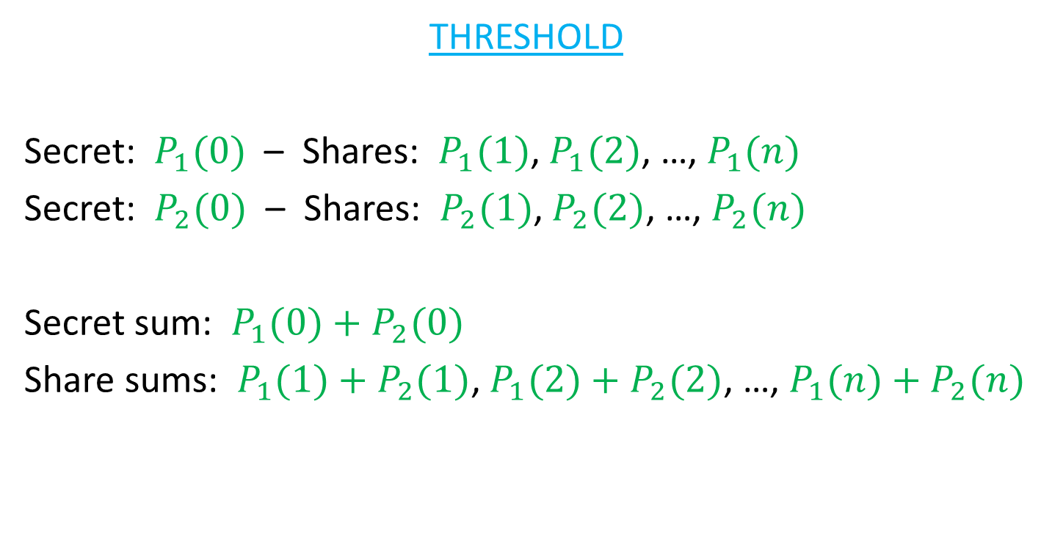
Secret Sharing Homomorphisms
THRESHOLD
Secret: $P_{1}(0)$ – Shares: $P_{1}(1)$, $P_{1}(2)$, …, $P_{1}(n)$
Secret: $P_{2}(0)$ – Shares: $P_{2}(1)$, $P_{2}(2)$, …, $P_{2}(n)$
Secret sum: $P_{1}(0)+P_{2}(0)$
Share sums: $P_{1}(1)+P_{2}(1)$, $P_{1}(2)+P_{2}(2)$, …, $P_{1}(n)+P_{2}(n)$

Slide 7
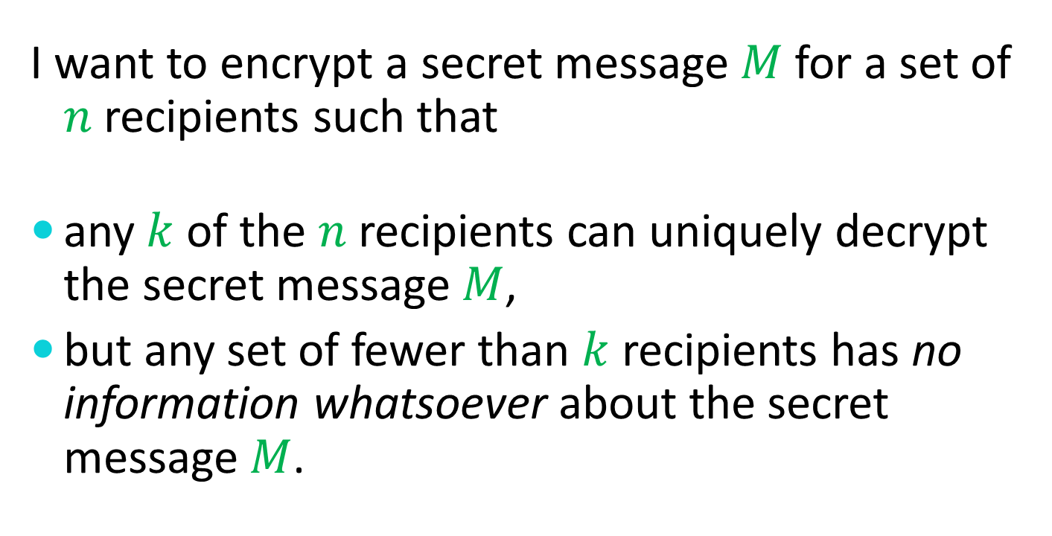
Threshold Encryption
I want to encrypt a secret message $M$ for a set of $n$ recipients such that
any $k$ of the $n$ recipients can uniquely decrypt the secret message $M$,
but any set of fewer than $k$ recipients has no information whatsoever about the secret message $M$.

Slide 8
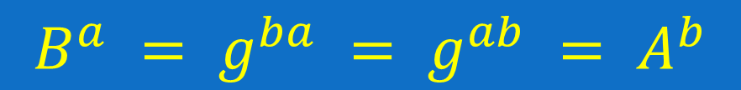
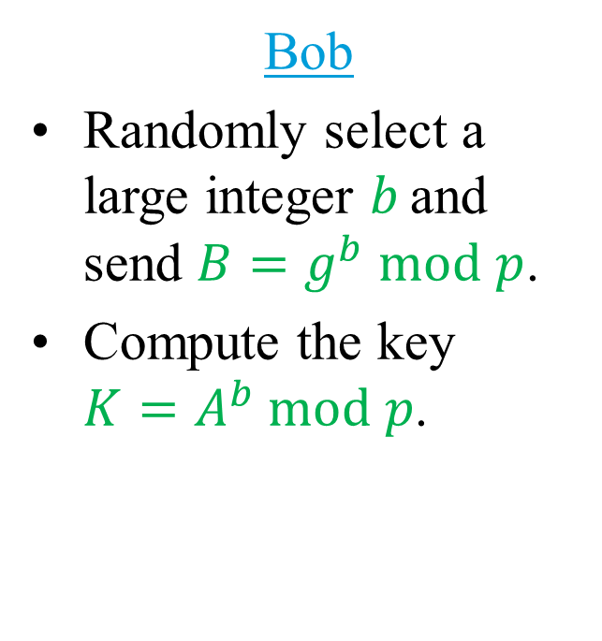
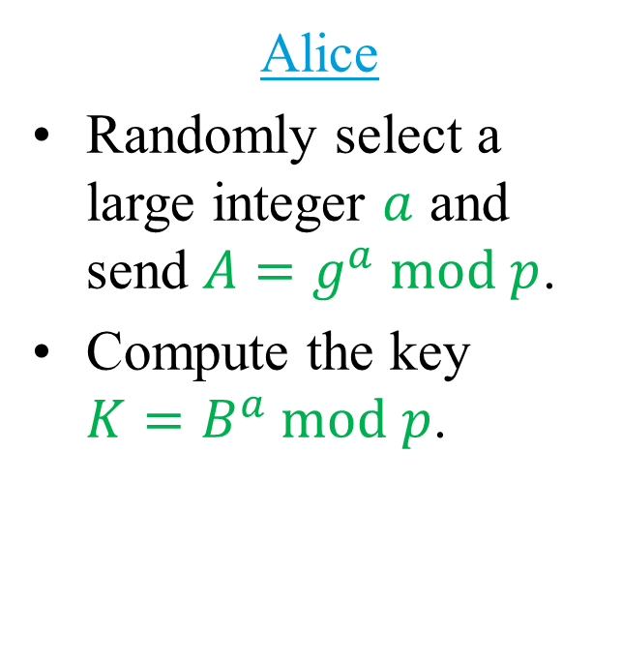
Recall Diffie-Hellman
Alice
Randomly select a large integer $a$ and send $A=g^{a} mod p$.
Compute the key $K=B^{a} mod p$.
Bob
Randomly select a large integer $b$ and send $B=g^{b} mod p$.
Compute the key $K=A^{b} mod p$.
$$B^{a} = g^{ba} = g^{ab} = A^{b}$$

Slide 9
ElGamal Encryption

Slide 10

ElGamal Encryption
Alice selects a large random private key $a$ and computes an associated public key $A=g^{a} mod p$.

Slide 11

ElGamal Encryption
Alice selects a large random private key $a$ and computes an associated public key $A=g^{a} mod p$.
To send a message $M$ to Alice, Bob selects a random value $r$ and computes the pair $(X,Y) = (A^{r}M mod p, g^{r} mod p)$.

Slide 12
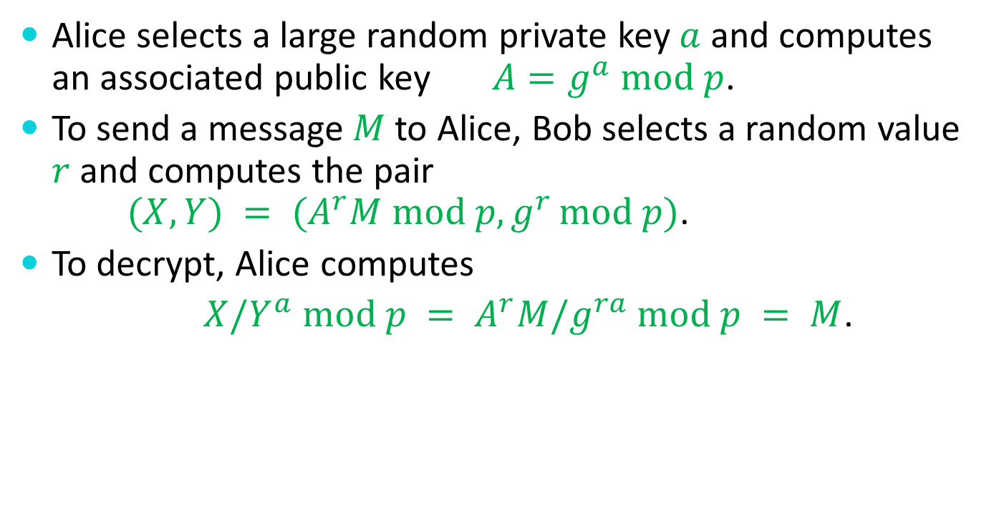
ElGamal Encryption
Alice selects a large random private key $a$ and computes an associated public key $A=g^{a} mod p$.
To send a message $M$ to Alice, Bob selects a random value $r$ and computes the pair $(X,Y) = (A^{r}M mod p, g^{r} mod p)$.
To decrypt, Alice computes
$X/Y^{a} mod p = A^{r}M/g^{ra} mod p = M$.

Slide 13
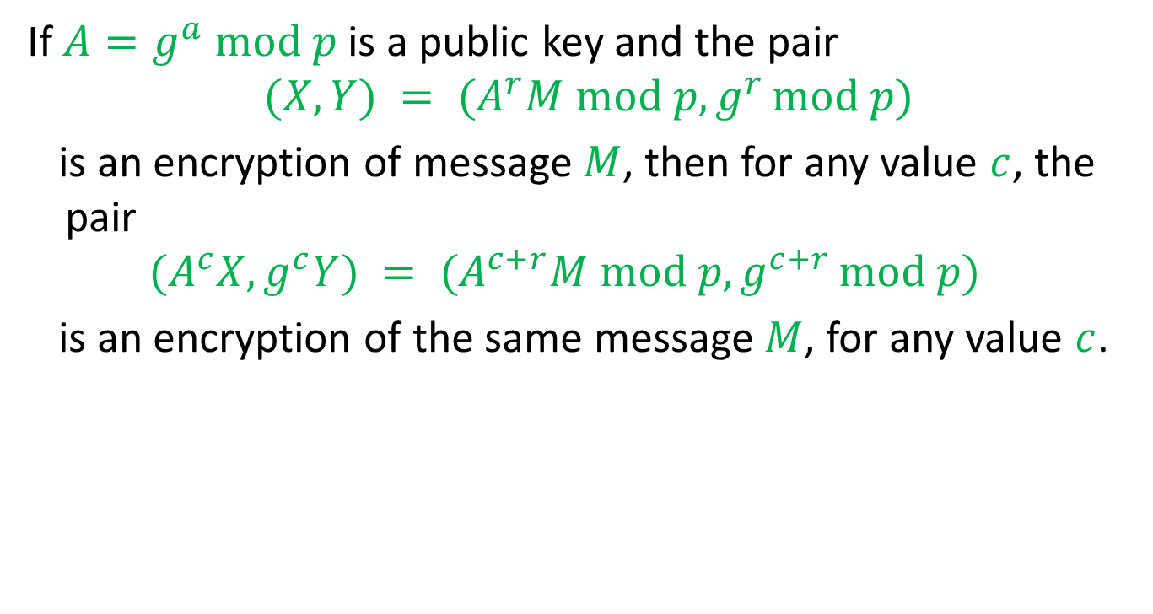
ElGamal Re-Encryption
If $A=g^{a} mod p$is a public key and the pair
$$(X,Y) = (A^{r}M mod p, g^{r} mod p)$$
is an encryption of message $M$, then for any value $c$, the pair
$$(A^{c}X,g^{c}Y) = (A^{c+r}M mod p, g^{c+r} mod p)$$
is an encryption of the same message $M$, for any value $c$.

Slide 14
Group ElGamal Encryption

Slide 15

Group ElGamal Encryption
Each recipient selects a large random private key $ai$ and computes an associated public key $Ai = g^{a_{i}} mod p$.

Slide 16

Group ElGamal Encryption
Each recipient selects a large random private key $ai$ and computes an associated public key $Ai = g^{a_{i}} mod p$.
The group key is $A = \prod{A_{i}}mod p = g^{\sum{a_{i}}} mod p$.

Slide 17
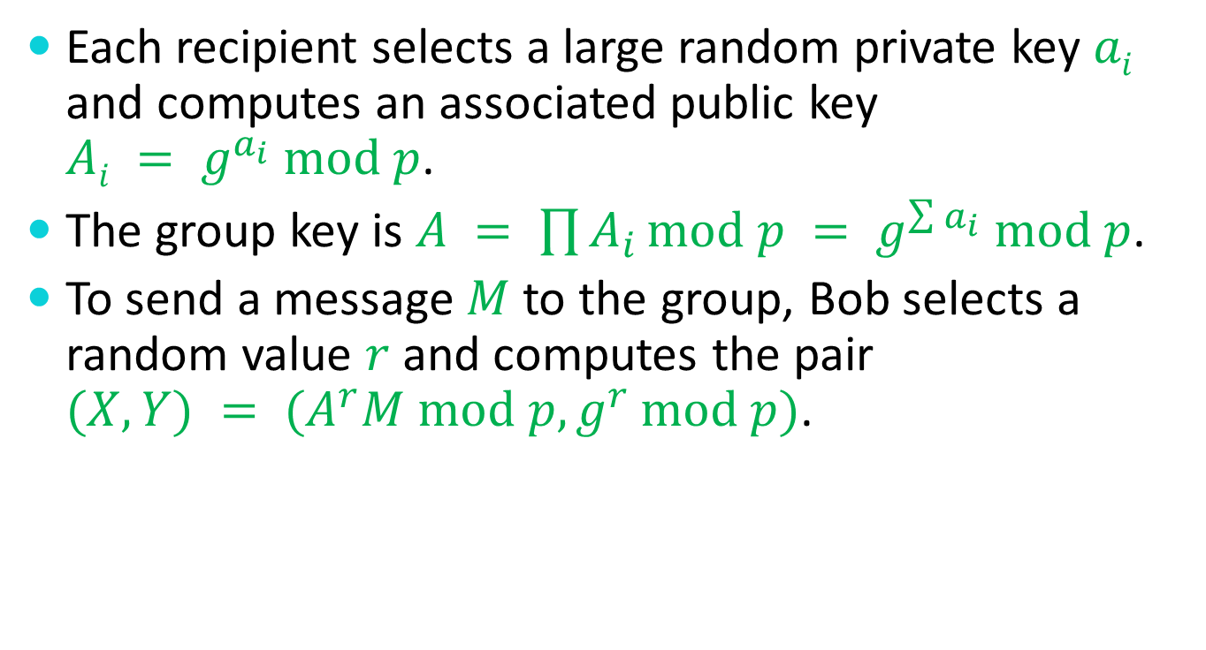
Group ElGamal Encryption
Each recipient selects a large random private key $ai$ and computes an associated public key $Ai = g^{a_{i}} mod p$.
The group key is $A = \prod{A_{i}}mod p = g^{\sum{a_{i}}} mod p$.
To send a message $M$ to the group, Bob selects a random value $r$ and computes the pair $(X,Y) = (A^{r}M mod p, g^{r} mod p)$.

Slide 18
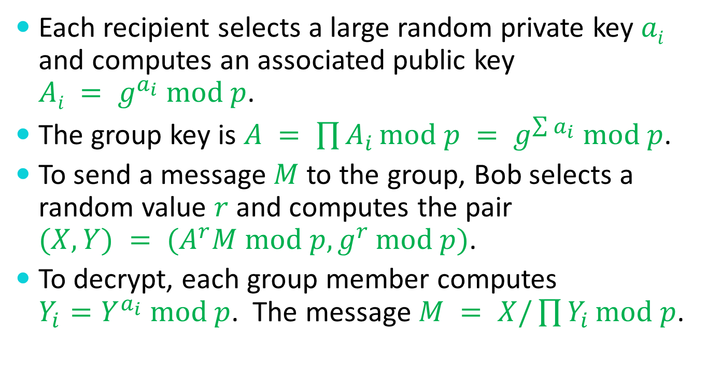
Group ElGamal Encryption
Each recipient selects a large random private key $ai$ and computes an associated public key $Ai = g^{a_{i}} mod p$.
The group key is $A = \prod{A_{i}}mod p = g^{\sum{a_{i}}} mod p$.
To send a message $M$ to the group, Bob selects a random value $r$ and computes the pair $(X,Y) = (A^{r}M mod p, g^{r} mod p)$.
To decrypt, each group member computes $Y_{i}=Y^{a_{i}} mod p$. The message $M = X/\prod{Y_{i}}mod p$.

Slide 19
Threshold Encryption (ElGamal)

Slide 20

Threshold Encryption (ElGamal)
Each recipient selects $k$ large random secret coefficients $a_{i,0}$, $a_{i,1}$, …, $a_{i,k−2}$, $a_{i,k−1}$ and forms the polynomial
$$P_{i}\left(x\right)=a_{i,k−1}x^{k−1}+a_{i,k−2}x^{k−2}+⋯+a_{i,1}x+a_{i,0}$$

Slide 21

Threshold Encryption (ElGamal)
Each recipient selects $k$ large random secret coefficients $a_{i,0}$, $a_{i,1}$, …, $a_{i,k−2}$, $a_{i,k−1}$ and forms the polynomial
$$P_{i}\left(x\right)=a_{i,k−1}x^{k−1}+a_{i,k−2}x^{k−2}+⋯+a_{i,1}x+a_{i,0}$$
Each polynomial $P_{i}(x)$is then verifiably shared with the other recipients by distributing each $g^{a_{i,j}}$.

Slide 22
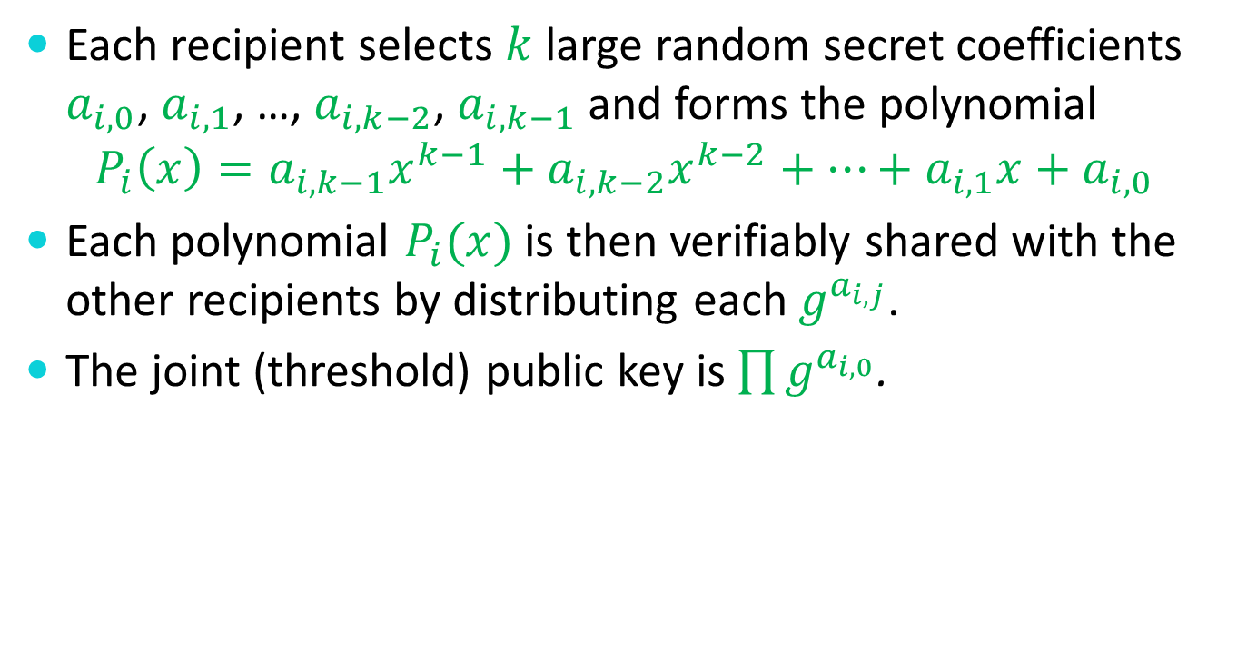
Threshold Encryption (ElGamal)
Each recipient selects $k$ large random secret coefficients $a_{i,0}$, $a_{i,1}$, …, $a_{i,k−2}$, $a_{i,k−1}$ and forms the polynomial
$$P_{i}\left(x\right)=a_{i,k−1}x^{k−1}+a_{i,k−2}x^{k−2}+⋯+a_{i,1}x+a_{i,0}$$
Each polynomial $P_{i}(x)$is then verifiably shared with the other recipients by distributing each $g^{a_{i,j}}$.
The joint (threshold) public key is $\prod{g^{a_{i,0}}}$.

Slide 23
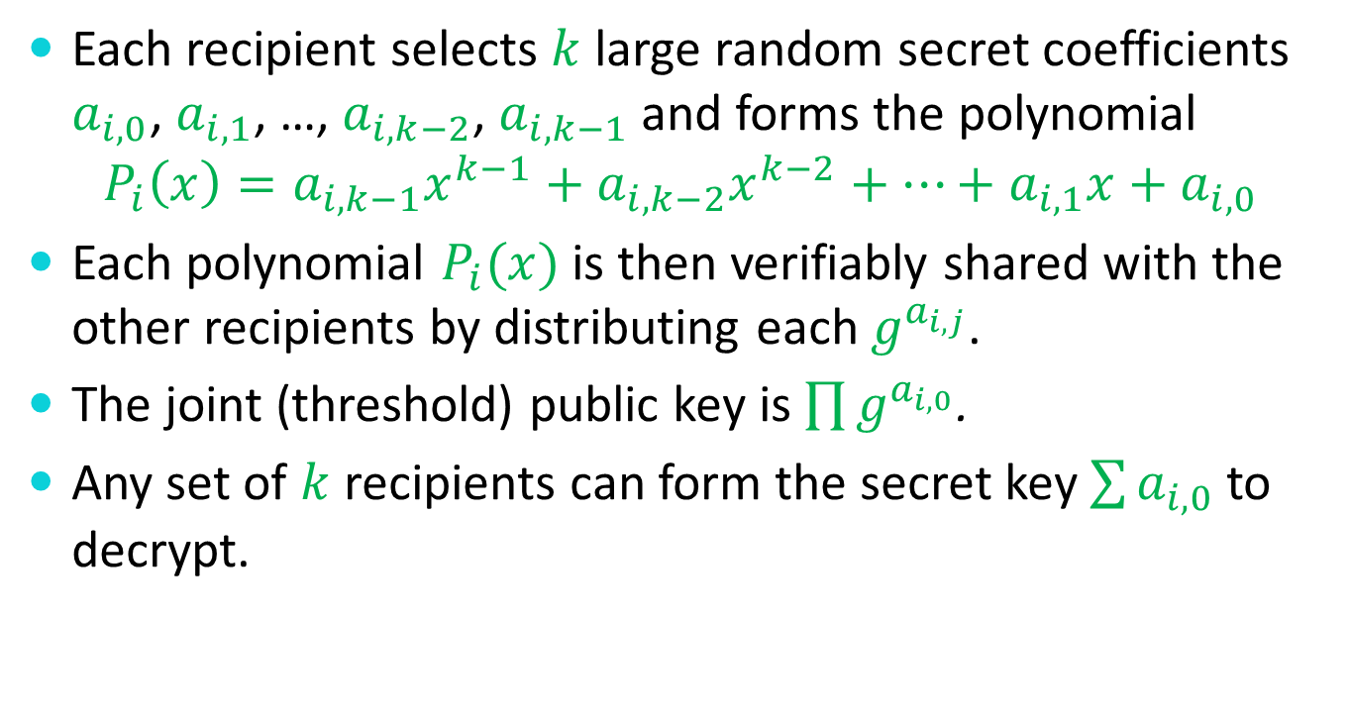
Threshold Encryption (ElGamal)
Each recipient selects $k$ large random secret coefficients $a_{i,0}$, $a_{i,1}$, …, $a_{i,k−2}$, $a_{i,k−1}$ and forms the polynomial
$$P_{i}\left(x\right)=a_{i,k−1}x^{k−1}+a_{i,k−2}x^{k−2}+⋯+a_{i,1}x+a_{i,0}$$
Each polynomial $P_{i}(x)$is then verifiably shared with the other recipients by distributing each $g^{a_{i,j}}$.
The joint (threshold) public key is $\prod{g^{a_{i,0}}}$.
Any set of $k$ recipients can form the secret key $\sum{a_{i,0}}$ to decrypt.

Slide 24
An Application
Verifiable
Elections

Slide 25
Verifiable Election Technologies
As a voter, you can check that
your vote is correctly recorded
all recorded votes are correctly counted
…even in the presence of malicious software, hardware, and election officials.

Slide 26
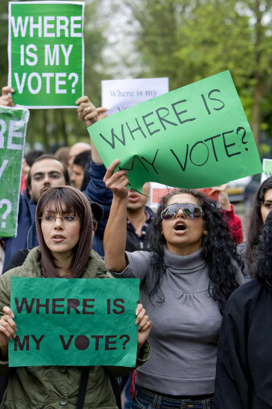

Slide 27
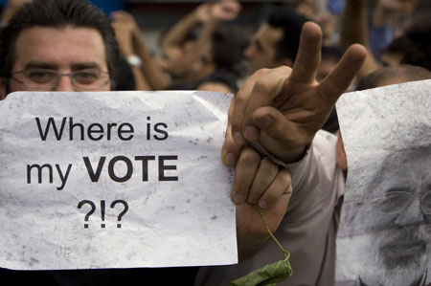
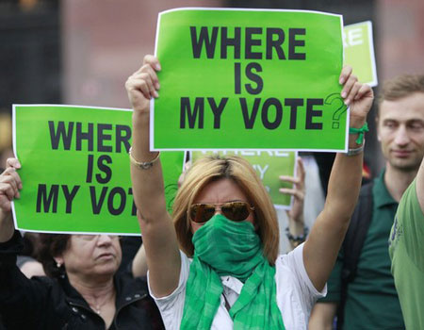
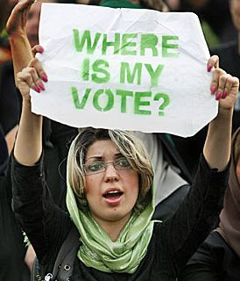
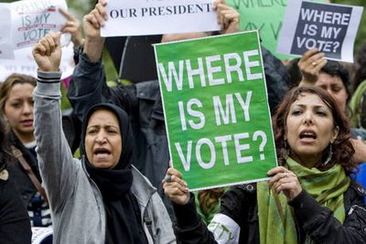

Slide 28
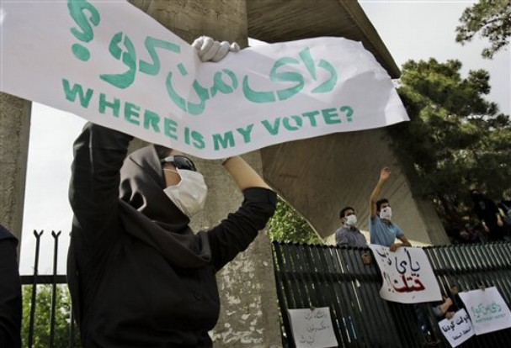
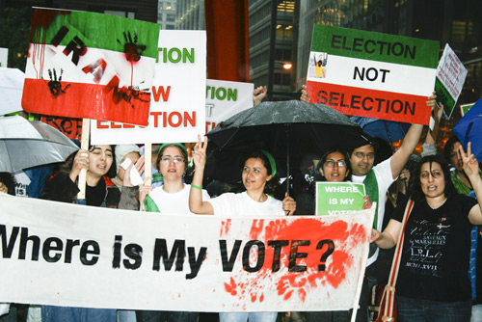
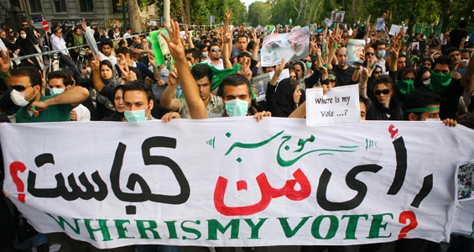

Slide 29
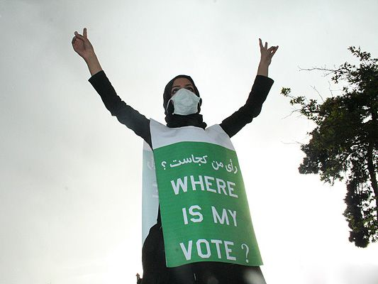
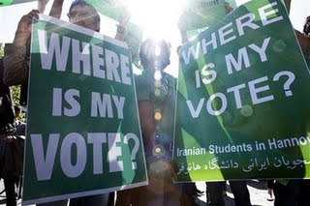

Slide 30

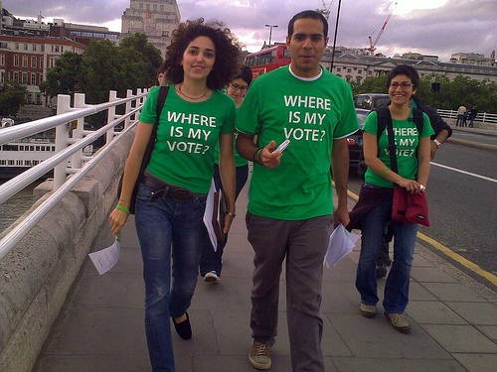

Slide 31



Slide 32



Slide 33
Traditional Voting Methods

Slide 34
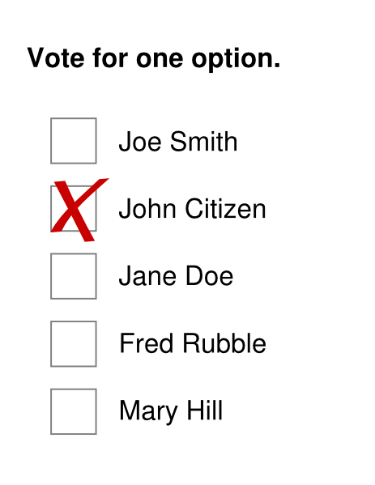
Traditional Voting Methods
Hand-Counted Paper

Slide 35
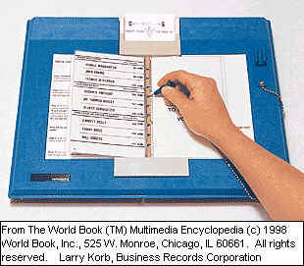
Traditional Voting Methods
Hand-Counted Paper
Punch Cards

Slide 36
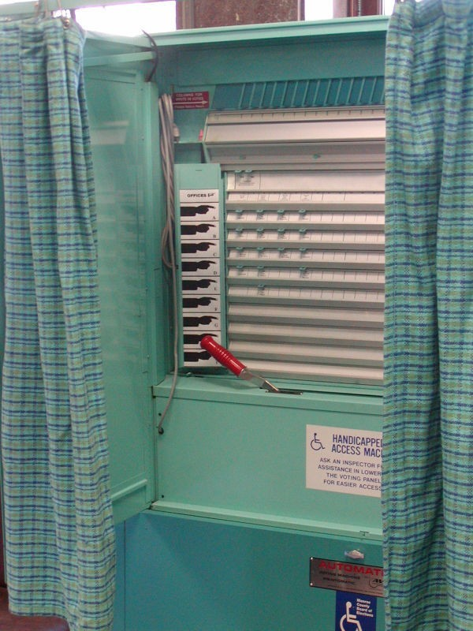
Traditional Voting Methods
Hand-Counted Paper
Punch Cards
Lever Machines

Slide 37
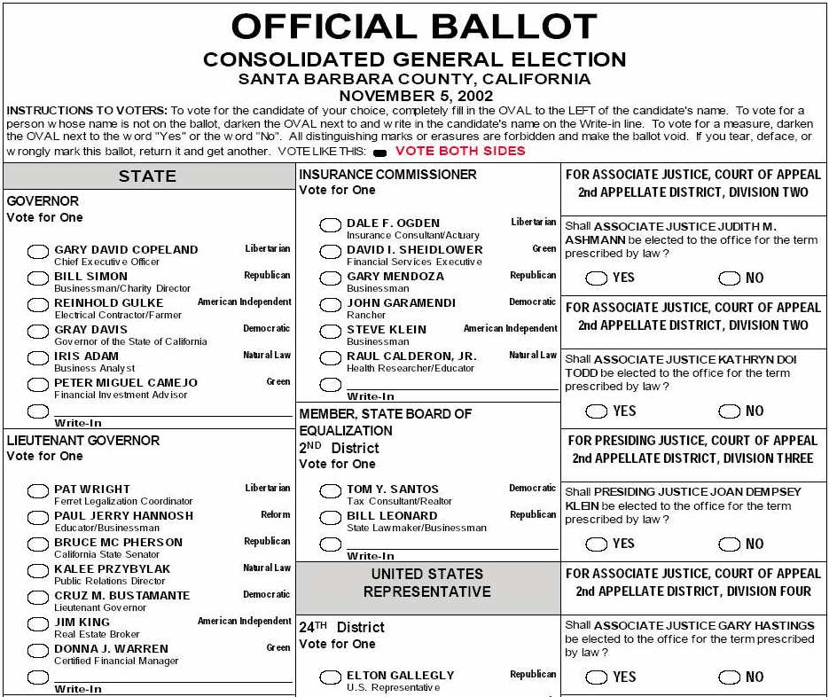
Traditional Voting Methods
Hand-Counted Paper
Punch Cards
Lever Machines
Optical Scan Ballots

Slide 38
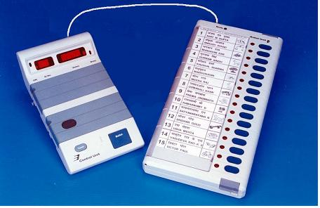
Traditional Voting Methods
Hand-Counted Paper
Punch Cards
Lever Machines
Optical Scan Ballots
Electronic Voting Machines

Slide 39
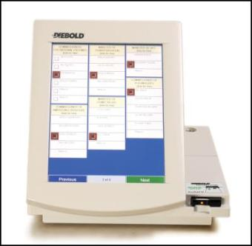
Traditional Voting Methods
Hand-Counted Paper
Punch Cards
Lever Machines
Optical Scan Ballots
Electronic Voting Machines
Touch-Screen Terminals

Slide 40
Traditional Voting Methods
Hand-Counted Paper
Punch Cards
Lever Machines
Optical Scan Ballots
Electronic Voting Machines
Touch-Screen Terminals
Various Hybrids

Slide 41
Vulnerabilities and Trust
All of these systems have substantial vulnerabilities.
All of these systems require trust in the honesty and expertise of election officials (and usually the equipment vendors as well).
Can we do better?

Slide 42
The Voter’s Perspective

Slide 43

The Voter’s Perspective

Slide 44
The Voter’s Perspective

Slide 45

The Voter’s Perspective

Slide 46
The Voter’s Perspective

Slide 47

The Voter’s Perspective

Slide 48

The Voter’s Perspective

Slide 49

The Voter’s Perspective

Slide 50

The Voter’s Perspective

Slide 51

The Voter’s Perspective

Slide 52
The Voter’s Perspective

Slide 53
The Voter’s Perspective
As a voter, you don’t really know what happens behind the curtain.

Slide 54
The Voter’s Perspective
As a voter, you don’t really know what happens behind the curtain.
You have no choice but to trust the people working behind the curtain.

Slide 55
The Voter’s Perspective
As a voter, you don’t really know what happens behind the curtain.
You have no choice but to trust the people working behind the curtain.
You don’t even get to choose the people who you will have to trust.

Slide 56
Fully-Verifiable Election Technologies
(End-to-End Verifiable)

Slide 57
Fully-Verifiable Election Technologies
(End-to-End Verifiable)
Allows voters to track their individual (sealed) votes and ensure that they are properly counted…

Slide 58
Fully-Verifiable Election Technologies
(End-to-End Verifiable)
Allows voters to track their individual (sealed) votes and ensure that they are properly counted…
… even in the presence of faulty or malicious election equipment …

Slide 59
Fully-Verifiable Election Technologies
(End-to-End Verifiable)
Allows voters to track their individual (sealed) votes and ensure that they are properly counted…
… even in the presence of faulty or malicious election equipment …
… and/or careless or dishonest election personnel.

Slide 60
Voters can check …

Slide 61
Voters can check …
… that their (sealed) votes have been properly recorded

Slide 62
Voters can check …
… that their (sealed) votes have been properly recorded
… and that all recorded votes have been properly counted

Slide 63
Voters can check …
… that their (sealed) votes have been properly recorded
… and that all recorded votes have been properly counted
This is not just checking a claim that the right steps have been taken …

Slide 64
Voters can check …
… that their (sealed) votes have been properly recorded
… and that all recorded votes have been properly counted
This is not just checking a claim that the right steps have been taken …
This is actually a check that the counting is correct.

Slide 65
Where is My Vote?

Slide 66
Where is My Vote?
Alice Johnson, 123 Main – Yes
Bob Ramirez, 79 Oak – No
Carol Wilson, 821 Market – No

Slide 67
End-to-End Verifiability

Slide 68
End-to-End Verifiability
As a voter, I can be sure that

Slide 69
End-to-End Verifiability
As a voter, I can be sure that
My vote is

Slide 70
End-to-End Verifiability
As a voter, I can be sure that
My vote is
  Cast as intended

Slide 71
End-to-End Verifiability
As a voter, I can be sure that
My vote is
  Cast as intended
  Counted as cast

Slide 72
End-to-End Verifiability
As a voter, I can be sure that
My vote is
  Cast as intended
  Counted as cast
All votes are counted as cast

Slide 73
End-to-End Verifiability
As a voter, I can be sure that
My vote is
  Cast as intended
  Counted as cast
All votes are counted as cast
… without having to trust anyone or anything.

Slide 74
One Thing Missing …

Slide 75
One Thing Missing …
… that pesky little secret-ballot requirement.

Slide 76
One Thing Missing …
… that pesky little secret-ballot requirement.
Elections would be sooooooo… much easier without it.

Slide 77
Full Voter-Verifiability is Possible

Slide 78
Full Voter-Verifiability is Possible
Even though this “toy” public election is not secret-ballot, it’s enough to show that voter-verifiability is possible

Slide 79
Full Voter-Verifiability is Possible
Even though this “toy” public election is not secret-ballot, it’s enough to show that voter-verifiability is possible
… and also to falsify arguments that electronic elections are inherently untrustworthy.

Slide 80
Privacy

Slide 81
Privacy
The only ingredient missing from this transparent election is privacy – and the things which flow from privacy (e.g. protection from coercion).

Slide 82
Privacy
The only ingredient missing from this transparent election is privacy – and the things which flow from privacy (e.g. protection from coercion).
Performing tasks while preserving privacy is the bailiwick of cryptography.

Slide 83
Privacy
The only ingredient missing from this transparent election is privacy – and the things which flow from privacy (e.g. protection from coercion).
Performing tasks while preserving privacy is the bailiwick of cryptography.
Cryptographic techniques can enable end-to-end verifiable elections while preserving voter privacy.

Slide 84

Where is My Vote?
Alice Johnson, 123 Main – Yes
Bob Ramirez, 79 Oak – No
Carol Wilson, 821 Market – No

Slide 85

Where is My Vote?
Alice Johnson, 123 Main – Yes
Bob Ramirez, 79 Oak – No
Carol Wilson, 821 Market – No

Slide 86
Where is My Vote?

Slide 87
Where is My Vote?

Slide 88
Where is My Vote?
No – 2
Yes – 1
⇐

Slide 89
Where is My Vote?
No – 2
Yes – 1
⇐
Mathematical
Proof

Slide 90
The Voter’s Perspective

Slide 91
The Voter’s Perspective
Verifiable election systems can be built to look exactly like current systems …

Slide 92
The Voter’s Perspective
Verifiable election systems can be built to look exactly like current systems …
… with one addition …

Slide 93
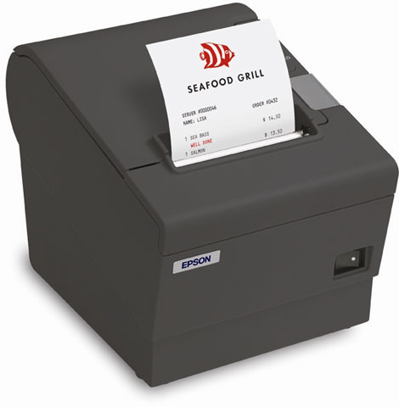
A Verifiable Receipt

Slide 94

A Verifiable Receipt

Slide 95
A Verifiable Receipt
Precinct 37 – Machine 4
Nov. 6, 2012 1:39PM
Vote receipt tag:
7A34ZR9K4BX
***VOTE COMFIRMED***

Slide 96
The Voter’s Perspective

Slide 97
The Voter’s Perspective
Voters can …

Slide 98
The Voter’s Perspective
Voters can …
Use receipts to check their results are properly recorded on a public web site.

Slide 99
The Voter’s Perspective
Voters can …
Use receipts to check their results are properly recorded on a public web site.
Throw their receipts in the trash.

Slide 100
The Voter’s Perspective
Voters can …

Slide 101
The Voter’s Perspective
Voters can …
Write their own applications to verify the mathematical proof of the tally.

Slide 102
The Voter’s Perspective
Voters can …
Write their own applications to verify the mathematical proof of the tally.
Download verification apps from sources of their choice.

Slide 103
The Voter’s Perspective
Voters can …
Write their own applications to verify the mathematical proof of the tally.
Download verification apps from sources of their choice.
Believe verifications done by their political parties, LWV, ACLU, etc.

Slide 104
The Voter’s Perspective
Voters can …
Write their own applications to verify the mathematical proof of the tally.
Download verification apps from sources of their choice.
Believe verifications done by their political parties, LWV, ACLU, etc.
Accept the results without question.

Slide 105
So How Does It Work?

Slide 106
Secure MPC is not Enough

Slide 107
Secure MPC is not Enough
Secure Multi-Party Computation allows any public function to be computed on any number of private inputs without compromising the privacy of the inputs.

Slide 108
Secure MPC is not Enough
Secure Multi-Party Computation allows any public function to be computed on any number of private inputs without compromising the privacy of the inputs.
But secure MPC does not prevent parties from revealing their private inputs if they so choose.

Slide 109
End-to-End Verifiable Elections
Two principle phases …

Slide 110
End-to-End Verifiable Elections
Two principle phases …
Voters publish their names and encrypted votes.

Slide 111
End-to-End Verifiable Elections
Two principle phases …
Voters publish their names and encrypted votes.
At the end of the election, administrators compute and publish the tally together with a cryptographic proof that the tally “matches” the set of encrypted votes.

Slide 112
End-to-End Verifiable Elections
Two questions must be answered …

Slide 113
End-to-End Verifiable Elections
Two questions must be answered …
  How do voters turn their preferences into encrypted votes?

Slide 114
End-to-End Verifiable Elections
Two questions must be answered …
  How do voters turn their preferences into encrypted votes?
  How are voters convinced that the published set of encrypted votes corresponds the announced tally?

Slide 115
Is it Really This Easy?

Slide 116
Is it Really This Easy?
Yes …

Slide 117
Is it Really This Easy?
Yes …
… but there are lots of details to get right.

Slide 118
Fundamental Tallying Decision

Slide 119
Fundamental Tallying Decision
There are essentially two paradigms to choose from …

Slide 120
Fundamental Tallying Decision
There are essentially two paradigms to choose from …
Anonymized Ballots

Slide 121
Fundamental Tallying Decision
There are essentially two paradigms to choose from …
Anonymized Ballots
(Mix Networks)

Slide 122
Fundamental Tallying Decision
There are essentially two paradigms to choose from …
Anonymized Ballots
(Mix Networks)
Ballotless Tallying

Slide 123
Fundamental Tallying Decision
There are essentially two paradigms to choose from …
Anonymized Ballots
(Mix Networks)
Ballotless Tallying
(Homomorphic Encryption)

Slide 124
Anonymized Ballots

Slide 125
Ballotless Tallying

Slide 126
Homomorphic Tallying

Slide 127
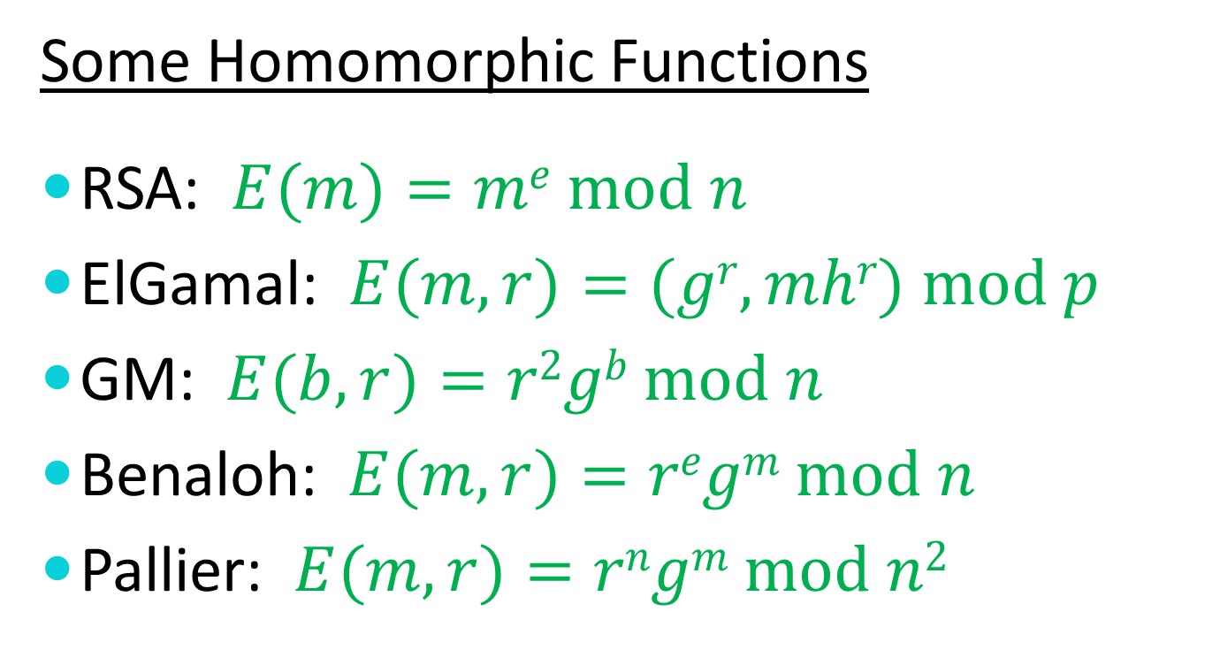
Homomorphic Encryption
Some Homomorphic Functions
RSA: $E(m)=me mod n$
ElGamal: $E(m,r)=(gr,mhr) mod p$
GM: $E(b,r)=r2gb mod n$
Benaloh: $E(m,r)=regm mod n$
Pallier: $E(m,r)=rngm mod n2$

Slide 128
Homomorphic Elections
Alice | 0
Bob | 0
Carol | 1
David | 0
Eve | 1

Slide 129
Homomorphic Elections
Alice | 0
Bob | 0
Carol | 1
David | 0
Eve | 1
 | Σ =

Slide 130
Homomorphic Elections
Alice | 0
Bob | 0
Carol | 1
David | 0
Eve | 1
 | Σ =
 | 2

Slide 131
Homomorphic Elections
Alice | 0
Bob | 0
Carol | 1
David | 0
Eve | 1

Slide 132
Homomorphic Elections
Alice | 0
Bob | 0
Carol | 1
David | 0
Eve | 1

Slide 133
Homomorphic Elections
Alice | 0
Bob | 0
Carol | 1
David | 0
Eve | 1
 | ⊗=
 | 2

Slide 134
Homomorphic Elections
Alice | 0
Bob | 0
Carol | 1
David | 0
Eve | 1
 | ⊗=
 | 2

Slide 135
Homomorphic Elections
Alice | 0
Bob | 0
Carol | 1
David | 0
Eve | 1
 | ⊗=
 | 2

Slide 136
Multiple Authorities
Alice | 0
Bob | 0
Carol | 1
David | 0
Eve | 1

Slide 137
Homomorphic Encryption
The product of the encryptions of the votes constitutes an encryption of the sum of the votes.

Slide 138
Multiple Authorities
 |  |  | X₁ | X₂ | X₃
Alice | 0 | = Σ | 3 | -5 | 2
Bob | 0 | = Σ | -4 | 5 | -1
Carol | 1 | = Σ | 2 | -3 | 2
David | 0 | = Σ | -2 | -1 | 3
Eve | 1 | = Σ | 4 | -1 | -2

Slide 139
Multiple Authorities
 |  |  | X₁ | X₂ | X₃
Alice | 0 | = Σ | 3 | -5 | 2
Bob | 0 | = Σ | -4 | 5 | -1
Carol | 1 | = Σ | 2 | -3 | 2
David | 0 | = Σ | -2 | -1 | 3
Eve | 1 | = Σ | 4 | -1 | -2
 |  |  | Σ = | Σ = | Σ =

Slide 140
Multiple Authorities
 |  |  | X₁ | X₂ | X₃
Alice | 0 | = Σ | 3 | -5 | 2
Bob | 0 | = Σ | -4 | 5 | -1
Carol | 1 | = Σ | 2 | -3 | 2
David | 0 | = Σ | -2 | -1 | 3
Eve | 1 | = Σ | 4 | -1 | -2
 |  |  | Σ = | Σ = | Σ =
 |  |  | 3 | -5 | 4

Slide 141
Multiple Authorities
 |  |  | X₁ | X₂ | X₃
Alice | 0 | = Σ | 3 | -5 | 2
Bob | 0 | = Σ | -4 | 5 | -1
Carol | 1 | = Σ | 2 | -3 | 2
David | 0 | = Σ | -2 | -1 | 3
Eve | 1 | = Σ | 4 | -1 | -2
 |  |  | Σ = | Σ = | Σ =
 |  | = Σ | 3 | -5 | 4

Slide 142
Multiple Authorities
 |  |  | X₁ | X₂ | X₃
Alice | 0 | = Σ | 3 | -5 | 2
Bob | 0 | = Σ | -4 | 5 | -1
Carol | 1 | = Σ | 2 | -3 | 2
David | 0 | = Σ | -2 | -1 | 3
Eve | 1 | = Σ | 4 | -1 | -2
 |  |  | Σ = | Σ = | Σ =
 | 2 | = Σ | 3 | -5 | 4

Slide 143
Multiple Authorities
 |  |  | X₁ | X₂ | X₃
Alice | 0 | = Σ | 3 | -5 | 2
Bob | 0 | = Σ | -4 | 5 | -1
Carol | 1 | = Σ | 2 | -3 | 2
David | 0 | = Σ | -2 | -1 | 3
Eve | 1 | = Σ | 4 | -1 | -2
 | Σ = |  | Σ = | Σ = | Σ =
 | 2 | = Σ | 3 | -5 | 4

Slide 144
Multiple Authorities
The sum of the shares of the votes constitute shares of the sum of the votes.

Slide 145
Multiple Authorities
 |  |  | X₁ | X₂ | X₃
Alice | 0 | = Σ | 3 | -5 | 2
Bob | 0 | = Σ | -4 | 5 | -1
Carol | 1 | = Σ | 2 | -3 | 2
David | 0 | = Σ | -2 | -1 | 3
Eve | 1 | = Σ | 4 | -1 | -2
 | Σ = |  | Σ = | Σ = | Σ =
 | 2 | = Σ | 3 | -5 | 4

Slide 146
Multiple Authorities
 |  |  | X₁ | X₂ | X₃
Alice | 0 |  | 3 | -5 | 2
Bob | 0 |  | -4 | 5 | -1
Carol | 1 |  | 2 | -3 | 2
David | 0 |  | -2 | -1 | 3
Eve | 1 |  | 4 | -1 | -2

Slide 147
Multiple Authorities
 |  |  | X₁ | X₂ | X₃
Alice | 0 |  | 3 | -5 | 2
Bob | 0 |  | -4 | 5 | -1
Carol | 1 |  | 2 | -3 | 2
David | 0 |  | -2 | -1 | 3
Eve | 1 |  | 4 | -1 | -2
 |  |  | ⊗ = | ⊗ = | ⊗ =

Slide 148
Multiple Authorities
 |  |  | X₁ | X₂ | X₃
Alice | 0 |  | 3 | -5 | 2
Bob | 0 |  | -4 | 5 | -1
Carol | 1 |  | 2 | -3 | 2
David | 0 |  | -2 | -1 | 3
Eve | 1 |  | 4 | -1 | -2
 |  |  | ⊗ = | ⊗ = | ⊗ =
 |  |  | 3 | -5 | 4

Slide 149
Multiple Authorities
 |  |  | X₁ | X₂ | X₃
Alice | 0 |  | 3 | -5 | 2
Bob | 0 |  | -4 | 5 | -1
Carol | 1 |  | 2 | -3 | 2
David | 0 |  | -2 | -1 | 3
Eve | 1 |  | 4 | -1 | -2
 |  |  | ⊗ = | ⊗ = | ⊗ =
 |  |  | 3 | -5 | 4

Slide 150
Multiple Authorities
 |  |  | X₁ | X₂ | X₃
Alice | 0 |  | 3 | -5 | 2
Bob | 0 |  | -4 | 5 | -1
Carol | 1 |  | 2 | -3 | 2
David | 0 |  | -2 | -1 | 3
Eve | 1 |  | 4 | -1 | -2
 |  |  | ⊗ = | ⊗ = | ⊗ =
 |  | = Σ | 3 | -5 | 4

Slide 151
Multiple Authorities
 |  |  | X₁ | X₂ | X₃
Alice | 0 |  | 3 | -5 | 2
Bob | 0 |  | -4 | 5 | -1
Carol | 1 |  | 2 | -3 | 2
David | 0 |  | -2 | -1 | 3
Eve | 1 |  | 4 | -1 | -2
 |  |  | ⊗ = | ⊗ = | ⊗ =
 | 2 | = Σ | 3 | -5 | 4

Slide 152
Double Commutivity
The product of the encryptions of the shares of the votes constitute an encryption of a share the sum of the votes.

Slide 153
Robust Sharing

Slide 154
Robust Sharing
Note that votes can be “shared” with a polynomial threshold scheme instead of a simple sum.

Slide 155
Robust Sharing
Note that votes can be “shared” with a polynomial threshold scheme instead of a simple sum.
This provides robustness in case one or more trustees fails to properly decrypt their shares.

Slide 156
Mix-Based Elections

Slide 157
The Mix-Net Paradigm
MIX

Slide 158
The Mix-Net Paradigm
MIX

Slide 159
The Mix-Net Paradigm
MIX

Slide 160
The Mix-Net Paradigm
MIX

Slide 161
The Mix-Net Paradigm
MIX
Vote
Vote
Vote
Vote

Slide 162
The Mix-Net Paradigm
MIX
Vote
Vote
Vote
Vote

Slide 163
Multiple Mixes

Slide 164
Multiple Mixes

Slide 165
Multiple Mixes

Slide 166
Multiple Mixes
MIX

Slide 167
Multiple Mixes
MIX

Slide 168
Multiple Mixes
MIX

Slide 169
Multiple Mixes
MIX

Slide 170
Multiple Mixes
MIX

Slide 171
Multiple Mixes
MIX
MIX

Slide 172
Multiple Mixes
MIX
MIX

Slide 173
Multiple Mixes
MIX
MIX

Slide 174
Multiple Mixes
MIX
MIX
Vote
Vote
Vote
Vote

Slide 175
Multiple Mixes


MIX
❖
MIX
Vote

Vote




◎
Vote
☺
Vote

✵

Slide 176
Decryption Mix-net

Slide 177
Decryption Mix-net
  Each object is encrypted with a pre-determined set of encryption layers.

Slide 178
Decryption Mix-net
  Each object is encrypted with a pre-determined set of encryption layers.
  Each mix, in pre-determined order performs a decryption to remove its associated layer.

Slide 179
Re-encryption Mix-net

Slide 180
Re-encryption Mix-net
  The decryption and shuffling functions are decoupled.

Slide 181
Re-encryption Mix-net
  The decryption and shuffling functions are decoupled.
  Mixes can be added or removed dynamically with robustness.

Slide 182
Re-encryption Mix-net
  The decryption and shuffling functions are decoupled.
  Mixes can be added or removed dynamically with robustness.
  Proofs of correct mixing can be published and independently verified.

Slide 183
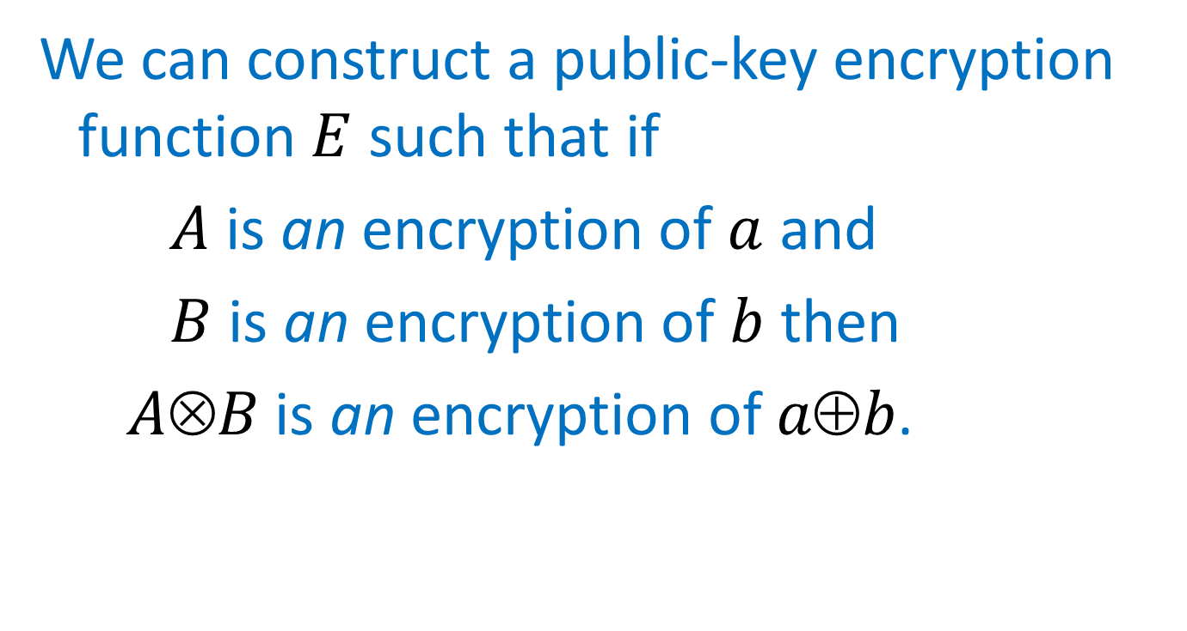
More Homomorphic Encryption
We can construct a public-key encryption function $E$ such that if
$A$ is an encryption of $a$ and
$B$ is an encryption of $b$ then
$AB$ is an encryption of $ab$.

Slide 184
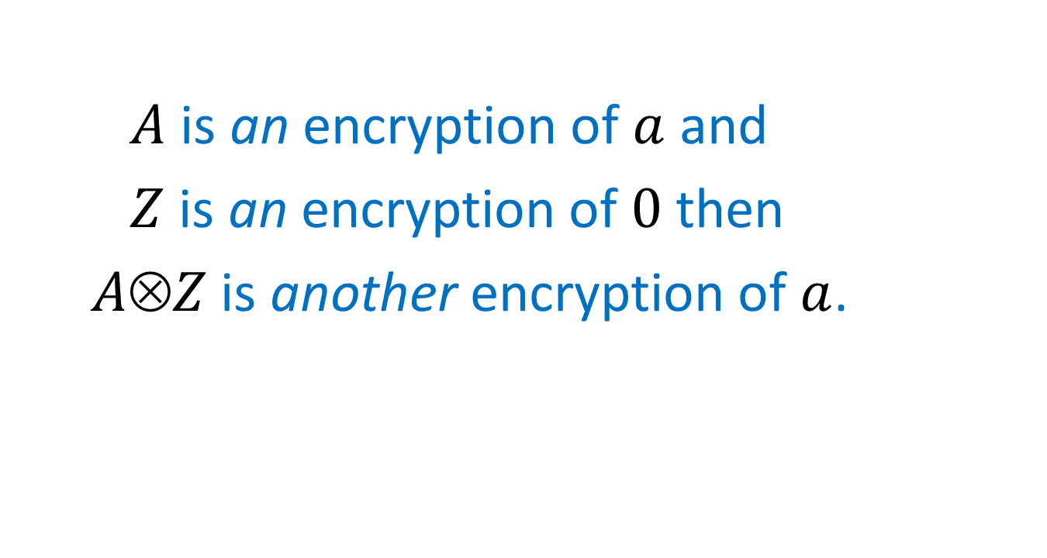
Re-encryption (additive)
$A$ is an encryption of $a$ and
$Z$ is an encryption of $0$ then
$AZ$ is another encryption of $a$.

Slide 185
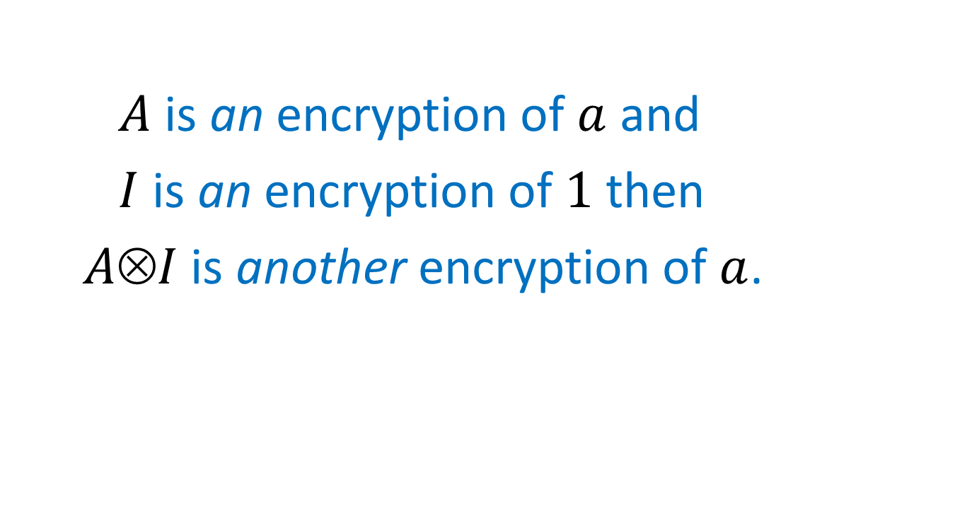
Re-encryption (multiplicative)
$A$ is an encryption of $a$ and
$I$ is an encryption of $1$ then
$AI$ is another encryption of $a$.

Slide 186
A Re-encryption Mix
MIX

Slide 187
A Re-encryption Mix
MIX

Slide 188
A Re-encryption Mix
MIX

Slide 189
A Re-encryption Mix
MIX

Slide 190
A Re-encryption Mix
MIX

Slide 191
A Re-encryption Mix
MIX

Slide 192
Re-encryption Mix-nets
MIX
MIX

Slide 193
Re-encryption Mix-nets
MIX
MIX

Slide 194
Re-encryption Mix-nets
MIX
MIX

Slide 195
Re-encryption Mix-nets
MIX
MIX

Slide 196
Re-encryption Mix-nets
MIX
MIX

Slide 197
Re-encryption Mix-nets
MIX
MIX

Slide 198
Re-encryption Mix-nets
MIX
MIX

Slide 199
Re-encryption Mix-nets
MIX
MIX

Slide 200
Re-encryption Mix-nets
MIX
MIX

Slide 201
Re-encryption Mix-nets
MIX
MIX

Slide 202
Re-encryption Mix-nets
MIX
MIX
Vote
Vote
Vote
Vote

Slide 203
Verifiability

Slide 204
Verifiability
Each re-encryption mix provides a mathematical proof that its output is a permutation of re-encryptions of its input.

Slide 205
Verifiability
Each re-encryption mix provides a mathematical proof that its output is a permutation of re-encryptions of its input.
Any observer can verify this proof.

Slide 206
Verifiability
Each re-encryption mix provides a mathematical proof that its output is a permutation of re-encryptions of its input.
Any observer can verify this proof.
The decryptions are also proven to be correct.

Slide 207
Verifiability
Each re-encryption mix provides a mathematical proof that its output is a permutation of re-encryptions of its input.
Any observer can verify this proof.
The decryptions are also proven to be correct.
If a mix’s proof is invalid, its mixing will be bypassed.

Slide 208
Recent Mix Work
1993 Park, Itoh, and Kurosawa
1995 Sako and Kilian
2001 Furukawa and Sako
2001 Neff
2002 Jakobsson, Juels, and Rivest
2003 Groth

Slide 209
Re-encryption Mix Operation
MIX

Slide 210
Re-encryption Mix Operation
Input Ballot Set
MIX

Slide 211
Re-encryption Mix Operation
Input Ballot Set
Output Ballot Set
MIX

Slide 212
Re-encryption Mix Operation
Input Ballot Set
Output Ballot Set
Re-encryptions

Slide 213
Re-encryption

Slide 214
Re-encryption
Each value is re-encrypted homomorphically.

Slide 215
Re-encryption
Each value is re-encrypted homomorphically.
This can be done without knowing the decryptions.

Slide 216
Verifying a Re-encryption

Slide 217
Verifying a Re-encryption
A prover could simply reveal the specifics of the “blinding factors” used for re-encryption, but this would also reveal the permutation.

Slide 218
Verifying a Re-encryption
A prover could simply reveal the specifics of the “blinding factors” used for re-encryption, but this would also reveal the permutation.
Instead, an interactive proof can be performed to demonstrate the equivalence of the input and output ballot sets.

Slide 219
Verifying a Re-encryption
A prover could simply reveal the specifics of the “blinding factors” used for re-encryption, but this would also reveal the permutation.
Instead, an interactive proof can be performed to demonstrate the equivalence of the input and output ballot sets.
The Fiat-Shamir heuristic can be used to “publish” the proof.

Slide 220
The Encryption

Slide 221
The Encryption
Anyone with the decryption key can read all of the votes – even before mixing.

Slide 222
The Encryption
Anyone with the decryption key can read all of the votes – even before mixing.
A threshold encryption scheme is used to distribute the decryption capabilities.

Slide 223
Most Verifiable Election Protocols

Slide 224
Most Verifiable Election Protocols
Step 1

Slide 225
Most Verifiable Election Protocols
Step 1
  Encrypt your vote and …

Slide 226
Most Verifiable Election Protocols
Step 1
  Encrypt your vote and …
  How?

Slide 227
How do Humans Encrypt?

Slide 228
How do Humans Encrypt?
If voters encrypt their votes with devices of their own choosing, they are subject to coercion and compromise.

Slide 229
How do Humans Encrypt?
If voters encrypt their votes with devices of their own choosing, they are subject to coercion and compromise.
If voters encrypt their votes on “official” devices, how can they trust that their intentions have been properly captured?

Slide 230
The Human Encryptor
  We need to find ways to engage humans in an interactive proof process to ensure that their intentions are accurately reflected in encrypted ballots cast on their behalf.

Slide 231
MarkPledge Ballot
Alice | 367 | 248 | 792 | 141 | 390 | 863 | 427 | 015
Bob | 629 | 523 | 916 | 504 | 129 | 077 | 476 | 947
Carol | 285 | 668 | 049 | 732 | 859 | 308 | 156 | 422
David | 863 | 863 | 863 | 863 | 863 | 863 | 863 | 863
Eve | 264 | 717 | 740 | 317 | 832 | 399 | 441 | 946

Slide 232
MarkPledge Ballot
Alice | 367 | 248 | 792 | 141 | 390 | 863 | 427 | 015
Bob | 629 | 523 | 916 | 504 | 129 | 077 | 476 | 947
Carol | 285 | 668 | 049 | 732 | 859 | 308 | 156 | 422
David | 863 | 863 | 863 | 863 | 863 | 863 | 863 | 863
Eve | 264 | 717 | 740 | 317 | 832 | 399 | 441 | 946

Slide 233
MarkPledge Ballot
Alice | 367 | 248 | 792 | 141 | 390 | 863 | 427 | 015
Bob | 629 | 523 | 916 | 504 | 129 | 077 | 476 | 947
Carol | 285 | 668 | 049 | 732 | 859 | 308 | 156 | 422
David | 863 | 863 | 863 | 863 | 863 | 863 | 863 | 863
Eve | 264 | 717 | 740 | 317 | 832 | 399 | 441 | 946
Device commitment to voter: “You’re candidate’s number is 863.”

Slide 234
MarkPledge Ballot
Alice | 367 | 248 | 792 | 141 | 390 | 863 | 427 | 015
Bob | 629 | 523 | 916 | 504 | 129 | 077 | 476 | 947
Carol | 285 | 668 | 049 | 732 | 859 | 308 | 156 | 422
David | 863 | 863 | 863 | 863 | 863 | 863 | 863 | 863
Eve | 264 | 717 | 740 | 317 | 832 | 399 | 441 | 946
Device commitment to voter: “You’re candidate’s number is 863.”
Voter challenge: “Decrypt column number 5.”

Slide 235
MarkPledge Ballot
Alice | 367 | 248 | 792 | 141 | 390 | 863 | 427 | 015
Bob | 629 | 523 | 916 | 504 | 129 | 077 | 476 | 947
Carol | 285 | 668 | 049 | 732 | 859 | 308 | 156 | 422
David | 863 | 863 | 863 | 863 | 863 | 863 | 863 | 863
Eve | 264 | 717 | 740 | 317 | 832 | 399 | 441 | 946
Device commitment to voter: “You’re candidate’s number is 863.”
Voter challenge: “Decrypt column number 5.”

Slide 236
MarkPledge Ballot
Alice | 367 | 248 | 792 | 141 | 390 | 863 | 427 | 015
Bob | 629 | 523 | 916 | 504 | 129 | 077 | 476 | 947
Carol | 285 | 668 | 049 | 732 | 859 | 308 | 156 | 422
David | 863 | 863 | 863 | 863 | 863 | 863 | 863 | 863
Eve | 264 | 717 | 740 | 317 | 832 | 399 | 441 | 946

Slide 237
Prêt à Voter Ballot
Bob
Eve
Carol
Alice
David
 | 17320508

Slide 238
Prêt à Voter Ballot
Bob
Eve
Carol
Alice | X
David
 | 17320508

Slide 239
Prêt à Voter Ballot
 | X
 | 17320508

Slide 240
PunchScan Ballot
Y – Alice
X – Bob
#001
X
Y

Slide 241
PunchScan Ballot
Y – Alice
X – Bob
#001
Y
X

Slide 242
PunchScan Ballot
X – Alice
Y – Bob
#001
Y
X

Slide 243
PunchScan Ballot
X – Alice
Y – Bob
#001
Y
X

Slide 244
PunchScan Ballot
X – Alice
Y – Bob
#001
#001
Y
X

Slide 245
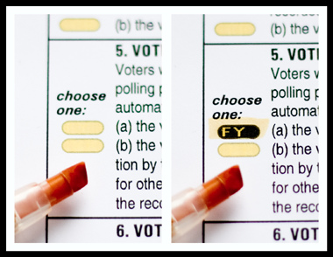
Scantegrity

Slide 246
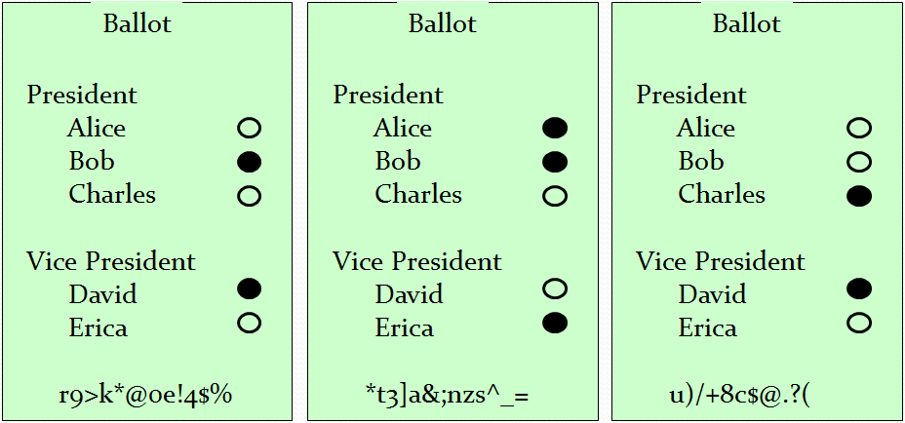
Three-Ballot

Slide 247
Voter-Initiated Auditing

Slide 248
Voter-Initiated Auditing
Voter can use “any” device to make selections (touch-screen DRE, OpScan, etc.)

Slide 249
Voter-Initiated Auditing
Voter can use “any” device to make selections (touch-screen DRE, OpScan, etc.)
After selections are made, voter receives an encrypted receipt of the ballot.

Slide 250

Voter-Initiated Auditing
734922031382
Encrypted Vote

Slide 251
Voter-Initiated Auditing
Voter choice: Cast or Challenge
734922031382
Encrypted Vote

Slide 252
Voter-Initiated Auditing
Cast
734922031382

Slide 253
Voter-Initiated Auditing
Challenge
734922031382

Slide 254

Voter-Initiated Auditing
Challenge

Slide 255
Voter-Initiated Auditing
Challenge

Slide 256
Voter-Initiated Auditing
Challenge
Vote for Alice
Random # is
28637582738

Slide 257
Ballot Casting Assurance
The voter front ends shown here differ in both their human factors qualities and the level of assurance that they offer.
All are feasible and provide greater integrity than current methods.

Slide 258
True Verifiability
The end-to-end verifiable election technologies described here allow individuals to choose who to trust.
Individuals are not forced to trust officials with special status. They can depend on verifications from entities of their choice.
Sufficiently paranoid individuals can check everything for themselves.

Slide 259
Real-World Deployments

Slide 260
Real-World Deployments
Helios (www.heliosvoting.org) – Ben Adida and others
  Remote electronic voting system using voter-initiated auditing and homomorphic backend.
  Used to elect president of UC Louvain, Belgium.
  Used in Princeton University student government.
  Used to elect IACR Board of Directors.

Slide 261
Real-World Deployments
Helios (www.heliosvoting.org) – Ben Adida and others
  Remote electronic voting system using voter-initiated auditing and homomorphic backend.
  Used to elect president of UC Louvain, Belgium.
  Used in Princeton University student government.
  Used to elect IACR Board of Directors.
Scantegrity II (www.scantegrity.org) – David Chaum, Ron Rivest, many others.
  Optical scan system with codes revealed by invisible ink markers and “plugboard-mixnet” backend.
  Used for municipal elections in Takoma Park, MD.

Slide 262
End-to-End Verifiability

Slide 263
End-to-End Verifiability
… is a fundamentally different paradigm,

Slide 264
End-to-End Verifiability
… is a fundamentally different paradigm,
… is not just a security enhancement,

Slide 265
End-to-End Verifiability
… is a fundamentally different paradigm,
… is not just a security enhancement,
… democratizes the electoral process,

Slide 266
End-to-End Verifiability
… is a fundamentally different paradigm,
… is not just a security enhancement,
… democratizes the electoral process,
… but it is not a panacea.

Slide 267
End-to-End System Properties

Slide 268
End-to-End System Properties
Accuracy/Integrity

Slide 269
End-to-End System Properties
Accuracy/Integrity
– enormously improved

Slide 270
End-to-End System Properties
Accuracy/Integrity
– enormously improved
Privacy/Coercion

Slide 271
End-to-End System Properties
Accuracy/Integrity
– enormously improved
Privacy/Coercion
– not substantially changed

Slide 272
End-to-End System Properties
Accuracy/Integrity
– enormously improved
Privacy/Coercion
– not substantially changed
Reliability/Survivability

Slide 273
End-to-End System Properties
Accuracy/Integrity
– enormously improved
Privacy/Coercion
– not substantially changed
Reliability/Survivability
– not substantially changed

Slide 274
End-to-End System Properties
Accuracy/Integrity
– enormously improved
Privacy/Coercion
– not substantially changed
Reliability/Survivability
– not substantially changed
Usability/Comprehensibility

Slide 275
End-to-End System Properties
Accuracy/Integrity
– enormously improved
Privacy/Coercion
– not substantially changed
Reliability/Survivability
– not substantially changed
Usability/Comprehensibility
– not substantially changed

Slide 276
Is There any Deployment Hope?
The U.S. Election Assistance Commission is considering new guidelines.
These guidelines explicitly include an “innovation class” which could be satisfied by truly verifiable election systems.
Election supervisors must choose to take this opportunity to change the paradigm.
However, a bill was recently introduced in Congress that explicitly precludes use of crypto.

