Slide 1
Block Ciphers
John Manferdelli
jmanfer@microsoft.com
JohnManferdelli@hotmail.com
© 2004-2011, John L. Manferdelli.
This material is provided without warranty of any kind including, without limitation, warranty of non-infringement or suitability for any purpose. This material is not guaranteed to be error free and is intended for instructional use only

Slide 2
The wiretap channel: “In the beginning”
The Sender
Alice
The Receiver
Bob
Noisy insecure
channel
Plaintext
(P)
Encrypt
Decrypt
Plaintext
(P)
Key (K₁)
Key (K₂)
Message sent is:
C= E_{K1}(P)
Decrypted as:
P=D_{K2}(C)
P is called plaintext.
C is called ciphertext.
Eavesdropper
Symmetric Key: K₁=K₂
Public Key: K₁¹K₂
K₁ is publicly known
K₂ is Bob’s secret

Slide 3
Cryptography and adversaries
Cryptography is computing in the presence of an adversary.
What do you want to protect?
Against who?
Under what circumstances?
An adversary is characterized by:
Talent
Access to information
Probable plaintext attacks.
Known plaintext/ciphertext attacks.
Chosen plaintext attacks.
Adaptive interactive chosen plaintext attacks (oracle model).
Computational resources

Slide 4
Computational strength of adversary
Infinite - Perfect Security
Information Theoretic
Doesn’t depend on computing resources or time available
Polynomial
Asymptotic measure of computing power
Indicative but not dispositive
Realistic
The actual computing resources under known or suspected attacks.
This is us, low brow.

Slide 5
Symmetric ciphers
Encrypt
E_{k}(P)
Ciphertext (C)
Plaintext (P)
Decrypt
D_{k}(P)
Plaintext (P)
Key (k)
Key (k)
Encryption and Decryption use the same key.
The transformations are simple and fast enough for practical implementation and use.
Two major types:
Stream ciphers: bit at a time
Block ciphers: n bits → n bits
Examples: DES, AES, RC4, A5, Enigma, SIGABA, etc.

Slide 6
Cipher Requirements
WW II
Universally available (simple, light instrumentation) – interoperability.
Compact, rugged: easy for people (soldiers) to use.
Kerckhoff’s Principle: Security in key only: We assume that the attacker knows the complete details of the cryptographic algorithm and implementation
Adversary has access to some corresponding plain and cipher-text
Now
Adversary has access to unlimited cipher-text and lots of chosen text.
Implementation in digital devices (power/speed) paramount.
Easy for computers to use.
Resistant to ridiculous amount of computing power.

Slide 7
Practical attacks
Exhaustive search of theoretical key space.
Exhaustive search of actual key space as restricted by poor practice.
Exploiting bad key management or storage.
Stealing keys.
Exploiting encryption errors.
Spoofing (ATM PIN).
Leaking due to size, position, language choice, frequency, inter-symbol transitions, timing differences, side channels..

Slide 8
Mathematical view of block ciphers
E(k, x)= y.
E: GF(2)^{m}xGF(2)^{n} GF(2)^{n}, often m=n.
E(k,x) is a bijection in second variable.
E(k, ·) in S_{N}, N= 2^{n}. In other words, k selects a permutation from S_{N}. If n=64, N=2⁶⁴ and |S_{N}|= 2⁶⁴! which is enormous
Each bit position is a balanced boolean function.
E (and its inverse) should be easy to compute if you know k but not if you don’t.

Slide 9
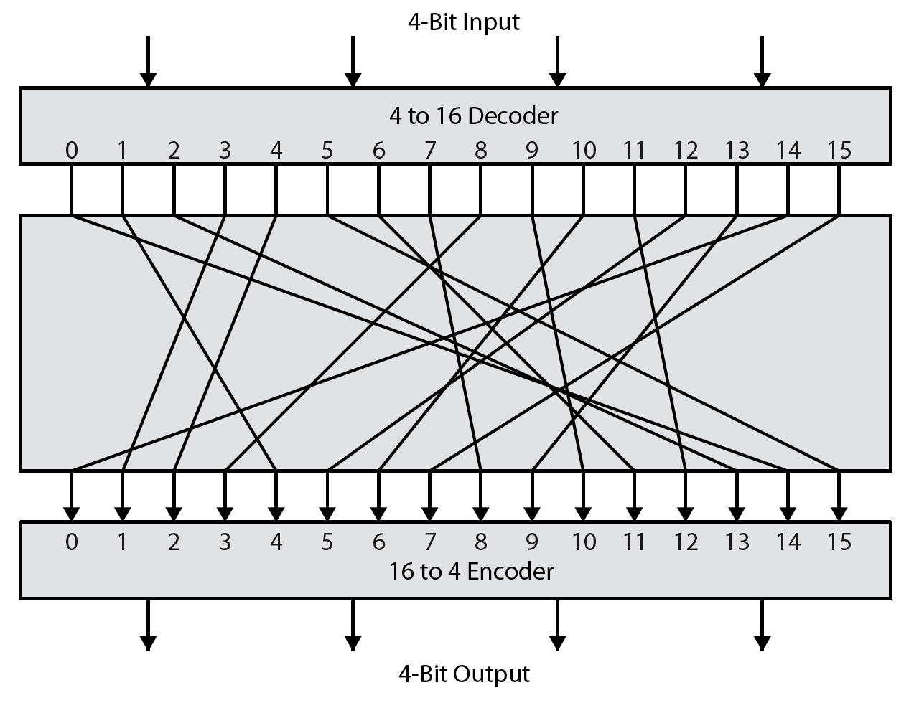
What is a block cipher
Notes:
Feistel refers to an n-bit general substitution as an ideal block cipher, because it allows for the maximum number of possible encryption mappings from the plaintext to ciphertext block. A 4-bit input produces one of 16 possible input states, which is mapped by the substitution cipher into a unique one of 16 possible output states, each of which is represented by 4 ciphertext bits. The encryption and decryption mappings can be defined by a tabulation, as shown in Stallings Figure 3.1. It illustrates a tiny 4-bit substitution to show that each possible input can be arbitrarily mapped to any output - which is why its complexity grows so rapidly.

Slide 10
Iterated key dependant transformations
Building an unpredictable or random permutation is easy if you’re allowed to use enormous keys.
Each bit position must be a horribly complicated function of key and input to defeat cryptanalysis
Lots of constraints must be satisfied (bijection, balance, …)
How do we do this?
Use a simple (key dependant) transformation (called a “round”) and apply it many (~n) times.
The simple transformation must change for each round otherwise E_{k}(x)= s_{k}(x)^{r} which is not safe.
Easiest way to do this is to make the simple transformation depend on different portions of the key in each round. This is called a “key schedule”.

Slide 11
Block ciphers -review
Complicated keyed invertible functions constructed from iterated elementary rounds.
Characteristics:
Fast
Data encrypted in fixed “block sizes” (64,128,256 bit blocks are common).
Key and message bits non-linearly mixed in cipher-text

Slide 12
Horst Feistel to the rescue!
f
k_{i}
Graphic courtesy of Josh Benaloh
F(K_{i},X)= non-linear function
Note: If s_{i}(L,R)= (LÅf(E(R)Åk_{i}), R) and t(L, R)= (R, L), this round is ts_{i}(L, R).
To invert: swap halves and apply same transform with same key:
s_{i}tts_{i}(L,R)= (L,R).

Slide 13
Iterated Feistel Cipher
Key
Key Schedule
Plaintext
k₁
k₂
r Feistel
Rounds
k_{r}
Ciphertext

Slide 14
Data Encryption Standard
Federal History
1972 study.
RFP: 5/73, 8/74.
NSA: S-Box influence, key size reduction.
Published in Federal Register: 3/75.
FIPS 46: January, 1976.
DES
Descendant of Feistel’s Lucifer.
Designers: Horst Feistel, Walter Tuchman, Don Coppersmith, Alan Konheim, Edna Grossman, Bill Notz, Lynn Smith, and Bryant Tuckerman.
Brute Force Cracking
EFS DES Cracker: $250K, 1998. 1,536 custom chips. Can brute force a DES key in days.
Deep Crack and distributed net break a DES key in 22.25 hours.

Slide 15
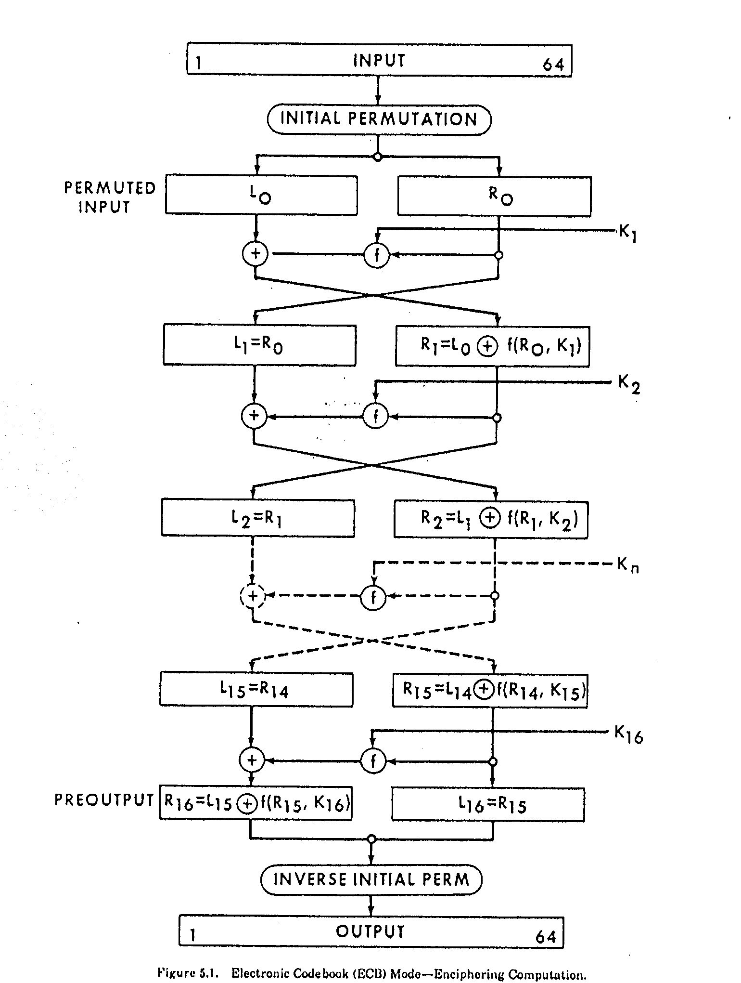

Slide 16
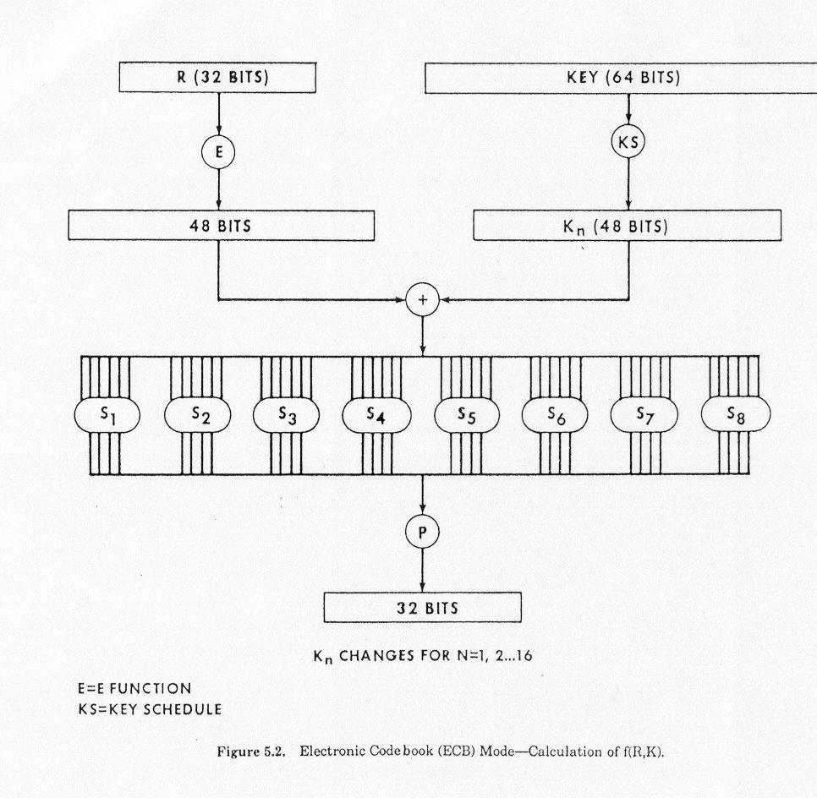

Slide 17
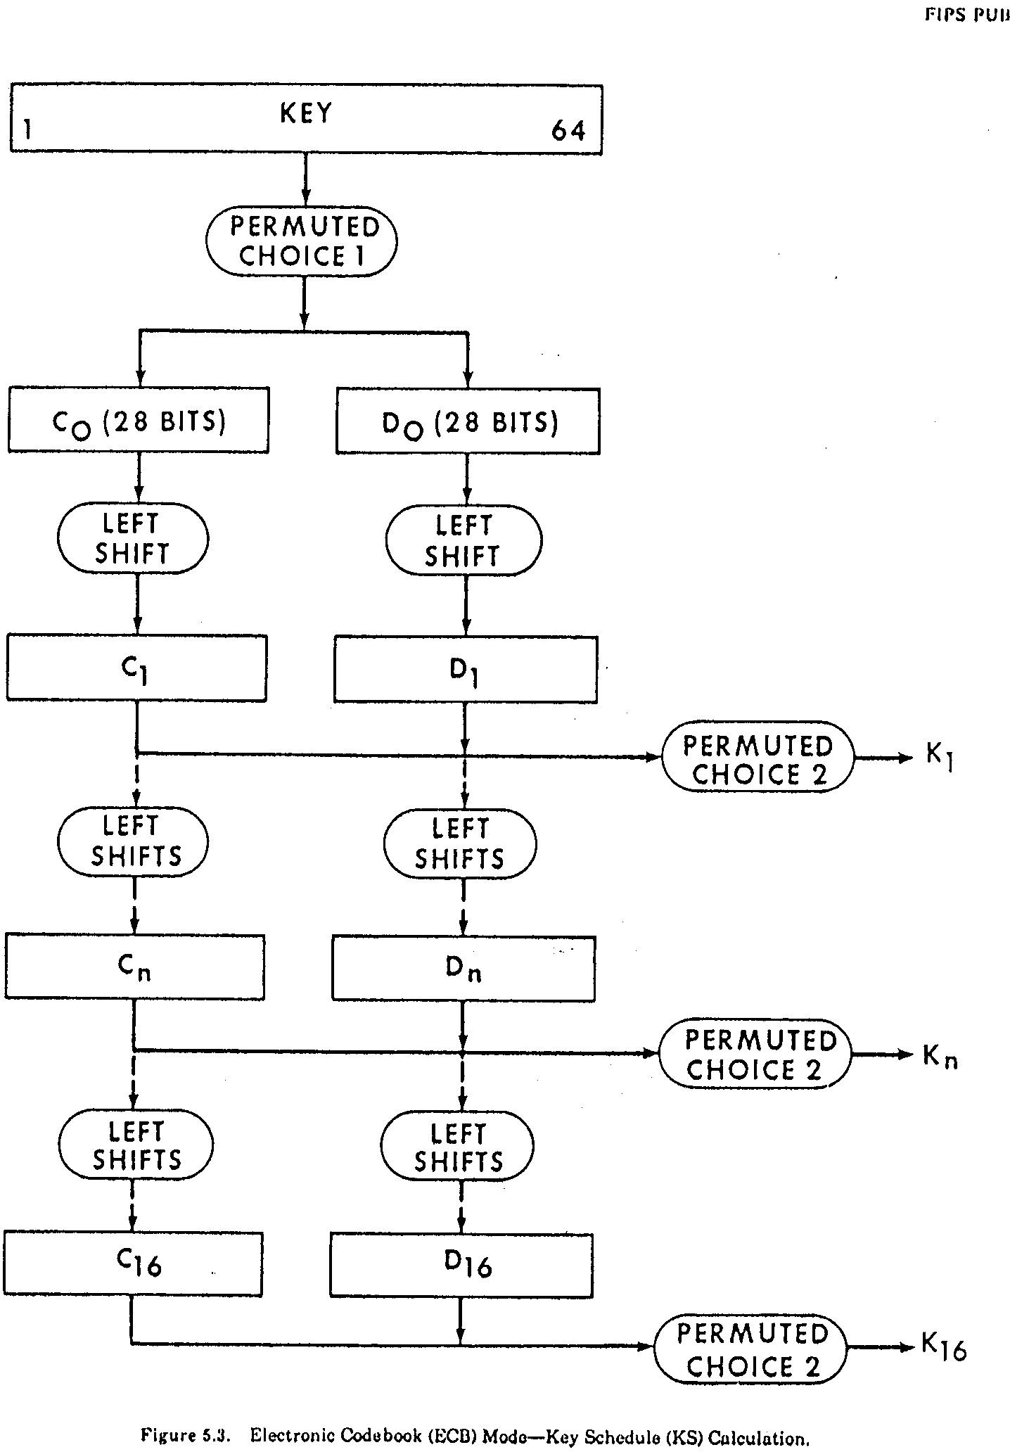

Slide 18
DES Described Algebraically
s_{i}(L,R)= (LÅf(E(R)Åk_{i}), R)
k_{i} is 48 bit sub-key for round i.
f(x)= P(S₁S₂S₃ … S₈(x)). Each S –box operates on 6 bit quantities and outputs 4 bit quantities.
P permutes the resulting 32 output bits.
t(L, R)= (R, L).
Each round (except last) is ts_{i.}
Note that tt= t²= 1= s_{i} s_{i} = s_{i}².
Full DES is: DES_{K}(x)= IP⁻¹ s₁₆t ... s₃t s₂ts₁ IP(x).
So its inverse is: DES_{K}⁻¹(x)= IP⁻¹ s₁t ... s₁₄ts₁₅ts₁₆ IP(x).

Slide 19
DES Key Schedule
Key schedule round 1
10 51 34 60 49 17 33 57 2 9 19 42
3 35 26 25 44 58 59 1 36 27 18 41
22 28 39 54 37 4 47 30 5 53 23 29
61 21 38 63 15 20 45 14 13 62 55 31
Key schedule round 2
2 43 26 52 41 9 25 49 59 1 11 34
60 27 18 17 36 50 51 58 57 19 10 33
14 20 31 46 29 63 39 22 28 45 15 21
53 13 30 55 7 12 37 6 5 54 47 23

Slide 20
What can go wrong
Key space is too small
E_{k}(x)= r_{r} r_{r-1} … r₁, all linear in the key bits.
Resulting transformation is linear
It’s easy to solve the resulting linear equations
E_{k}(x) decomposible into transformations with independent key bits
E_{k1||k2}(x)= E’_{k1}(x)||E’’_{k2}(x)
E_{k}(x) should “look” like a random permutation and the effect of k should “look” like it picks the random permutations unpredictibly

Slide 21
DES Attacks: Exhaustive Search
Symmetry DES(kÅ1, xÅ1)=DES(k, x)Å1
Suppose we know plain/cipher text pair (p,c)
for(k=0;k<2⁵⁶;k++) {
if(DES(k,p)==c) {
printf(“Key is %x\n”, k);
break;
}
}
Expected number of trials (if k was chosen at random) before success: 2⁵⁵

Slide 22
Random mappings
Let F_{n} denote all functions (mappings) from a finite domain of size n to a finite co-domain of size n
Every mapping is equally likely to be chosen, |F_{n}| = n^{n} the probability of choosing a particular mapping is 1/ n^{n}
Example. f : {1, 2, …, 13} → {1, 2, …, 13}
As n tends to infinity, the following are expectations of some parameters associated with a random point in {1, 2, …, n} and a random function from F_{n}: (i) tail length: √(πn/8) (ii) cycle length: √( π n/8) (iii) rho-length: √ (π n/2).
Graphic by Maithili Narasimha

Slide 23
Time memory trade off (“TMTO”)
If we can pre-compute a table of (k, E_{k}(x)) for a fixed x, then given corresponding (x,c) we can find the key in O(1) time.
Trying random keys takes O(N) time (where N, usually, 2^{k}, is the number of possible keys)
Can we balance “memory” and “time” resources?
It is not a 50-50 proposition. Hellman showed we could cut the search time to O(N^{(1/2)}) by pre-computing and storing O(N^{(1/2)}) values.

Slide 24
Group theory and DES
What is the minimum length of a product of involutions from a fixed set required to generate S_{n}?
What does this have to do with the number of rounds in a cipher?
How does this affect the increased security by “enciphering twice” with different keys?
Theorem (Coppersmith and Grossman): If s_{K}(L,R)= (LÅf(E(R)ÅK , R), <t, s_{K}>= A_{N}, N= 2^{n}.
Note (Netto): If a and b are chosen at random from S_{n} there is a good chance (~¾) that <a,b>= A_{n} or S_{n} .

Slide 25
Weak Keys
DES has:
Four weak keys k for which E_{k}(E_{k}(m))= m.
Twelve semi-weak keys which come in pairs k₁ and k₂ and are such that E_{k1}(E_{k2}(m))= m.
Weak keys are due to “key schedule” algorithm
How they arise:
A 28 bit quantity has potential symmetries of period 1, 2, 4, 7, and 14.
Suppose each of C₀ and D₀ has a symmetry of period 1; for example C₀ =0x0000000, D₀= 0x1111111. We can easily figure out a master key (K) that produces such a C₀ and D₀.

Slide 26
Feistel Ciphers defeat simple attacks
After 4 to 6 rounds to get flat statistics.
Parallel system attack
Solve for key bits or constrain key bits
k_{i(1)}= a₁₁(K)p₁ c₁ + a₁₂(K)p₂ c₁ +…+ a_{1N}(K)p_{n}c_{n}
… … … …
k_{i(m)}= a_{m1}(K)p₁ c₁ + a_{m2}(K)p₂ c₁ +…+ a_{mN}(K)p_{n}c_{n}
Solving Linear equations for coefficients determining cipher
c₁= f₁₁(K)p₁ + f₁₂(K)p₂ +…+ f_{1n}(K)p_{n}
c₂= f₂₁(K)p₁ + f₂₂(K)p₂ +…+ f_{2n}(K)p_{n}
… … … …
c_{m}= f_{m1}(K)p₁ + f_{m2}(K)p₂ +…+ f_{mn}(K)p_{n}
Even a weak round function can yield a strong Feistel cipher if iterated sufficiently.
Provided it’s non-linear

Slide 27
The sophisticated attacks
Exhaustive search
Differential cryptanalysis
Differentials
Linear Cryptanalysis
Linear approximations

Slide 28
Polynomial representation
If f is boolean function on n variables x₁, x₂, …, x_{n} and a=(a1, a2, …, an ) then f(x₁, x₂, …, x_{n})= S_{a}g(a) x₁^{a1} x₂^{a2} …, x_{n}^{an} where g(a) = S_{b<a} f(b₁, b₂, …, b_{n}). Here b<a means the binary representation of b does not have a 1 unless there is a corresponding 1 in the representation of a.
x₁ | x₂ | x₃ | f(x₁, x₂, x₃)
0 | 0 | 0 | 1
1 | 0 | 0 | 0
0 | 1 | 0 | 1
1 | 1 | 0 | 0
0 | 0 | 1 | 1
1 | 0 | 1 | 0
0 | 1 | 1 | 0
1 | 1 | 1 | 1
g(0,0,0)= f(0,0,0)=1
g(0,1,0)=f(0,0,0)+f(0,1,0)=0
g(1,0,0)=f(0,0,0)+f(1,0,0)=1
g(1,1,0)=f(0,0,0)+f(1,0,0) )+f(0,1,0))+f(1,1,0)=0
g(0,0,1)=f(0,0,0)+f(0,0,1)=0
g(0,1,1)=f(0,0,0)+f(0,0,1) +f(0,1,0)+f(0,1,1)=1
g(0,0,1)= g(1,0,1)= g(0,1,1)= g(1,1,1)= 0
f(x₁, x₂, x₃)= 1+x₁+x₂ x₃

Slide 29
S Boxes as Polynomials over GF(2)
1,1: 56+4+35+2+26+25+246+245+236+2356+16+15+156+14+146+145+13+135+134+1346+1345+13456+125+1256+1245+123+12356+1234+12346
1,2: C+6+5+4+45+456+36+35+34+346+26+25+24+246+2456+23+236+235+234+2346+1+15+156+134+13456+12+126+1256+124+1246+1245+12456+123+1236+1235+12356+1234+12346
1,3: C+6+56+46+45+3+35+356+346+3456+2+26+24+246+245+236+16+15+145+13+1356+134+13456+12+126+125+12456+123+1236+1235+12356+1234+12346
1,4: C+6+5+456+3+34+346+345+2+23+234+1+15+14+146+135+134+1346+1345+1256+124+1246+1245+123+12356+1234+12346
Legend: C+6+56+46 means 1Åx₆Åx₅x₆Åx₄x₆

Slide 30
Differential Cryptanalysis
Let E and E* be inputs to a cipher and C and C* be corresponding outputs with EÅE*=E’ and CÅC*=C’.
The notation E’ → C’, p means the “input xor”, E’ produces the “output xor” C’ with probability p. Not all input/output xors and possible and the distribution is uneven. This can be used to find keys. E’ → C’, p is called a characteristic.
Notation: D_{j}(x’,y’)= {u: S_{j}(u)ÅS_{j}(uÅx’)= y’}. k_{j}ÎxÅD_{j}(x’,y’)= t_{j}(x,x’,y’).
test(E_{j}, E_{j}*,C_{j}’)= t_{j}(E_{j},E_{j}Å E_{j}*’, C_{j}’)
For the characteristic 0x34→d in S-box 1 from inputs1Å35=34, D₁(34,d)= {06, 10, 16, 1c, 22, 24, 28, 32} and k_{j}Î{7, 10, 17, 1d, 23, 25, 29, 33}= 1ÅD₁(34,d)

Slide 31
Simplified DES
L₀R₀
L_{i+1}= R_{i}, each 6 bits.
R_{i+1}= L_{i}Åf(R_{i},K_{i})
K is 9 bits.
E(x)= (x₁ x₂ x₄ x₃ x₄ x₃ x₅ x₆)
S₁
101 010 001 110 011 100 111 000
001 100 110 010 000 111 101 011
S₂
100 000 110 101 111 001 011 010
101 011 000 111 110 010 001 100
K_{i} is 8 bits of K starting at i^{th} bit.
L₀
R₀
Å
F
L₁
R₁
Å
F
L₂
R₂
Å
F
Å
L₃
R₃
F
L₄
R₄
L₄ R₄

Slide 32
Differential Cryptanalysis – 3 rounds
R₄ÅR₁= f(k₃,R₂). ………. (1)
L₄ÅL₃=f (k₄,R₃). ………. (2)
R₄=R₃, L₂=R₁, L₃=R₂.
1&2→ L₄ÅL₃ÅR₂ÅL₁= f(k₂,R₁)Åf(k₄,R₃).
L₃=R₂→ L₄ÅL₁= f(k₂,R₁)Åf(k₄,R₃).
L₄ÅL₁= f(k₂,R₁)Åf(k₄,R₃). ……..(3)
L₄*ÅL₁*= f(k₂,R₁*)Åf(k₄,R₃*). ....(4)
3&4→ L₄’ÅL₁’= f(k₂,R₁*)Åf(k₄,R₃*)Åf(k₂,R₁*)Åf(k₄,R₃*).
R₁=R₁* →L₄’ÅL₁’= f(k₄,R₃)Åf(k₄,R₃*).
L₁ R₁
L₁
R₁
Å
F
L₂
R₂
Å
F
Å
L₃
R₃
F
L₄ R₄

Slide 33
Differential Cryptanalysis – 3 rounds
L₁, R₁ : 000111 011011
L₁*, R₁*: 101110 011011
L₁’, R₁’: 101001 000000
L₄, R₄ : 100101 000011
L₄*, R₄*: 011000 100100
L₄’, R₄’: 111101 100111
E(R₄) : 0000 0011
E(R₄’) : 1010 1011
L₄’ÅL₁’ : 111 101Å 101 001= 010 100.
S₁’: 1010 → 010(1001,0011).
S₂’: 1011 → 100(1100,0111).
(E(R₄ Åk₄)_{1..4}=1001|0011, k₄= 1001|0011.
(E(R₄)Åk₄)_{5..8}= 1100|0111,k₄= 1111|0100.
K= 00x001101
L₁ R₁
L₁
R₁
Å
F
L₂
R₂
Å
F
Å
L₃
R₃
F
L₄ R₄

Slide 34
Comments on Differential Cryptanalysis of full DES
# Rounds | Needed pairs | Analyzed Pairs | Bits Found | # Char rounds | Char prob | S/N | Chosen Plain
4 | 2³ | 2³ | 42 | 1 | 1 | 16 | 2⁴
6 | 2⁷ | 2⁷ | 30 | 3 | 1/16 | 2¹⁶ | 2⁸
8 | 2¹⁵ | 2¹³ | 30 | 5 | 1/10486 | 15.6 | 2¹⁶
16 | 2⁵⁷ | 2⁵ | 18 | 15 | 2^{-55.1} | 16 | 2⁵⁸

Slide 35
DES S-Box Design Criteria
No S-box is linear or affine function of its input.
Changing one bit in the input of an S-Box changes at least two output bits.
S-boxes were chosen to minimize the difference between the number of 1’s and 0’s when any input bit is held constant.
S(X) and S(XÅ001100) differ in at least 2 bits
S(X)¹S(XÅ11xy00)

Slide 36
1R Differential attack
L₁ R₁
L₁
R₁
Å
F
Trial decode last round with all possible subkeys, see if differential holds.
L₂
R₂
Å
F
…
Å
L_{n}
R_{n}
F
L₄ R₄

Slide 37
Linear Cryptanalysis
Basic idea:
Suppose a_{i}(P)Åb_{i}(C)=g_{i}(k) holds with g_{i}, linear, for i= 1, 2, …, m.
Each equation imposes a linear constraint and reduces key search by a factor of 2.
Guess (n-m-1) bits of key. There are 2^{(n-m-1)}. Use the constraints to get the remaining keys.
Can we find linear constraints in the “per round” functions and knit them together?
No! Per Round functions do not have linear constraints.

Slide 38
Linear Cryptanalysis
Next idea
Can we find a(P)Åb(C)= g(k) which holds with g, linear, with probability p?
Suppose a(P)Åb(C)= g(k), with probability p>.5.
Collect a lot of plain/cipher pairs.
Each will “vote” for g(k)=0 or g(k)=1.
Pick the winner.
p= 1/2+e requires ce⁻² texts (we’ll see why later).
e is called “bias”.

Slide 39
Linear Cryptanalysis Notation
Matsui numbers bits from right to left, rightmost bit is bit 0. FIPS (and everyone else) goes from left to right starting at 1. I will use the FIPS conventions. To map Matsui positions to everyone else’s:
M(i)= 64-EE(i). For 32 bits make the obvious change.
Matsui also refers to the two portions of the plaintext and cipher-text as (P_{H}, P_{L}), (C_{H}, C_{L}), we’ll stick with (P_{L}, P_{R}), (C_{L}, C_{R}).
P_{L} P_{R}
Å
Y₁
X₁
F
k₁
Y₂
X₂
Å
F
k₂
Å
Y₃
X₃
F
k₃
C_{L} C_{R}

Slide 40
Linear and near linear dependence
Here is a linear relationship over GF(2) in S5 that holds with probability 52/64 (from NS₅(010000,1111)= 12:
X[2]ÅY[1]ÅY[2]ÅY[3]ÅY[4]=K[2]Å1.
Sometimes written: X[2]ÅY[1,2,3,4]=K[2]Å1.
You can find relations like this using the “Boolean Function” techniques we describe a little later
After applying P, this becomes
X[17]ÅF(X,K)[3,8,14,25]= K[26]Å1
X_{[1..6]}
Y_{[1..4]}
S5
K_{[1..6]}

Slide 41
Linear Cryptanalysis of 3 round DES
X[17] ÅY[3,8,14,25]= K[26] Å1, p= 52/64
Round 1
X₁[17]ÅY₁[3,8,14,25]= K₁[26]Å1
P_{R}[17]ÅP_{L}[3,8,14,25]ÅR₁[3,8,14,25]=
K₁[26] Å1
Round 3
X₃[17]ÅY₃[3,8,14,25]= K₃[26]Å1
R₁[3,8,14,25]ÅC_{L}[3,8,14,25]ÅC_{R}[17]=
K₃[26] Å1
Adding the two get:
P_{R}[17]ÅP_{L}[3,8,14,25]ÅC_{L}[3,8,14,25]ÅC_{R}[17]=
K₁[26]ÅK₃[26]
Thus holds with p= (52/64)²+(12/64)²=.66
P_{L} P_{R}
L₀
R₀
Å
Y₁,
3,8,14,25
X₁, 17
F
k₁
L₁
R₁
Å
Y₂
X₂
F
k₂
L₂
R₂
Å
Y₃
X₃
F
k₃
C_{L} C_{R}

Slide 42
Piling up Lemma
Let X_{i} (1cicn) be independent random variables whose values are 0 with probability p_{i}. Then the probability that X₁ÅX₂Å ... ÅX_{n}= 0 is
½+2^{n-1} P_{[1,n]} (p_{i}-1/2)
Proof:
By induction on n. It’s tautological for n=1.
Suppose Pr[X₁ÅX₂Å ... ÅX_{n-1}= 0]= q= ½+2^{n-2} P_{[1,n-1]} (p_{i}-1/2).
Then Pr[X₁ÅX₂Å ... ÅX_{n}= 0]= qp_{n} +(1-q)(1-p_{n})= ½+2^{n-1} P_{[1,n]} (p_{i}-1/2) as claimed.

Slide 43
Linear Cryptanalysis of full DES
Can be accomplished with ~2⁴³ known plaintexts, using a14 round approximation
For each 48 bit last round sub-key, decrypt cipher-text backwards across last round for all sample cipher-texts
Increment count for all sub-keys whose linear expression holds true to the penultimate round
This is done for the first and last round yielding 13 key bits each (total: 26)
Here they are:
P_{R}[8,14,25]ÅC_{L}[3,8,14,25]ÅC_{R}[17]= K₁[26]ÅK₃[4]ÅK₄[26]ÅK₆[26]Å
K₇[4]ÅK₈[26]ÅK₁₀[26]ÅK₁₁[4]ÅK₁₂[26]ÅK₁₄[26]
with probability ½ -1.19x2⁻²¹
C_{R}[8,14,25]ÅP_{L}[3,8,14,25]ÅP_{R}[17]= K₁₃[26]ÅK₁₂[24]ÅK₁₁[26]Å
K₉[26] ÅK₈[24]ÅK₇[26]ÅK₅[26]ÅK₄[4]ÅK₃[26]ÅK₁ [26]
with probability ½ -1.19x2⁻²¹

Slide 44
Estimating cost of Linear attack
Let X be the random variable representing the number of “1’s” resulting from an approximate linear relation of bias q.
Linear attack is successful if for n trials, X>N/2
What is Pr(X>N/2)? X is normally distributed as X~N(m, s), where m=N/2+Nq and s= N^{1/2}/2. N~O(q⁻²)

Slide 45
Full Linear Attack on DES
Linear cryptanalysis can be accomplished with ~2⁴³ known plaintexts, using a more sophisticated estimation 14 round approximation
For each 48 bit last round sub-key, decrypt cipher-text backwards across last round for all sample cipher-texts
Increment count for all sub-keys whose linear expression holds true to the penultimate round
This is done for the first and last round yielding 13 key bits each (total: 26)
Here they are:
P_{R}[8,14,25]ÅC_{L}[3,8,14,25]ÅC_{R}[17]= K₁[26]ÅK₃[4]ÅK₄[26]ÅK₆[26]ÅK₇[4]ÅK₈[26] ÅK₁₀[26]ÅK₁₁[4]ÅK₁₂[26]ÅK₁₄[26]
with probability ½ -1.19x2⁻²¹
C_{R}[8,14,25]ÅP_{L}[3,8,14,25]ÅP_{R}[17]= K₁₃[26]ÅK₁₂[24]ÅK₁₁[26]ÅK₉[26]ÅK₈[24] ÅK₇[26]ÅK₅[26]ÅK₄[4] ÅK₃[26]ÅK₁ [26]
with probability ½ -1.19x2⁻²¹

Slide 46
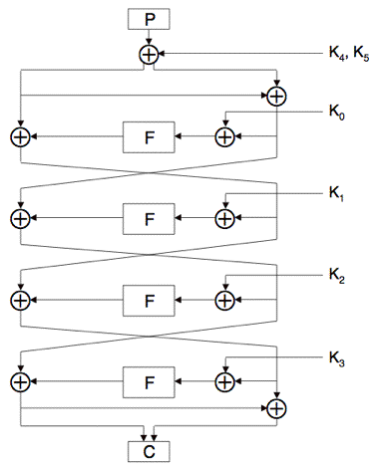
FEAL-4 Cipher
Four round Feistel cipher with a 64-bit block and 64-bit key
Plaintext: P, Cipher-text: C
Round function: F
32-bit sub-keys: K₀, K₁, …, K₅
Most important failed cipher: showed the power of differential cryptanalysis and linear cryptanalysis
Slide adapted from Mark Stamp

Slide 47
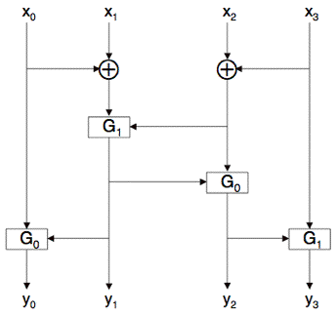
FEAL-4 Round Function
G₀(a,b) = (a+b (mod 256))<<< 2
G₁(a,b) = (a+b+1 (mod 256))<<< 2
Where “<<<” is left cyclic shift (rotation)
Then F(x₀,x₁,x₂,x₃) = (y₀,y₁,y₂,y₃) where
y₁ = G₁(x₀⊕x₁, x₂⊕x₃)
y₀ = G₀(x₀, y₁)
y₂ = G₀(y₁, x₂⊕x₃)
y₃ = G₁(y₂, x₃)
Diagram from Mark Stamp

Slide 48
FEAL-4 Key Schedule
F_{K}(a₀||a₁||a₂||a₃, b₀||b₁||b₂||b₃)= c₀||c₁||c₂||c₃ by
d₁= a₀⊕a₁
d₂= a₂⊕a₃
c₁= G₁(d₁,a₂⊕b₀)
c₂= G₀(d₂,c₁⊕b₁)
c₀= G₀(a₀,c₁⊕b₂)
c₃= G₁(a₃,c₂⊕b₃)
K₋₂= 0
K₋₁= K_{L}
K₀= K_{R}
K_{i}= f_{K}(K_{i-2}, K_{i-1}⊕K_{i-3})
Slide adapted from Mark Stamp

Slide 49
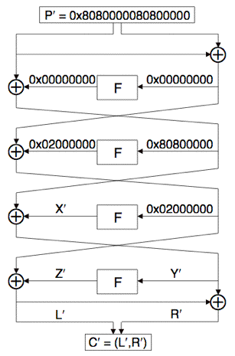
FEAL-4 Differential Attack
If A₀⊕A₁ = 0 then F(A₀) = F(A₁), p=1.
If A₀⊕A₁= 0x80800000 then F(A₀)⊕F(A₁)= 0x02000000, p=1
Choose (P₀, P₁):
P₀⊕P₁=0x8080000080800000
P′= P₀⊕P₁, C′= C₀⊕C₁
L′= 0x02000000⊕Z′, Y′= 0x80800000 ⊕ X′
For C= (L,R) we have Y = L⊕R
Solve for sub-key K₃: Z′ = 0x02000000⊕L′
Compute Y₀= L₀⊕R₀, Y₁= L₁⊕R₁
Guess K₃ and compute putative Z₀, Z₁
Note: Z_{i}= F(Y_{i}⊕K₃)
Compare true Z′ to putative Z′
R’
S’
T’
Slide adapted from Mark Stamp

Slide 50
FEAL-4 Differential Attack
Using 4 chosen plaintext pairs
Work is of order 2³²
Expect one K₃ to survive
Can reduce work to about 2¹⁷
For 32-bit word A=(a₀,a₁,a₂,a₃), define
M(A) = (z, a₀⊕a₁, a₂⊕a₃, z), where z is all-zero byte
For all possible A=(z, a₀, a₁, z), compute
Q₀ = F(M(Y₀)⊕A) and Q₁ = F(M(Y₁)⊕A)
Can be used to find 16 bits of K₃
When A = M(K₃), we have ⟨Q₀⊕Q₁⟩_{8…23} = ⟨Z′⟩_{8…23} where ⟨X⟩_{i…j} is bits i thru j of X. Can recover K₃ with about 2¹⁷ work
Once K₃ is known, can successively recover K₂,K₁,K₀ and finally K₄,K₅
Second characteristic: 0xa200 8000 0x2280 8000
Slide adapted from Mark Stamp

Slide 51
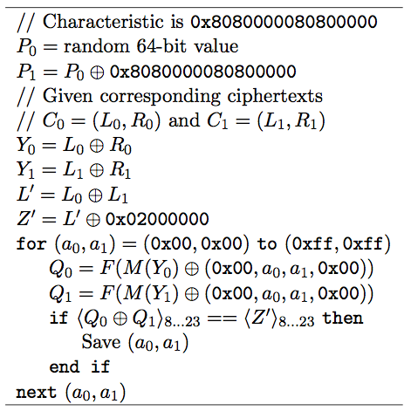
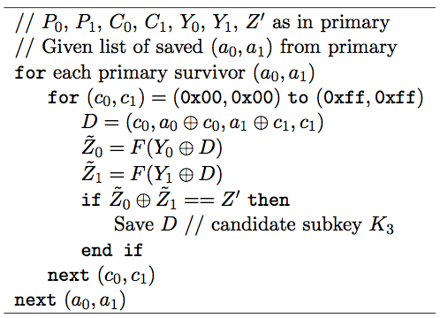
FEAL-4 Differential Attack
Primary for K₃
Secondary for K₃
Assuming only one chosen plaintext pair
Slide adapted from Mark Stamp

Slide 52
FEAL-4 Linear Attack
Y=F(X)
Y=(y₀, y₁, y₂, y₃)
X=(x₀, x₁, x₂, x₃)
X = X[0], …, X[31]), Y=F(X). Notation: X[i,j]= X[i]⊕X[j]
(a⊕b)[7] = (a+b(mod 256))[7], so
G₀(a,b)[5] = (a⊕b)[7]
(a⊕b⊕1)[7] = (a+b+1(mod 256))[7], so
G₁(a,b)[5] = (a⊕b⊕1)[7]
Since y₁= G₁(x₀⊕x₁, x₂⊕x₃),
Y[13]=y₁[5]=x₀[7]⊕x₁[7]⊕x₂[7]⊕x₃[7]⊕1=X[7,15,23,31]⊕1
Since y₀=G₀(x₀, y₁), Y[5]=y₀[5]=y₁[7]⊕x₀[7] =Y[15]⊕X[7]
Since y₂=G₀(y₁, x₂⊕x₃),
Y[21]=y₂[5]=y₁[7]⊕x₂[7]⊕x₃[7] = Y[15]⊕X[23,31]
Since y₃=G₁(y₂,x₃),
Y[29]=y₃[5]=y₂[7]⊕x₃[7]⊕1= Y[23]⊕X[31]⊕1
Y
F
X

Slide 53
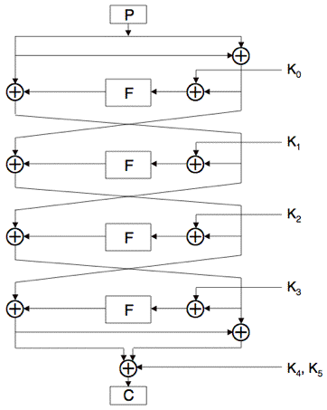
FEAL-4 Linear Attack
P_{L}, P_{R}
L₀
L₀= P_{L}, R₀= P_{L}⊕P_{R}
Y₀= F(R₀⊕K₀), R₁= L₀⊕Y₀, L₁= R₀
Y₁= F(R₁⊕K₁), R₂= L₁⊕Y₁, L₂= R₁
Y₂= F(R₂⊕K₂), R₃= L₂⊕Y₂, L₃= R₂
Y₃= F(R₃⊕K₃)
C_{L}= L₃⊕Y₃⊕K₄, C_{R}= C_{L}⊕R₃⊕K₅
C_{L}= L₁⊕Y₁⊕Y₃⊕K₄= P_{L}⊕P_{R}⊕Y₁⊕Y₃⊕K₄
So C_{L}⊕P_{L}⊕P_{R}⊕K₄= Y₁⊕Y₃
C_{L}⊕P_{L}⊕P_{R}⊕K₄ =F(R₁⊕K₁)⊕F(R₃⊕K₃)
C_{L}⊕P_{L}⊕P_{R}⊕K₄ =F(L₀⊕Y₀⊕K₁)⊕F(R₃⊕K₃)
Since R₃ = C_{L}⊕C_{R}⊕K₅, and L₀= P_{L}
C_{L}⊕P_{L}⊕P_{R}⊕K₄ = F(P_{L}⊕Y₀⊕K₁)⊕F(C_{L}⊕C_{R}⊕K₅⊕K₃)
R₀
Y₀
X₀
L₁
Y₁
X₁
R₁
L₂
Y₂
X₂
R₂
L₃
Y₃
X₃
R₃
C_{L}, C_{R}

Slide 54
FEAL-4 Linear Attack
We’ve show
C_{L}⊕P_{L}⊕P_{R}⊕K₄ = F(P_{L}⊕Y₀⊕K₁)⊕F(C_{L}⊕C_{R}⊕K₅⊕K₃),
Y₀= F(R₀⊕K₀)=F(P_{L}⊕P_{R}⊕K₀)
Y[13]=X[7,15,23,31]⊕1
Y[5] =Y[15]⊕X[7]
Y[21]=Y[15]⊕X[23,31]
Y[29]⊕Y[23] = X[31]⊕1
From 1,
(C_{L}⊕P_{L}⊕P_{R}⊕K₄)[23,29]= F(P_{L}⊕Y₀⊕K₁)[23,29]⊕F(C_{L}⊕C_{R}⊕K₅⊕K₃)[23,29]
From 6,
F(P_{L}⊕Y₀⊕K₁)[23,29]= (P_{L}⊕Y₀⊕K₁)[31]⊕1
F(C_{L}⊕C_{R}⊕K₅⊕K₃)[23,29]= (C_{L}⊕C_{R}⊕K₅⊕K₃)[31]⊕1
Adding 8 and 9,
(C_{L}⊕P_{L}⊕P_{R}⊕K₄)[23,29]= (P_{L}⊕Y₀⊕K₁)[31]⊕(C_{L}⊕C_{R}⊕K₅⊕K₃)[31]
Slide adapted from Mark Stamp

Slide 55
FEAL-4 Linear Attack
From the last slide,
(C_{L}⊕P_{L}⊕P_{R}⊕K₄)[23,29]= (P_{L}⊕Y₀⊕K₁)[31]⊕(C_{L}⊕C_{R}⊕K₅⊕K₃)[31], so
K₄[23,29]⊕(K₁⊕K₅⊕K₃)[31]=
(C_{L}⊕P_{L}⊕P_{R})[23,29]⊕P_{L}[31]⊕Y₀[31]⊕(C_{L}⊕C_{R})[31]=
(C_{L}⊕P_{L}⊕P_{R})[23,29]⊕P_{L}[31]⊕(C_{L}⊕C_{R})[31]⊕ F(P_{L}⊕P_{R}⊕K₀)[31]
The left hand side is a constant for fixed key.
The attack consists of guessing K₀ and computing
h(P,C)= (C_{L}⊕P_{L}⊕P_{R})[23,29]⊕P_{L}[31]⊕(C_{L}⊕C_{R})[31]⊕F(P_{L}⊕P_{R}⊕K₀)[31]
for a number of corresponding (P_{L}, P_{R}), (C_{L}, C_{R})
If the guessed K₀ is right, h(P,C) will have the same value for each corresponding pair of plain-text and cipher-text.

Slide 56
FEAL-4 Linear Attack - Improvement
Possible to improve on linear attack
Put K₀’= ((K₀)_{0,…,7}⊕(K₀)_{8,…,15}, (K₀)_{16,…,23}⊕(K₀)_{24,…,31})
Consider reduced cipher to get a new relation
h’(P,C)= (C_{L}⊕P_{L}⊕P_{R})[5,13,21]⊕P_{L}[15]⊕(C_{L}⊕C_{R})[15]⊕F(P_{L}⊕P_{R}⊕K₀)[15]
h’(P,C) depends only on bits 0,9,…,15,17,…,23 of K₀
Find these 12 bits of K₀ first, then the remaining 20 can be found using similar approximations and exhaustive search.

Slide 57
DESX and whitening
Attacks like differential and linear cryptanalysis are easier since we can direct observe the input to the first round and output of the last round directly.
Rivest and Killian:
DESX(k₁,k₂,k₃,x)= k₃⊕DES(k₁, k₂⊕x)
Strategy adopted by almost all the AES participants.

Slide 58
AES History
Call for DES successor 1/97
Nine Submissions
CAST-256, CRYPTON, DEAL, DFC (cipher), E2, FROG, HPC, LOKI97, MAGENTA, MARS, RC6, Rijndael, SAFER+, Serpent, and Twofish.
Finalists
MARS, RC6, Rijndael, Serpent, and Twofish
And
the winner is Rijndael: FIPS 197 published 11/2001
Good References:
Daemen and Rijimen, The Design of Rijndael. Springer.
Ferguson et. al., The Twofish Encryption Algorithm. Wiley.
Tons of contemporaneous material, thesis, etc. Almost all on WWW.

Slide 59
AES
Key
Key Schedule
Plaintext
k₁
k₂
r Rounds
k_{r}
Ciphertext

Slide 60
AES Requirements
128, 192, 256 bit keys
Algorithms will be judged on the following factors:
Actual security of the algorithm compared to other submitted algorithms (at the same key and block size).
The extent to which the algorithm output is indistinguishable from a random permutation on the input block.
Soundness of the mathematical basis for the algorithm’s security.
Other security factors raised by the public during the evaluation process, including any attacks which demonstrate that the actual security of the algorithm is less than the strength claimed by the submitter.
Claimed attacks will be evaluated for practicality.
Key agility (NSA): “Two blocks encrypted with two different keys should not take much more time than two blocks encrypted with the same key.

Slide 61
End

