Slide 1
Unlimited Potential Emerging strategies in emerging markets
James Utzschneider
General Manager
Microsoft Corporation

Slide 2
Notes:
When you see pictures like this …

Slide 3
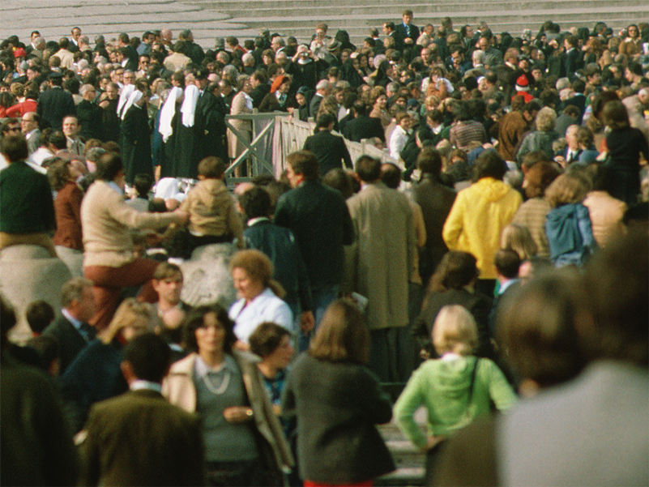
Notes:
… or this …

Slide 4
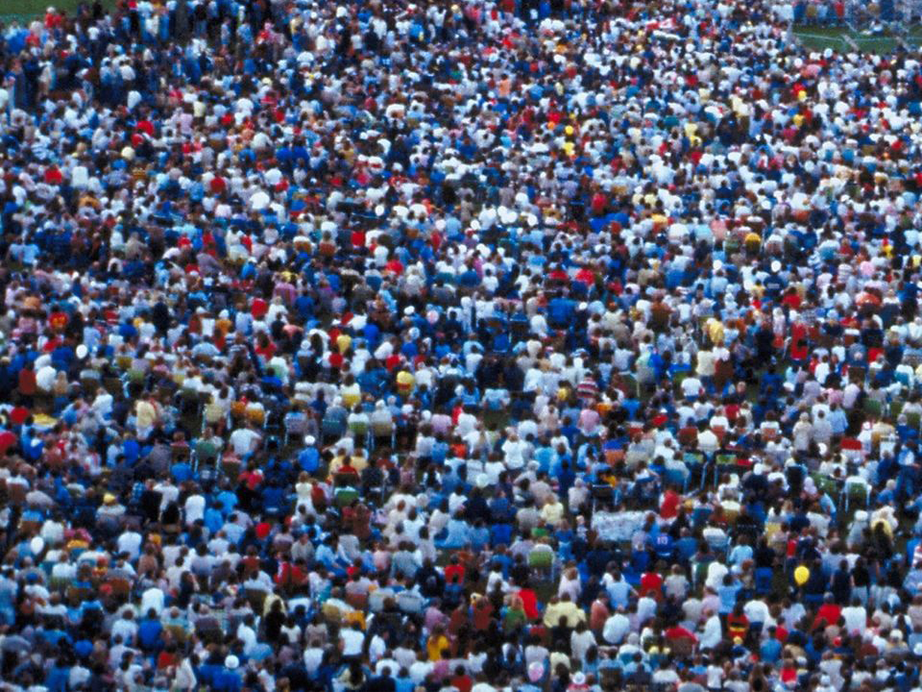
Notes:
… or even this … do you ever wonder how many of the people here are actual Microsoft customers? Well, if you assume that the photo is an accurate representation of the world’s population, then the answer is … not many. There are 6 billion people in the world today, and about a billion use PC technology (and about half of those actually pay us for it). So think of the Microsoft customers as being the people who are wearing light blue shirts in the photo.
As a company, we face challenges for growth, and one could argue there are 2 ways we can do so. We can sell more software and services to existing customers, or we can sell software and services to new customers.
Our team is focused on the latter strategy.

Slide 5
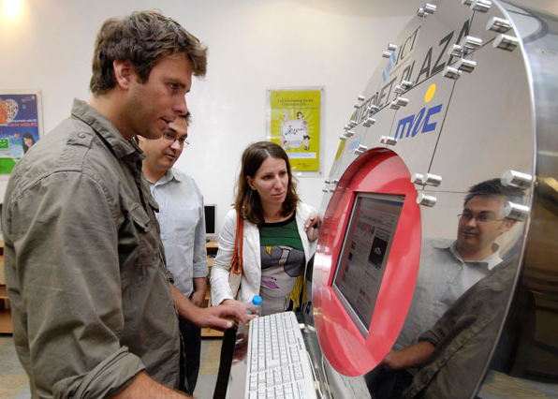
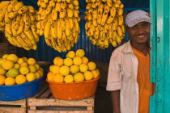
Enable sustained social and economic opportunity for the next five billion people
Communities Partnerships
Transforming
Education
Fostering Local Innovation
Enabling Jobs & Opportunity

Slide 6
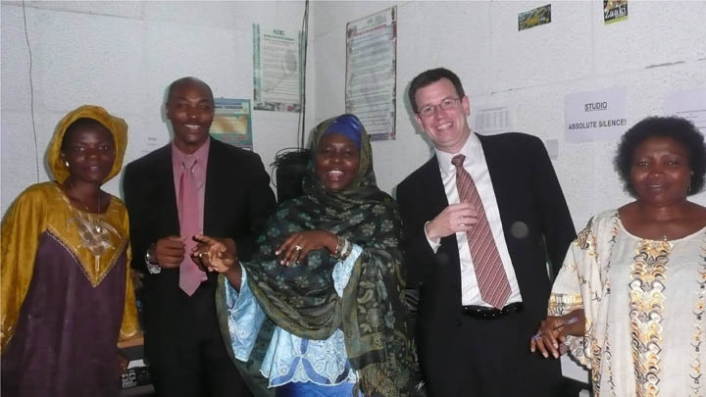
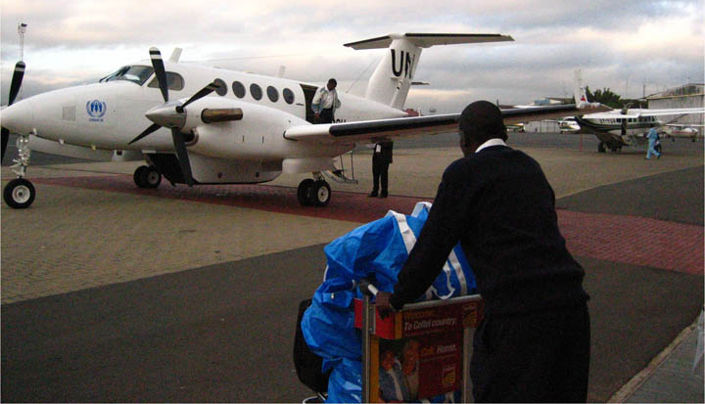
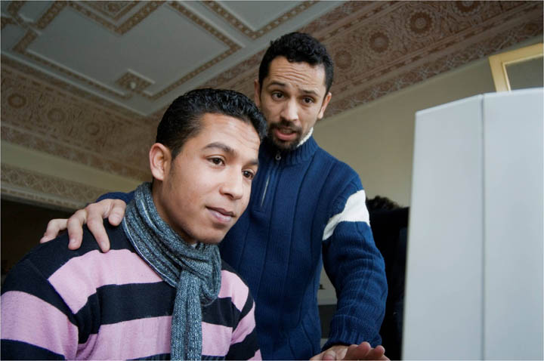
Field Capacity + R&D
Global Story
Pooled effort around existing programs:
Citizenship
Education
DPE
Public Sector
UPG
Product Innovation
New product and solutions incubation:
Low Cost Computing
Shared Access
Mobile
Education
Relevance
Access
Affordability
“Creative Capitalism”
Nontraditional business opportunity for Microsoft
supporting social and economic agenda of governments

Slide 7
Our Target Market
TOP
High
Disposable
Income
.76B
+25%
.84B
MOP
Some
Disposable Income
2.2B
+22%
2.7B
BOP
Little/No Disposable Income
3.5B
-3%
3.4B
Socio-economic Pyramid
2005
Socio-economic “Barn”
2011
Notes:
Ais.
Younger populations in EM’s – hungry to consume
Median age in Africa is 19, India is 24, China is 33. (Europe 45)
Include WW numbers
Adjust table top left. Inflation adjustments, market oppty.
Top right. Geo Growth View.
Number the boxes to drive discussion.
Review implications to MS.
Less than 5% of total students will go on to college – almost all from TOP and upper MOP
BRIC GDP growth outpaces G-6 countries by 2010
Consumer spending growth accelerating
Communications 389% & Education 235% (2005-2010 BRIC+M)
Increasing ICT4D funding from governments and donors
Africa key focus & China now key player in donor money flows
Significant education opportunity
1.1B K-12 students in EM’s of which over 82% are from BOP and MOP
Government education spending increasing 175% (2005-2010 All EM)

Slide 8
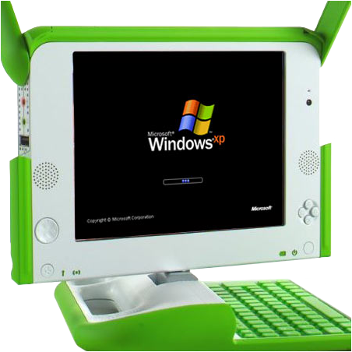
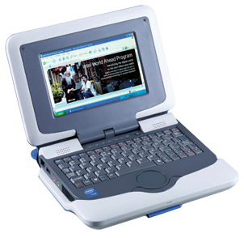
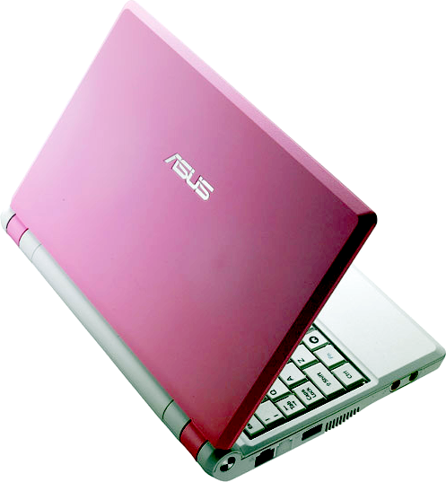
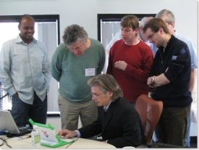
Ultra Low Cost PCs for Education
Target
Transformational schoolchildren in emerging markets
New class of sub-$300 machines used in "1-1" government education programs
Licensing, Partnerships, Education Evangelism
Via
OLPC XO
Challenges
Intel ClassMate
ASUS eeePC
Demoing XP

Slide 9
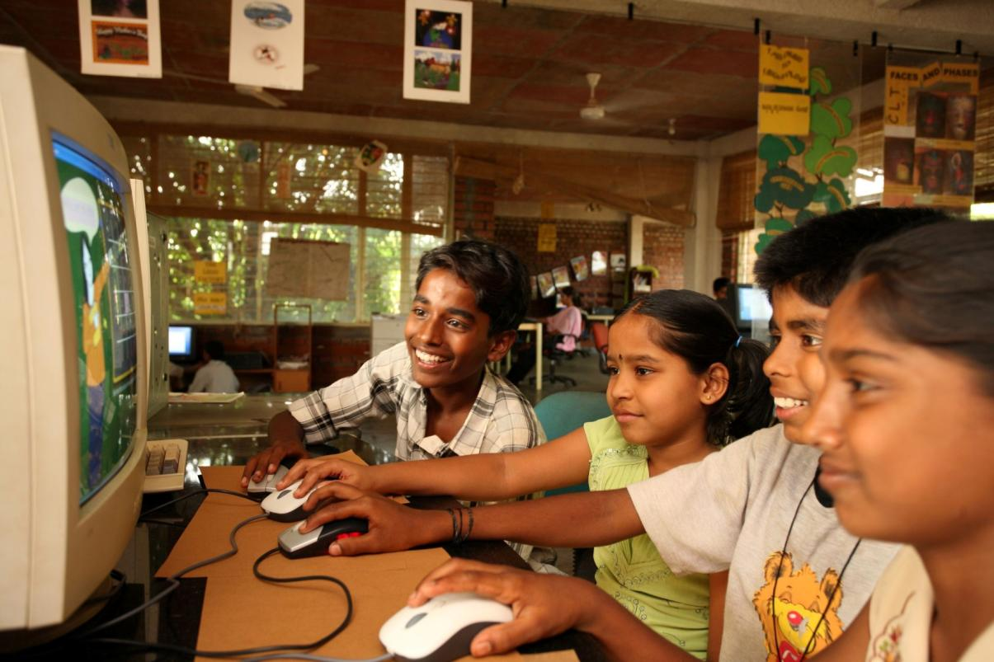
Windows MultiPoint
Target
Children in schools that cannot afford PCs for every student
MSR SDK that enables collaborative education applications using multiple cursors and mice on a single PC
Education ISV and developer evangelism, pricing and licensing
Via
Challenges
Notes:
UPG released the SDK on MSFT Download Center in 2007 that was based on the MSR technology.
Completed a pilot with the Thailand Ministry of Education for elementary students that was extended because they saw increased engagement with the students during learning exercises.
Have since heard that an instructor involved with this pilot has travelled to Vietnam to assist with adding MultiPoint to other schools’ classroom engagement plans (done without any assistance or encouragement from MSFT).

Slide 10
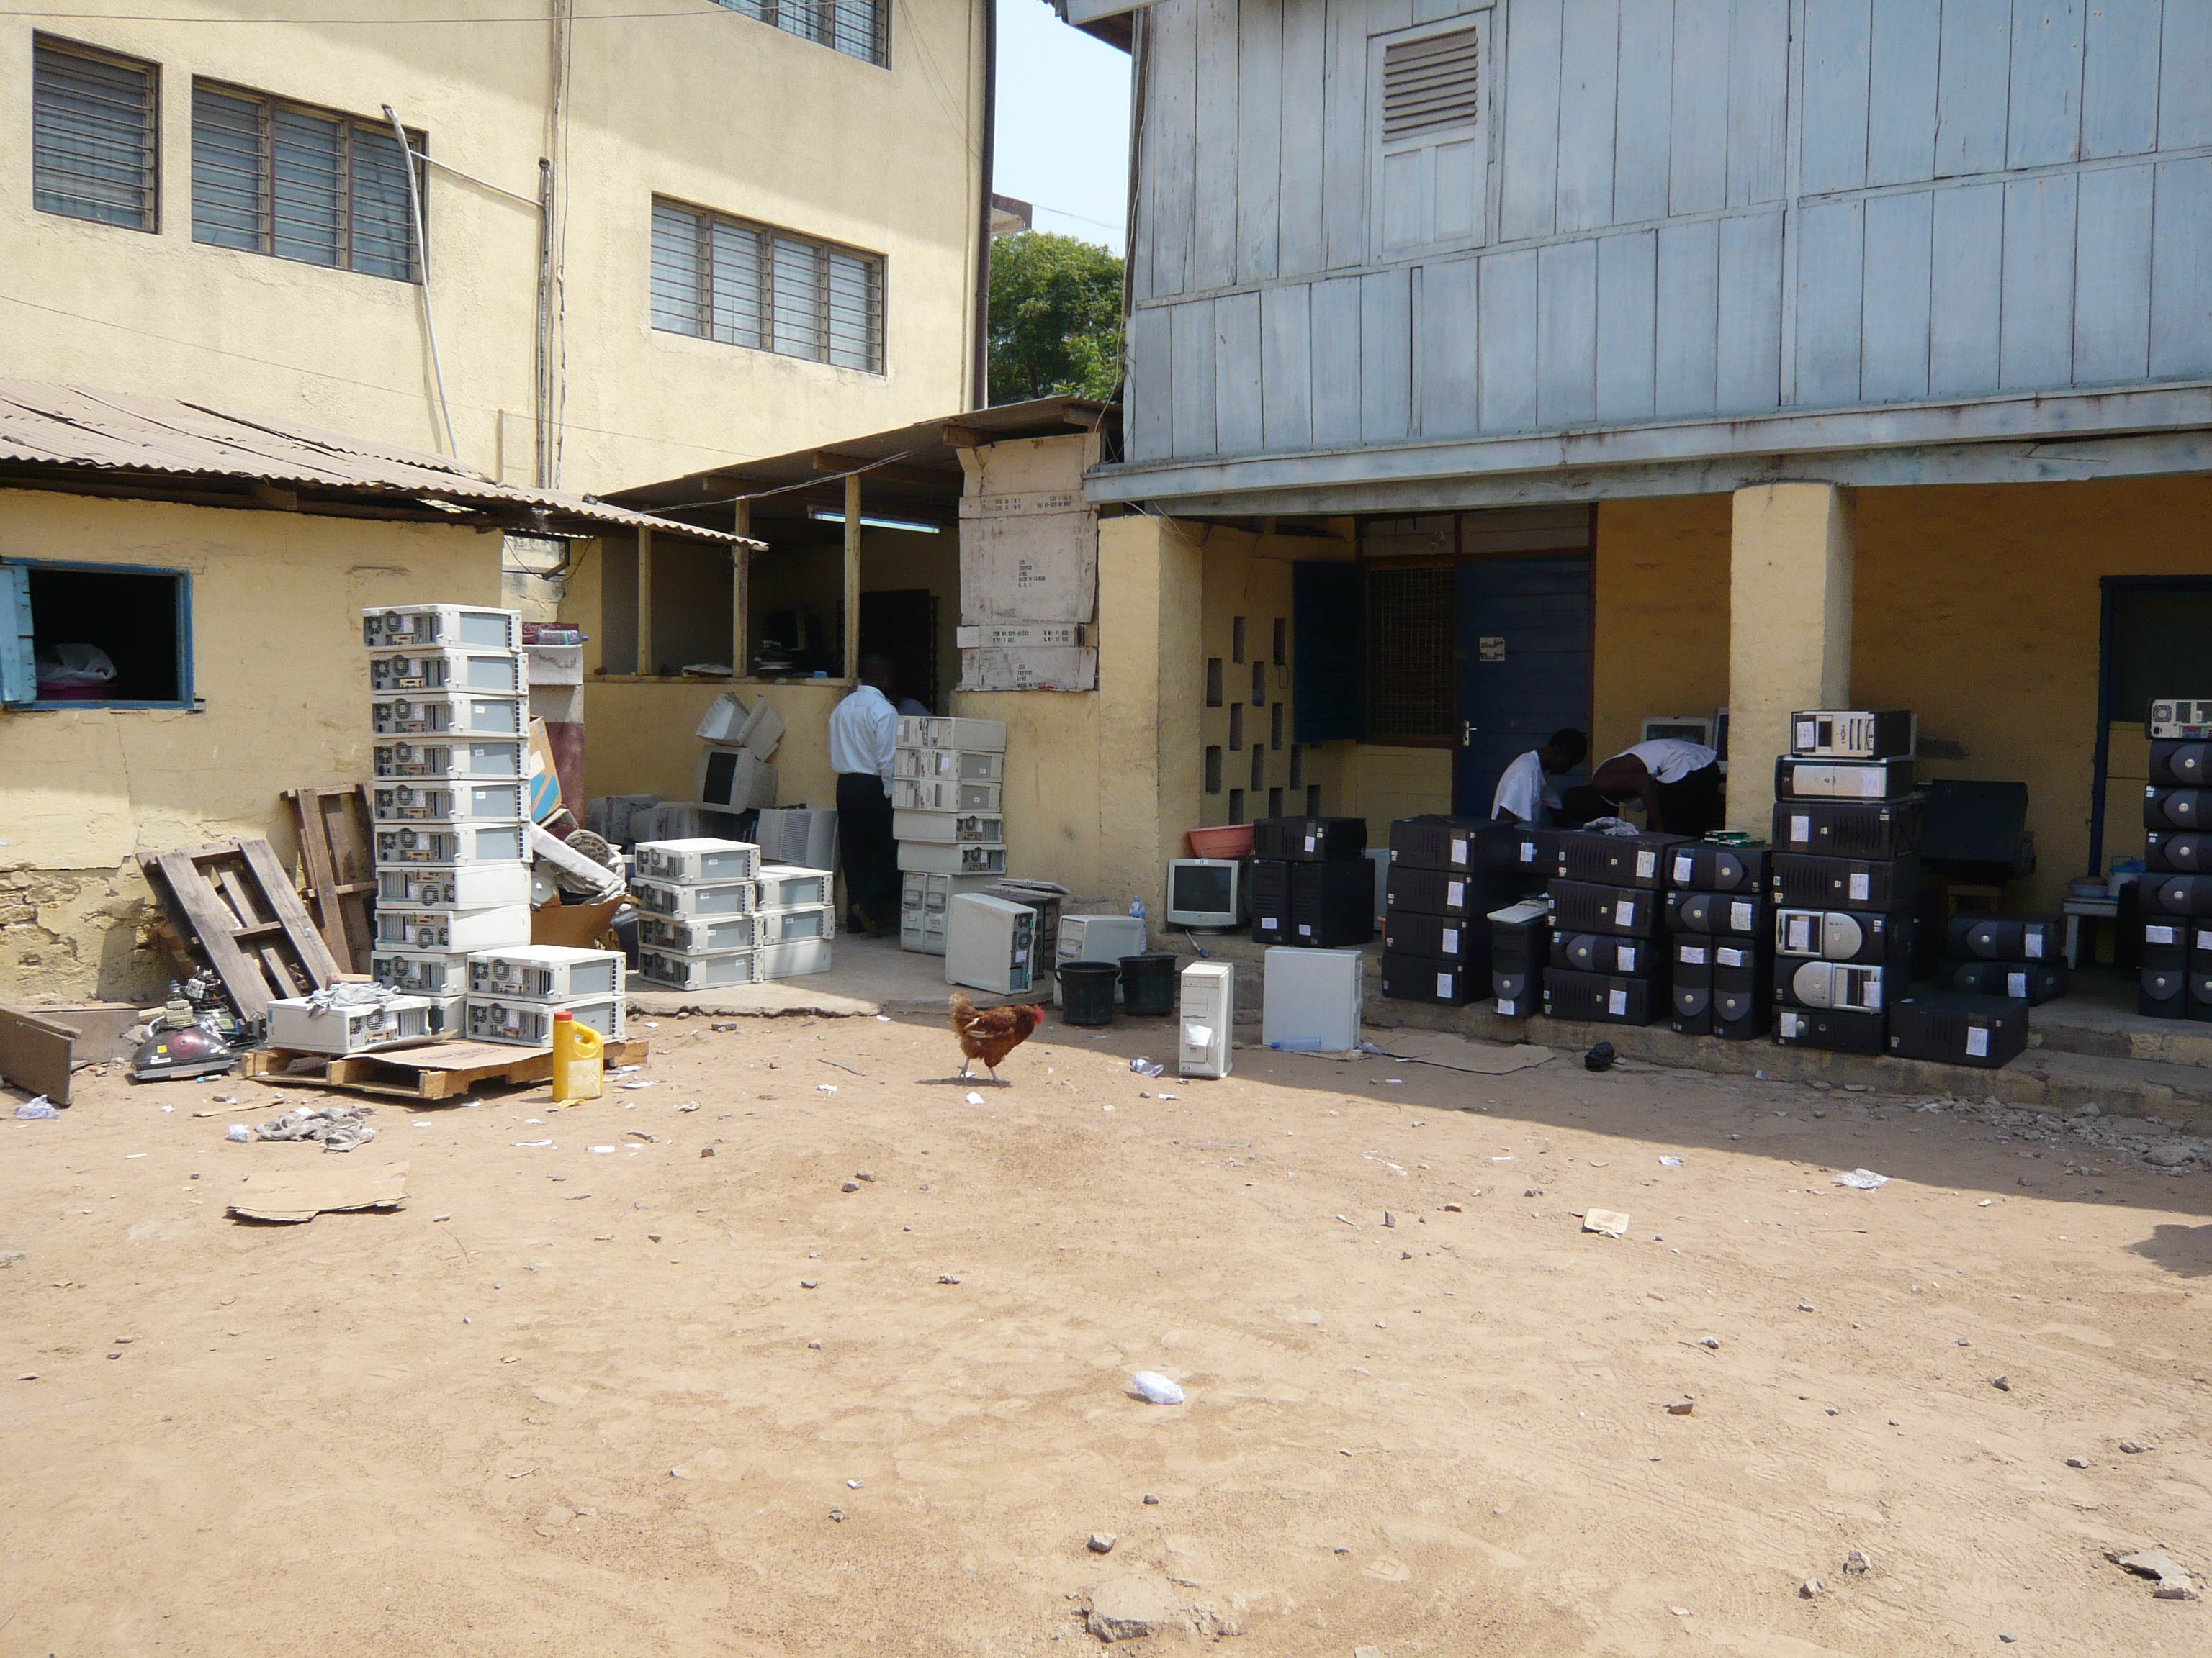
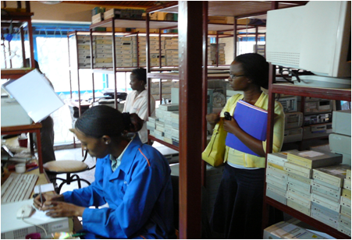
Secondary PCs
Target
Small businesses and governments in emerging markets
Global ecosystem for resold, repurposed, and donated PCs (74 million in 2007)
Category branding, licensing, government evangelism, new channel
Via
Challenges
Notes:
General Secondary PC info:
Secondary PCs are second user PCs that are resold, repurposed or donated.
Estimated 74 million PCs in 2007.
Thriving global ecosystem that supplies to Middle and Bottom of the pyramid.
Main price range is US$50 to US$250.
Customers:
In Uganda 50% of PCs in small businesses are Secondary.
In Nigeria and Morocco for every 2 new PCs 1 Secondary PC is acquired.
In Bulgaria Secondary PCs are over 20% of the commercial market.
In Canada nearly 1 million Secondary PCs have been supplied to schools and communities through a government funded program.
Vision:
Target the secondary PC market, a market that Microsoft does not adequately address today – estimated 15 million PCs eligible – to reach MOP/BOP customers with affordable original Windows licenses (approx. 100% of software on refurb PCs is pirated today.) From focus groups, consumers and small businesses – even if they haven’t owned a PC before understood differences between pirated/counterfeit and original software and wanted to own genuine (and would even pay a bit more.)
Develop broad channel program with smaller “refurbisher” partners who will resell and repurpose refurbished PCs
Marketing information:
We’ve conducted both quantitative and qualitative research on this market. Qualitative research was focus groups and interviews with consumers, small businesses and refurbishers in Ghana, Peru, Malaysia and the UK.
Messaging frameworks are now being re-written to include the information.
General awareness of the secondary PC market, and Microsoft’s role in the ecosystem, will be launched in May via a new website with a whitepaper, a refurbished PC lifecycle document, customer evidence, expert spokespeople, etc.
We are currently in POC phase in Uganda, Peru and Malaysia and are just kicking off Pilot assessment for EMEA.
We will be building out all marketing and sales tools for the field, partners and customers to launch a new Microsoft refurbisher channel for breadth partners.

Slide 11
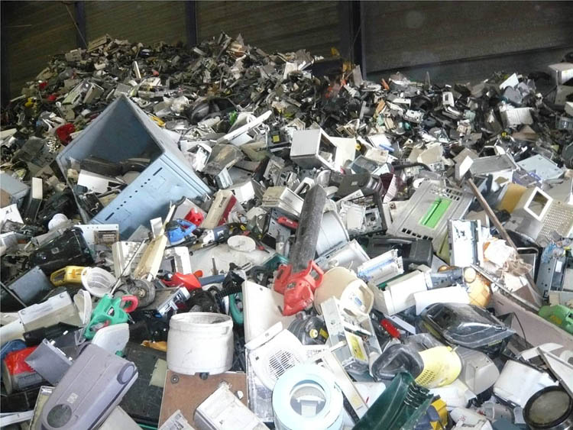
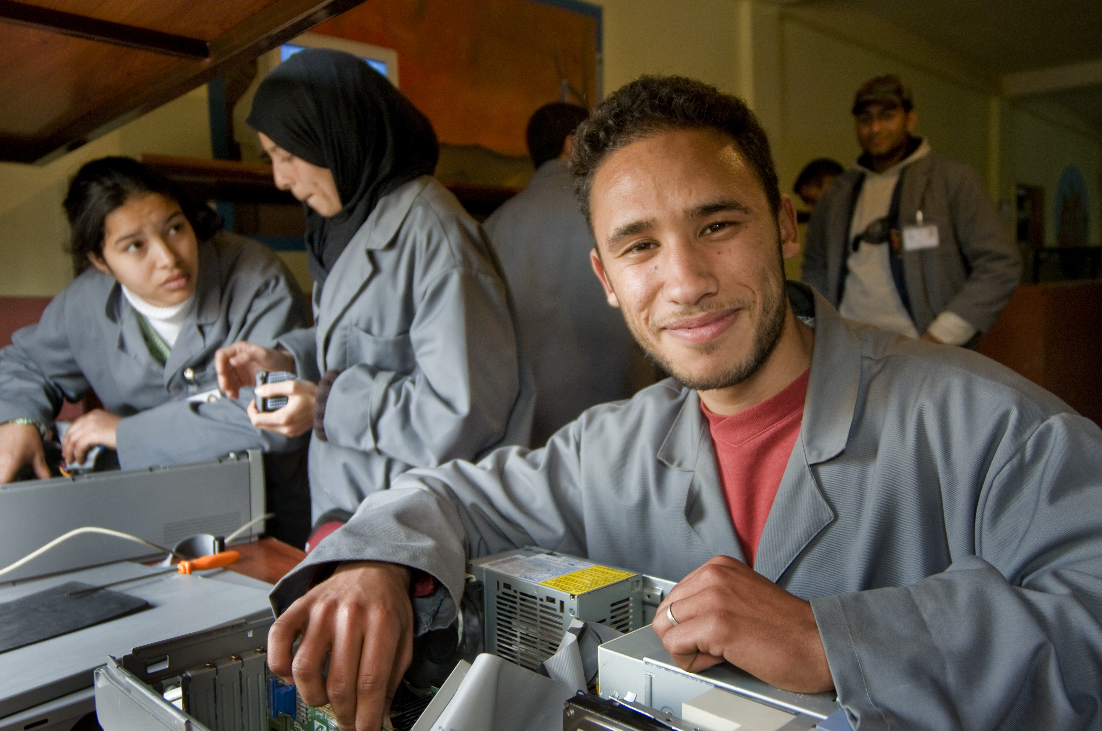
Social Impact of Secondary PCs
Environment
Local Jobs

Slide 12
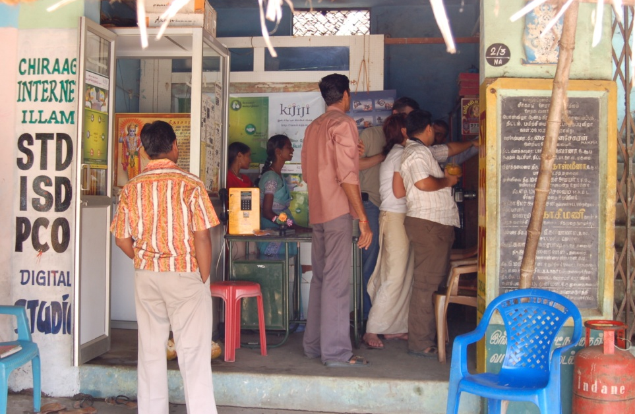
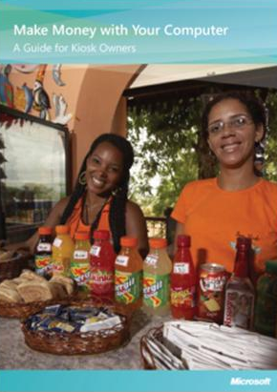
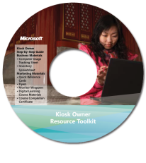
Shared Access: Telecenters
Target
Rural poor who don't use PCs
Government and donor funded PC kiosks used for agriculture, skills training, microfinance ($7.4 Billion spend)
Sustainability, NGO and government evangelism, scale, training kiosk owners
Via
Challenges
Notes:
Audience: gov’t elites, gov’t implementers, kiosk owners, end users.
The customer:
Governments and Multilaterals rallying behind ICT4D as rural development tool with US$7.8B approximate spent
Kiosk owners with limited to no technology expertise
End customers that have never used a PC before (or have very limited use.)
Challenges:
Market leadership requires deep engagement models with key countries
OS actively pursuing rural and EM governments’ platform
Lots of work has been done, but no stand out best practice of sustainability
The payoff:
Becoming a trusted advisor around ICT4D secures our technology in first time users and governments’ platform
What marketing is doing:
Developing field engagement playbook
Developing to-gov’t materials to help sell our credibility
Developing/packaging how-to guides, key learnings, and other frameworks/info. to help gov’t implementers make their rural shared access plans actionable.
Developing business and marketing aids for kiosk owners to skill them up on technology and enable them to offer technology solutions to their customers.

Slide 13
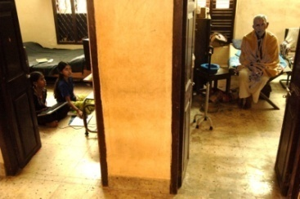
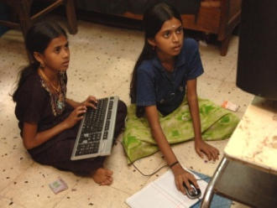
Subscription Computing: "Thin Man"
Target
Urban families avoiding iCafes who cannot afford a PC
Terminal-based PC service sold by telcos and other partners
Terminal-based home computing!; Channel development; pricing and licensing
Via
Challenges

Slide 14
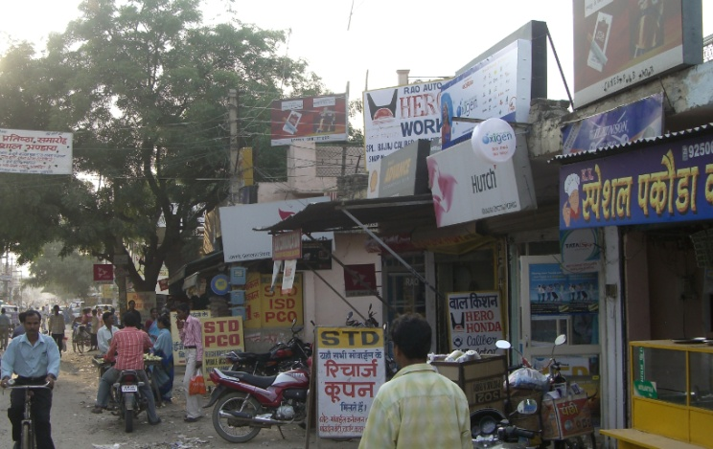
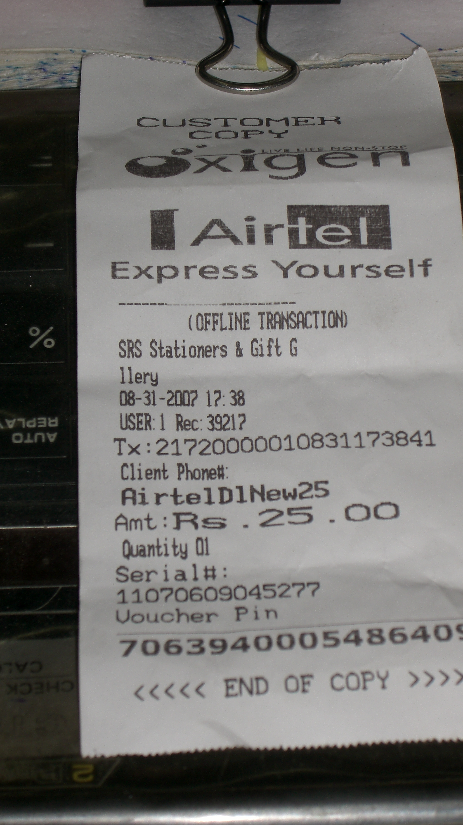
Mobile Services: "Kirana"
Target
People who use cell phones but not PCs (estimated to be billion)
Services platform (including advertising and Live) anchored around mobile payments system involving pre-paid cards and POS kiosks in Africa and India
Channel development, scale, value proposition
Via
Challenges

Slide 15
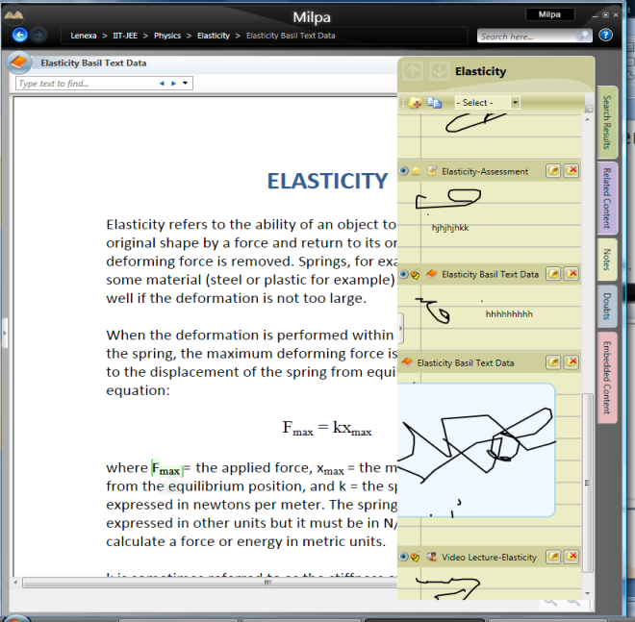
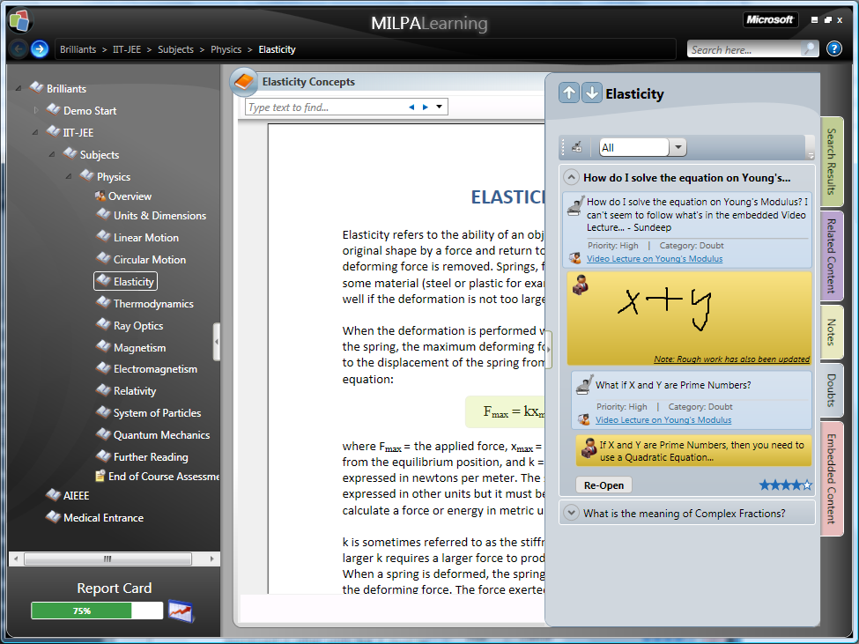
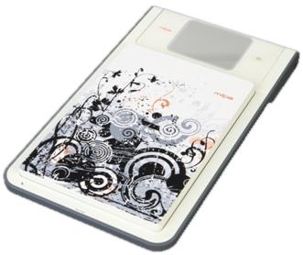
Education: "Milpa"
Target
People trying to get ahead by passing certification exams
Locally relevant training content targeting skills acquisition delivered in a "Complete" education system involving rich client + web services design + new device, assuming occasional or no Internet connection
Content ecosystem, new channel, value proposition, new device
Via
Challenges
Notes:
Exam Prep Market overview
US : ITT Tech, DeVry, Kaplan,
India : 1.6 Billion +, 30% YOY Brilliant, Fit-JEE, Heritage Institute
China : 1.5 Billion +, 20% YOY New Oriental (5% of market)
Brazil : 150 technical training courses officially recognized

Slide 16
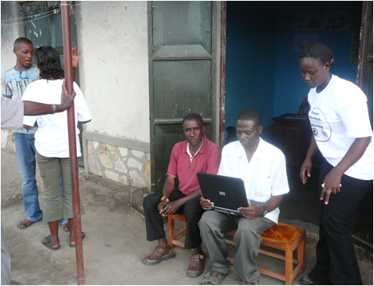
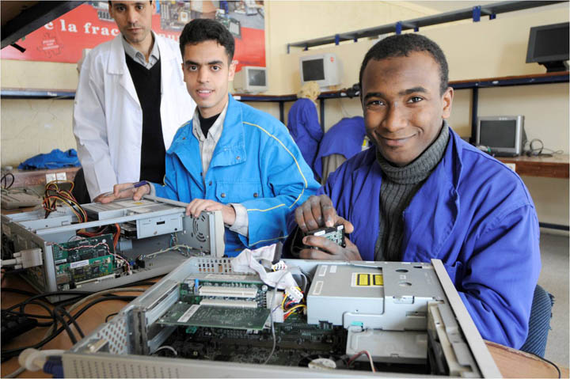
What We Are Learning …
Holes exist in Microsoft's existing business models
Segmetnation matters, even in this space
MOP willing to "go high" when they see good, better, best
Willing to pay (a little) for genuine software
Few big retail channels
Limited credit, small purchases
No digital marketing yet: word of mouth, newspaper, billboard and in-store advertising
Limited awareness of Microsoft

Slide 17
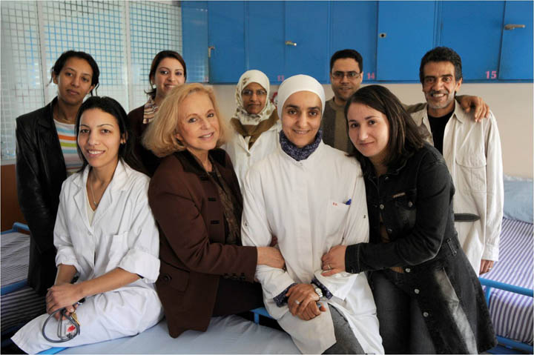
UPG in FY09
More digital storytelling targeting elites
More shared campaigns with partners
Formal MOP/BOP consumer model with tracker
Ongoing execution of pilots and incubations
Development of an online community

Slide 18
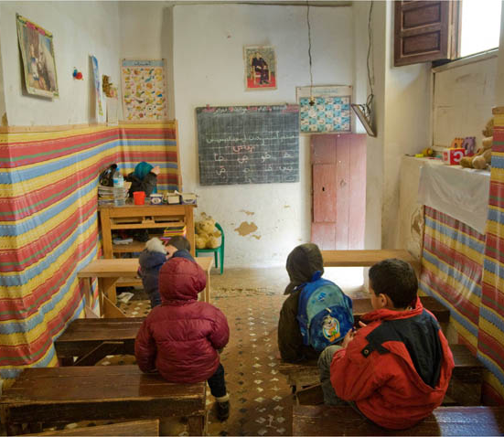
Get Involved
Visit the UPG site
Leverage our research
Play with our technology
Join our team
Email: jamesu@microsoft.com

Slide 19
© 2008 Microsoft Corporation. All rights reserved. Microsoft, Windows, Windows Vista and other product names are or may be registered trademarks and/or trademarks in the U.S. and/or other countries.
The information herein is for informational purposes only and represents the current view of Microsoft Corporation as of the date of this presentation. Because Microsoft must respond to changing market conditions, it should not be interpreted to be a commitment on the part of Microsoft, and Microsoft cannot guarantee the accuracy of any information provided after the date of this presentation. MICROSOFT MAKES NO WARRANTIES, EXPRESS, IMPLIED OR STATUTORY, AS TO THE INFORMATION IN THIS PRESENTATION.

