Slide 1
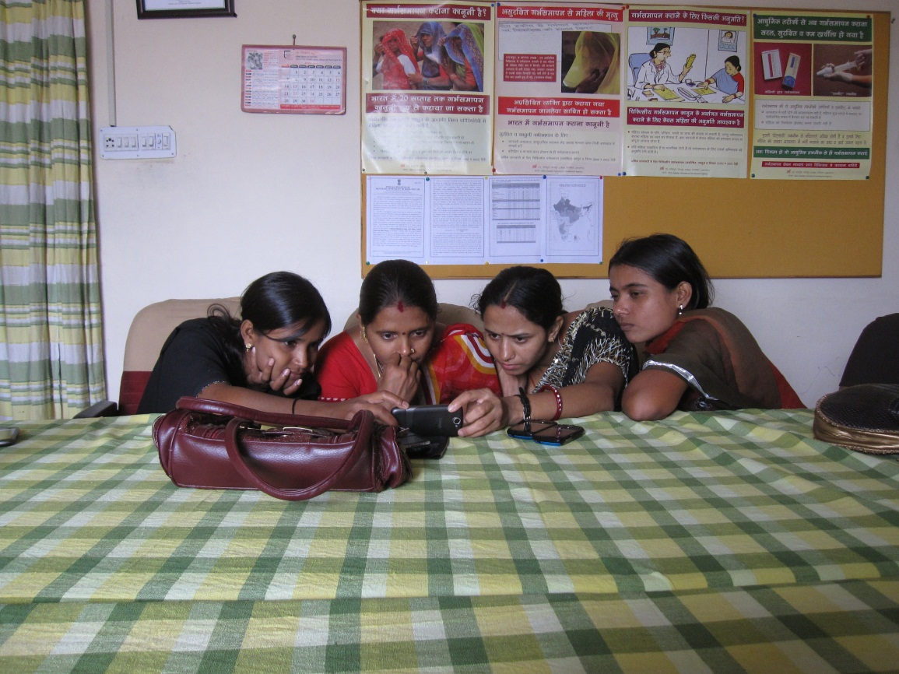
Mobile video for patient education: The midwives’ perspective
Brittany Fiore-Silfvast, Carl Hartung, Kirti Iyengar, Sharad Iyengar, Kiersten Israel-Ballard, Noah Perin, Richard Anderson

Slide 2
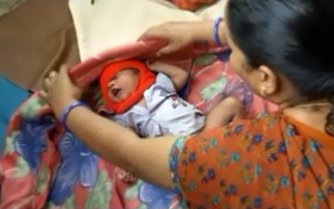
Talk overview
Study of Nurse Midwife reaction to using mobile videos to support patient education
Based on a one year project conducted in Udaipur, India
Key contribution
Focus on the acceptability of a mobile device to help a midwife’s work

Slide 3
mHealth
How can the wide-scale deployment of mobile devices enhance health worker and health system performance?

Slide 4
Sustainability
Technical feasibility: the device must work reliably in the field.
Usability: the target users must be able to operate the device.
Acceptability: the users must be willing to use the device in the course of their work.
Maintainability: it must be possible to keep the devices running at low cost.
Affordability: the total cost of the system must be low enough that the health system can pay for it and sees commensurate value.

Slide 5
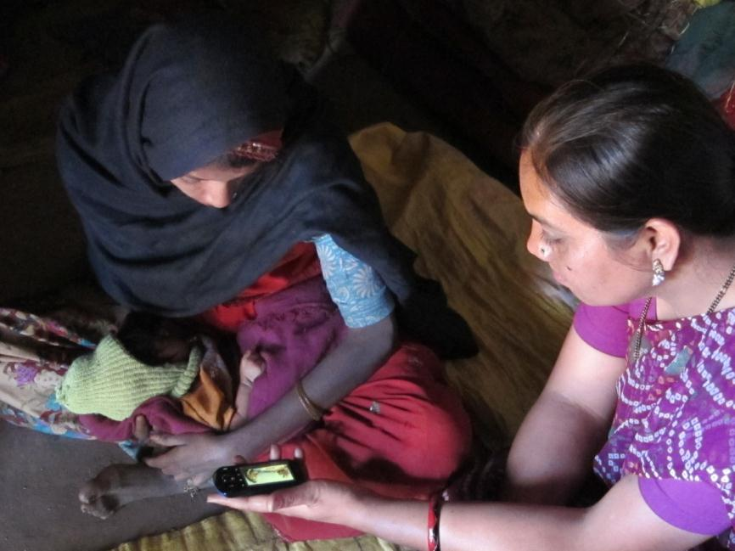
Acceptability
In order for a technology to be adopted, it must provide perceived value to those that are expected to use it

Slide 6
ARTH, Udaipur India
Action Research and Training for Health
Two maternal health clinics for a population of 64,000
Clinic and outreach services by two doctors and eight nurse midwives
Post Natal Care (PNC) visits using ARTH protocol
Two visits
In clinic or home

Slide 7
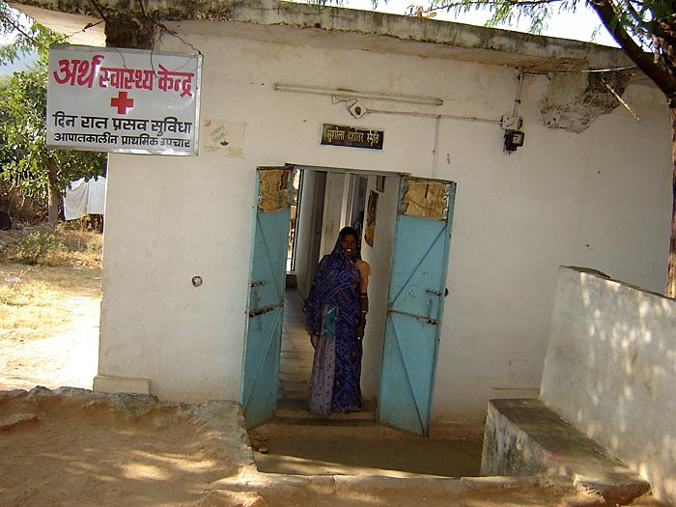
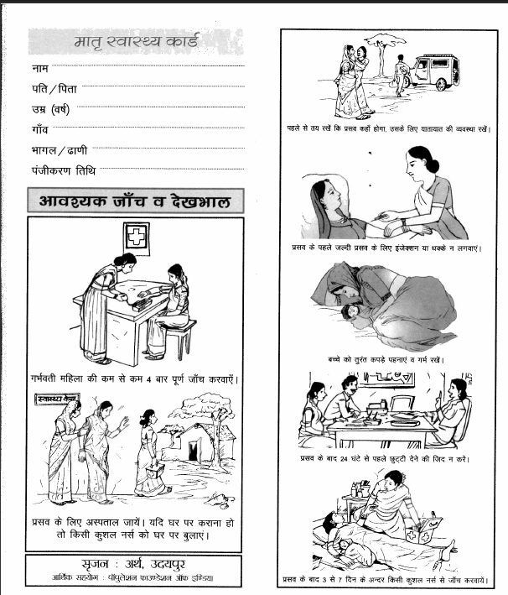
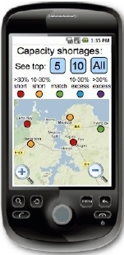
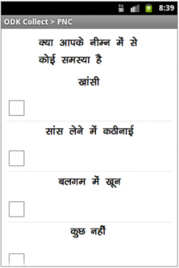
Mobile Midwife Platform
Mobile data collection to support PNC visits
Data collection
Protocol support
Open Data Kit application
Android phones deployed with nurse midwives

Slide 8
Health videos
Three videos created
Maternal nutrition
Breast feeding
Thermal care
Videos shown during PNC
Launched from ODK form at specific points in visit
Nurse midwives were already expected to address these topics

Slide 9
Mobile device use
One year pilot for data collection and visit support
Nurse midwives had difficulty with data collection and continued to use paper forms
Device logging showed that the videos were shown regularly
Midwives identified video the most successful component of the project
 | Nutrition | Breast-feeding | Thermal care | Total
Video played entirely | 554 (77.1 %) | 497 (77.7 %) | 288 (62.5 %) | 1339 (73.4 %)
Video partially played | 46 (6.4 %) | 52 (8.1 %) | 26 (5.6 %) | 124 (6.8 %)
Video stopped | 110 (15.3 %) | 89 (13.9 %) | 146 (32.7 %) | 345 (19.0 %)
Video play extended | 9 (1.2 %) | 2 (0.3 %) | 1 (0.2 %) | 12 (0.7 %)

Slide 10
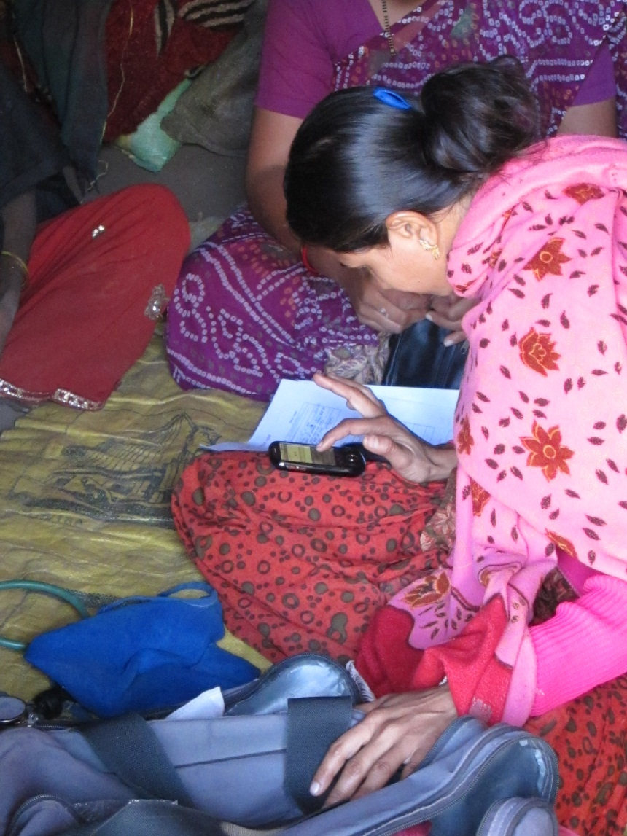
Study methodology for evaluating video
Ethnographic observations of 22 PNC visits
Semi-structured interviews with the 8 nurse midwives
Iterative coding scheme of qualitative data using Atlas.ti
Triangulation with quantitative data from deployment

Slide 11
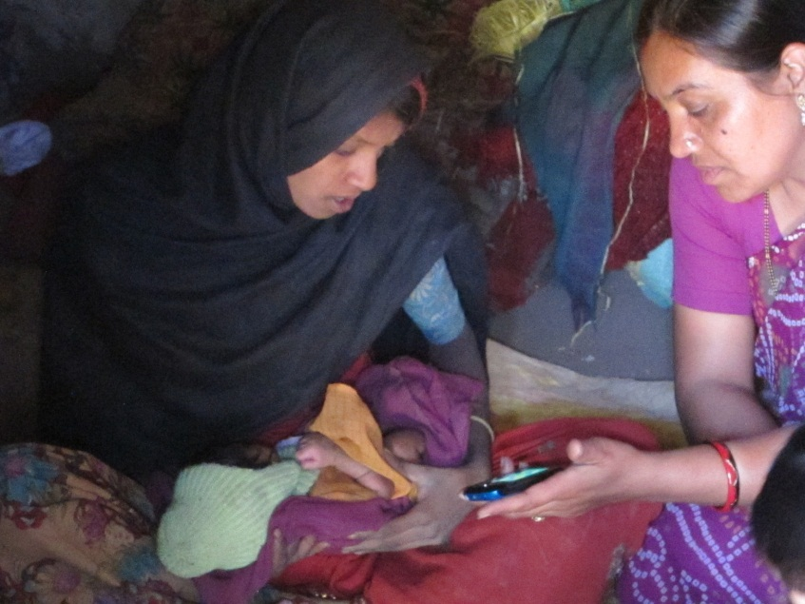
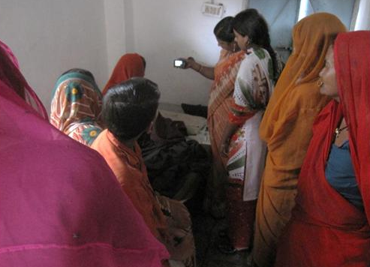
Summary of results
The use of video is feasible in PNC visits
The PNC environment is complicated
Patient education occurs throughout visits with various levels of effort
Multiple settings and participants
Authority and trust
Nurses viewed video as being authoritative and enhancing their communication

Slide 12
Feasibility
Video used consistently on PNC visits
Midwives reported a favorable reaction and identified this as the best feature of the mobile device
Minor difficulties in using videos in the mobile app
“The video that we show is very good – it becomes very easy for the people to understand. There is a big difference between telling something and showing it. On watching the video people understand that yes, this is how it is to be done.”

Slide 13
Complexity
Multiple people might be present for home and clinic PNCs
Process of doing an examination did not fully align with the protocol on the device
Introduction of videos made educational component more explicit
“When we do PNC before, only the patient and I are present . . . Now I am showing the video, now others too come on hearing the sound from the video, so they too remember that yes, we have to do this, so more people come inside, we tell the patient, and everyone hears.”

Slide 14
Multitasking
Nurses used time while video played for other activities
Multiple ways of showing the video
Video was rarely stopped for discussion
Time for playing the video was an issue
“[The good thing about the video] is that the video explains how to feed the baby and gives advice, so we don’t have to talk much. So while they watch the video, we can continue with our work”

Slide 15
Authority
Videos extended nurses ability to deliver complete messages
Some nurses felt that by featuring older nurses the videos had additional authority
No conflicts with the video messaging
“We explained that this too is showing how to feed the baby, the things that you should eat, is it necessary for you to have the tablets or not. We are telling you through the mobile. It is just like the nurse used to tell you. You should take it the same way. We show the video and they feel it is right”

Slide 16
Trust
Video considered to be trustworthy
Nurses had a theory that people understand by seeing
Advantages identified: clarity of message, use of local language, and local participants
“What will the mother think? She thinks the video is correct. A movie has been made, so it is right because there is a lady in it, a patient and a nurse, so she understands. . . She understands on seeing the patient. If there had been only two nurses, she wouldn’t have understood”

Slide 17
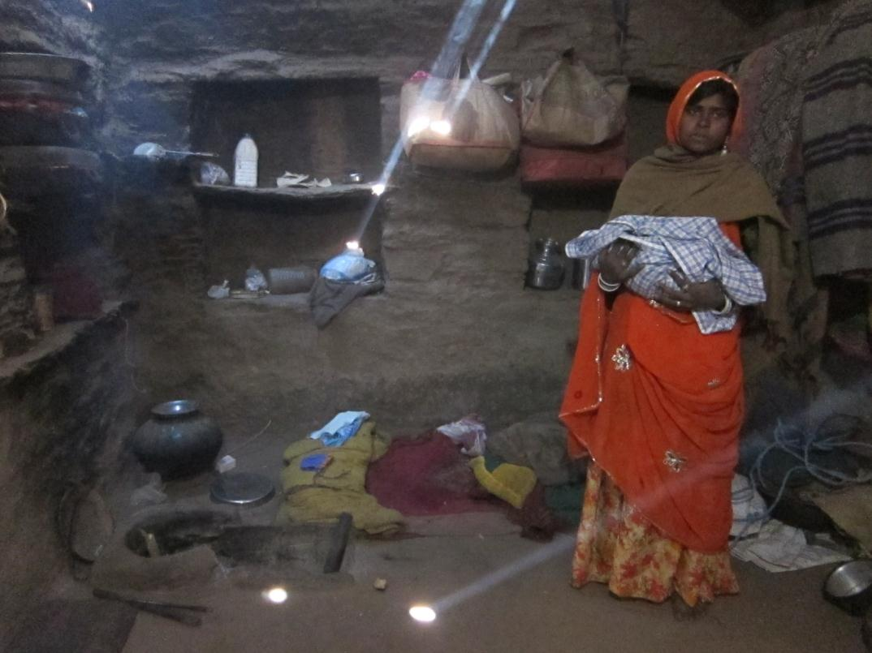
Questions?

Slide 18
Acknowledgement
Action Research and Training for Health

