Slide 1
Dynamically Switching between Synergistic Workflows for Crowdsourcing
Christopher H. Lin, Mausam, Daniel S. Weld
University of Washington
AAAI-2012, Toronto, ON, Canada
Notes:
I’m going to tell you about why and how you can dynamically switch between workflows when crowdsourcing
I’m going to tell you about why two workflows is better than one.

Slide 2
Notes:
Few quick examples of significance:
Mturk: Over 500,000 workers
OdesK: over 100 million paid out last year
This talk: focus on crowdsourcing on Mturk

Slide 3
Translate A→B
Notes:
Workflow is a series of steps that accomplish a task.
Workflows can be complex and you
Can have different workflows for the same task.

Slide 4
Translate A→B
HumanTr
A→B
Choose
HumanTr
A→B

Slide 5
Translate A→B
MachineTr
A→B
ProofRd

Slide 6
Translate A→B
Translate
A→C
Translate
C→B

Slide 7
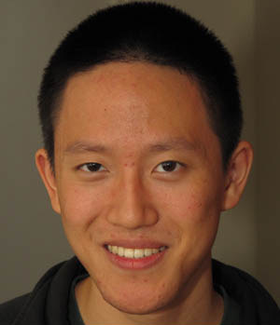
www.crowdsourcing.com
Is this a face?
Yes
No
Notes:
Just showed you some complicated workflows
workflows can be as easy as a one-step multiple choice question.
For the purposes of this talk, we consider the simplest case, where workflows are just simple multiple-choice and where different workflows are just two different ways of asking the same question. However, the ideas that I will present are equally applicable for more complex workflows

Slide 8
NER Tagging
Congressman Tony Coelho landed a million - dollar job on Wall Street after resigning over a controversial junk - bond investment last summer.
Notes:
Example of NER

Slide 9
NER Tagging
Congressman Tony Coelho landed a million - dollar job on Wall Street after resigning over a controversial junk - bond investment last summer.
location
Notes:
Wall street is a location

Slide 10
www.crowdsourcing.com
Congressman Tony Coelho landed a million - dollar job on Wall Street after resigning over a controversial junk - bond investment last summer.
location
film
Notes:
When requesters have a task they want completed, they can create lots of different workflows for the same task, and then pick their favorite.

Slide 11
www.crowdsourcing.com
Congressman Tony Coelho landed a million - dollar job on Wall Street after resigning over a controversial junk - bond investment last summer.
Wall Street
http://en.wikipedia.org/wiki/Wall_Street
Wall Street is the financial district of New York City, named after and centered on the eight-block-long street running from Broadway to South Street.…
Wall Street (1987 film)
http://en.wikipedia.org/wiki/Wall_Street _(1987_film)
Wall Street is a 1987 American drama film released by 20th Century Fox. It was directed by Oliver Stone and stars Michael Douglas, Charlie Sheen, and Daryl Hannah…

Slide 12
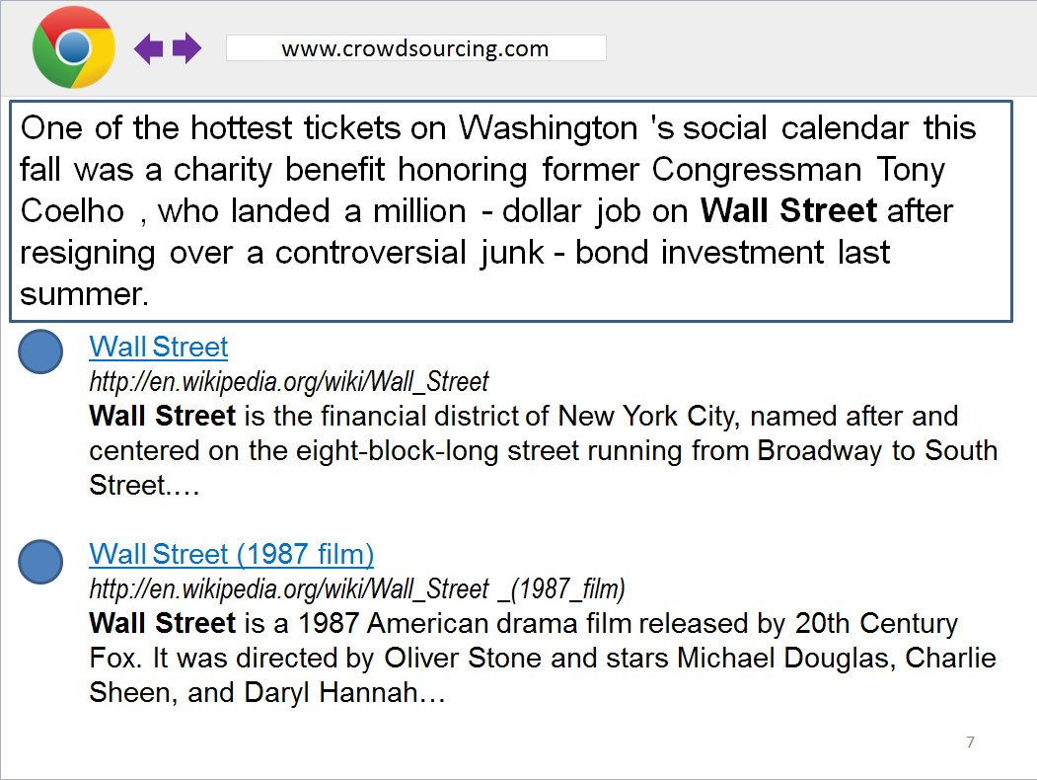
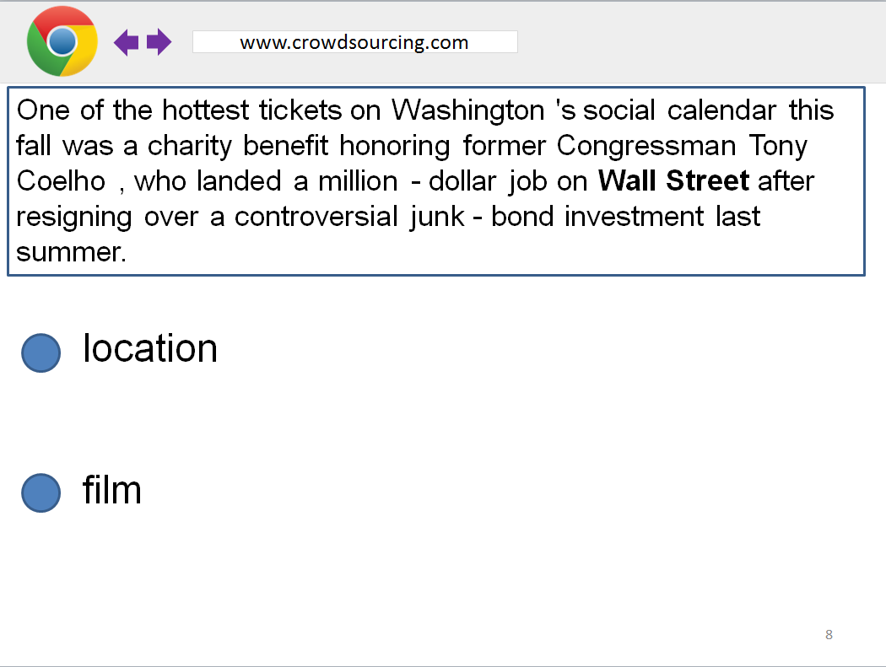
A/B Testing Accuracy
70%
90%

Slide 13
A/B Testing Accuracy
70%
90%
Notes:
After picking the best workflow, in order to account for variations in worker skill, Majority Voting.

Slide 14
Washington State
Washington D.C
www.crowdsourcing.com
us_county
location
citytown
location
Notes:
Or, use decision-theoretic agent to aggregate responses.

Slide 15
Washington State
Washington D.C
www.crowdsourcing.com
us_county
location
citytown
location

Slide 16
Washington State
Washington D.C
www.crowdsourcing.com
us_county
location
citytown
location

Slide 17
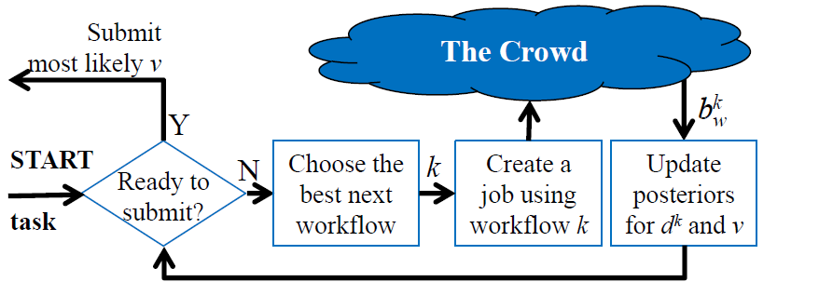
Create job using best workflow
N
[Dai et al, 2010]
Notes:
Input: task, and the value of a correct answer
If a correct answer is valued to be say $1 dollar and the cost is 1 dollar, agent won’t keep creating jobs
If correct answer is valued to be say $100000, then it will cycle around a lot

Slide 18
suboptimal
Create job using best workflow
N
[Dai et al, 2010]
Notes:
This method of crowdsourcing wrong and suboptimal.

Slide 19
Create job using best workflow
N
Notes:
To show you why we shouldn’t

Slide 20
Washington State
Washington D.C
www.crowdsourcing.com
us_county
location
citytown
location
Notes:
Why is it subooptimal?

Slide 21
Washington State
Washington D.C
www.crowdsourcing.com
Washington
http://en.wikipedia.org/wiki/Washington
Washington, D.C., formally the District of Columbia and commonly referred to as Washington, “the District,” or simply D.C., is the capital of the United States….
Washington(state)
http://en.wikipedia.org/wiki/Washington_(state)
Washington () is a state in the Pacific Northwest region of the United States located north of Oregon, west of Idaho, and south of the Canadian province of British Columbia, on the coast of the Pacific Ocean….

Slide 22
Washington State
Washington D.C
www.crowdsourcing.com
Washington
http://en.wikipedia.org/wiki/Washington
Washington, D.C., formally the District of Columbia and commonly referred to as Washington, “the District,” or simply D.C., is the capital of the United States….
Washington(state)
http://en.wikipedia.org/wiki/Washington_(state)
Washington () is a state in the Pacific Northwest region of the United States located north of Oregon, west of Idaho, and south of the Canadian province of British Columbia, on the coast of the Pacific Ocean….

Slide 23
Washington State
Washington D.C
www.crowdsourcing.com
Washington
http://en.wikipedia.org/wiki/Washington
Washington, D.C., formally the District of Columbia and commonly referred to as Washington, “the District,” or simply D.C., is the capital of the United States….
Washington(state)
http://en.wikipedia.org/wiki/Washington_(state)
Washington () is a state in the Pacific Northwest region of the United States located north of Oregon, west of Idaho, and south of the Canadian province of British Columbia, on the coast of the Pacific Ocean….

Slide 24
Before
Create job using best workflow
N
[Dai et al, 2010]

Slide 25
AgentHunt
Notes:
In this talk, I will tell you how to construct such an agent

Slide 26
AgentHunt
Dynamically
Notes:
The important part is that it chooses the best next workflow dynamically.

Slide 27
POMDP
States
Actions
Transition Function
Observation Probabilities
Notes:
Turns out we can define our agent as a pomdp.

Slide 28
POMDP
States
Actions
Transition Function
Observation Probabilities
Notes:
To define the states, introduce the notion of difficulty of a workflow

Slide 29
Notes:
Define the notion of the difficulty of a given task.
Difficulty is ranges from 0 to 1.

Slide 30
www.crowdsourcing.com
2 + 2 = ?

Slide 31
www.crowdsourcing.com
EASY
2 + 2 = ?
d = 0

Slide 32
www.crowdsourcing.com
?
=

Slide 33
www.crowdsourcing.com
?
HARD
=
d = 1

Slide 34
Workflow Difficulties
Correct Answer
Notes:
Hidden state.
Agent maintains a belief. Probability distribution over all possible states.

Slide 35
POMDP
States
Actions
Transition Function
Observation Probabilities

Slide 36
K+1 actions

Slide 37
POMDP
States
Actions
Transition Function
Observation Probabilities
Notes:
In our NER example, Purely-sensing POMDP.

Slide 38
POMDP
States
Actions
Transition Function
Observation Probabilities

Slide 39
Notes:
Observation Probabilities
Need a generative model for worker responses

Slide 40
Difficulty
Notes:
Assume tasks are binary.
Accuracy depends on difficulty, which we’ve already talked about

Slide 41
Worker Ability
Difficulty
Notes:
Also depends on worker ability.

Slide 42
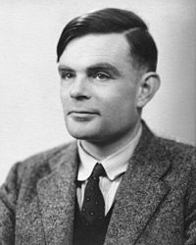
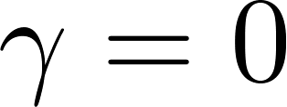
Source:Wikipedia

Slide 43
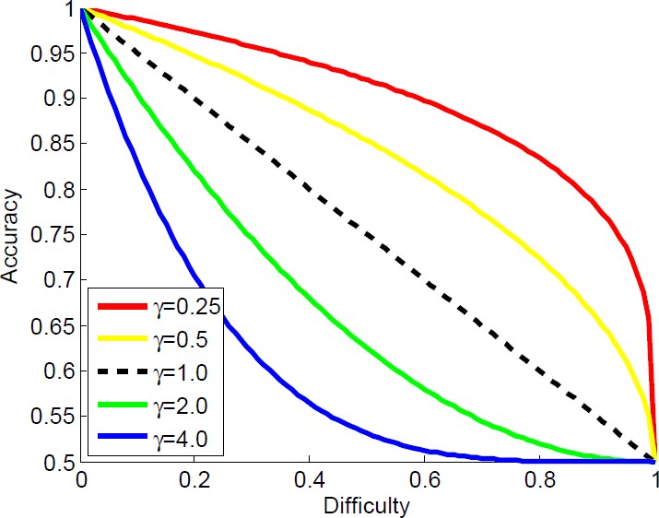
4.0
2.0
1.0
0.5
0.25
[Figure courtesy Peng Dai]
Notes:
As a worker gets better, it takes longer for his accuracy to drop
As a worker gets worse, his accuracy drops much faster.

Slide 44
Notes:
Update the agent’s belief about the state.

Slide 45
Learn New Parameters
Notes:
Haven’t told you how to learn gamma

Slide 46
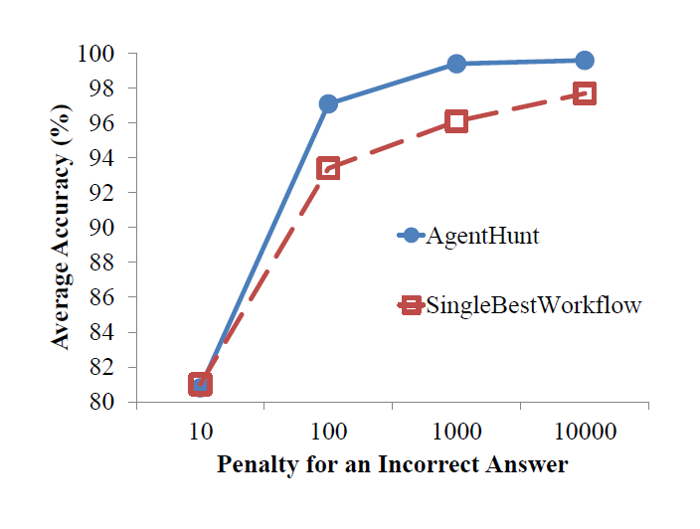
AgentHunt beats SingleBestWorkflow
[Dai et al, 2010]
Notes:
First, we try some simulations.
1000 simulations for each penalty. Recall one of the inputs is the value of a correct answer.
Agent that uses single-best workflow

Slide 47
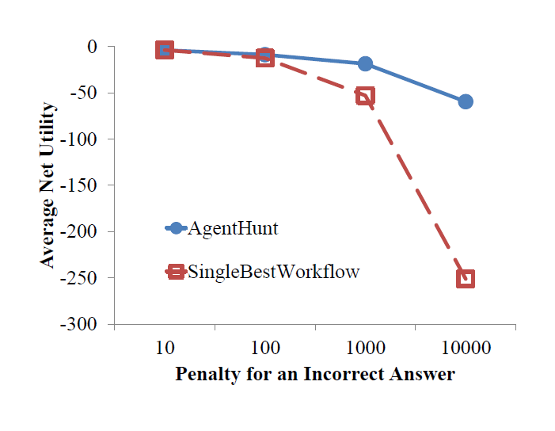
AgentHunt beats SingleBestWorkflow
[Dai et al, 2010]

Slide 48
AgentHunt beats SingleBestWorkflow
 | AgentHunt | Single Best Workflow
Average Accuracy (%) | 92.45 | 85.85
Average Net Utility | -13.36 | -18.35
Notes:
106 real NER tasks
Statistical significance

Slide 49
Contributions
A probabilistic model for multiple workflows
A decision-theoretic agent that dynamically switches between workflows
Real experiments that show you should not throw away your workflows

Slide 50
INTERESTED?
http://cs.washington.edu/homes/chrislin
Notes:
Software for download

Slide 51
Repeated Labeling
Romney et al, 1986; Sheng et al, 2008; Raykar et al, 2010; Whitehill et al, 2009; Dai et al, 2010, 2011; Kamar et al, 2012; Parameswaran et al, 2010; Karger et al, 2011; Snow et al, 2008;
Complicated Workflows
Little et al, 2009; Bernstein et al, 2010; Liem et al, 2011; Noronha et al, 2011; Lasecki et al, 2011; Kulkarni et al, 2012;
AI Control of Workflows
Dai et al, 2010,2011; Shahaf et al, 2010; Weld et al, 2011;
Kamar et al, 2012;

Slide 52
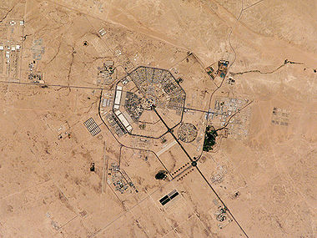
www.crowdsourcing.com
How many people are there
in this military base?
Source:Wikipedia
Notes:
To simplify, we, along with all other research that we know of, restrict tasks to multiple choice.
Extend to case of infinite possible answers

Slide 53
Christopher H. Lin, Mausam,
and Daniel S. Weld.
“Crowdsourcing Control:
Moving Beyond Multiple Choice.”
In UAI 2012

