Slide 1

Re-active Learning:
Active Learning with Re-labeling
Christopher H. Lin
University of Washington
Mausam
IIT Delhi
Daniel S. Weld
University of Washington
Notes:
I’m going to talk to you today about a problem that we’re calling reactive learning – a generalization of active learning to the case of noisy labels that allows for the relabeling of examples. Ok, so why is generalizing active learning so that you can relabel example important?

Slide 2

*Speaker not paid by Oracle Corporation
Notes:
Typically, active learning assumes that labels come from a single oracle, right?

Slide 3
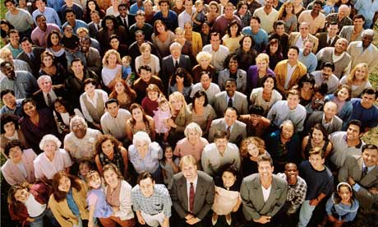
CROWDSOURCING
Notes:
But these days, everybody is using crowdsourcing to label training data for their learning algorithms.
And so we can no longer assume that labels come from a single annotator.

Slide 4
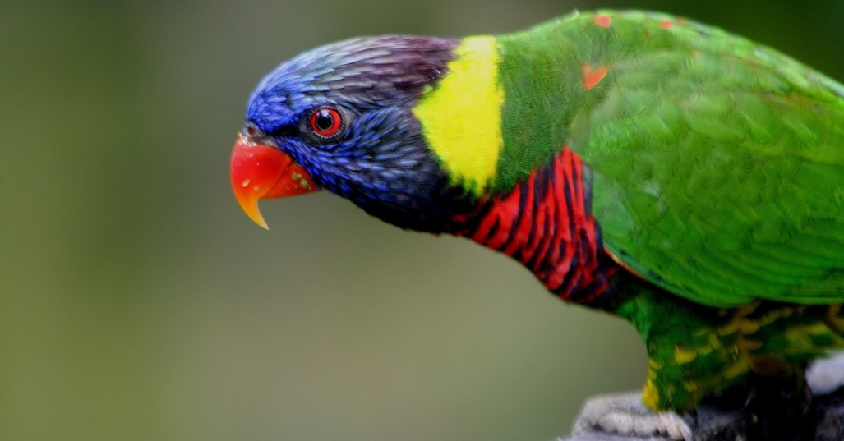
(Labeling) Mistakes Were Made
Human
Notes:
Why? Because crowd workers make mistakes.
Workers will label training data incorrectly.
So when people crowdsource their training data,

Slide 5

Majority Vote
Parrot
Parakeet
Parrot
Parrot
Notes:
because humans make mistakes, instead of getting one label for each example,
They ask multiple crowdworkers to label each example

Slide 6
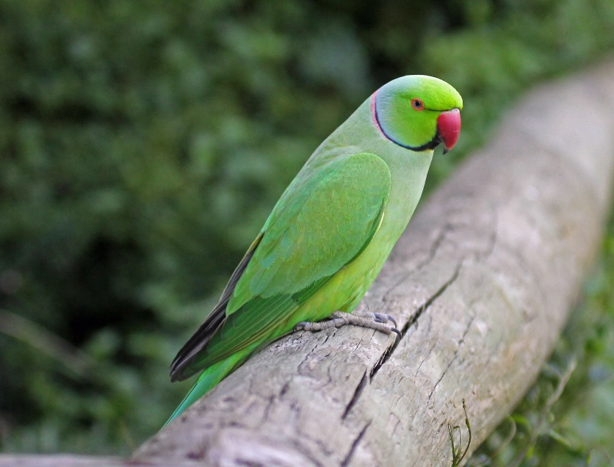
Relabel?
Parakeet
Parrot
VS
New label?
Parakeet
Notes:
So we must generalize active learning to allow relabeling
And this relabeling causes us to
Now we have to make a tradeoff that didn’t exist before.
Should we relabel, or gather additional labels for an existing training example
In other words, should we denoise the existing training set, or should we expand our training set with new example
This is reactive learning.

Slide 7
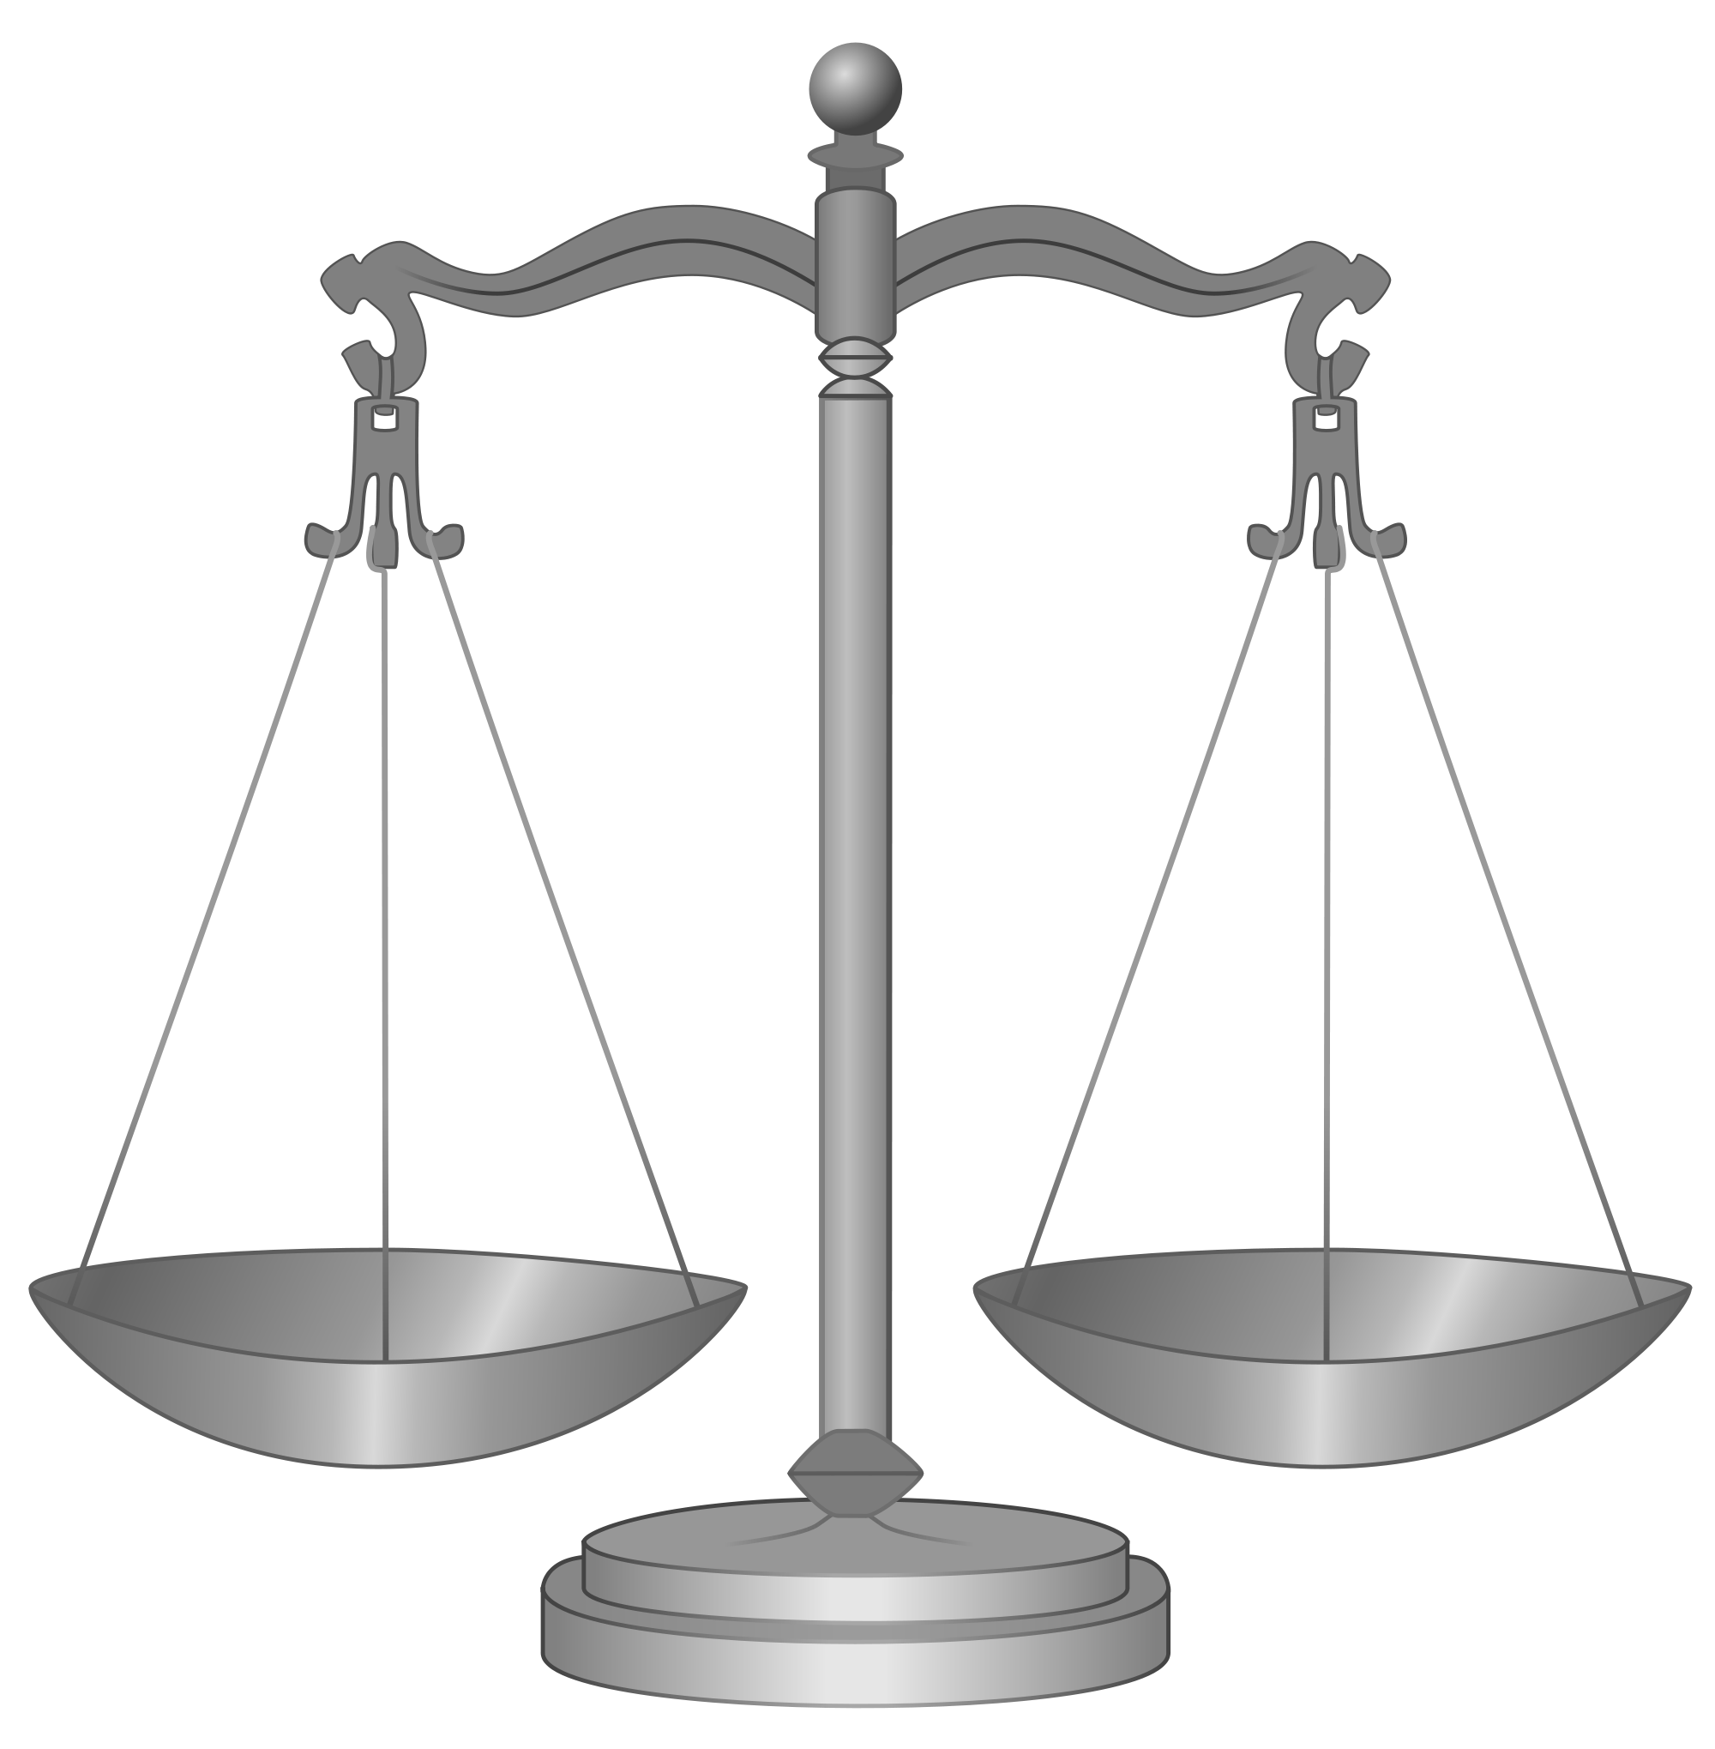
MORE
NOISY
DATA
LESS
BETTER
DATA
Notes:
That is, How do we best balance between more noisy data and less better data

Slide 8
MORE
NOISY
DATA
LESS
BETTER
DATA
[Sheng et al. 2008, Lin et al. 2014]
Notes:
I do want to note that this current paper of ours is not the first that has noticed this tradeoff, and
We as well as others have considered this tradeoff before in a static learning setting.
The biggest difference between the existing work and our current work is that instead of considering this tradeoff
In a static learning setting, we dynamically decide as we are training, which examples are best

Slide 9
Re-active Learning Contributions
Standard Active Learning Algorithms Fail
Uncertainty Sampling
[Lewis and Catlett 1994]
Expected Error Reduction
[Roy and McCallum 2001]
Re-active Learning Algorithms
Extensions of Uncertainty Sampling
Impact Sampling
Notes:
Ok, so hopefully I’ve convinced you why reactive learning is an important problem.
So now I’m going to tell you about the contributions we’ve made to reactive learning.
Our first contribution, we show that
In particular, I’m going to show you why uncertainty sampling and expected error reduction,
Surprisingly a generalization of uncertainty sampling!

Slide 10
Standard active learning algorithms fail!

Slide 11
h*
True Hypothesis
Notes:
Suppose we’re trying to learn
Green diamonds and yellow circles
Maybe enlarge examples

Slide 12
h
h*
Current Hypothesis
Notes:
Suppose we’re trying to learn
Maybe enlarge examples

Slide 13
h
h*
Uncertainty Sampling
[Lewis and Catlett (1994)]
Notes:
Consider uncertainty sampling extended to reactive learning.
What does that mean? It means now instead of only allowing it…
They don’t leverage the two sources of information about labels: classifier uncertainty and label uncertainty, and consequently get trapped

Slide 14
h
h*
Suppose labeled many times already!
Notes:
For inductive purposes, suppose we’ve labeled them many times already.
So because they’ve been labeled many times, they’ve converged to the correct labels.

Slide 15
h
h*
Uncertainty Sampling labels these two examples
Infinitely many times!
Notes:
Then we receive another label. But because we’ve labeled these points so many

Slide 16
Fundamental Problem:
Does not use all sources of information
h
h*
Uncertainty Sampling labels these two examples
Infinitely many times!
Notes:
So what is the fundamental problem here?
If 100 workers have told you that…

Slide 17
Re-active Learning Contributions
Standard Active Learning Algorithms Fail
Uncertainty Sampling
[Lewis and Catlett 1994]
Expected Error Reduction
[Roy and McCallum 2001]
Re-active Learning Algorithms
Extensions of Uncertainty Sampling
Impact Sampling
Notes:
EER next

Slide 18
Expected Error Reduction (EER)
[Roy and McCallum (2001)]
Also suffers from infinite looping!
Notes:
Ok, so I’ve just told you about how uncertainty sampling, a standard active learning algorithm, doesn’t work
But it’s not just US, other algorithms suffer from similar problems.
Another common algorithm is Expected Error Reduction .

Slide 19
Re-active Learning Contributions
Standard Active Learning Algorithms Fail
Uncertainty Sampling
[Lewis and Catlett 1994]
Expected Error Reduction
[Roy and McCallum 2001]
Re-active Learning Algorithms
Extensions of Uncertainty Sampling
Impact Sampling
Notes:
Ok, so hopefully I’ve convinced you why reactive learning is an important problem.
So now I’m going to tell you about the contributions we’ve made to reactive learning.
Our first contribution, we show that
In particular, I’m going to show you why uncertainty sampling and expected error reduction,
Surprisingly a generalization of uncertainty sampling!

Slide 20
How to fix?
Consider the aggregate label uncertainty!
M_{L}
Notes:
So I just told you about the first contribution of our work– understanding
Now I’m going to talk about our first algorithmic contribution.
Define label uncertainty!

Slide 21
How to fix?
Consider the aggregate label uncertainty!
M_{L}
h
h*
High # annotations = LOW UNCERTAINTY
Notes:
Now I’m going to tell you about our first two algorithmic contributions to reactive learning.
TALK ABOUT NUMBER OF LABELS

Slide 22
How to fix?
Consider the aggregate label uncertainty!
M_{L}
Low # annotations = HIGH UNCERTAINTY
h
h*
High # annotations = LOW UNCERTAINTY
Notes:
Now I’m going to tell you about our first two algorithmic contributions to reactive learning.

Slide 23
Alpha-weighted uncertainty sampling
^{(1-α)}
.
Classifier uncertainty
+
^{α}
.
Aggregate Label uncertainty
Notes:
For the purposes of this talk, We call this alpha-weighted uncertainty sampling

Slide 24
Fixed-Relabeling Uncertainty Sampling
Pick new unlabeled example using classifier uncertainty
Get a fixed number of labels for that example
Notes:
Weaknesses of the two methods: parameter choosing.
So next, I’m going to tell you about a new algorithm that we’ve come up with
For reactive learning that not only elegantly fixes the problems,

Slide 25
Re-active Learning Contributions
Standard Active Learning Algorithms Fail
Uncertainty Sampling
[Lewis and Catlett 1994]
Expected Error Reduction
[Roy and McCallum 2001]
Re-active Learning Algorithms
Extensions of Uncertainty Sampling
Impact Sampling
Notes:
Ok, so hopefully I’ve convinced you why reactive learning is an important problem.
So now I’m going to tell you about the contributions we’ve made to reactive learning.
Our first contribution, we show that
In particular, I’m going to show you why uncertainty sampling and expected error reduction,
Surprisingly a generalization of uncertainty sampling!

Slide 26
Impact (ψ) Sampling
Notes:
Both uncertainty sampling and EER starve examples.
So we came up with a new algorithm that we’re calling impact sampling.
Impact sampling works by seeing how much impact a label will have on the predictions of the resulting classifier.
Thus, a point labeled many times will be unlikely to change the classifier.
We’ll use psi to denote impact.

Slide 27
h
Current Hypothesis
Notes:
Suppose again that we’re trying to learn a 1-d threshold that separates diamonds and circles

Slide 28
Labeled
Labeled
h
Notes:
Impact sampling algorithms work by computing the impact a new point will have on the algorithm.
Suppose again that you are learning a threshold
And you’ve currently labeled two points on the end.

Slide 29
Labeled
Labeled
h
What is the impact of labeling this example?
Notes:
Let’s suppose we want to compute the impact of this example.
In order to compute the impact of an example, we have to consider the impact of the two possible labels.

Slide 30
Labeled
Labeled
h
Impact of labeling this example a diamond
Notes:
Impact sampling algorithms work by computing the impact a new point will have on the algorithm.
Suppose again that you are learning a threshold
And you’ve currently labeled two points on the end.

Slide 31

Labeled
Labeled
h
Ψ (x)
Impact of labeling this example a diamond
Notes:
So 5 examples is the impact

Slide 32
Labeled
Labeled
h
Impact of labeling this example a circle
Notes:
Impact sampling algorithms work by computing the impact a new point will have on the algorithm.
Suppose again that you are learning a threshold
And you’ve currently labeled two points on the end.

Slide 33
Labeled
Labeled
h
Ψ (x)
Impact of labeling this example a circle
Notes:
Impact sampling algorithms work by computing the impact a new point will have on the algorithm.
Suppose again that you are learning a threshold
And you’ve currently labeled two points on the end.

Slide 34
Total Expected Impact of
h
Ψ (x)
Notes:
So now we can compute the total expected impact

Slide 35
Total Expected Impact of
h
h
Ψ (x)
Ψ (x)
Notes:
So now we can compute the total expected impact

Slide 36
Total Expected Impact of
h
h
Ψ (x)
Ψ (x)
Ψ (x) = P(x = ) Ψ (x) + P(x = ) Ψ (x)
Notes:
So now we can compute the total expected impact

Slide 37
Ψ (x) = P(x = ) Ψ (x) + P(x = ) Ψ (x)
Use classifier’s belief as prior.
Bayesian update using annotations.

Slide 38
Assuming annotation accuracy > 0.5:
As # annotations (x) goes to infinity,
Ψ(x) goes 0.
Notes:
In other words, If an example has many labels already, an additional label is highly unlikely to change the classifier.

Slide 39
Theorem
In many noiseless settings, when relabeling is unnecessary,
impact sampling = uncertainty sampling
Notes:
Now ostensibly, uncertainty sampling and impact sampling are optimizing for 2 completely different objectives.

Slide 40
Theorem
In many noiseless settings, when relabeling is unnecessary,
impact sampling = uncertainty sampling
When relabeling is necessary:
impact sampling = uncertainty sampling
Notes:
Now ostensibly, uncertainty sampling and impact sampling are optimizing for 2 completely different objectives.

Slide 41

Consider an example with the following labels:
Aggregated Label
via majority vote
Notes:
Now you may have noticed that impact sampling is myopic.
In that doesn’t consider the effect of multiple labels
Suppose we are using majority vote.

Slide 42
Before:
After adding an additional label:
NO CHANGE

Slide 43
Pseudolookahead
Let r be the minimum number of labels to flip the aggregate label.
Notes:
In order to allow impact sampling to do some lookahead, we came up
With the method of pseudolookahead.

Slide 44
Pseudolookahead
Let r be the minimum number of labels to flip the aggregate label.

Slide 45
Pseudolookahead
Let r be the minimum number of labels to flip the aggregate label.
r = 3

Slide 46
Pseudolookahead
Ψ (x) = Ψ (x) / r
Redefine
r

Slide 47
Pseudolookahead
Ψ (x) = Ψ (x) / r
Redefine
r
Careful Optimism!
Notes:
So we are essentially taking the future impact from labeling an example multiple times, and normalizing it by how long it will take.
It’s like careful optimism.

Slide 48
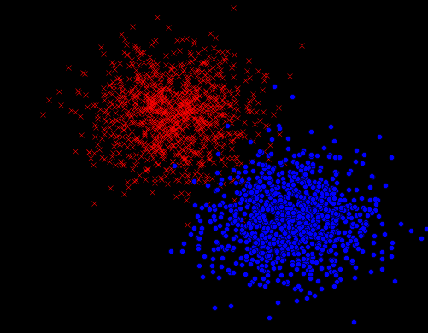
Budget = 1000
Label Accuracy = 75%
10,30,50,70,90 Features

Slide 49
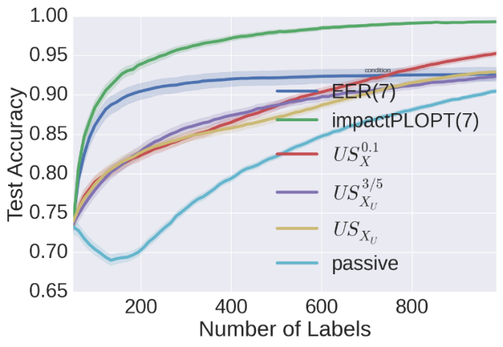
EER
impact
Alpha-uncertainty
Fixed-uncertainty
uncertainty
passive
Gaussian (num features = 90)
Notes:
We begin with the passive line.

Slide 50
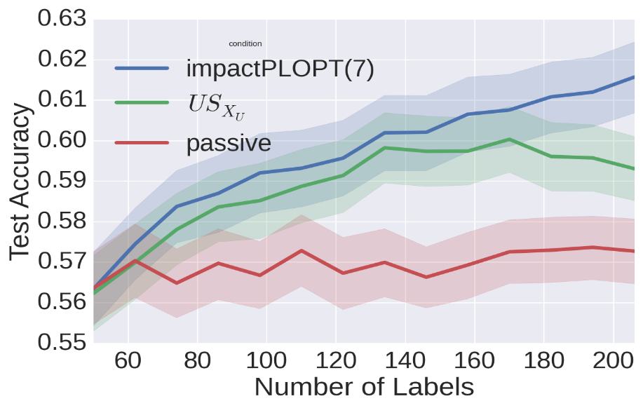
impact
uncertainty
passive
Arrhythmia (num features = 279)

Slide 51
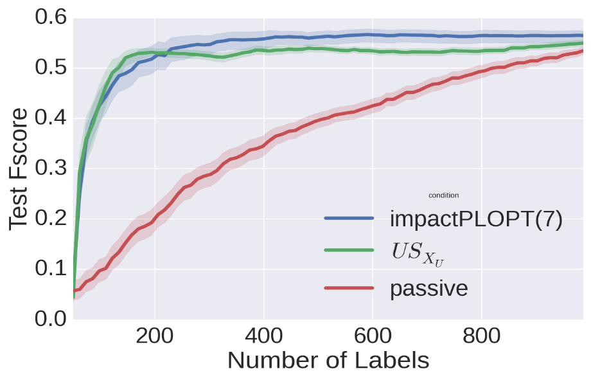
impact
uncertainty
passive
Relation Extraction (num features = 1013 features)

Slide 52
Re-active Learning Contributions
Standard Active Learning Algorithms Fail
Uncertainty Sampling
[Lewis and Catlett 1994]
Expected Error Reduction
[Roy and McCallum 2001]
Re-active Learning Algorithms
Extensions of Uncertainty Sampling
Impact Sampling
Notes:
In particular, I’m going to show you why uncertainty sampling and expected error reduction,

