Slide 1
Precise Dynamic Data-Race Detection At The Right Abstraction Level
Dan Grossman
University of Washington
Facebook Faculty Summit
August 6, 2013

Slide 2
My plan
Background: Why data races really matter
Semantics, compiler, hardware
Every programmer must know this (most don’t)
UW work on dynamic data-race detection
Hardware/software hybrid for speed
Virtualizing detection so correct for high-level languages
Other UW work on concurrency
Then we can eat ☺

Slide 3
An example
// shared memory
a = 0; b = 0;
// Thread 1
x = a + b;
y = a;
z = a + b;
assert(z>=y);
// Thread 2
b = 1;
a = 1;
Can the assertion fail?

Slide 4
An example
// shared memory
a = 0; b = 0;
// Thread 1
x = a + b;
y = a;
z = a + b;
assert(z>=y);
// Thread 2
b = 1;
a = 1;
Argue assertion cannot fail:
a never decreases and b is never negative, so z>=y
But argument makes implicit assumptions you cannot make in Java, C#, C++, etc. (!)

Slide 5
Common-subexpression elimination
// shared memory
a = 0; b = 0;
// Thread 1
x = a + b;
y = a;
z = a + b; x;
assert(z>=y);
// Thread 2
b = 1;
a = 1;
Now assertion can fail
Most compiler optimizations can have effect of reordering/removing/adding memory operations
Hardware also reorders memory operations

Slide 6
A decision…
// shared memory
a = 0; b = 0;
// Thread 1
x = a + b;
y = a;
z = a + b; x;
assert(z>=y);
// Thread 2
b = 1;
a = 1;
Language semantics must resolve this tension:
If assertion can fail, the program is wrong
If assertion cannot fail, the compiler is wrong
Greatest practical failure of computer science?

Slide 7
Memory-consistency model
A memory-consistency model for a shared-memory language specifies which write a read can see
Essential part of language definition
Widely under-appreciated until a few years ago
Natural, strong model is sequential consistency (SC) [Lamport]
Intuitive “interleaving semantics” with a global memory
No reordering

Slide 8
Considered too strong
Under SC, compiler is wrong in our example
Cannot use optimization/hardware that effectively reorders memory operations
[on mutable, thread-shared memory]
So modern languages do not guarantee SC
But still need some language semantics to reason about programs…
The grand compromise…

Slide 9
The “grand compromise”
T1
T2
SC only for “data-race free” programs [Adve,Boehm]
Rely on programmer to synchronize correctly
More precisely:
Data race [technical term]: read/write or write/write of the same location by distinct threads not ordered by synchronization
Semantics: If every SC execution of a program P has no data races, then every execution of P is equivalent to an SC execution
Known as “DRF implies SC”
rd(x)
rd(x)
wr(y)
rel(m)
acq(m)
rd(z)
wr(x)
rd(x)

Slide 10
Under the compromise
Programmer: write a DRF program
Language implementer: provide SC assuming program is DRF
Suffice not to add memory ops, turns reads into writes, or move memory ops across possible synchronization
But what if there is a data race:
C++: “catch-fire semantics”
Java/C#: complicated story almost nobody understands
Preserve safety/security despite reorderings
Most others: disturbing mumbles
One saner alternative: Data-race exceptions (DREs)

Slide 11
My plan
Background: Why data races really matter
Semantics, compiler, hardware
Every programmer must know this (most don’t)
UW work on dynamic data-race detection
Hardware/software hybrid for speed
Virtualizing detection so correct for high-level languages
Other UW work on concurrency
Then we can eat ☺

Slide 12
Performance Problem
Prior work: precise dynamic data-race detection
No false data races + no missed data races
See FastTrack [Flanagan/Freund 2009]
But 2-10x slowdown
Our work:
Step 1: Can hardware speed it up? RADISH¹
Step 2: Can hardware do the right thing? LARD²
¹ with Joe Devietti, Ben Wood, Karin Strauss, Luis Ceze, Shaz Qadeer [ISCA12]
¹ with Ben Wood, Luis Ceze [under submission]

Slide 13
The hardware story (hand-wave version)
Most memory accesses:
Hit in cache
A couple bits of metadata-state suffice to show cannot-race
Can delay updating per-location metadata until cache change
In less common cases, communicate with other processors
When multiprocessor cache protocols already do
In even less common cases, communicate with software system
Example: If data last accessed by a swapped out thread

Slide 14
What we did
High-level architectural design (RADISH)
Hardware/software hybrid essential to design
Use same data cache for data and metadata
Software can indicate no-metadata (e.g., for thread-local)
Compare speed and precision for:
Software simulation of our hardware design
Software-only variant (FastTrack algorithm for assembly)

Slide 15
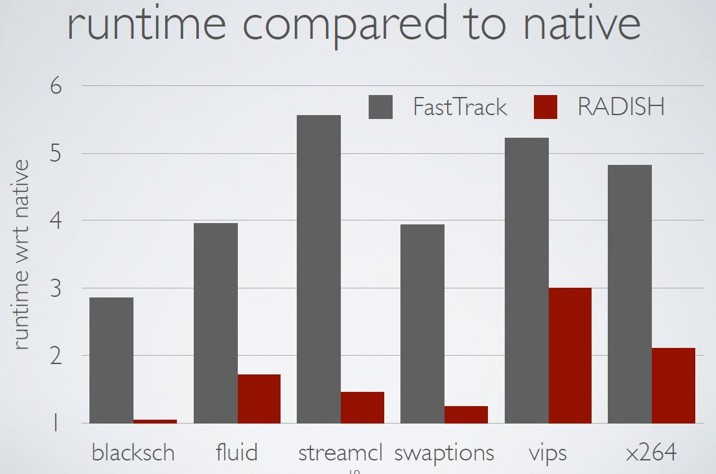

Slide 16
That was C…
Maybe for a managed language we would do better
Baseline has more overhead per memory operation
In case you’re in lunch-mode: THIS DOESN’T WORK!
Java Bytecodes
exception
JVM + JIT
HW + Race Detection
trap

Slide 17
The problem
Java data-race detection must use the Java memory abstraction
Reads/writes to object fields
Lock acquires/releases
Java thread identity
This is not the memory abstraction running on hardware
Same memory reused for multiple Java objects (GC)
Same Java object in multiple locations (GC)
JVM does its own racy operations (concurrent GC, …)
JVM does its own synchronization
JVM can multiplex onto system threads
Each of these can miss races or cause false races

Slide 18
Our work
Identify the problem:
Data-race detection fundamentally for one memory abstraction
Get the performance of low-level detection with the semantics of high-level detection via HW + run-time system cooperation
Communicate via a few new assembly instructions (LARD)
Example: Copy metadata for address range
Empirical results:
4 of 5 issues break precision in practice for at least 1 benchmark
Thanks to RADISH + LARD, actual Jikes modifications small
Results agree with FastTrack and retain almost all of RADISH’s performance

Slide 19
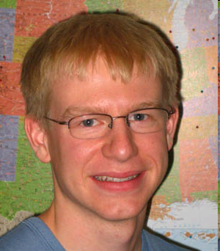
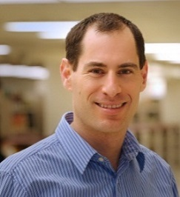
A common story
First, fundamental problems:
+ great PhD students
But then hardware/software hybrids
Software: what/how to check
Hardware: fast common cases
(Need more research that marches across the system stack)
Applications
SE
PL
Compilers
Architecture
Microarchitecture
Circuits
Devices

Slide 20
Much, much more
Some other UW work on concurrency:
Deterministic execution: Joe Devietti [Penn], Tom Bergan, …
Symbolic execution and constrained schedulers: Tom Bergan
Bug Detection/Avoidance: Brandon Lucia [MSR], …
Language design for no races: Colin Gordon
And foundational work on aliasing + verification
And much more too:
Approximate computing: Adrian Sampson [FB fellow] + others
Program analysis for math-problem synthesis
System design with emerging memory technologies
Large low-locality graph problems [hi FB! ☺]
…

Slide 21
Thanks!
Questions?
Lunch?

