Slide 1


Reflections From a Happy MOOC Instructor
Dan Grossman
Department of Computer Science & Engineering
University of Washington
SPLASH-E
October 28, 2013

Slide 2
Roles
Instructor: Design course, record videos, write homeworks, …
TAs: Monitor forums, manage autograding, …
Administrator: University strategy, partner relations, recruit faculty, …
Logistics: Upload files, set deadlines, squash bugs, …
A/V crew: Edit videos, …
Liaison to provider: Schedules, changes, questions, …

Slide 3

Being an early adopter is fun and exhausting because you assume all the roles
  I was a MOOC spectator 16 months ago
  Cf. 1970s systems research

Slide 4

Why do a MOOC?
Believe I have a great course and want to have worldwide impact
  10x more students in 1 year than in last decade combined
  Have people learn instead of watching Real Housewives
  Influence and fame (not fortune)
Be part of academic change
  Not read about it in the newspaper

Slide 5

Like writing a textbook
A MOOC is not
  A conventional course
  A conventional textbook
But much more like a textbook with interactvity and a social-network component
  A ton of work
  Attrition ≠ failure
  Rarely profitable for authors
  Influence other educators
  Assessment a secondary issue
  “21st-century textbook plus social”

Slide 6

Perspective
It is plausible MOOCs will destroy universities as we know them (!)
  Disruptive change can happen
But universities have survived before:

Slide 7
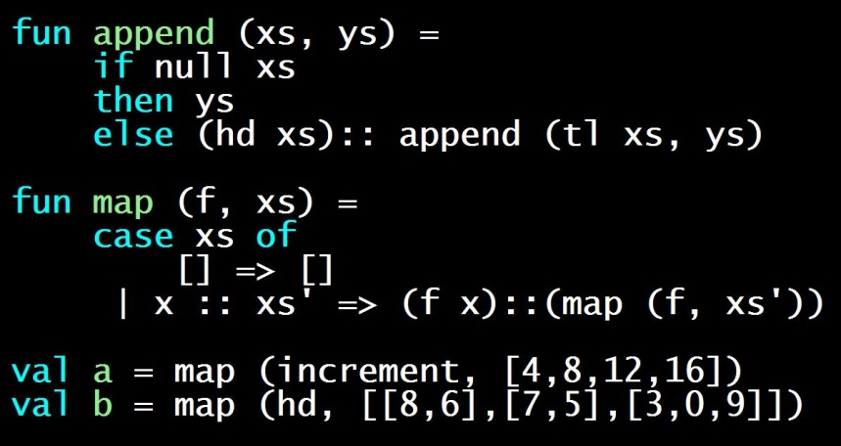
What did I do?
Challenging sophomore-level PL course
  FP, pattern-matching, static vs. dynamic, ML module basics, …
Same challenging homeworks
  With auto-testing and peer-review
Replaced exams with clever multiple choice and check-boxes
One of the most challenging and time-consuming MOOCs
  8-16 hours / week
  “The real deal” loved by many, but not for everyone

Slide 8
So what was [the first offering] like behind the scenes?
Four pictures…

Slide 9
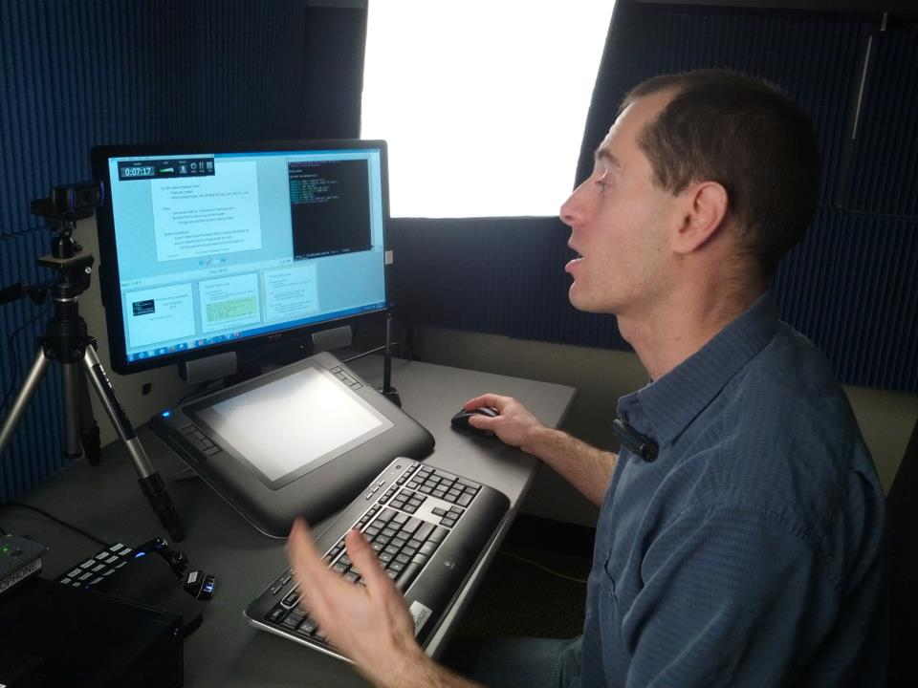
Four pictures

Slide 10
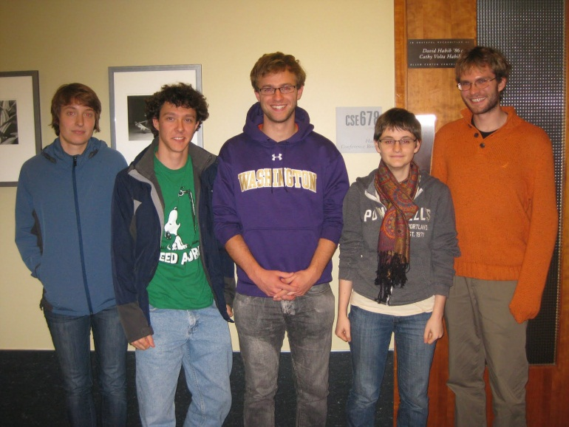
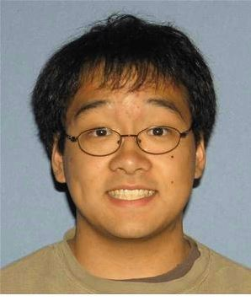
Four pictures

Slide 11
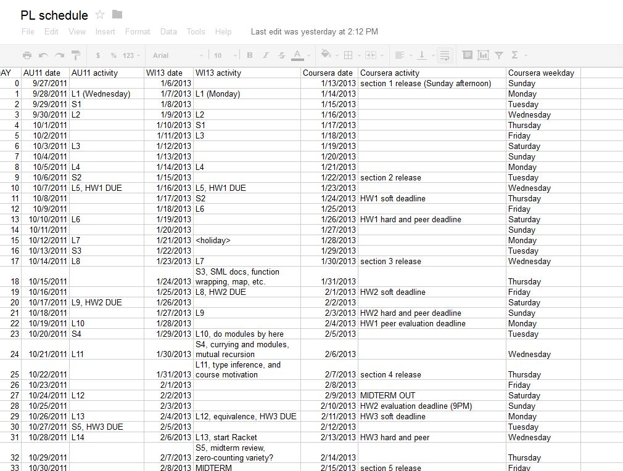


Four Pictures

Slide 12
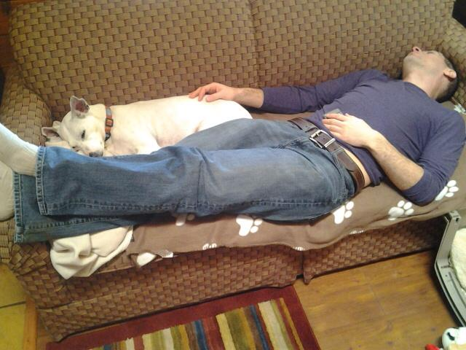
Four pictures

Slide 13
Working with Coursera
The fun of a start-up because…
they’re a start-up!
  18 months old today and I’ve worked with them for 16 months
  60ish people today (growing)
  Much younger than me
Their goals and mine simply have not been in conflict

Slide 14
Data
  Have more data than I could collect on campus in a lifetime
    Ask me about it!
  Here: High-level bits on completion rate
    Because everyone asks…

Slide 15
Participation numbers
“Registered”: 65,000 totally irrelevant
Clicked play in first 2 weeks: 27,000 many didn’t have pre-reqs!
Watched an hour of video: 12,000 like coming to first day!
Turned in 1st homework: 4,000
Turned in 5th homework: 2,100 attrition doesn’t stop
“Passed”: 1,716
Define success however you want
  Many love it in parts, start late, don’t do the homework, etc.

Slide 16
Choose your denominator
I personally do not say, “65K took my course”!
We need a more realistic “completion rate”
Registered: 65,000
Completers: 1716 2.6%
Took pre-survey: 16,587
Completers therein: 1479
8.9%
>70% (*) on Homework 1: 3170
Completers therein: 1552
49.0%
* UW median >95%

Slide 17
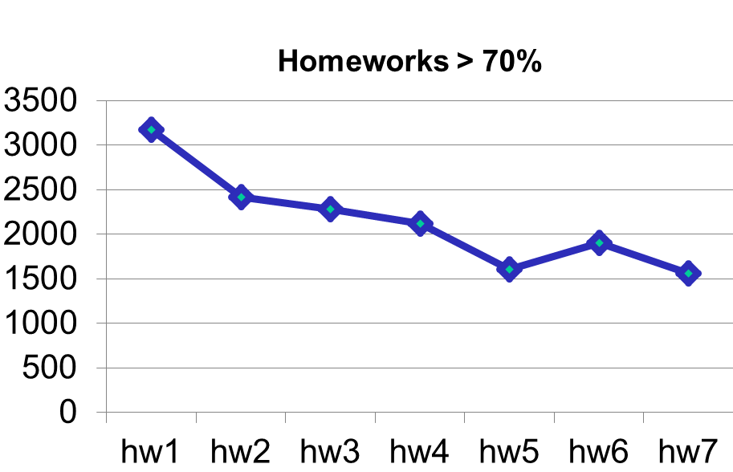
Attrition steady

Slide 18
Cynic’s view
Data makes clear how to drive up completion rates:
  Make the course shorter
  Make it harder to sign up (e.g., no sign-up until 2 weeks before)
  Require less work
  Let them resubmit endlessly
  Set the bar for passing lower

Slide 19

For me…
One of the coolest things I have ever done
  Rewarding, influential, exhausting
  Share my passion with thousands around the world!
No “one right way” to teach a MOOC
(or write a textbook)
Demographics very different from on campus
Early days – nobody knows where MOOCs are heading
I believe MOOCs are more fantastic than horrible

Slide 20
Roles: Early Adopter = All-of-the-above
Instructor: Design course, record videos, write homeworks, …
TAs: Monitor forums, manage autograding, …
Administrator: University strategy, partner relations, recruit faculty, …
Logistics: Upload files, set deadlines, squash bugs, …
A/V crew: Edit videos, …
Liaison to provider: Schedules, changes, questions, …

Slide 21
Video
Silverlight with nice navigation:
http://www.colorado.edu/atlas/newatlas/mainphoto/photo142.html
Plain-old Youtube
http://www.youtube.com/watch?v=1T4IQrOJr5U

Slide 22
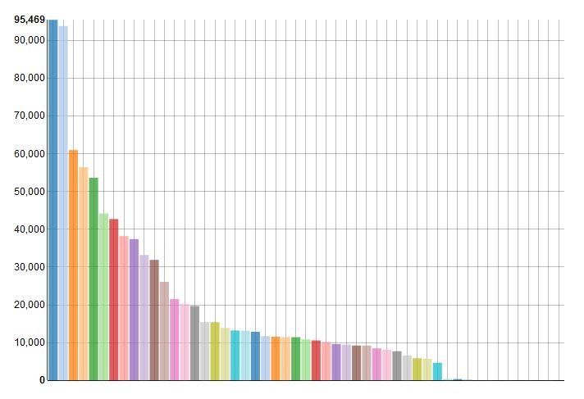

Slide 23
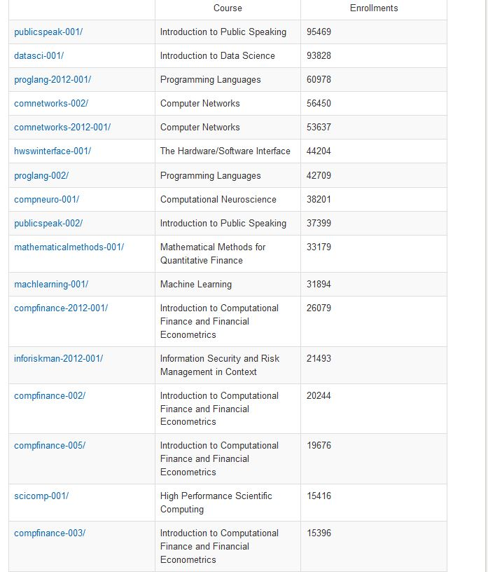

Slide 24
