Slide 1
PLDI 2018 Program-Chair Report Dan Grossman

Slide 2
Process [with some data]
Data [with some reflections]
Reflections [with some thank-yous]

Slide 3
Submissions
Anonymous, better known as “double blind”
Conflicts-of-interest (precisely defined) indicated by authors
Double-checked by Program Chair
Reviewers could not “see” papers they were conflicted with
PC members could not see submissions by other PC members

Slide 4
Reviewers
PC: ~35 people, ~20 reviews each, decide on non-PC papers
EPC: ~20 people, ~10 reviews each, decide on PC papers
ERC: ~50 people, ~5 reviews each
External reviewers to complement expertise: ~25 people, 1 review

Slide 5
Review Preferences
Better known as “bidding”
Give both “desire” and “likely expertise”, e.g., 5X or -10Y
Such preferences are much more useful
Number / letter often correlated but not always
No automation here beyond sorting by topic scores

Slide 6
Review Assignments
Round 1: All papers received 3 or 4 reviews
Aim to give each paper at least one “X” and not reviewers who “really don’t want to do it”
Started with an automated assignment and then spent a dozen hours of “ad hoc hill-climbing” using review preferences
Round 2: Additional 1-2 reviews for most papers (> 2/3)
Online discussion to identify complementary expertise
Assignments done manually over a couple days

Slide 7
Decisions
Extensive online discussion after round-two reviews
2-day PC meeting
Not all papers discussed, but those discussed in almost-random order
No target acceptance rate
EPC conference call for PC papers – “clearly within acceptance envelope”
“Double-blind until accept” with one slight, appropriate exception

Slide 8
Shepherding
All acceptances were conditional with shepherd from PC/EPC
Mandatory vs. recommended changes from the discussion
This year, all conditional acceptances were accepted
Healthy process with no “issues”

Slide 9
Process [with some data]
Data [with some reflections]
Reflections

Slide 10
262 submissions (but 4 not sent to reviewers)
55 acceptances
For an acceptance rate of…
I’m not going to write that down for you
Unclear to me what it’s measuring
Well within historic norms though somewhat higher than recent years

Slide 11
Submissions were down
Upsides
No decrease in number of high-quality submissions (acceptances up)
More reasonable reviewing loads with manageable committee sizes
Have some theories, but none with evidence ☺
PLDI seems plenty healthy
2018 | 262
2017 | 322
2016 | 304
2015 | 303
2014 | 287
2013 | 267
2012 | 255
2011 | 236
2010 | 206
2009 | 196
2008 | 184
2007 | 178

Slide 12
Numbers through the process
262 submissions
258 received round-one reviews
179 received round-two reviews
92 discussed at the PC meeting
47 accepted by the PC (8 more than last year)
8 PC papers accepted by the EPC (same as last year)

Slide 13
Expertise levels
[Mostly for fun, don’t read much into this]
238 papers received >= 1 expert (“X”) review, 52 accepted
20 papers received 0 expert reviews, 3 accepted
Often expected an X
Always discussed if an X was needed
6 papers received all expert reviews, 0 accepted
(Average would have been 1)

Slide 14
Paper topics
[grain of salt: all self-reported at time of submission]
The list:
Started with last year, made ~10-15 edits
Examples: Split verification in three; removed unused topics
Incorporated additional feedback from PC/EPC/ERC
Mostly used to assist with review preferences/assignments

Slide 16
(>= 17)
(turns out all >= 3)

Slide 17
(>= 8, <= 16)

Slide 18
(<= 7)

Slide 19
Choose your own narrative
Infinite number of theories consistent with the data
Many don’t hold one standard deviation away
This is entirely a post hoc analysis
Mostly done in the last 48 hours ☺

Slide 20
Process [with some data]
Data [with some reflections]
Reflections [with some thank-yous]

Slide 21
Jeff

Slide 22
PC
PC (1 of 2)

Slide 23
PC (2 of 2)

Slide 24
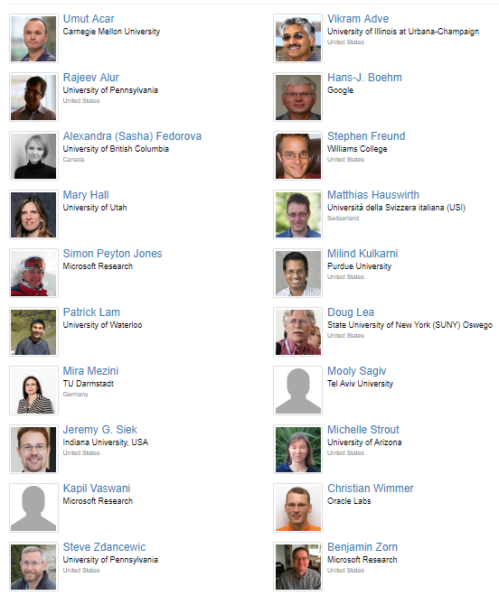
EPC (1 of 1)

Slide 25
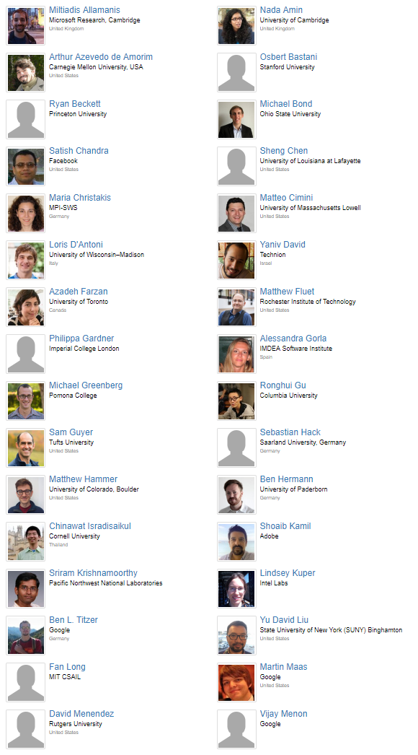
ERC (1 of 2)

Slide 26
ERC (2 of 2)

Slide 27
Also…
Submitters
Rest of organizing committee
Student volunteers
Attendees
…

Slide 28
When you’re PC chair…
Committee selection is worth lots of time and effort
Primary influence of review expertise and quality
Emphasize courteous and constructive reviews
There is literally no downside
Emphasize accepting:
Imperfect papers (else zero papers)
But not flawed papers

Slide 29
Goal
My goal has been “cautious caretaker” for a healthy community
If you enjoy the conference and learn something, I’m happy!

Slide 30
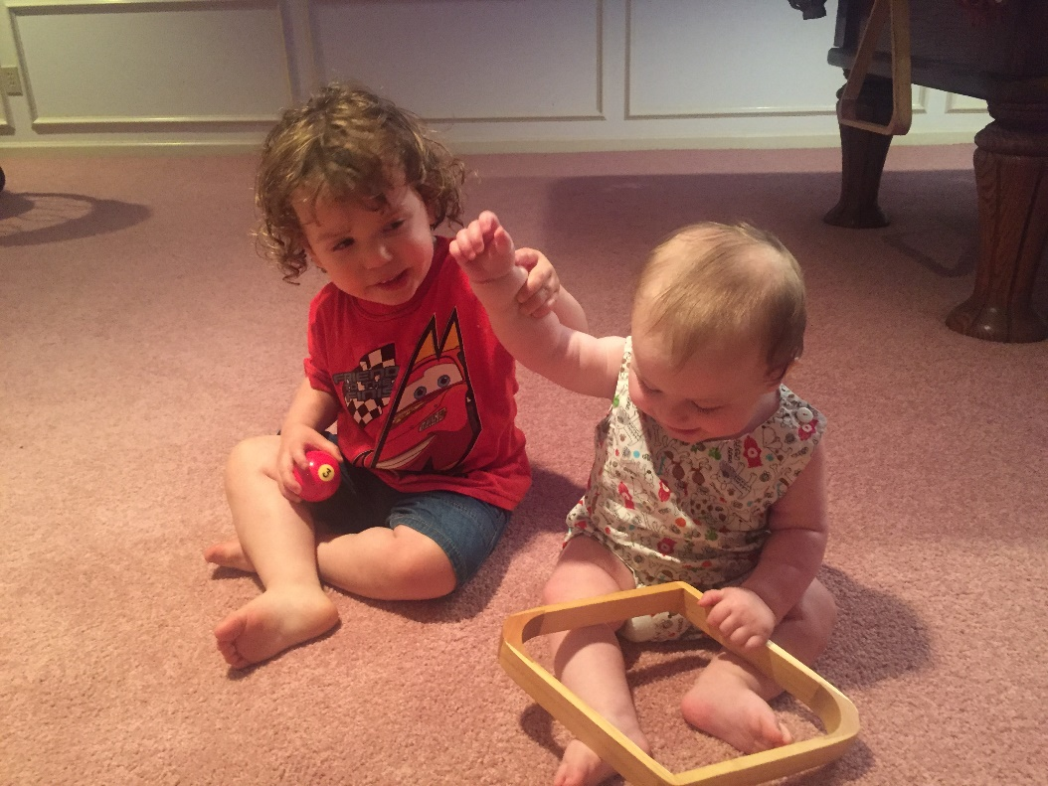
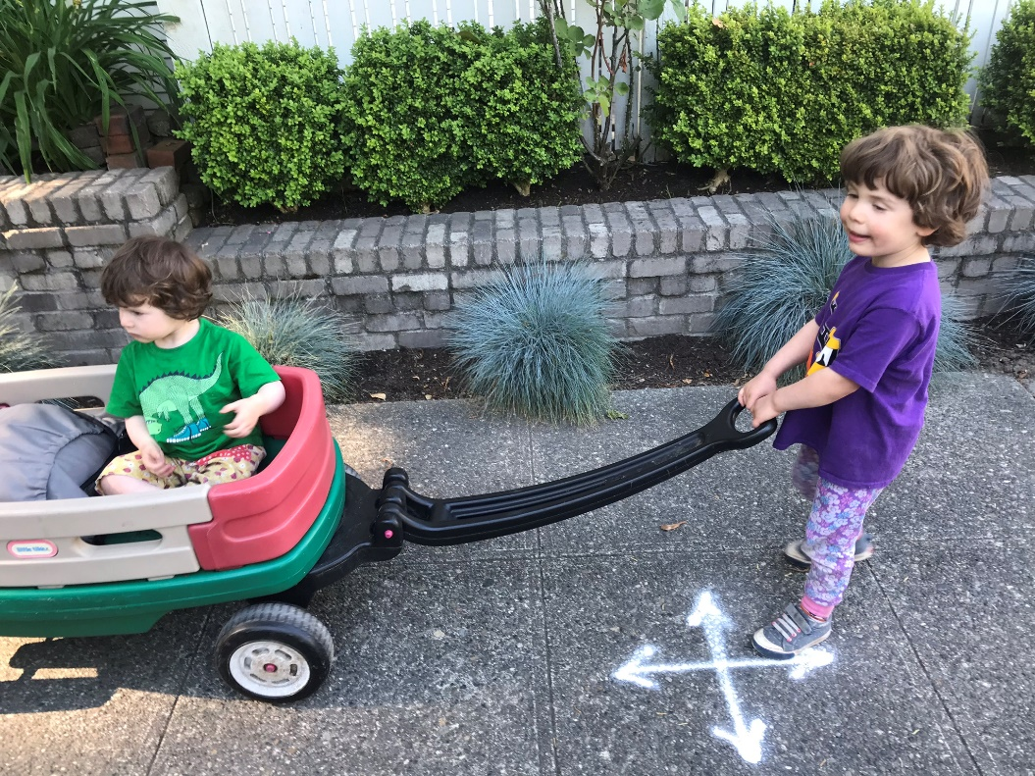
A long road
I first attended PLDI in ‘98 [it had a lot of great papers!]
Also attended ‘99, ’01, ‘02, ’04, ’06, ‘07, ‘09, ‘10, ‘11, ‘13, ‘15, ‘17
Jeff invited me to be PLDI 2018 PC Chair 756 days ago

Slide 31
Thanks!

Slide 33
 | submit | accept | rate
2000 | 173 | 30 | 17.3%
2001 | 144 | 30 | 20.8%
2002 | 169 | 28 | 16.6%
2003 | 131 | 28 | 21.4%
2004 | 127 | 25 | 19.7%
2005 | 135 | 28 | 20.7%
2006 | 174 | 36 | 20.7%
2007 | 178 | 45 | 25.3%
2008 | 184 | 34 | 18.5%
2009 | 196 | 41 | 20.9%
2010 | 206 | 41 | 19.9%
2011 | 236 | 55 | 23.3%
2012 | 255 | 48 | 18.8%
2013 | 267 | 46 | 17.2%
2014 | 287 | 52 | 18.1%
2015 | 303 | 58 | 19.1%
2016 | 304 | 48 | 15.8%
2017 | 322 | 47 | 14.6%
2018 | 262 | 55 | 21.0%
Average 2000-2017: 19.4%

