Slide 1
Toward Commoditized Verification
Todd Schiller
Michael Ernst

Slide 2
Verification: does the program fulfill the specified contract?
class Queue{
...
/**
* @ requires x != null;
* @ ensures currentSize == \old(currentSize+1);
* @ exsures (QueueFullException) ...
*/
public void enqueue(Object x)
throws QueueFullException
{
...
}
}
Notes:
One popular way is method and class contracts.
1. What is required of the client?
2. If the client upholds it’s end of the contract, what does the method ensure?

Slide 3
Verifying a Specification
$$∀$$
$$∃$$
Source Code
$$\left(a∧b\right)$$
Logical Formulas
Theorem Prover
(SMT solver)
$$∀$$
$$∃$$
$$\left(a∧b\right)$$
Counter-Example
Specification
Notes:
One powerful way to verify a specification.
If the source and specification are incompatible ➔ theorem prover returns abstract counter-example

Slide 4
Verification isn’t Cost-Effective
Evidence: only used for safety critical systems
Essential complexity
Precision and completeness
Accidental complexity
Tool design tradeoffs
Bad interface design
Labor intensive
& Expert users
Notes:
Automation impossible / intractable
Tool interfaces often inscrutable

Slide 5
Worker Skill Spectrum
Verification Experts
Programmers
Commoditization
Engineers
Task-level Crowdsourcing

Slide 6
Barriers to Commoditization
Interface usability is limited
Complicated internal representations
Decomposition into subtasks is hard
Module and methods interdependent
Information loss
Notes:
Information has to be translated from logical formula to source code or specification language.
The underlying technologies, such as SMT solving or abstract interpretation are difficult to explain to users.
Can’t split up the task into manageable subtasks

Slide 7
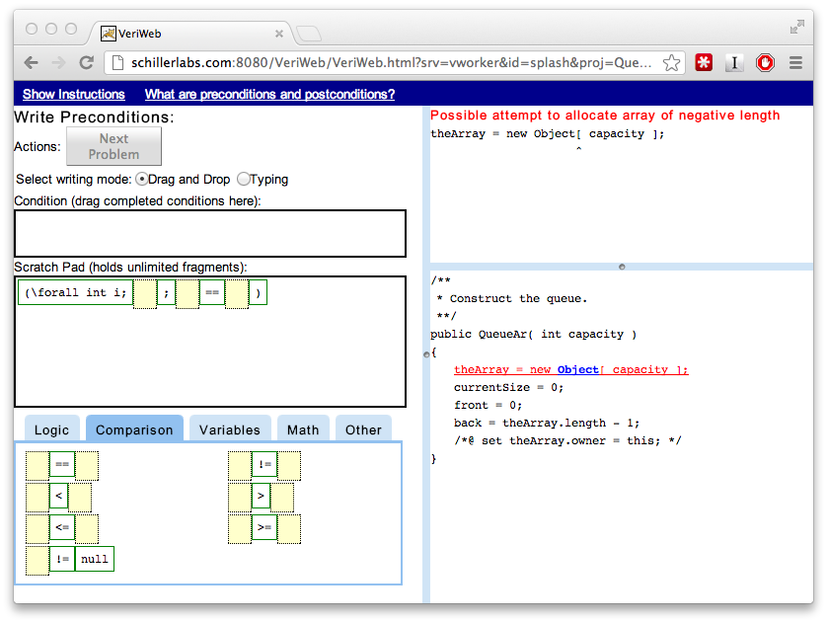
VeriWeb: a web IDE for writing verified specifications of existing code
More cost- and time-effective than a traditional interface
Enables collaborative verification via decomposition
Notes:
Before I jump into a demo, I wanted to give an overview of VeriWeb’s workflow, since it’s different than what you’d typically expect for verification

Slide 8
VeriWeb Workflow
Writes Feature
Skilled Developer
ESC/Java2
Verifiable
Specification
Notes:
Skilled developer (Einstein) write feature, and wants to get back a verifiable specification
The tool shown here, farms out tasks to workers using ESC/Java2 to judge to correctness of specifications

Slide 9
VeriWeb Interface
Contract Entry
Warnings &
Specifications
Source Code
Notes:
- Decomposition into subtasks
- Task activation follows callgraph
- Explicit communication between subtasks

Slide 11
VeriWeb Outputs a Partial Specification
Client code does not throw unexpected exceptions
Properties (optionally) specified by the feature developer
Plus other necessary properties for #1 and #2
Notes:
Not full functional verification

Slide 12
Talk Outline
VeriWeb design principles
Active guidance
Explanations in context
Toward crowdsourcing: lessons learned
Challenges and open questions

Slide 13
Principle #1: Active Guidance
Prevent mistakes
Suggest actions
Caveat: being too restrictive annoys users
Caveat: too many suggestions overwhelm users

Slide 14
Principle #2: Explanations in Context
Give concrete feedback about what the tool knows, and doesn’t know
Concrete Counter-Examples
Contract Inlining
Caveat: still must teach users how to use feedback
Caveat: irrelevant feedback overwhelms users

Slide 15
Talk Outline
VeriWeb design principles
Active guidance
Explanations in context
Paying for verification: lessons learned
Challenges and open questions

Slide 16
Research Questions
What is the cost (time and money) of program veriﬁcation?
Can ad-hoc labor be used to crowdsource program veriﬁcation?
How does decomposition and communication overhead affect the performance of collaborative veriﬁcation?

Slide 17
What is the Cost of Verification?
Hired programmers on vWorker
Workers bid hourly wage
Accepted 18 of 22 bids ($6 - $22 per hour)
No correlation between experience (skill) and wage
Two treatments:
ESC/Java2 Eclipse Plugin (Control)
VeriWeb
Learning effect control:
Tutorial writing a verified specification for a toy program
Comprehension quiz
Notes:
We try to use wage as a proxy for skill

Slide 18
Method Dependency Graph
Client
Stack ADT
Notes:
Second reason is why we chose a small, simple program. Little variability in specifications

Slide 19
VeriWeb Workers Finish Faster
Notes:
Statistically significant if we throw out this Eclipse outlier
VeriWeb workers appear to make consistent progress, Eclipse workers go off on tangents

Slide 20
VeriWeb Workers Cost Less
Notes:
Also significant if you throw out the Eclipse outlier.
Interesting: depending on what you’re optimizing for, you’d choose different workers.

Slide 21
Counter-Examples Are Important
All workers tried to introduce false properties
Slowest Eclipse worker had most trouble
Lifetime of false properties skewed:
Median: 2 min.
Mean lifetime: 34 min.
Notes:
We’re going to explore concrete counter-example feature in isolation
Second result suggests that we need a way of reducing noise – users had a tendency of inspecting all of them, even when not needed.

Slide 22
Can VeriWeb Use Crowdsourcing?
Mechanical Turk: worker paid per small task
Paid 15¢ - 30¢ per subproblem, determined randomly for each worker upfront
No. Low response and high reserve wage
Notes:
Next question we asked
This failed miserably

Slide 23
Lessons and Challenges
Additional compensation for learning to complete the tasks
Chicken and egg problem: need many verification tasks to make learning attractive

Slide 24
Talk Outline
VeriWeb design principles
Active guidance
Explanations in context
Paying for verification: lessons learned
Challenges and open questions

Slide 25
Other Approaches
Approach
UW: Players solve puzzles to infer qualified types
Berkeley: Workers find visual patterns in traces for verification
HKUST: “Players” chain together method calls for test generation
Must show benefit over automation of human strategy
Cannot not claim labor supply from small trials

Slide 26
Open Design and Research Questions
What latency is acceptable?
Is abstraction required to protect intellectual property?
How do you control worker error?
Rethinking the Economics of Software Engineering (FoSER 2010)

Slide 27
VeriWeb: a web IDE for writing verified specifications of existing code
More cost- and time-effective than a traditional interface
Enables collaborative verification via decomposition
Study Materials: http://homes.cs.washington.edu/~tws/veriweb/

