Slide 1

Learning 5000 Relational Extractors
Raphael Hoffmann, Congle Zhang, Daniel S. Weld
University of Washington
Talk at ACL 2010
07/12/10

Slide 2
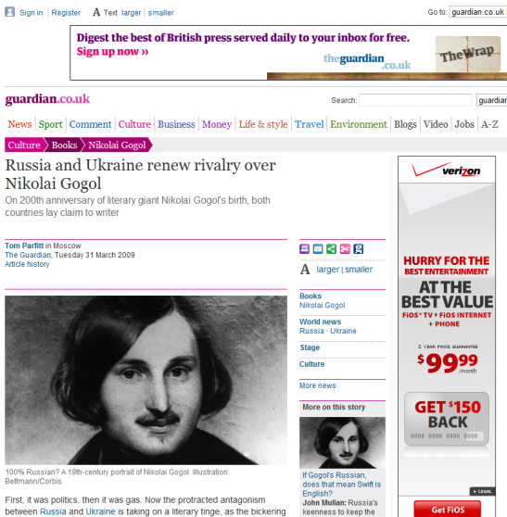
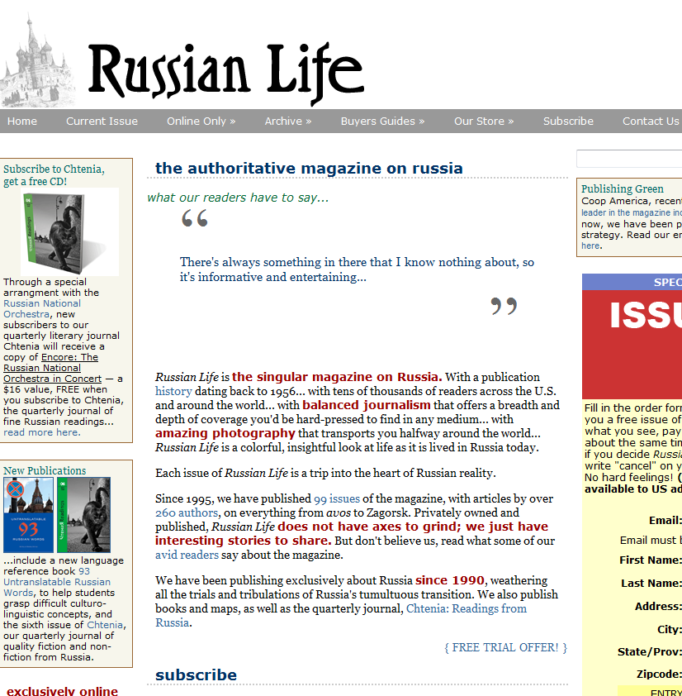
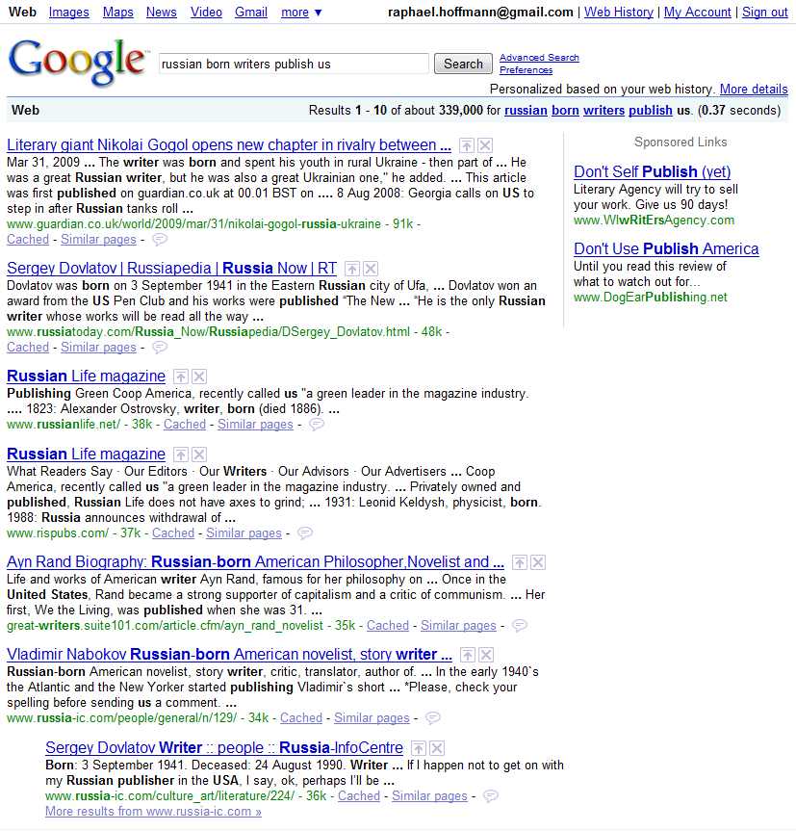
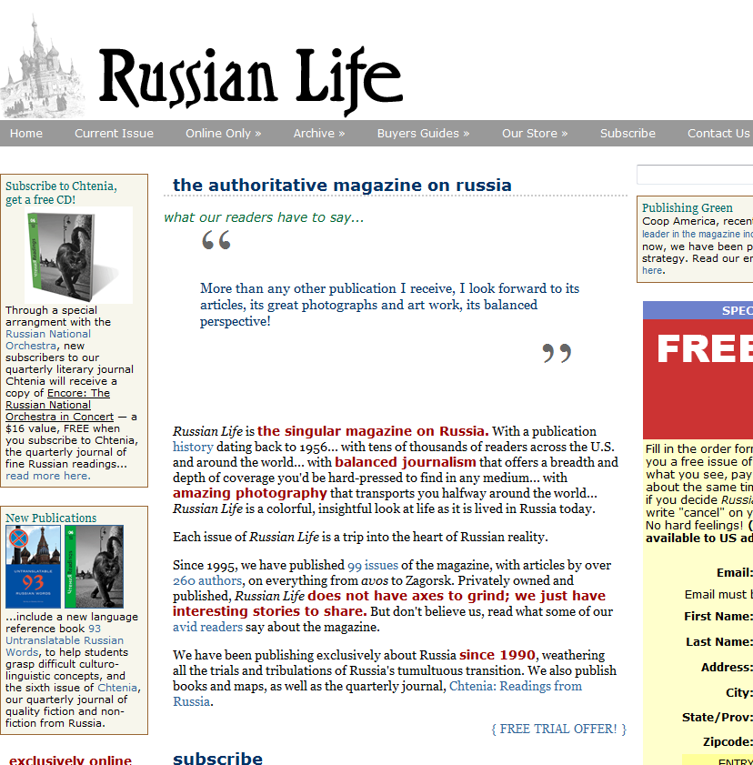
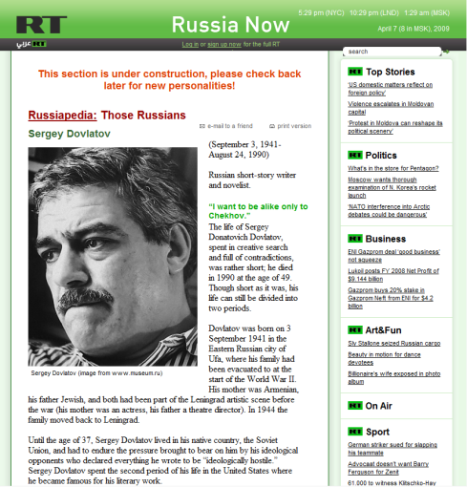
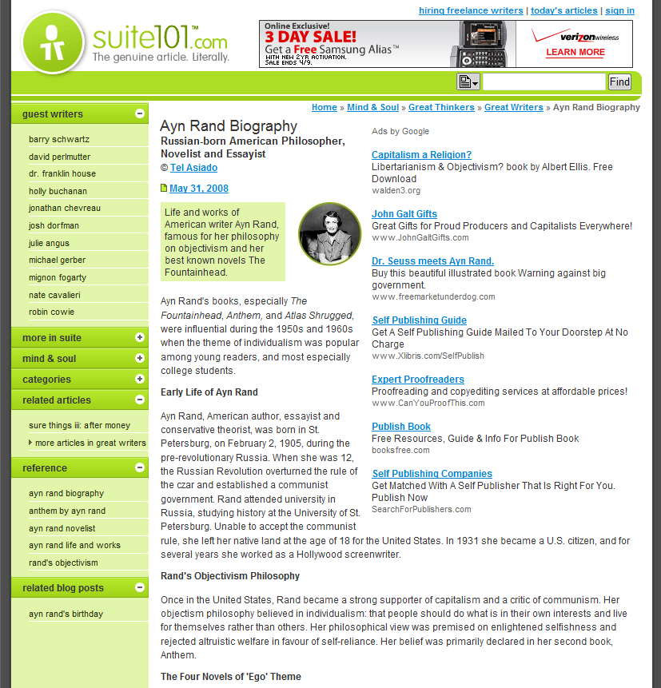
“What Russian-born writers publish in the U.K.?”
Use Information Extraction

Slide 3
Types of Information Extraction
Traditional,
Supervised IE
TextRunner &
WOE OpenIE
Corpus + Manual Labels
Specified in Advance
O(D*R)
Corpus + Wikipedia/PennTB + DI Methods
Discovered Automatically
O(D)
Input
Uninterpreted
Text Strings
Relations
Complexity

Slide 4
Types of Information Extraction
Traditional,
Supervised IE
TextRunner &
WOE OpenIE
Kylin & Luchs
Weak Supervision
Corpus + Manual Labels
Specified in Advance
O(D*R)
Corpus + Wikipedia/PennTB + DI Methods
Discovered Automatically
O(D)
Corpus + Wikipedia + Domain-Indep. Methods
Learned
O(D*R)
Input
Uninterpreted
Text Strings
Relations
Complexity

Slide 5
Weak Supervision
Heuristically match Wikipedia infobox values to article text (Kylin)
[Wu and Weld, 2007]
Jerry Seinfeld
birth-date: April 29, 1954
birth-place: Brooklyn
nationality: American
genre: comedy, satire
height: 5 ft 11 in
Jerome Allen “Jerry” Seinfeld is an American stand-up comedian, actor and writer, best known for playing a semi-fictional version of himself in the situation comedy Seinfeld (1989-1998), which he co-created and co-wrote with Larry David, and, in the show’s final two seasons, co-executive-produced.
Seinfeld was born in Brooklyn, New York. His father, Kalman Seinfeld, was of Galician Jewish background and owned a sign-making company; his mother, Betty, is of Syrian Jewish descent.
American
Brooklyn
American
Brooklyn

Slide 6
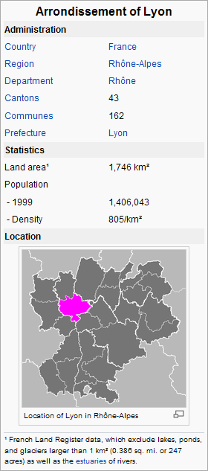

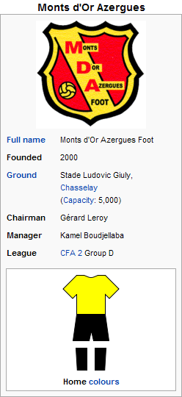
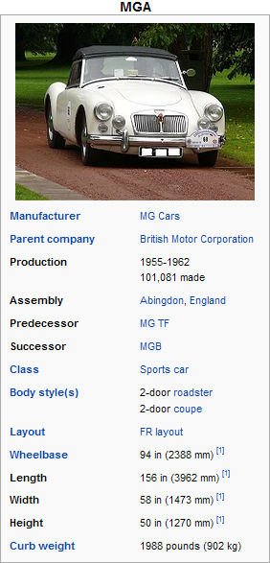
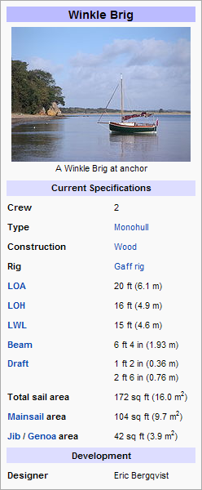
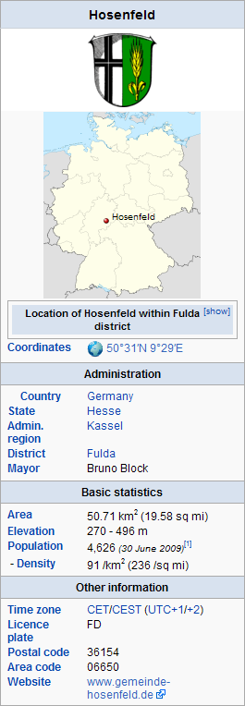
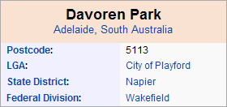
Wikipedia Infoboxes
Thousands of relations encoded in infoboxes
Infoboxes are interesting target:
  By-broduct of thousands of contributors
  Broad in coverage and growing quickly
  Schema noisy and sparse, extraction is challenging

Slide 7
Existing work on Kylin
Kylin performs well on popular classes …
Precision: mid 70% ~ high 90%
Recall: low 50% ~ mid 90%
… but flounders on sparse classes.
(too little training data)
Is this a big problem?
18% >= 100 instances
60% >= 10 instances

Slide 8
Contributions
luchs – an autonomous, weakly-supervised system which learns 5025 relational extractors
luchs introduces dynamic lexicon features, a new technique which dramatically improves performance from sparse data and that way enables scalability
luchs reaches an average F1 score of 61%

Slide 9
Outline
Motivation
Learning Extractors
Extraction with Dynamic Lexicons
Experiments
Next Steps

Slide 10

Overview of luchs
Learning
Matcher
Harvester
WWW
Training Data
Training Data
Filtered Lists
Classifier
Learner
CRF Learner
Lexicon Learner
Extraction
Extractor
Article
Classifier
Extractor
Attribute
Extractor
Classified Articles
Tuples

Slide 11
Overview of luchs
Learning
Matcher
Harvester
WWW
Training Data
Training Data
Filtered Lists
Classifier
Learner
CRF Learner
Lexicon Learner
Extraction
Extractor
Article
Classifier
Extractor
Attribute
Extractor
Classified Articles
Tuples

Slide 12
Overview of luchs
Learning
Matcher
Harvester
WWW
Training Data
Training Data
Filtered Lists
Classifier
Learner
CRF Learner
Lexicon Learner
Extraction
Extractor
Article
Classifier
Extractor
Attribute
Extractor
Classified Articles
Tuples

Slide 13
Overview of luchs
Learning
Matcher
Harvester
WWW
Training Data
Training Data
Filtered Lists
Classifier
Learner
CRF Learner
Lexicon Learner
Extraction
Extractor
Article
Classifier
Extractor
Attribute
Extractor
Classified Articles
Tuples

Slide 14
Learning Extractors
Classifier: multi-class classifier using features: words in title, words in first sentence, …
CRF extractor: linear-chain CRF predicting label for each word, using features: words, state transitions, capitalization, word contextualization, digits, dependencies, first sentence, lexicons, Gaussians
Trained using Voted Perceptron algorithm
[Collins 2002, Freund and Schapire 1999]
lexicons
Gaussians

Slide 15
Overview of luchs
Learning
Matcher
Harvester
WWW
Training Data
Training Data
Filtered Lists
Classifier
Learner
CRF Learner
Lexicon Learner
Lexicons
Extraction
Extractor
Article
Classifier
Extractor
Attribute
Extractor
Classified Articles
Tuples

Slide 16
Outline
Motivation
Learning Extractors
Extraction with Dynamic Lexicons
Experiments
Next Steps

Slide 17
Harvesting Lists from the Web
Must extract and index lists prior to learning
Lists extremely noisy: navigation bars, tag sets, spam links, long text; filtering steps necessary
49M lists containing 56M unique phrases
WWW
Mozart
Beethoven
Vivaldi
John
Paul
Simon
Ed
Nick
Boston
Seattle
<html><body><ul>
<li>Boston</li>
<li>Seattle</li>
</ul><body></html>
5B pages
49M lists, 56M phrases

Slide 18
Semi-Supervised Learning of Lexicons
Generate lexicons specific to relation in 3 steps:
Seinfeld was born in Brooklyn, New York…
Born in Omaha, Tony later developed …
His birthplace was Boston. …
Brooklyn
1.
Extract seed phrases
from training set
Omaha
✓
Boston
Brooklyn
Omaha
Boston
2.
Expand seed phrases
into a set of lexicons
?
Brooklyn
Omaha
Boston
London
Miami
Boston
Denver
Omaha
London
Miami
Boston
Monterey
Omaha
Dallas
...
3.
Add lexicons as
features to CRF

Slide 19
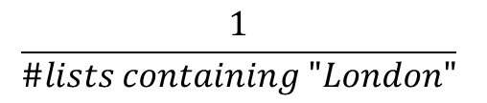
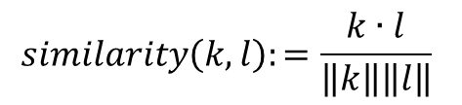


From Seeds to Lexicons
Similarity between lists using vector-space model:
Intuition: lists are similar if they have many overlapping phrases, the phrases are not too common, and lists are not too long
$$k:$$
0
.10
.06
.18
0
.50
$$\frac{1}{\#lists containing "London"}$$
Tokyo
London
Moscow
Redmond
$$l:$$
.22
.10
0
0
.15
0
$$similarity\left(k,l\right):=\frac{k∙l}{\left\|k\right\|\left\|l\right\|}$$
Yokohama
Tokyo
Osaka

Slide 20
From Seeds to Lexicons
Produce lexicons of different Pr/Re compromises:
Sort by
similarity
to seeds
Omaha
Boston
Denver
Brooklyn
Omaha
Boston
Denver
Brooklyn
Omaha
Boston
Denver
Brooklyn
London
Omaha
Boston
Denver
Brooklyn
London
Denver
Brooklyn
George
Union of
phrases
on top lists
.87
London
Omaha
Boston
.79
.54
London
Denver
Omaha
Boston
Brooklyn
Omaha
seeds
.23
.17
Brooklyn
George
Brooklyn
John
George

Slide 21
Semi-Supervised Learning of Lexicons
Generate lexicons specific to relation in 3 steps:
Seinfeld was born in Brooklyn, New York…
Born in Omaha, Tony later developed …
His birthplace was Boston. …
Brooklyn
1.
Extract seed phrases
from training set
Omaha
✓
Boston
Brooklyn
Omaha
Boston
2.
Expand seed phrases
into a set of lexicons
✓
Brooklyn
Omaha
Boston
London
Miami
Boston
Denver
Omaha
London
Miami
Boston
Monterey
Omaha
Dallas
...
3.
?
Add lexicons as
features to CRF

Slide 22
Preventing Lexicon Overfitting
Lexicons created from seeds in training set
CRF may overfit if trained on same examples that generated the lexicon features
Seinfeld was born in Brooklyn, New York…
Born in Omaha, Tony later developed …
His birthplace was Boston. …
His hometown Denver is well known for …
Redmond where he was born is …
Simon, born and grown up in Seattle, …
He was born in Spokane.
Portland is his hometown.
Tony was born in Austin.
Brooklyn
Omaha
Boston
Denver
Redmond
Seattle
Spokane
Portland
Austin

Slide 23
With … Cross-Training
Lexicons created from seeds in training set
CRF may overfit if trained on same examples
that generated the lexicon features
Split training set into k partitions, use different partitions for lexicon creation, feature generation
Seinfeld was born in Brooklyn, New York…
Born in Omaha, Tony later developed …
His birthplace was Boston. …
His hometown Denver is well known for …
Redmond where he was born is …
Simon, born and grown up in Seattle, …
He was born in Spokane.
Portland is his hometown.
Tony was born in Austin.
generate lexicons
Brooklyn
Omaha
Boston
Brooklyn
Omaha
Boston
London
Miami
Boston
Denver
Omaha
London
Miami
Boston
Monterey
Omaha
Dallas
...
Denver
Redmond
Seattle
add lexicon
features
Spokane
Portland
Austin

Slide 24
Outline
Motivation
Learning Extractors
Extraction with Dynamic Lexicons
Experiments
Next Steps

Slide 25
Impact of Lexicons
100 random attributes, heuristic matches as gold:
Lexicons substantially improve F1
Cross-training essential
F1
Text attributes
Baseline | .491
Baseline + lexicons w/o cross-training | .367
Baseline + lexicons w/ cross-training | .545
Numeric attributes
Baseline | .586
Baseline + Gaussians w/o cross-training | .623
Baseline + Gaussians w/ cross-training | .627

Slide 26
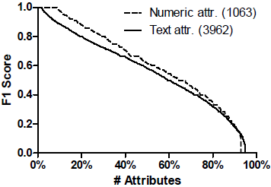
Scaling to all of Wikipedia
Extract all 5025 attributes (matches as gold)
1138 attributes reach F1 score of .80 or higher
Average F1 of .56 for text and .60 for numeric attr.
Weighted by #instances, .64 and .78 respectively

Slide 27
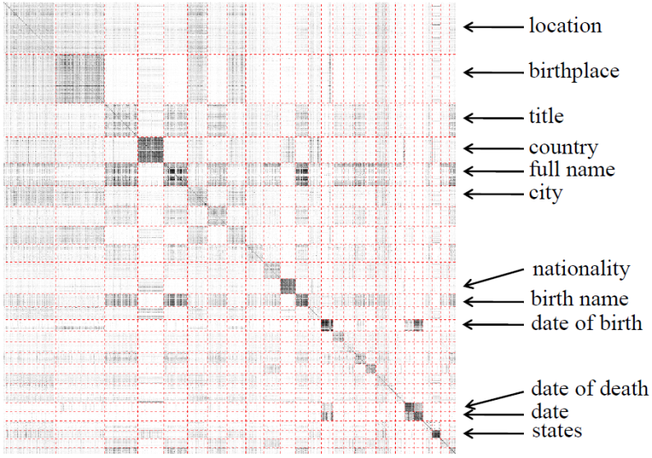
Towards an Attribute Ontology
True promise of relation-specific extraction if ontology ties system together
“Sloppiness” in infoboxes: identify duplicate relations
i,j-th pixel indicates F1 of training on i and testing on j for the 1000 attributes in the largest clusters

Slide 28
Next Steps
luchs’ performance may benefit substantially from an ontology & luchs may also facilitate ontology learning: thus, learn both jointly
Enhance robustness by performing deeper linguistic analysis; also combine with Open extraction techniques

Slide 29
Related Work
  YAGO[Suchanek et al WWW 2007]
  Bayesian Knowledge Corroboration [Kasneci et al MSR 2010]
  PORE [Wang et al 2007]
  TextRunner [Banko et al IJCAI 2007]
  Distant Supervision [Mintz et al ACL 2009]
  Kylin [Wu et al CIKM 2007, Wu et al KDD 2008]

Slide 30
Conclusions
Weakly-supervised learning of relation-specific extractors does scale
Introduced dynamic lexicon features, which enable hyper-lexicalized extractors

Slide 31
Thank You!

Slide 32
Experiments
English Wikipedia 10/2008 dump
Classes with at least 10 instances:
1,583, comprising 981,387 articles
5025 attributes
Consider first 10 sentences of each article
Evaluate extraction on a token-level

Slide 33
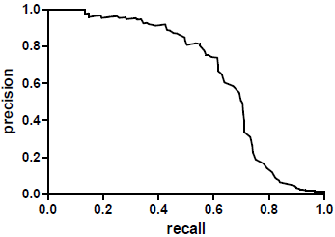
Overall Extraction Performance
Tested pipeline of classification and extraction:
Compared to manually created gold labels
  on 100 articles not used for training
Observations:
Many remaining
errors from “ontology” sloppiness
low recall for heuristic matches
F1 | 0.61
P | 0.55
R | 0.68

Slide 34
Article Classification
Take all 981,387 articles which have infoboxes
4/5 for training, 1/5 for testing,
Use existing infobox as gold standard
Accuracy: 92%
Again, many errors due to “ontology” sloppiness:
e.g. Infobox Minor Planet vs. Infobox Planet

Slide 35
Attribute Extraction
For each of 100 attributes
sample 100 articles for training and
100 articles for testing
Use heuristic matches as gold labels
Baseline extractor
iteratively add feature with largest improvement (except lexicon & Gaussian)

Slide 36
Impact on Sparse Attributes
# train. articles
∆F1
∆Precision
∆Recall
Lexicons very effective for sparse attributes
Gains mostly in recall
Text attributes
10 | +16% | +10% | +20%
25 | +13% | +7% | +20%
100 | +11% | +5% | +17%
Numeric attributes
10 | +10% | +4% | +13%
25 | +8% | +4% | +10%
100 | +7% | +5% | +8%

Slide 37
Outline
Motivation
Learning Extractors
Extraction with Dynamic Lexicons
Experiments
Next Steps

