Slide 1

Amplifying
Community Content Creation with Mixed-Initiative
Information Extraction
Raphael Hoffmann, Saleema Amershi, Kayur Patel,
Fei Wu, James Fogarty, Daniel S. Weld

Slide 2
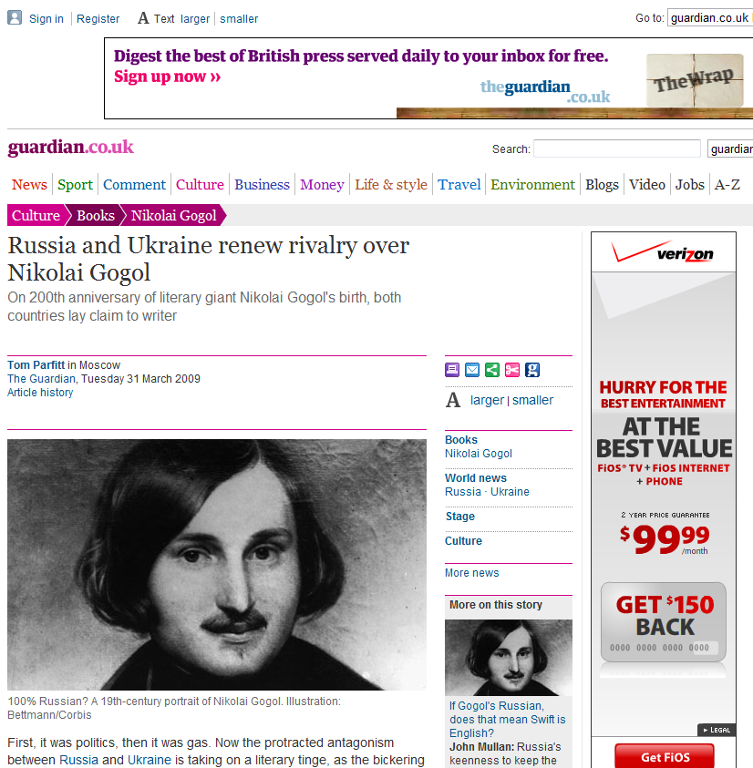
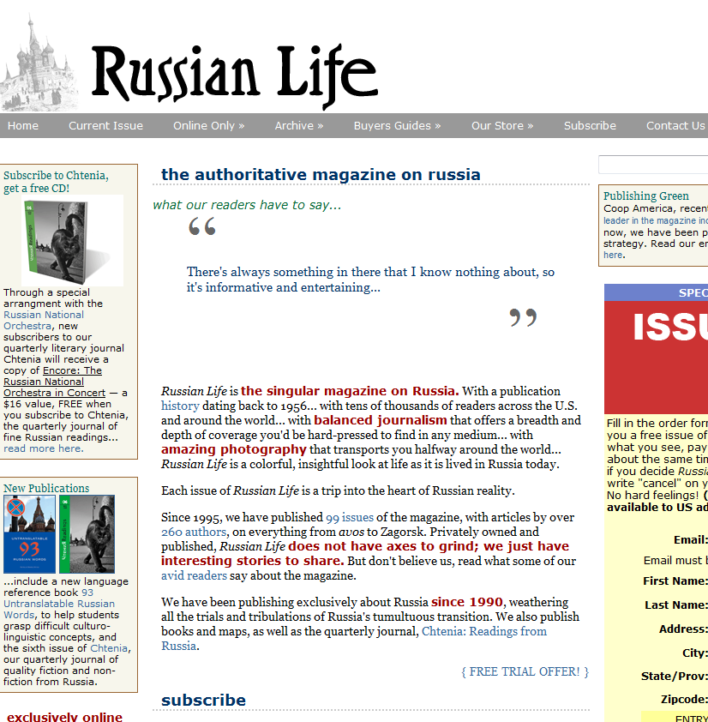
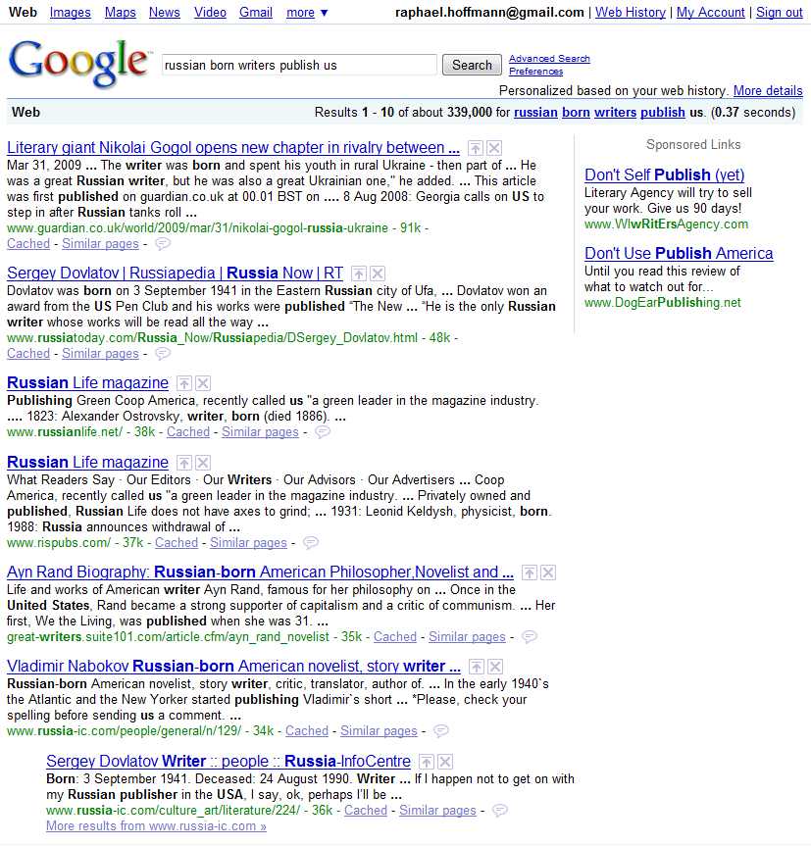
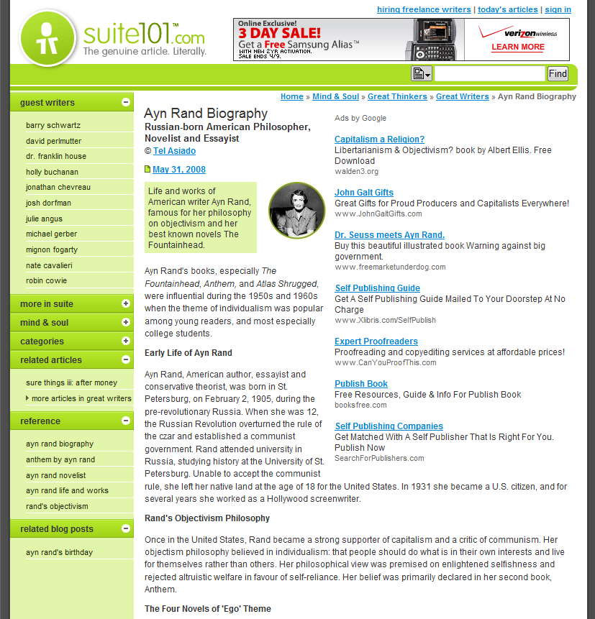
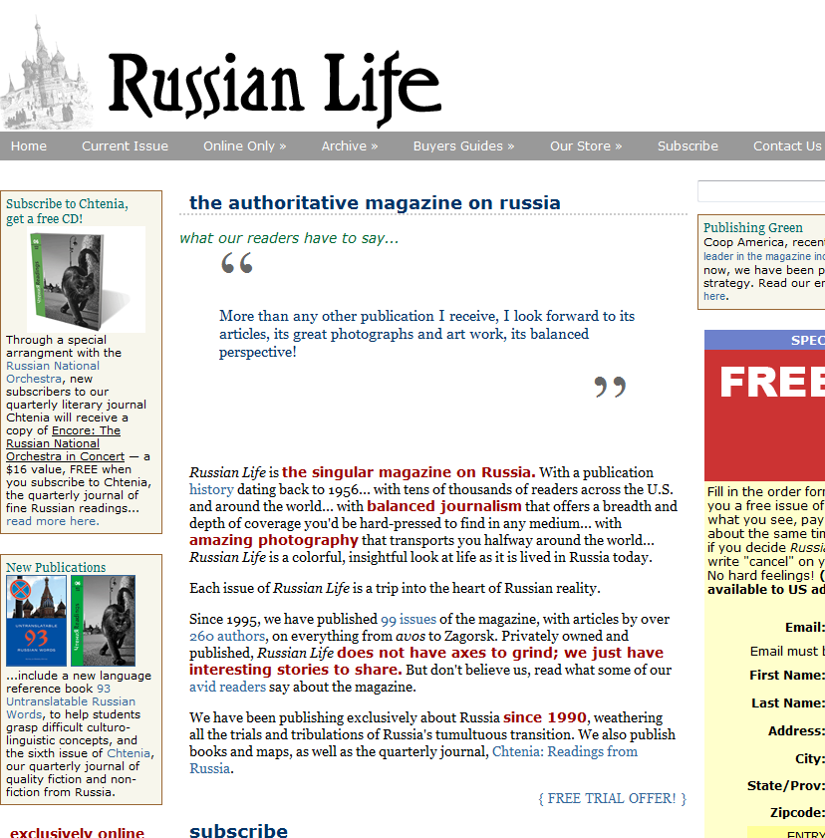
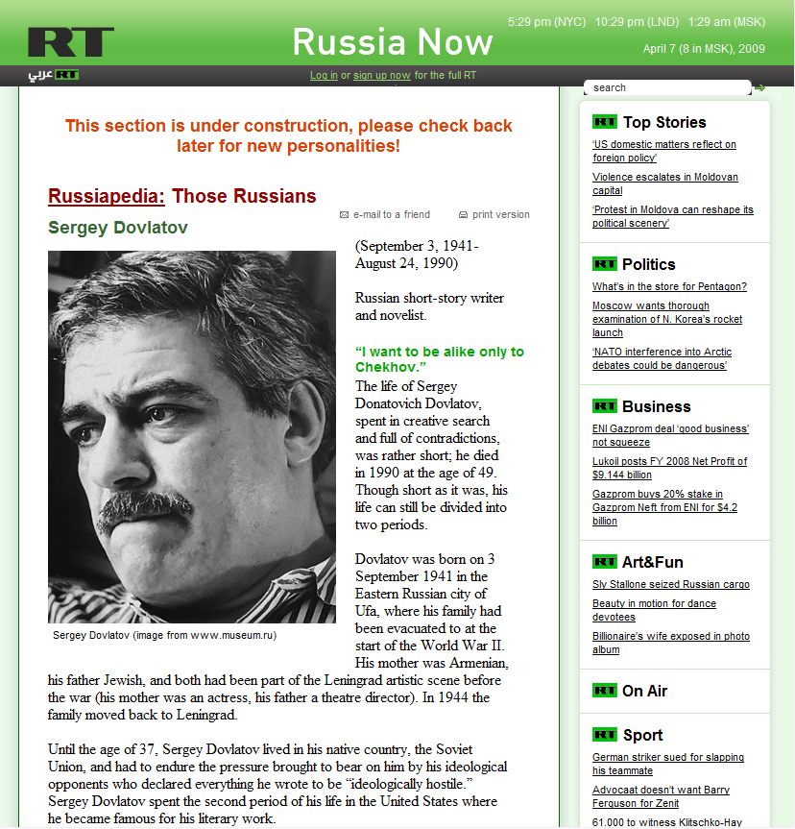
“What Russian-born writers publish in the U.S.?”

Slide 3
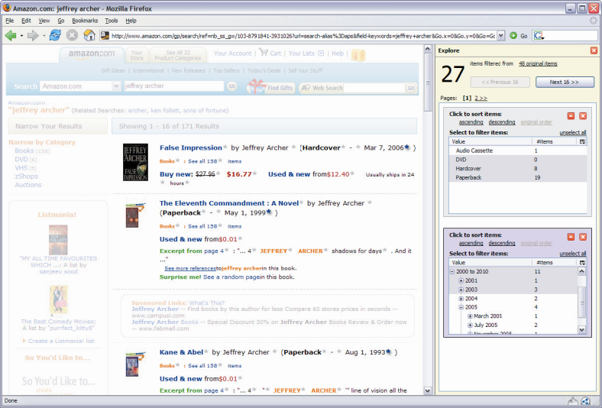
Advanced Interfaces Leverage Structure of Content
Huynh et al., UIST’06
Dontcheva et al.,
UIST’06, UIST’07
Toomim et al., CHI’09
Hoffmann et al., UIST’07

Slide 4
How can we obtain the necessary structure on Web scale?
Community Content Creation
Information Extraction

Slide 5
Community Content Creation

Slide 6
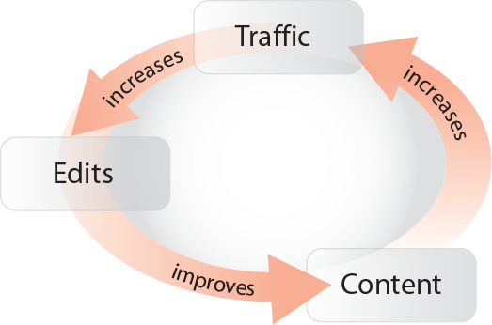
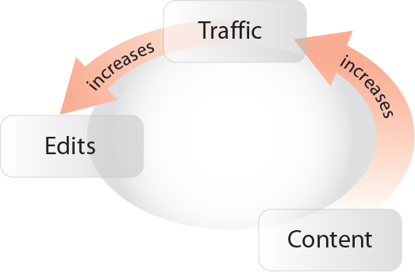
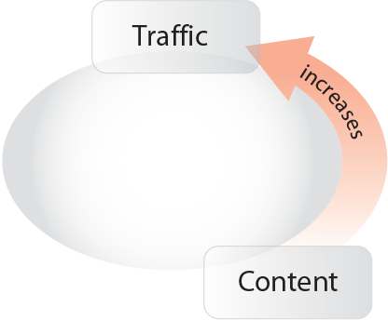
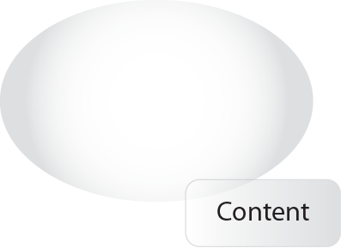

Community Content Creation
Requires
Critical mass
Incentives

Slide 7
Information Extraction

Slide 8
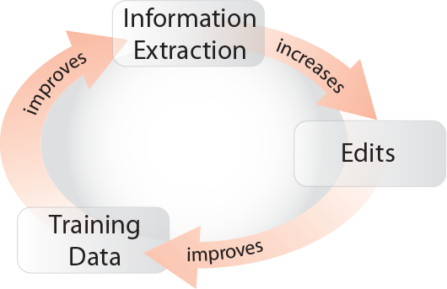
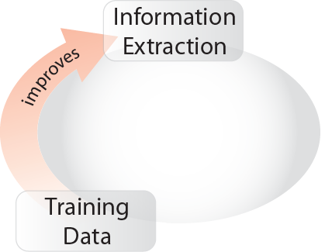
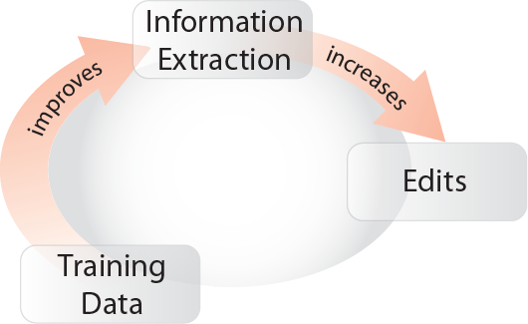
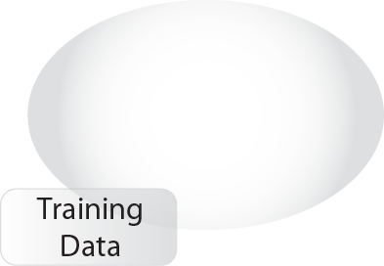

Information Extraction
Training data
expensive
Error-prone

Slide 9
Our Goal: Synergistic Pairing

Slide 10
More user contributions

Slide 11
More precise extractors

Slide 12
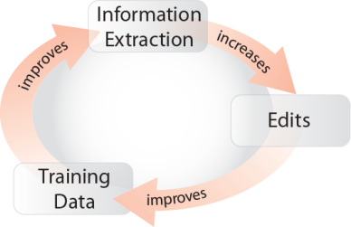




What this work is about
Synergistic method for amplifying Community Content Creation and Information Extraction
Use of search advertising for evaluation

Slide 13
Outline
Motivation
Case Study: Intelligence in Wikipedia
Designing for the Wikipedia Community
Search Advertising Deployment Study
Conclusion

Slide 14
Case Study:
Intelligence in Wikipedia
What Russian-born writers publish in the U.S.?
Search

Slide 15
Some Structured Content in Wikipedia
<Ayn Rand, birthdate, February 2, 1905>
<Ayn Rand, birthplace, Saint Petersburg>
<Ayn Rand, occupation, writer>

Slide 16
Lack of Structured Content in Wikipedia

Slide 17


Previous Work:
Learning from Existing Infoboxes
[Wu et.al. CIKM’07]
Ben is living in Paris.
<Ben, birthplace, Paris>
Extractor
(~60-90% precision)

Slide 18


Community-based Validation of Extractions
“We think Ayn Rand’s birthplace is
Saint Petersburg. Is this correct?”

Slide 19
Outline
Motivation
Case Study: Intelligence in Wikipedia
Designing for the Wikipedia Community
Search Advertising Deployment Study
Conclusion

Slide 20
Method
Design
Interviews with Wikipedians
Design of 3 interfaces
Talk-aloud studies with 9 participants
Evaluation
Search advertising study with 2473 visitors

Slide 21
Incentivizing Contribution
Audience
Target experienced Wikipedians (power law)
Target newcomers
Motivation
Co-ercion (unacceptable to Wikipedia)
Using information extraction to make the ability to contribute visible and easy

Slide 22
Contribution as a Non-Primary Task
We want to solicit contributions from people pursuing some other task
(the information need that brought them to this article)
Using information extraction to ease contribution, we explore a tradeoff between intrusiveness and contribution rate
(Popup, Highlight, and Icon designs)

Slide 23
Designed Three Interfaces
Popup
(immediate interruption strategy)
Highlight
(negotiated interruption strategy)
Icon
(negotiated interruption strategy)

Slide 24
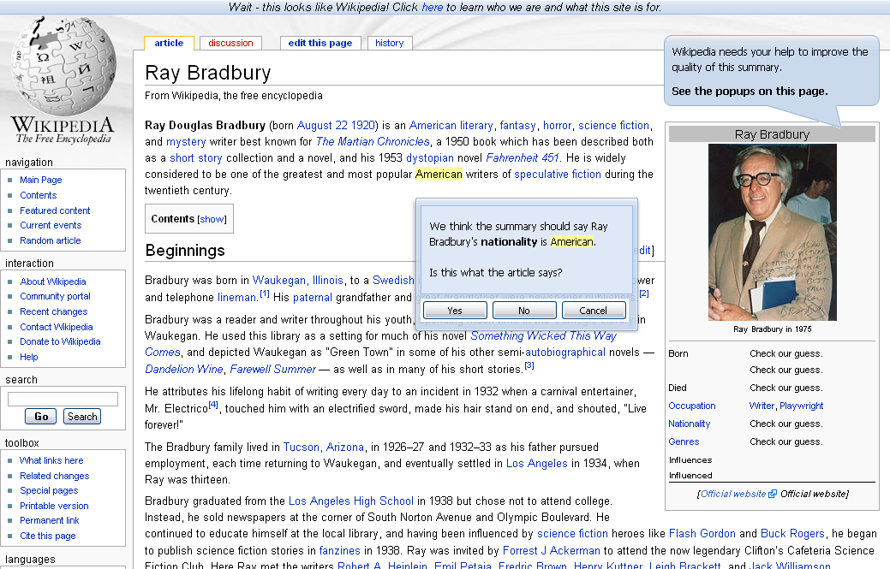
Popup Interface

Slide 25
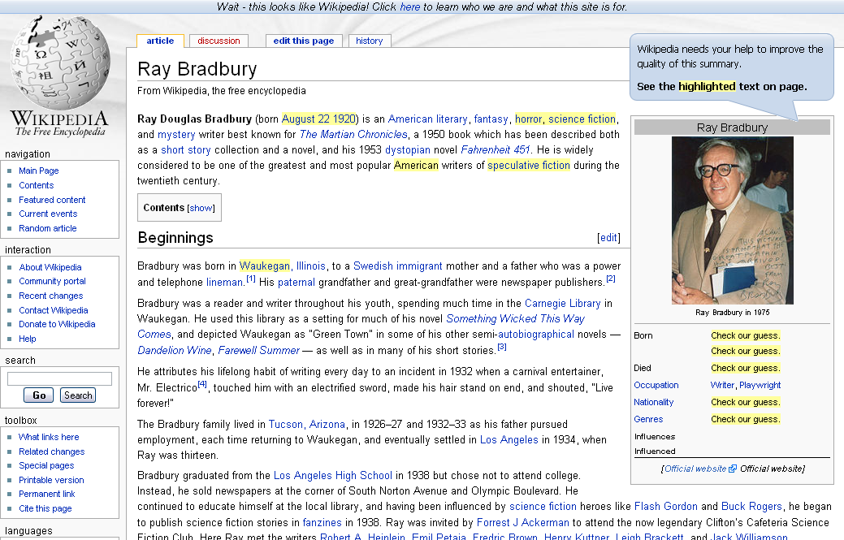
hover
Highlight Interface

Slide 26
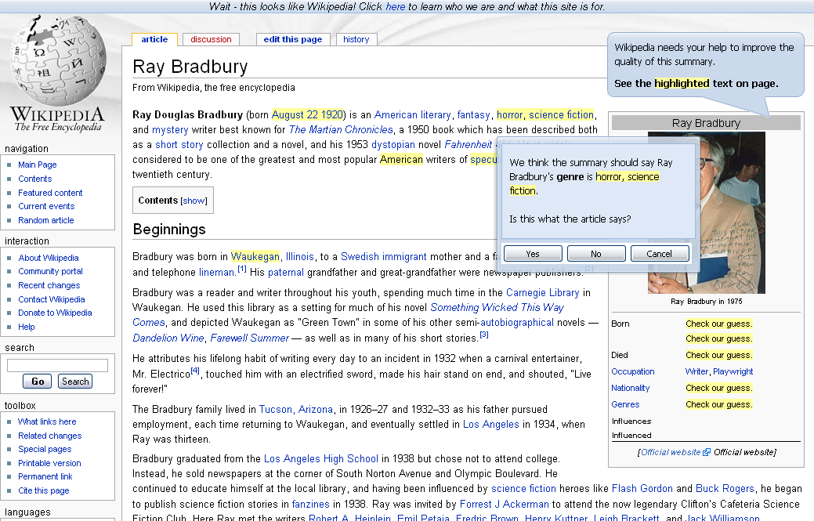
Highlight Interface

Slide 27
hover
Highlight Interface

Slide 28
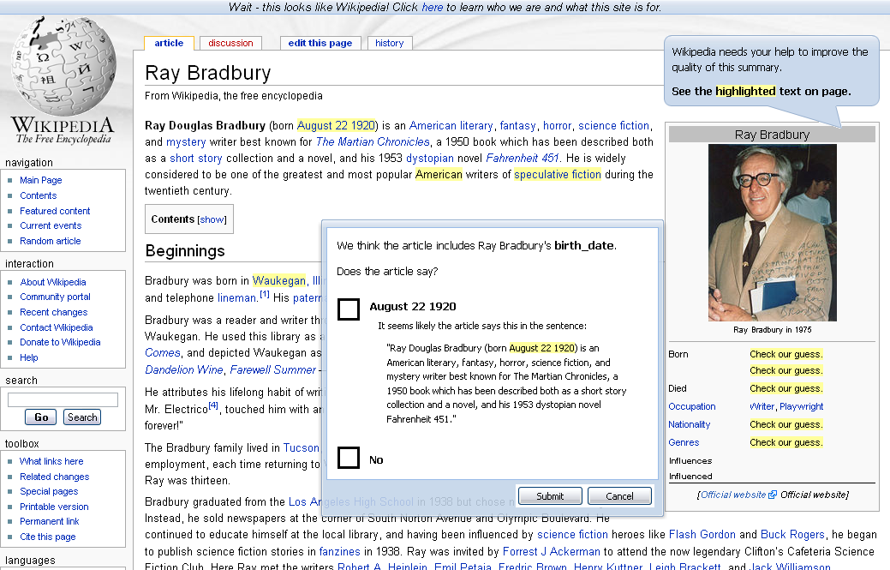
Highlight Interface

Slide 29
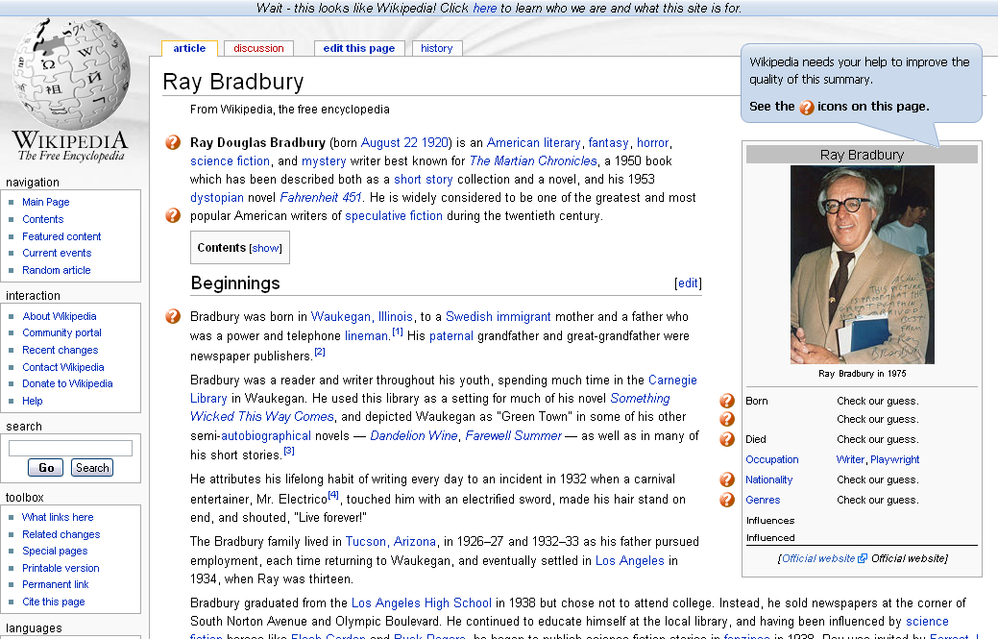
hover
Icon Interface

Slide 30
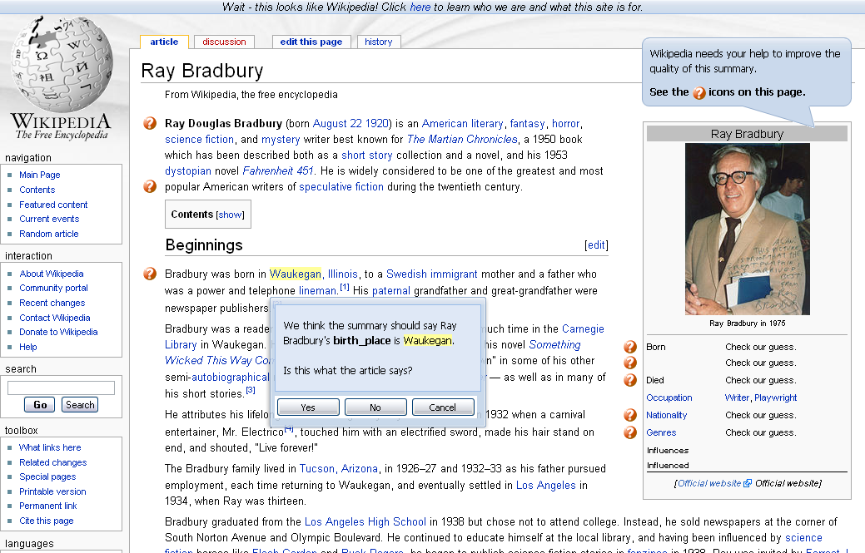
Icon Interface

Slide 31
hover
Icon Interface

Slide 32
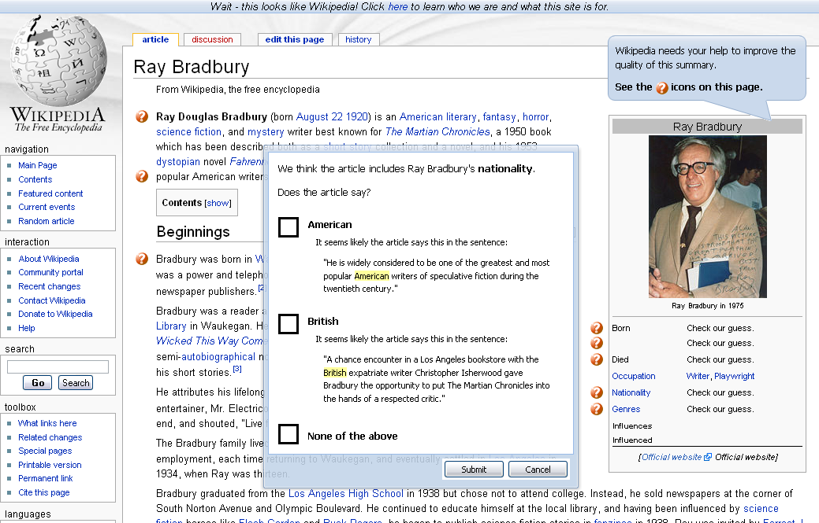
Icon Interface

Slide 33
Outline
Motivation
Case Study: Intelligence in Wikipedia
Designing for the Wikipedia Community
Search Advertising Deployment Study
Conclusion

Slide 34
How do you evaluate this?
Contribution as a non-primary task
Can lab study show if interfaces increase
spontaneous contributions?

Slide 35
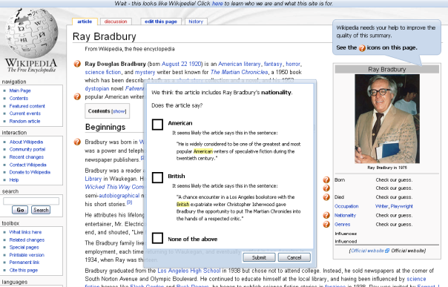
Search Advertising Study
Deployed interfaces on Wikipedia proxy
2000 articles
One ad per article
“ray bradbury”

Slide 36
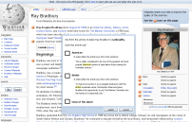
Search Advertising Study
Select interface round-robin
Track session ID, time, all interactions
Questionnaire pops up 60 sec after page loads
baseline
popup
proxy
Logs
highlight
icon

Slide 37
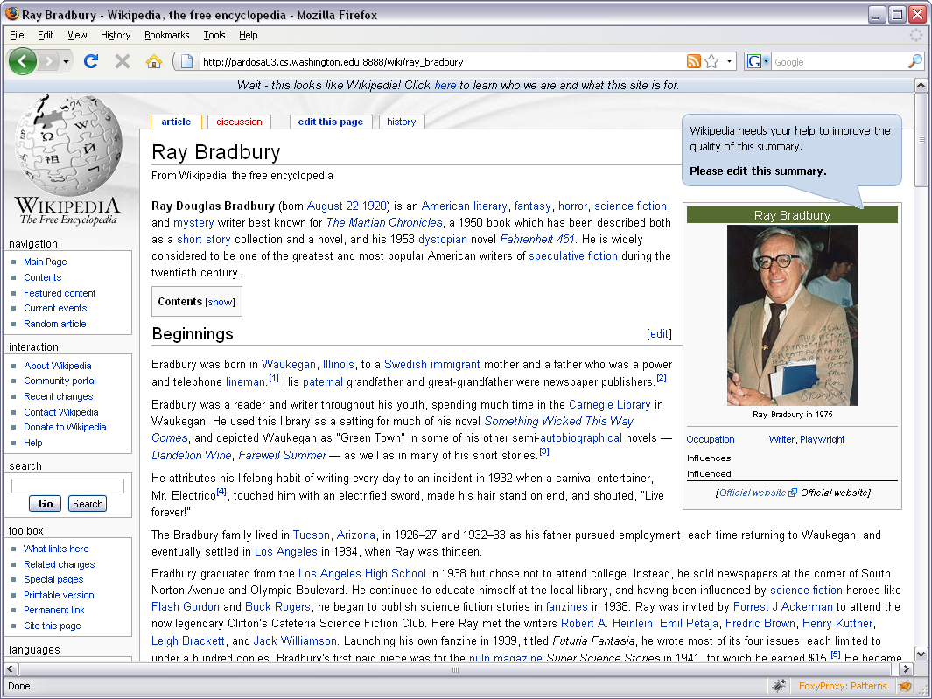
Baseline Interface

Slide 38
Search Advertising Study
Used Yahoo and Google
2473 visitors
Deployment for ~ 7 days
~ 1M impressions
Estimated cost: $1500
(generous support from Yahoo)

Slide 39
An Early Observation
“We think Ray Bradbury’s nationality
is American. Is this correct?”
“Please check with the Britannica!”
“We think the summary should say Ray Bradbury’s nationality is American. Is this what the article says?”
“If I knew would I really need to look”

Slide 40
 | Baseline | Icon | Highlight | Popup
Visitors | 476 | 869 | 563 | 565
Distinct Contributors | 0 | 26 | 42 | 44
Contribution Likelihood | 0% | 3.0% | 7.5% | 7.8%
Number of Contributions | 0 | 58 | 88 | 78
Contributions per Visit | 0 | .07 | .16 | .14
Survey Responses | 12 | 24 | 25 | 18
Saw I Could Help Improve | 11/33 (33%) | 30/73 (41%) | 23/58 (40%) | 24/52 (46%)
Intrusiveness (1:not – 5:very) | 3.0 | 3.3 | 3.5 | 3.5

Slide 41
 | Baseline | Icon | Highlight | Popup
Visitors | 476 | 869 | 563 | 565
Distinct Contributors | 0 | 26 | 42 | 44
Contribution Likelihood | 0% | 3.0% | 7.5% | 7.8%
Number of Contributions | 0 | 58 | 88 | 78
Contributions per Visit | 0 | .07 | .16 | .14
Survey Responses | 12 | 24 | 25 | 18
Saw I Could Help Improve | 11/33 (33%) | 30/73 (41%) | 23/58 (40%) | 24/52 (46%)
Intrusiveness (1:not – 5:very) | 3.0 | 3.3 | 3.5 | 3.5

Slide 43
More user contributions

Slide 44
More precise extractors

Slide 45
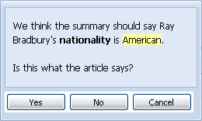
Users are conservative
Of extractions that visitors marked as correct, 90.4% were indeed valid
Of extractions that visitors marked as incorrect, 57.9% were indeed incorrect

Slide 46
Area under Precision/Recall curve with only existing infoboxes
.12
Area
under
P/R curve
0
birth_date
birth_place
death_date
nationality
occupation
Using 5 existing infoboxes per attribute

Slide 47
Area under Precision/Recall curve after adding user contributions
.12
Area
under
P/R curve
0
birth_date
birth_place
death_date
nationality
occupation
Using 5 existing infoboxes per attribute

Slide 48
Improvements and
Number of Existing Infoboxes
Improvements larger if few existing infoboxes
  significant improvements for 5, 10, 25, 50, 100 existing infoboxes
Most infobox classes have few instances
  72% of classes have 100 or fewer instances
  40% of classes have 10 or fewer instances

Slide 49
Synergy

Slide 50
Going Beyond Wikipedia
Research on contribution to communities shows parallels between Wikipedia and others
Wikipedians may not be typical, but our contributions were solicited from people using search to complete their everyday tasks
Goal: Hooks to platforms like MediaWiki

Slide 51
Conclusions
Synergistic method for amplifying Community Content Creation and Information Extraction
  Significantly increased likelihood of contribution
  Significantly improved quality of extraction
Demonstrated use of search advertising in evaluating interfaces as a non-primary task

Slide 52





Thank You!
Raphael Hoffmann
Saleema Amershi
Kayur Patel
Fei Wu
James Fogarty
Daniel S. Weld
{raphaelh,samershi,kayur,wufei,jfogarty,weld}
@cs.washington.edu
University of Washington
This work was supported by Office of Naval Research grant N00014-06-1-0147, CALO grant 03-000225, NSF grant IIS-0812590, the WRF / TJ Cable Professorship, a UW CSE Microsoft Endowed Fellowship, a NDSEG Fellowship, a Web-advertising donation by Yahoo, and an equipment donation from Intel’s Higher Education Program.

Slide 53
Related Work
Snow, O’Connor, Jurafsky, Ng. Cheap and Fast – But is it Good? Evaluating Non-Expert Annotations for Natural Language Tasks, EMNLP’08
DeRose, Chai, Gao, Shen, Doan, Bohannon, Zhu. Building Community Wikipedias: A Human-Machine Approach, ICDE’08
Ahn, Dabbish. Labeling Images with a Computer Game, CHI’04
Mankoff, Hudson, Abowd. Interaction Techniques for Ambiguity Resolution in Recognition-Based Interface, UIST’00
Culotta, Kristjansson, McCallum, Viola. Corrective Feedback and Persistent Learning for Information Extraction. Artificial Intelligence 170(14)
Cosley, Frankowski, Terveen, Riedl. SuggestBot: Using Intelligent Task Routing to Help People Find Work in Wikipedia, IUI’07

