Slide 1
Haar Random Forest Features Combined with a Spatial Matching Kernel for Stoneﬂy Species Identiﬁcation
Natalia Larios*
Bilge Soran*
Linda Shapiro*
Gonzalo Martinez-Munoz^
Jeffrey Lin+
Tom Dietterich+
*University of Washington
+Oregon State University
^Universidad Autónoma de Madrid

Slide 2
Goal: to identify the species of insect specimens rapidly and accurately

Slide 3
Motivation and Challenge
Automated biomonitoring: assessment of the environment by population counts of different stonefly species:
Allows long term measurement capturing cumulative effects
Manually intensive and time consuming for experts
Significant challenge:
Some species are closely related i.e. Calineuria and Doroneuria
The specimens are in different positions in 3D and in different developmental and degradation stages.
Calineuria Doroneuria

Slide 4
Overview of our Classification Method
Training Image Set
Positive and Negative
Testing
Patch extraction
Test Image Patches
Forest Learning
Image Patches
HRF Feature Extraction
HRF
Test Image Features
HRF Feature Extraction
SVM
Classification
Training Vectors
SVM Learning
Prediction

Slide 5
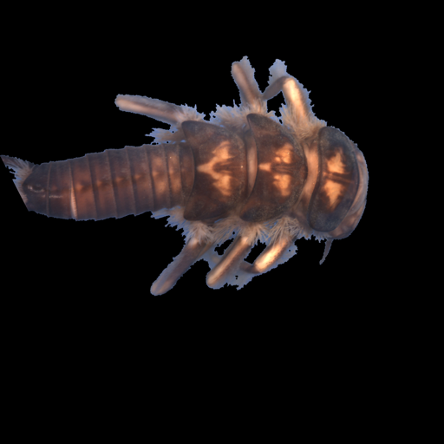
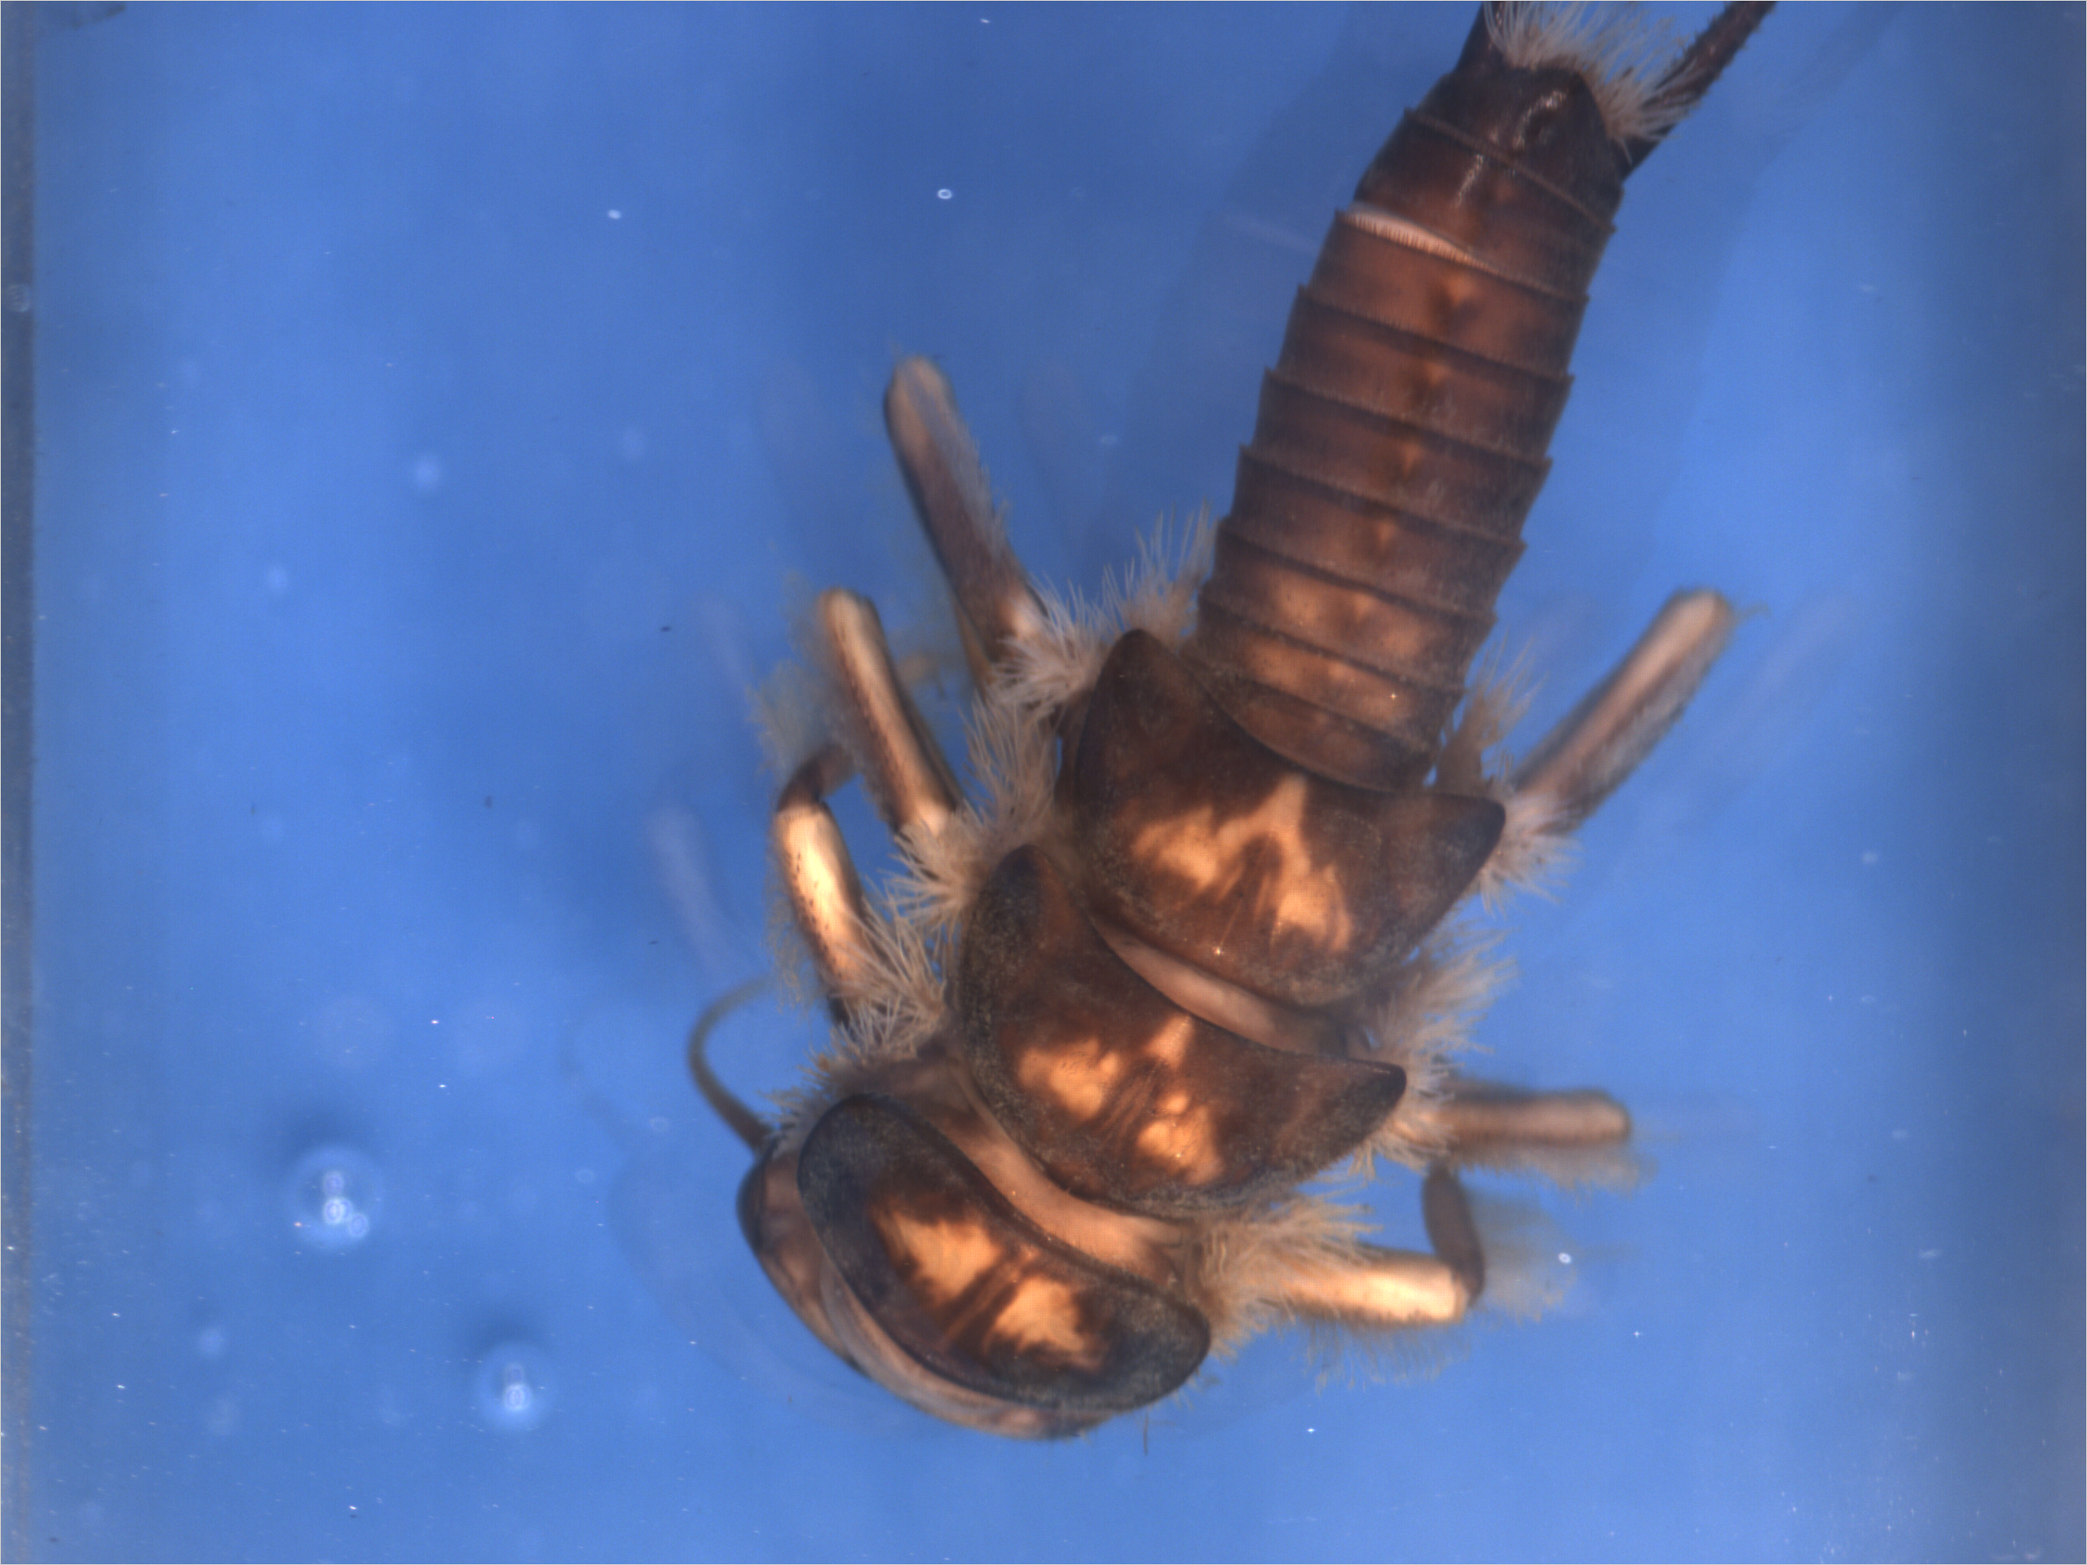
Preprocessing and Patch Extraction
Patches for all window locations over all feature bands
Scanning window
Set of Patches W
Segmentation and Orientation
Feature bands
3 color bands in CIELAB space
9 gradient-orientation bands
Image I

Slide 6
Haar Random Forest Learning
Training set of patches W
The training patch data is recursively split using information gain.
Sampling with replacement
Tree
Sampled set W’
Tree Learning
W^{n}
n
Learning at node n
W^{l}
W^{r}

Slide 7
Node Learning Details
The set of candidate functions at
a node is the set of (roughly 84,000)
Haar-like features over each of the
B image channels.
Thus each candidate function is
just the cross-correlation of a Haar-
like feature with the appropriate
band of the incoming image patch.
Sample Haar-like features
Node n
W^{n}
Information Gain Search
ΔH_{f}
(f, τ)
f < τ
W^{l}
W^{r}

Slide 8
HRF Feature Generation
For each training image, each extracted patch of each band is dropped through the Haar Random Forest.
Patches from a given image band are evaluated by Haar-like features from that band.
Each node accumulates a histogram of the patches that have passed through that node.
The image feature vector is the concatenation of the spatial histograms at every node in the HRF.
n₁
n₂
n_{M}
4 | 2 | 0 | 4 | 2 | 5 | 2 | 1 | 2
4 | 2 | 0 | 4 | 2 | 5 | 2 | 1 | 2
…
4 | 2 | 0 | 4 | 2 | 5 | 2 | 1 | 2

Slide 9
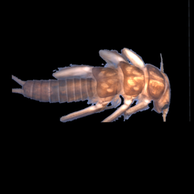
SVM Image Classifier
Image I
HRF
Feature extraction
Test image features
Spatial-Pyramid Kernel SVM
Classification
Prediction

Slide 10
Pyramid-Matching Kernel Evaluation
The kernel K(P, Q) uses Lazebnik’s spatial pyramid kernel at each node of the forest.
The basic operation at different levels of the pyramid is histogram intersection.
At every node n
Histogram P
Histogram Q
r = 1
r = 2
Histogram intersection
I(P[d,n,r], Q[d,n,r])

Slide 11
Experiments
Two versions of our algorithm were tested:
One used only CIELAB color features.
The second used CIELAB features plus gradient-orientation features.
Both versions were compared to the stacked evidence trees (SET) algorithm published in CVPR’09, the best of the previously published stonefly classification algorithms.
SET uses 3 different interest operators (Hessian-affine, Kadir, and PCBR (principal curvature based regions) that are much slower to compute than our Haar-like features.

Slide 12
RESULTS: Stonefly Identification: Classification Error [%]
Task | SET | CIELAB color | CIELAB+G
Cal vs Dor | 6.26 | 10.16 | 4.60
Hes vs Iso | 3.74 | 9.05 | 3.55
Pte vs Swe | 2.71 | 8.75 | 2.80
Dor vs Hes | 2.25 | 8.09 | 2.20
Mos vs Pte | 2.06 | 7.95 | 1.92
Yor vs Zap | 1.52 | 6.89 | 1.60
Zap vs Cal | 1.52 | 7.02 | 1.76
Swe vs Yor | 1.44 | 6.85 | 1.50
Iso vs Mos | 1.29 | 6.90 | 1.30
Average | 2.53 | 7.96 | 2.25
most difficult

Slide 13
Feature Extraction Average Timing Results
Average image timing [seconds] | SET | HRF LAB+G
Hessian-Afﬁne | 9 | 5
KB Salient | 390
PCBR | 516
Keyword assignment | 2
Total | 917 | 5
The classification stage for both systems is very efficient timing about 0.2 seconds on average per image.

Slide 14
Conclusion
Our algorithm combines efficient low-level extraction with discriminative learning.
The HRF algorithm generates a semantic image representation with spatial information in a single step.
This low-level discriminative method enables the creation of a feature extractor tailored to the application.
The use of scale-invariant, constant-time Haar-like features achieves a much lower average processing time than general detectors with similar invariance characteristics.

Slide 15
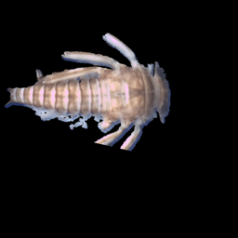
Future Work
Employ other types of features: shape, invariant local features
Combine specialized classifiers for each feature type
Create a multiclass version and evaluate on different datasets

