Slide 1
The Case for Offloading Continuous High-Datarate Perception to the Cloud
ON
Phone
Seungyeop Han and Matthai Philipose
University of Washington and Microsoft Research

Slide 2
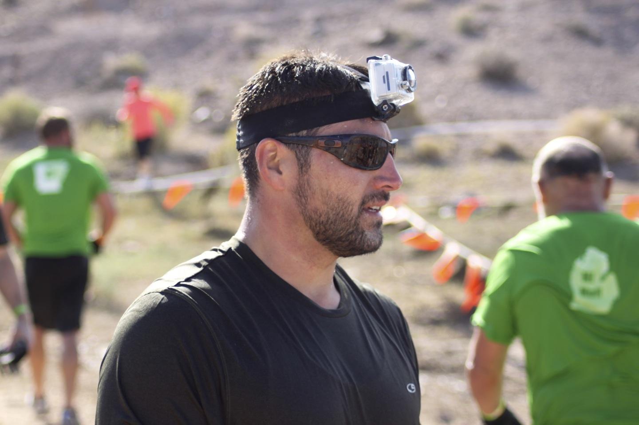
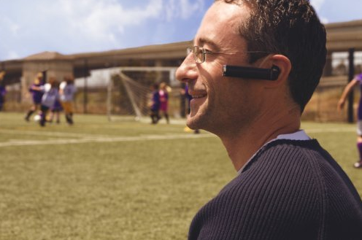
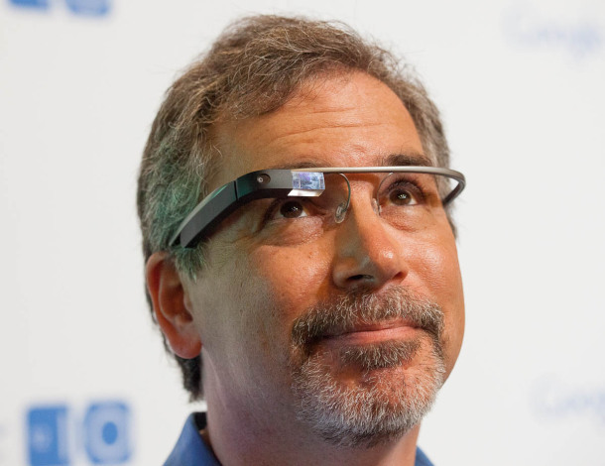
Who?
What?
Where?

Slide 3
It’s Worth It!
Change behaviors
Aid in complex tasks
Augment cognition

Slide 4
The Performance Gap
Resource use of today’s best systems:
1000x CPU, 100x memory relative to today’s phone
 | Speech | Face | Object | Location
Model Size | 0.5 – 600 GB | 1M/person | 3-6 GB | 20M/floor
Compute | 16kHz @ 160% Xeon E5640 | 30fps @ 8-core SandyBridge | 30fps @ Nvidia 580 GPU | 30fps @ 2-core 2.4 GHz ‘09 Intel CPU

Slide 5
Offloading Does Not Bridge the Gap
Continuous vision requires:
High availability
High core network capacity
High compute capacity
A good privacy story

Slide 6
Bridging the gap
Processors getting more efficient
Most bytes are irrelevant
Drop frames if | Fraction to process
None | 100%
No voice | 6%
High acceleration | 2.5%
Low light | 1.5%
Gaining ~50x efficiency
Gaining ~50x efficiency

Slide 7
Vision algorithms are reaching maturity
Applications could add huge value
Vision on the phone likely necessary + feasible
What does the OS do?

Slide 8
The OS Multiplexes Across Apps …
Cached cloud-scale models
Privacy primitives
… while providing efficient access to:
Heterogeneous resources
Sensor gating services
GPU
Accelerometer
CPU
Light sensor
GPS
CPU
DSP
CPU
ASIC
Model Cache
X
CPU
GPU
DSP
ASIC
…

Slide 9
Vision algorithms are reaching maturity
Applications could add huge value
Vision on the phone likely necessary + feasible
OS provides efficient, private cross-app access:
processors, models, low-power sensors
THANKS!

