Slide 1
3D Printing Internet Connected Objects
Vikram Iyer, Justin Chan, Shyam Gollakota
3D Printing Internet Connected Objects [SIGGRAPH Asia ’17]

Slide 2
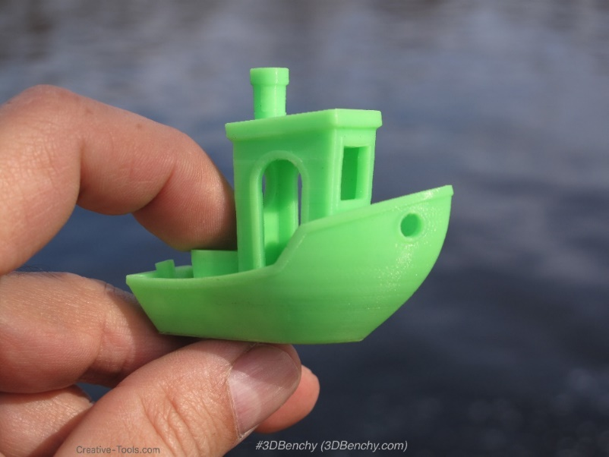
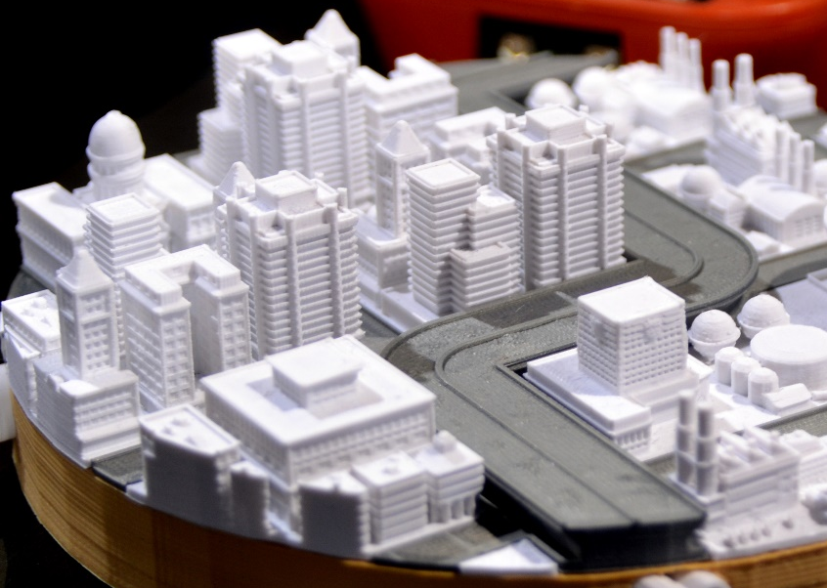
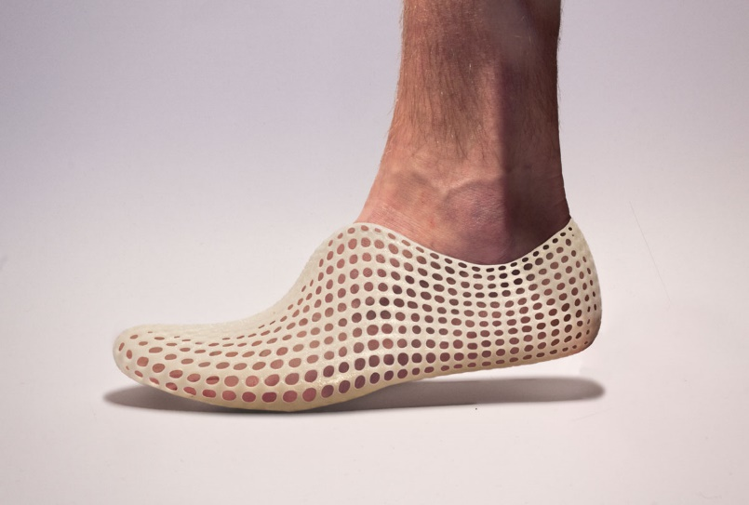
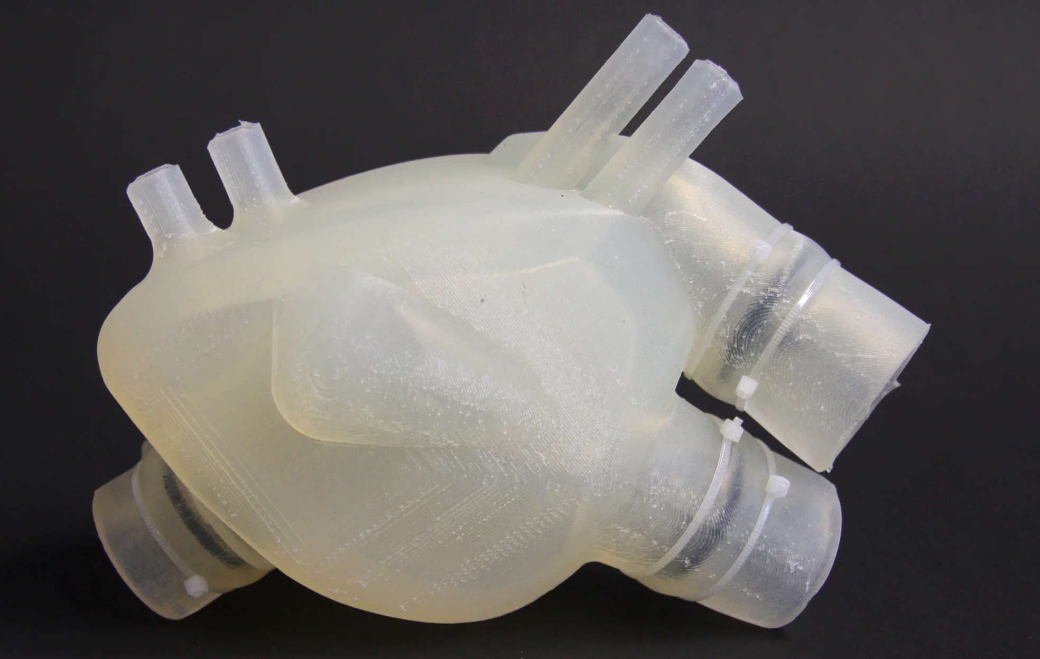
3D Printing: Revolutionizing Manufacturing
3D Printing Internet Connected Objects [SIGGRAPH Asia ’17]

Slide 3
Today, we can’t print connected objects
Printed Object
+
Cloud
We can’t 3D print radios with plastic
3D Printing Internet Connected Objects [SIGGRAPH Asia ’17]

Slide 4
How can we make fully printed IoT devices using commodity 3D printers?

Slide 5
Connectivity toolkit for 3D printing
Printed Wi-Fi
3D printed wireless communication
No batteries
No electronics
Printed Maglink
Information embedded in objects
3D Printing Internet Connected Objects [SIGGRAPH Asia ’17]

Slide 6
Printed Wi-Fi uses Reflections
Use mechanical motion to reflect Wi-Fi
Wi-Fi TX
Printed Wi-Fi Object
Wi-Fi RX
3D Printing Internet Connected Objects [SIGGRAPH Asia ’17]

Slide 7
Printed Wi-Fi uses Reflections
Use mechanical motion to reflect Wi-Fi
Printed Wi-Fi Components:
Antenna
Switch
Data storage/encoding
Power
Wi-Fi TX
Printed Wi-Fi Object
Wi-Fi RX
3D Printing Internet Connected Objects [SIGGRAPH Asia ’17]

Slide 8
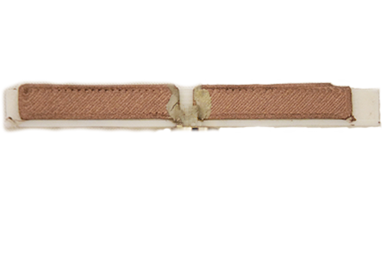
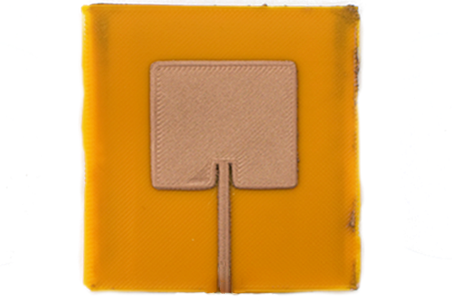
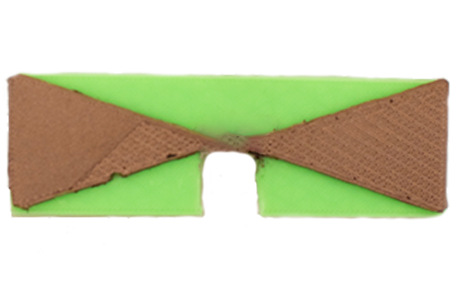
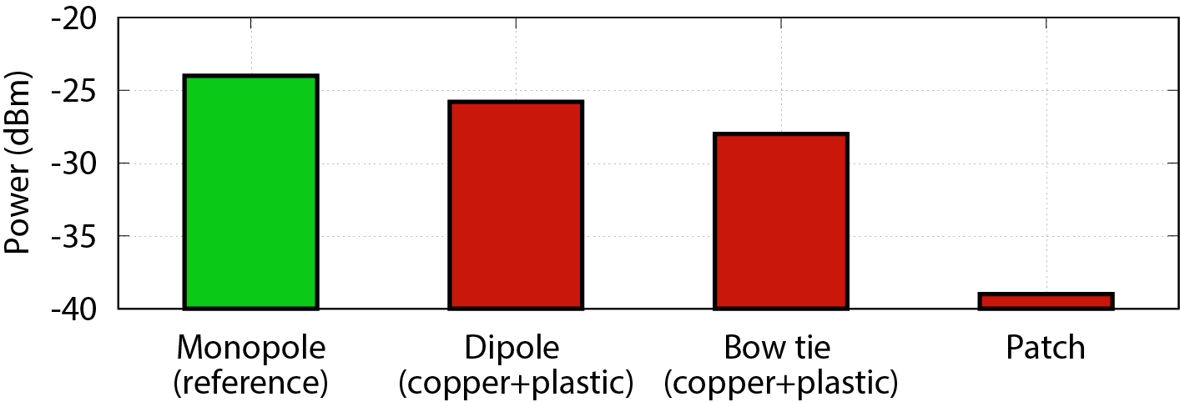
3D Printed Antennas
Dipole
Patch
Bowtie
-20
-25
-30
-35
-40
Power (dbm)
Monopole
(reference)
Dipole
Bow tie
Patch
3D Printing Internet Connected Objects [SIGGRAPH Asia ’17]

Slide 9
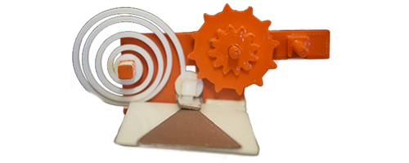
3D Printed Switch
Switch
spring
Gear
Switch contact
(conductive)
Antenna
(conductive)
Switch closes in 1 ms
3D Printing Internet Connected Objects [SIGGRAPH Asia ’17]

Slide 10
Encoding Data
Normal gear
On-off
keying
Width
encoding
24 bits per gear
3D Printing Internet Connected Objects [SIGGRAPH Asia ’17]

Slide 11
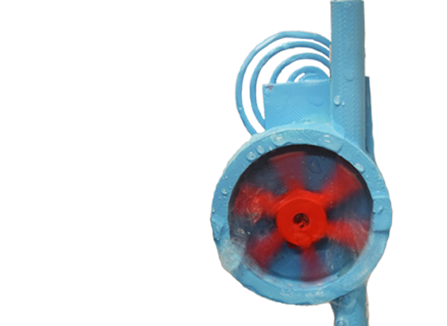
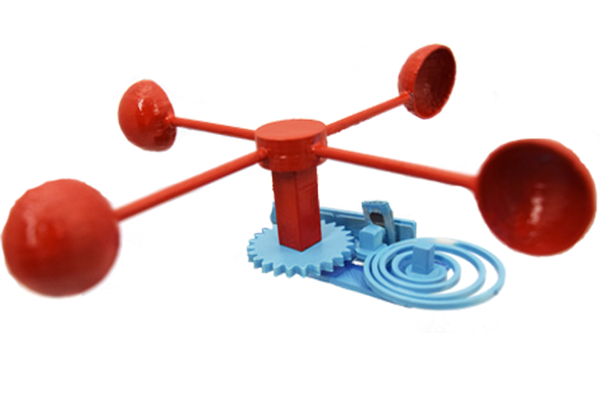
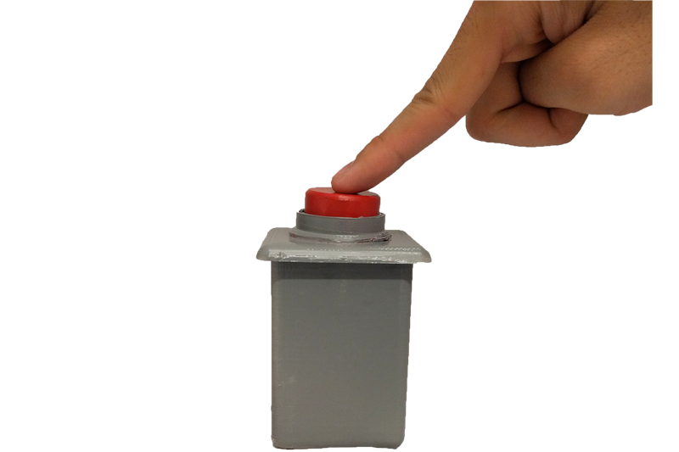
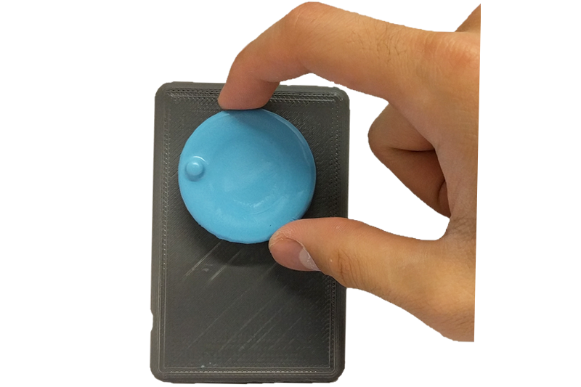
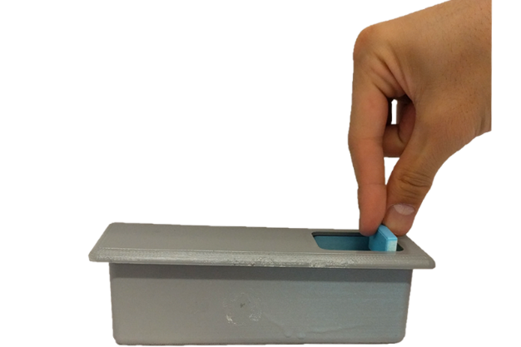
Power
Sensors
Interaction Devices
3D Printing Internet Connected Objects [SIGGRAPH Asia ’17]

Slide 12
Printed Wi-Fi
Gear
Switch
Antenna
3D Printing Internet Connected Objects [SIGGRAPH Asia ’17]

Slide 13
3D Printed Sensors
3D Printing Internet Connected Objects [SIGGRAPH Asia ’17]

Slide 14
3D Printed Sensors
3D Printing Internet Connected Objects [SIGGRAPH Asia ’17]

Slide 15
Printed Input Devices
3D Printing Internet Connected Objects [SIGGRAPH Asia ’17]

Slide 16
Connectivity toolkit for 3D printing
Printed Wi-Fi
3D printed wireless communication
No batteries
No electronics
Printed Maglink
Information embedded in objects
3D Printing Internet Connected Objects [SIGGRAPH Asia ’17]

Slide 17
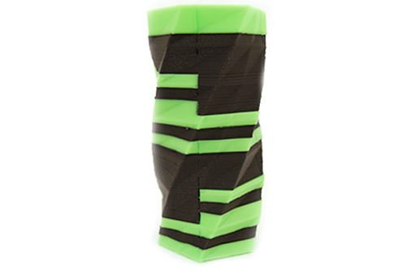
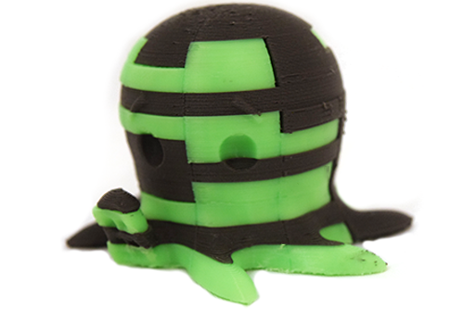
Printed Maglink
Original objects
Painted objects
3D Printing Internet Connected Objects [SIGGRAPH Asia ’17]

Slide 18
Embedding Information in Objects
3D Printing Internet Connected Objects [SIGGRAPH Asia ’17]

Slide 19
Embedding Information in 2D
3D Printing Internet Connected Objects [SIGGRAPH Asia ’17]

Slide 20
Printed Wi-Fi
Students:
Vikram Iyer
Justin Chan
Faculty:
Shyam Gollakota
Printed Maglink

