Slide 1
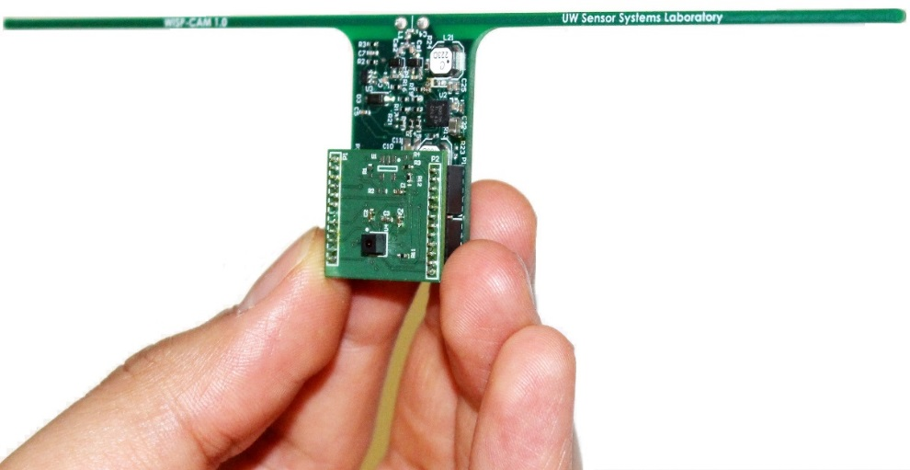
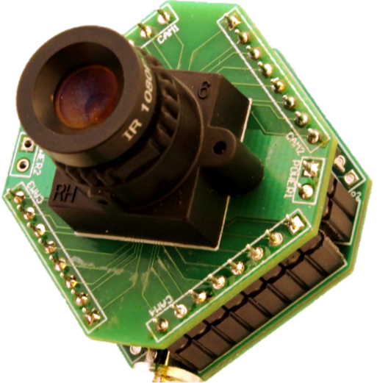
Battery-free Cameras for IoT
Saman Naderiparizi, Mehrdad Hessar, Zerina Kapetanovic, Aaron Parks, Vamsi Talla, Benjamin Ransford, Shyamnath Gollakota, Joshua R Smith

Slide 2
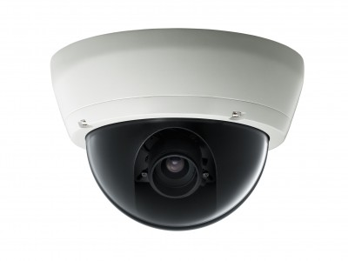
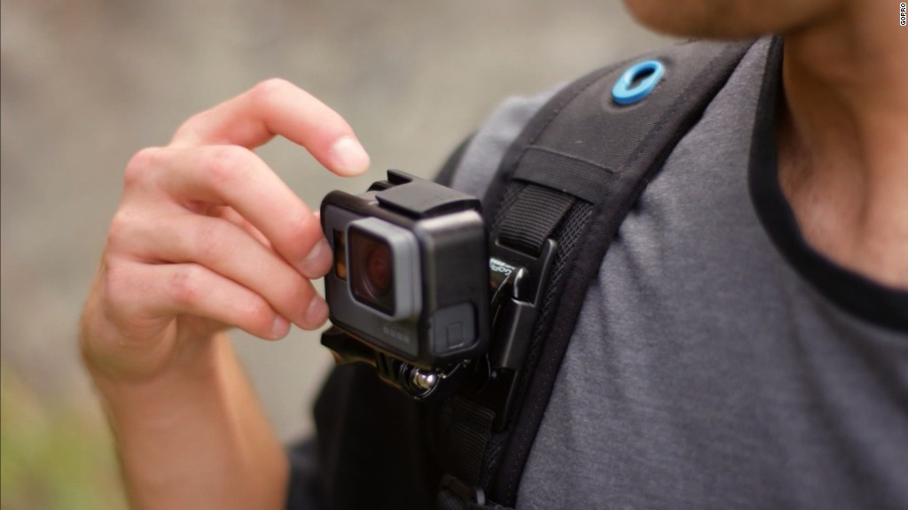
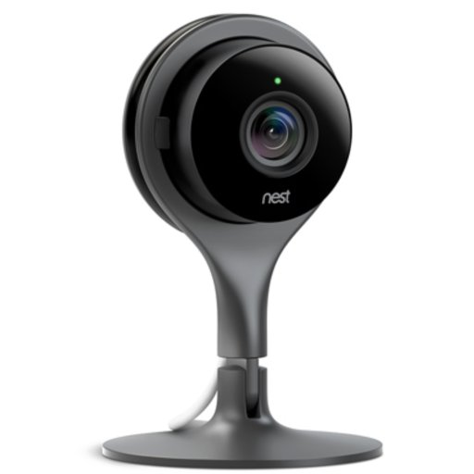
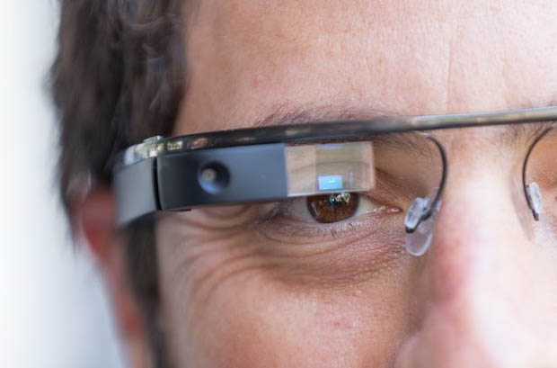
Cameras Are Part of Our Everyday Life

Slide 3
How Many Security Cameras are Out There?
Data Contribution: 2.5% of the total data, that is huge!
How Many: 245M active security cameras in 2014
Notes:
1.5B smart phone users at 2014, so 16% of this number we had active security cameras.

Slide 4
Why Wireless Cameras are Power Hungry?
Image Sensor @4K and 15fps (~200mW)
Video Compression Module and off-chip Image Processor (~1500mW)
Wireless Communication (~800mW)
Total about 2500mW.
Frequent battery replacement.
Notes:
Modify the transition, make it better and more smooth. Maybe mention that we are here focusing only on the power limitation.

Slide 5
Our Solution: Building Ultra-low-power (Possibly Battery-free) Wireless Cameras
Notes:
1.5B smart phone users at 2014, so 16% of this number we had active security cameras.

Slide 6
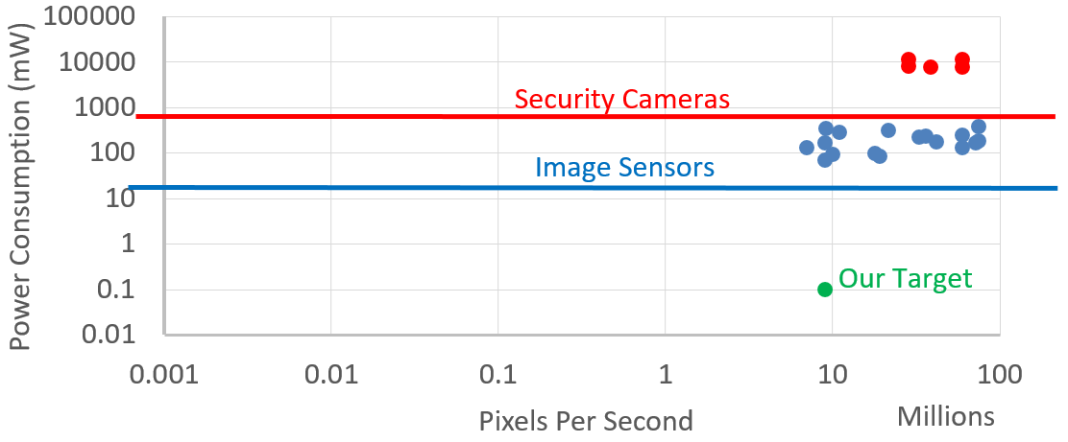
Battery-Free Camera Trajectory

Slide 7
Our Approach: Decoupling the Power Hungry Components from the Camera Front
Notes:
Change the flow.

Slide 8
Remove Power Hungry Components from Camera
Conventional Camera Arch
Our Proposed Camera Arch
Notes:
Mention custom built PWM converter and the base-station

Slide 9
PSNR vs Distance from the AP

Slide 10
Performance for Face Detection
Notes:
Mention the curve is face detection accuracy.

