Slide 1
More Counting
CSE 312 Spring 21
Lecture 2

Slide 2
Announcements
Syllabus is up! Thank you for your patience.
Please read the collaboration policy, in particular:
on homeworks you are encouraged to collaborate, but the writeup must be your own.
  If you’re working with others, don’t take notes from your discussions
  And take a 30 minute break between discussions and your writeup
The goal of these rules is to make sure you’ve learned how to do the problems.

Slide 3
Announcements
Homework 1 will come out tonight.
Mostly written problems.
Every written problem requires a justification.
Not a proof (unless we say to prove something). But enough explanation that someone who followed lecture but hasn’t seen the problem would fully understand where your answer came from (and believe it’s correct)
There’s also one programming question – submission on gradescope, but it will be easiest to do the questions on Ed (Ed has a python interpreter built in, you could set up your own python environment, but Ed will be sufficient for this quarter).

Slide 4
Announcements
You’ll have 6 late days to use for the quarter.
At most 3 late days per assignment.
Late days are for “normal” things during the quarter
If you have an unusual or extended or extreme issue, please let us know.
The sooner you let us know, the more options we have for accommodations.

Slide 5
Where Are We?
Last time:
  Sum and Product Rules
  Sequential Processes
  Representation is important!
  Today:
  Combinations and Permutations.

Slide 6

More sequence practice
How many length 3 sequences are there consisting of distinct elements of $\{1,2,3\}$.

Slide 7
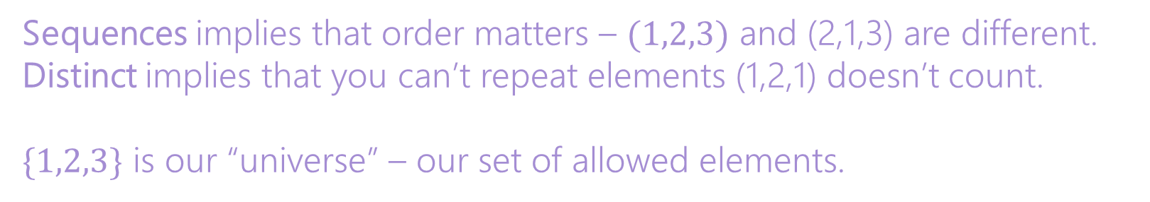
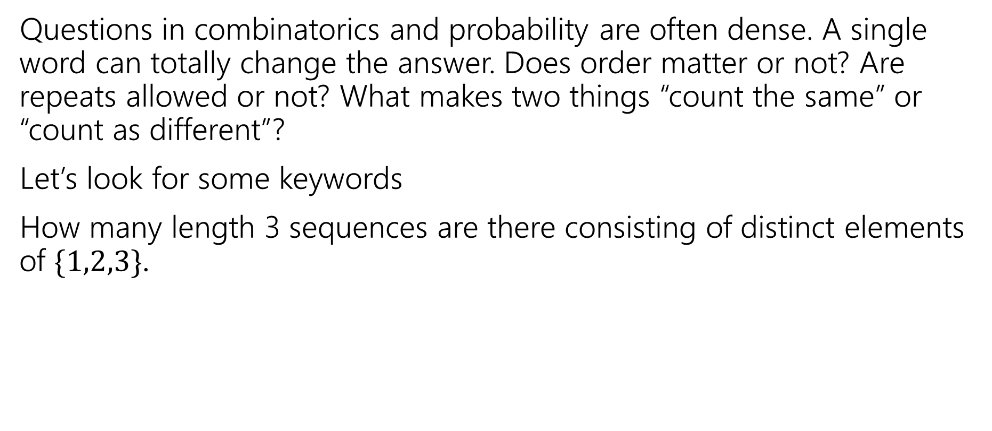
Pause
Questions in combinatorics and probability are often dense. A single word can totally change the answer. Does order matter or not? Are repeats allowed or not? What makes two things “count the same” or “count as different”?
Let’s look for some keywords
How many length 3 sequences are there consisting of distinct elements of $\{1,2,3\}$.
Sequences implies that order matters – $(1,2,3)$ and (2,1,3) are different.
Distinct implies that you can’t repeat elements (1,2,1) doesn’t count.
$\{1,2,3\}$ is our “universe” – our set of allowed elements.

Slide 8
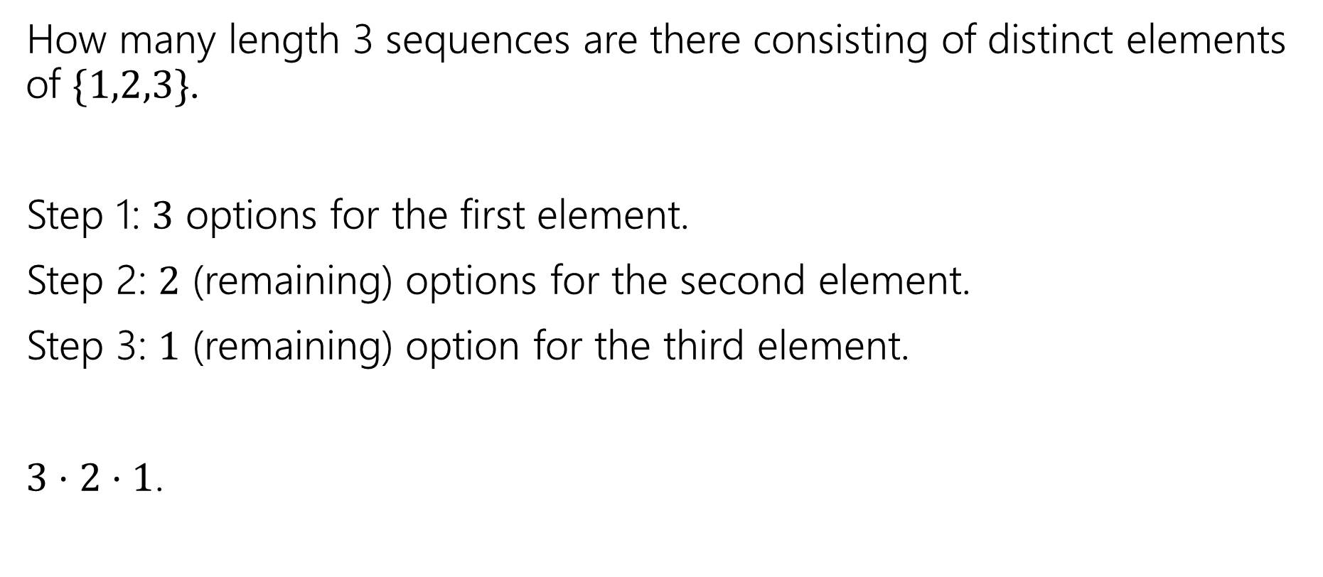
More sequence practice
How many length 3 sequences are there consisting of distinct elements of $\{1,2,3\}$.
Step 1: $3$ options for the first element.
Step 2: $2$ (remaining) options for the second element.
Step 3: $1$ (remaining) option for the third element.
$3⋅2⋅1$.

Slide 9

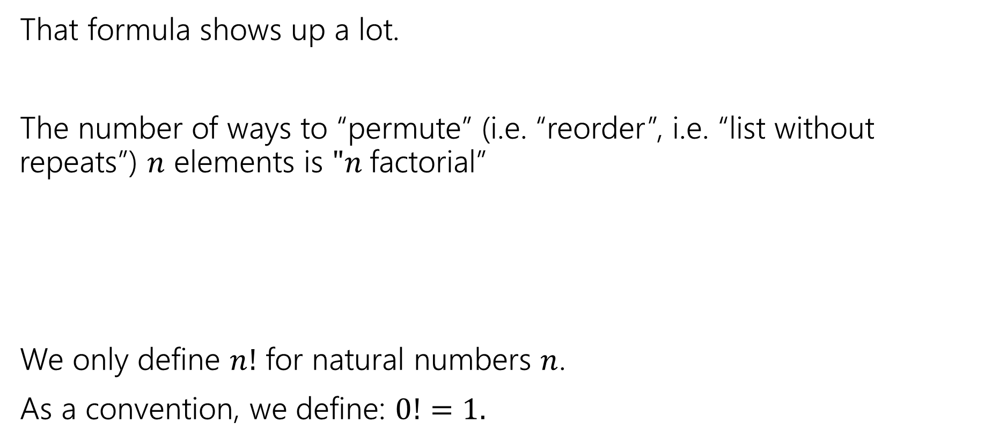

Factorial
That formula shows up a lot.
The number of ways to “permute” (i.e. “reorder”, i.e. “list without repeats”) $n$ elements is $"n$factorial”
We only define $n!$ for natural numbers $n$.
As a convention, we define: $0!=1.$
$$n!=n⋅\left(n−1\right)⋅\left(n−2\right)⋯1$$
$n$ factorial

Slide 10


Distinct Letters
How many length $5$ strings are there over the alphabet $\{a,b,…,z\}$ where each string does not repeat a letter.
E.g. “azure” is an allowed string, but “steve” is not, nor is “abcdef”
$26⋅25⋅24⋅23⋅22$

Slide 11
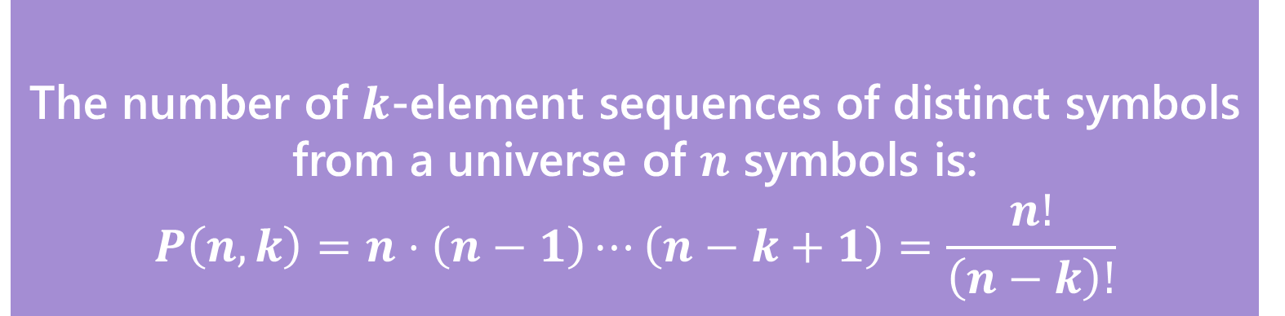
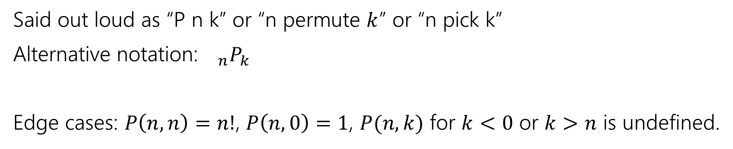
In General
The number of $k$-element sequences of distinct symbols from a universe of $n$ symbols is:
$$P\left(n,k\right)=n⋅\left(n−1\right)⋯\left(n−k+1\right)=\frac{n!}{\left(n−k\right)!}$$
$k$-permutation
Said out loud as “P n k” or “n permute $k$” or “n pick k”
Alternative notation:${}_{n}P_{k}$
Edge cases: $P\left(n,n\right)=n!$, $P\left(n,0\right)=1$, $P(n,k)$ for $k<0$ or $k>n$ is undefined.

Slide 12
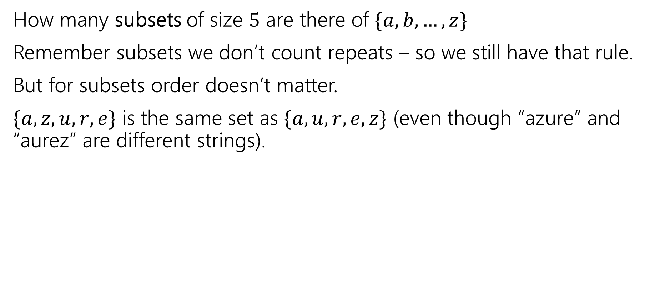
Change it slightly
How many subsets of size $5$ are there of $\{a,b,…,z\}$
Remember subsets we don’t count repeats – so we still have that rule.
But for subsets order doesn’t matter.
$\{a,z,u,r,e\}$ is the same set as $\{a,u,r,e,z\}$ (even though “azure” and “aurez” are different strings).

Slide 13
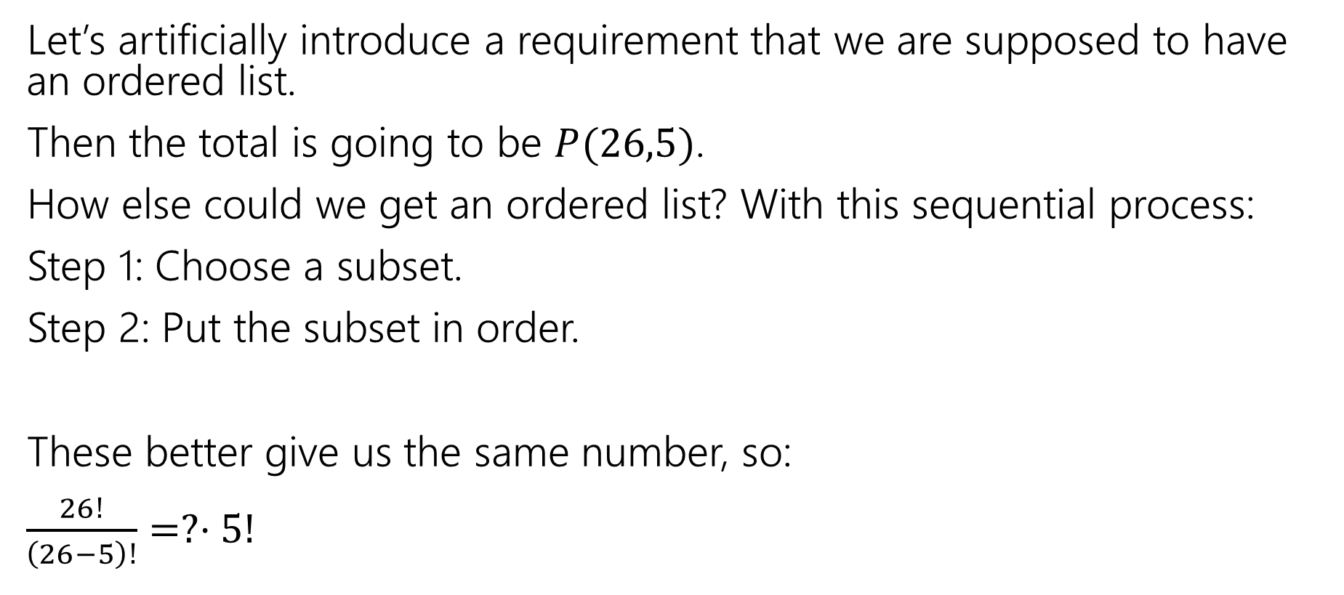
Clever approach – count two ways
Let’s artificially introduce a requirement that we are supposed to have an ordered list.
Then the total is going to be $P(26,5)$.
How else could we get an ordered list? With this sequential process:
Step 1: Choose a subset.
Step 2: Put the subset in order.
These better give us the same number, so:
$\frac{26!}{\left(26−5\right)!}=?⋅5!$

Slide 14
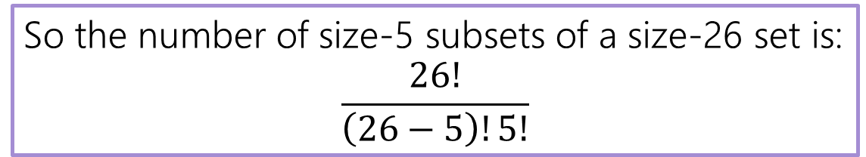
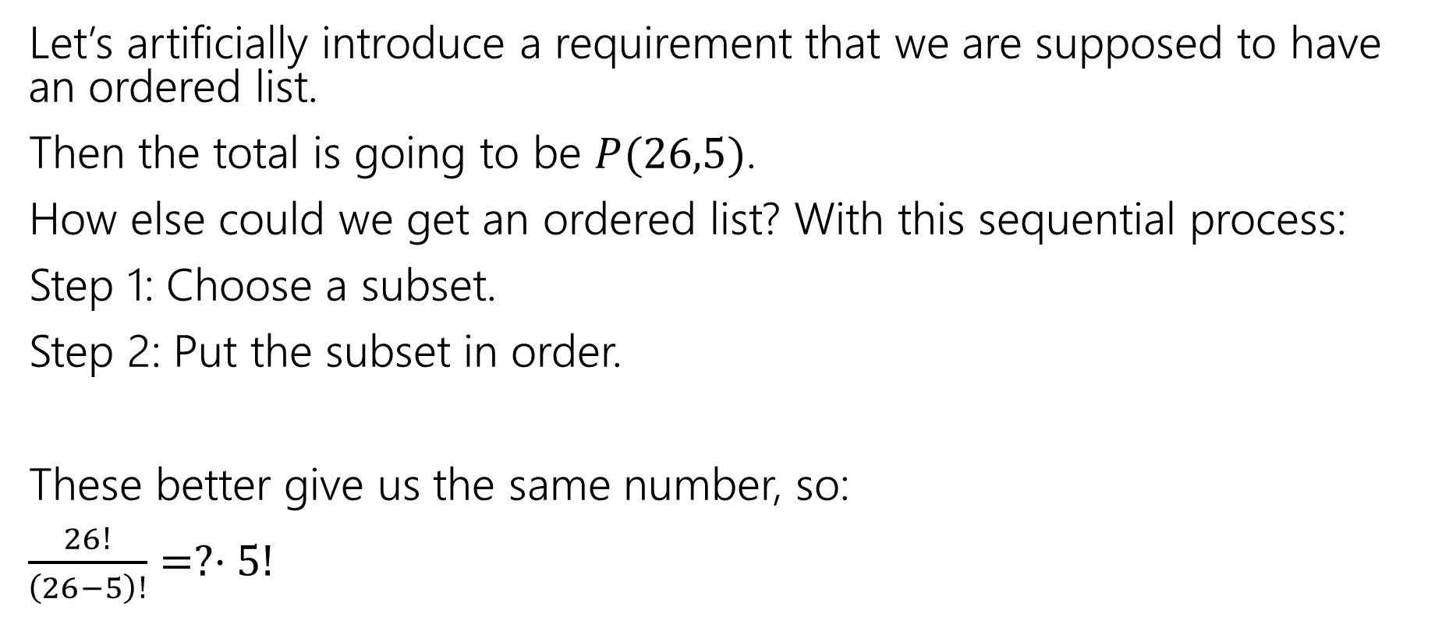
Clever approach – count two ways
Let’s artificially introduce a requirement that we are supposed to have an ordered list.
Then the total is going to be $P(26,5)$.
How else could we get an ordered list? With this sequential process:
Step 1: Choose a subset.
Step 2: Put the subset in order.
These better give us the same number, so:
$\frac{26!}{\left(26−5\right)!}=?⋅5!$
So the number of size-5 subsets of a size-26 set is:
$$\frac{26!}{\left(26−5\right)!5!}$$

Slide 15
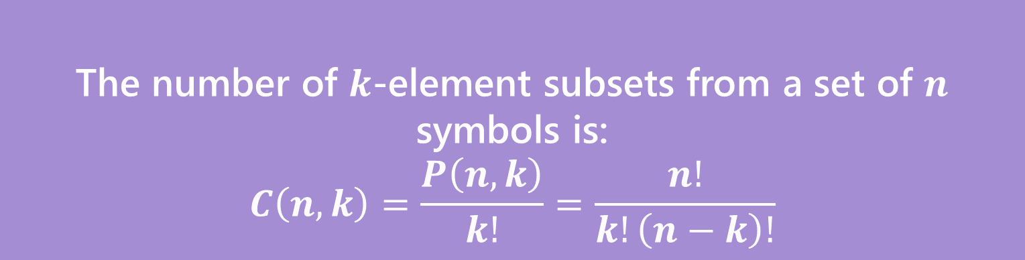
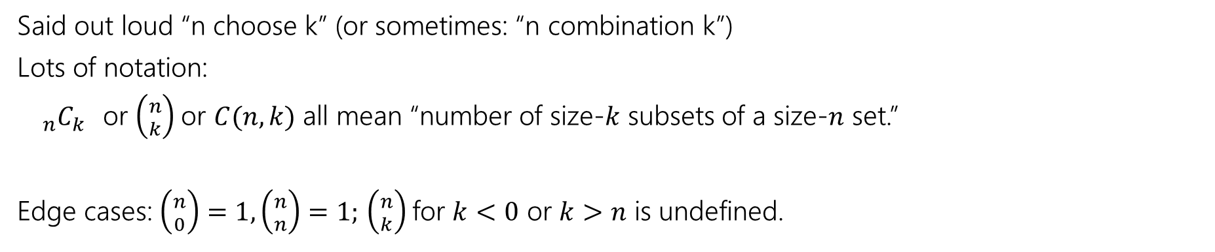
Number of Subsets
The number of $k$-element subsets from a set of $n$ symbols is:
$$C\left(n,k\right)=\frac{P\left(n,k\right)}{k!}=\frac{n!}{k!\left(n−k\right)!}$$
$k$-combination
Said out loud “n choose k” (or sometimes: “n combination k”)
Lots of notation:
${}_{n}C_{k}$or $\left({n \atop k}\right)$or $C(n,k)$ all mean “number of size-$k$ subsets of a size-$n$ set.”
Edge cases: $\left({n \atop 0}\right)=1,\left({n \atop n}\right)=1;$ $\left({n \atop k}\right)$for $k<0$ or $k>n$ is undefined.

Slide 16
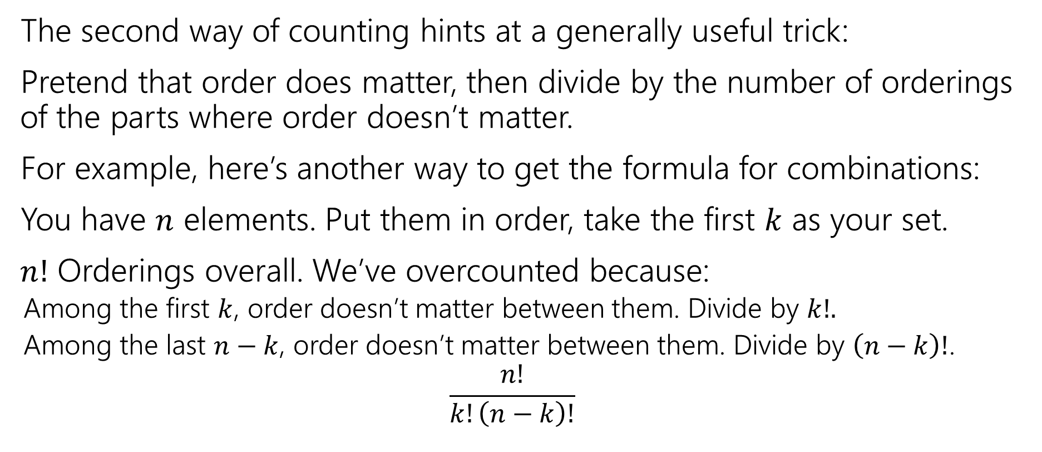
Second Takeaway
The second way of counting hints at a generally useful trick:
Pretend that order does matter, then divide by the number of orderings of the parts where order doesn’t matter.
For example, here’s another way to get the formula for combinations:
You have $n$ elements. Put them in order, take the first $k$ as your set.
$n!$ Orderings overall. We’ve overcounted because:
  Among the first $k$, order doesn’t matter between them. Divide by $k!.$
  Among the last $n−k$, order doesn’t matter between them. Divide by $\left(n−k\right)!$.
  $$\frac{n!}{k!\left(n−k\right)!}$$

Slide 17
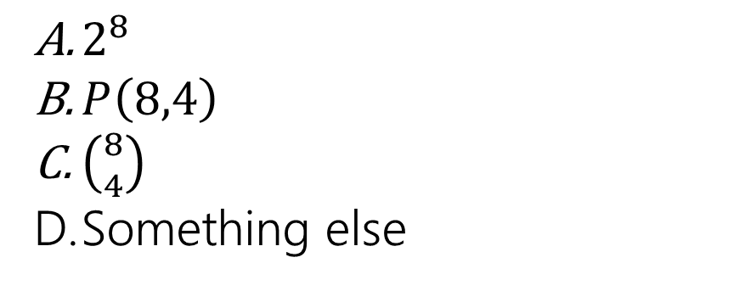
Path Counting
We’re in the lower-left corner, and want to get to the upper-right corner.
We’re only going to go right and up.
How many different paths are there?
$2^{8}$
$P\left(8,4\right)$
$\left({8 \atop 4}\right)$
Something else
Fill out the poll everywhere so Robbie knows how much to explain
Go to pollev.com/cse312 and login with your UW identity

Slide 18
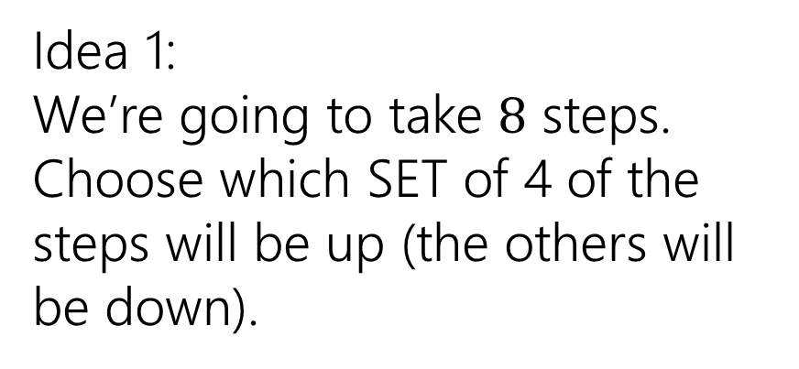
Path Counting
We’re in the lower-left corner, and want to get to the upper-right corner.
We’re only going to go right and up.
How many different paths are there?
Idea 1:
We’re going to take $8$ steps. Choose which SET of 4 of the steps will be up (the others will be down).

Slide 19
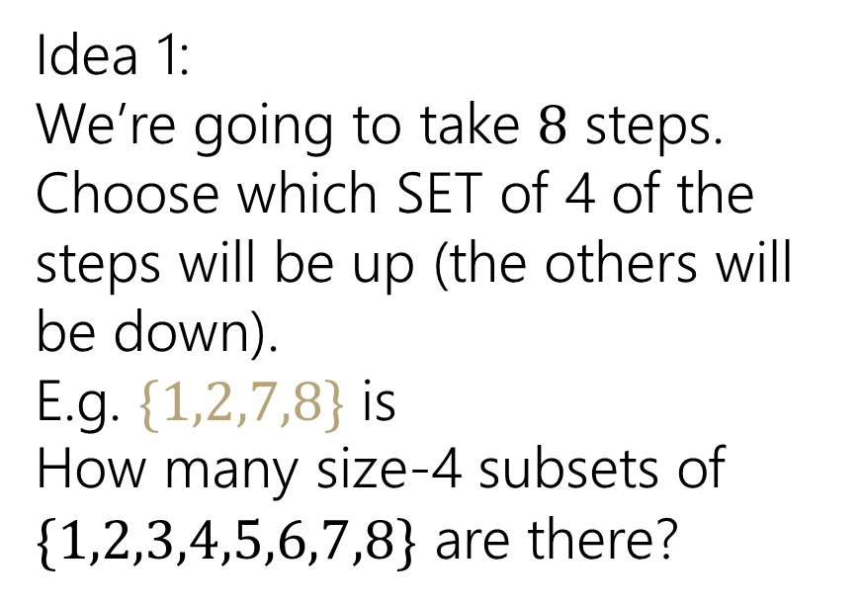
Path Counting
We’re in the lower-left corner, and want to get to the upper-right corner.
We’re only going to go right and up.
How many different paths are there?
Idea 1:
We’re going to take $8$ steps. Choose which SET of 4 of the steps will be up (the others will be down).
E.g. $\{1,2,7,8\}$ is
How many size-4 subsets of $\{1,2,3,4,5,6,7,8\}$ are there?

Slide 20
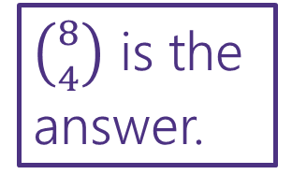
Path Counting
We’re in the lower-left corner, and want to get to the upper-right corner.
We’re only going to go right and up.
How many different paths are there?
Idea 1:
We’re going to take $8$ steps. Choose which SET of 4 of the steps will be up (the others will be down).
E.g. $\{1,2,7,8\}$ is
How many size-4 subsets of $\{1,2,3,4,5,6,7,8\}$ are there?
$\left({8 \atop 4}\right)$ is the answer.

Slide 21
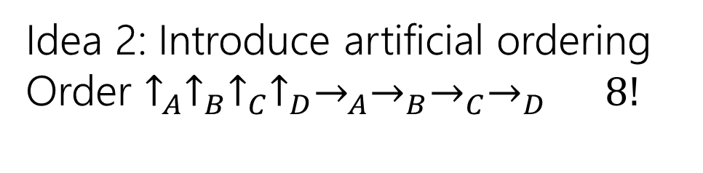
Path Counting
We’re in the lower-left corner, and want to get to the upper-right corner.
We’re only going to go right and up.
How many different paths are there?
Idea 2: Introduce artificial ordering
Order $↑_{A}↑_{B}↑_{C}↑_{D}→_{A}→_{B}→_{C}→_{D}$ $8!$

Slide 22

Path Counting
We’re in the lower-left corner, and want to get to the upper-right corner.
We’re only going to go right and up.
How many different paths are there?
Idea 2: Introduce artificial ordering
Order $↑_{A}↑_{B}↑_{C}↑_{D}→_{A}→_{B}→_{C}→_{D}$ $8!$
Remove the overcounting
Those $4$ $↑$ are really the same,
divide by $4!$
The $4→$ are really the same,
divide by $4!$
Total: $\frac{8!}{4!⋅4!}$
$\left({8 \atop 4}\right)$ is the answer.

Slide 23
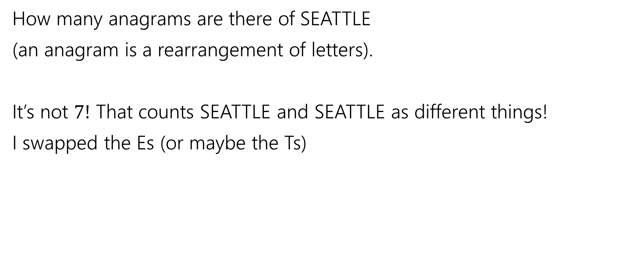
Overcounting
How many anagrams are there of SEATTLE
(an anagram is a rearrangement of letters).
It’s not $7!$ That counts SEATTLE and SEATTLE as different things!
I swapped the Es (or maybe the Ts)

Slide 24
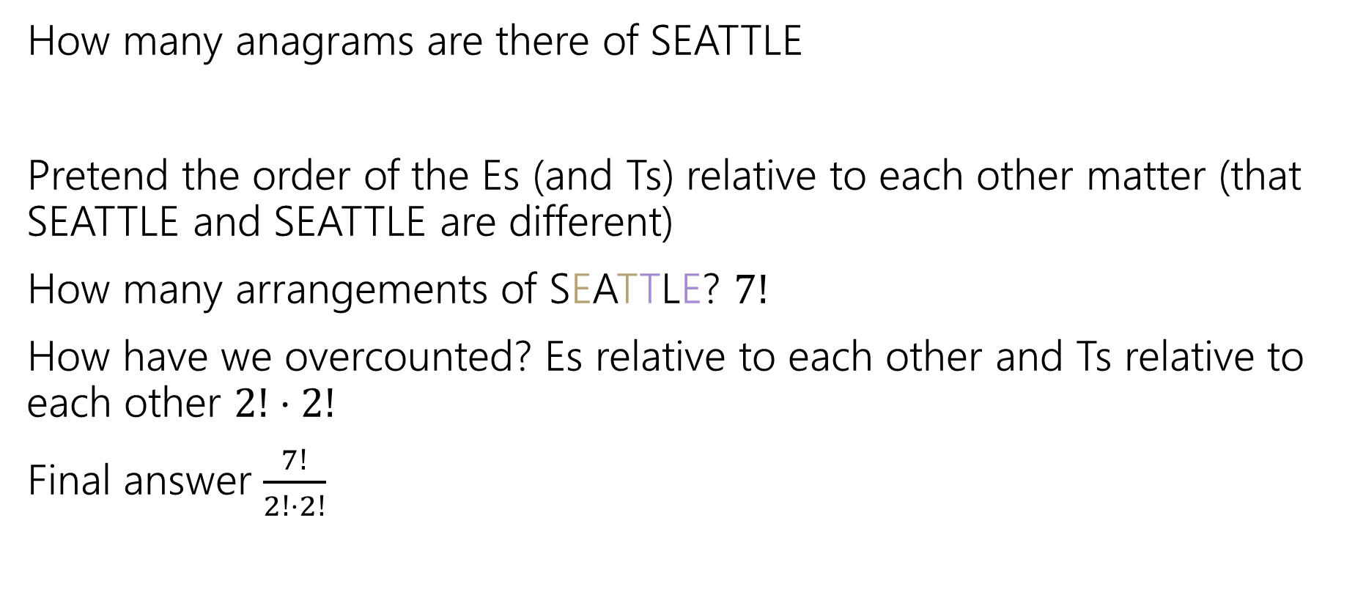
Overcounting
How many anagrams are there of SEATTLE
Pretend the order of the Es (and Ts) relative to each other matter (that SEATTLE and SEATTLE are different)
How many arrangements of SEATTLE? $7!$
How have we overcounted? Es relative to each other and Ts relative to each other $2!⋅2!$
Final answer $\frac{7!}{2!⋅2!}$

Slide 25
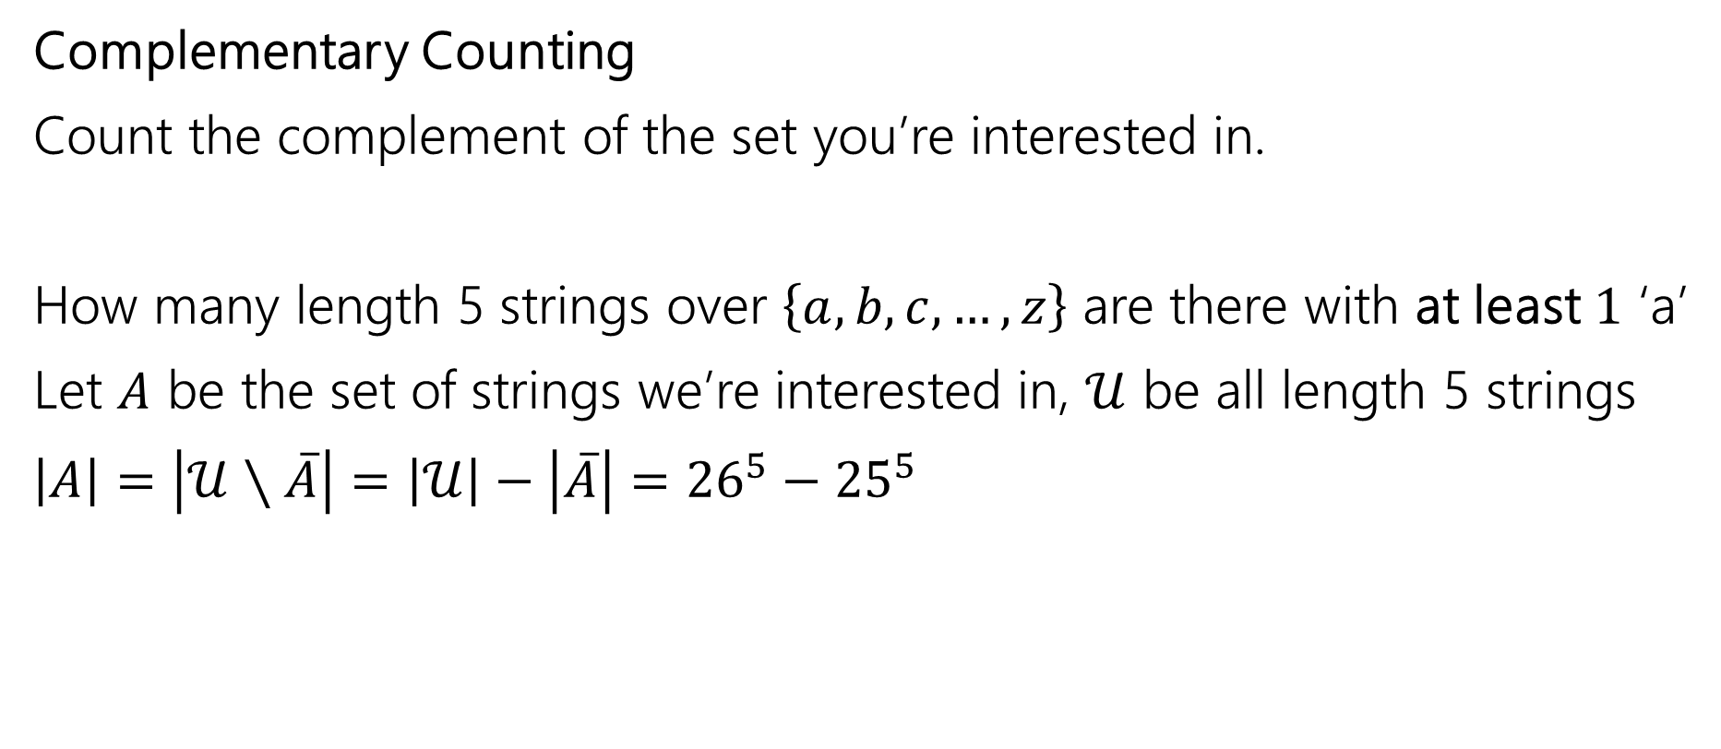
One More Counting Technique
Complementary Counting
Count the complement of the set you’re interested in.
How many length 5 strings over $\left\{a,b,c,…,z\right\}$ are there with at least $1$ ‘a’
Let $A$ be the set of strings we’re interested in, $𝒰$ be all length 5 strings
$\left|A\right|=\left|𝒰∖\overline{A}\right|=\left|𝒰\right|−\left|\overline{A}\right|={26}^{5}−{25}^{5}$

Slide 26
Combination Facts

Slide 27

Some Facts about combinations
Symmetry of combinations: $\left({n \atop k}\right)=\left({n \atop n−k}\right)$
Pascal’s Rule: $\left({n \atop k}\right)=\left({n−1 \atop k−1}\right)+\left({n−1 \atop k}\right)$

Slide 28

Two Proofs of Symmetry
Proof 1: By algebra
$\left({n \atop k}\right)=\frac{n!}{k!\left(n−k\right)!}$
$=\frac{n!}{\left(n−k\right)!k!}$
$=\left({n \atop n−k}\right)$
Definition of Combination
Algebra (commutativity of multiplication)
Definition of Combination

Slide 29
Two Proofs of Symmetry
Wasn’t that a great proof.
Airtight. No disputing it.
Got to say “commutativity of multiplication.”
But…do you know why? Can you feel why it’s true?

Slide 30
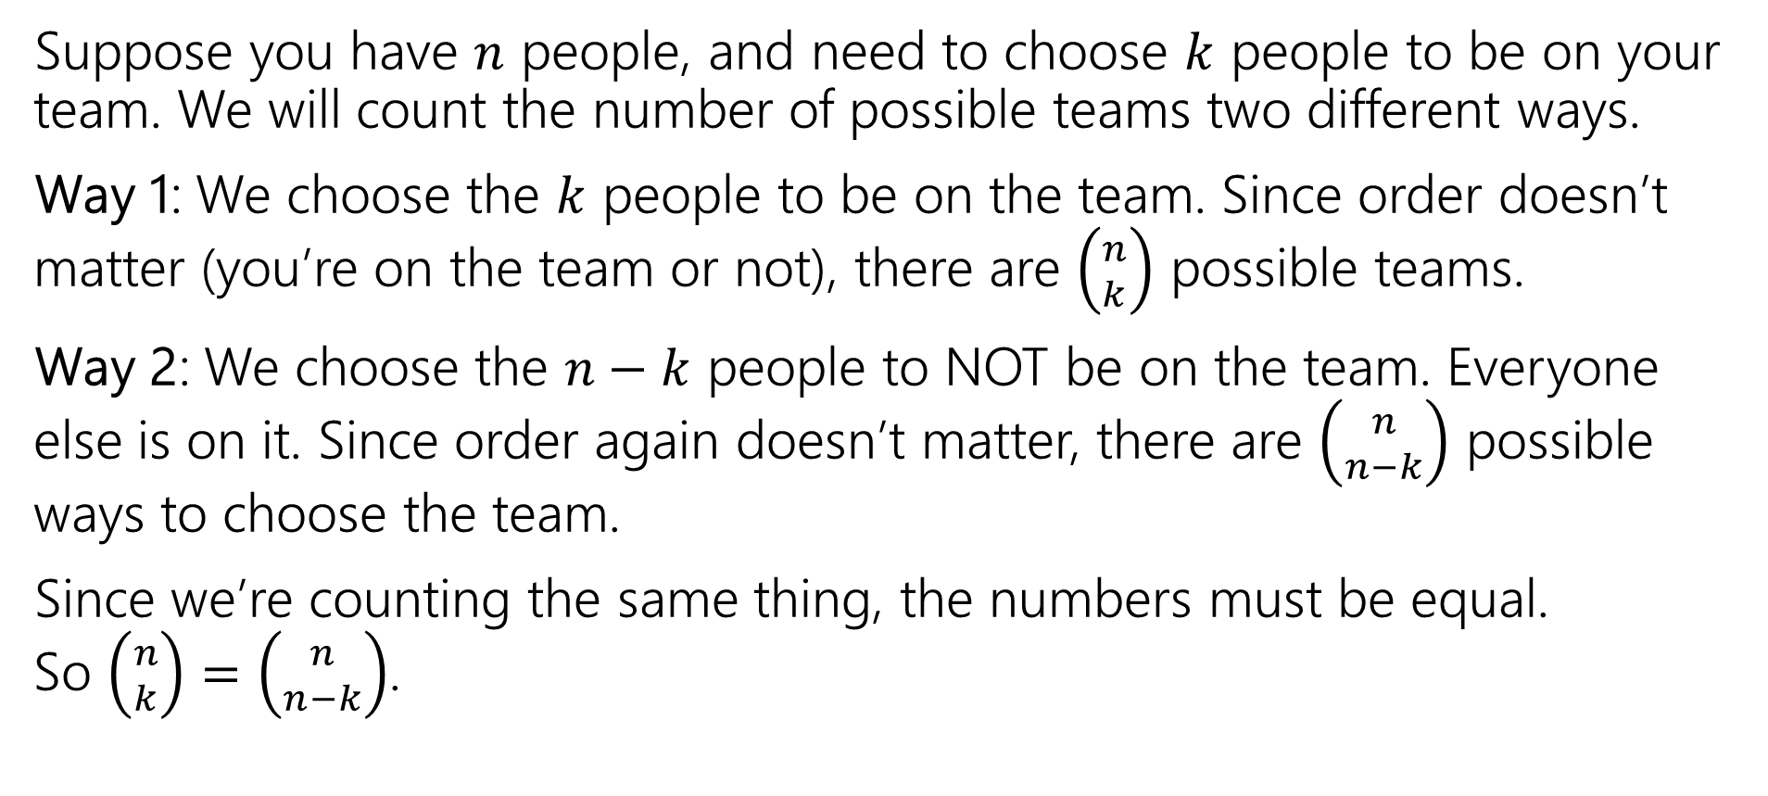
Two Proofs of Symmetry
Suppose you have $n$ people, and need to choose $k$ people to be on your team. We will count the number of possible teams two different ways.
Way 1: We choose the $k$ people to be on the team. Since order doesn’t matter (you’re on the team or not), there are $\left({n \atop k}\right)$ possible teams.
Way 2: We choose the $n−k$ people to NOT be on the team. Everyone else is on it. Since order again doesn’t matter, there are $\left({n \atop n−k}\right)$ possible ways to choose the team.
Since we’re counting the same thing, the numbers must be equal.
So $\left({n \atop k}\right)=\left({n \atop n−k}\right)$.

Slide 31
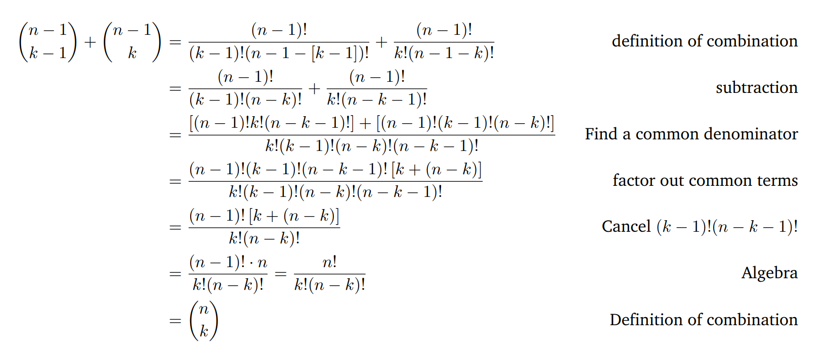

Pascal’s Rule: $\left({n \atop k}\right)=\left({n−1 \atop k−1}\right)+\left({n−1 \atop k}\right)$

Slide 32
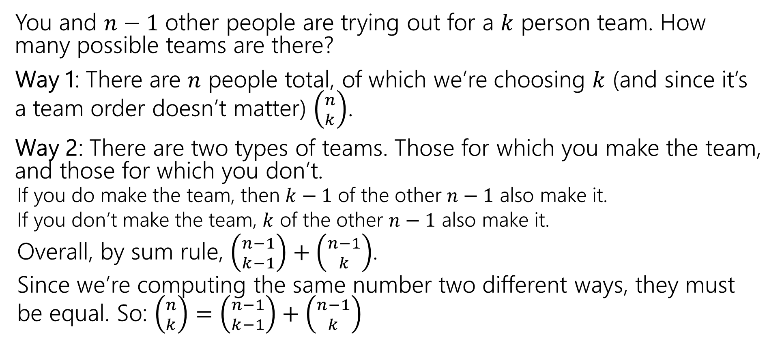
Pascal’s Rule: $\left({n \atop k}\right)=\left({n−1 \atop k−1}\right)+\left({n−1 \atop k}\right)$
You and $n−1$ other people are trying out for a $k$ person team. How many possible teams are there?
Way 1: There are $n$ people total, of which we’re choosing $k$ (and since it’s a team order doesn’t matter) $\left({n \atop k}\right)$.
Way 2: There are two types of teams. Those for which you make the team, and those for which you don’t.
  If you do make the team, then $k−1$ of the other $n−1$ also make it.
  If you don’t make the team, $k$ of the other $n−1$ also make it.
  Overall, by sum rule, $\left({n−1 \atop k−1}\right)+\left({n−1 \atop k}\right)$.
  Since we’re computing the same number two different ways, they must be equal. So: $\left({n \atop k}\right)=\left({n−1 \atop k−1}\right)+\left({n−1 \atop k}\right)$

Slide 33
Takeaways
Formulas for factorial, permutations, combinations.
A useful trick for counting is to pretend order matters, then account for the overcounting at the end (by dividing out repetitions)
When trying to prove facts about counting, try to have each side of the equation count the same thing.
  Much more fun and much more informative than just churning through algebra.

Slide 34
Extra Practice

Slide 35
Books, revisited
Remember the books problem from lecture 1? Books 1,2,3,4,5 need to be assigned to Alice, Bob, and Charlie (each book to exactly one person).
Now that we know combinations, try a sequential process approach. It won’t be as nice as the change of perspective, but we can make it work.
Break into cases based on how many books Alice gets, use the sum rule to combine.

Slide 36
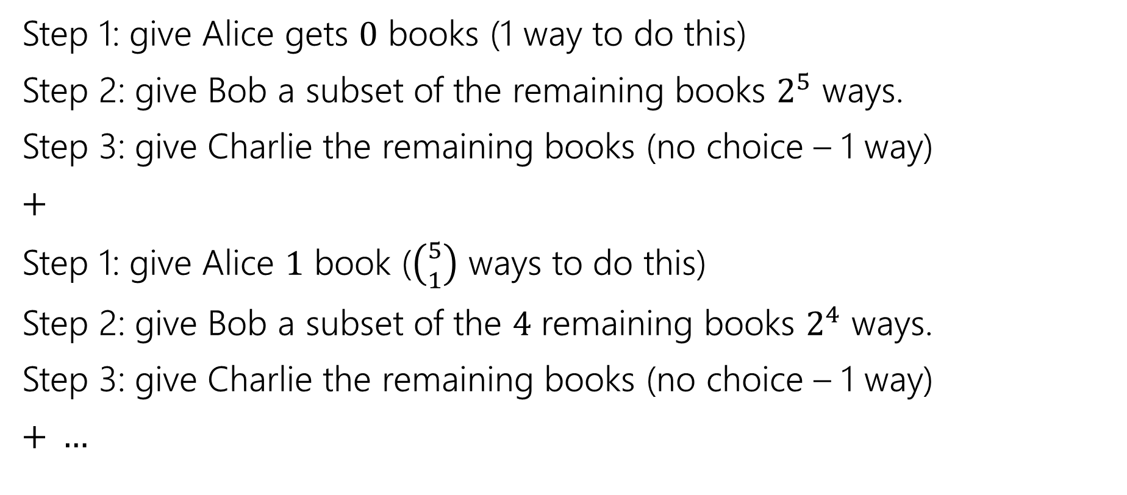
Books, revisited
Step 1: give Alice gets $0$ books (1 way to do this)
Step 2: give Bob a subset of the remaining books $2^{5}$ ways.
Step 3: give Charlie the remaining books (no choice – 1 way)
$+$
Step 1: give Alice $1$ book ($\left({5 \atop 1}\right)$ ways to do this)
Step 2: give Bob a subset of the $4$ remaining books $2^{4}$ ways.
Step 3: give Charlie the remaining books (no choice – 1 way)
$+ …$

Slide 37

Books, revisited
Add all the options together
$1⋅2^{5}⋅1+\left({5 \atop 1}\right)⋅2^{4}⋅1+\left({5 \atop 2}\right)⋅2^{3}⋅1+\left({5 \atop 3}\right)⋅2^{2}⋅1+\left({5 \atop 4}\right)⋅2^{1}⋅1+\left({5 \atop 5}\right)⋅2^{0}⋅1$
If you plug and chug, you’ll get the number we got last time. It took quite a bit of work, but we got there!

