Slide 1
Random Variables
CSE 312 Spring 21
Lecture 10

Slide 2

Announcements
We clarified problem 5 on HW3 (details on edge cases, like whether $q$ can be $1$).

Slide 3
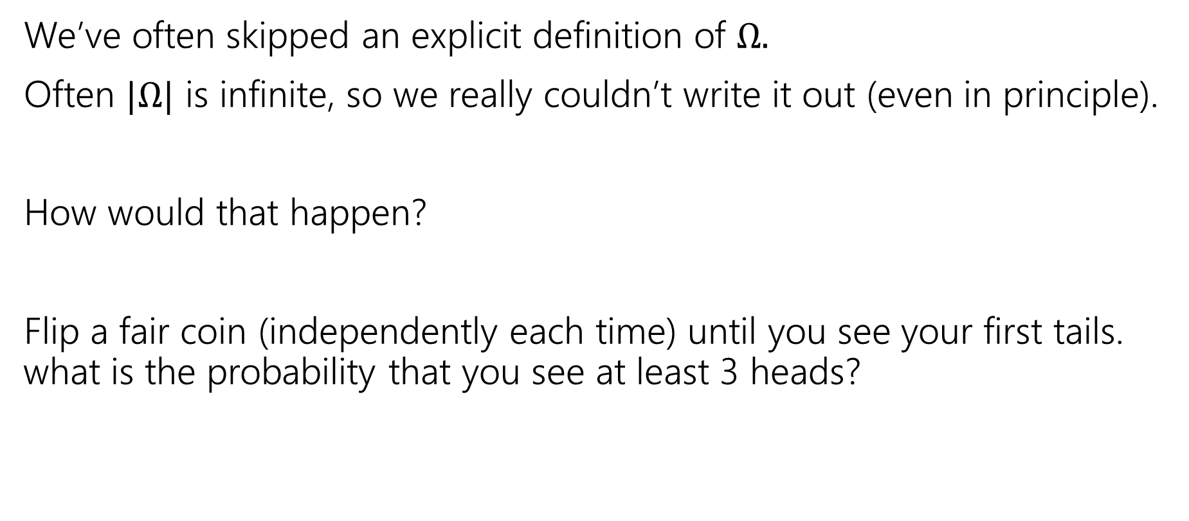

Implicitly defining $Ω$
We’ve often skipped an explicit definition of $Ω.$
Often $|Ω|$ is infinite, so we really couldn’t write it out (even in principle).
How would that happen?
Flip a fair coin (independently each time) until you see your first tails. what is the probability that you see at least 3 heads?

Slide 4

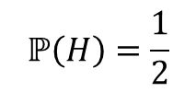

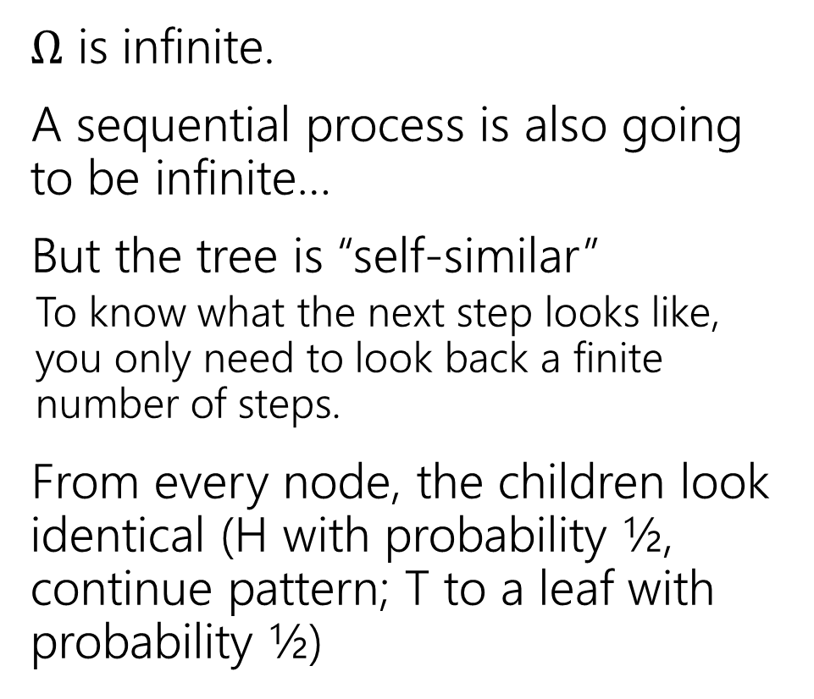




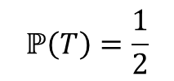

An infinite process.
$Ω$ is infinite.
A sequential process is also going to be infinite…
But the tree is “self-similar”
  To know what the next step looks like, you only need to look back a finite number of steps.
From every node, the children look identical (H with probability ½, continue pattern; T to a leaf with probability ½)
$$ℙ\left(H\right)=\frac{1}{2}$$
$$ℙ\left(T\right)=\frac{1}{2}$$
H
$$ℙ\left(T\right)=1/2$$
$$ℙ\left(HH|H\right)=\frac{1}{2}$$
$$ℙ\left(HT|H\right)=\frac{1}{2}$$
H
$$ℙ\left(HT\right)=1/4$$
$$ℙ\left(HHH|HH\right)=\frac{1}{2}$$
$$ℙ\left(HHT|HH\right)=\frac{1}{2}$$
H
$$ℙ\left(HHT\right)=1/8$$
…

Slide 5
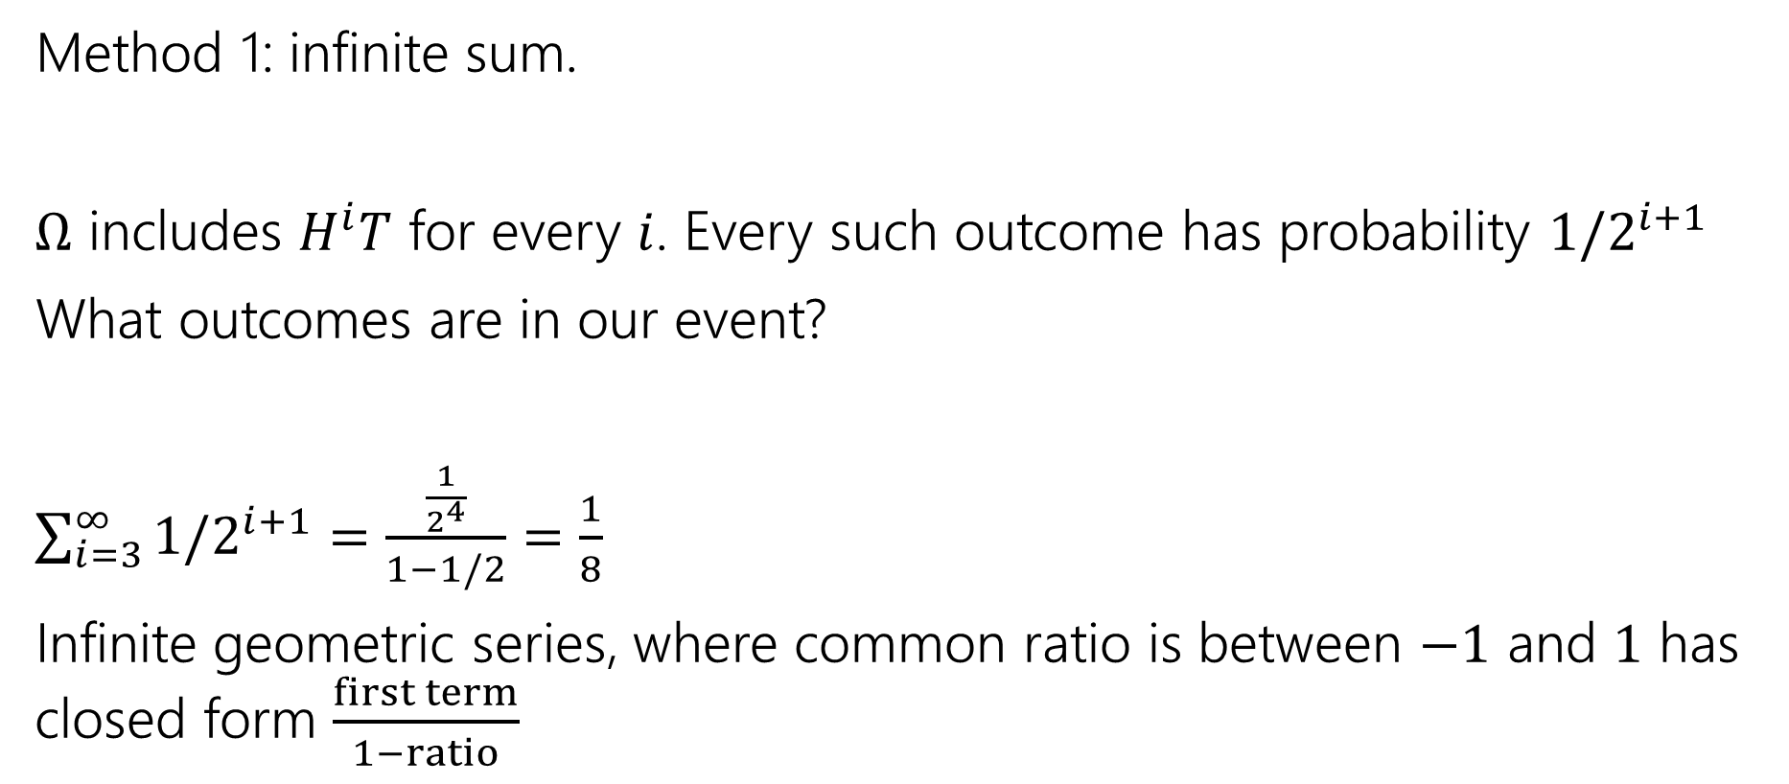

Finding $ℙ($at least $3$ heads)
Method 1: infinite sum.
$Ω$ includes $H^{i}T$ for every $i$. Every such outcome has probability $1/2^{i+1}$
What outcomes are in our event?
$\sum_{i=3}^{∞}{1/2^{i+1}}=$ $\frac{\frac{1}{2^{4}}}{1−1/2}=\frac{1}{8}$
Infinite geometric series, where common ratio is between $−1$ and $1$ has closed form $\frac{first term}{1−ratio}$

Slide 6

Finding $ℙ($at least $3$ heads)
Method 2:
Calculate the complement
$ℙ($at most 2 heads) = $\frac{1}{2}+\frac{1}{4}+\frac{1}{8}$
$ℙ($at least 3 heads)= $1−\left(\frac{1}{2}+\frac{1}{4}+\frac{1}{8}\right)=\frac{1}{8}$

Slide 7
Random Variables

Slide 8
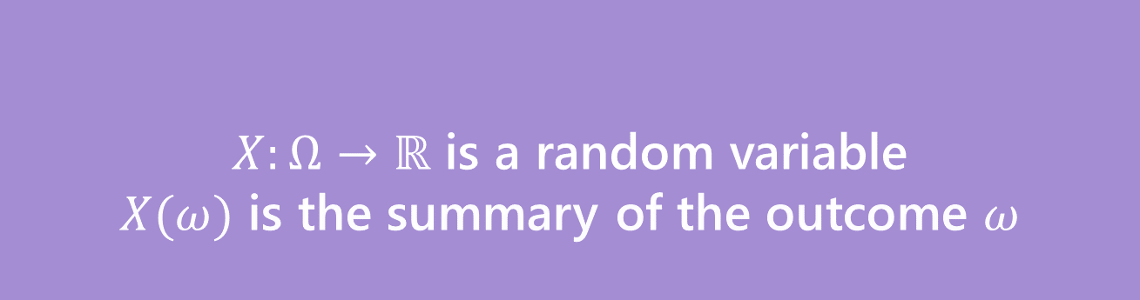
Random Variable
What’s a random variable?
Formally
Informally: A random variable is a way to summarize the important (numerical) information from your outcome.
$X:Ω→ℝ$ is a random variable
$X(ω)$ is the summary of the outcome $ω$
Random Variable

Slide 9

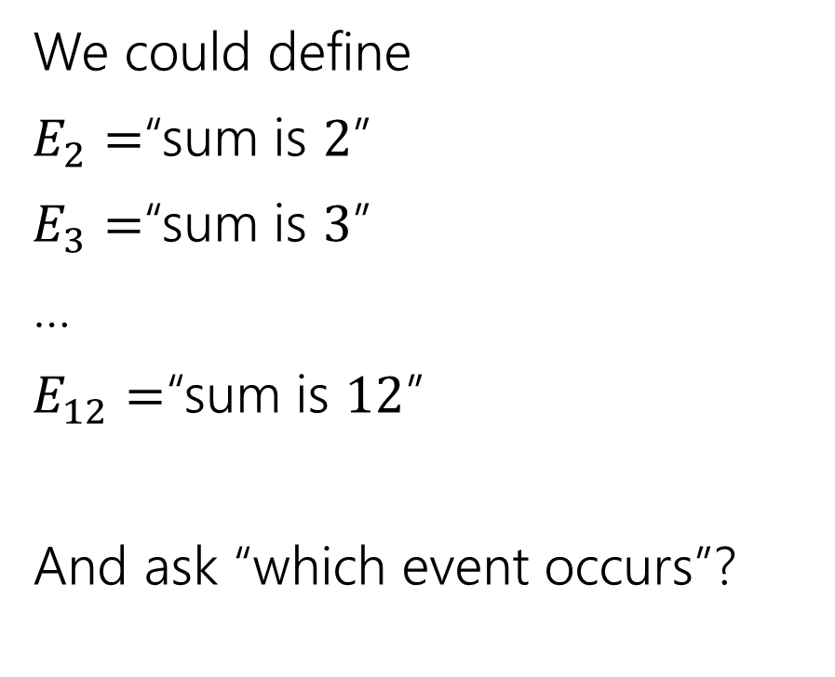
The sum of two dice
Events
Random variable
We could define
$E_{2}=$“sum is $2$”
$E_{3}=$“sum is $3$”
…
$E_{12}=$“sum is $12$”
And ask “which event occurs”?
$X:Ω→ℝ$
$X$is the sum of the two dice.

Slide 10
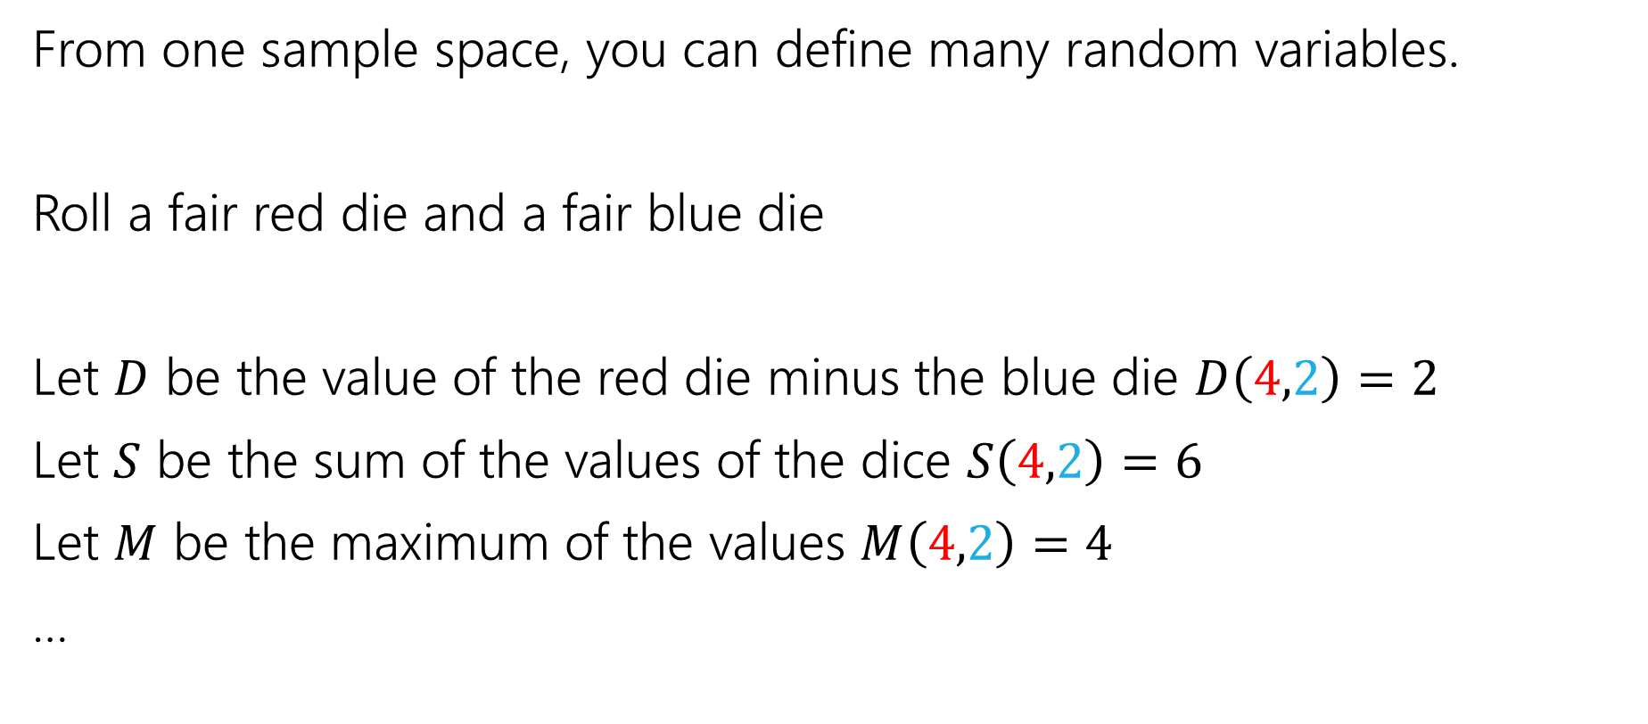
More random variables
From one sample space, you can define many random variables.
Roll a fair red die and a fair blue die
Let $D$ be the value of the red die minus the blue die $D\left(4,2\right)=2$
Let $S$ be the sum of the values of the dice $S\left(4,2\right)=6$
Let $M$ be the maximum of the values $M\left(4,2\right)=4$
…

Slide 11
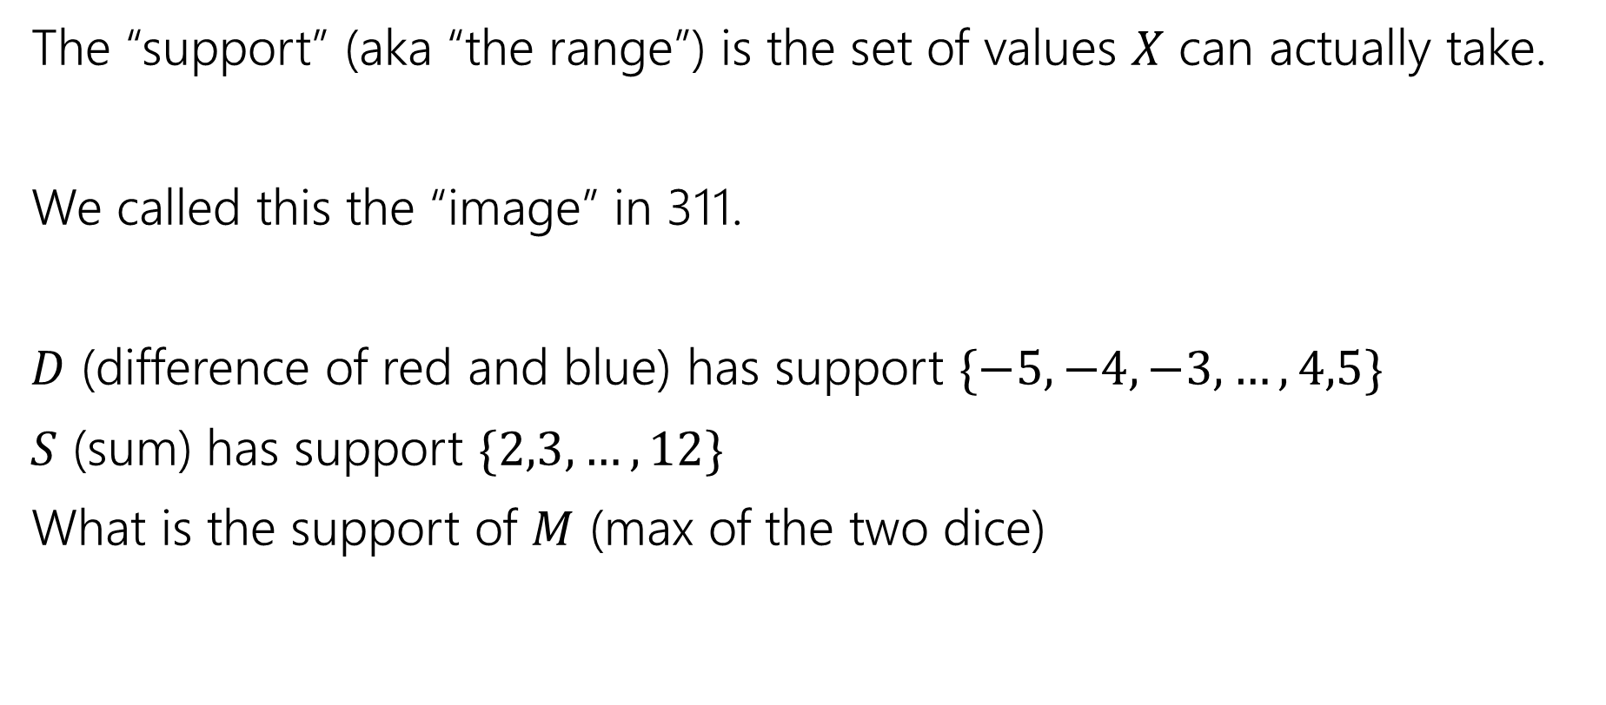
Support
The “support” (aka “the range”) is the set of values $X$ can actually take.
We called this the “image” in 311.
$D$ (difference of red and blue) has support $\{−5,−4,−3,…,4,5\}$
$S$ (sum) has support $\{2,3,…,12\}$
What is the support of $M$ (max of the two dice)

Slide 12
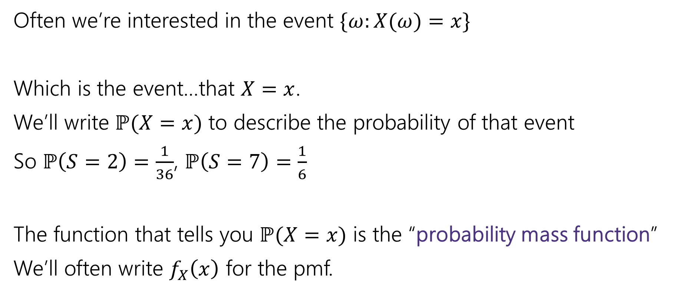
Probability Mass Function
Often we’re interested in the event $\{ω:X(ω)=x\}$
Which is the event…that $X=x$.
We’ll write $ℙ(X=x)$ to describe the probability of that event
So $ℙ\left(S=2\right)=\frac{1}{36}$, $ℙ\left(S=7\right)=\frac{1}{6}$
The function that tells you $ℙ(X=x)$ is the “probability mass function”
We’ll often write $f_{X}\left(x\right)$ for the pmf.

Slide 13
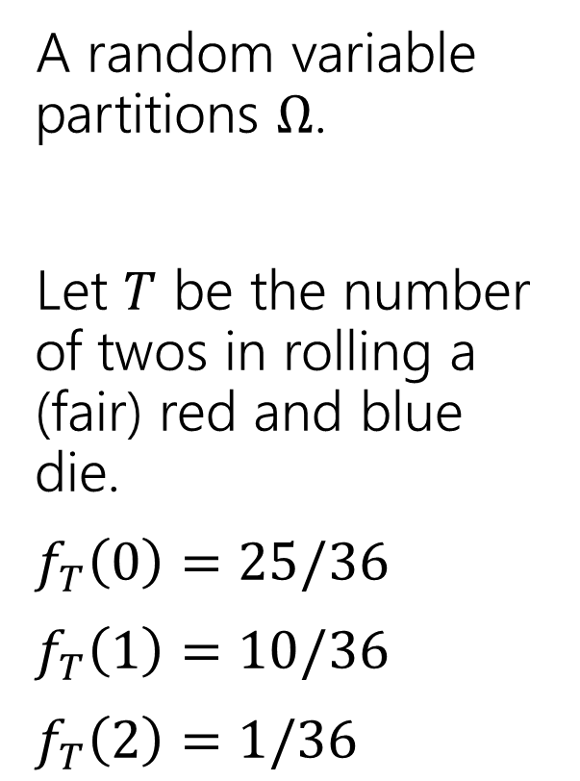
Partition
A random variable partitions $Ω$.
Let $T$ be the number of twos in rolling a (fair) red and blue die.
$f_{T}\left(0\right)=25/36$
$f_{T}\left(1\right)=10/36$
$f_{T}\left(2\right)=1/36$
 | D2=1 | D2=2 | D2=3 | D2=4 | D2=5 | D2=6
D1=1 | (1,1) | (1,2) | (1,3) | (1,4) | (1,5) | (1.6)
D1=2 | (2,1) | (2,2) | (2,3) | (2,4) | (2,5) | (2,6)
D1=3 | (3,1) | (3,2) | (3,3) | (3,4) | (3,5) | (3,6)
D1=4 | (4,1) | (4,2) | (4,3) | (4,4) | (4,5) | (4,6)
D1=5 | (5,1) | (5,2) | (5,3) | (5,4) | (5,5) | (5,6)
D1=6 | (6,1) | (6,2) | (6,3) | (6,4) | (6,5) | (6,6)

Slide 14
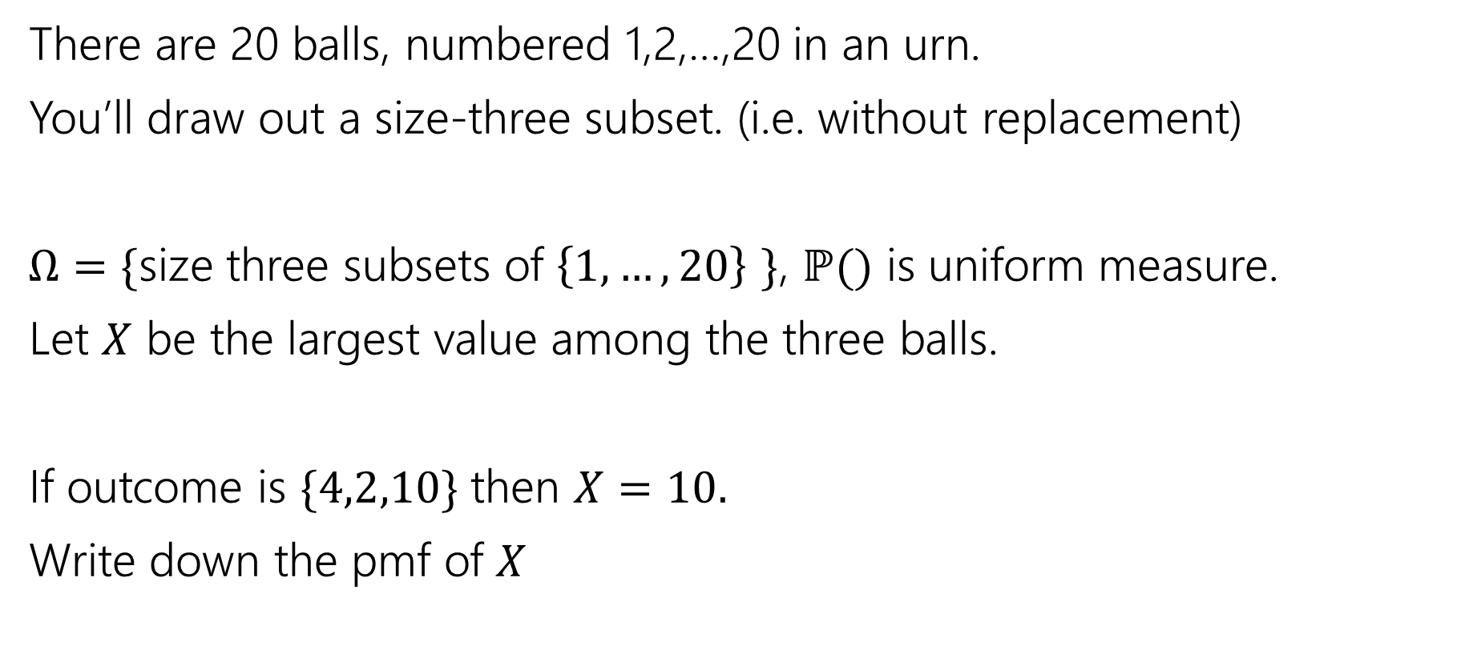
Try It Yourself
There are 20 balls, numbered 1,2,…,20 in an urn.
You’ll draw out a size-three subset. (i.e. without replacement)
$Ω=\{$size three subsets of $\left\{1,…,20\right\}$ $\}$, $ℙ()$ is uniform measure.
Let $X$ be the largest value among the three balls.
If outcome is $\{4,2,10\}$ then $X=10.$
Write down the pmf of $X$
Fill out the poll everywhere so Robbie knows how long to explain
Go to pollev.com/cse312

Slide 15
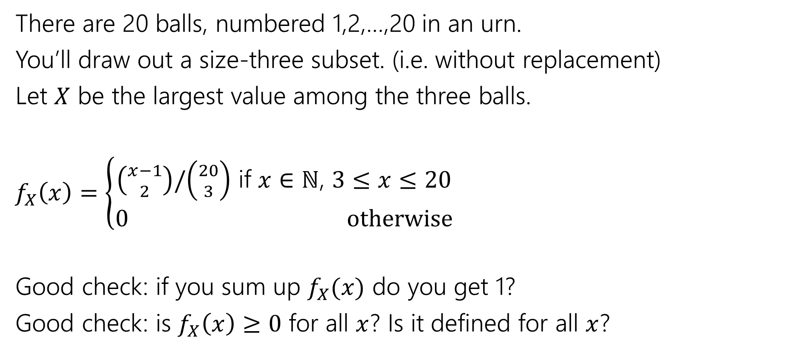
Try It Yourself
There are 20 balls, numbered 1,2,…,20 in an urn.
You’ll draw out a size-three subset. (i.e. without replacement)
Let $X$ be the largest value among the three balls.
$f_{X}\left(x\right)=\left\{\begin{aligned}\left({x−1 \atop 2}\right)/\left({20 \atop 3}\right) \text{if} x∈ℕ\text{, }3≤x≤20 \\ 0 otherwise\end{aligned}\right.$
Good check: if you sum up $f_{X}(x)$ do you get 1?
Good check: is $f_{X}\left(x\right)≥0$ for all $x$? Is it defined for all $x$?

Slide 16
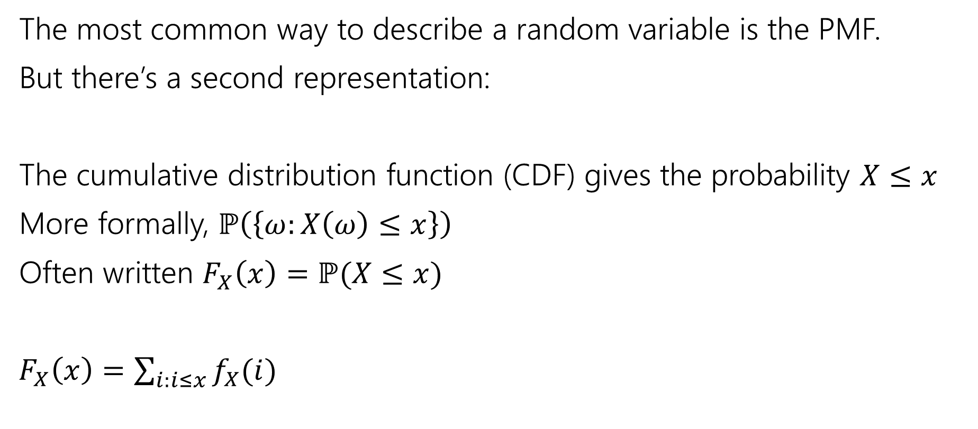
Describing a Random Variable
The most common way to describe a random variable is the PMF.
But there’s a second representation:
The cumulative distribution function (CDF) gives the probability $X≤x$
More formally, $ℙ\left(\left\{ω:X\left(ω\right)≤x\right\}\right)$
Often written $F_{X}\left(x\right)=ℙ(X≤x)$
$F_{X}\left(x\right)=\sum_{i:i≤x}{f_{X}(i)}$

Slide 17

Try it yourself
What is the CDF of $X$ where
$X$ be the largest value among the three balls. (Drawing 3 of the 20 without replacement)

Slide 18
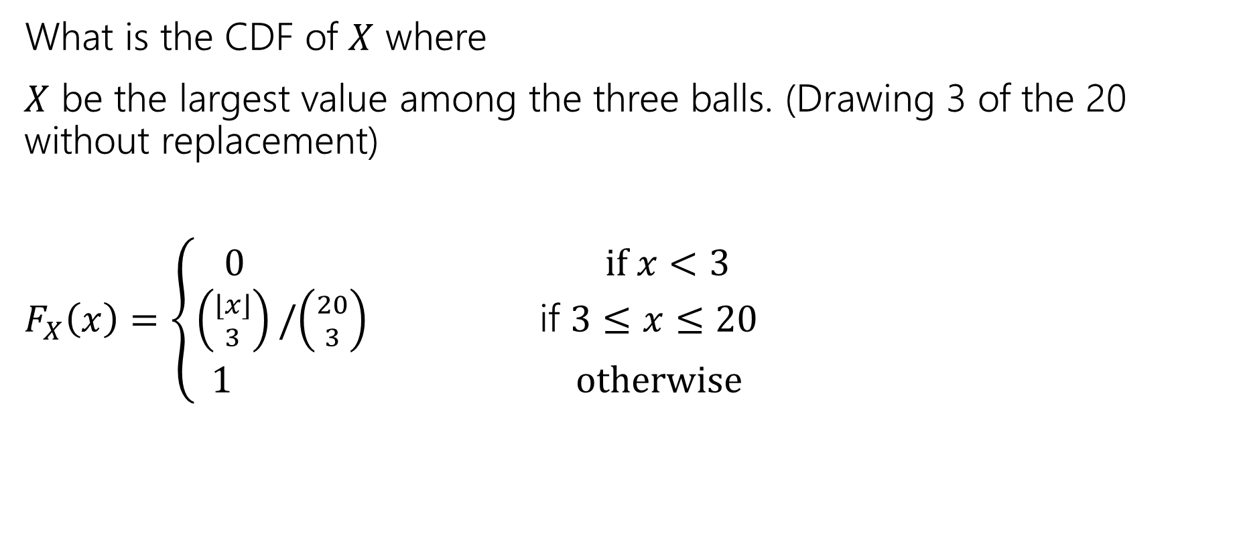
Try it yourself
What is the CDF of $X$ where
$X$ be the largest value among the three balls. (Drawing 3 of the 20 without replacement)
$F_{X}\left(x\right)=\left\{\begin{aligned}\begin{aligned}0 if x<3 \\ \left({⌊x⌋ \atop 3}\right)/\left({20 \atop 3}\right) \text{if} 3≤x≤20\end{aligned} \\ 1 otherwise\end{aligned}\right.$

Slide 19
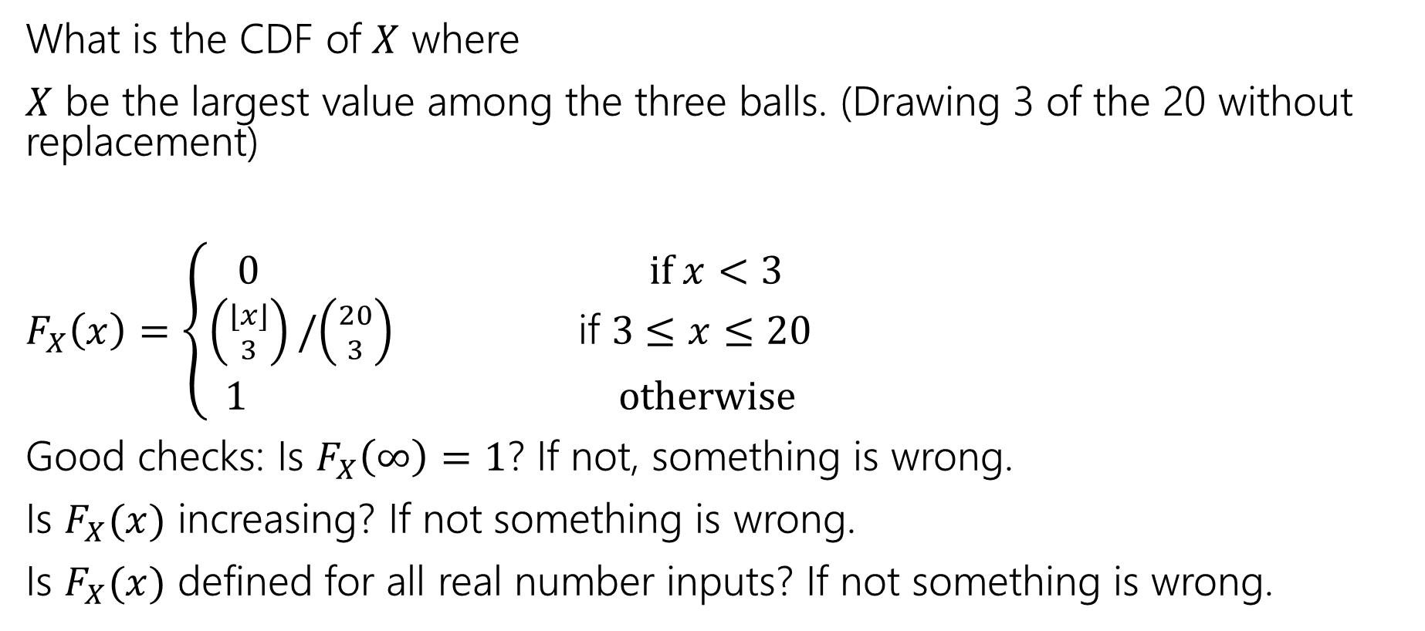
Try it yourself
What is the CDF of $X$ where
$X$ be the largest value among the three balls. (Drawing 3 of the 20 without replacement)
$F_{X}\left(x\right)=\left\{\begin{aligned}\begin{aligned}0 if x<3 \\ \left({⌊x⌋ \atop 3}\right)/\left({20 \atop 3}\right) \text{if} 3≤x≤20\end{aligned} \\ 1 otherwise\end{aligned}\right.$
Good checks: Is $F_{X}\left(∞\right)=1$? If not, something is wrong.
Is $F_{X}(x)$ increasing? If not something is wrong.
Is $F_{X}(x)$ defined for all real number inputs? If not something is wrong.

Slide 20
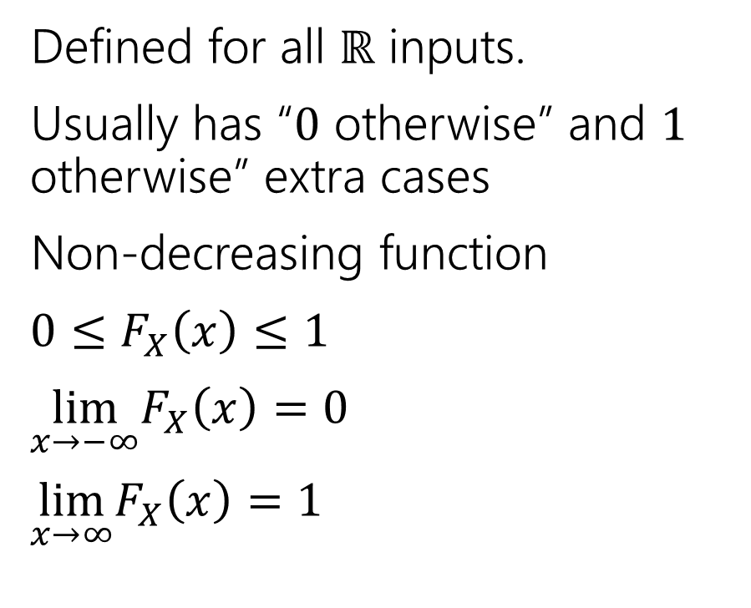
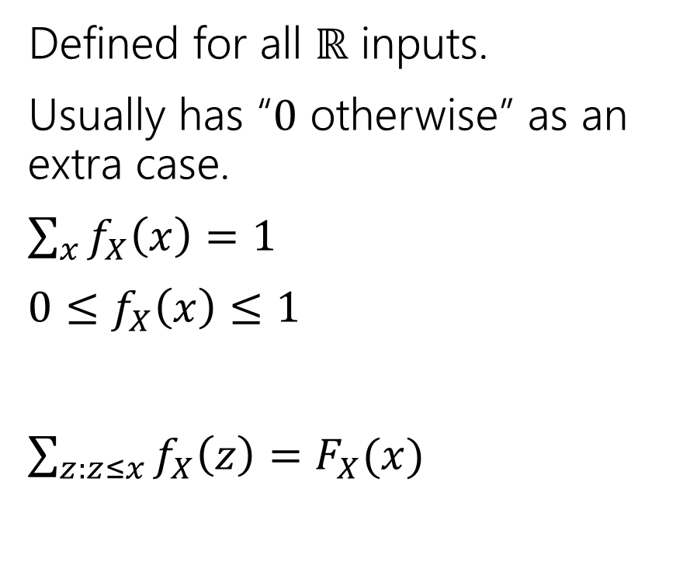
Two descriptions
Probability mass function
Cumulative Distribution function
Defined for all $ℝ$ inputs.
Usually has “$0$ otherwise” as an extra case.
$\sum_{x}{f_{X}\left(x\right)=1}$
$0≤f_{X}\left(x\right)≤1$
$\sum_{z:z≤x}{f_{X}\left(z\right)=F_{X}(x)}$
Defined for all $ℝ$ inputs.
Usually has “$0$ otherwise” and $1$ otherwise” extra cases
Non-decreasing function
$0≤F_{X}\left(x\right)≤1$
$\lim_{x→−∞}F_{X}\left(x\right)=0$
$\lim_{x→∞}F_{X}\left(x\right)=1⁡$

Slide 21

More Random Variable Practice
Roll a fair die $n$ times. Let $X$ be the number of rolls that are $5s$ or $6s$.
What is the pmf?
Don’t try to write the CDF…it’s a mess…
Or try for a few minutes to realize it isn’t nice.

Slide 22
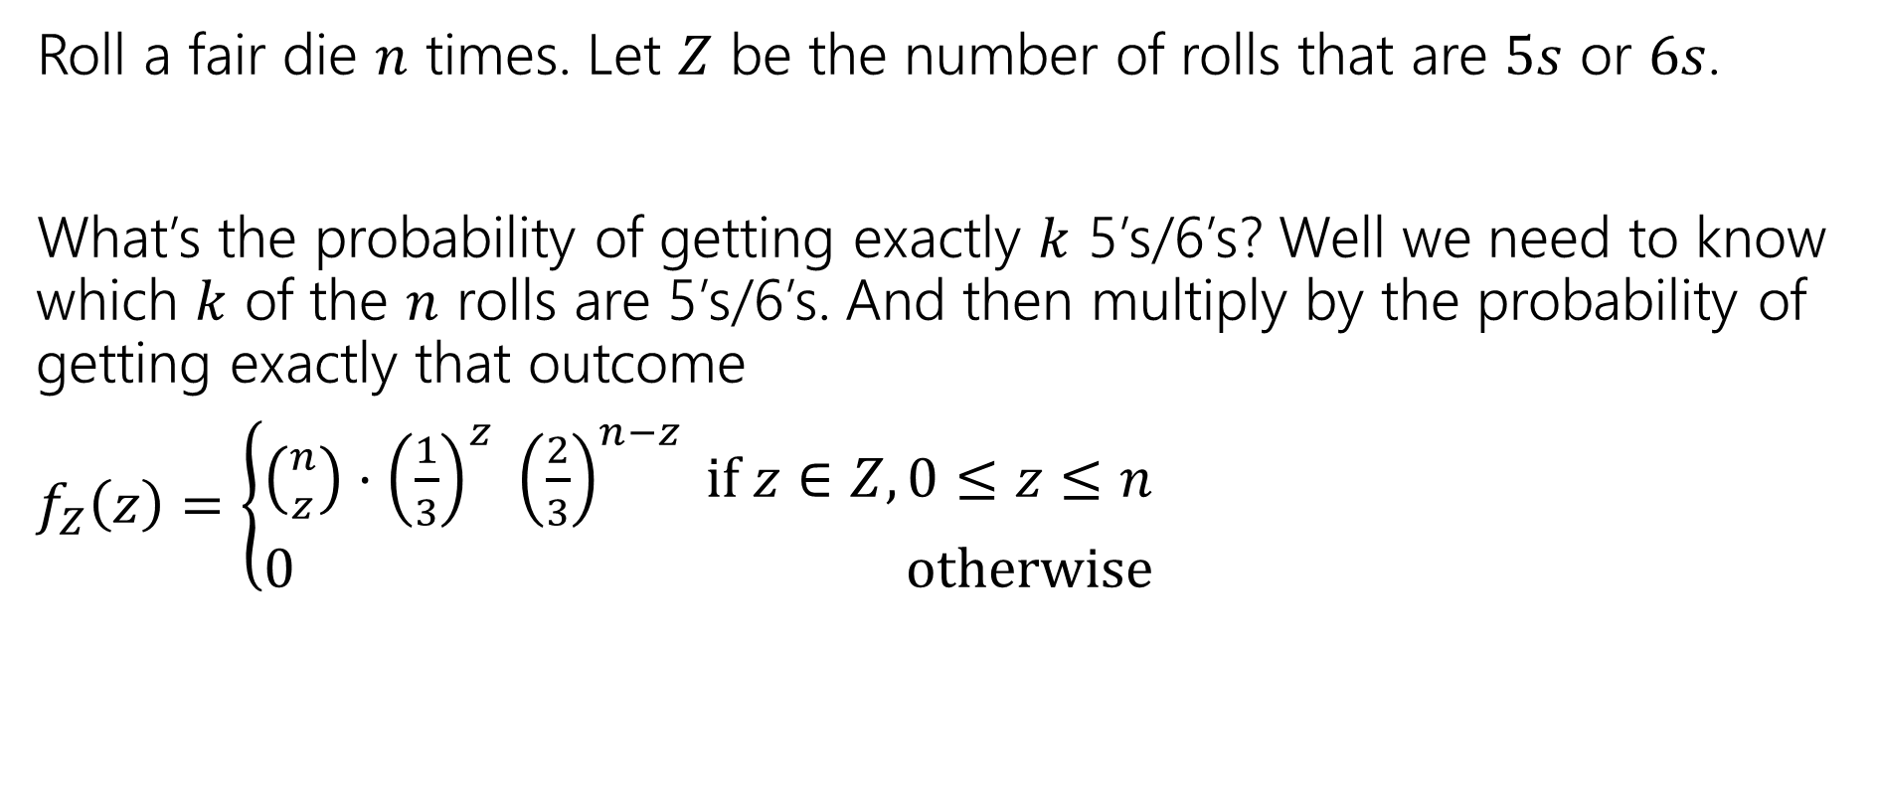
More Random Variable Practice
Roll a fair die $n$ times. Let $Z$ be the number of rolls that are $5s$ or $6s$.
What’s the probability of getting exactly $k$ 5’s/6’s? Well we need to know which $k$ of the $n$ rolls are 5’s/6’s. And then multiply by the probability of getting exactly that outcome
$f_{Z}\left(z\right)=\left\{\begin{aligned}\left({n \atop z}\right)⋅{\left(\frac{1}{3}\right)}^{z} {\left(\frac{2}{3}\right)}^{n−z} if z∈Z,0≤z≤n \\ 0 otherwise\end{aligned}\right.$

Slide 23
More Practice: Infinite sequential processes

Slide 24
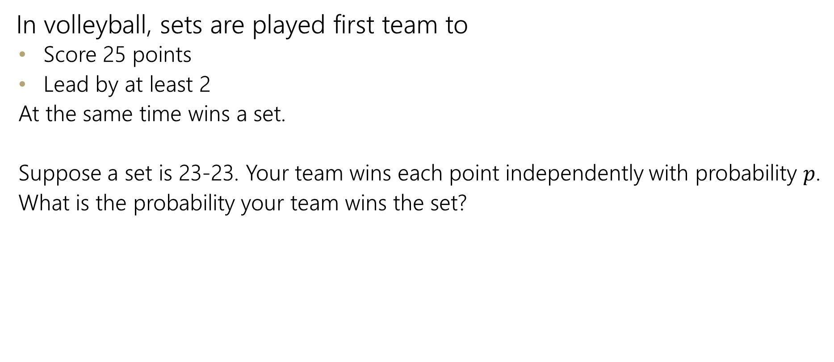
Infinite sequential process
In volleyball, sets are played first team to
  Score 25 points
  Lead by at least 2
  At the same time wins a set.
  Suppose a set is 23-23. Your team wins each point independently with probability $p$.
  What is the probability your team wins the set?

Slide 25
Sequential Process
0
$$ℙ\left(win from even\right)=p^{2}+2p\left(1−p\right)ℙ(win from even)$$
+
-
W
0
L
+
-
W
0
L
+
-
…

Slide 26
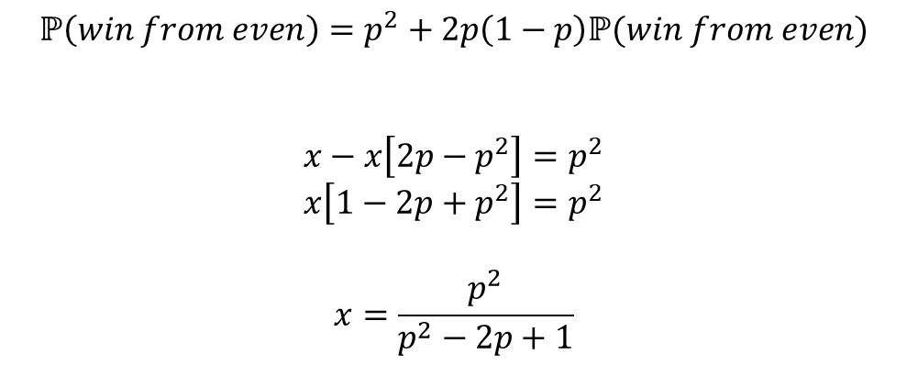
Sequential Process
0
$$ℙ\left(win from even\right)=p^{2}+2p\left(1−p\right)ℙ(win from even)$$
$$x−x\left[2p−p^{2}\right]=p^{2}$$
$$x\left[1−2p+p^{2}\right]=p^{2}$$
$$x=\frac{p^{2}}{p^{2}−2p+1}$$
+
-
W
0
L
+
-
W
0
L
+
-
…

