Slide 1
Expectation
CSE 312 Spring 21
Lecture 11

Slide 2
Announcements
HW2 was just released
There’s a post on Ed about a common bug in HW2 P6. Please read that before filing a regrade request on that problem.
HW3 due tonight
  Remember you have late days. Particularly if you run into debugging issues with the programming part.
HW4 out (late) tonight

Slide 3

Try it yourself
What is the CDF of $X$ where
$X$ be the largest value among the three balls. (Drawing 3 of the 20 without replacement)

Slide 4
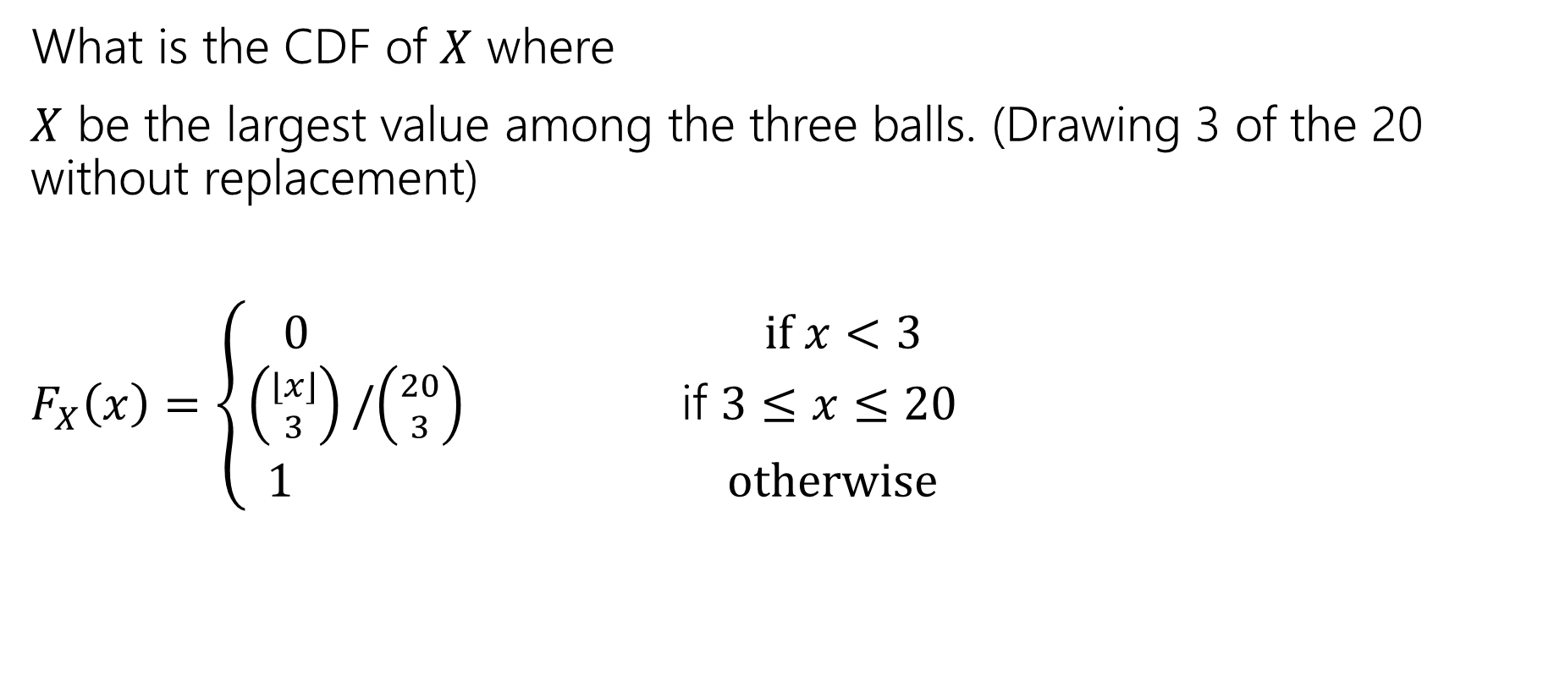
Try it yourself
What is the CDF of $X$ where
$X$ be the largest value among the three balls. (Drawing 3 of the 20 without replacement)
$F_{X}\left(x\right)=\left\{\begin{aligned}\begin{aligned}0 if x<3 \\ \left({⌊x⌋ \atop 3}\right)/\left({20 \atop 3}\right) \text{if} 3≤x≤20\end{aligned} \\ 1 otherwise\end{aligned}\right.$

Slide 5
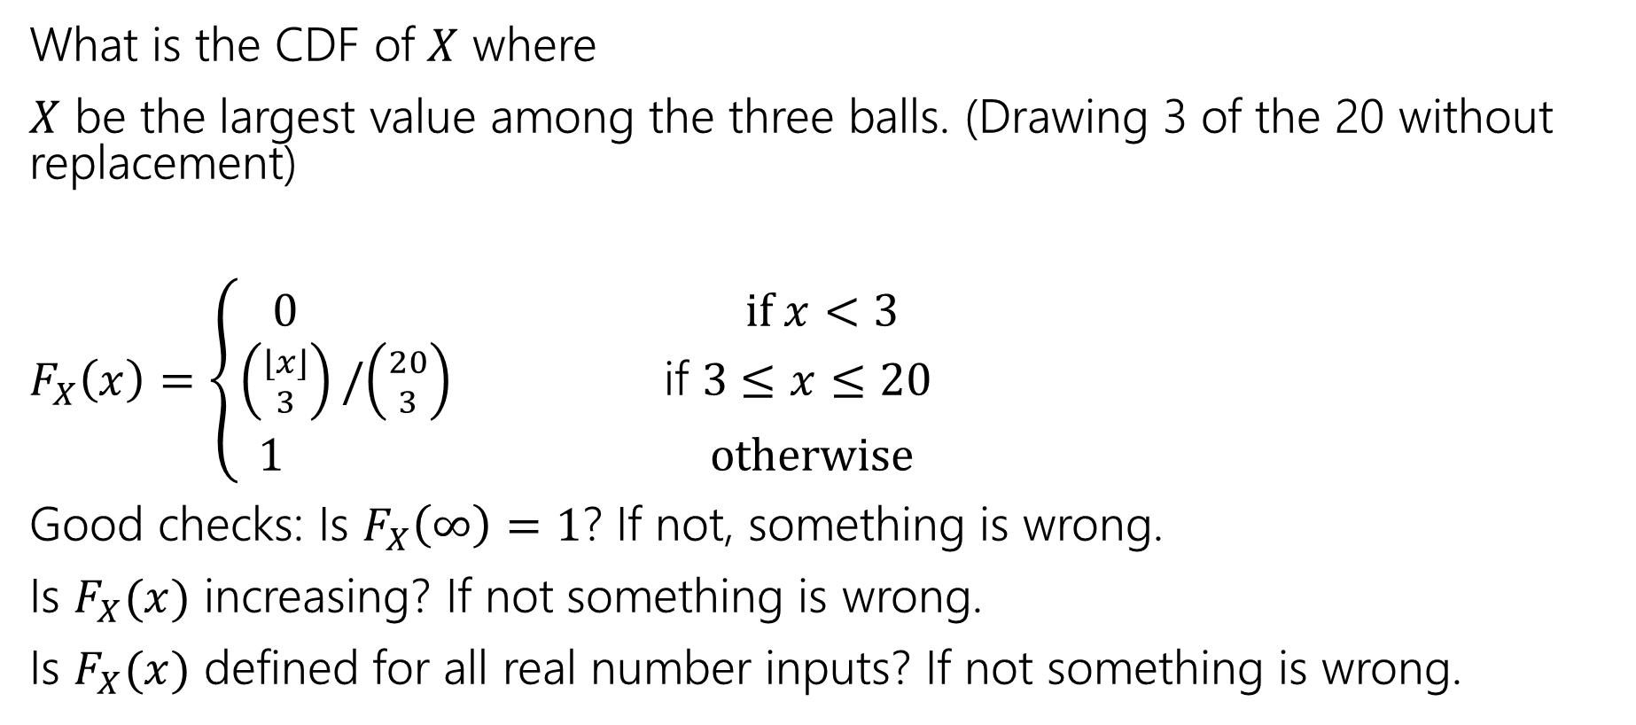
Try it yourself
What is the CDF of $X$ where
$X$ be the largest value among the three balls. (Drawing 3 of the 20 without replacement)
$F_{X}\left(x\right)=\left\{\begin{aligned}\begin{aligned}0 if x<3 \\ \left({⌊x⌋ \atop 3}\right)/\left({20 \atop 3}\right) \text{if} 3≤x≤20\end{aligned} \\ 1 otherwise\end{aligned}\right.$
Good checks: Is $F_{X}\left(∞\right)=1$? If not, something is wrong.
Is $F_{X}(x)$ increasing? If not something is wrong.
Is $F_{X}(x)$ defined for all real number inputs? If not something is wrong.

Slide 6
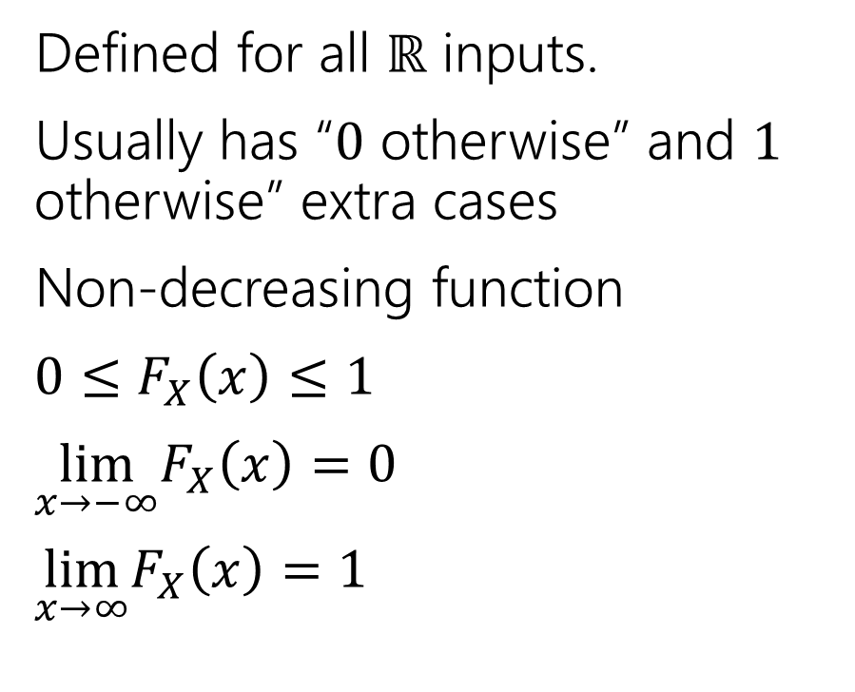
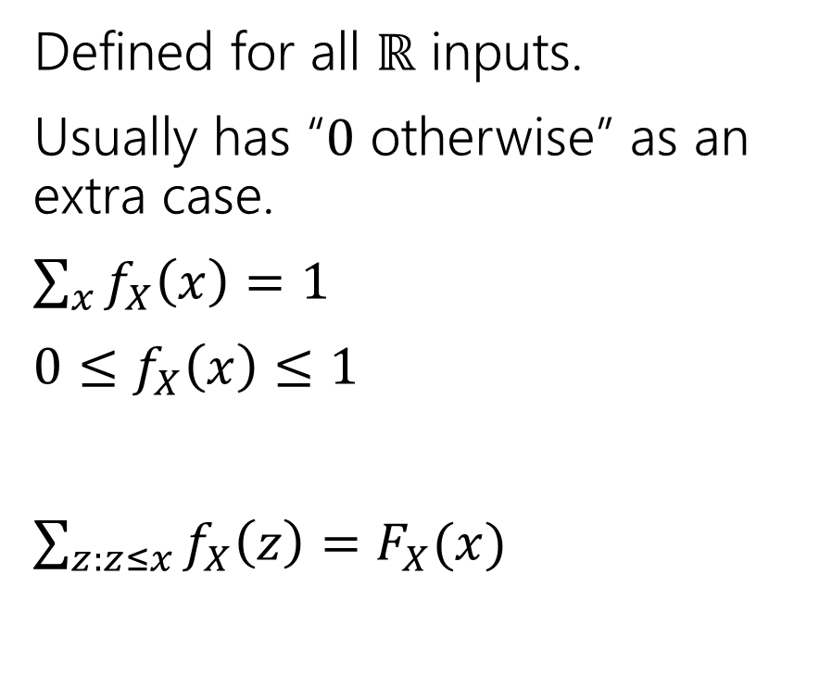
Two descriptions
Probability mass function
Cumulative Distribution function
Defined for all $ℝ$ inputs.
Usually has “$0$ otherwise” as an extra case.
$\sum_{x}{f_{X}\left(x\right)=1}$
$0≤f_{X}\left(x\right)≤1$
$\sum_{z:z≤x}{f_{X}\left(z\right)=F_{X}(x)}$
Defined for all $ℝ$ inputs.
Usually has “$0$ otherwise” and $1$ otherwise” extra cases
Non-decreasing function
$0≤F_{X}\left(x\right)≤1$
$\lim_{x→−∞}F_{X}\left(x\right)=0$
$\lim_{x→∞}F_{X}\left(x\right)=1⁡$

Slide 7
Expectation

Slide 8


Expectation
The “expectation” (or “expected value”) of a random variable $X$ is:
$$𝔼\left[X\right]=\sum_{k}{k⋅ℙ(X=k)}$$
Expectation
Intuition: The weighted average of values $X$ could take on.
Weighted by the probability you actually see them.

Slide 9

Example 1
Flip a fair coin twice (independently)
Let $X$be the number of heads.
$Ω=\{TT,TH,HT,HH\}$, $ℙ()$ is uniform measure.
$𝔼\left[X\right]=\frac{1}{4}⋅0+\frac{1}{2}⋅1+\frac{1}{4}⋅2=0+\frac{1}{2}+\frac{1}{2}=1$.

Slide 10
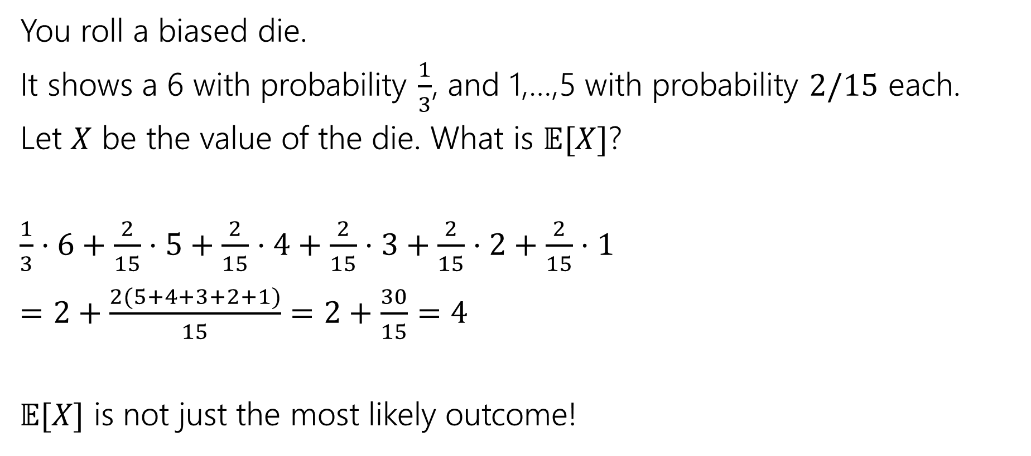
Example 2
You roll a biased die.
It shows a 6 with probability $\frac{1}{3}$, and 1,…,5 with probability $2/15$ each.
Let $X$ be the value of the die. What is $𝔼[X]$?
$\frac{1}{3}⋅6+\frac{2}{15}⋅5+\frac{2}{15}⋅4+\frac{2}{15}⋅3+\frac{2}{15}⋅2+\frac{2}{15}⋅1$
$=2+\frac{2(5+4+3+2+1)}{15}=2+\frac{30}{15}=4$
$𝔼[X]$ is not just the most likely outcome!

Slide 11

Try it yourself
Let $X$ be the result shown on a fair die. What is $𝔼[X]$?
Let $Y$ be the sum of two (independent) fair die rolls. What is $𝔼[Y]$?
Fill out the poll everywhere so Robbie knows how long to explain
Go to pollev.com/cse312

Slide 12

Try it yourself
Let $X$ be the result shown on a fair die. What is $𝔼[X]$
$6⋅\frac{1}{6}+5⋅\frac{1}{6}+4⋅\frac{1}{6}+3⋅\frac{1}{6}+2⋅\frac{1}{6}+1⋅\frac{1}{6}$
$=\frac{21}{6}=3.5$
$𝔼[X]$ is not necessarily a possible outcome!
That’s ok, it’s an average!

Slide 13

Try it yourself
$𝔼\left[Y\right]=$
$\frac{1}{36}⋅2+\frac{2}{36}⋅3+\frac{3}{36}⋅4+\frac{4}{36}⋅5+\frac{5}{36}⋅6+\frac{6}{36}⋅7+\frac{5}{36}⋅8+\frac{4}{36}⋅9+\frac{3}{36}⋅10+\frac{2}{36}⋅11+\frac{1}{36}⋅12$
$=7$
$𝔼\left[Y\right]=2𝔼[X]$. That’s not a coincidence…we’ll talk about why next time.

Slide 14

Subtle but Important
$X$ is random. You don’t know what it is (at least until you run the experiment).
$𝔼[X]$ is not random. It’s a number.
You don’t need to run the experiment to know what it is.

Slide 15
More Independence

Slide 16
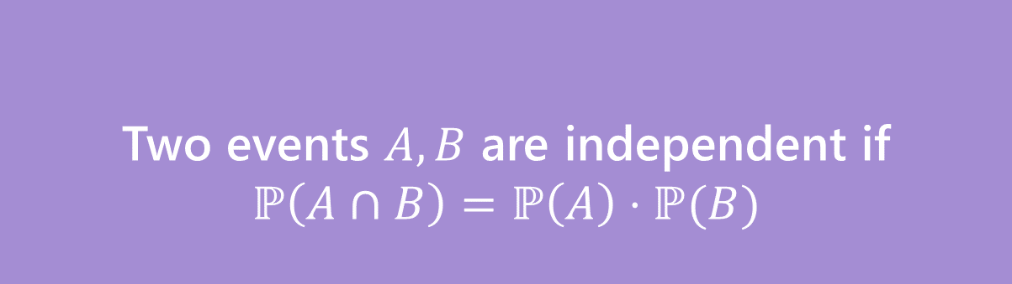
Independence of events
Recall the definition of independence of events:
Two events $A,B$ are independent if
$$ℙ\left(A∩B\right)=ℙ\left(A\right)⋅ℙ(B)$$
Independence

Slide 17

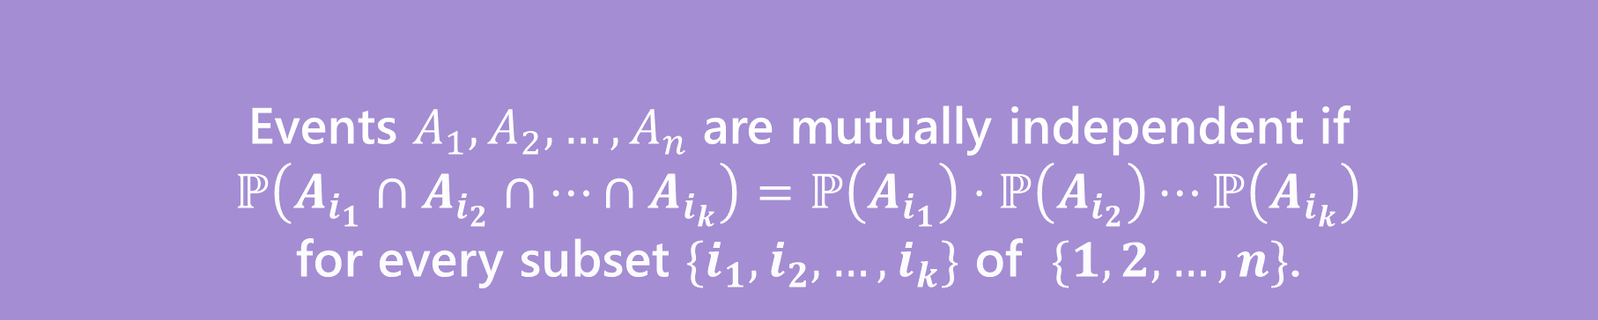
Independence for 3 or more events
For three or more events, we need two kinds of independence
Events $A_{1},A_{2},…,A_{n}$ are pairwise independent if
$ℙ\left(A_{i}∩A_{j}\right)=ℙ\left(A_{i}\right)⋅ℙ\left(A_{j}\right)$ for all $i,j$
Pairwise Independence
Events $A_{1},A_{2},…,A_{n}$ are mutually independent if
$ℙ\left(A_{i_{1}}∩A_{i_{2}}∩…∩A_{i_{k}}\right)=ℙ\left(A_{i_{1}}\right)⋅ℙ\left(A_{i_{2}}\right)⋯ℙ\left(A_{i_{k}}\right)$
for every subset $\{i_{1},i_{2},…,i_{k}\}$ of $\{1,2,…,n\}$.
Mutual Independence

Slide 18

Pairwise Independence vs. Mutual Independence
Roll two fair dice (one red one blue) independently
$R=$“red die is $3$”
$B=$“blue die is 5”
$S=$“sum is $7$”
How should we describe these events?

Slide 19
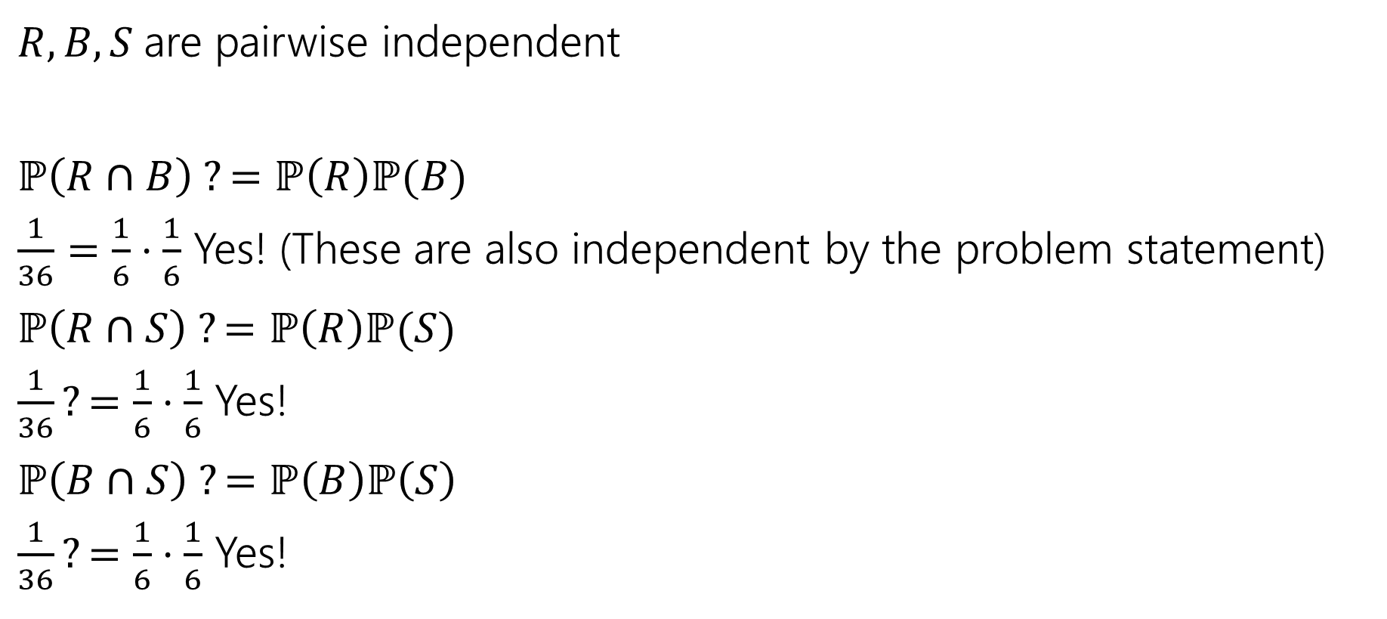
Pairwise Independence
$R,B,S$are pairwise independent
$ℙ\left(R∩B\right) ?=ℙ\left(R\right)ℙ(B)$
$\frac{1}{36}=\frac{1}{6}⋅\frac{1}{6}$ Yes! (These are also independent by the problem statement)
$ℙ\left(R∩S\right) ?=ℙ\left(R\right)ℙ(S)$
$\frac{1}{36}?=\frac{1}{6}⋅\frac{1}{6}$ Yes!
$ℙ\left(B∩S\right) ?=ℙ\left(B\right)ℙ\left(S\right)$
$\frac{1}{36}?=\frac{1}{6}⋅\frac{1}{6}$ Yes!
Since all three pairs are independent, we say the random variables are pairwise independent.

Slide 20

Mutual Independence
$R,B,S$ are not mutually independent.
$ℙ\left(R∩B∩S\right)=0;$if the red die is 3, and blue die is 5 then the sum is 8 (so it can’t be 7)
$ℙ\left(R\right)ℙ\left(B\right)ℙ\left(S\right)={\left(\frac{1}{6}\right)}^{3}=\frac{1}{216}≠0$

Slide 21
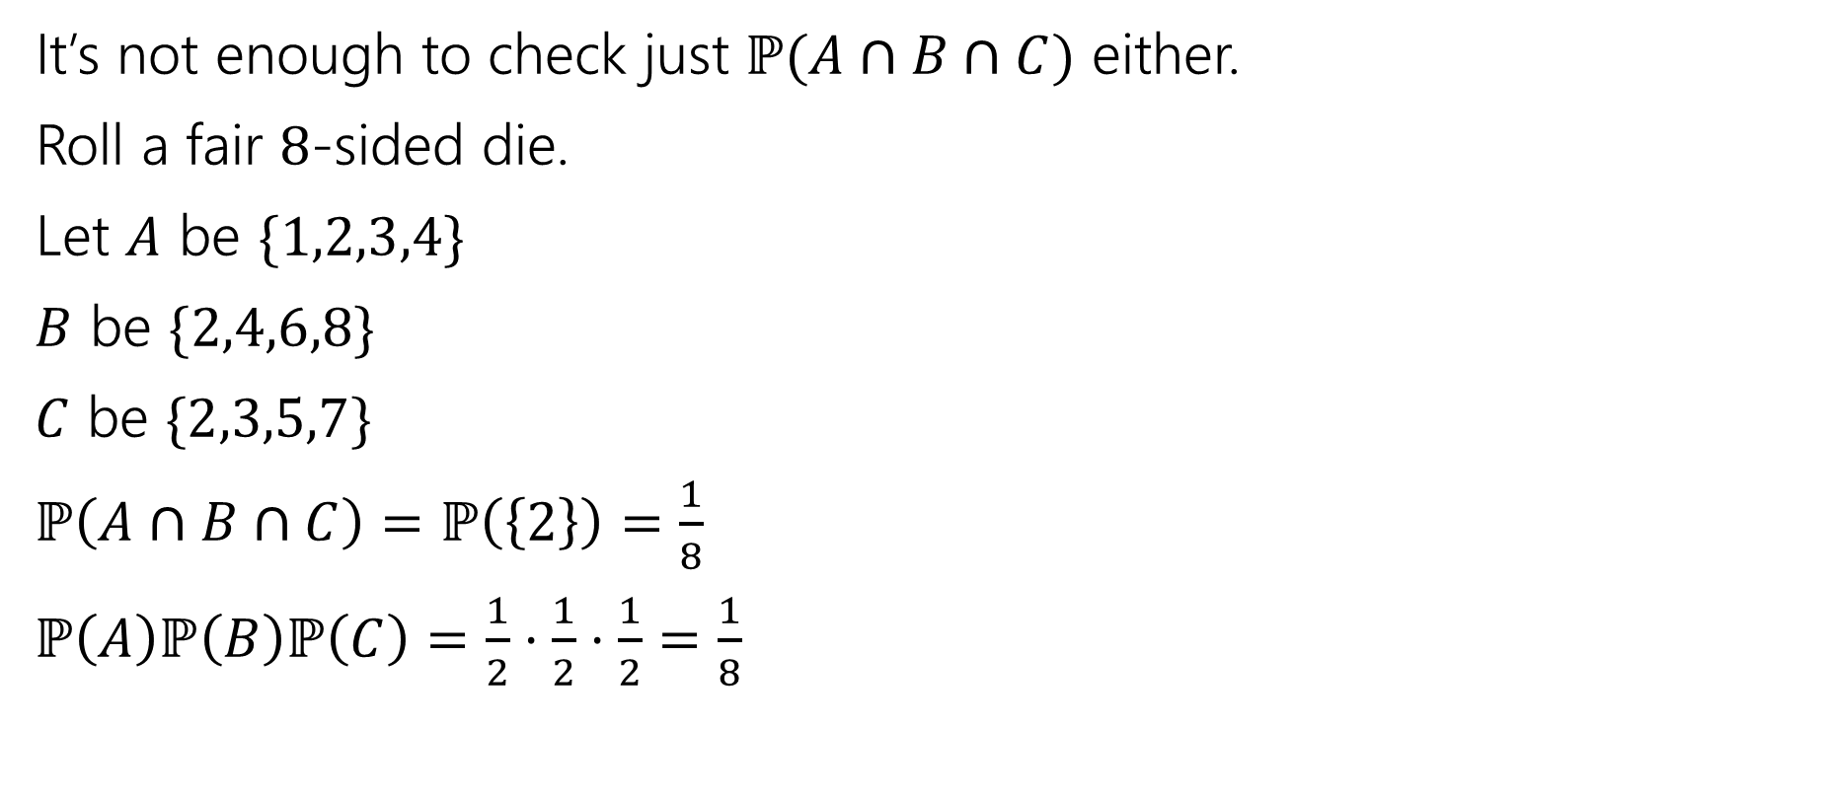
Checking Mutual Independence
It’s not enough to check just $ℙ(A∩B∩C)$ either.
Roll a fair $8$-sided die.
Let $A$ be $\{1,2,3,4\}$
$B$ be $\{2,4,6,8\}$
$C$ be $\{2,3,5,7\}$
$ℙ\left(A∩B∩C\right)=ℙ\left(\left\{2\right\}\right)=\frac{1}{8}$
$ℙ\left(A\right)ℙ\left(B\right)ℙ\left(C\right)=\frac{1}{2}⋅\frac{1}{2}⋅\frac{1}{2}=\frac{1}{8}$

Slide 22
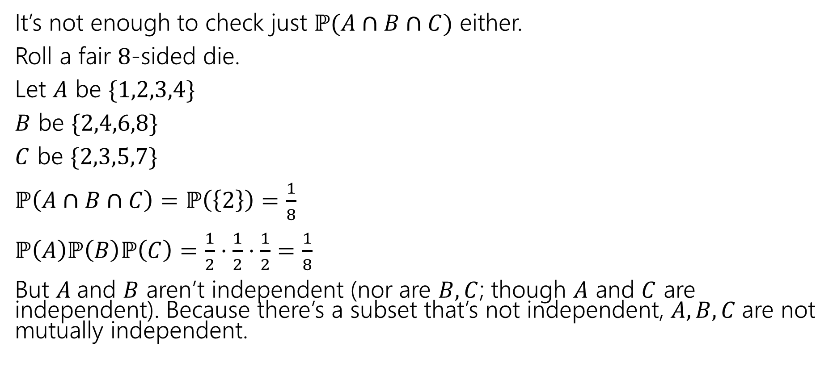
Checking Mutual Independence
It’s not enough to check just $ℙ(A∩B∩C)$ either.
Roll a fair $8$-sided die.
Let $A$ be $\{1,2,3,4\}$
$B$ be $\{2,4,6,8\}$
$C$ be $\{2,3,5,7\}$
$ℙ\left(A∩B∩C\right)=ℙ\left(\left\{2\right\}\right)=\frac{1}{8}$
$ℙ\left(A\right)ℙ\left(B\right)ℙ\left(C\right)=\frac{1}{2}⋅\frac{1}{2}⋅\frac{1}{2}=\frac{1}{8}$
But $A$and $B$ aren’t independent (nor are $B,C$; though $A$ and $C$ are independent). Because there’s a subset that’s not independent, $A,B,C$are not mutually independent.

Slide 23
Checking Mutual Independence
To check mutual independence of events:
Check every subset.
To check pairwise independence of events:
Check every subset of size two.

Slide 24

Independence of Random Variables
That’s for events…what about random variables?
$X$ and $Y$ are independent if for all $k,ℓ$
$$ℙ\left(X=k, Y=ℓ\right)=ℙ\left(X=k\right)ℙ(Y=ℓ)$$
Independence (of random variables)
We’ll often use commas instead of $∩$ symbol.

Slide 25

Independence of Random Variables
The “for all values” is important.
We say that the event “the sum is 7” is independent of “the red die is 5”
What about $S=$“the sum of two dice” and $R=$“the value of the red die”

Slide 26
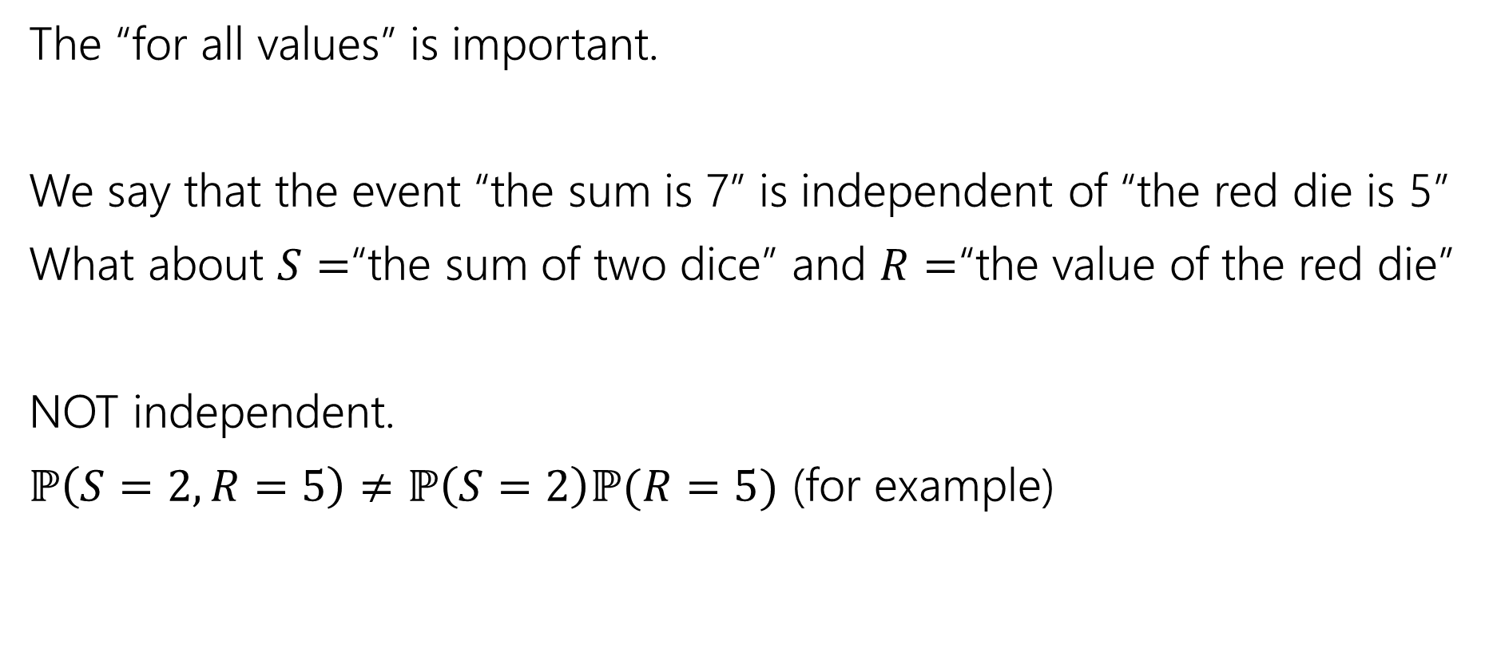
Independence of Random Variables
The “for all values” is important.
We say that the event “the sum is 7” is independent of “the red die is 5”
What about $S=$“the sum of two dice” and $R=$“the value of the red die”
NOT independent.
$ℙ\left(S=2, R=5\right)≠ℙ\left(S=2\right)ℙ(R=5)$ (for example)

Slide 27

Independence of Random Variables
Flip a coin independently $2n$ times.
Let $X$ be “the number of heads in the first $n$ flips.”
Let $Y$ be “the number of heads in the last $n$ flips.”
$X$ and $Y$ are independent.

Slide 28
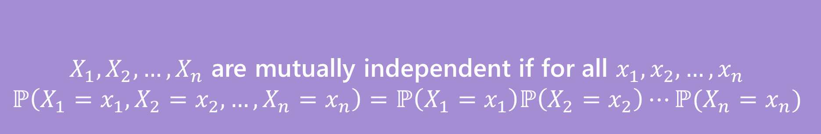

Mutual Independence for RVs
A little simpler to write down than for events
DON’T need to check all subsets for random variables…
But you do need to check all values (all possible $x_{i}$) still.
$X_{1},X_{2},…,X_{n}$ are mutually independent if for all $x_{1},x_{2},…,x_{n}$
$$ℙ\left(X_{1}=x_{1}, X_{2}=x_{2},…,X_{n}=x_{n}\right)=ℙ\left(X_{1}=x_{1}\right)ℙ\left(X_{2}=x_{2}\right)⋯ℙ(X_{n}=x_{n})$$
Mutual Independence (of random variables)

Slide 29
Extra Practice

Slide 30

More Practice
Suppose you flip a coin until you see a heads for the first time.
Let $X$ be the number of trials (including the heads)
What is the pmf of $X$?
The cdf of $X$?
$𝔼[X]$?

Slide 31
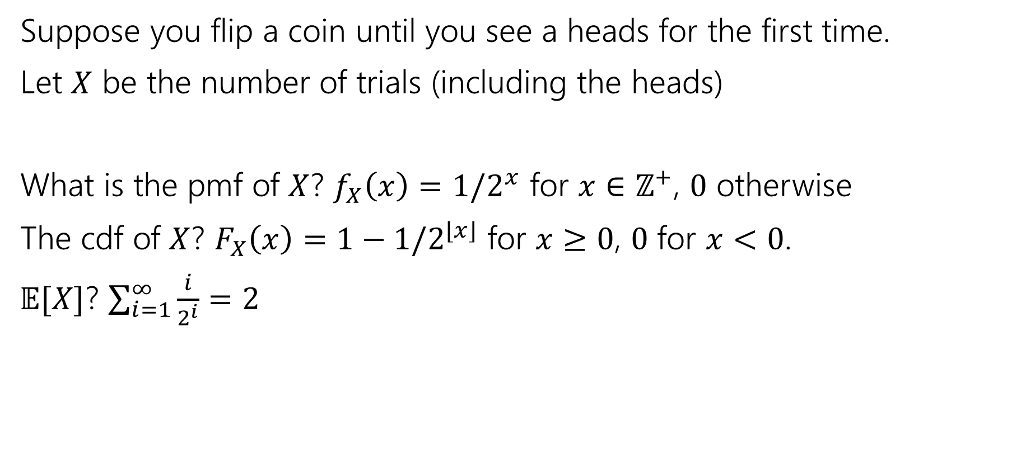
More Practice
Suppose you flip a coin until you see a heads for the first time.
Let $X$ be the number of trials (including the heads)
What is the pmf of $X$? $f_{X}\left(x\right)=1/2^{x}$ for $x∈ℤ^{+}$, $0$ otherwise
The cdf of $X$? $F_{X}\left(x\right)=1−1/2^{⌊x⌋}$ for $x≥0$, $0$ for $x<0$.
$𝔼[X]$? $\sum_{i=1}^{∞}{\frac{i}{2^{i}}}=2$

Slide 32
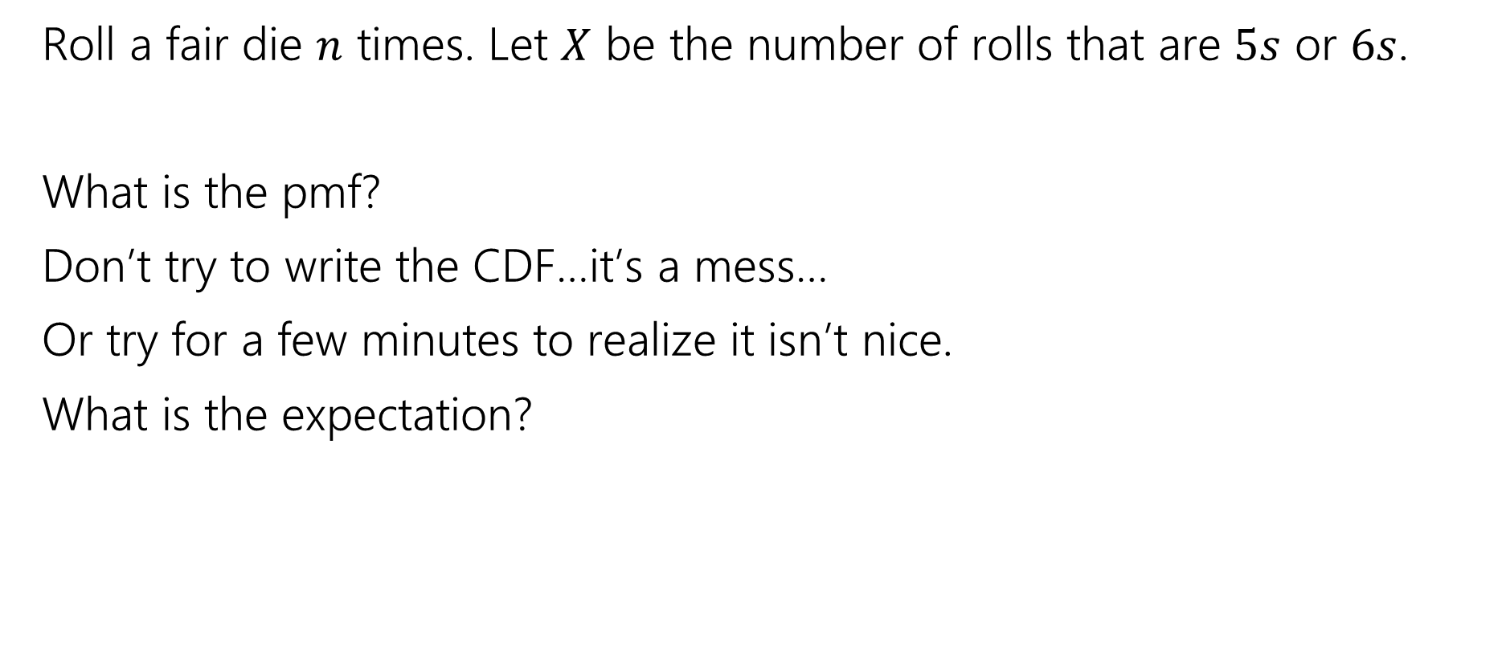
More Random Variable Practice
Roll a fair die $n$ times. Let $X$ be the number of rolls that are $5s$ or $6s$.
What is the pmf?
Don’t try to write the CDF…it’s a mess…
Or try for a few minutes to realize it isn’t nice.
What is the expectation?

Slide 33
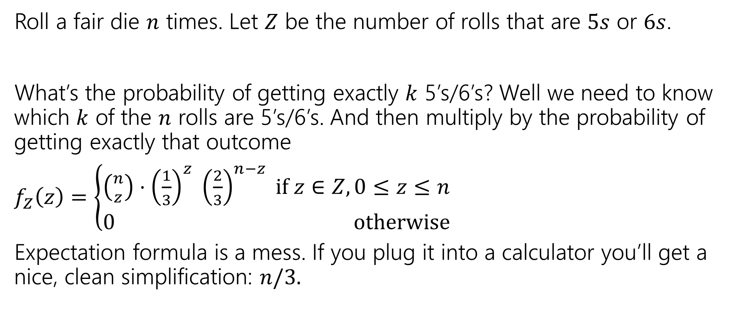
More Random Variable Practice
Roll a fair die $n$ times. Let $Z$ be the number of rolls that are $5s$ or $6s$.
What’s the probability of getting exactly $k$ 5’s/6’s? Well we need to know which $k$ of the $n$ rolls are 5’s/6’s. And then multiply by the probability of getting exactly that outcome
$f_{Z}\left(z\right)=\left\{\begin{aligned}\left({n \atop z}\right)⋅{\left(\frac{1}{3}\right)}^{z} {\left(\frac{2}{3}\right)}^{n−z} if z∈Z,0≤z≤n \\ 0 otherwise\end{aligned}\right.$
Expectation formula is a mess. If you plug it into a calculator you’ll get a nice, clean simplification: $n/3.$

