Slide 1
Variance
CSE 312 Spring 21
Lecture 13

Slide 2

Announcements
Two typo fixes in the homework.
Problem 1, the example lost a negative sign
Problem 6, the example’s second bullet assigned one test to two people (that can’t happen). It’s corrected on the webpage as well.
Office hour shifts this week:
Robbie will stay after B lecture longer today (until about 3)
Howard’s OH today are cancelled; moved to Wednesday 10:30

Slide 3
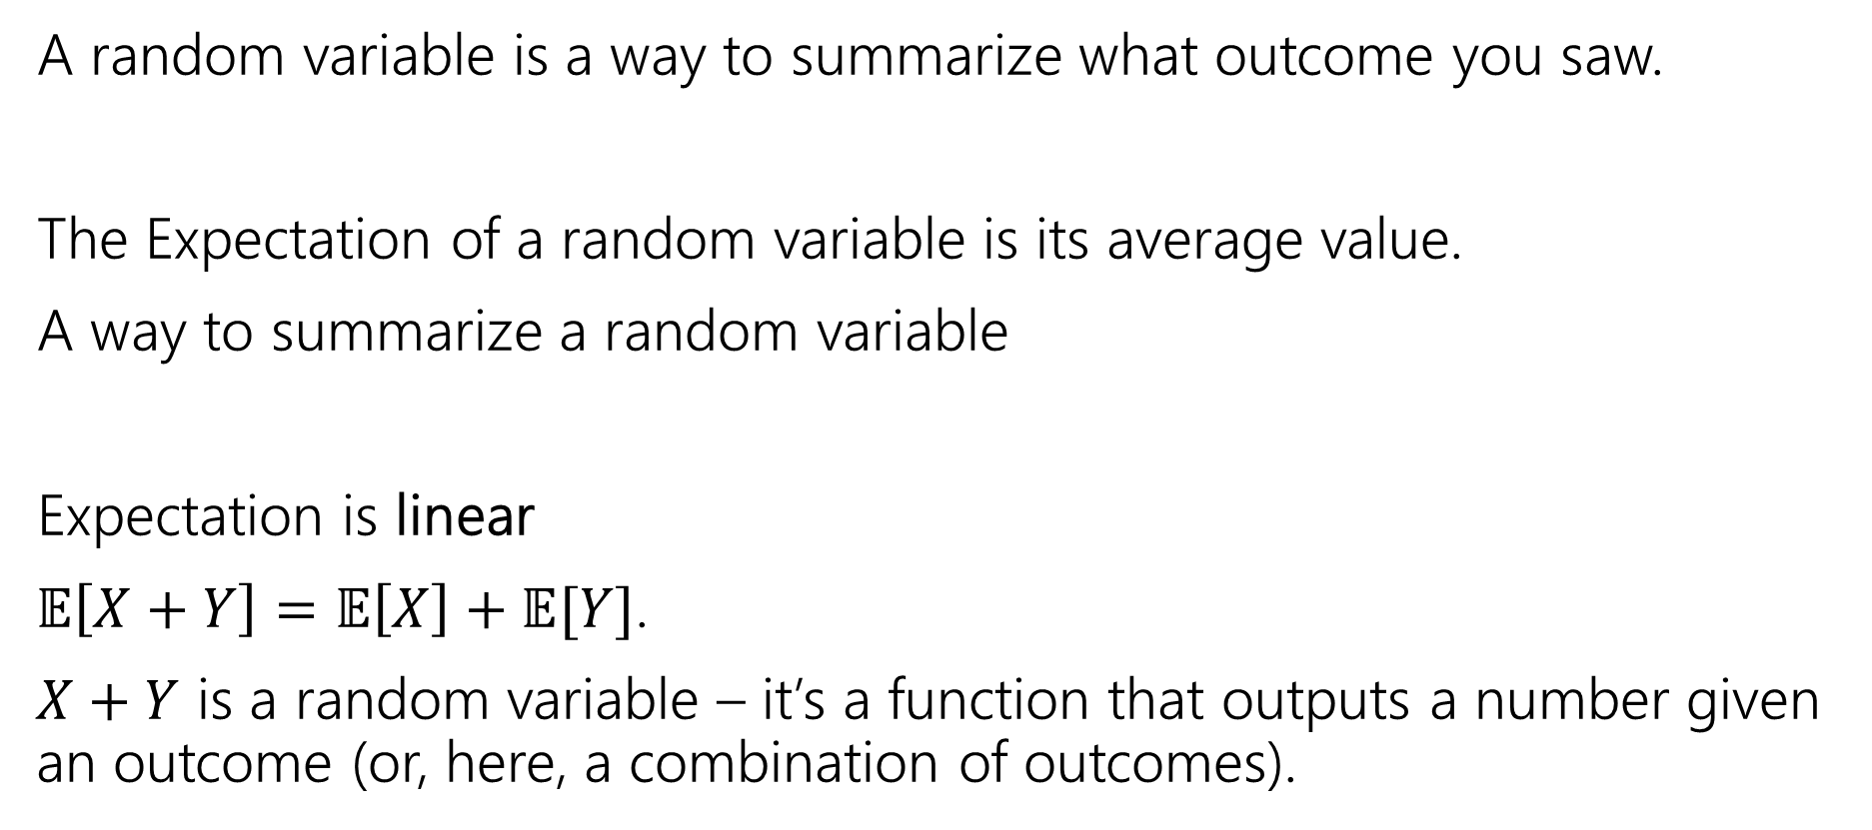
Where are we?
A random variable is a way to summarize what outcome you saw.
The Expectation of a random variable is its average value.
A way to summarize a random variable
Expectation is linear
$𝔼\left[X+Y\right]=𝔼\left[X\right]+𝔼[Y]$.
$X+Y$ is a random variable – it’s a function that outputs a number given an outcome (or, here, a combination of outcomes).

Slide 4
Variance
Another one number summary of a random variable.
But wait, we already have expectation, what’s this for?

Slide 5
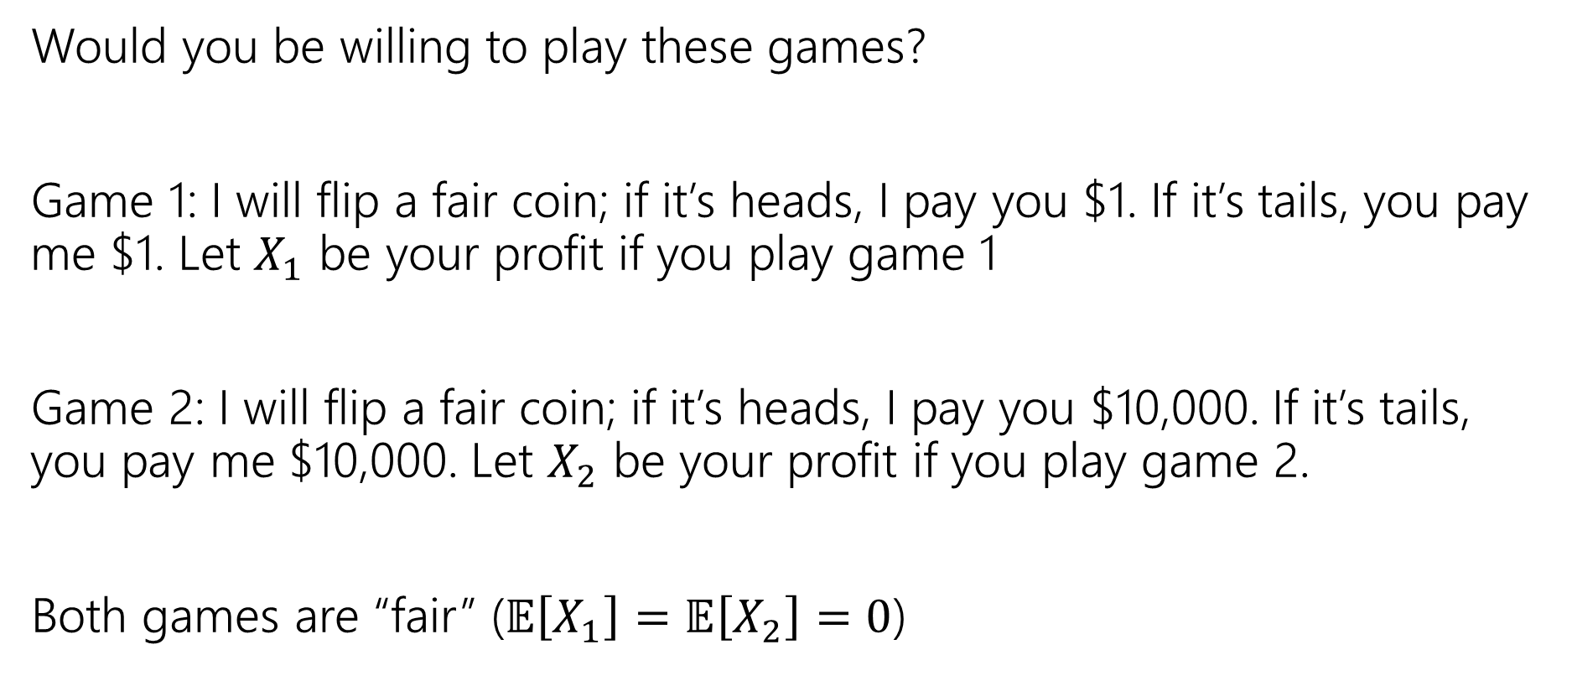
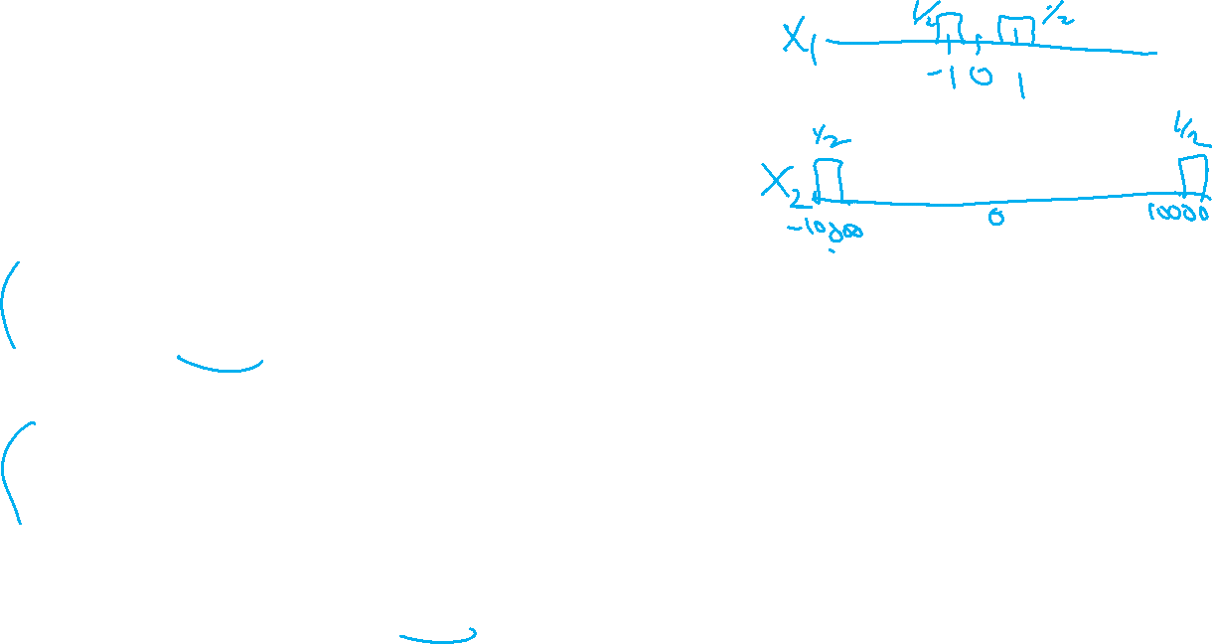
Consider these two games
Would you be willing to play these games?
Game 1: I will flip a fair coin; if it’s heads, I pay you $1. If it’s tails, you pay me $1. Let $X_{1}$ be your profit if you play game 1
Game 2: I will flip a fair coin; if it’s heads, I pay you $10,000. If it’s tails, you pay me $10,000. Let $X_{2}$ be your profit if you play game 2.
Both games are “fair” ($𝔼\left[X_{1}\right]=𝔼\left[X_{2}\right]=0$)

Slide 6
What’s the difference
Expectation tells you what the average will be…
But it doesn’t tell you how “extreme” your results could be.
Nor how likely those extreme results are.
Game 2 has many (well, only) very extreme results.
In expectation they “cancel out” but if you can only play once…
…it would be nice to measure that.

Slide 7
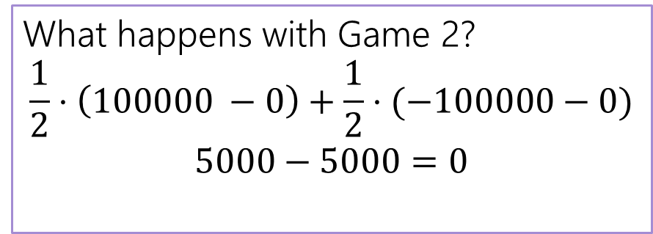
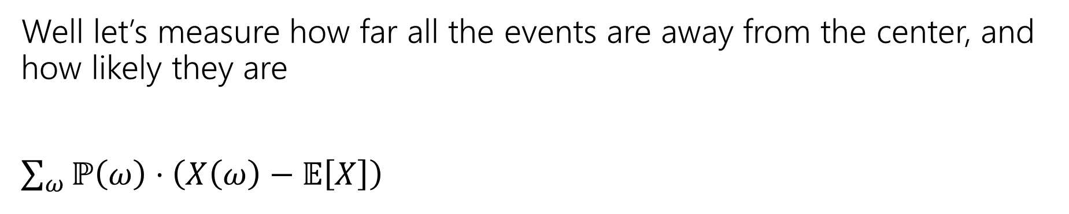
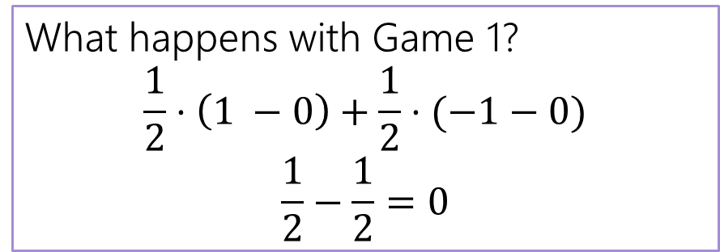
Designing a Measure – Try 1
Well let’s measure how far all the events are away from the center, and how likely they are
$\sum_{ω}{ℙ\left(ω\right)⋅\left(X\left(ω\right)−𝔼\left[X\right]\right) }$
What happens with Game 1?
$$\frac{1}{2}⋅\left(1 −0\right)+\frac{1}{2}⋅(−1−0)$$
$$\frac{1}{2}−\frac{1}{2}=0$$
What happens with Game 2?
$$\frac{1}{2}⋅\left(100000 −0\right)+\frac{1}{2}⋅(−100000−0)$$
$$5000−5000=0$$

Slide 8
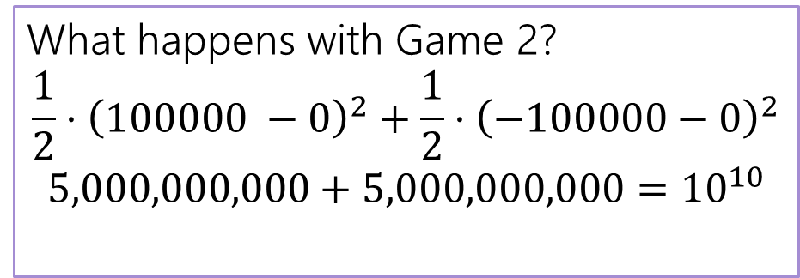
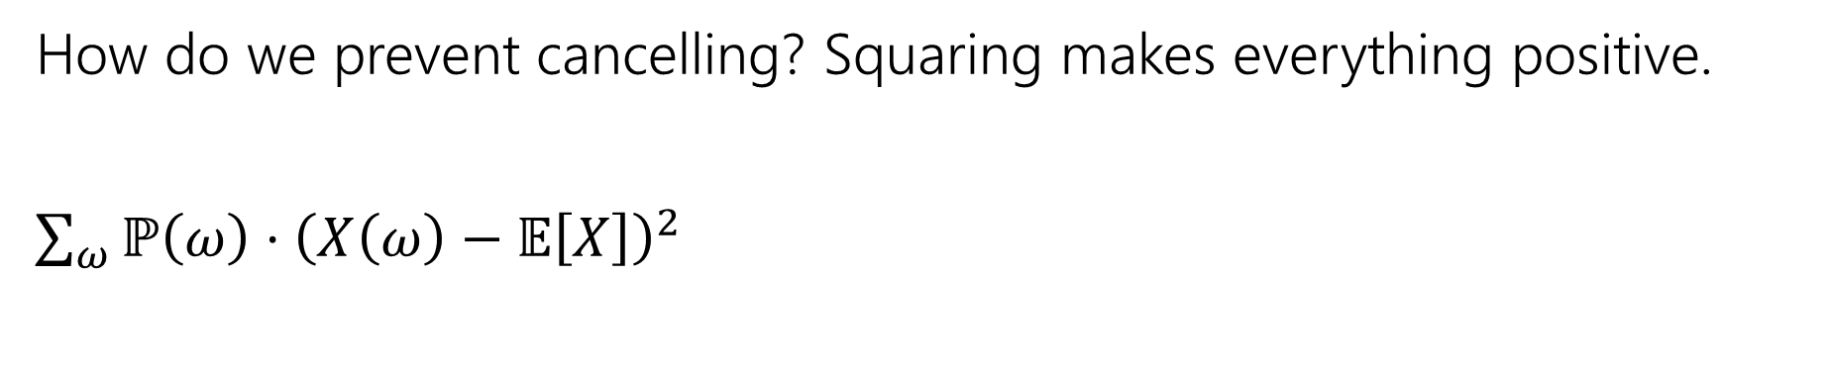

Designing a Measure – Try 2
How do we prevent cancelling? Squaring makes everything positive.
$\sum_{ω}{ℙ\left(ω\right)⋅{\left(X\left(ω\right)−𝔼\left[X\right]\right)}^{2} }$
What happens with Game 1?
$$\frac{1}{2}⋅{\left(1 −0\right)}^{2}+\frac{1}{2}⋅{\left(−1−0\right)}^{2}$$
$$\frac{1}{2}+\frac{1}{2}=1$$
What happens with Game 2?
$$\frac{1}{2}⋅{\left(100000 −0\right)}^{2}+\frac{1}{2}⋅{\left(−100000−0\right)}^{2}$$
$$5,000,000,000+5,000,000,000={10}^{10}$$

Slide 9
Why Squaring
Why not absolute value? Or Fourth power?
Squaring is nicer algebraically.
Our goal with variance was to talk about the spread of results. Squaring makes extreme results even more extreme.
Fourth power over-emphasizes the extreme results (for our purposes).

Slide 10
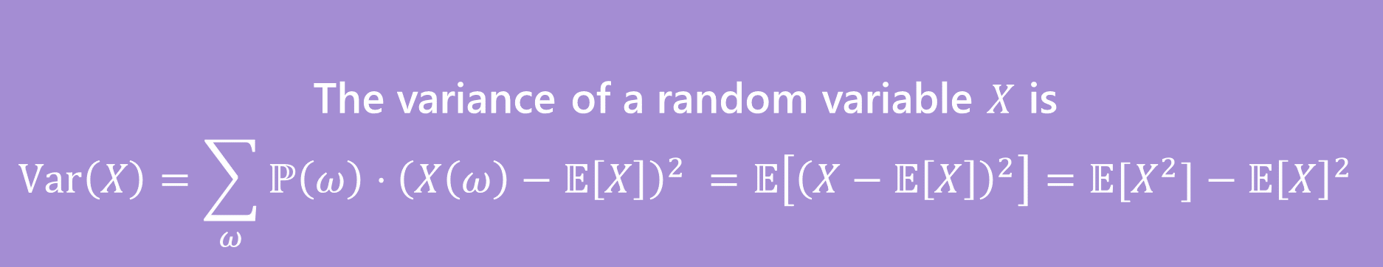
Variance
The first form forms are the definition. The last one is an algebra trick.
The variance of a random variable $X$ is
$$Var\left(X\right)=\sum_{ω}{ℙ\left(ω\right)⋅{\left(X\left(ω\right)−𝔼\left[X\right]\right)}^{2} }=𝔼\left[{\left(X−𝔼\left[X\right]\right)}^{2}\right]=𝔼[X^{2}]−𝔼{\left[X\right]}^{2}$$
Variance

Slide 11
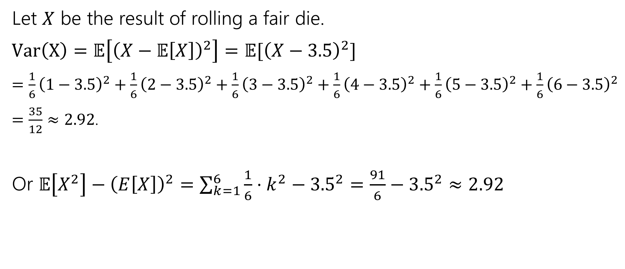
Variance of a die
Let $X$ be the result of rolling a fair die.
$Var\left(X\right)=𝔼\left[{\left(X−𝔼\left[X\right]\right)}^{2}\right]=𝔼[{\left(X−3.5\right)}^{2}]$
$=\frac{1}{6}{\left(1−3.5\right)}^{2}+\frac{1}{6}{\left(2−3.5\right)}^{2}+\frac{1}{6}{\left(3−3.5\right)}^{2}+\frac{1}{6}{\left(4−3.5\right)}^{2}+\frac{1}{6}{\left(5−3.5\right)}^{2}+\frac{1}{6}{\left(6−3.5\right)}^{2}$
$=\frac{35}{12}≈2.92$.
Or $𝔼\left[X^{2}\right]−{\left(E\left[X\right]\right)}^{2}=\sum_{k=1}^{6}{\frac{1}{6}⋅k^{2}−{3.5}^{2}}=\frac{91}{6}−{3.5}^{2}≈2.92$

Slide 12
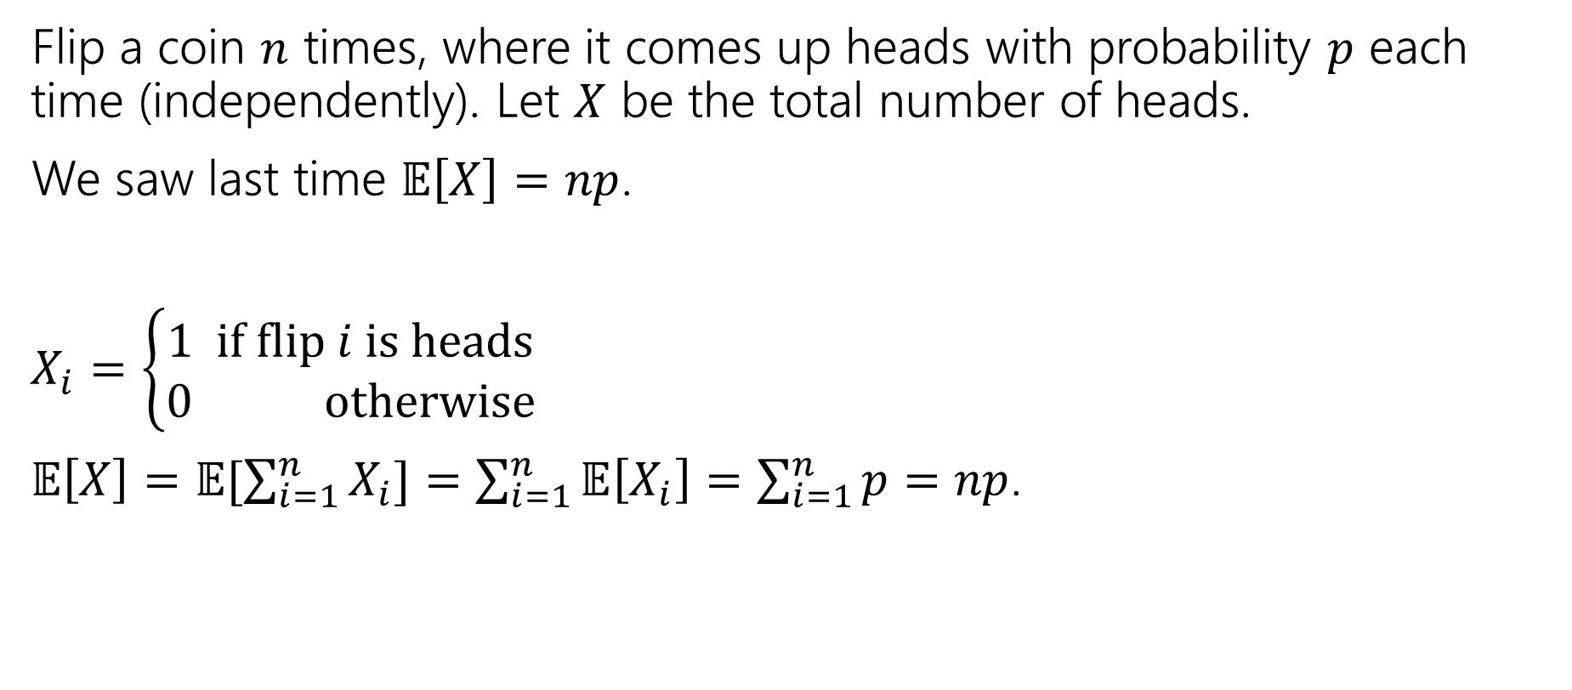

Variance of $n$ Coin Flips
Flip a coin $n$ times, where it comes up heads with probability $p$ each time (independently). Let $X$ be the total number of heads.
We saw last time $𝔼\left[X\right]=np$.
$X_{i}=\left\{\begin{aligned}1 if flip i is heads \\ 0 otherwise\end{aligned}\right.$
$𝔼\left[X\right]=𝔼[\sum_{i=1}^{n}{X_{i}]=\sum_{i=1}^{n}{𝔼\left[X_{i}\right]=\sum_{i=1}^{n}{p=np}}}$.

Slide 13
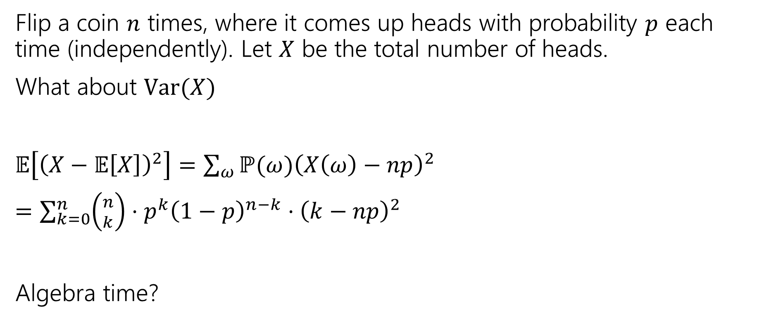
Variance of $n$ Coin Flips
Flip a coin $n$ times, where it comes up heads with probability $p$ each time (independently). Let $X$ be the total number of heads.
What about $Var(X)$
$𝔼\left[{\left(X−𝔼\left[X\right]\right)}^{2}\right]=\sum_{ω}{ℙ(ω){\left(X\left(ω\right)−np\right)}^{2}}$
$=\sum_{k=0}^{n}{\left({n \atop k}\right)⋅p^{k}{\left(1−p\right)}^{n−k}⋅{\left(k−np\right)}^{2}}$
Algebra time?

Slide 14

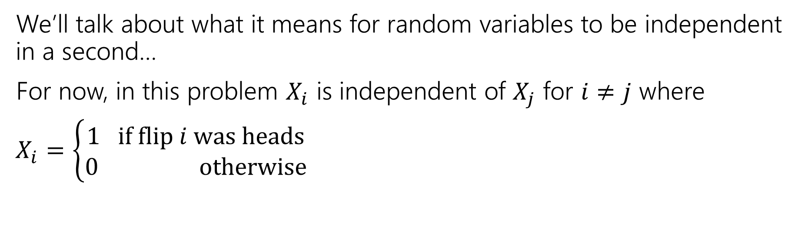
Variance
If $X$ and $Y$ are independent then
$$Var\left(X+Y\right)=Var\left(X\right)+Var(Y)$$
We’ll talk about what it means for random variables to be independent in a second…
For now, in this problem $X_{i}$ is independent of $X_{j}$ for $i≠j$ where
$X_{i}=\left\{\begin{aligned}1 if flip i was heads \\ 0 otherwise\end{aligned}\right.$

Slide 15
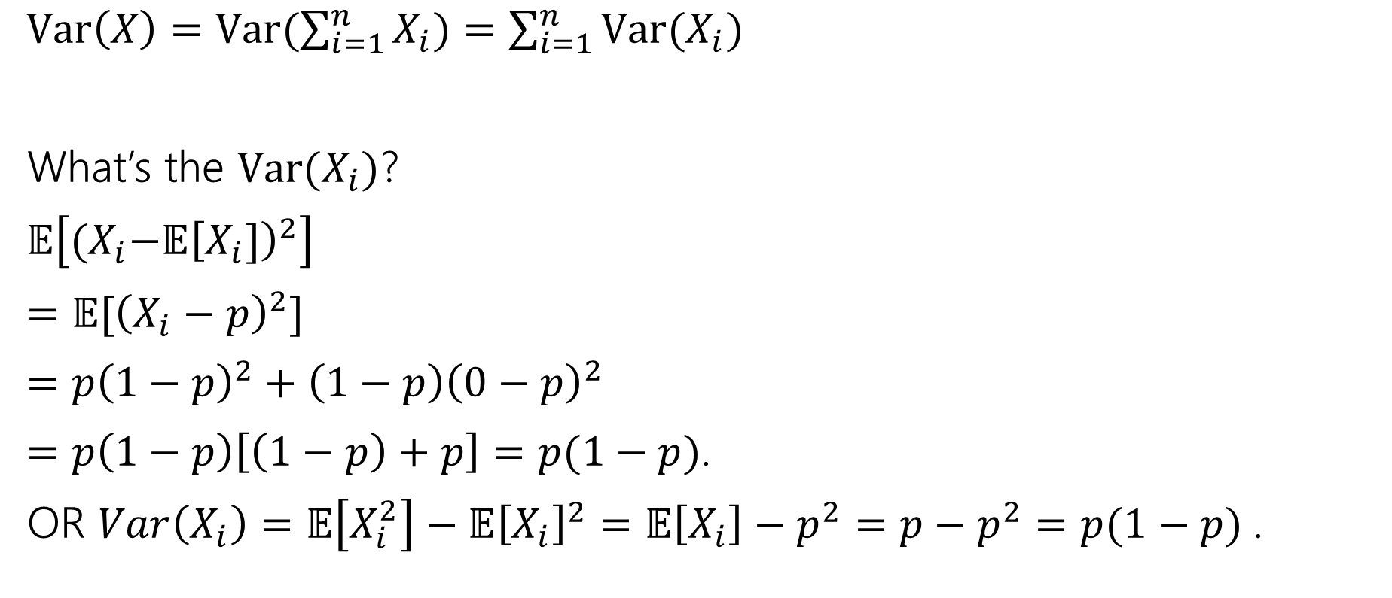
Variance
$Var\left(X\right)=Var(\sum_{i=1}^{n}{X_{i})=\sum_{i=1}^{n}{Var(X_{i})}}$
What’s the $Var(X_{i})$?
$𝔼\left[{(X}_{i}−𝔼{\left[X_{i}]\right)}^{2}\right]$
$=𝔼[{\left(X_{i}−p\right)}^{2}]$
$=p{\left(1−p\right)}^{2}+\left(1−p\right){\left(0−p\right)}^{2}$
$=p\left(1−p\right)\left[\left(1−p\right)+p\right]=p(1−p)$.
OR $Var\left(X_{i}\right)=𝔼\left[X_{i}^{2}\right]−𝔼{\left[X_{i}\right]}^{2}=𝔼\left[X_{i}\right]−p^{2}=p−p^{2}=p(1−p)$.

Slide 16

Plugging In
$Var\left(X\right)=Var(\sum_{i=1}^{n}{X_{i})=\sum_{i=1}^{n}{Var(X_{i})}}$
What’s the $Var(X_{i})$?
$p(1−p)$.
$Var\left(X\right)=\sum_{i=1}^{n}{p\left(1−p\right)=}np(1−p)$.

Slide 17
Expectation and Variance aren’t everything
Alright, so expectation and variance is everything right?
No!
A PMF or CDF *does* fully describe a random variable.
Flip a fair coin 3 times indep. Count heads.
Flip a biased coin (prob heads=2/3) until heads. Count flips.
…

Slide 18
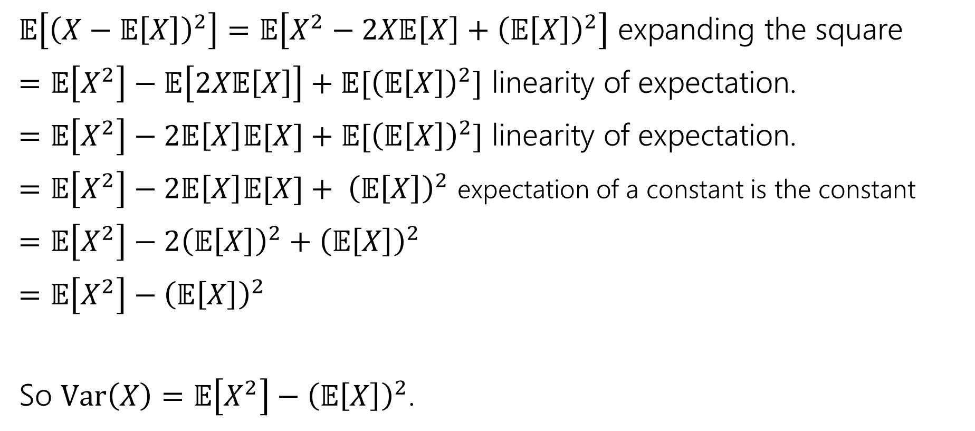
Calculation Trick
$𝔼\left[{\left(X−𝔼\left[X\right]\right)}^{2}\right]=𝔼\left[X^{2}−2X𝔼\left[X\right]+{\left(𝔼\left[X\right]\right)}^{2}\right]$ expanding the square
$=𝔼\left[X^{2}\right]−𝔼\left[2X𝔼\left[X\right]\right]+𝔼[{\left(𝔼\left[X\right]\right)}^{2}]$ linearity of expectation.
$=𝔼\left[X^{2}\right]−2𝔼\left[X\right]𝔼[X]+𝔼[{\left(𝔼\left[X\right]\right)}^{2}]$ linearity of expectation.
$=𝔼\left[X^{2}\right]−2𝔼\left[X\right]𝔼[X]+ {\left(𝔼\left[X\right]\right)}^{2}$ expectation of a constant is the constant
$=𝔼\left[X^{2}\right]−2{\left(𝔼\left[X\right]\right)}^{2}+{\left(𝔼\left[X\right]\right)}^{2}$
$=𝔼\left[X^{2}\right]−{\left(𝔼\left[X\right]\right)}^{2}$
So $Var\left(X\right)=𝔼\left[X^{2}\right]−{\left(𝔼\left[X\right]\right)}^{2}$.

Slide 19
Independence

Slide 20

Independence of Random Variables
That’s for events…what about random variables?
$X$ and $Y$ are independent if for all $k,ℓ$
$$ℙ\left(X=k, Y=ℓ\right)=ℙ\left(X=k\right)ℙ(Y=ℓ)$$
Independence (of random variables)
We’ll often use commas instead of $∩$ symbol.

Slide 21

Independence of Random Variables
The “for all values” is important.
We say that the event “the sum is 7” is independent of “the red die is 5”
What about $S=$“the sum of two dice” and $R=$“the value of the red die”

Slide 22
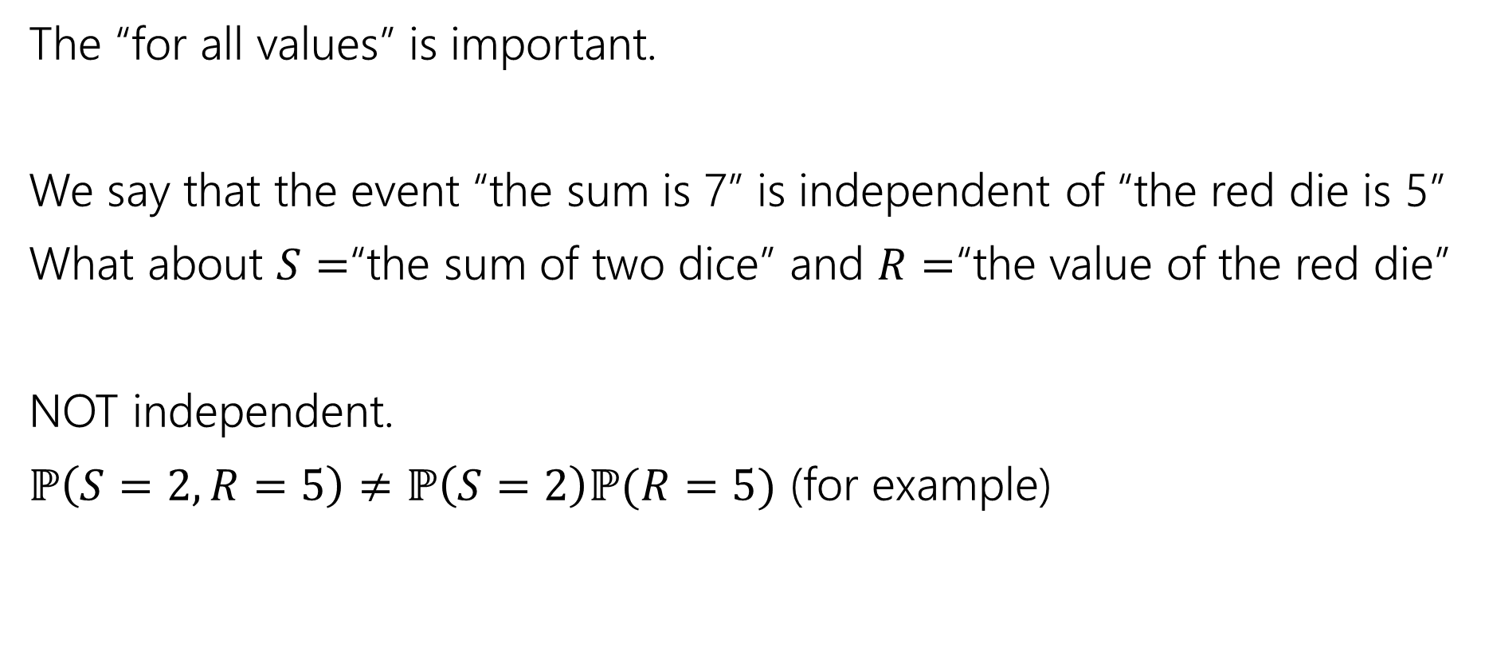
Independence of Random Variables
The “for all values” is important.
We say that the event “the sum is 7” is independent of “the red die is 5”
What about $S=$“the sum of two dice” and $R=$“the value of the red die”
NOT independent.
$ℙ\left(S=2, R=5\right)≠ℙ\left(S=2\right)ℙ(R=5)$ (for example)

Slide 23

Independence of Random Variables
Flip a coin independently $2n$ times.
Let $X$ be “the number of heads in the first $n$ flips.”
Let $Y$ be “the number of heads in the last $n$ flips.”
$X$ and $Y$ are independent.

Slide 24
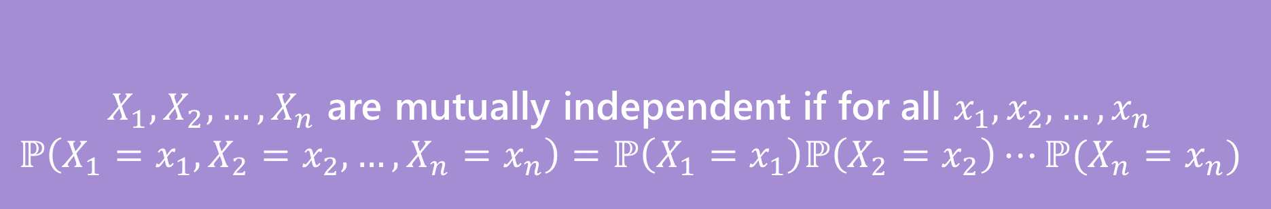

Mutual Independence for RVs
A little simpler to write down than for events
DON’T need to check all subsets for random variables…
But you do need to check all values (all possible $x_{i}$) still.
$X_{1},X_{2},…,X_{n}$ are mutually independent if for all $x_{1},x_{2},…,x_{n}$
$$ℙ\left(X_{1}=x_{1}, X_{2}=x_{2},…,X_{n}=x_{n}\right)=ℙ\left(X_{1}=x_{1}\right)ℙ\left(X_{2}=x_{2}\right)⋯ℙ(X_{n}=x_{n})$$
Mutual Independence (of random variables)

Slide 25
Common Distributions

Slide 26

What Does Independence Give Us?
If $X$ and $Y$ are independent random variables, then
$Var\left(X+Y\right)=Var\left(X\right)+Var(Y)$
$𝔼\left[X⋅Y\right]=𝔼\left[X\right]𝔼\left[Y\right]$
$𝔼\left[\frac{X}{Y}\right]=𝔼\left[X\right]⋅𝔼\left[\frac{1}{Y}\right]$

Slide 27
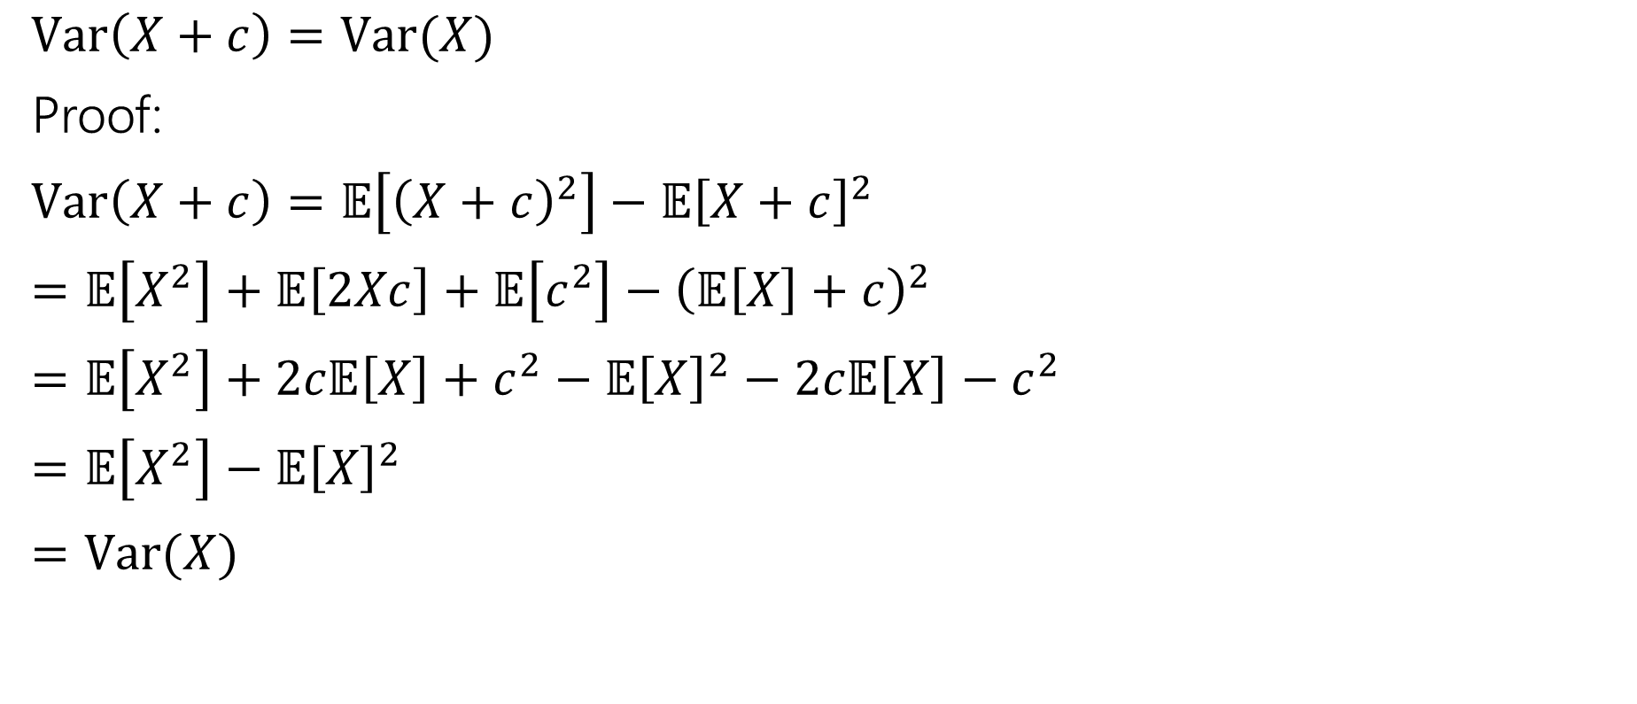
Facts About Variance
$Var\left(X+c\right)=Var(X)$
Proof:
$Var\left(X+c\right)=𝔼\left[{\left(X+c\right)}^{2}\right]−𝔼{\left[X+c\right]}^{2}$
$=𝔼\left[X^{2}\right]+𝔼\left[2Xc\right]+𝔼\left[c^{2}\right]−{\left(𝔼\left[X\right]+c\right)}^{2}$
$=𝔼\left[X^{2}\right]+2c𝔼\left[X\right]+c^{2}−𝔼{\left[X\right]}^{2}−2c𝔼\left[X\right]−c^{2}$
$=𝔼\left[X^{2}\right]−𝔼{\left[X\right]}^{2}$
$=Var(X)$

Slide 28

Facts about Variance
$Var\left(aX\right)=a^{2}Var(X)$
$=𝔼\left[{\left(aX\right)}^{2}\right]−(𝔼{\left[aX\right])}^{2}$
$=a^{2}𝔼\left[X^{2}\right]−{\left(a𝔼\left[X\right]\right)}^{2}$
$=a^{2}𝔼\left[X^{2}\right]−a^{2}𝔼{\left[X\right]}^{2}$
$=a^{2}\left(𝔼\left[X^{2}\right]−𝔼{\left[X\right]}^{2}\right)$

