Slide 1
Continuous Probability
CSE 312 Spring 21
Lecture 16

Slide 2
Today
Continuous Probability.
Probability Density Function
Cumulative Distribution Function
Goal for today is to get intuition on what’s different in the continuous case. Your goal today is to start building up a gut-feeling of what’s happening.
ASK QUESTIONS, (always, but today especially).

Slide 3
Continuous Random Variables
We’ll need continuous probability spaces and continuous random variables to describe experiments that have uncountably-infinite sample spaces.
  e.g. all real numbers
How long until the next bus shows up?
What location does a dart land?

Slide 4
Continuous Random Variables
Wait, we’re computer scientists. Computers don’t do real numbers, why should we?
Continuous random variables will be a useful model for enormous sample spaces. The math will be easier.
Example: polling a large population. The sample space is actually discrete. But we’re going to round the result anyway. Make it continuous first for easier math, then round.

Slide 5
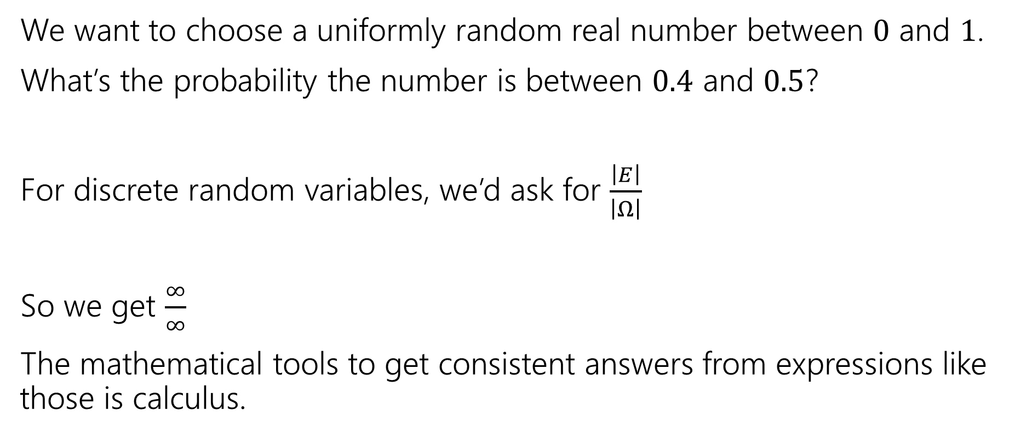
Why Need New Rules?
We want to choose a uniformly random real number between $0$ and $1$.
What’s the probability the number is between $0.4$ and $0.5$?
For discrete random variables, we’d ask for $\frac{\left|E\right|}{\left|Ω\right|}$
So we get $\frac{∞}{∞}$
The mathematical tools to get consistent answers from expressions like those is calculus.

Slide 6
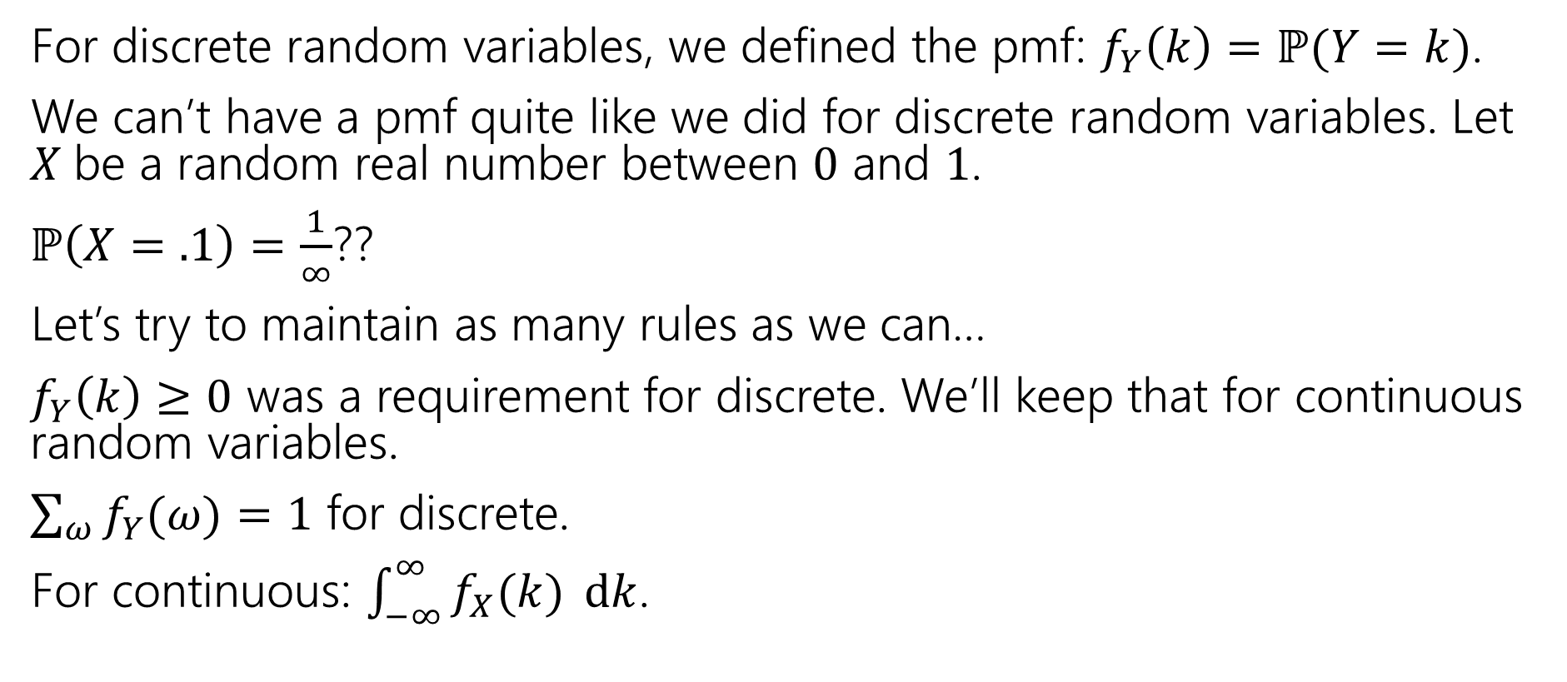
Let’s start with the pmf
For discrete random variables, we defined the pmf: $f_{Y}\left(k\right)=ℙ(Y=k)$.
We can’t have a pmf quite like we did for discrete random variables. Let $X$be a random real number between $0$ and $1$.
$ℙ\left(X=.1\right)=\frac{1}{∞}$??
Let’s try to maintain as many rules as we can…
$f_{Y}\left(k\right)≥0$ was a requirement for discrete. We’ll keep that for continuous random variables.
$\sum_{ω}{f_{Y}(ω)}=1$ for discrete.
For continuous: $\int_{−∞}^{∞}{f_{X}(k)} dk$.

Slide 7

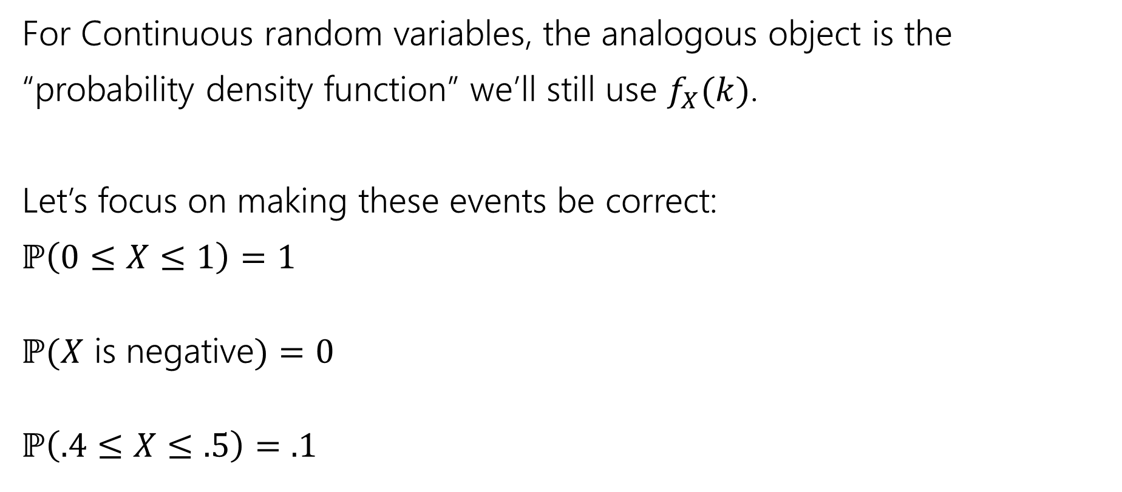
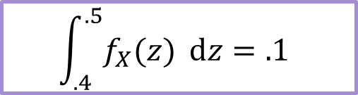
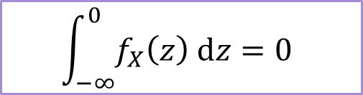
The probability density function
For Continuous random variables, the analogous object is the
“probability density function” we’ll still use $f_{X}(k)$.
Let’s focus on making these events be correct:
$ℙ\left(0≤X≤1\right)=1$
$ℙ(X$ is negative$)=0$
$ℙ\left(.4≤X≤.5\right)=.1$
$$\int_{0}^{1}{f_{X}\left(z\right) dz}=1$$
integrating is analogous to sum.
$$\int_{−∞}^{0}{f_{X}\left(z\right) dz=0}$$
$$\int_{.4}^{.5}{f_{X}(z)} dz=.1$$

Slide 8

PDF for uniform
Let $X$ be a uniform real number between $0$ and $1$.
What should $f_{X}(k)$ be to make all those events integrate to the right values?
$f_{X}\left(k\right)=\left\{\begin{aligned}0 if k<0 or k>1 \\ 1 if 0≤k≤1\end{aligned}\right.$

Slide 9


Probability Density Function
So $ℙ\left(X=.1\right)=??$
$f_{X}\left(.1\right)=1$
The number that best represents $ℙ(X=.1)$ is $0$.
This is different from $f_{X}(x)$
So…what is $f_{X}(x)$???
For continuous probability spaces:
Impossible events have probability $0$,
but some probability $0$ events might be possible.

Slide 10

Using the PDF
Compare the events: $X≈.2$ and $X≈.5$
$ℙ(.2−ε/2≤X≤.2+ε/2)$
What will the pdf give? $\int_{.2−ε/2}^{−2+ε/2}{f_{X}\left(z\right) dz}$
$f_{X}\left(.2\right)⋅ε$
What happens if we look at the ratio
$\frac{ℙ(X≈.2)}{ℙ(X≈.5)}$
.2
.5

Slide 11
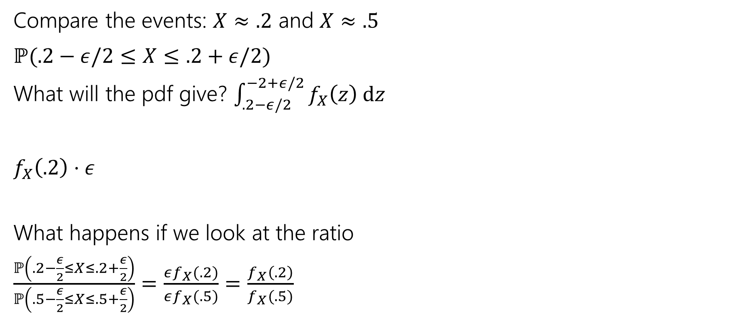
Using the PDF
Compare the events: $X≈.2$ and $X≈.5$
$ℙ(.2−ε/2≤X≤.2+ε/2)$
What will the pdf give? $\int_{.2−ε/2}^{−2+ε/2}{f_{X}\left(z\right) dz}$
$f_{X}\left(.2\right)⋅ε$
What happens if we look at the ratio
$\frac{ℙ\left(.2−\frac{ε}{2}≤X≤.2+\frac{ε}{2}\right)}{ℙ\left(.5−\frac{ε}{2}≤X≤.5+\frac{ε}{2}\right)}=\frac{εf_{X}(.2)}{εf_{X}(.5)}=\frac{f_{X}\left(.2\right)}{f_{X}(.5)}$
.2
.5

Slide 12
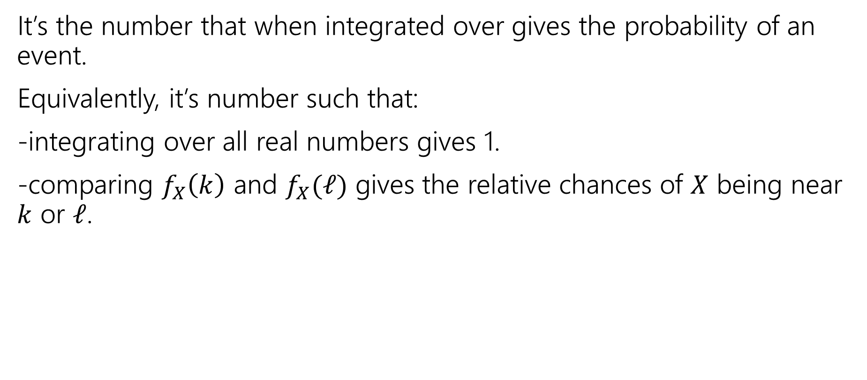
So what’s the pdf?
It’s the number that when integrated over gives the probability of an event.
Equivalently, it’s number such that:
-integrating over all real numbers gives 1.
-comparing $f_{X}\left(k\right)$ and $f_{X}(ℓ)$ gives the relative chances of $X$ being near $k$ or $ℓ$.

Slide 13

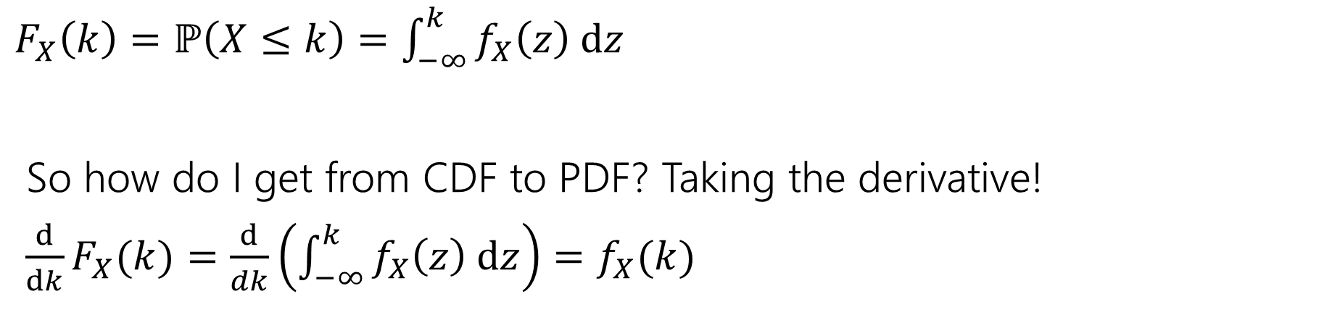
What’s a CDF?
The Cumulative Distribution Function $F_{X}\left(k\right)=ℙ(X≤k)$ is analogous to the CDF for discrete variables.
$F_{X}\left(k\right)=ℙ\left(X≤k\right)=\int_{−∞}^{k}{f_{X}\left(z\right) dz}$
So how do I get from CDF to PDF? Taking the derivative!
$\frac{d}{dk}F_{X}(k)=\frac{d}{dk}\left(\int_{−∞}^{k}{f_{X}\left(z\right) dz}\right)=f_{X}(k)$

Slide 14
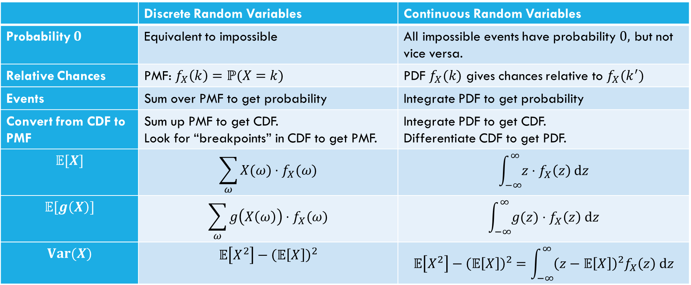
Comparing
 | Discrete Random Variables | Continuous Random Variables
Probability $0$ | Equivalent to impossible | All impossible events have probability $0,$ but not vice versa.
Relative Chances | PMF: $f_{X}\left(k\right)=ℙ(X=k)$ | PDF $f_{X}(k)$ gives chances relative to $f_{X}(k^{′})$
Events | Sum over PMF to get probability | Integrate PDF to get probability
Convert from CDF to PMF | Sum up PMF to get CDF. Look for “breakpoints” in CDF to get PMF. | Integrate PDF to get CDF. Differentiate CDF to get PDF.
$$𝔼[X]$$ | $$\sum_{ω}{X(ω)⋅f_{X}(ω)}$$ | $$\int_{−∞}^{∞}{z⋅f_{X}\left(z\right) dz}$$
$$𝔼[g\left(X\right)]$$ | $$\sum_{ω}{g\left(X\left(ω\right)\right)⋅f_{X}(ω)}$$ | $$\int_{−∞}^{∞}{g(z)⋅f_{X}\left(z\right) dz}$$
$$Var(X)$$ | $$𝔼\left[X^{2}\right]−{\left(𝔼\left[X\right]\right)}^{2}$$ | $$𝔼\left[X^{2}\right]−{\left(𝔼\left[X\right]\right)}^{2}=\int_{−∞}^{∞}{{\left(z−𝔼\left[X\right]\right)}^{2}f_{X}\left(z\right) dz}$$

Slide 15

What about expectation?
For a random variable $X$, we define:
$𝔼\left[X\right]=\int_{−∞}^{∞}{{X(z)⋅f}_{X}\left(z\right) dz}$
Just replace summing over the pmf with integrating the pdf.
It still represents the average value of $X$.

Slide 16

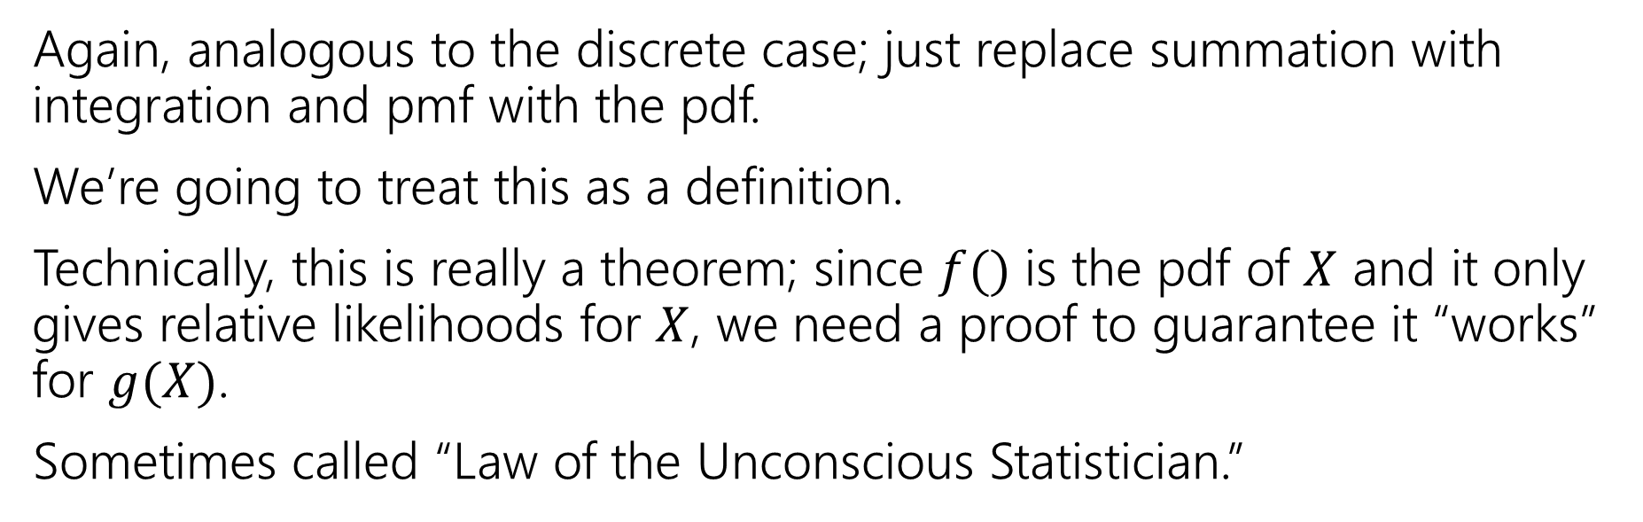
Expectation of a function
For any function $g$ and any continuous random variable, $X:$
$𝔼\left[g\left(X\right)\right]=\int_{−∞}^{∞}{g\left(X(z)\right)⋅f_{X}\left(z\right) dz}$
Again, analogous to the discrete case; just replace summation with integration and pmf with the pdf.
We’re going to treat this as a definition.
Technically, this is really a theorem; since $f()$ is the pdf of $X$ and it only gives relative likelihoods for $X$, we need a proof to guarantee it “works” for $g(X)$.
Sometimes called “Law of the Unconscious Statistician.”

Slide 17

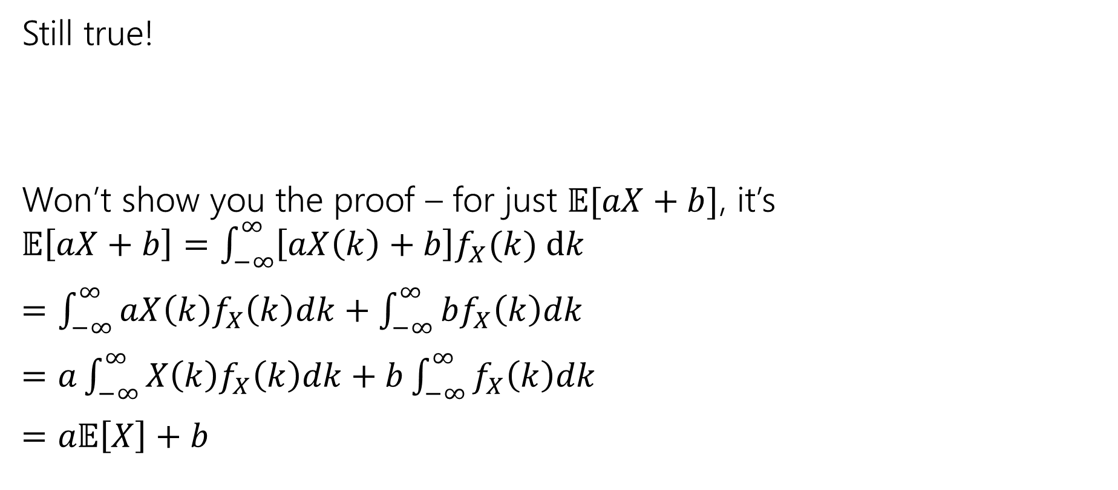
Linearity of Expectation
Still true!
Won’t show you the proof – for just $𝔼[aX+b]$, it’s
$𝔼\left[aX+b\right]=\int_{−∞}^{∞}{\left[aX\left(k\right)+b\right]f_{X}(k) dk}$
$=\int_{−∞}^{∞}{aX\left(k\right)f_{X}\left(k\right)dk}+\int_{−∞}^{∞}{bf_{X}\left(k\right)dk}$
$=a\int_{−∞}^{∞}{X\left(k\right)f_{X}\left(k\right)dk}+b\int_{−∞}^{∞}{f_{X}\left(k\right)dk}$
$=a𝔼\left[X\right]+b$
$$𝔼\left[aX+bY+c\right]=a𝔼\left[X\right]+b𝔼\left[Y\right\}+c$$
For all $X,Y$; even if they’re continuous.

Slide 18
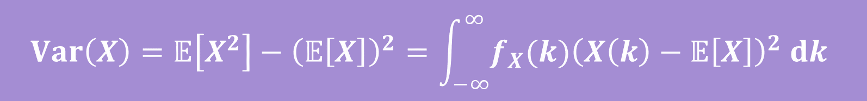
Variance
No surprises here
$$Var\left(X\right)=𝔼\left[X^{2}\right]−{\left(𝔼\left[X\right]\right)}^{2}=\int_{−∞}^{∞}{{f_{X}(k)\left(X\left(k\right)−𝔼\left[X\right]\right)}^{2} dk}$$

Slide 19
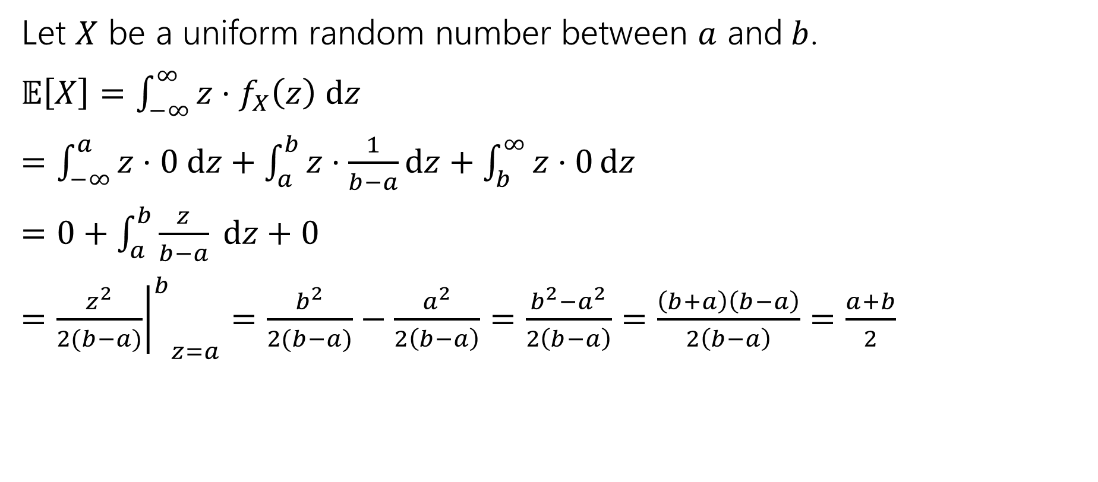
Let’s calculate an expectation
Let $X$ be a uniform random number between $a$ and$b$.
$𝔼\left[X\right]=\int_{−∞}^{∞}{z⋅f_{X}\left(z\right) dz}$
$=\int_{−∞}^{a}{z⋅0 dz}+\int_{a}^{b}{z⋅\frac{1}{b−a}dz}+\int_{b}^{∞}{z⋅0}dz$
$=0+\int_{a}^{b}{\frac{z}{b−a} dz+0}$
$={{\left.\frac{z^{2}}{2(b−a)}\right|}^{b}}_{z=a}=\frac{b^{2}}{2(b−a)}−\frac{a^{2}}{2\left(b−a\right)}=\frac{b^{2}−a^{2}}{2\left(b−a\right)}=\frac{\left(b+a\right)\left(b−a\right)}{2\left(b−a\right)}=\frac{a+b}{2}$

Slide 20
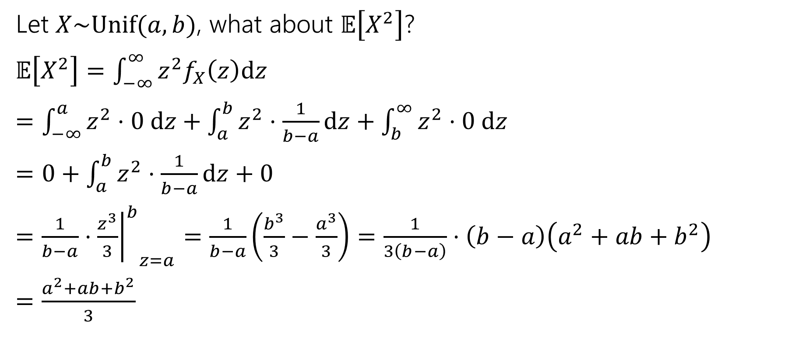

What about $𝔼\left[g\left(X\right)\right]$
Let $X\sim Unif(a,b)$, what about $𝔼\left[X^{2}\right]$?
$𝔼\left[X^{2}\right]=\int_{−∞}^{∞}{z^{2}f_{X}\left(z\right)dz}$
$=\int_{−∞}^{a}{z^{2}⋅0 dz+\int_{a}^{b}{z^{2}⋅\frac{1}{b−a}dz}+\int_{b}^{∞}{z^{2}⋅0 dz}}$
$=0+\int_{a}^{b}{z^{2}⋅\frac{1}{b−a}dz}+0$
$=\frac{1}{b−a}⋅{{\left.\frac{z^{3}}{3}\right|}^{b}}_{z=a}=\frac{1}{b−a}\left(\frac{b^{3}}{3}−\frac{a^{3}}{3}\right)=\frac{1}{3\left(b−a\right)}⋅\left(b−a\right)\left(a^{2}+ab+b^{2}\right)$
$=\frac{a^{2}+ab+b^{2}}{3}$

Slide 21

Let’s assemble the variance
$Var\left(X\right)=𝔼\left[X^{2}\right]−{\left(𝔼\left[X\right]\right)}^{2}$
$=\frac{a^{2}+ab+b^{2}}{3}−{\left(\frac{a+b}{2}\right)}^{2}$
$=\frac{4(a^{2}+ab+b^{2})}{12}−\frac{{3(a}^{2}+2ab+b^{2})}{12}$
$=\frac{a^{2}−2ab+b^{2}}{12}$
$=\frac{{\left(a−b\right)}^{2}}{12}$

Slide 22
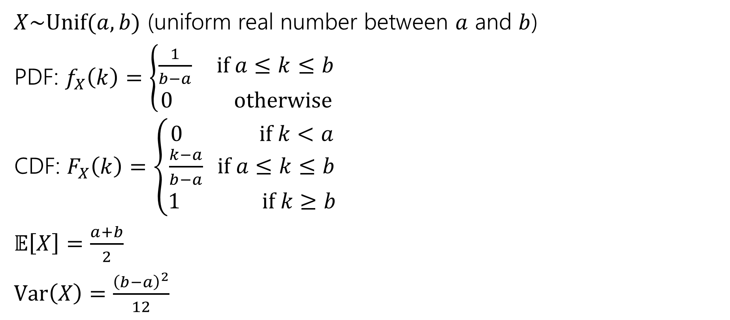
Continuous Uniform Distribution
$X\sim Unif(a,b)$ (uniform real number between $a$ and $b$)
PDF: $f_{X}\left(k\right)=\left\{\begin{aligned}\frac{1}{b−a} if a≤k≤b \\ 0 otherwise\end{aligned}\right.$
CDF: $F_{X}\left(k\right)=\left\{\begin{aligned}0 if k<a \\ \frac{k−a}{b−a} if a≤k≤b \\ 1 if k≥b\end{aligned}\right.$
$𝔼\left[X\right]=\frac{a+b}{2}$
$Var\left(X\right)=\frac{{\left(b−a\right)}^{2}}{12}$

