Slide 2
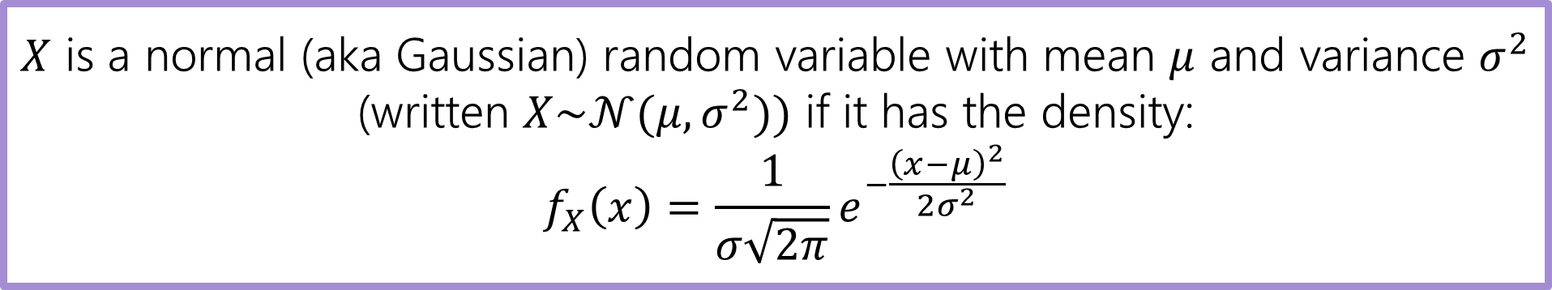

Normal Random Variable
$X$ is a normal (aka Gaussian) random variable with mean $μ$ and variance $σ^{2}$ (written $X\sim 𝒩(μ,σ^{2}))$ if it has the density:
$$f_{X}\left(x\right)=\frac{1}{σ\sqrt{2π}}e^{−\frac{{\left(x−μ\right)}^{2}}{2σ^{2}}}$$
Let’s get some intuition for that density…
Is $𝔼\left[X\right]=μ$?
Yes! Plug in $μ−k$ and $μ+k$ and you’ll get the same density for every $k$. The density is symmetric around $μ.$The expectation must be $μ$.

Slide 3
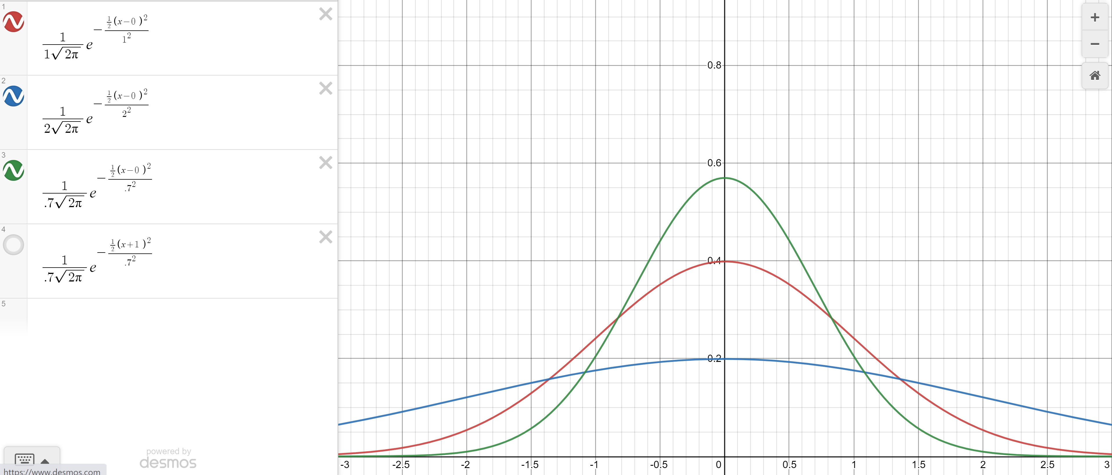

Changing the variance
Green: $σ^{2}=.7$
Red $σ^{2}=1$
Blue: $σ^{2}=2$

Slide 4
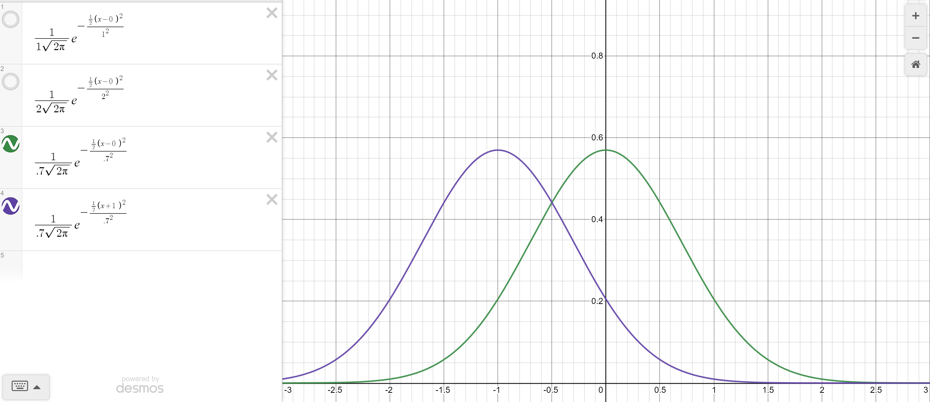

Changing the mean
Green: $σ^{2}=.7, μ=0$
Purple $σ^{2}=.7, μ=−1$

Slide 5
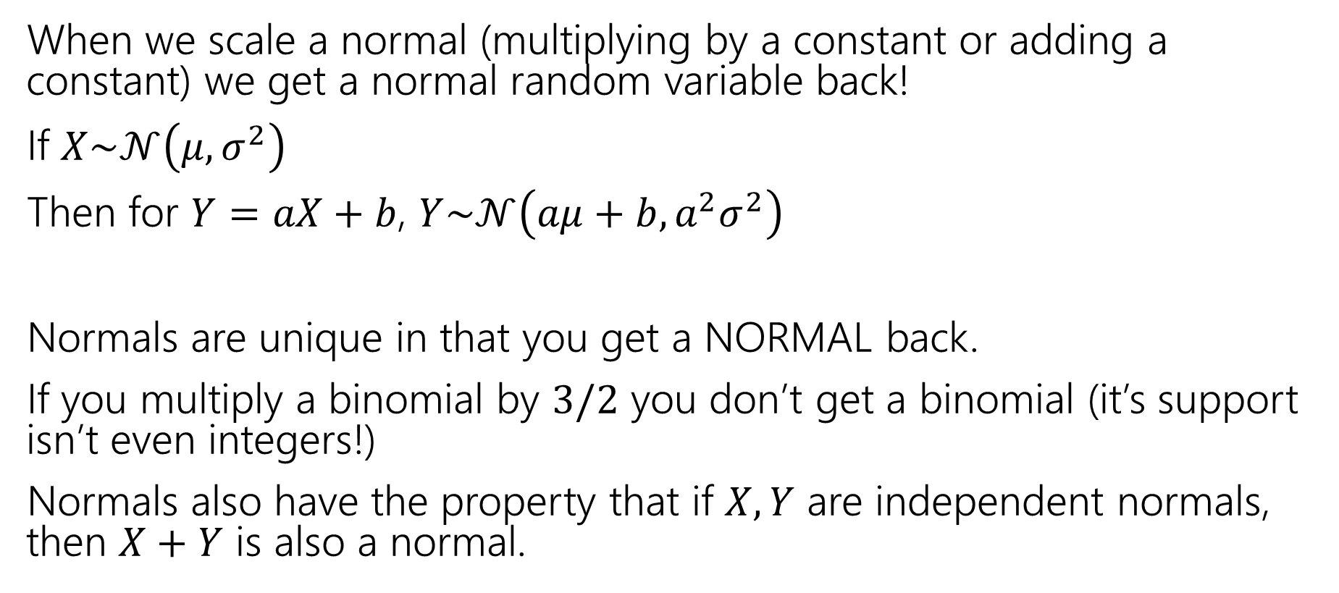
Scaling Normals
When we scale a normal (multiplying by a constant or adding a constant) we get a normal random variable back!
If $X\sim 𝒩\left(μ,σ^{2}\right)$
Then for $Y=aX+b$, $Y\sim 𝒩\left(aμ+b, a^{2}σ^{2}\right)$
Normals are unique in that you get a NORMAL back.
If you multiply a binomial by $3/2$ you don’t get a binomial (it’s support isn’t even integers!)
Normals also have the property that if $X,Y$ are independent normals, then $X+Y$ is also a normal.

Slide 6
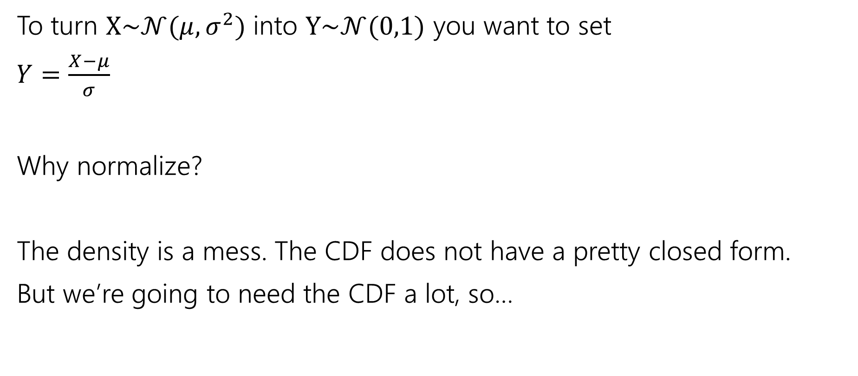
Normalize
To turn $X\sim 𝒩(μ,σ^{2})$ into $Y\sim 𝒩(0,1)$ you want to set
$Y=\frac{X−μ}{σ}$
Why normalize?
The density is a mess. The CDF does not have a pretty closed form.
But we’re going to need the CDF a lot, so…

Slide 7
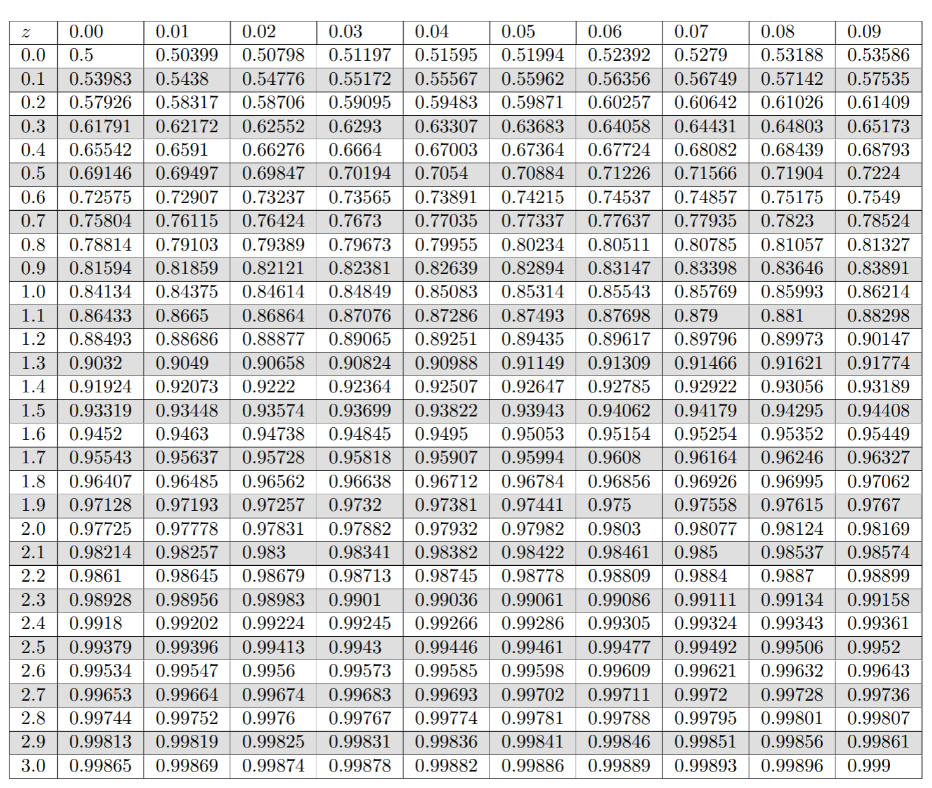
Table of Standard Normal CDF
The way we’ll evaluate the CDF of a normal is to:
1. convert to a standard normal
2. Round the “z-score” to the hundredths place.
3. Look up the value in the table.
It’s 2021, we’re using a table?
The table makes sure we have consistent rounding rules (makes it easier for us to debug with you).
You can’t evaluate this by hand – the “z-score” can give you intuition right away.

Slide 8
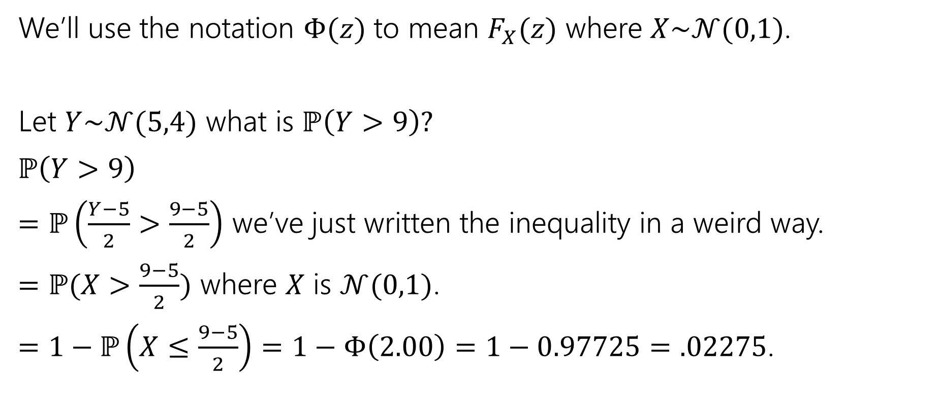
Use the table!
We’ll use the notation $Φ(z)$ to mean $F_{X}(z)$ where $X\sim 𝒩(0,1)$.
Let $Y\sim 𝒩(5,4)$ what is $ℙ\left(Y>9\right)?$
$ℙ\left(Y>9\right)$
$=ℙ\left(\frac{Y−5}{2}>\frac{9−5}{2}\right)$ we’ve just written the inequality in a weird way.
$=ℙ(X>\frac{9−5}{2})$ where $X$ is $𝒩(0,1)$.
$=1−ℙ\left(X≤\frac{9−5}{2}\right)=1−Φ\left(2.00\right)=1−0.97725=.02275$.

Slide 9
More practice

Slide 10
In real life
What’s the probability of being at most two standard deviations from the mean?

