Slide 1
Central Limit Theorem
CSE 312 Spring 21
Lecture 19

Slide 2
Announcements
No responsibilities this summer? Enjoying this class? Consider Taing for it. Kushal will be the instructor! (more info on Ed).

Slide 3
Why Learn Normals?
When we add together independent normal random variables, you get another normal random variable.
The sum of any independent random variables approaches a normal distribution.
Let $X_{1},X_{2},…,X_{n}$ be i.i.d. random variables, with mean $μ$ and variance $σ^{2}$. Let $Y_{n}=\frac{X_{1}+X_{2}+…+X_{n}−nμ}{σ\sqrt{n}}$
As $n→∞$, the CDF of $Y_{n}$ converges to the CDF of $𝒩(0,1)$
Central Limit Theorem

Slide 4
Breaking down the theorem
Let $X_{1},X_{2},…,X_{n}$ be i.i.d. random variables, with mean $μ$ and variance $σ^{2}$. Let $Y_{n}=\frac{X_{1}+X_{2}+…+X_{n}−nμ}{σ\sqrt{n}}$
As $n→∞$, the CDF of $Y_{n}$ converges to the CDF of $𝒩(0,1)$
Central Limit Theorem

Slide 5
Proof of the CLT?
No.
How is the proof done?
Step 1: Prove that for all positive integers $k, 𝔼\left[{\left(Y_{n}\right)}^{k}\right]→𝔼[Z^{k}]$
Step 2: Prove that if $𝔼\left[{\left(Y_{n}\right)}^{k}\right]=𝔼\left[Z^{k}\right]$ for all $k$ then $F_{Y_{n}}\left(z\right)=F_{Z}(z)$

Slide 6
“Proof by example”
The dotted lines show an “empirical pmf” – a pmf estimated by running the experiment a large number of times.
The blue line is the normal rv that the CLT predicts.
Shown are $n=1,2,3,10$

Slide 7
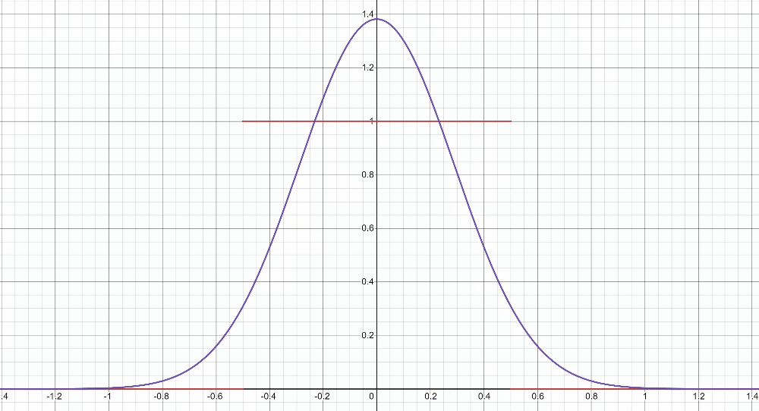
“Proof by example” -- uniform
https://www.desmos.com/calculator/2n2m05a9km

Slide 8
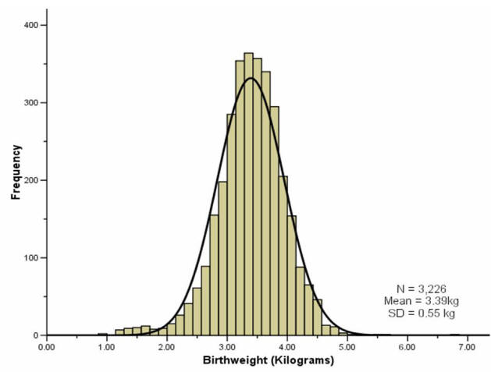
“Proof by real-world”
A lot of real-world bell-curves can be explained as:
1. The random variable comes from a combination of independent factors.
2. The CLT says the distribution will become like a bell curve.
birthweight

Slide 9
Theory vs. Practice
The formal theorem statement is “in the limit”
You might not get exactly a normal distribution for any finite $n$ (e.g. if you sum indicators, your random variable is always discrete and will be discontinuous for every finite $n$.
In practice, the approximations get very accurate very quickly (at least with a few tricks we’ll see soon).
They won’t be exact (unless the $X_{i}$ are normals) but it’s close enough to use even with relatively small $n$.

Slide 10
Using the Central Limit Theorem
Suppose you are managing a factory, that produces widgets. Each widget produced is defective (independently) with probability 5%.
Your factory will produce 1000 (possibly defective) widgets. You want to know what the chances are of having a “very bad day” where “very bad” means producing at most 940 non-defective widgets. (In expectation, you produce 950 non-defective widgets)
What is the probability?

Slide 11
True Answer
Let $X\sim Bin(1000,.95)$
What is $ℙ(X≤940)$?
The cdf is ugly…and that’s a big summation.
$\sum_{k=0}^{940}{\left({1000 \atop k}\right)(.{95)}^{k}⋅(.{05)}^{1000−k}≈}.08673$
What does the CLT give?

Slide 12
CLT setup
Bin(1000,.95) is the sum of a bunch of independent random variables (the indicators/Bernoullis we summed to get the binomial)
So, let’s use the CLT instead
$𝔼\left[X_{i}\right]=p=.95$.
$Var\left(X_{i}\right)=p\left(1−p\right)=.0475$
$Y_{1000}=\frac{\sum_{i=1}^{1000}{X_{i}}−1000⋅.95}{\sqrt{1000⋅.0475}}$ is approximately $𝒩(0,1)$.

Slide 13
With the CLT.
The event we’re interested in is $ℙ(X≤940)$
$ℙ(X≤940$)
$=ℙ\left(\frac{X−1000⋅.95}{\sqrt{1000⋅.0475}}≤\frac{940−1000⋅.95}{\sqrt{1000⋅.0475}}\right)$
$=ℙ(Y_{1000}≤\frac{940−1000⋅.95}{\sqrt{1000⋅.0475}})$
$≈ℙ\left(Y≤\frac{940−1000⋅.95}{\sqrt{1000⋅.0475}}\right)$ by CLT
$=Φ\left(\frac{940−1000⋅.95}{\sqrt{1000⋅.0475}}\right)$
$≈Φ\left(−1.45\right)=1−Φ(1.45)$
$≈1−.92647=.07353$.

Slide 14
It’s an approximation!
The true probability is
$1−\sum_{k=941}^{1000}{\left({1000 \atop k}\right)(.{95)}^{k}⋅(.{05)}^{1000−k}≈}.08673$
The CLT estimate is off by about 1.3 percentage points.
We can get a better estimate if we fix a subtle issue with this approximation.

Slide 15
A problem
What’s the probability that $X=950$? (exactly)
True value, we can get with binomial:
$\left({1000 \atop 950}\right)⋅(.{95)}^{950}⋅(.05)^{50}≈.05779$
What does the CLT say?
$=ℙ\left(\frac{X−1000⋅.95}{\sqrt{1000}⋅.0475}=\frac{950−1000⋅.95}{\sqrt{1000}⋅.0475}\right)$
$≈ℙ\left(Y=0\right)$
$=0$
Uh oh.

Slide 16
Continuity Correction
The binomial distribution is discrete, but the normal is continuous.
Let’s correct for that (called a “continuity correction”)
Before we switch from the binomial to the normal, ask “what values of a continuous random variable would round to this event?”

Slide 17
Applying the continuity correction
$ℙ(X=950)$
$=ℙ\left(949.5≤X<950.5\right)$
$=ℙ\left(\frac{949.5−950}{\sqrt{1000⋅.0475}}≤\frac{X−950}{\sqrt{1000⋅.0475}}<\frac{950.5−950}{\sqrt{1000⋅.0475}}\right)$
$≈ℙ\left(\frac{949.5−950}{\sqrt{1000⋅.0475}}≤Y<\frac{950.5−950}{\sqrt{1000⋅.0475}}\right)$ By CLT
$=Φ\left(\frac{950.5−950}{\sqrt{1000⋅.0475}}\right)−Φ\left(\frac{949.5−950}{\sqrt{1000⋅.0475}}\right)$
$≈Φ\left(0.07\right)−Φ\left(−0.07\right)=Φ\left(0.07\right)−(1−Φ(0.07)$)
$≈0.5279−\left(1−0.5279\right)=0.0558$
Continuity correction. This is an “exactly equal to” The discrete rv $X$ can’t equal $950.2.$

Slide 18
Still an Approximation
$\left({1000 \atop 950}\right)⋅(.{95)}^{950}⋅(.05)^{50}≈.05779$ is the true value
The CLT approximates: $0.0558$
Very close! But still not perfect.

Slide 19
Let’s fix that other one
Question was “what’s the probability of seeing at most 940 non-defective widgets?”

Slide 20
With the CLT.
The event we’re interested in is $ℙ(X≤940)$
$ℙ(X≤940$)
$=ℙ\left(\frac{X−1000⋅.95}{\sqrt{1000⋅.0475}}≤\frac{940−1000⋅.95}{\sqrt{1000⋅.0475}}\right)$
$≈ℙ\left(Y≤\frac{940−1000⋅.95}{\sqrt{1000⋅.0475}}\right)$ By CLT
$=Φ\left(\frac{940−1000⋅.95}{\sqrt{1000⋅.0475}}\right)$
$≈Φ\left(−1.45\right)=1−Φ(1.45)$
$≈1−.92647=.07353$.
$ℙ(X≤940.5$)
$=ℙ\left(\frac{X−1000⋅.95}{\sqrt{1000⋅.0475}}≤\frac{940.5−1000⋅.95}{\sqrt{1000⋅.0475}}\right)$
$≈ℙ\left(Y≤\frac{940.5−1000⋅.95}{\sqrt{1000⋅.0475}}\right)$By CLT
$=Φ\left(\frac{940.5−1000⋅.95}{\sqrt{1000⋅.0475}}\right)$
$≈Φ\left(−1.38\right)=1−Φ(1.38)$
$≈1−.91621=.08379$.
True answer: $.08673$

Slide 21
Approximating a continuous distribution
You buy lightbulbs that burn out according to an exponential distribution with parameter of $λ=1.8$ lightbulbs per year.
You buy a 10 pack of (independent) light bulbs. What is the probability that your 10-pack lasts at least 5 years?
Let $X_{i}$ be the time it takes for lightbulb $i$ to burn out.
Let $X$ be the total time. Estimate $ℙ(X≥5)$.

Slide 22
Where’s the continuity correction?
There’s no correction to make – it was already continuous!!
$ℙ\left(X≥5\right)$
$=ℙ\left(\frac{X−10/1.8}{\sqrt{10/{1.8}^{2}} }≥\frac{5−10/1.8}{\sqrt{10/{1.8}^{2}}}\right)$
$≈ℙ\left(Y≥\frac{5−10/1.8}{\sqrt{10/{1.8}^{2}}}\right)$ By CLT
$≈ℙ(Y≥−0.32)$
$=1−Φ\left(−0.32\right)=Φ(0.32)$
$≈.62552$
True value (needs a distribution not in our zoo) is $≈0.58741$

Slide 23
Outline of CLT steps
1. Write event you are interested in, in terms of sum of random variables.
2. Apply continuity correction if RVs are discrete.
3. Normalize RV to have mean $0$ and standard deviation $1$.
4. Replace RV with $𝒩(0,1)$.
5. Write event in terms of $Φ$
6. Look up in table.

Slide 24
Polling
Suppose you know that 60% of CSE students support you in your run for SAC. If you draw a sample of $30$ students, what is the probability that you don’t get a majority of their votes.
How are you sampling?
Method 1: Get a uniformly random subset of size $30$.
Method 2: Independently draw $30$ people with replacement.
Which do we use?

Slide 25
Polling
Method 1 is what’s accurate to what is actually done…
…but we’re going to use the math from Method 2.
Why? Hypergometric variable formulas are rough, and for increasing population size they’re very close to binomial.
And we’re going to approximate with the CLT anyway, so…the added inaccuracy isn’t a dealbreaker.
If we need other calculations, independence will make any of them easier.

Slide 26
Polling
Let $X_{i}$ be the indicator for “person $i$ in the sample supports you.”
$\overline{X}=\frac{\sum_{i=1}^{n}{X_{i}}}{30}$ is the fraction who support you.
We’re interested in the event $ℙ\left(\overline{X}≤.5\right)$.
What is $𝔼\left[\overline{X}\right]$? What is $Var\left(\overline{X}\right)$?
$𝔼\left[\overline{X}\right]=\frac{1}{30}𝔼\left[{∑X}_{i}\right]=\frac{.6⋅30}{30}=\frac{3}{5}$.
$Var\left(\overline{X}\right)=\frac{1}{{30}^{2}}Var\left(∑X_{i}\right)=\frac{1}{30}⋅.6⋅.4=\frac{1}{125}$.

Slide 27
Using the CLT
$ℙ\left(\overline{X}≤.5\right)$
$=ℙ\left(\frac{\overline{X}−.6}{1/\sqrt{125}}≤\frac{.5−.6}{1/\sqrt{125}}\right)$
$≈ℙ\left(Y≤\frac{.5−.6}{1/\sqrt{125}}\right)$ where $Y\sim 𝒩(0,1)$
$≈ℙ(Y≤−1.12)$
$=Φ\left(−1.12\right)=1−Φ\left(1.12\right)≈1−0.86864=0.13136$

