Slide 1
Tail Bounds 2
CSE 312 Spring 21
Lecture 22

Slide 2
Announcements
Final logistical information coming to Ed in the next two days.
Pset 6 grades back. Trying an experiment – regrade requests will open tomorrow.
Real World 2 is out, due Tuesday June 1.
Pset 8 out tonight (due in one week)

Slide 3
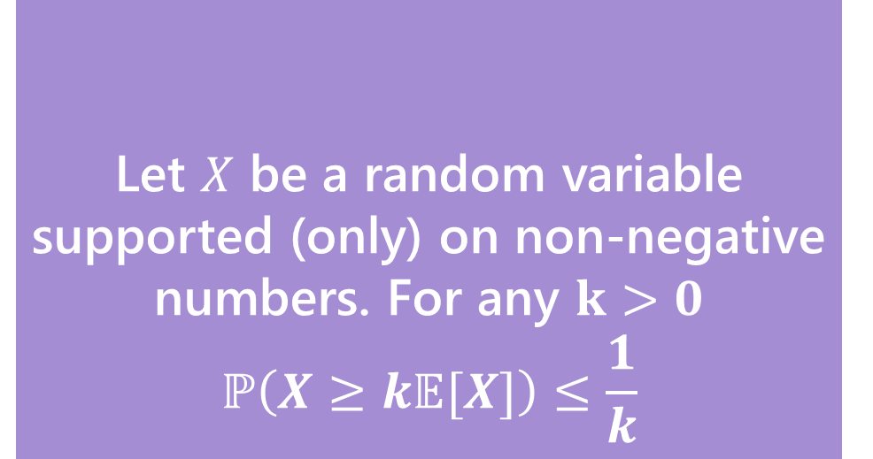
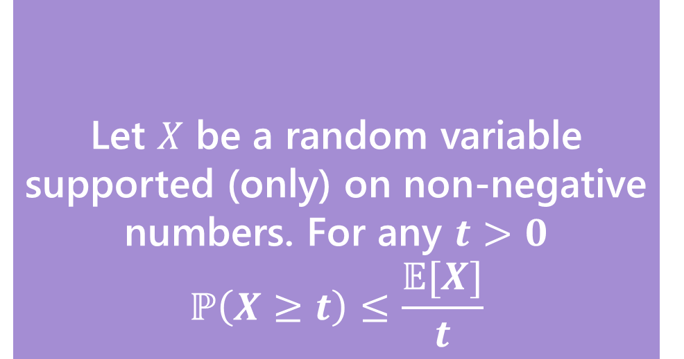
Our First bound
Two statements are equivalent. Left form is often easier to use. Right form is more intuitive.
Let $X$ be a random variable supported (only) on non-negative numbers. For any $t>0$
$$ℙ\left(X≥t\right)≤\frac{𝔼[X]}{t}$$
Let $X$ be a random variable supported (only) on non-negative numbers. For any $k>0$
$$ℙ\left(X≥k𝔼[X]\right)≤\frac{1}{k}$$
Markov’s Inequality
Markov’s Inequality
To apply this bound you only need to know:
1. it’s non-negative
2. Its expectation.

Slide 4
So…what do we do?
A better inequality!
We’re trying to bound the tails of the distribution.
What parameter of a random variable describes the tails?
The variance!

Slide 5
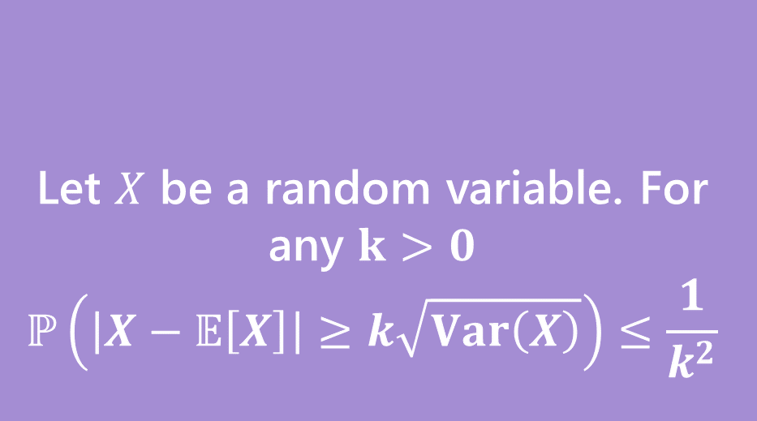
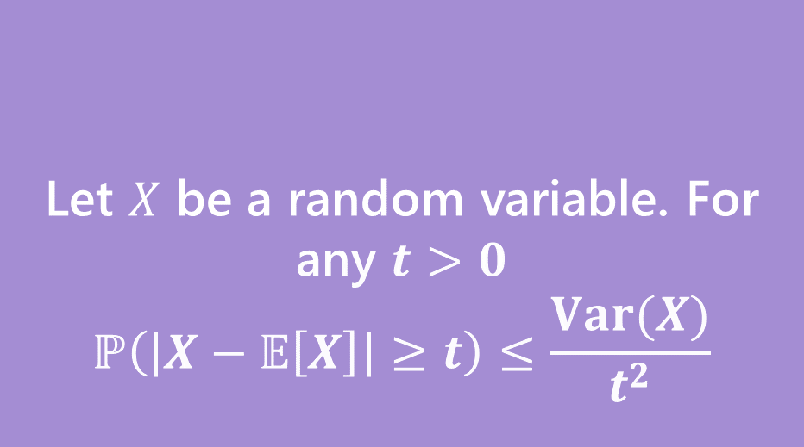
Chebyshev’s Inequality
Two statements are equivalent. Left form is often easier to use. Right form is more intuitive.
Let $X$ be a random variable. For any $t>0$
$$ℙ\left(\left|X−𝔼\left[X\right]\right|≥t\right)≤\frac{Var(X)}{t^{2}}$$
Let $X$ be a random variable. For any $k>0$
$$ℙ\left(\left|X−𝔼\left[X\right]\right|≥k\sqrt{Var\left(X\right)}\right)≤\frac{1}{k^{2}}$$
Chebyshev’s Inequality
Chebyshev’s Inequality

Slide 6

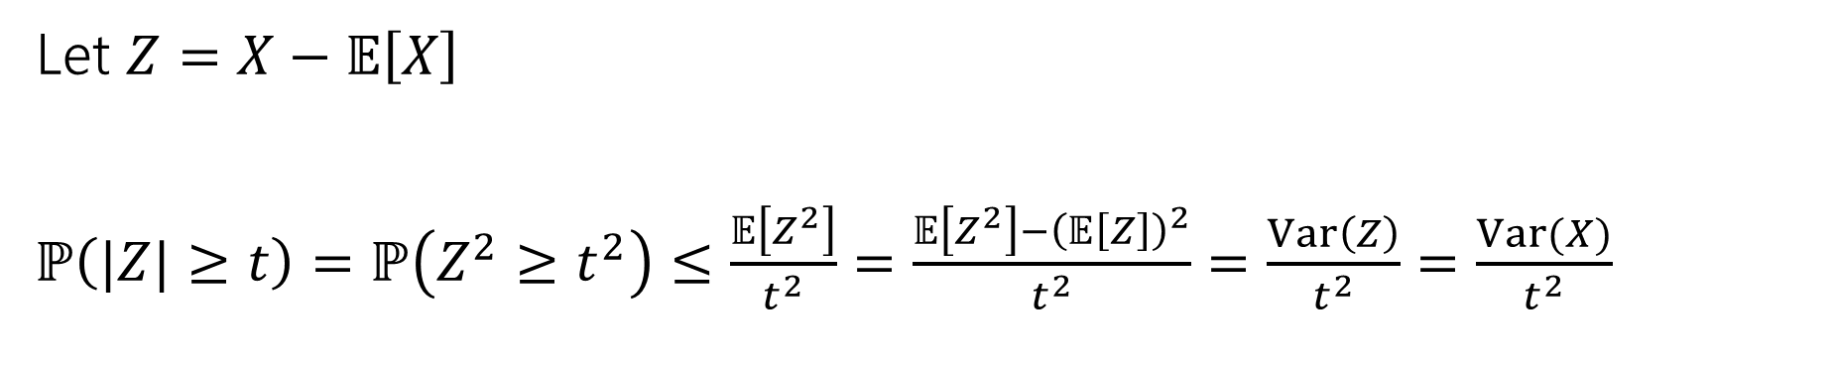
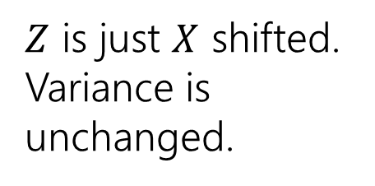
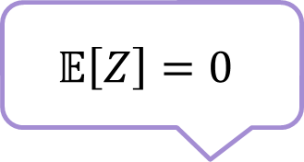
Proof of Chebyshev
Let $X$ be a random variable. For any $t>0$
$$ℙ\left(\left|X−𝔼\left[X\right]\right|≥t\right)≤\frac{Var(X)}{t^{2}}$$
Chebyshev’s Inequality
Let $Z=X−𝔼\left[X\right]$
$ℙ\left(|Z|≥t\right)=ℙ\left(Z^{2}≥t^{2}\right)≤\frac{𝔼\left[Z^{2}\right]}{t^{2}}=\frac{𝔼\left[Z^{2}\right]−{\left(𝔼\left[Z\right]\right)}^{2}}{t^{2}}=\frac{Var\left(Z\right)}{t^{2}}=\frac{Var(X)}{t^{2}}$
Markov’s Inequality
$$𝔼\left[Z\right]=0$$
Inequalities are equivalent (square each side).
$Z$ is just $X$ shifted. Variance is unchanged.

Slide 7


Example with geometric RV
Suppose you roll a fair (6-sided) die until you see a 6. Let $X$ be the number of rolls.
Bound the probability that $X≥12$
Let $X$ be a random variable. For any $t>0$
$$ℙ\left(\left|X−𝔼\left[X\right]\right|≥t\right)≤\frac{Var(X)}{t^{2}}$$
Chebyshev’s Inequality

Slide 8
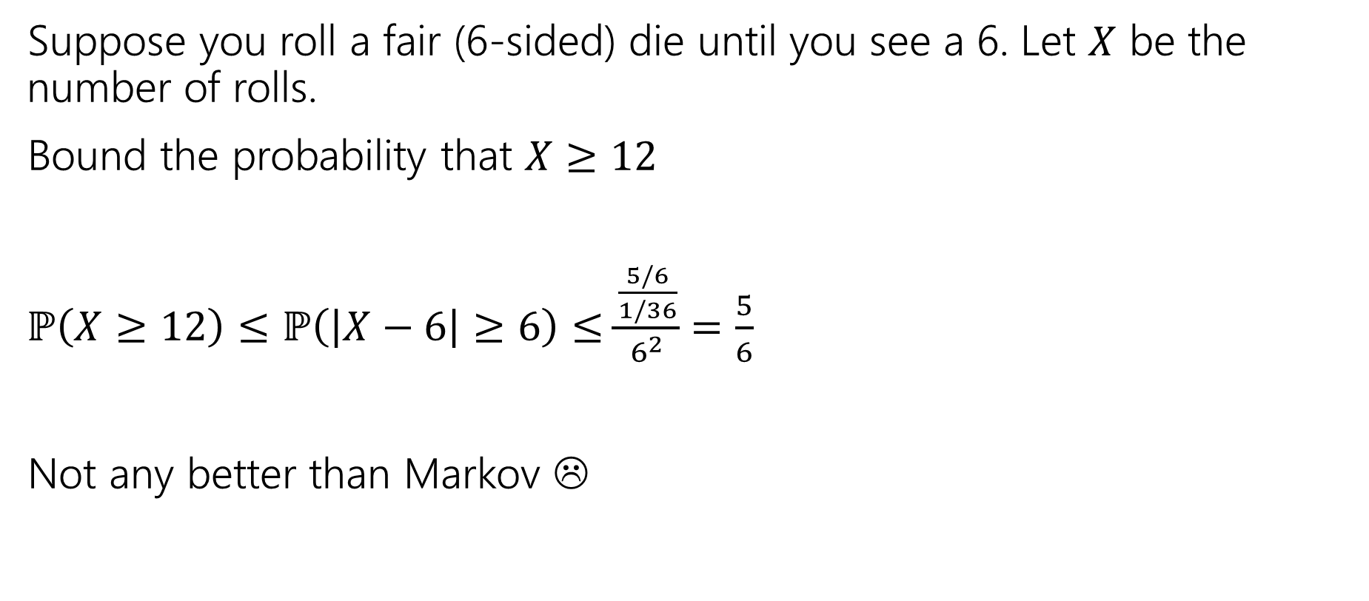
Example with geometric RV
Suppose you roll a fair (6-sided) die until you see a 6. Let $X$ be the number of rolls.
Bound the probability that $X≥12$
$ℙ\left(X≥12\right)≤ℙ\left(\left|X−6\right|≥6\right)≤\frac{\frac{5/6}{1/36}}{6^{2}}$ $=\frac{5}{6}$
Not any better than Markov ☹
Let $X$ be a random variable. For any $t>0$
$$ℙ\left(\left|X−𝔼\left[X\right]\right|≥t\right)≤\frac{Var(X)}{t^{2}}$$
Chebyshev’s Inequality

Slide 9
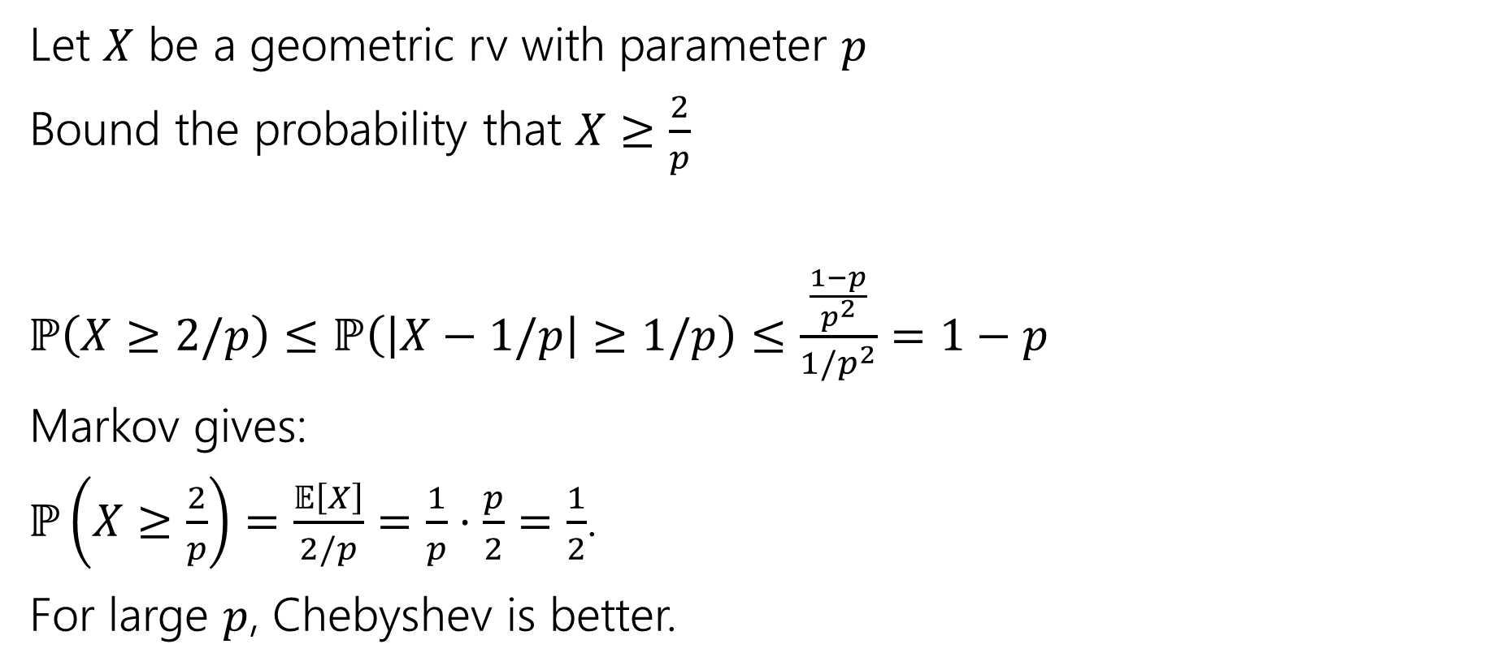
Example with geometric RV
Let $X$ be a geometric rv with parameter $p$
Bound the probability that $X≥\frac{2}{p}$
$ℙ\left(X≥2/p\right)≤ℙ\left(\left|X−1/p\right|≥1/p\right)≤\frac{\frac{1−p}{p^{2}}}{{1/p}^{2}}$ $=1−p$
Markov gives:
$ℙ\left(X≥\frac{2}{p}\right)=\frac{𝔼\left[X\right]}{2/p}=\frac{1}{p}⋅\frac{p}{2}=\frac{1}{2}$.
For large $p$, Chebyshev is better.
Let $X$ be a random variable. For any $t>0$
$$ℙ\left(\left|X−𝔼\left[X\right]\right|≥t\right)≤\frac{Var(X)}{t^{2}}$$
Chebyshev’s Inequality

Slide 10
Better Example
Suppose the average number of ads you see on a website is 25. And the variance of the number of ads is 16. Give an upper bound on the probability of seeing a website with 30 or more ads.

Slide 11
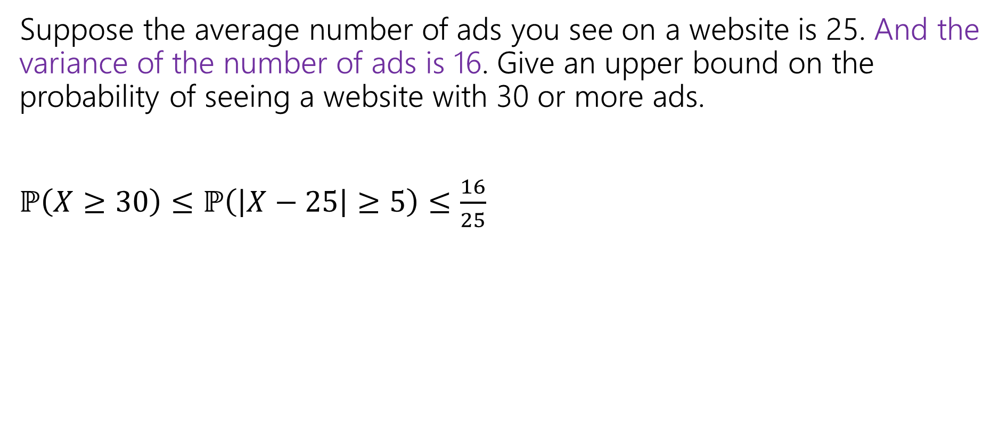
Better Example
Suppose the average number of ads you see on a website is 25. And the variance of the number of ads is 16. Give an upper bound on the probability of seeing a website with 30 or more ads.
$ℙ\left(X≥30\right)≤ℙ\left(\left|X−25\right|≥5\right)≤\frac{16}{25}$

Slide 12
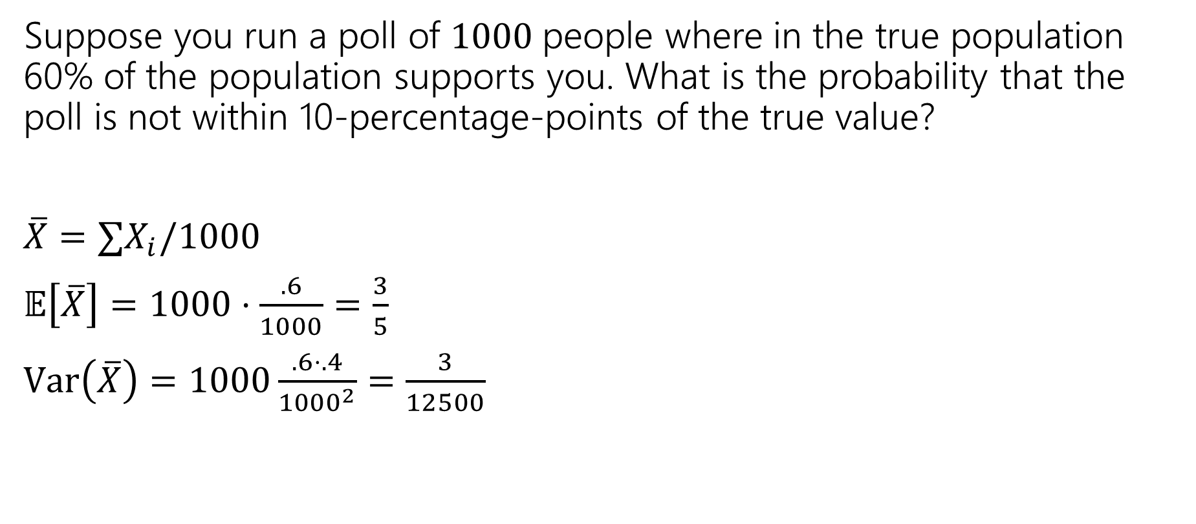
Near the mean
Suppose you run a poll of $1000$people where in the true population 60% of the population supports you. What is the probability that the poll is not within 10-percentage-points of the true value?
$\overline{X}=∑X_{i}/1000$
$𝔼\left[\overline{X}\right]=1000⋅\frac{.6}{1000}=\frac{3}{5}$
$Var\left(\overline{X}\right)=1000\frac{.6⋅.4}{{1000}^{2}}=\frac{3}{12500}$
Let $X$ be a random variable. For any $t>0$
$$ℙ\left(\left|X−𝔼\left[X\right]\right|≥t\right)≤\frac{Var(X)}{t^{2}}$$
Chebyshev’s Inequality
Chebyshev’s Inequality

Slide 13
Near the mean
Suppose you run a poll of $1000$people where in the true population 60% of the population supports you. What is the probability that the poll is not within 10-percentage-points of the true value?
$\overline{X}=∑X_{i}/1000$
$𝔼\left[\overline{X}\right]=1000⋅\frac{.6}{1000}=\frac{3}{5}$
$Var\left(\overline{X}\right)=1000\frac{.6⋅.4}{{1000}^{2}}=\frac{3}{12500}$
Let $X$ be a random variable. For any $t>0$
$$ℙ\left(\left|X−𝔼\left[X\right]\right|≥t\right)≤\frac{Var(X)}{t^{2}}$$
Chebyshev’s Inequality
Chebyshev’s Inequality

Slide 14
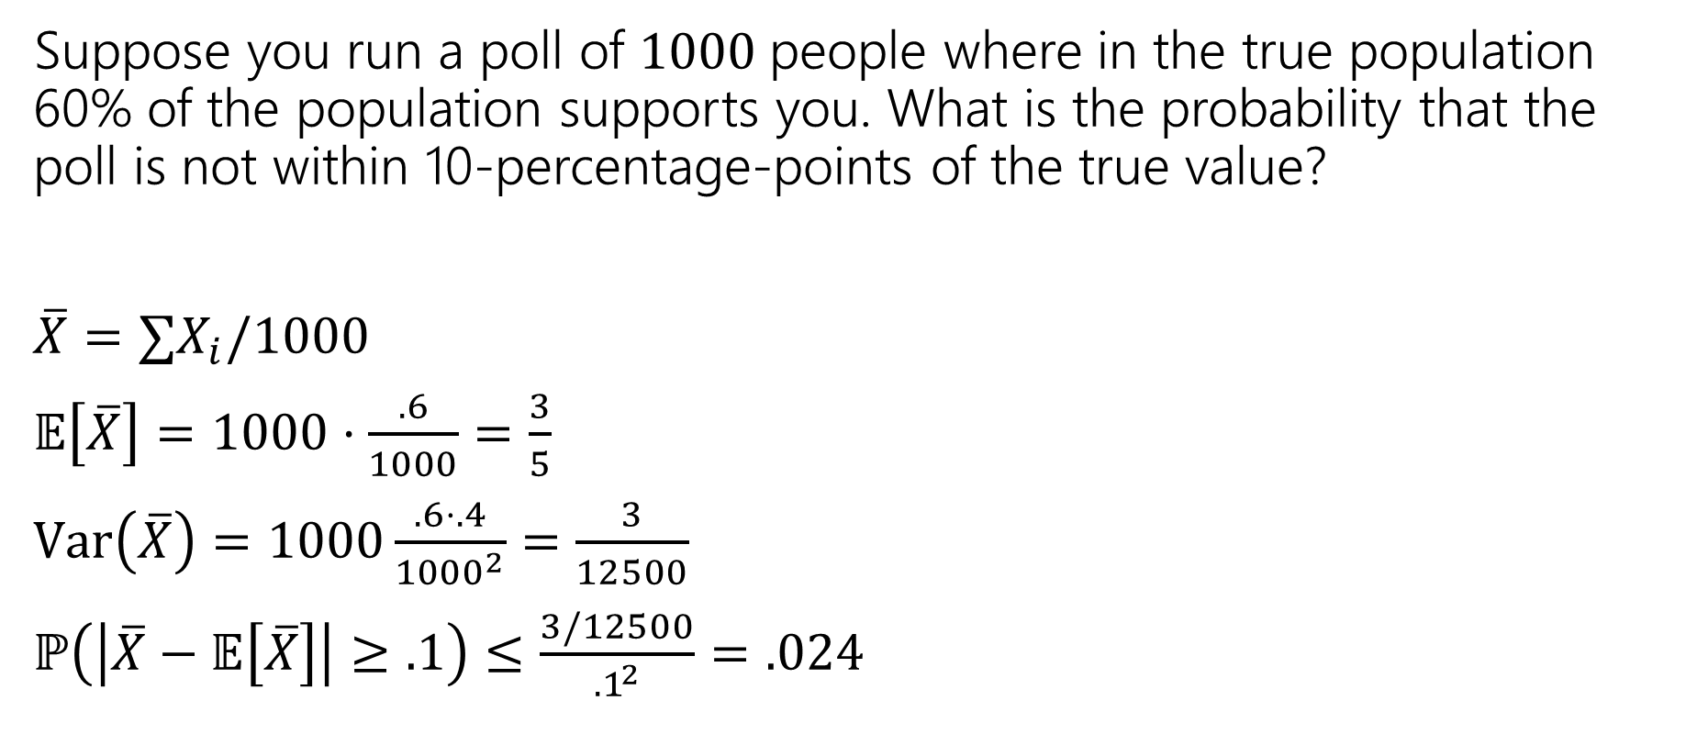
Near the mean
Suppose you run a poll of $1000$people where in the true population 60% of the population supports you. What is the probability that the poll is not within 10-percentage-points of the true value?
$\overline{X}=∑X_{i}/1000$
$𝔼\left[\overline{X}\right]=1000⋅\frac{.6}{1000}=\frac{3}{5}$
$Var\left(\overline{X}\right)=1000\frac{.6⋅.4}{{1000}^{2}}=\frac{3}{12500}$
$ℙ\left(\left|\overline{X}−𝔼\left[\overline{X}\right]\right|≥.1\right)≤\frac{3/12500}{{.1}^{2}}$ $=.024$
Let $X$ be a random variable. For any $t>0$
$$ℙ\left(\left|X−𝔼\left[X\right]\right|≥t\right)≤\frac{Var(X)}{t^{2}}$$
Chebyshev’s Inequality
Chebyshev’s Inequality

Slide 15

Chebyshev’s – Repeated Experiments
How many coin flips (each head with probability $p$) are needed until you get $n$ heads.
Let $X$ be the number necessary. What is probability $X≥2n/p$?
Markov
Chebyshev

Slide 16
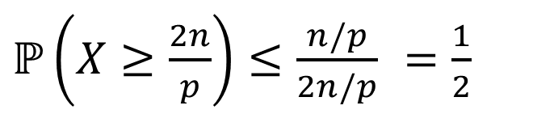
Chebyshev’s – Repeated Experiments
How many coin flips (each head with probability $p$) are needed until you get $n$ heads.
Let $X$ be the number necessary. What is probability $X≥2n/p$?
Markov
Chebyshev
$ℙ\left(X≥\frac{2n}{p}\right)≤\frac{n/p}{2n/p}$ $=\frac{1}{2}$
$ℙ\left(X≥\frac{2n}{p}\right)≤ℙ\left(\left|X−\frac{n}{p}\right|≥\frac{n}{p}\right)≤\frac{Var(X)}{n^{2}/p^{2}}$ $=\frac{n(1−p)/p^{2}}{n^{2}/p^{2}}$ $=\frac{1−p}{n}$

Slide 17
Takeaway
Chebyshev gets more powerful as the variance shrinks.
Repeated experiments are a great way to cause that to happen.

Slide 18
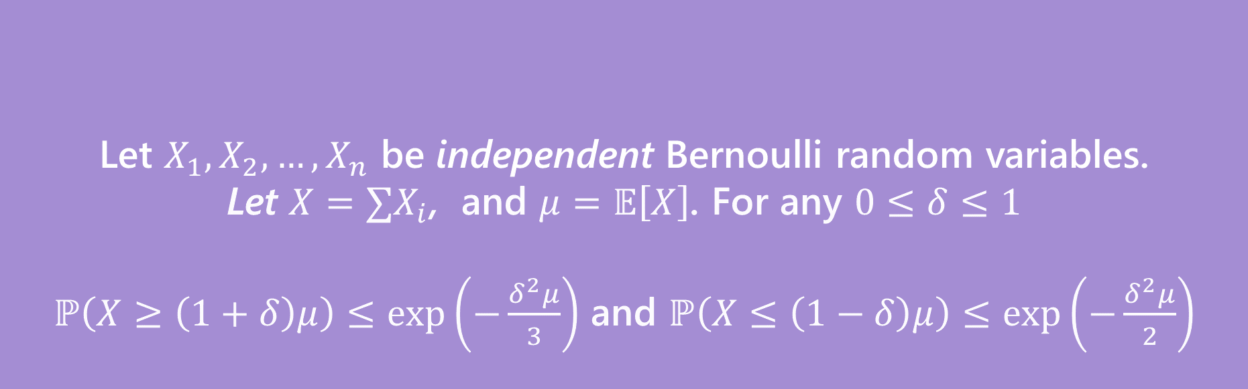
More Assumptions → Better Guarantee
Let $X_{1},X_{2},…,X_{n}$ be independent Bernoulli random variables.
Let $X=∑X_{i}$, and $μ=𝔼\left[X\right]$. For any $0≤δ≤1$
$ℙ\left(X≥\left(1+δ\right)μ\right)≤\exp\left(−\frac{δ^{2}μ}{3}\right)$ and $ℙ\left(X≤\left(1−δ\right)μ\right)≤\exp\left(−\frac{δ^{2}μ}{2}\right)$
(Multiplicative) Chernoff Bound

Slide 19
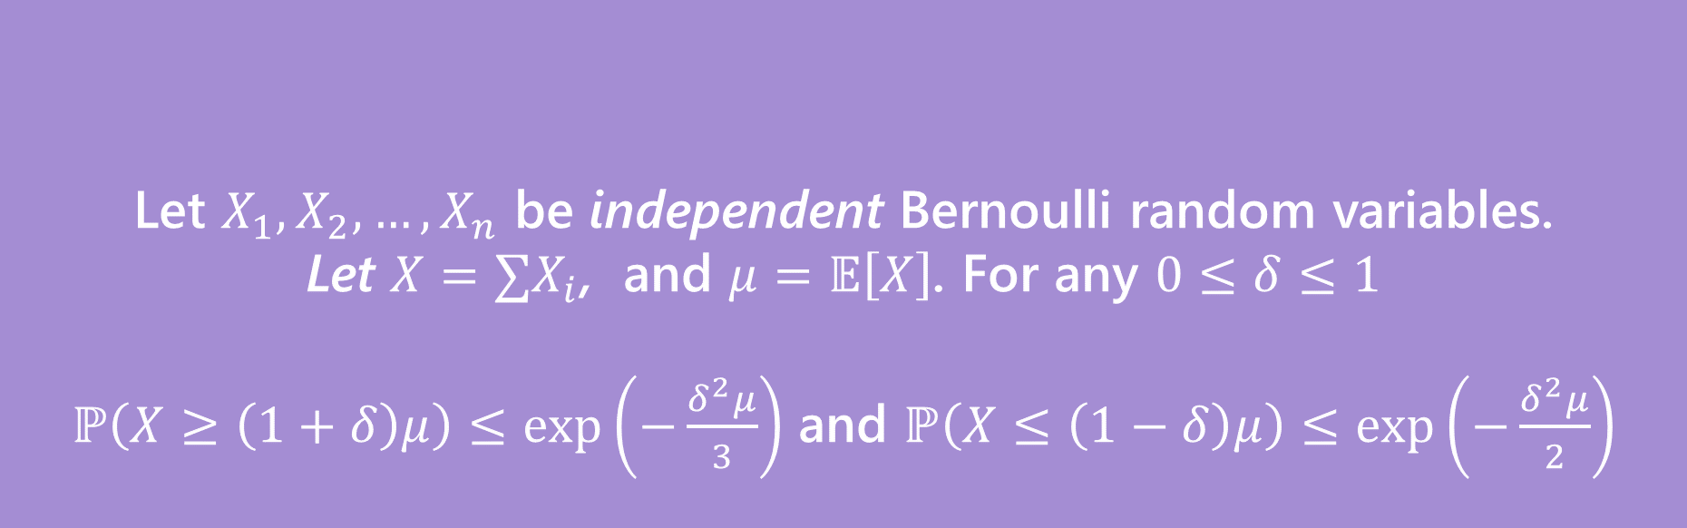

Same Problem, New Solution
Suppose you run a poll of $1000$people where in the true population 60% of the population supports you. What is the probability that the poll is not within 10-percentage-points of the true value?
Let $X_{1},X_{2},…,X_{n}$ be independent Bernoulli random variables.
Let $X=∑X_{i}$, and $μ=𝔼\left[X\right]$. For any $0≤δ≤1$
$ℙ\left(X≥\left(1+δ\right)μ\right)≤\exp\left(−\frac{δ^{2}μ}{3}\right)$ and $ℙ\left(X≤\left(1−δ\right)μ\right)≤\exp\left(−\frac{δ^{2}μ}{2}\right)$
(Multiplicative) Chernoff Bound

Slide 20


Right Tail
Suppose you run a poll of $1000$people where in the true population 60% of the population supports you. What is the probability that the poll is not within 10-percentage-points of the true value?
Want $ℙ\left(\frac{X}{1000}≥.7\right)=ℙ(X≥.7⋅1000)$
$=ℙ\left(X≥\left(1+.1/.6\right)⋅(.6⋅1000)\right)$
So $δ=\frac{1}{6}$ and $μ=.6⋅1000$
$ℙ\left(X≥700\right)≤\exp\left(−\frac{\frac{1}{6^{2}}⋅.6⋅1000}{3}\right)$
$≤0.0039$
Let $X_{1},X_{2},…,X_{n}$ be independent Bernoulli random variables.
Let $X=∑X_{i}$, and $μ=𝔼\left[X\right]$. For any $0≤δ≤1$
$ℙ\left(X≥\left(1+δ\right)μ\right)≤\exp\left(−\frac{δ^{2}μ}{3}\right)$
Chernoff Bound (right tail)

Slide 21


Left Tail
Suppose you run a poll of $1000$people where in the true population 60% of the population supports you. What is the probability that the poll is not within 10-percentage-points of the true value?
Want $ℙ\left(\frac{X}{1000}≤.5\right)=ℙ(X≤.5⋅1000)$
$=ℙ\left(X≤\left(1−.1/.6\right)⋅(.6⋅1000)\right)$
So $δ=\frac{1}{6}$ and $μ=.6⋅1000$
$ℙ\left(X≤500\right)≤\exp\left(−\frac{\frac{1}{6^{2}}⋅.6⋅1000}{2}\right)$
$≤0.0003$
Let $X_{1},X_{2},…,X_{n}$ be independent Bernoulli random variables.
Let $X=∑X_{i}$, and $μ=𝔼\left[X\right]$. For any $0≤δ≤1$
$ℙ\left(X≤\left(1−δ\right)μ\right)≤\exp\left(−\frac{δ^{2}μ}{2}\right)$
Chernoff Bound (left tail)

Slide 22
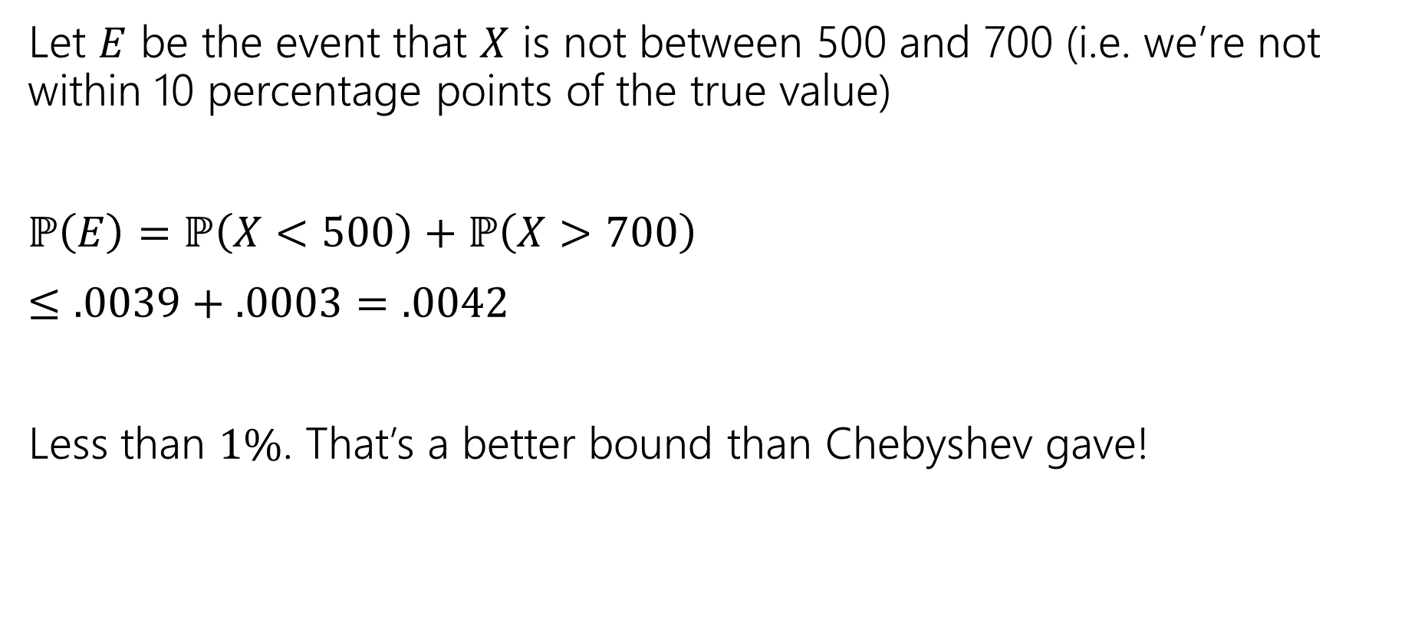
Both Tails
Let $E$ be the event that $X$ is not between 500 and 700 (i.e. we’re not within 10 percentage points of the true value)
$ℙ\left(E\right)=ℙ\left(X<500\right)+ℙ\left(X>700\right)$
$≤.0039+.0003=.0042$
Less than $1\%$. That’s a better bound than Chebyshev gave!

Slide 23
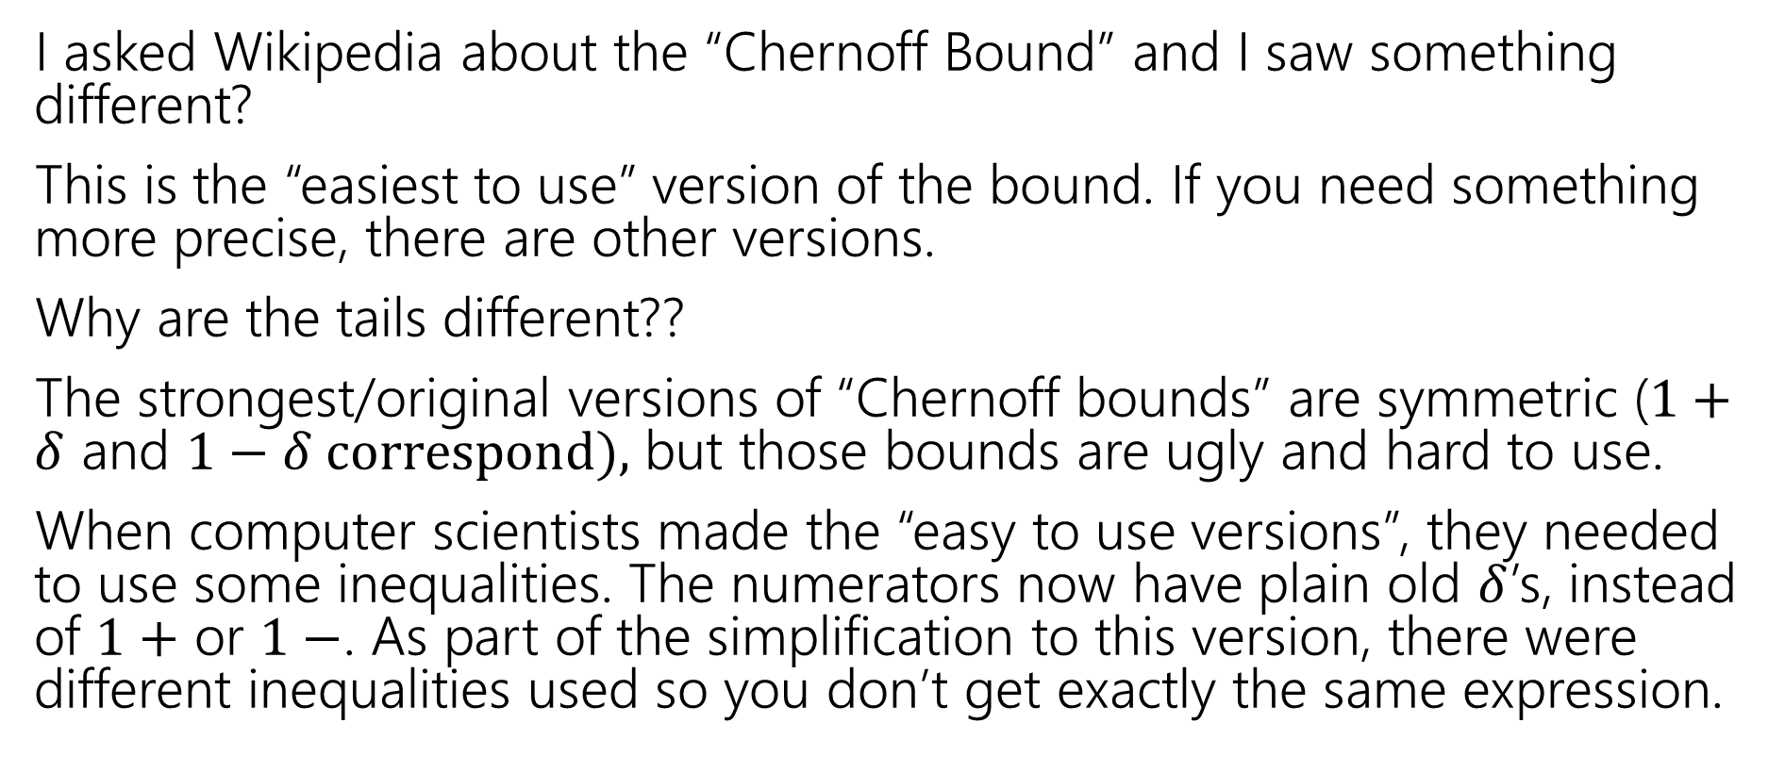
Wait a Minute
I asked Wikipedia about the “Chernoff Bound” and I saw something different?
This is the “easiest to use” version of the bound. If you need something more precise, there are other versions.
Why are the tails different??
The strongest/original versions of “Chernoff bounds” are symmetric ($1+δ$ and $1−δ correspond),$ but those bounds are ugly and hard to use.
When computer scientists made the “easy to use versions”, they needed to use some inequalities. The numerators now have plain old $δ$’s, instead of $1+$ or $1−$. As part of the simplification to this version, there were different inequalities used so you don’t get exactly the same expression.

Slide 24
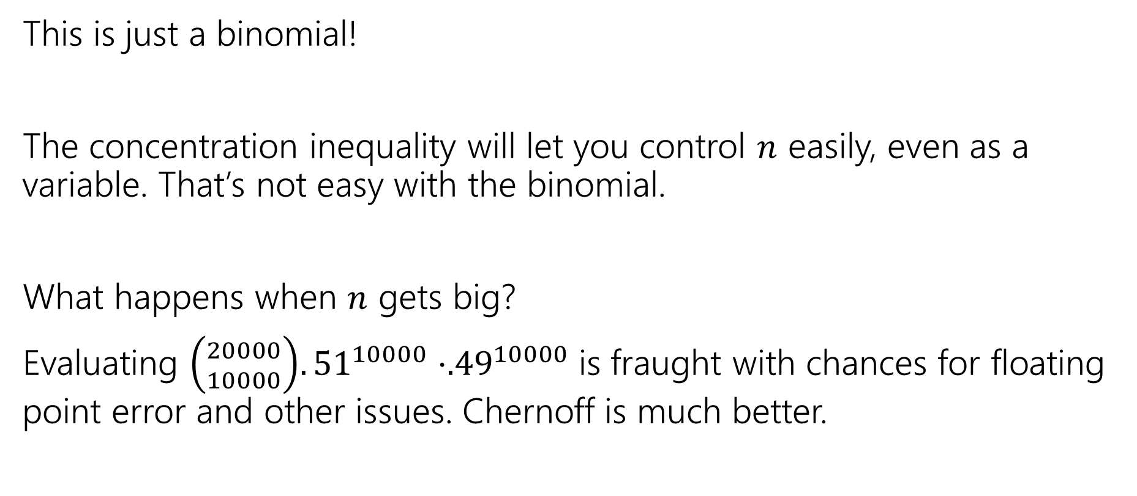
Wait a Minute
This is just a binomial!
The concentration inequality will let you control $n$ easily, even as a variable. That’s not easy with the binomial.
What happens when $n$ gets big?
Evaluating ${\left({20000 \atop 10000}\right).51}^{10000}⋅{.49}^{10000}$is fraught with chances for floating point error and other issues. Chernoff is much better.

Slide 25
But Wait! There’s More
For this class, please limit yourself to:
Markov, Chebyshev, and Chernoff, as stated in these slides…
But for your information. There’s more.
Trying to apply Chebyshev, but only want a “one-sided” bound (and tired of losing that almost-factor-of-two)Try Cantelli’s Inequality
In a position to use Chernoff, but want additive distance to the mean instead of multiplicative? They got one of those.
Have a sum of independent random variables that aren’t indicators, but are bounded, you better believe Wikipedia’s got one
Have a sum of random matrices instead of a sum of random numbers. Not only is that a thing you can do, but the eigenvalue of the matrix concentrates

Slide 26
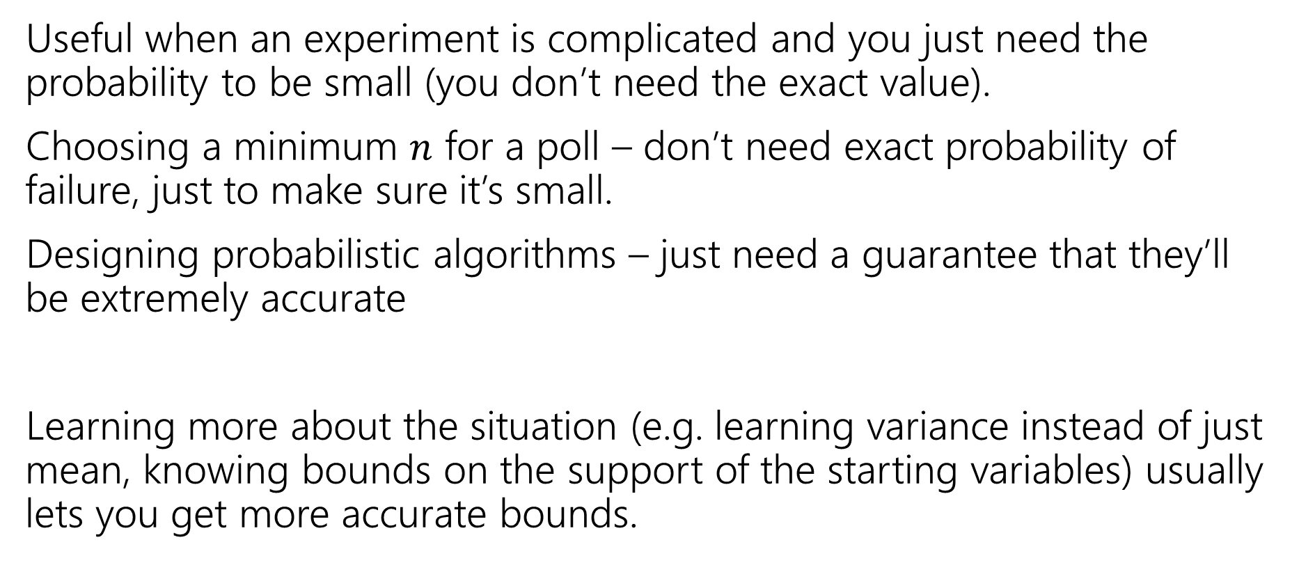
Tail Bounds – Takeaways
Useful when an experiment is complicated and you just need the probability to be small (you don’t need the exact value).
Choosing a minimum $n$ for a poll – don’t need exact probability of failure, just to make sure it’s small.
Designing probabilistic algorithms – just need a guarantee that they’ll be extremely accurate
Learning more about the situation (e.g. learning variance instead of just mean, knowing bounds on the support of the starting variables) usually lets you get more accurate bounds.

Slide 27
Next Time
One more bound (the union bound)
Not a concentration bound -- one more tool for handling non-independence.
We’ll see it in the context of some applications!

